Slide 1


Schizophrenia
Care for Adults in Hospitals
INFORMATION AND DATA BRIEF: Why this quality standard is needed
Let’s make our health system healthier

Slide 2
What Are Quality Standards
Concise sets of easy-to-understand statements outlining what care should look like for people living with certain conditions and being cared for in specific settings
Based on the best available evidence
Designed for health care providers to know what care they should be offering
To also help patients, residents, families and caregivers know what to ask for in their care

Slide 3
The Purpose of this Brief
Schizophrenia affects approximately 1% of the Canadian population, which translates to more than 100,000 people in Ontario who live with this condition [1]
This brief provides information and data demonstrating why a quality standard is needed for adults with schizophrenia
Specifically, it provides performance data on indicators that reflect the care received by adults with schizophrenia in hospital settings
[1] Public Health Agency of Canada: http://www.phac-aspc.gc.ca/publicat/miic-mmac/chap_3-eng.php

Slide 4
The Purpose of this Brief
The data demonstrate that care for adults living with schizophrenia needs to be improved
That is why this quality standard has been created:
  To inform clinicians and organizations on what high-quality health care for people living with this condition should look like
  To help clinicians and organizations assess the quality of care they are delivering, so they can identify gaps and areas for improvement

Slide 5
How We Look at the Data
When available, the information presented reflects different perspectives
  Provincial results over time offer a broad overall system view
  Results by LHIN region highlight some of the local differences
  The distribution of the results across facilities provides some points of reference to hospitals

Slide 6
The Data

Slide 7
Some Context
Because the quality standard aims at improving health outcomes among people living with schizophrenia in hospitals, a set of indicators has been selected to measure the impact of the schizophrenia quality standard as a whole. We examine the following as overall measures of performance:
  Percentage of patients who were readmitted to hospital for a mental health or addictions condition within 30 days of a previous hospital discharge for schizophrenia
  Percentage of patients who revisited the emergency department for a mental health or addictions condition within 30 days of a previous emergency department visit for schizophrenia

Slide 8
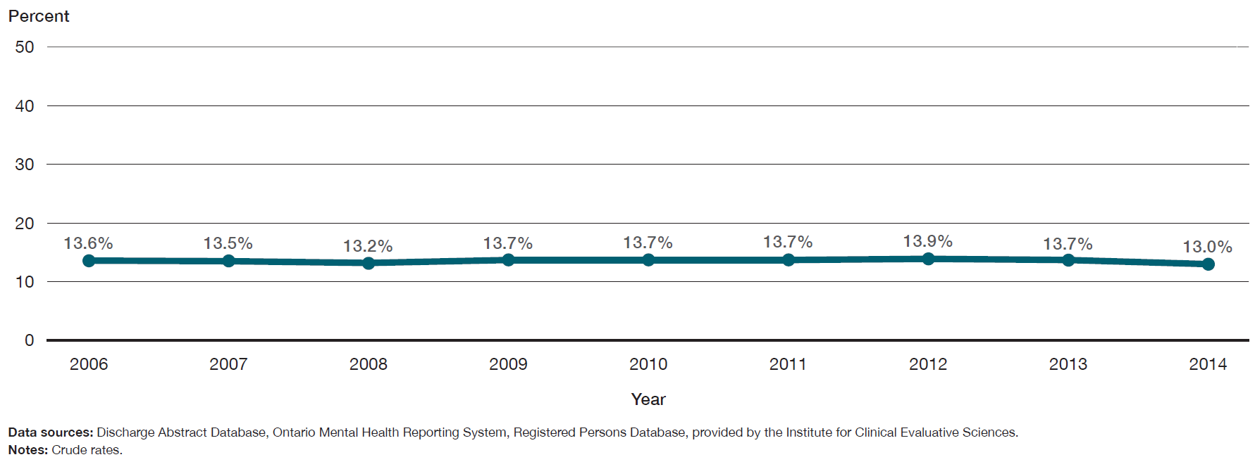
In 2014, 13% of patients were readmitted to hospital for a mental health or addictions condition within 30 days of a previous hospital discharge for schizophrenia, and this proportion has not changed over the last eight years.
Percentage of patients who were readmitted to hospital for a mental health or addictions condition within 30 days of a previous hospital discharge for schizophrenia, in Ontario, 2006 to 2014

Slide 9
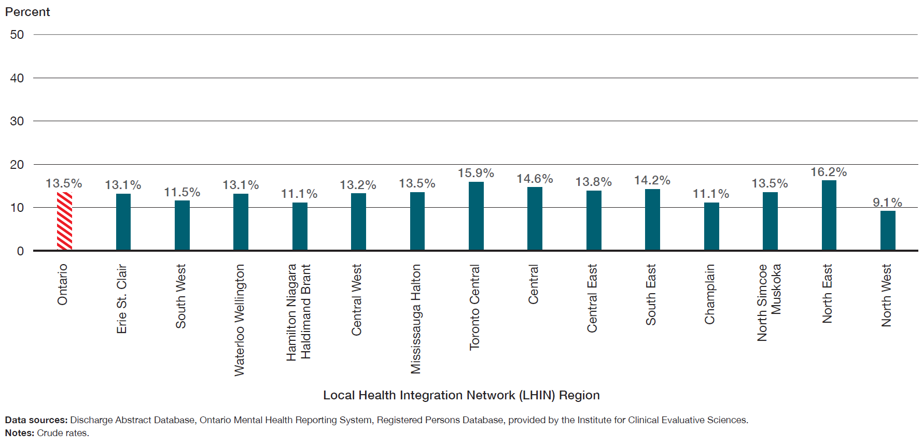
The percentage of patients who were readmitted to hospital for a mental health or addictions condition within 30 days of a previous hospital discharge for schizophrenia ranged from 9.1% to 16.2% across LHIN regions.
Percentage of patients who were readmitted to hospital for a mental health or addictions condition within 30 days of a previous hospital discharge for schizophrenia, in Ontario, by LHIN region, three-year average for 2012 to 2014

Slide 10
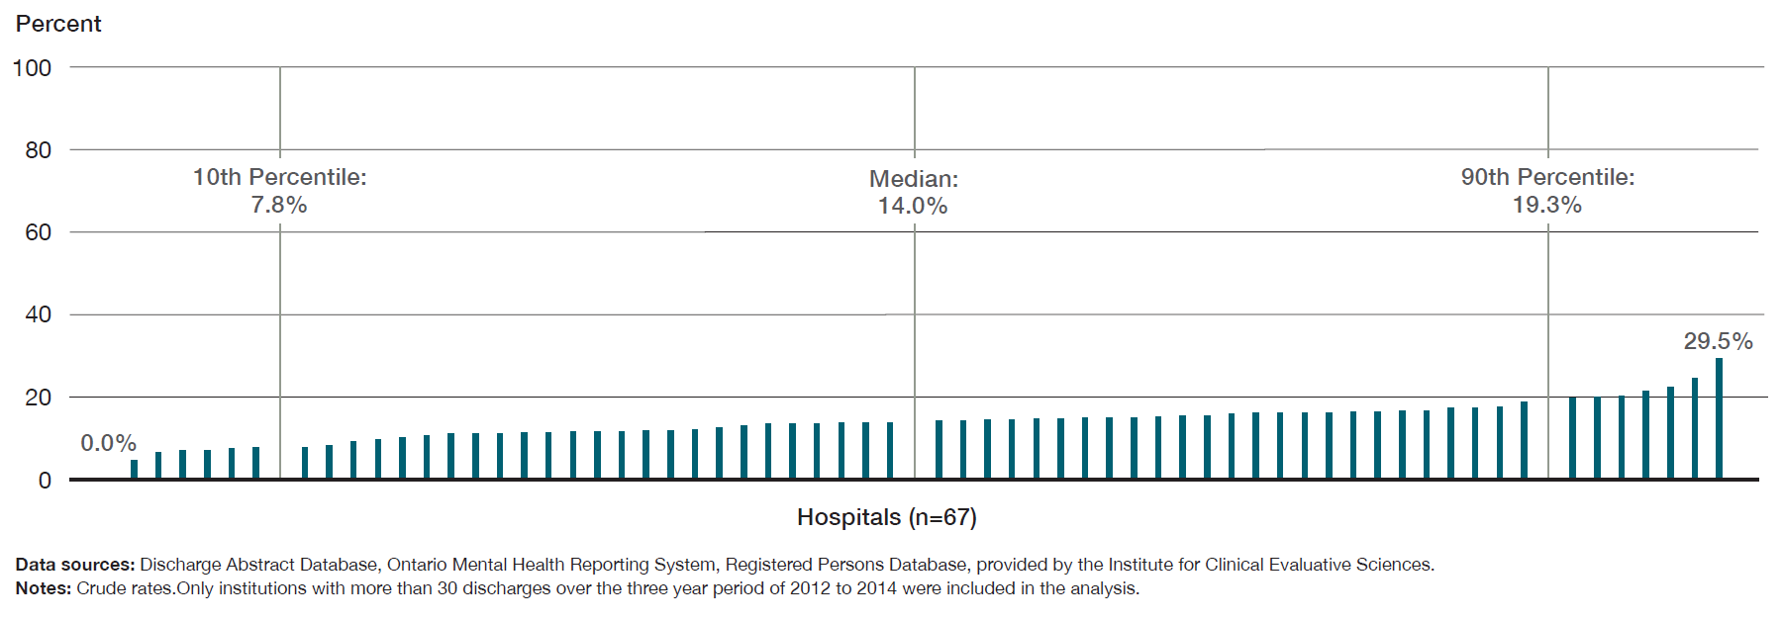
Across facilities in Ontario, the percentage of patients who were readmitted for a mental health or addictions condition within 30 days of a previous hospital discharge for schizophrenia ranged from 0% to 29.5%.
Percentage of patients who were readmitted to hospital for a mental health or addictions condition within 30 days of a previous hospital discharge for schizophrenia, in Ontario, by facility, three-year average for 2012 to 2014

Slide 11
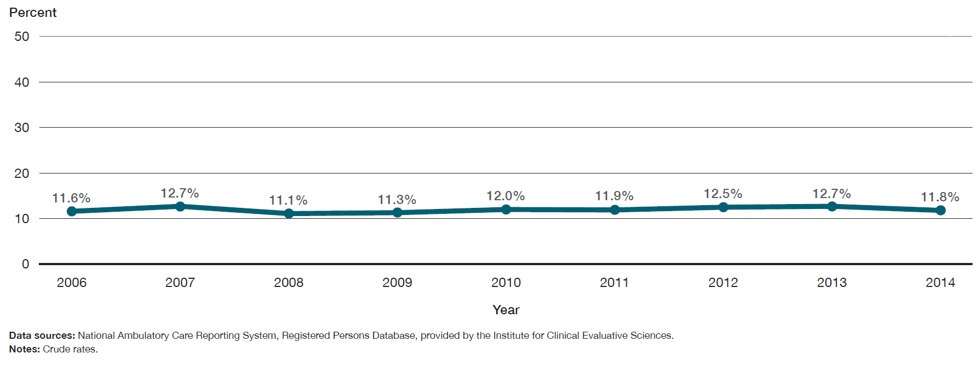
11.8% of patients revisited the emergency department for a mental health or addictions condition within 30 days of a previous emergency department visit for schizophrenia, and this proportion has not improved over the last eight years.
Percentage of patients who revisited the emergency department for a mental health or addictions condition within 30 days of a previous emergency department visit for schizophrenia, in Ontario, 2006 to 2014

Slide 12
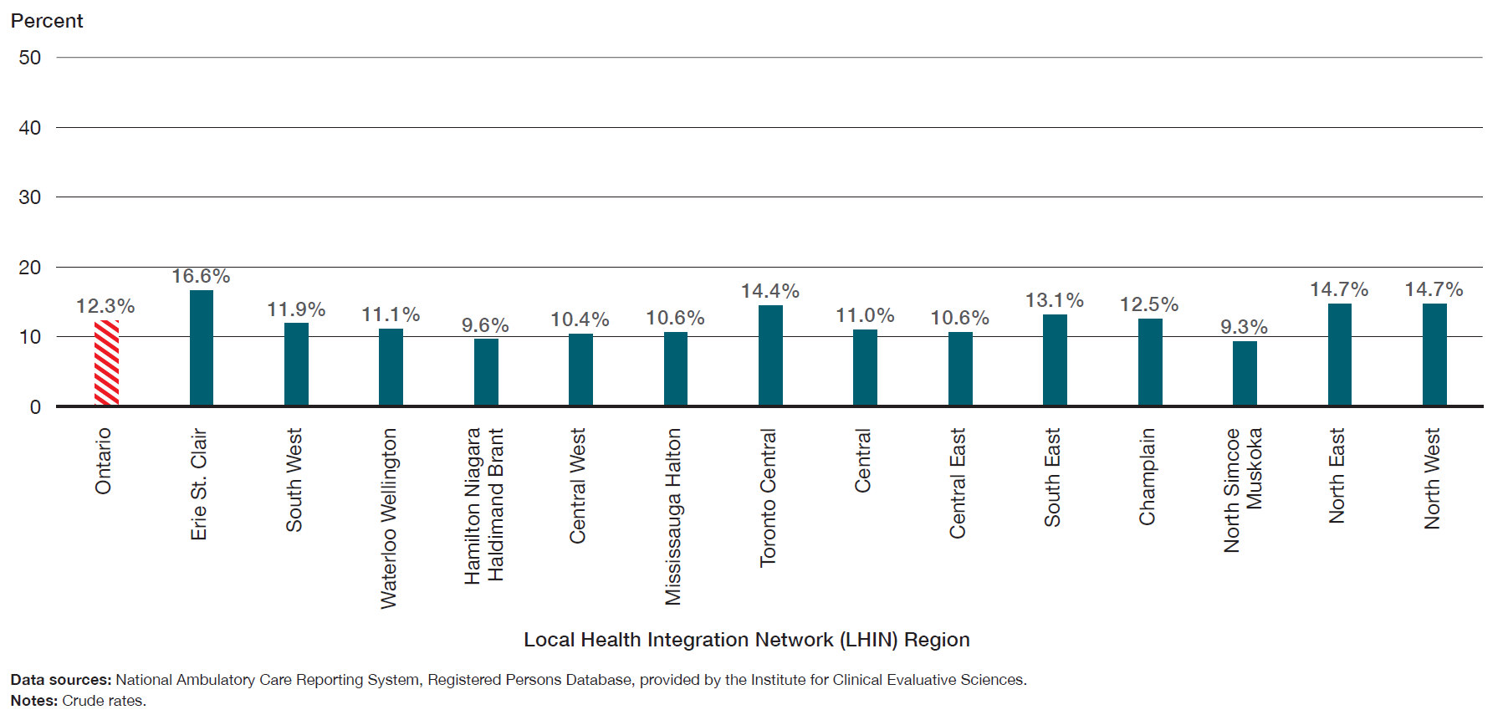
The percentage of patients who revisited the emergency department for a mental health or addictions condition within 30 days of a previous emergency department visit for schizophrenia ranged from 9.3% to 16.6% across LHIN regions.
Percentage of patients who revisited the emergency department for a mental health or addictions condition within 30 days of a previous emergency department visit for schizophrenia, in Ontario, by LHIN region, three-year average for 2012 to 2014

Slide 13
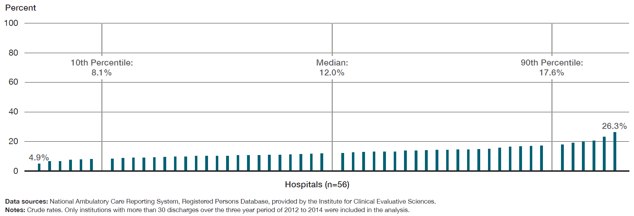
Across facilities in Ontario, the percentage of patients who visited the emergency department for a mental health or addictions condition within 30 days of a previous emergency department visit for schizophrenia ranged from 4.9% to 26.3%.
Percentage of patients who revisited the emergency department for a mental health or addictions condition within 30 days of a previous emergency department visit for schizophrenia, in Ontario, by facility, three-year average for 2012 to 2014

Slide 14
Some Context
Because the quality standard recommends that adults with a primary diagnosis of schizophrenia who are discharged from an inpatient setting have a follow-up appointment within seven days, we examined the percentage of patients who had contact with a family doctor or a psychiatrist within seven days of a previous hospital discharge for schizophrenia.

Slide 15
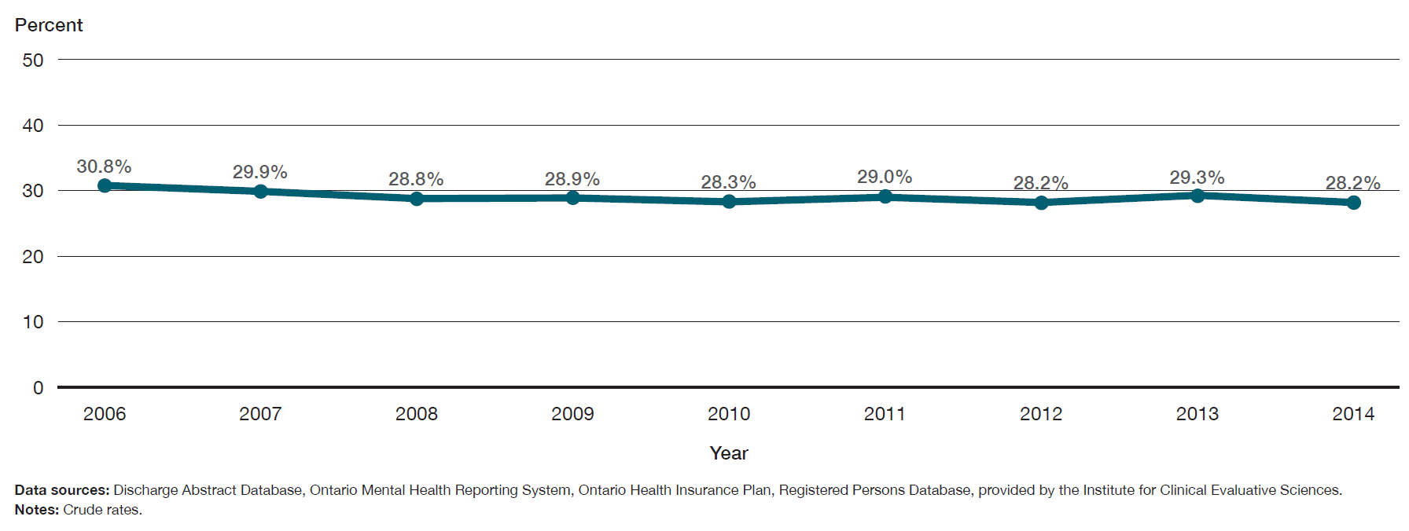
28.2% of patients had contact with a family doctor or a psychiatrist within seven days of a previous hospital discharge for schizophrenia, and this has not improved over the last eight years.
Percentage of patients who had contact with a family doctor or a psychiatrist within seven days of a previous hospital discharge for schizophrenia, in Ontario, 2006 to 2014

Slide 16
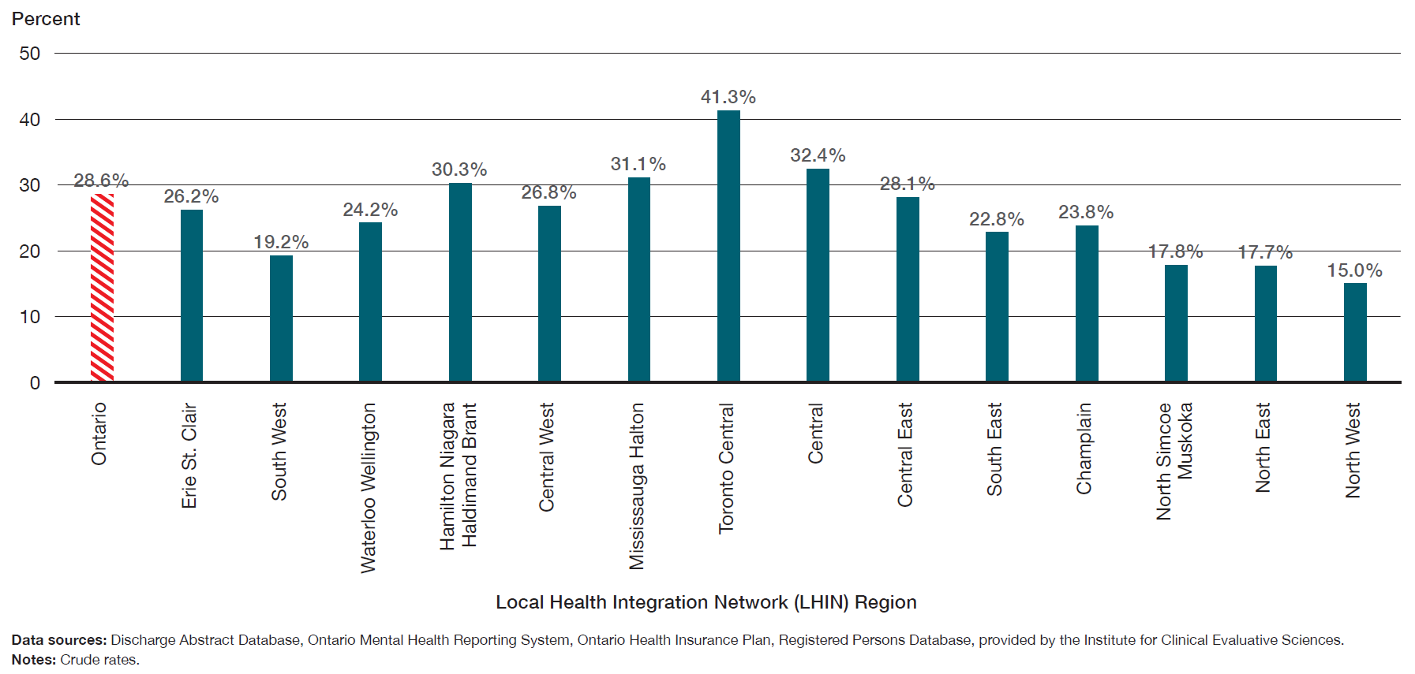
The percentage of patients who had contact with a family doctor or a psychiatrist within seven days of a previous hospital discharge for schizophrenia varied across LHIN regions from 15.0% to 41.3%.
Percentage of patients who had contact with a family doctor or a psychiatrist within seven days of a previous hospital discharge for schizophrenia, in Ontario, by LHIN region, three-year average for 2012 to 2014

Slide 17
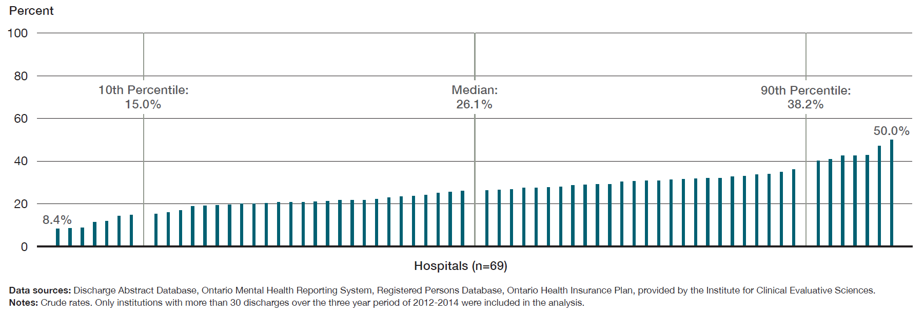
Across facilities in Ontario, the percentage of patients who had contact with a family doctor or a psychiatrist within seven days of a previous hospital discharge for schizophrenia ranged from 8.4% to 50.0%.
Percentage of patients who had contact with a family doctor or a psychiatrist within seven days of a previous hospital discharge for schizophrenia, in Ontario, by facility, three-year average for 2012 to 2014

Slide 18
Additional Resources
This Information Brief is intended to support the Schizophrenia Quality Standard, which can be found in full HERE

Slide 19
Acknowledgements
Health Quality Ontario thanks Paul Kurdyak (Institute for Clinical and Evaluative Sciences (ICES) and Centre for Addiction and Mental Health (CAMH)) for his contributions to this publication. Health Quality Ontario would also like to thank Abigail Amartey, Jenny Gatov, Julie Yang and Maria Chiu of the MHASEF (Mental Health and Addictions Scorecard and Evaluation Framework) Research Team. The MHASEF Research Team is supported by a grant from the Ontario Ministry of Health and Long-Term Care.

Slide 20
Acknowledgements
Notes:
Some of the indicators in this report were derived using health administrative datasets from Ontario. These datasets were linked using unique encoded identifiers and analyzed at ICES.

Slide 21
www.HQOntario.ca
FOLLOW@HQOntario

