Slide 1
QUALITY STANDARDS
Hip Fracture
Guiding evidence-based care for people in Ontario
Notes:
If you have any questions about the content of this presentation, please contact us at QualityStandards@OntarioHealth.ca

Slide 2
Objectives
Overview of quality standards: What are they? How are they used?​
Why this quality standard is needed: Gaps and variations in quality of care for people with hip fracture in Ontario
Quality statements to improve care: The key statements in the hip fracture quality standard
Measures to support improvement: Indicators that can help measure your quality improvement efforts
2

Slide 3
Quality standards
Inform clinicians and patients what quality care looks like
Focus on conditions or processes where there are large variations in how care is delivered, or where there are gaps between the care provided in Ontario and the care patients should receive
Are grounded in the best available evidence
3
Notes:
Quality standards are a small set of high impact statements that describe optimal care where identified quality gaps exist in Ontario.
Voluntary and aspirational in nature​.
Designed to “raise the ceiling” with the goal of having the best possible care available to all Ontarians, regardless of where they live in the province.
There are many guidelines, professional standards, and other recommendations that contribute to the evidence ecosystem. Quality standards complement these resources.
Quality standards outline the what of care that should be delivered but are agnostic on who should be delivering it (unlike other CPGs, BPGs).
Quality standards are:
Concise: 5 to 15 strong, evidence-based statements focused on high-priority areas for improvement.
Accessible: help clinicians and provider organizations offer the highest-quality care; and patients to know what to discuss with their care providers (compared with CPGs that are quite dense, these are very accessible, also written in plain language).
Measurable: each statement is accompanied by one or more quality indicators (structure, process, or outcome), with a set of outcome measures for the overall standard.
Implementable: quality improvement tools and resources support each standard, to fuel adoption.

Slide 4
Quality standards
Help patients, residents, families, and care partners know what to ask for in their care
Help health care professionals know what care to offer, based on evidence and expert consensus
Help health care organizations measure, assess, and improve the quality of care they provide
Help ensure consistent, high-quality care across the province
4
Notes:
Patients, care partners, and the public can use quality standards to understand what excellent care looks like, what they should expect from their health care providers, and how to discuss the quality of their care.
Provincial regions and disease agencies can use quality standards to measure health outcomes, hold health service providers accountable for delivering high-quality care, and inform regional improvement strategies.
Provider organizations can use quality standards to measure and audit their quality of care, identify gaps, guide organizational improvement strategies, and inform clinical program investments.
Health care professionals can use quality standards to evaluate their practice and identify areas for personal and organizational quality improvement and can incorporate the evidence-based statements into professional education.
Government can use quality standards to identify provincial priority areas, inform new data collection and reporting initiatives, and design performance indicators and funding incentives.

Slide 5
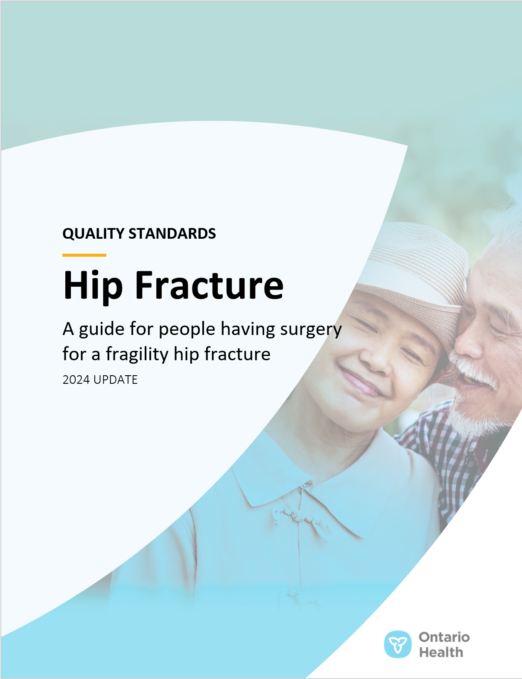
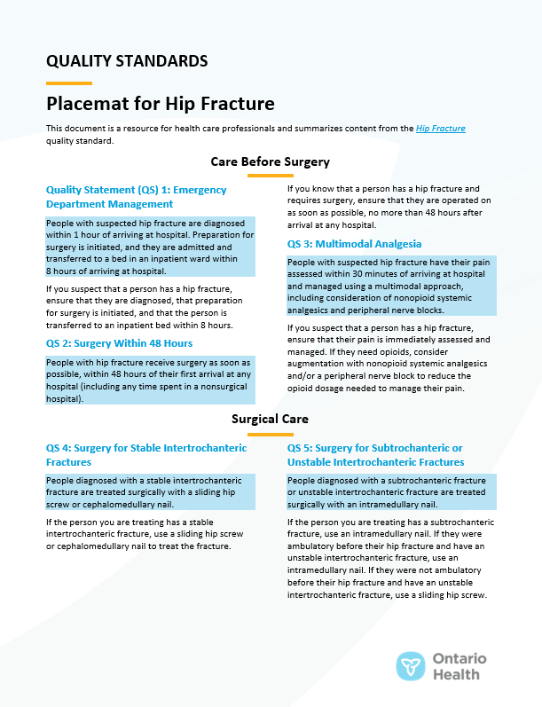
Quality standard resources
Quality Standard
Patient Guide
Placemat
Measurement Guide
Technical Specifications
Getting Started Guide
Find these resources here: https://www.hqontario.ca/evidence-to-improve-care/quality-standards/view-all-quality-standards/hip-fracture
5
Notes:
Each quality standard focuses on a specific health care issue. The development of each quality standard is accompanied by an assortment of resources.
Through concise, easy-to-understand statements, quality standards outline what quality care looks like for a condition or topic based on the evidence.
Each quality standard is accompanied by a:
Patient guide
Placemat
Measurement guide
Technical specifications
Getting started guide
Quality standards provide the blueprint to enable the health care system in Ontario to work better, facilitate smooth transitions, and ensure patients receive the same high-quality care, regardless of where they reside.

Slide 6
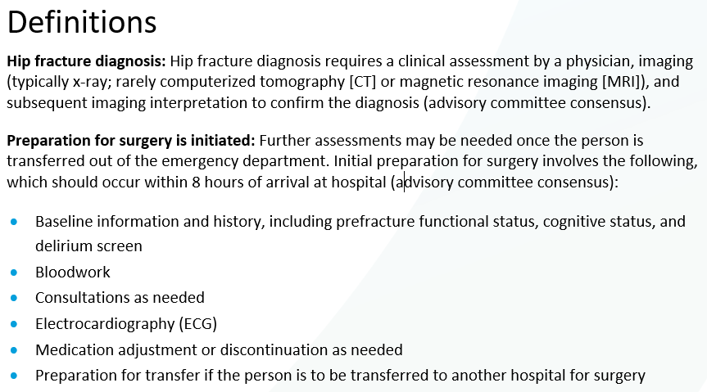
Inside the quality standard
The Quality Statement
The Audience Statements
The Definitions
The Indicators
6

Slide 7
Patient guide
Quality standards
The patient guide is designed to give patients information about what quality care looks like for various conditions based on the best evidence, so they can ask informed questions of their health care providers.
7
Notes:
Every quality standard includes a plain language summary for patients, families, care partners, and the public called the patient guide.
Patient engagement in quality standards:
Membership on advisory committees
Focus groups and key informant interviews on topic-specific content (when necessary)
Public comment period for each quality standard
Consultations on the patient guide

Slide 8
Placemat
Quality standards
The placemat is a quick-reference resource for clinicians that summarizes the quality standard and includes links to helpful resources and tools.
8

Slide 9
How the health care system can support implementation
Quality standards
Implementing quality standards can be challenging owing to system-level barriers or gaps, many of which have been identified throughout the development of this standard
Ontario Health will work with and support other provincial partners, including the Ministry of Health, to bridge system-level gaps to support the implementation of quality standards
9

Slide 10
Implementation tools
Quality standards
The Getting Started Guide:
Outlines the process for using the quality standard as a resource to deliver high-quality care
Contains evidence-based approaches, as well as useful tools and templates for implementing change ideas at the practice level
10
Notes:
There are things we can do today despite the larger systemic barriers that may take time to resolve. The Getting Started Guide is a document that outlines a process for using the quality standards as a resource to deliver high-quality care. It compiles a number of resources to support adoption, such as links to implementation and quality improvement resources, examples and activities for reflection, and templates and documents to support the implementation planning activities. The Getting Started Guide also includes an Action Plan Template and examples on how Quality Improvement Plans can help to advance quality standards.

Slide 11
Quorum
Quality standard adoption tools
Quorum is an online community dedicated to improving the quality of health care in Ontario.
The Quality Standards Adoption Series highlights efforts in the field to implement changes and close gaps in care related to quality standard topics.
quorum.hqontario.ca
11
Notes:
The Quality Standards program has highlighted several stories from organizations and groups using various standards and statements within their clinical care settings, organization, or institutions; these are available through posts and discussions on Quorum.
As well, we are working on compiling resources and tools, for both clinicians and patients and families.
The focus is on implementation/adoption stories and how organizations are using quality standards in practice to inform care.
We’d love to hear from you if you are interested in contributing to a post or article.

Slide 12
Measurement guide
Quality standards
The measurement guide describes:
The measurement principles behind the quality indicators included in quality standards
The types of indicators included in quality standards
How local and provincial data are collected and measured
12

Slide 13
Technical specifications
Quality standards
The technical specifications report outlines 2 types of measurement:
Provincial measurement: how we can monitor the progress being made to improve care on a provincial level
Local measurement: what you can do to assess the quality of care that you provide locally
13

Slide 14
Why do we need a quality standard for hip fracture?

Slide 15
Each year, about 12,000 people in Ontario aged 50 years and older experience a hip fracture
A fragility hip fracture is a fracture of the femur from low-energy trauma.
Females account for two-thirds of people who undergo surgery for hip fracture.
The risk of hip fracture increases with age: those aged 80 to 89 years make up the largest proportion of people who undergo surgery for hip fracture.
Note: Based on data for people aged 50 years and older. Abbreviations: F, female; M, male. FY; fiscal year. Source: Discharge Abstract Database (DAD), FY 2022/23.
15

Slide 16
The all-cause mortality rate following hip fracture surgery varies across Ontario
About 6% and 12% of people who had a fragility hip fracture in Ontario died within 30 days and within 90 days of hospital admission for hip fracture surgery, respectively.
Notes: Based on data for people aged 50 years and older. Results not risk-adjusted. Ontario Health region boundaries as of April 2023. Abbreviation: FY, fiscal year. Sources: DAD, Registered Persons Database (RPDB), FY 2022/23.
16

Slide 17
In FY 2022/23, one-third (34%) of people with hip fracture were admitted and transferred to an inpatient bed within 8 hours of arriving at hospital
The median wait time from the ED to inpatient care for people with hip fracture increased from 7.6 hours in FY 2016/17 to 10.7 hours in FY 2022/23.
Notes: Based on data for people aged 50 years and older admitted through the ED. Wait time calculated as the difference between triage time and left ED time. Abbreviations: ED, emergency department; FY, fiscal year. Sources: DAD, National Ambulatory Care Reporting System (NACRS), FY 2016/17 to FY 2022/23.
17

Slide 18
In FY 2022/23, one-quarter (25%) of people with hip fracture waited longer than the recommended 48 hours for surgery
Median wait time | 90th percentile wait time
30 hours | 68 hours
Most people who had hip fracture surgery (85%) were admitted through the ED. However, those admitted through the ED had longer wait times than those admitted directly as an inpatient, with median wait times of 33 hours and 21 hours, respectively.
Notes: Based on data for people aged 50 years and older. Patients with incomplete triage time, admit time, or surgery start time were excluded from the analysis. Abbreviations: ED, emergency department; FY; fiscal year. Sources: DAD, NACRS, 2022/23
18

Slide 19
Postoperative blood transfusion rates vary by hospital
People who are asymptomatic and have a postoperative hemoglobin level of 80 g/L or more should not receive a blood transfusion. Although the percentage of people with hip fracture who receive a postoperative blood transfusion has decreased slightly over time, there is significant variation among hospitals, with rates ranging from 5.6% to 46.4%.
Percentage of people who had hip fracture surgery and received a blood transfusion in FY 2022/23, median (range) | 90th percentile wait time
Highest 10 hospitals | Lowest 10 hospitals
30% (27.8%–46.4%) | 12% (5.6%–15.6%)
Notes: Based on data for people aged 50 years and older. Includes blood transfusions within the same hospitalization as the hip fracture surgery. Abbreviation: FY; fiscal year. Source: DAD, FY 2016/17 to FY 2022/23.
19

Slide 20
In FY 2022/23, the median length of stay for hip fracture surgery hospitalizations was 9 days
Median length of stay varied by Ontario Health region. Stays were shortest in the North East and North West regions.
Ontario Health region | Overall | Central | West | East | Toronto | North East | North West
Number of hospitalizations | 12,357 | 2,575 | 3,994 | 2,975 | 1,862 | 685 | 266
Notes: Based on data for people aged 50 years and older. Results not risk-adjusted. Abbreviations: FY; fiscal year. Source: DAD, 2022/23.
20

Slide 21
Readmission rates following hip fracture surgery have increased over time and vary by region
The 90-day readmission rate for hip fracture in Ontario has increased from 13 per 100 hospitalizations in FY 2016/17 to 17 per 100 hospitalizations in FY 2022/23.
The highest readmission rates were in the North East and North West regions.
Note: Based on data for people aged 50 years and older. Results not risk-adjusted. Abbreviation: FY, fiscal year. Source: DAD, 2016/17 to 2022/23.
21

Slide 22
About half those who have hip fracture surgery return to the community within 90 days of being hospitalized
In Ontario in FY 2021/22, 54% of previously community-dwelling people were discharged back to the community within 90 days of hospital admission for hip fracture surgery.
People who successfully return to the community 90 days post-admission tend to be younger (median, 79 vs. 86 years) and have a shorter total length of stay (median, 8 vs. 12 days) compared with those who do not.
Note: Based on data for people aged 50 years and older. Abbreviation: FY, fiscal year. Sources: Continuing Care Reporting System (CCRS), DAD, National Rehabilitation Reporting System (NRS), RPDB, FY 2021/22. Limitations: The latest year for which data were available from all sources at the time of analysis was FY 2021/22. Community-dwelling status 90 days post-admission is determined based on a lack of CCRS, DAD, NRS, and RPDB mortality records within that time period. Because patient care settings may be inadequately determined in administrative databases, comprehensive patient tracking requires information from a variety of sources, including chart review and local data exchange.
22

Slide 23
Quality statements to improve care

Slide 24
Scope of this quality standard
This quality standard focuses on adults aged 50 years and older undergoing surgery for fragility hip fractures and the care delivered from the point at which they present to the emergency department until 3 months following surgery
This quality standard does not apply to people with hip fractures resulting from high-energy trauma or people with fragility fractures who are not candidates for surgery
24
Notes:
Scope of This Quality Standard
This quality standard focuses on adults aged 50 years and older undergoing surgery for fragility hip fractures and the care delivered from the point at which they present to the emergency department until 3 months following surgery. Fragility hip fractures are fractures of the femur caused by low-energy trauma, such as falls from a standing height. This quality standard does not apply to people with hip fractures resulting from high-energy trauma or people with fragility fractures who are not candidates for surgery.

Slide 25
Quality statement topics
Emergency department management
Surgery within 48 hours
Multimodal analgesia
Surgery for stable intertrochanteric fractures
Surgery for subtrochanteric or unstable intertrochanteric fractures
Surgery for displaced intracapsular fractures
Postoperative blood transfusions
Weight-bearing as tolerated
Daily mobilization
Screening for and managing delirium
Postoperative management
Information for patients, families, and care partners
Rehabilitation
Osteoporosis management
Follow-up care
25

Slide 26
Emergency department management
Quality statement 1:
People with suspected hip fracture are diagnosed within 1 hour of arriving at hospital. Preparation for surgery is initiated, and they are admitted and transferred to a bed in an inpatient ward within 8 hours of arriving at hospital.
26

Slide 27
Surgery within 48 hours
Quality statement 2:
People with hip fracture receive surgery as soon as possible, within 48 hours of their first arrival at any hospital (including any time spent in a nonsurgical hospital).
27

Slide 28
Multimodal analgesia
Quality statement 3:
People with suspected hip fracture have their pain assessed within 30 minutes of arriving at hospital and managed using a multimodal approach, including consideration of nonopioid systemic analgesics and peripheral nerve blocks.
28

Slide 29
Surgery for stable intertrochanteric fractures
Quality statement 4:
People diagnosed with a stable intertrochanteric fracture are treated surgically with a sliding hip screw or cephalomedullary nail.
29

Slide 30
Surgery for subtrochanteric or unstable intertrochanteric fractures
Quality statement 5:
People diagnosed with a subtrochanteric fracture or unstable intertrochanteric fracture are treated surgically with an intramedullary nail.
30

Slide 31
Surgery for displaced intracapsular fractures
Quality statement 6:
People diagnosed with a displaced intracapsular hip fracture are treated surgically with arthroplasty.
31

Slide 32
Postoperative blood transfusions
Quality statement 7:
People with hip fracture do not receive blood transfusions if they are asymptomatic and have a postoperative hemoglobin level equal to or higher than 80 g/L.
32

Slide 33
Weight-bearing as tolerated
Quality statement 8:
People with hip fracture are mobilized to weight-bearing as tolerated within 24 hours following surgery.
33

Slide 34
Daily mobilization
Quality statement 9:
After surgery, people with hip fracture are mobilized on a daily basis to increase their functional tolerance.
34

Slide 35
Screening for and managing delirium
Quality statement 10:
People with hip fracture are screened for delirium using a standardized, validated tool as part of their initial assessment and then at least once every 12 hours while in hospital, after transitions between settings, and after any change in medical status. They receive interventions to prevent delirium and to promote recovery if delirium is present.
35

Slide 36
Postoperative management
Quality statement 11:
People with hip fracture receive postoperative care from an interprofessional team in accordance with principles of geriatric care.
36

Slide 37
Information for patients, families, and care partners
Quality statement 12:
People with hip fracture and their families and care partners are given information on patient care that is tailored to meet their needs and delivered at appropriate times in the care continuum.
37

Slide 38
Rehabilitation
Quality statement 13:
People with hip fracture participate in an interprofessional rehabilitation program (in an inpatient setting, a community setting, or a combination of both) with the goal of returning to their prefracture functional status.
38

Slide 39
Osteoporosis management
Quality statement 14:
While in hospital, people with hip fracture undergo a fracture risk assessment from a clinician with osteoporosis expertise and, when appropriate, are offered medications for osteoporosis.
39

Slide 40
Follow-up care
Quality statement 15:
People with hip fracture are discharged from inpatient care with a scheduled follow-up appointment with a primary care provider within 2 weeks of discharge and a scheduled follow-up appointment with the orthopaedic service within 12 weeks of their surgery.
40

Slide 41
Measures to support improvement
Notes:
The Hip Fracture Quality Standard Advisory Committee identified a set of overarching goals for this quality standard. These have been mapped to indicators that may be used to assess quality of care provincially and locally.

Slide 42
Indicators that can be measured using provincial data
Percentage of people who undergo hip fracture surgery who die within 30 days or within 90 days of surgery
Percentage of people who undergo hip fracture surgery who are readmitted to hospital within 30 days or within 90 days of surgery
Percentage of previously community-dwelling people who undergo hip fracture surgery who return to the community
42

Slide 43
Indicators that can be measured using only local data
Percentage of people who undergo hip fracture surgery who achieve weight-bearing as tolerated within 24 hours of surgery
Percentage of people who undergo hip fracture surgery who return to their prefracture functional status within 90 days or within 6 months of surgery
43

Slide 44
Data sources and acknowledgement
Parts of this material are based on data and information compiled and provided by the Canadian Institute for Health Information (CIHI). However, the analyses, conclusions, opinions, and statements expressed herein are those of the authors and not necessarily those of CIHI.
44

Slide 45
Thank you

