Slide 1


Problematic Alcohol Use
and Alcohol Use Disorder
Quality Standard
Guiding evidence-based care for people 15 years of age and older living in Ontario
Notes:
If you have any questions about the content of this presentation, please contact us at QualityStandards@hqontario.ca

Slide 2
Objectives
Overview of quality standards
What are they? How are they used?​
Why this quality standard is needed
Gaps and variations in quality of care for people with alcohol use disorder in Ontario
How success can be measured
Indicators that can help measure your quality improvement efforts
Quality statements in brief
The key statements in the alcohol use disorder quality standard

Slide 3
Quality Standards
Inform clinicians and patients what quality care looks like
Focus on conditions or processes where there are large variations in how care is delivered, or where there are gaps between the care provided in Ontario and the care patients should receive
Are grounded in the best available evidence
Notes:
Quality standards are a small set of high-impact statements that describe optimal care where identified quality gaps exist in Ontario.
Voluntary and aspirational in nature​.
Designed to “raise the ceiling” with the goal of having the best possible care available to all Ontarians, regardless of where they live in the province.
There are many guidelines, professional standards, and other recommendations that contribute to the evidence ecosystem. Quality standards complement these resources.
Quality standards outline the what of care that should be delivered but are agnostic on who should be delivering it (unlike other clinical practice guidelines, best practice guidelines).
Quality standards are:
Concise: 5 to 15 strong, evidence-based statements focused on high-priority areas for improvement.
Accessible: help clinicians and provider organizations offer the highest-quality care and help patients know what to discuss with their care providers (compared with clinical practice guidelines, which are quite dense, quality standards are very accessible and written in plain language).
Measurable: each statement is accompanied by one or more quality indicators (structure, process, and outcome), and a set of outcome measures for the overall standard is provided.
Implementable: quality improvement tools and resources support each standard to fuel adoption.

Slide 4
Quality Standards
Help health care professionals know what care to offer, based on evidence and expert consensus
Help health care organizations measure, assess, and improve the quality of care they provide
Help ensure consistent,
high-quality care across the province
Help patients, residents, families, and caregivers know what to ask for in their care
Notes:
Patients, caregivers, and the public can use quality standards to understand what excellent care looks like, what they should expect from their health care providers, and how to discuss the quality of their care.
Regions and disease agencies can use quality standards to measure health outcomes, hold health service providers accountable for delivering high-quality care, and inform regional improvement strategies.
Provider organizations can use quality standards to measure and audit their quality of care, identify gaps, guide organizational improvement strategies, and inform clinical program investments.
Health care professionals can use quality standards to evaluate their practice and identify areas for personal and organizational quality improvement, and they can incorporate the evidence-based statements into professional education.
Government can use quality standards to identify provincial priority areas, inform new data collection and reporting initiatives, and design performance indicators and funding incentives.

Slide 5
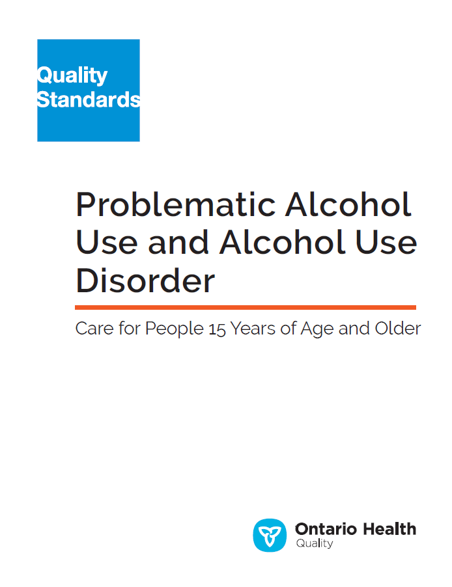
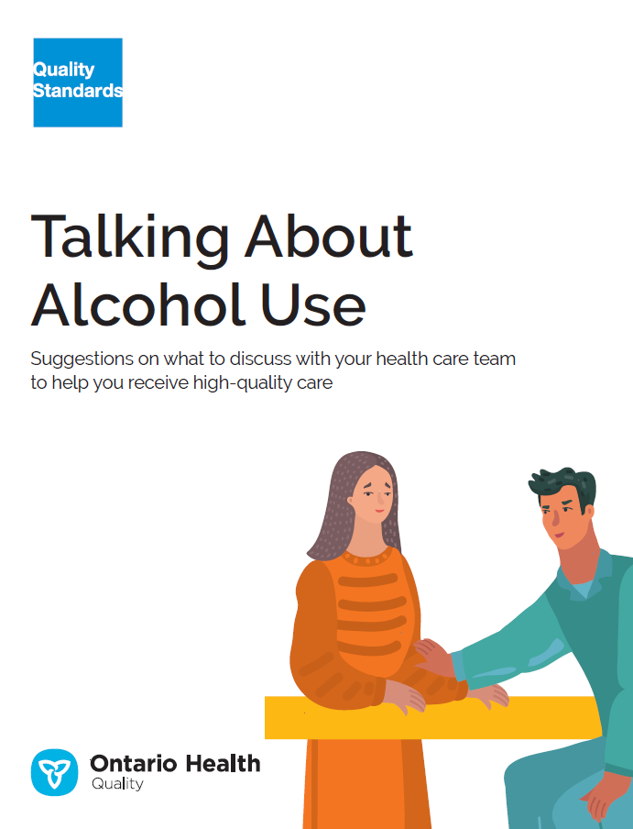
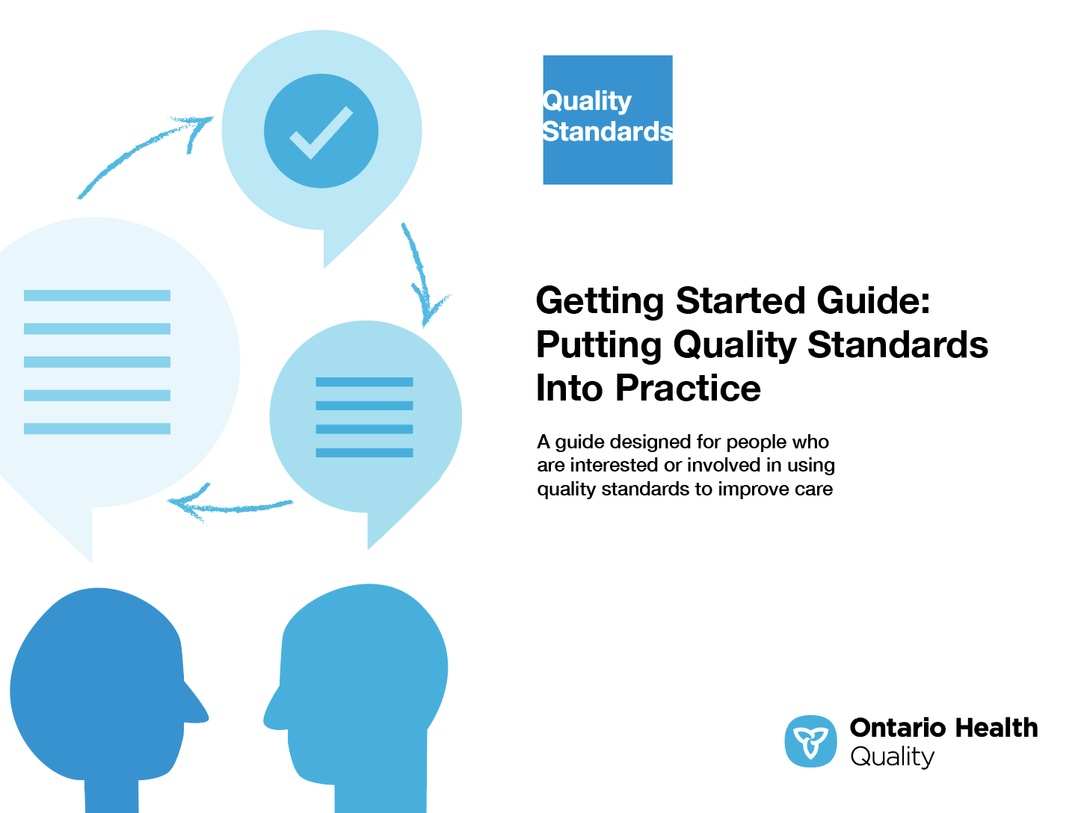
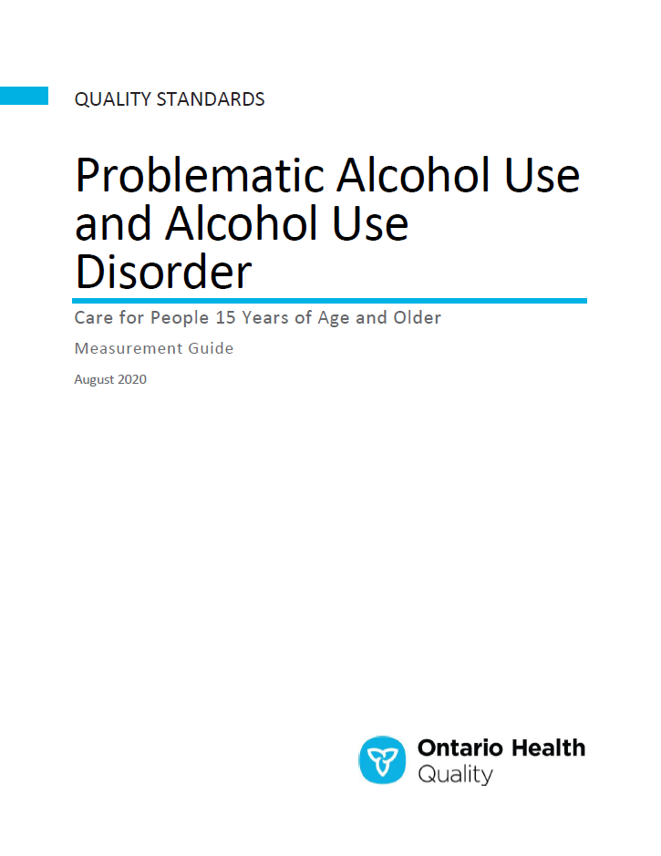
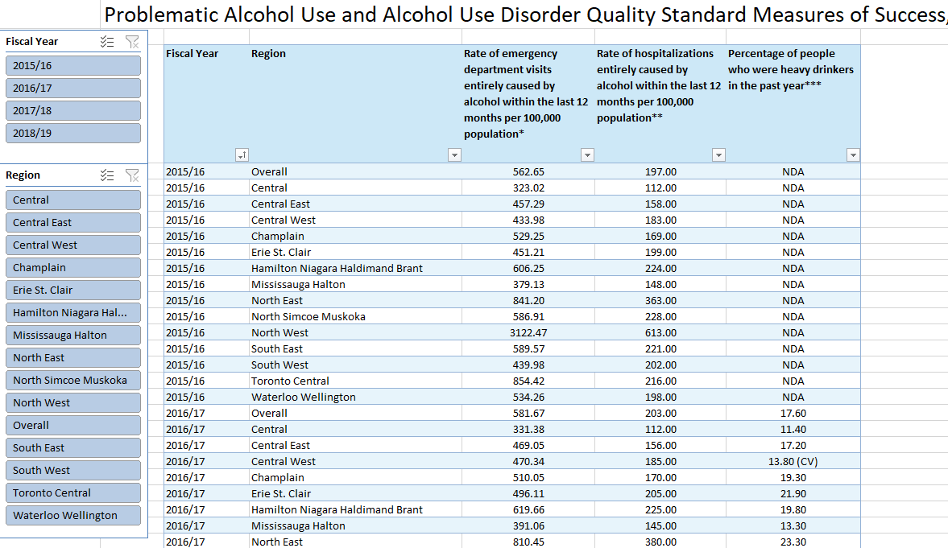
Quality Standard Resources
Quality Standard
Patient Conversation Guide
Getting Started Guide
Data Tables
Measurement Guide
Find these resources here:
https://www.hqontario.ca/evidence-to-improve-care/quality-standards/view-all-quality-standards/problematic-alcohol-use-and-alcohol-use-disorder
Notes:
Each quality standard focuses on a specific health care issue and is accompanied by an assortment of resources.
Through concise, easy-to-understand statements, quality standards outline what quality care looks like for a condition or topic based on the evidence.
Each quality standard is accompanied by:
A patient conversation guide
A getting-started guide
Data tables
A measurement guide
Quality standards provide the blueprint to enable the health care system in Ontario to work better, facilitate smooth transitions, and ensure patients receive the same high-quality care regardless of where they reside.

Slide 6
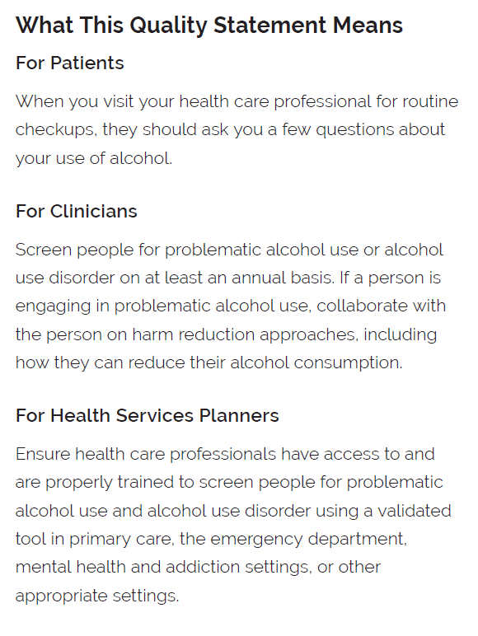
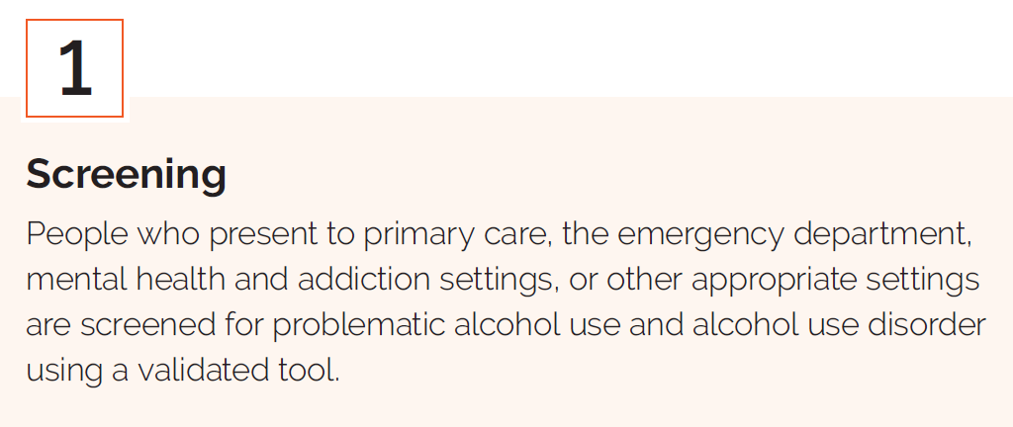
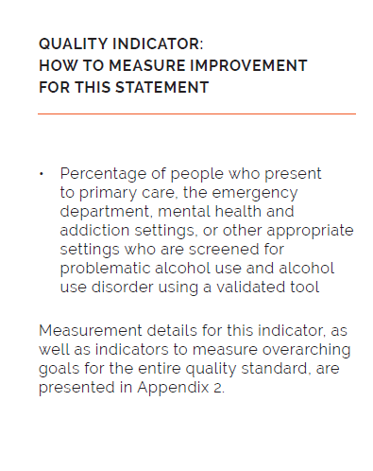
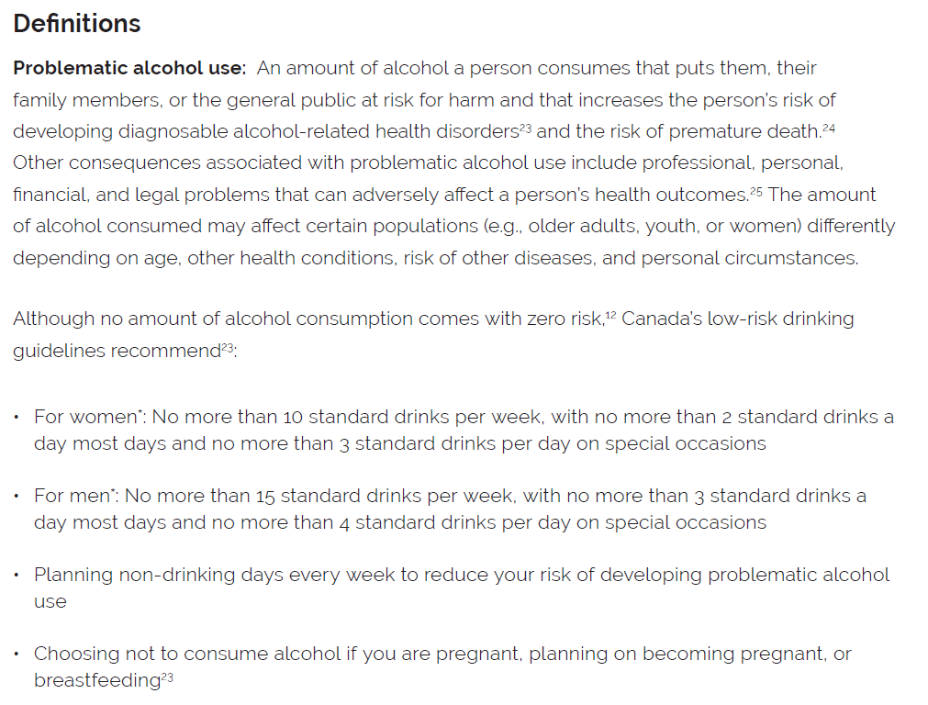
Inside the Quality Standard
The Statement
The Audience
Definitions
The Indicators

Slide 7
Quality Standards:
Patient Guide
The patient guide is designed to give patients information about what quality
care looks like for various conditions based on the best evidence, so they can ask informed questions of their health care providers.
Notes:
Every quality standard includes a plain-language summary for patients, families, caregivers, and the public called the patient conversation guide.
Patient engagement in quality standards:
Membership on advisory committees
Focus groups and key informant interviews on topic-specific content (when necessary)
Public comment period for each quality standard
Consultations on the patient conversation guide

Slide 8
Quality Standards:
How the Health Care System Can Support Implementation
Implementing quality standards can be challenging due to system-level barriers or gaps, many of which have been identified throughout the development of this standard. Ontario Health will work with and support other provincial partners, including Ministry of Health, to bridge system-level gaps to support the implementation of quality standards.

Slide 9
Quality Standards:
Implementation Tools
The Getting Started Guide:
Outlines the process for using the quality standard as a resource to deliver high-quality care
Contains evidence-based approaches, as well as useful tools and templates for implementing change ideas at the practice level
Notes:
There are things we can do today despite the larger systemic barriers that may take time to resolve. The Getting Started Guide is a document that outlines a process for using the quality standards as a resource to deliver high-quality care. It compiles a number of resources to support adoption, such as links to implementation and quality improvement resources, examples and activities for reflection, and templates and documents to support the implementation planning activities. The Getting Started Guide also includes an Action Plan Template and examples on how Quality Improvement Plans can help to advance quality standards.

Slide 10


Quality Standard Adoption Tools:
Quorum
Quorum is an online community dedicated to improving the quality of health care in Ontario.
The Quality Standards Adoption Series highlights efforts in the field to implement changes and close gaps in care related to quality standard topics.
quorum.hqontario.ca
Notes:
The Quality Standards program has highlighted several stories from organizations and groups using various standards and statements within their clinical care settings, organization, or institutions; these are available through posts and discussions on Quorum.
As well, we are working on compiling resources and tools, for both clinicians and patients and families.
The focus is on implementation/adoption stories and how organizations are using quality standards in practice to inform care.
We’d love to hear from you if you are interested in contributing to a post or article.

Slide 11
Quality Standards:
Measurement Guide
The measurement guide has two dedicated sections:
Local measurement: what you can do to assess the quality of care that you provide locally
Provincial measurement: how we can measure the success of the quality standard on a provincial level

Slide 12
Quality Standards:
Data Tables
Data tables can be used to examine variations in indicator results across the province. They include data on key indicators:
Over time for Ontario
Across regions in Ontario
For specific measures of equity (e.g., age, sex, rurality, household income)

Slide 13
Why Do We Need a Quality Standard for Problematic Alcohol Use and Alcohol Use Disorder?
Notes:
The data presented in the following slides relate to people with problematic alcohol use and alcohol use disorder, as well as their caregivers.

Slide 14
Every day, 10 Canadians die in hospital from harm caused by substance use;
3 in 4 of these deaths are due to alcohol use.
Data source: Canadian Institute for Health Information, 2018. Available online: https://yourhealthsystem.cihi.ca/hsp/inbrief?lang=en#!/indicators/080/hospital-stays-for-harm-caused-by-substance-use
Notes:
Alcohol use is the top risk factor for disease burden worldwide for people between the ages of 15 and 49 years and is listed as the sixth of the top 10 risk factors for disease burden for all Canadians.
Sources:
GBD 2016 Alcohol Collaborators. Alcohol use and burden for 195 countries and territories, 1990-2016: a systematic analysis for the Global Burden of Disease Study 2016. Lancet. 2018;392(10152):1015-35.
Alam S, Lang JJ, Drucker AM, Gotay C, Kozloff N, Mate K, et al. Assessment of the burden of diseases and injuries attributable to risk factors in Canada from 1990 to 2016: an analysis of the Global Burden of Disease Study. CMAJ Open. 2019;7(1):E140-E8.

Slide 15

In 2018, 17.6% of people in Ontario 12 years of age and older reported heavy alcohol consumption on one occasion at least once a month in the past year.
Heavy alcohol consumption is defined as people who identify as male consuming 5 or more drinks on one occasion at least once a month in the past year, and people who identify as female consuming 4 or more drinks, on one occasion at least once a month in the past year.
Note: Data are age-standardized.
Data source: Canadian Community Health Survey, provided by Statistics Canada.
Notes:
Heavy alcohol consumption is defined as people who identify as male consuming 5 or more drinks on one occasion at least once a month in the past year, and people who identify as female consuming 4 or more drinks, on one occasion at least once a month in the past year.
Based on the Canadian Community Heath Survey (CCHS) survey, a “drink” refers to:
A bottle or small can of beer, cider or cooler with 5% alcohol content, or a small draft;
A glass of wine with 12% alcohol content;
A glass or cocktail containing 1.5 oz. of a spirit with 40% alcohol content.
As defined in the Problematic Alcohol Use and Alcohol Use Disorder Quality Standard, Canada’s low-risk drinking guidelines define a single standard alcoholic drink as follows:
Beer: 341 mL or 12 oz, 5% alcohol content
Cider or cooler: 341 mL or 12 oz, 5% alcohol content
Wine: 142 mL or 5 oz, 12% alcohol content
Distilled alcohol (rye, rum, gin, etc.): 43 mL or 1.5 oz, 40% alcohol content

Slide 16
Heavy drinking rates varied by region
Percentage of people aged 12 and older who self-reported as heavy drinking, in Ontario,
by region, 2018
*Data point should be used with caution because the coefficient of variation is between 15% and 35%.
Heavy alcohol consumption is defined as people who identify as male consuming 5 or more drinks on one occasion at least once a month in the past year, and people who identify as female consuming 4 or more drinks, on one occasion at least once a month in the past year.
Note: Data are age-standardized.
Data source: Canadian Community Health Survey, provided by Statistics Canada.
Notes:
Heavy alcohol consumption is defined as people who identify as male consuming 5 or more drinks on one occasion at least once a month in the past year, and people who identify as female consuming 4 or more drinks, on one occasion at least once a month in the past year.
Based on the Canadian Community Heath Survey (CCHS) survey, a “drink” refers to:
A bottle or small can of beer, cider or cooler with 5% alcohol content, or a small draft;
A glass of wine with 12% alcohol content;
A glass or cocktail containing 1.5 oz. of a spirit with 40% alcohol content.
Heavy alcohol consumption rates are highest between the ages of 18 and 59 years. People who identify as male have a higher rate of heavy alcohol consumption than people who identify as female. (Data source: Canadian Community Health Survey, provided by Statistics Canada)
These data show the different regions across Ontario and the heavy alcohol consumption rates in each region.
As defined in the Problematic Alcohol Use and Alcohol Use Disorder Quality Standard, Canada’s low-risk drinking guidelines define a single standard alcoholic drink as follows:
Beer: 341 mL or 12 oz, 5% alcohol content
Cider or cooler: 341 mL or 12 oz, 5% alcohol content
Wine: 142 mL or 5 oz, 12% alcohol content
Distilled alcohol (rye, rum, gin, etc.): 43 mL or 1.5 oz, 40% alcohol content

Slide 17

There were over 27,000 hospitalizations in Ontario related to alcohol use in 2018/19.
This accounts for more than half of all substance use–related hospitalizations.
Data source: Canadian Institute for Health Information. Your Health System. Available online: https://yourhealthsystem.cihi.ca/hsp/inbrief?lang=en#!/indicators/080/hospital-stays-for-harm-caused-by-substance-use
Notes:
In Ontario, people aged 10 years and older who identify as male have a higher rate of hospitalization caused entirely by alcohol use compared to people who identify as female (Data source: Discharge Abstract Database, Hospital Morbidity Database, National Ambulatory Care Reporting System, Ontario Mental Health Reporting System, provided by Canadian Institute for Health Information).

Slide 18
Hospitalizations caused entirely by alcohol varied by region
Hospitalizations caused entirely by alcohol, per 100,000 population aged 10 years and older, in Ontario, by region, 2018/19
Note: Rates are age-standardized
Data source: Discharge Abstract Database, Hospital Morbidity Database, National Ambulatory Care Reporting System, Ontario Mental Health Reporting System, provided by Canadian Institute for Health Information
Notes:
This slide shows the variation among hospitalizations caused entirely by alcohol across regions in Ontario.

Slide 19

Alcohol use has cost implications
In 2017, alcohol contributed to a total cost of $6.17 billion in health, lost productivity, criminal justice, and other direct costs in Ontario.
Of the total costs, the health costs account for $2.01 billion.
Data source: Canadian Substance Use Costs and Harms online data visualization tool, provided by Canadian Substance Use Costs and Harms. Available online: https://csuch.ca/explore-the-data/
Notes:
The negative consequences of alcohol consumption are a major health concern and a common cause of death and injury: Alcohol use accounts for more than half of hospitalizations attributed to substance use in Canada, with about 82,000 hospitalizations resulting from harm caused by alcohol in 2017/18, with the type of harm experienced by people dependent on the substance used. The economic costs of alcohol-related harms in Canada were estimated to be $16.3 billion in 2017 ($6.17 billion in Ontario), and, of that, $5.43 billion was attributed to direct health care costs ($2.01 billion in Ontario).

Slide 20

About 1 in 4 people (26.4%) in Ontario reported having talked about alcohol use with their doctor or other clinical staff where they usually go for care during the past 2 years.
Data source: Canadian Institute for Health Information. How Canada Compares: Results From the Commonwealth Fund’s 2016 International Health Policy Survey of Adults in 11 Countries. 2017.
Notes:
Based on current research, only 1 in 4 people are being screened for or talking with their health care professionals about their alcohol use. And yet, screening for alcohol use is important for early identification of problematic alcohol use and alcohol use disorder. Research shows that everyone should be screened, that screening reduces the risks and complications associated with alcohol use, and that screening helps health care professionals identify how much alcohol use is impacting a person’s life.
Screening tools are used when clinically appropriate to assist clinicians to identify those with problematic alcohol use and alcohol use disorder. Less than half (41%; n = 119) of family physicians reported using validated tools with some patients to screen for alcohol use disorder. Only a small number of family physicians (7%) reported using validated tools with all patients to screen for alcohol use disorder.
References
Assembly of First Nations, National Native Addictions Partnership Foundation, First Nations Addictions Advisory Panel. Honouring our strengths: a renewed framework to address substance use issues among First Nations People in Canada. Ottawa (ON): Thunderbird Partnership Foundation and Health Canada; 2011. Health Canada Publication 110114.
Loheswaran G, Soklaridis S, Selby P, Le Foll B. Screening and treatment for alcohol, tobacco and opioid use disorders: a survey of family physicians across Ontario. PLoS One. 2015;10(4): e0124402.
Smith PC, Schmidt SM, Allensworth-Davies D, Saitz R. Primary care validation of a single-question alcohol screening test. J Gen Intern Med. 2009;24(7):783-8

Slide 21
“There’s a long way to go to improve care [for alcohol use disorder] in this province. In my experience, it was incredibly difficult to find resources, difficult to get a diagnosis, and difficult to find appropriate treatment options that could be accessed quickly. I received conflicting information from different providers, which was confusing. I had to research treatment options on my own, which was frustrating when I knew I needed help immediately.
This quality standard will help create structure in the way we treat alcohol use disorder, starting with screening for everyone and a brief intervention for those who have a problem. This will help those who need it get an assessment, regardless of the severity of their issue. This, in turn, will help direct them to the right resources."
– Paul Newcombe, Lived Experience Advisor, Alcohol Use Disorder Quality Standard Advisory Committee​
Notes:
Lived experience advisor quote

Slide 22
Quality Statements to Improve Care

Slide 23
Scope of the Problematic Alcohol Use and Alcohol Use Disorder Quality Standard
This quality standard addresses clinical care for people
15 years of age and older with problematic alcohol use or alcohol use disorder across all care settings.
The scope of the standard covers the screening and assessment of problematic alcohol use and the diagnosis, management, and treatment of alcohol use disorder. It addresses how to identify new or worsening symptoms of alcohol use disorder (withdrawal, tolerance, and cravings), and the support, treatment, and management of people with comorbid mental health disorders, other substance use disorders, or medical conditions.
Notes:
Scope of This Quality Standard
This quality standard addresses clinical care for people 15 years of age and older with problematic alcohol use or alcohol use disorder across all care settings and along the mental health and addictions care continuum.
The scope of the standard covers screening for problematic alcohol use; a brief intervention; and the assessment, diagnosis, management, and treatment of alcohol use disorder. It addresses how to identify new or worsening symptoms of alcohol use disorder (withdrawal, tolerance, and cravings), and the support, treatment, and management of people with comorbid mental health disorders, other substance use disorders, or medical conditions. This quality standard does not address the primary prevention of alcohol use, including public health interventions and regulatory policy.
Although this quality standard applies to the care of adolescents and young adults, the statements are based mostly on guideline evidence that primarily focuses on adults (aged 18 years and older) and nonpregnant people. The Ontario Health (Quality) Alcohol Use Disorder Quality Standard Advisory Committee agrees that the guidance in this quality standard is also relevant and applicable to people with alcohol use disorder who are 15 years of age and older and people who are pregnant. Health care professionals and service providers should consider that specialized skills and expertise may be required when providing treatment for specific populations, including children, youth, and pregnant people with alcohol use disorder. If treatment of these or other specific populations is beyond a service provider’s expertise, they should consult or work with another service provider who has appropriate expertise.

Slide 24
Quality Statement Topics
Screening
Brief Intervention
Comprehensive Assessment
Care Plan
Treatment of Alcohol Withdrawal Symptoms
Information and Education
Psychological and Social Interventions
Medications to Reduce Alcohol Cravings or Consumption
Concurrent Mental Health and Substance Use Disorders and Comorbid Physical Health Disorders
Monitoring, Support, and Follow-Up

Slide 25
Quality Statement 1:
Screening
People who present to primary care, the emergency department, mental health and addictions settings, or other appropriate settings are screened for problematic alcohol use and alcohol use disorder using a validated tool.

Slide 26
Quality Statement 2:
Brief Intervention
People who screen positive for problematic alcohol use are offered a brief intervention.

Slide 27
Quality Statement 3:
Comprehensive Assessment
People who may have alcohol use disorder are offered a comprehensive assessment that informs their care plan.

Slide 28
Quality Statement 4:
Care Plan
People with alcohol use disorder have an individualized care plan developed in collaboration with their health care professional that includes appropriate services and treatment goals. Care is seamlessly integrated, interprofessional, and provided in primary care or in collaboration with primary care.

Slide 29
Quality Statement 5:
Treatment of Alcohol Withdrawal Symptoms
People with alcohol use disorder who have withdrawal symptoms are offered assessment, treatment, and
support tailored to the severity of their symptoms.

Slide 30
Quality Statement 6:
Information and Education
People with alcohol use disorder and their caregivers are offered information, education, and support appropriate for their needs and preferences.

Slide 31
Quality Statement 7:
Psychological and Social Interventions
People with alcohol use disorder are offered information on psychological and social interventions that address their needs and preferences.

Slide 32
Quality Statement 8:
Medications to Reduce Alcohol Cravings or Consumption
People with alcohol use disorder have timely access to medications that reduce alcohol cravings or consumption based on their needs and preferences.

Slide 33
Quality Statement 9:
Concurrent Mental Health and Substance Use Disorders and Comorbid Physical Health Disorders
People with alcohol use disorder who also have a mental health disorder, physical health disorder, or another substance use disorder are offered treatment for their comorbid disorders.

Slide 34
Quality Statement 10:
Monitoring, Support, and Follow-Up
People with alcohol use disorder are offered ongoing follow-up with their health care professional on a regular basis to monitor treatment and response.

Slide 35
How to Measure Overall Success
Notes:
The Alcohol Use Disorder Quality Standard Advisory Committee identified a set of overarching goals for this quality standard. These have been mapped to indicators that may be used to assess quality of care provincially and locally.

Slide 36
Indicators That Can Be Measured Using Provincial Data
Rate of emergency department visits entirely caused by alcohol within the last 12 months per 100,000 population
Rate of hospitalizations entirely caused by alcohol within the last 12 months per 100,000 population
Percentage of people who were heavy drinkers in the past year

Slide 37
Indicators That Can Be Measured Using Only Locally Sourced Data
Percentage of people with alcohol use disorder who receive care in primary care settings
Percentage of people who present to primary care, the emergency department, mental health and addictions settings, or other appropriate settings who are screened for problematic alcohol use and alcohol use disorder using a validated tool
Percentage of people with alcohol use disorder who report a positive experience of care
Percentage of people with alcohol use disorder who have a follow-up appointment with a health care professional after leaving the hospital
Percentage of people with alcohol use disorder and their caregivers who received information, education, and support appropriate for their needs and preferences
Percentage of health care professionals and service providers who received education about alcohol use disorder
Notes:
Locally:
In addition, each quality statement within this quality standard is accompanied by one or more indicators.
These indicators are intended to guide measurement of quality improvement efforts related to implementation of the statement.

