Slide 1


Anxiety Disorders
Quality Standard
Guiding evidence-based care for people of all ages living in Ontario
Notes:
If you have any questions about the content of this presentation, please contact us at QualityStandards@hqontario.ca

Slide 2
Objectives
Overview of quality standards
What are they? How are they used?​
Why this quality standard is needed
Gaps and variations in quality of care for people with an anxiety disorder in Ontario
How to measure overall success
Indicators that can help measure your quality improvement efforts
Quality statements to improve care
The key statements in the anxiety disorders quality standard

Slide 3
Quality Standards
Inform clinicians and patients what quality care looks like
Focus on conditions or processes where there are large variations in how care is delivered, or where there are gaps between the care provided in Ontario and the care patients should receive
Are grounded in the best available evidence
Notes:
Quality standards are a smaller set of high impact statements that describe optimal care where identified quality gaps exist in Ontario.
Voluntary and aspirational in nature​.
Designed to “raise the ceiling” with the goal of having the best possible care available to all Ontarians, regardless of where they live in the province.
There are many guidelines, professional standards, and other recommendations that contribute to the evidence ecosystem. Quality standards complement these resources.
Quality standards outline the what of care that should be delivered but are agnostic on who should be delivering it (unlike other CPGs, BPGs).
Quality standards are:
Concise: 5 to 15 strong, evidence-based statements focused on high priority areas for improvement.
Accessible: help clinicians and provider organizations offer the highest-quality care; and patients to know what to discuss with their care providers (compared with CPGs that are quite dense, these are very accessible, also written in plain language).
Measurable: each statement is accompanied by one or more quality indicators (structure, process or outcome), with a set of outcome measures for the overall standard.
Implementable: quality improvement tools and resources support each standard, to fuel adoption.

Slide 4
Quality Standards
Help health care professionals know what care to offer, based on evidence and expert consensus
Help health care organizations measure, assess, and improve the quality of care they provide
Help ensure consistent,
high-quality care across the province
Help patients, residents, families, and caregivers know what to ask for in their care
Notes:
Patients, caregivers and the public can use quality standards to understand what excellent care looks like, what they should expect from their health care providers, and how to discuss the quality of their care.
Provincial regions and disease agencies can use quality standards to measure health outcomes, hold health service providers accountable for delivering high-quality care, and inform regional improvement strategies.
Provider organizations can use quality standards to measure and audit their quality of care, identify gaps, guide organizational improvement strategies, and inform clinical program investments.
Health care professionals can use quality standards to evaluate their practice and identify areas for personal and organizational quality improvement, and can incorporate the evidence-based statements into professional education.
Government can use quality standards to identify provincial priority areas, inform new data collection and reporting initiatives, and design performance indicators and funding incentives.

Slide 5
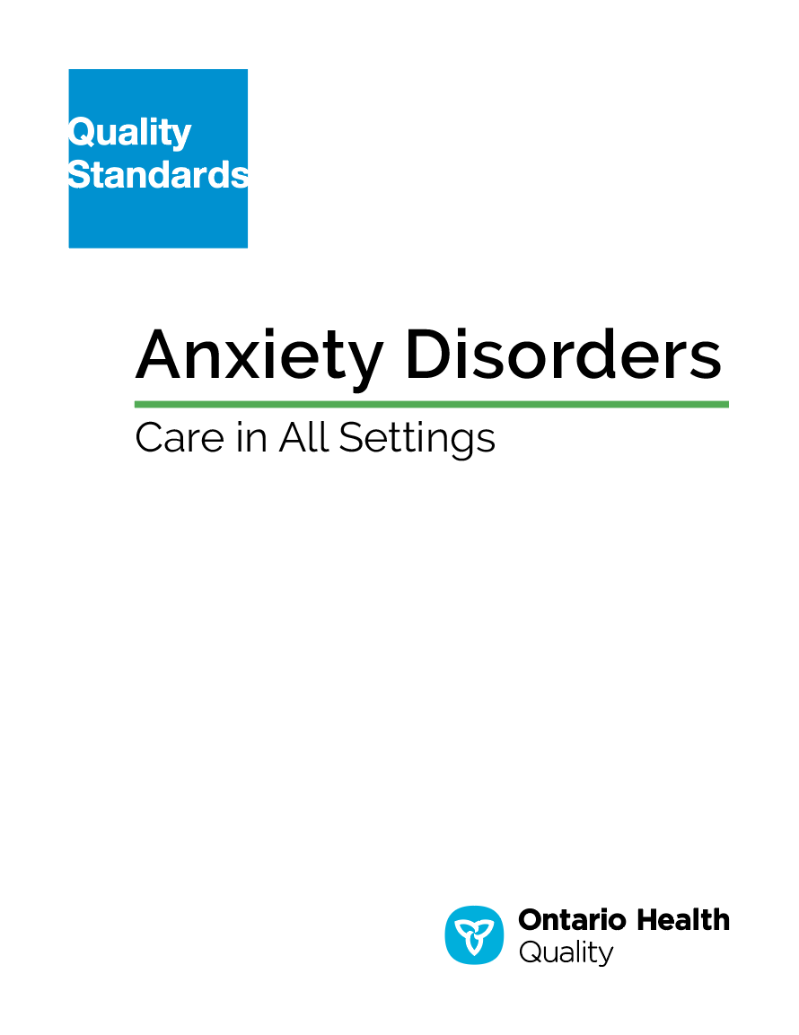
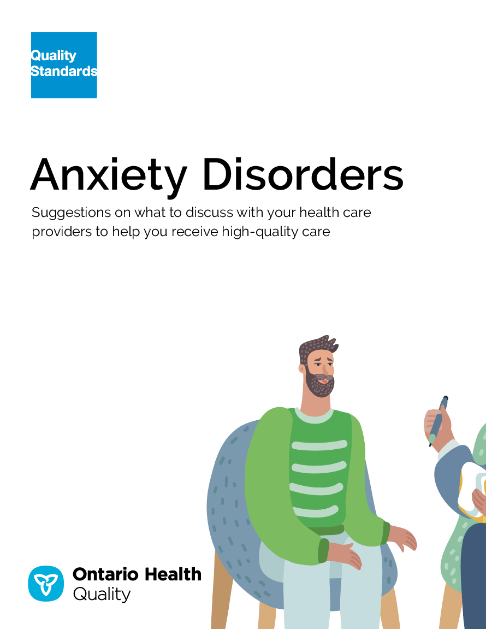
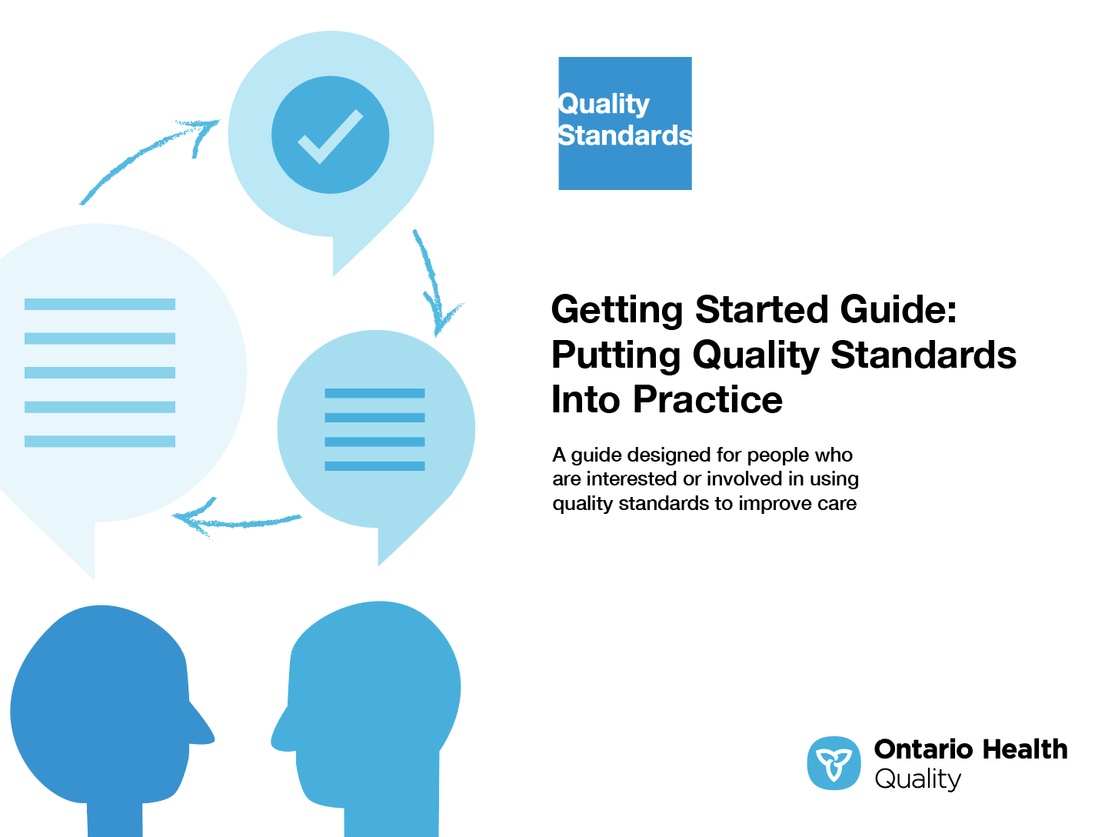
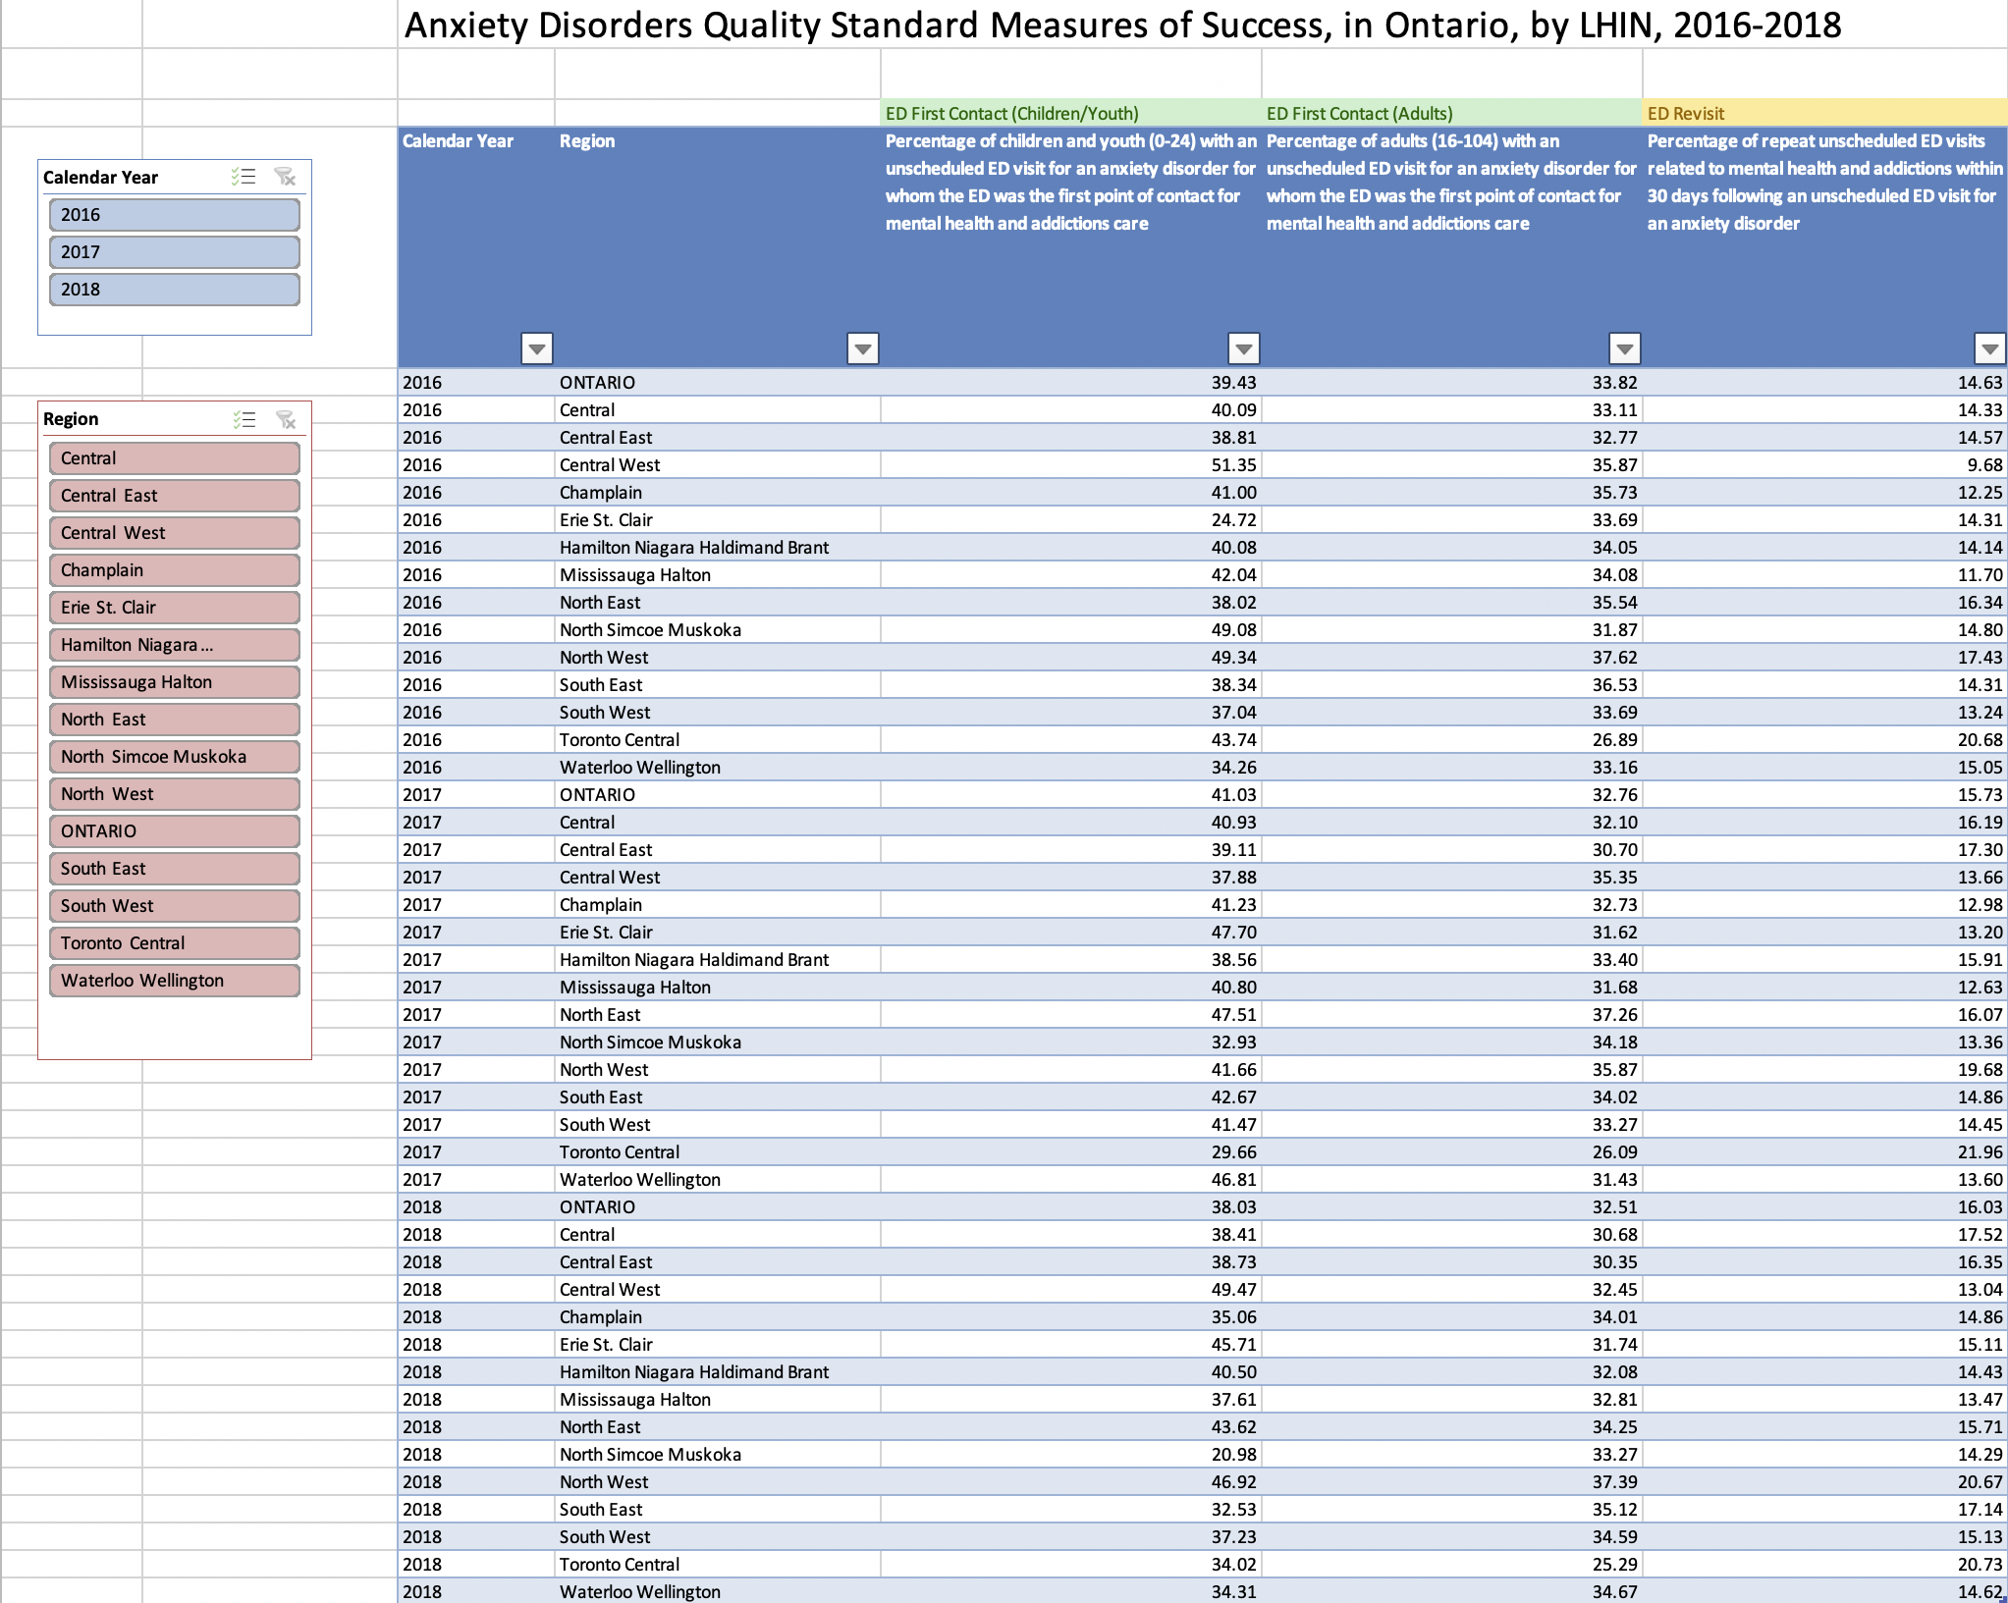
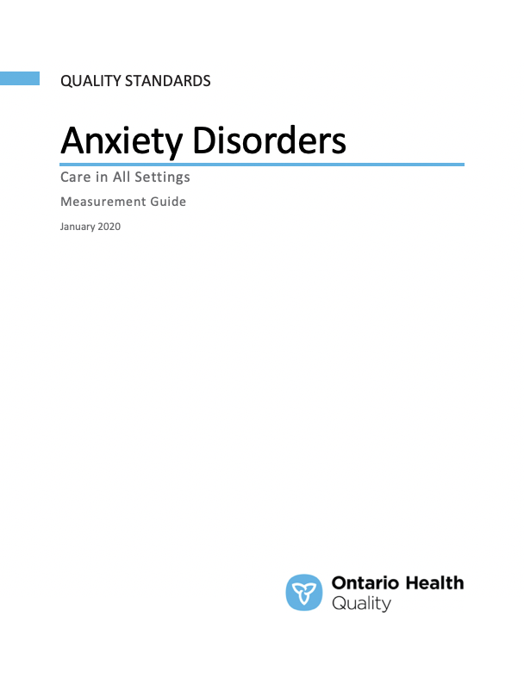
Quality Standard Resources
Quality Standard
Patient Guide
Getting Started Guide
Data Tables
Measurement Guide
Find these resources here:
https://www.hqontario.ca/evidence-to-improve-care/quality-standards/view-all-quality-standards/anxiety-disorders
Notes:
Each quality standard focuses on a specific health care issue. The development of each quality standard is accompanied by an assortment of resources.
Through concise, easy-to-understand statements, quality standards outline what quality care looks like for a condition or topic based on the evidence.
Each quality standard is accompanied by:
A patient conversation guide
Recommendations for adoption (note: this is included within the quality standard, Appendix 1: How the Health Care System Can Support Implementation)
A getting started guide
Data tables
A measurement guide
Quality standards provide the blueprint to enable the health care system in Ontario to work better, facilitate smooth transitions, and ensure patients receive the same high-quality care, regardless of where they reside.

Slide 6
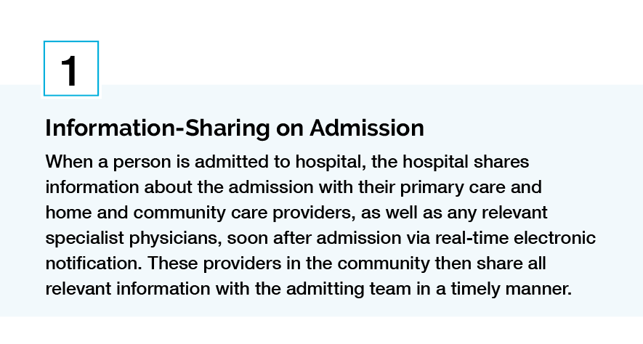
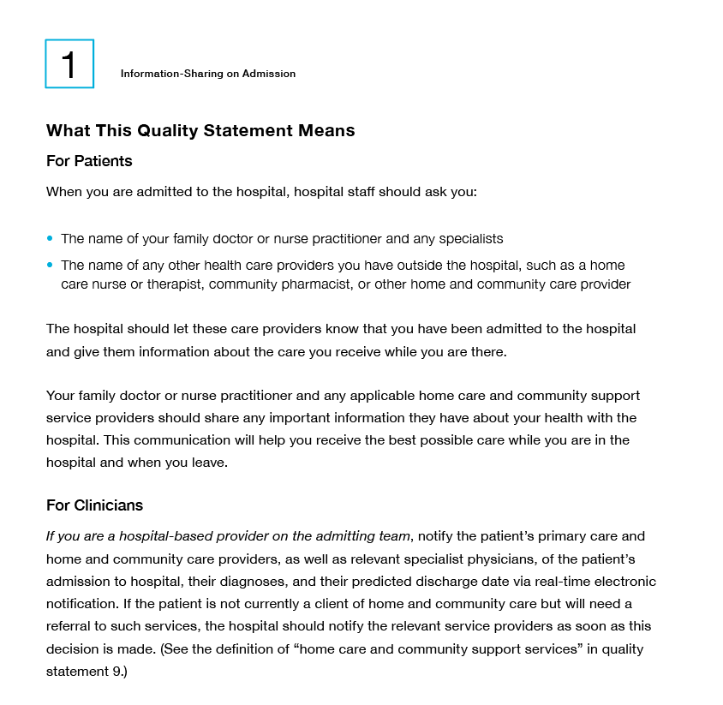
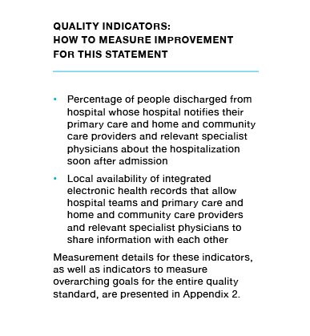
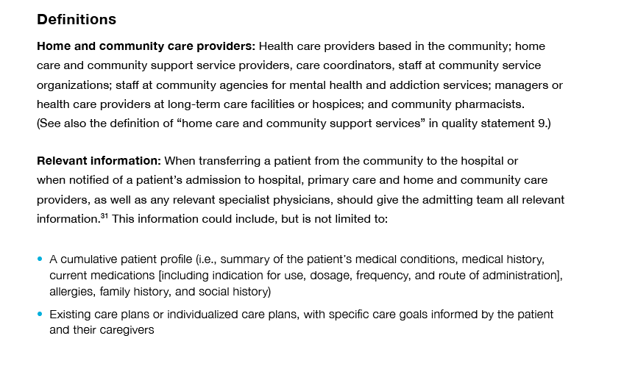
Inside the Quality Standard
The Statement
The Audience
Definitions
The Indicators
*Excerpts are from the Transitions between Hospital to Home quality standard

Slide 7
Quality Standards:
Patient Guide
The patient guide is designed to give patients information about what quality care looks like for various conditions based on the best evidence, so they can ask informed questions of their health care providers.
Notes:
Every quality standard includes a plain language summary for patients, families, caregivers and the public called the patient conversation guide.
Patient engagement in quality standards:
Membership on advisory committees
Focus groups and key informant interviews on topic-specific content (when necessary)
Public comment period for each quality standard
Consultations on the patient conversation guide

Slide 8
Quality Standards:
Recommendations for Adoption
Recommendations for policy makers, administrators, health care organizations, and professionals have been made that aim to bridge the gaps between current care and care outlined in the quality statements to enable adoption of the quality standard across Ontario.
Notes:
As many aspects of the quality standard represent care that can and should be made available today, it is recognized that there are larger systemic barriers that may impede care delivery as per the standard. The recommendations for adoption summarize the system-wide and regional requirements that are needed to help health care professionals and organizations meet these standards and the time horizon expected to resolve these barriers.

Slide 9
Quality Standards:
Implementation Tools
The Getting Started Guide:
Outlines the process for using the quality standard as a resource to deliver high-quality care
Contains evidence-based approaches, as well as useful tools and templates for implementing change ideas at the practice level
Notes:
There are things we can do today despite the larger systemic barriers that may take time to resolve. The Getting Started Guide is a document that outlines a process for using the quality standards as a resource to deliver high-quality care. It compiles a number of resources to support adoption, such as links to implementation and quality improvement resources, examples and activities for reflection, and templates and documents to support the implementation planning activities. The Getting Started Guide also includes an Action Plan Template and examples on how Quality Improvement Plans can help to advance quality standards.

Slide 10
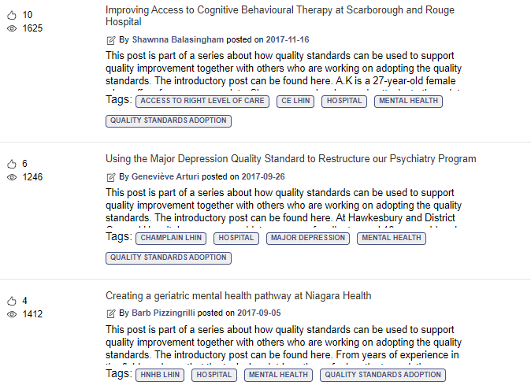
Quality Standards:
Quorum
Quorum is an online community dedicated to improving the quality of health care in Ontario.
The Quality Standards Adoption Series highlights efforts in the field to implement changes and close gaps in care related to quality standard topics.
Visit the Quality Standards Adoption Series on Quorum to learn how organizations are implementing quality standards.

Slide 11
Quality Standards:
Measurement Guide
The measurement guide has two dedicated sections:
Local measurement: what you can do to assess the quality of care that you provide locally
Provincial measurement: how we can measure the success of the quality standard on a provincial level

Slide 12
Quality Standards:
Data Tables
Data tables can be used to examine variations in indicator results across the province. They include data on key indicators:
Over time for Ontario
Across regions in Ontario
For specific measures of equity (age, sex, rurality, and household income)

Slide 13
Why Do We Need a Quality Standard for Anxiety Disorders?
Notes:
The data presented in the following slides is for people with an anxiety disorder and their caregivers.

Slide 14

The prevalence of anxiety disorders in Canada was 4.9% in 2015¹ and the lifetime prevalence (people who have the disorder at some point in their life) is 32%.²
Anxiety disorders are
the most common³
mental health conditions.
Note: For calculating prevalence and lifetime prevalence, anxiety disorders includes obsessive-compulsive disorder and post-traumatic stress disorder. The lifetime prevalence is based on data from the United States.
Sources: ¹World Health Organization. Depression and Other Common Mental Health Disorders: Global Health Estimates. 2017.
²Kessler RC, Petukhova M, Sampson NA, Zaslavsky AM, Wittchen HU. Twelve-month and lifetime prevalence and lifetime morbid risk of anxiety and mood disorders in the United States. Int J Methods Psychiatr Res. 2012; 21(3):169-184.
³Health Canada and Public Health Agency of Canada. Mental Health – Anxiety Disorders. July 2009.

Slide 15

Anxiety disorders are underdiagnosed and undertreated.¹
The median time between symptom onset and seeking care is 16.1 years,² and among people diagnosed with anxiety and related disorders, about 40% are untreated.¹
Sources: ¹Katzman MA, Bleau P, Blier P, Chokka P, Kjernisted K, Van Ameringen M, et al. Canadian clinical practice guidelines for the management of anxiety, posttraumatic stress and obsessive-compulsive disorders. BMC Psychiatry. 2014;14 Suppl 1:S1.
²Johnson EM, Coles ME. Failure and delay in treatment-seeking across Anxiety Disorders. Community Mental Health J. 2013; 49:668-674.

Slide 16

There were more than 40,000 adults and
13,000 children and youth who had an emergency department visit for an anxiety disorder in Ontario in 2018.
Note: Children and youth are defined as ages 0-24, and adults are defined as ages 16+. The rate is age- and sex-standardized.
Sources: Registered Persons Database (RPDB), National Ambulatory Care Reporting System (NACRS), 2018, provided by ICES.

Slide 17



Anxiety disorder-related visits are the second largest driver of emergency department costs related to mental health and addictions in Canada, costing
$27 million in fiscal year 2017/18.
Note: The cost is a partial national number, including Ontario, Alberta and Yukon, for fiscal year 2017/18.
Source: Canadian Institute for Health Information. Health System Resources for Mental Health and Addictions Care in Canada. July 2019.

Slide 18
1 in 3 adults and nearly 4 in 10 children and youth who had an emergency department visit for an anxiety disorder did not have any physician or hospital service for mental health and addictions care in the previous two years in Ontario in 2018.
That is, the first medical service they received for an anxiety disorder was in the emergency department.
Note: Previous mental health and addictions care includes medical services provided by a physician, in an emergency department or hospital. Children and youth are defined as ages 0-24, and adults are defined as ages 16+. The rate is age- and sex-standardized.
Sources: Registered Persons Database (RPDB), National Ambulatory Care Reporting System (NACRS), Discharge Abstract Database (DAD), Ontario Health Insurance Plan Claims Database (OHIP), Ontario Mental Health Reporting System (OMHRS), 2018, provided by ICES.
Notes:
Adults: 33%
Children and Youth: 38%

Slide 19
Rate of first contact in the emergency department for an anxiety disorder is highest in children aged 0-9, followed by adults aged 85+ in Ontario
Percentage of people who had an unscheduled emergency department (ED) visit for an anxiety disorder without any medical services for mental health and addictions care in the previous two years, in Ontario, by age, January 2018 to December 2018
■ Children/Youth (0-15)  Adults (16-104)
Notes: Previous mental health and addictions care includes medical services provided by a physician, in an emergency department or hospital.
There are some differences in the diagnostic codes included for children and youth compared to adults. The rate is sex-standardized.
Sources: Registered Persons Database (RPDB), National Ambulatory Care Reporting System (NACRS), Discharge Abstract Database
(DAD), Ontario Health Insurance Plan Claims Database (OHIP), Ontario Mental Health Reporting System (OMHRS), 2018, provided by ICES.

Slide 20
Rate of first contact in the emergency department for an anxiety disorder ranged from 21.0% to 49.5% for children and youth and 25.3% to 37.4% for adults across regions in Ontario
Percentage of people who had an unscheduled emergency department visit for an anxiety disorder without any medical services for mental health and addictions care in the previous two years, in Ontario, by local health integration network, January to December 2018
■ Children/Youth (0-24)  Adults (16-104)
Note: Previous mental health and addictions care includes medical services provided by a physician, in an emergency department or hospital. There are some differences in the diagnostic codes included for children and youth compared to adults. The rate is age- and sex-standardized.
Sources: Registered Persons Database (RPDB), National Ambulatory Care Reporting System (NACRS), Discharge Abstract Database
(DAD), Ontario Health Insurance Plan Claims Database (OHIP), Ontario Mental Health Reporting System (OMHRS), 2018, provided by ICES.

Slide 21
Nearly 1 in 6 emergency department visits for an anxiety disorder in Ontario in 2018 were followed within 30 days by an unplanned emergency department visit for mental health and addictions care.
Note: The rate is age- and sex-standardized.
Sources: Registered Persons Database (RPDB), National Ambulatory Care Reporting System (NACRS), 2018, provided by ICES.
Notes:
1 in 6 = 16.03%

Slide 22
Rate of emergency department visits for an anxiety disorder followed by a revisit within 30 days for mental health and addictions is higher among people aged 25-44 compared to the Ontario rate
Percentage of unscheduled emergency department visits for an anxiety disorder followed within 30 days by an unscheduled emergency department visit for mental health and addictions care, in Ontario, by age, January 2018 to December 2018
Note: The rate is sex-standardized.
Sources: Registered Persons Database (RPDB), National Ambulatory Care Reporting System (NACRS), 2018, provided by ICES.
Notes:
Ontario average: 16.0%

Slide 23
Rate of emergency department visits for an anxiety disorder followed by a revisit within 30 days for mental health and addictions ranged from 13.0% to 20.7% across regions in Ontario
Percentage of unscheduled emergency department visits for an anxiety disorder followed within 30 days by an unscheduled emergency department visit for mental health and addictions care, in Ontario, by local health integration network, January to December 2018
Note: The rate is age- and sex-standardized.
Source: Registered Persons Database (RPDB), National Ambulatory Care Reporting System (NACRS), 2018, provided by ICES.

Slide 24
“My experience has been as a caregiver and advocate for my mom, who experienced many issues, including anxiety disorder, depression, rheumatoid arthritis, and kidney disease. All of these things were interrelated, but everyone worked in silos, and physical health issues were always prioritized over anything to do with mental health. For over 40 years, pharmacological treatment was all she was able to access for her anxiety disorder, and this was an ineffective treatment for her.
“These quality statements validate the kind of care patients and families should expect. Being equipped with this information will help them ask providers the right questions so they can advocate for the level of care they need and should be entitled to.”
– Jaime Brown, Lived Experience Advisor, Anxiety Disorders and Obsessive-Compulsive Disorder Quality Standards Advisory Committee

Slide 25
“It is heartbreaking to hear of individuals whose suffering from anxiety disorders has been prolonged due to inadequate diagnosis and/or treatment. It is important that we help consumers and mental health care professionals better understand what constitutes best practice. We can improve clinical outcomes by using evidence-based resources to enhance the quality and effectiveness of the care we provide. These quality standards are a call to action for improved quality of care and greater access to evidence-based assessment and treatment for people with anxiety disorders in Ontario.”
– Judith Laposa, Anxiety Disorders and Obsessive-Compulsive Disorder Quality Standards Advisory Committee member

Slide 26
Quality Statements to Improve Care

Slide 27
Scope of the Anxiety Disorders Quality Standard
This quality standard addresses care for people living with an anxiety disorder. It applies to care for people in all settings but focuses on primary and community care.
This quality standard addresses the following anxiety disorder types: specific phobia, social anxiety disorder, generalized anxiety disorder, panic disorder, and agoraphobia. It focuses on care for adults (age 18 years and older), but it includes content that is relevant for children and adolescents (under age 18 years).
Notes:
Scope of This Quality Standard
This quality standard addresses care for people living with an anxiety disorder. It applies to care for people in all settings but focuses on primary and community care. This quality standard addresses the following anxiety disorder types: specific phobia, social anxiety disorder, generalized anxiety disorder, panic disorder, and agoraphobia. It focuses on care for adults (age 18 years and older), but it includes content that is relevant for children and adolescents (under age 18 years).
Few clinical practice guidelines were available to support the development of a comprehensive quality standard for children and adolescents. In this standard, guidance is provided where relevant clinical practice guideline recommendations and content for children and adolescents were available.
This quality standard uses the Diagnostic and Statistical Manual of Mental Disorders, Fifth Edition (DSM-5) categorization of anxiety disorders⁴:
Specific phobia: “intense fear or anxiety circumscribed to the presence of a particular situation or object. The fear or anxiety is out of proportion to the actual danger that the object or situation poses”
Social anxiety disorder: “marked, or intense, fear or anxiety of social situations in which the individual may be scrutinized by others”
Generalized anxiety disorder: “persistent and excessive anxiety and worry … about a number of events or activities, including work and school performance, that the individual finds difficult to control”
Panic disorder: “recurrent unexpected panic attacks … A panic attack is an abrupt surge of intense fear or intense discomfort that reaches a peak within minutes, and during which time four or more of a list of 13 physical and cognitive symptoms occur”
Agoraphobia: “intense fear [of escape being difficult or help not being available when needed in the event of having panic-like symptoms] … or anxiety triggered by the real or anticipated exposure to a wide range of situations [such as] public transportation, being in open spaces, being in enclosed spaces, standing in line or a crowd, or being outside of the family home”
Although this quality standard includes information that could apply to other anxiety disorders, the scope of this quality standard does not address selective mutism, separation anxiety disorder, substance- or medication-induced anxiety disorder, anxiety disorder owing to another medical condition, or unspecified anxiety disorder. This quality standard also does not address trauma or stressor-related disorders (including post-traumatic stress disorder).

Slide 28












Quality Statement Topics
Identification
Comprehensive Assessment
Support for Family
Stepped-Care Approach
Self-Help
Cognitive Behavioural Therapy
Pharmacological Treatment
Monitoring
Support During Initial Treatment Response
Specialized Expertise in Anxiety Disorders
Relapse Prevention
Transitions in Care
Notes:
.

Slide 29
Quality Statement 1:
Identification
People suspected to have an anxiety disorder are identified early using (1) a validated screening tool or recognized screening questions and (2) validated severity-rating scales.

Slide 30
Quality Statement 2:
Comprehensive Assessment
People suspected to have an anxiety disorder, or who have had a positive screening result for an anxiety disorder, receive a timely comprehensive assessment to determine whether they have a specific anxiety disorder, the severity of their symptoms, whether they have any comorbid conditions, and whether they have any associated functional impairment.

Slide 31
Quality Statement 3:
Support for Family
People with an anxiety disorder are encouraged to involve their family during their assessment and treatment, considering individual needs and preferences. Family members are connected to available resources and supports and provided with psychoeducation.

Slide 32
Quality Statement 4:
Stepped-Care Approach
People with an anxiety disorder receive treatment that follows a stepped-care approach, providing the least intensive, most effective intervention first, based on symptom severity, level of functional impairment, and individual needs and preferences.

Slide 33
Quality Statement 5:
Self-Help
People with an anxiety disorder are informed about and supported in accessing self-help resources, such as self-help books, Internet-based educational resources, and support groups, considering their individual needs and preferences and in alignment with a stepped-care approach.

Slide 34
Quality Statement 6:
Cognitive Behavioural Therapy
People with an anxiety disorder have timely access to cognitive behavioural therapy, considering their individual needs and preferences and in alignment with a stepped-care approach. The cognitive behavioural therapy is delivered by a health care professional with expertise in anxiety disorders.

Slide 35
Quality Statement 7:
Pharmacological Treatment
People with a moderate to severe anxiety disorder, or people who are not responding to psychological treatment, are offered pharmacological treatment based on their specific anxiety disorder, considering their individual needs and preferences and in alignment with a stepped-care approach.

Slide 36
Quality Statement 8:
Monitoring
People with an anxiety disorder have their response to treatment (effectiveness and tolerability) monitored regularly over the course of treatment using validated tools in conjunction with an assessment of their clinical presentation.

Slide 37
Quality Statement 9:
Support During Initial Treatment Response
People with an anxiety disorder are informed about what to expect and supported during their initial treatment response. When initial treatment is not working, people with an anxiety disorder are reassessed. They are offered other treatment options, considering their individual needs and preferences and in alignment with a stepped-care approach.

Slide 38
Quality Statement 10:
Specialized Expertise in Anxiety Disorders
People with an anxiety disorder who have not responded adequately to treatments are connected to a health care professional with specialized expertise in anxiety disorders.

Slide 39
Quality Statement 11:
Relapse Prevention
People with an anxiety disorder who are receiving treatment are provided with information and education about how to prevent relapse and manage symptoms if they re-emerge.

Slide 40
Quality Statement 12:
Transitions in Care
People with an anxiety disorder are given appropriate care throughout their lifespan and experience seamless transitions between services and health care professionals, including between care settings and from child and adolescent services to adult services.

Slide 41
How to Measure Overall Success
Notes:
The Anxiety Disorders and Obsessive-Compulsive Disorder Quality Standards Advisory Committee identified a set of overarching goals for this quality standard. These have been mapped to indicators that may be used to assess quality of care provincially and locally.

Slide 42
Indicators That Can Be Measured Using Provincial Data
Percentage of people with an unscheduled emergency department (ED) visit for an anxiety disorder for whom the ED was the first point of contact for mental health and addictions care
Percentage of repeat unscheduled ED visits related to mental health and addictions within 30 days after an unscheduled ED visit for an anxiety disorder

Slide 43
Indicators That Can Be Measured Using Only Local Data
Percentage of people suspected to have an anxiety disorder, or who have a positive screening result for an anxiety disorder, who receive a comprehensive assessment that determines whether they have a specific anxiety disorder, the severity of their symptoms, whether they have any comorbid conditions, and whether they have any associated functional impairment
Percentage of people with an anxiety disorder for whom cognitive behavioural therapy (CBT) was determined to be appropriate who receive disorder-specific CBT delivered by a health care professional with expertise in anxiety disorders
Percentage of people with an anxiety disorder who report an improvement in their quality
of life
Percentage of people with an anxiety disorder who “strongly agree” with the following question: “The services I have received have helped me deal more effectively with my life’s challenges”
Percentage of people with an anxiety disorder who complete CBT and have a reliable recovery
Percentage of people with an anxiety disorder who complete CBT and have reliable improvement

Slide 44
Data Sources and Acknowledgement
The data used in this presentation was provided by the Institute for Clinical Evaluative Sciences (ICES), which is funded by an annual grant from the Ontario Ministry of Health. The opinions, results, and conclusions included in this report are those of the authors and are independent from the funding sources. No endorsement by ICES or the Ministry of Health is intended or should be inferred. These datasets were linked using unique encoded identifiers and analyzed at ICES. Parts of this material are based on data and information compiled and provided by the Canadian Institute for Health Information (CIHI). However, the analyses, conclusions, opinions, and statements expressed herein are those of the authors, and not necessarily those of CIHI.

Slide 45
Connect with us:
https://quorum.hqontario.ca

