Slide 1
Asthma in Adults
QUALITY STANDARDS
Guiding evidence-based care for people 16 years of age and older in Ontario
Notes:
If you have any questions about the content of this presentation, please contact us at QualityStandards@OntarioHealth.ca.

Slide 2
Objectives
Overview of quality standards: What are they? How are they used?​
Why this quality standard is needed: Gaps and variations in quality of care for adults with asthma in Ontario
Quality statements to improve care: The key statements in the asthma quality standard
Measures to support improvement: Indicators that can help measure your quality improvement efforts

Slide 3
Quality standards
Inform clinicians and patients what quality care looks like
Focus on conditions or processes where there are large variations in how care is delivered, or where there are gaps between the care provided in Ontario and the care patients should receive
Are grounded in the best available evidence
Notes:
Quality standards are a small set of high impact statements that describe optimal care where identified quality gaps exist in Ontario.
Voluntary and aspirational in nature​.
Designed to “raise the ceiling” with the goal of having the best possible care available to all Ontarians, regardless of where they live in the province.
There are many guidelines, professional standards, and other recommendations that contribute to the evidence ecosystem. Quality standards complement these resources.
Quality standards outline the what of care that should be delivered but are agnostic on who should be delivering it (unlike other CPGs, BPGs).
Quality standards are:
Concise: 5 to 15 strong, evidence-based statements focused on high-priority areas for improvement.
Accessible: help clinicians and provider organizations offer the highest-quality care; and patients to know what to discuss with their clinicians (compared with CPGs that are quite dense, these are very accessible, also written in plain language).
Measurable: each statement is accompanied by one or more quality indicators (structure, process, or outcome), with a set of outcome measures for the overall standard.
Implementable: quality improvement tools and resources support each standard, to fuel adoption.

Slide 4
Benefits of quality standards
Help patients, residents, families, and care partners know what to ask for in their care
Help clinicians know what care to offer, based on evidence and expert consensus
Help health care organizations measure, assess, and improve the quality of care they provide
Help ensure consistent, high-quality care across the province
Notes:
Patients, care partners, and the public can use quality standards to understand what excellent care looks like, what they should expect from their clinicians, and how to discuss the quality of their care.
Provincial regions and disease agencies can use quality standards to measure health outcomes, hold health service providers accountable for delivering high-quality care, and inform regional improvement strategies.
Provider organizations can use quality standards to measure and audit their quality of care, identify gaps, guide organizational improvement strategies, and inform clinical program investments.
Clinicians can use quality standards to evaluate their practice and identify areas for personal and organizational quality improvement, and can incorporate the evidence-based statements into professional education.
Government can use quality standards to identify provincial priority areas, inform new data collection and reporting initiatives, and design performance indicators and funding incentives.

Slide 5
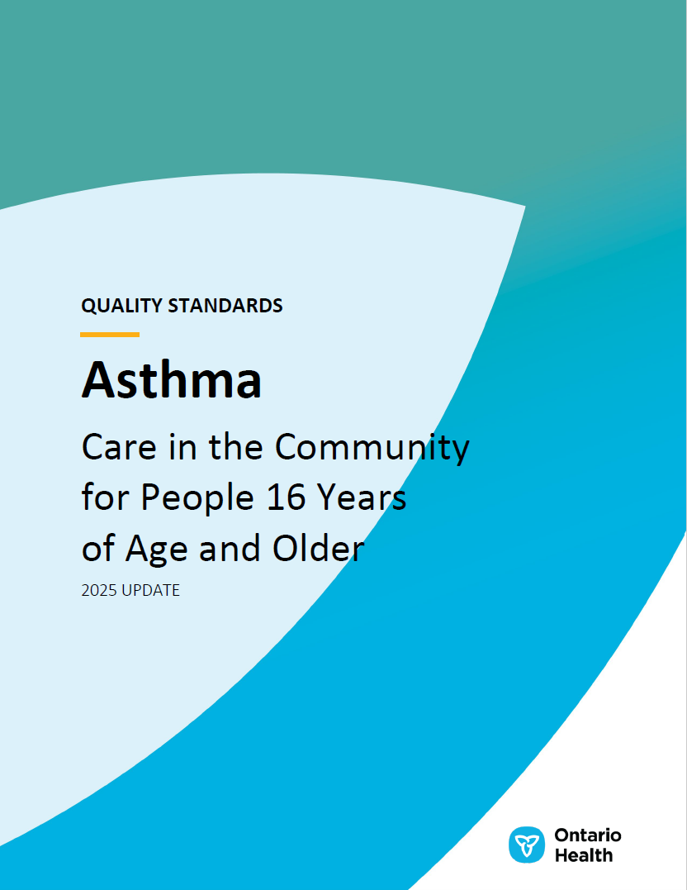
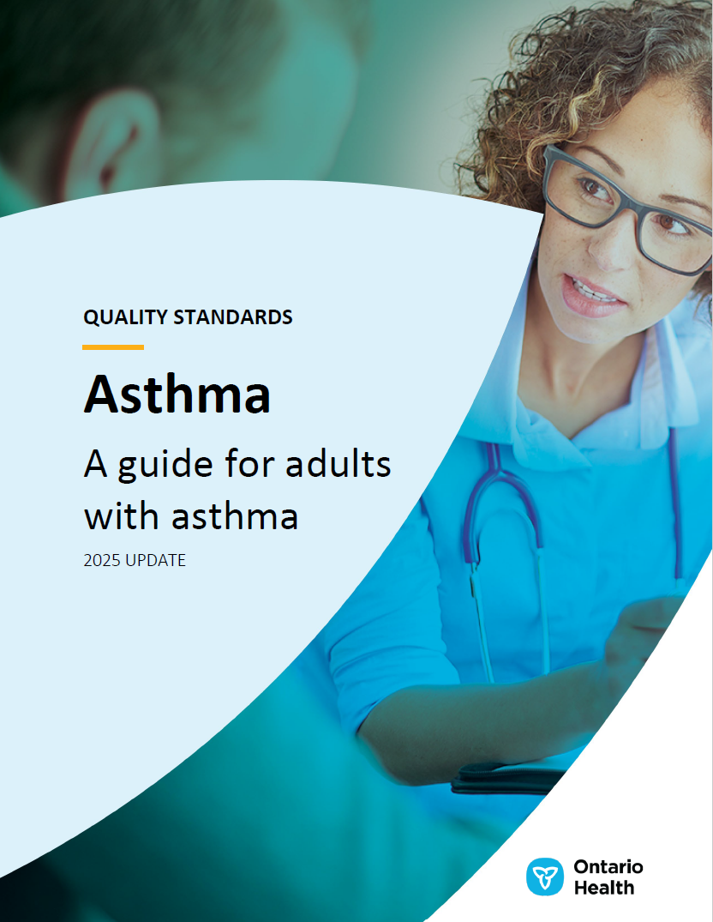
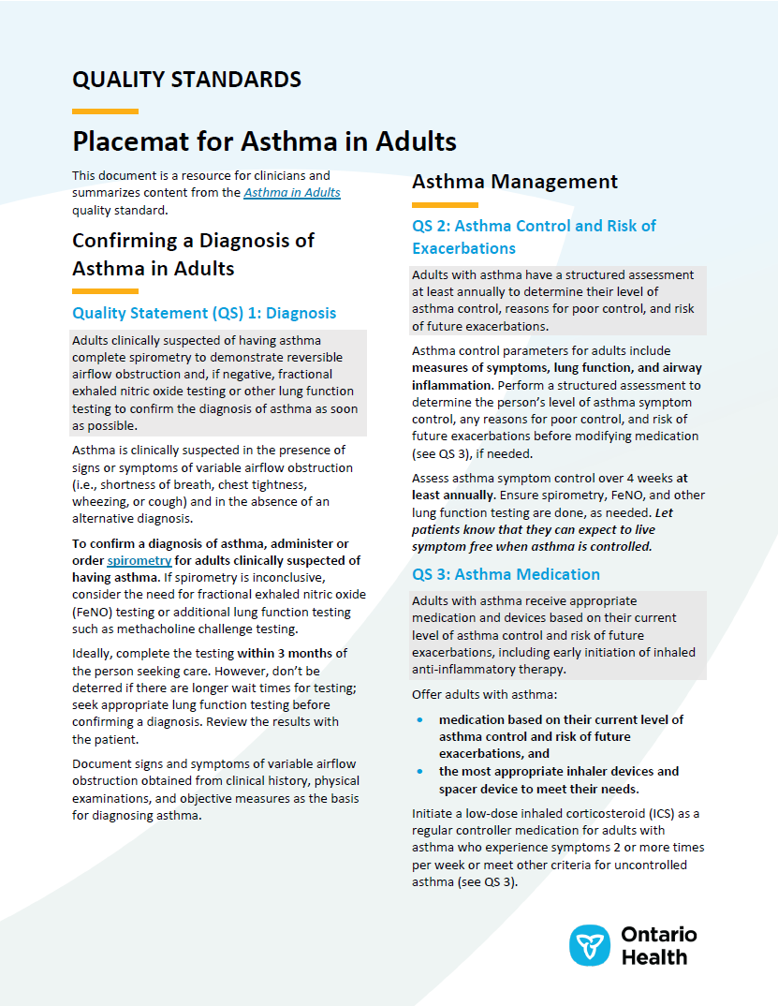
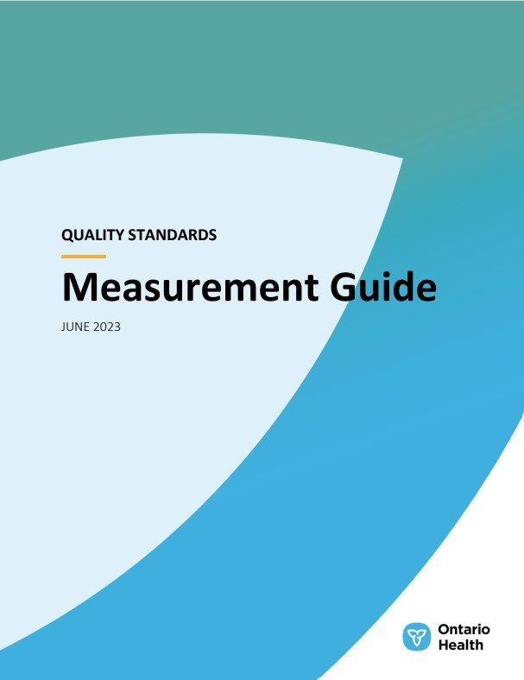
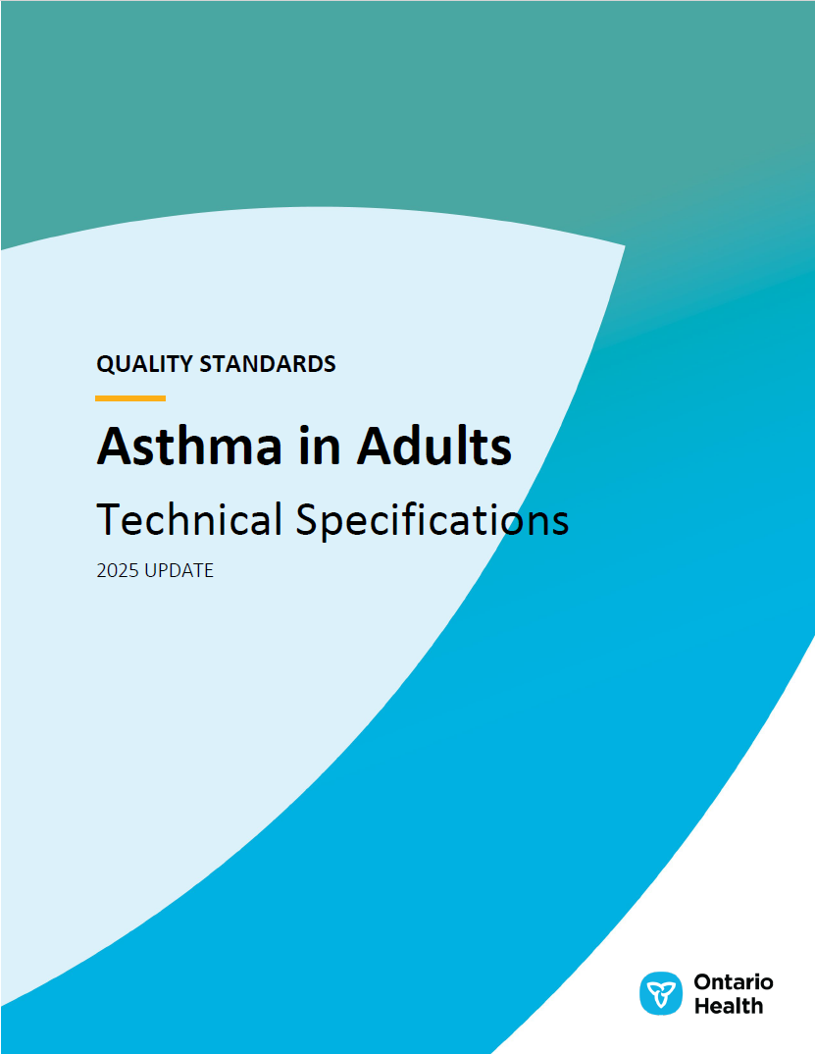
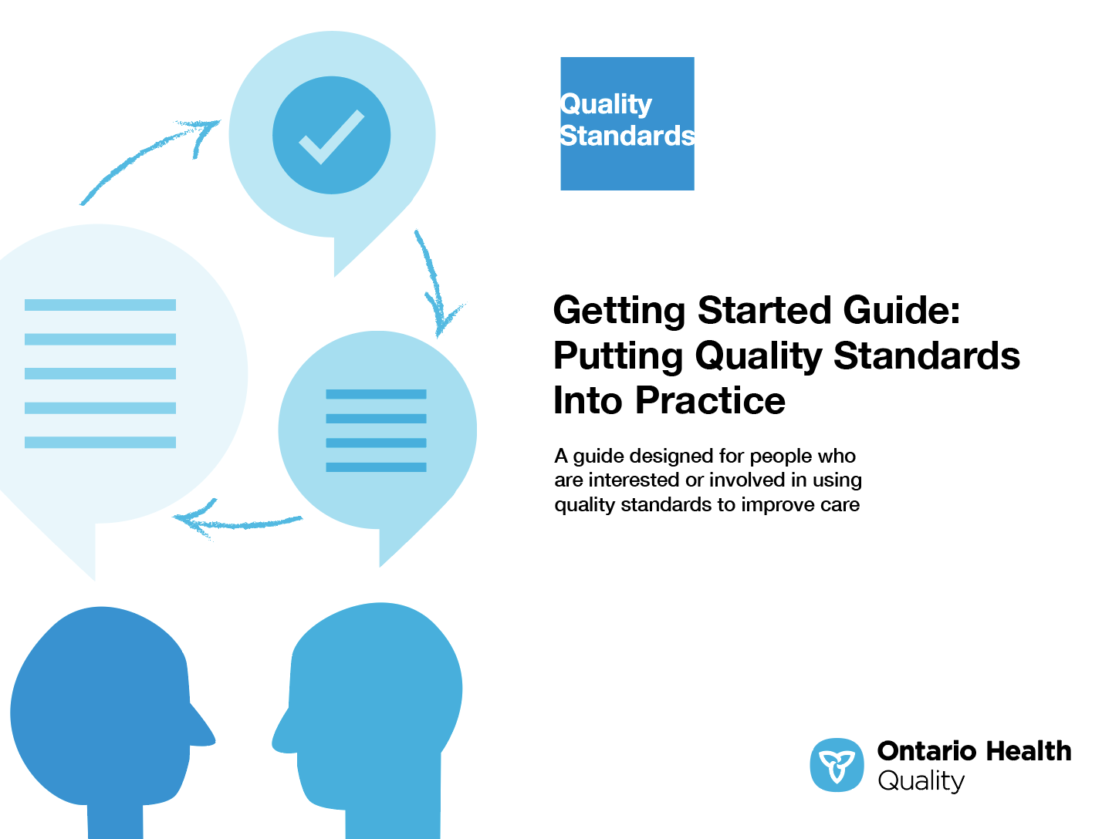
Quality standard resources
Quality Standard
Patient Guide
Placemat
Case for Improvement Deck
Measurement Guide
Technical Specifications
Getting Started Guide
Find these resources on the Asthma in Adults quality standard web page.
Notes:
Each quality standard focuses on a specific health care issue. The development of each quality standard is accompanied by an assortment of resources.
Through concise, easy-to-understand statements, quality standards outline what quality care looks like for a condition or topic based on the evidence.
Each quality standard is accompanied by a:
Patient guide
Placemat
Case for Improvement Deck
Measurement guide
Technical specifications
Getting started guide
Quality standards provide the blueprint to enable the health care system in Ontario to work better, facilitate smooth transitions, and ensure patients receive the same high-quality care, regardless of where they reside.

Slide 6
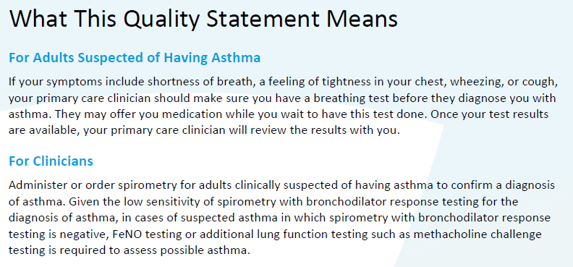
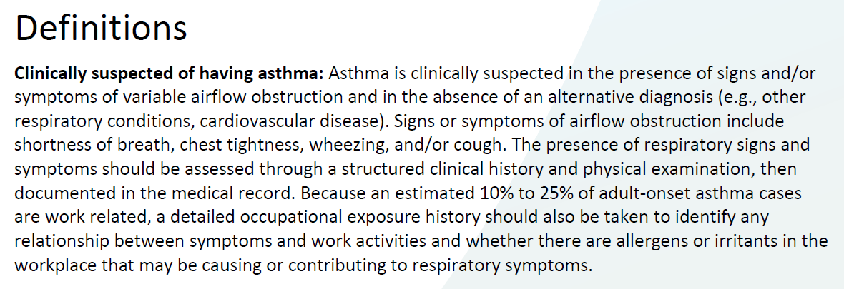
Inside the quality standard
The Quality Statement
The Audience Statements
The Definitions
The Indicators

Slide 7
Patient guide
The patient guide is designed to give patients information about what quality care looks like for various conditions based on the best evidence, so they can ask informed questions of their health care teams.
Notes:
Every quality standard includes a plain language summary for patients, families, care partners and the public called the patient guide.
Patient engagement in quality standards:
Membership on advisory committees
Focus groups and key informant interviews on topic-specific content (when necessary)
Public comment period for each quality standard
Consultations on the patient guide

Slide 8
Placemat
The placemat is a quick-reference resource for clinicians that summarizes the quality standard and includes links to helpful resources and tools.

Slide 9
Case for improvement deck
The case for improvement deck describes why the quality standard was created and shows some of the data used to develop it. Champions can use or adapt this deck to build support for the quality standard in their organizations.

Slide 10
How the health care system can support implementation
Implementing quality standards can be challenging owing to system-level barriers or gaps, many of which have been identified throughout the development of this standard
Ontario Health will work with and support other provincial partners, including the Ministry of Health, to bridge system-level gaps and support the implementation of quality standards

Slide 11
Implementation tools
The Getting Started Guide:
Outlines the process for using the quality standard as a resource to deliver high-quality care
Contains evidence-based approaches, as well as useful tools and templates for implementing change ideas at the practice level
Notes:
There are things we can do today despite the larger systemic barriers that may take time to resolve. The Getting Started Guide is a document that outlines a process for using the quality standards as a resource to deliver high-quality care. It compiles a number of resources to support adoption, such as links to implementation and quality improvement resources, examples and activities for reflection, and templates and documents to support the implementation planning activities. The Getting Started Guide also includes an Action Plan Template and examples on how Quality Improvement Plans can help to advance quality standards.

Slide 12
Quorum
Quorum is an online community dedicated to improving the quality of health care in Ontario.
The Quality Standards Adoption Series highlights efforts in the field to implement changes and close gaps in care related to quality standard topics.
Notes:
The Quality Standards program has highlighted several stories from organizations and groups using various standards and statements within their clinical care settings, organization, or institutions; these are available through posts and discussions on Quorum.
As well, we are working on compiling resources and tools, for both clinicians and patients and families.
The focus is on implementation/adoption stories and how organizations are using quality standards in practice to inform care.
We’d love to hear from you if you are interested in contributing to a post or article.

Slide 13
Measurement guide
The measurement guide describes:
The measurement principles behind the quality indicators included in quality standards
The types of indicators included in quality standards
How local and provincial data are collected and measured

Slide 14
Technical specifications
The technical specifications report outlines 2 types of measurement:
Provincial measurement: how we can monitor the progress being made to improve care at the provincial level
Local measurement: what you can do to assess the quality of care that you provide locally

Slide 15
Why do we need a quality standard for asthma in adults?

Slide 16
As of fiscal year 2022/23,* nearly 2.5 million people in Ontario have asthma (over 1 in 10).
*Data for fiscal year 2022/23 may be incomplete due to the 2-year algorithm to identify asthma, and numbers are subject to change. Due to the observed underutilization of health care services during the COVID-19 pandemic beginning in 2020/21, data captured during this time period may be underestimated.
Source: Ontario Asthma Surveillance Information System (OASIS) (ICES), asthma prevalence crude rates.

Slide 17
Asthma is one of the most common chronic respiratory diseases in Canada.¹
People diagnosed with asthma are more likely to have other chronic diseases and conditions (diabetes, hypertension, mood and/or anxiety disorders) and an overall poorer quality of life than those without asthma.^{2,3}
The presence of comorbidities can complicate asthma management, as it can worsen asthma symptoms, worsen the asthma itself, or impede appropriate asthma management.⁴
The direct costs of asthma to the Canadian economy, including direct health care costs and indirect costs, are projected to climb to $4.2 billion annually by 2030.⁵
Data Blog: Asthma in Canada [Internet]. Ottawa (ON): Government of Canada [updated 2018 May 1; cited 2025 Jan 24]. Available from: https://health-infobase.canada.ca/datalab/asthma-blog.html
Nunes C, Pereira AM, Morais-Almeida M. Asthma costs and social impact. Asthma Res Pract. 2017 Jan 6;3:1.
Ismaila AS, Sayani AP, Marin M, Su Z. Clinical, economic, and humanistic burden of asthma in Canada: a systematic review. BMC Pulm Med. 2013 Dec 5;13:70.
Gaffin JM, Castro M, Bacharier LB, Fuhlbrigge AL. The role of comorbidities in difficult-to-control asthma in adults and children. J Allergy Clin Immunol Pract. 2022 Feb;10(2):397-408.
Stonebridge C, Goldfarb D, Bounajm F, Hermus G, Theriault L. Cost risk analysis for chronic lung disease in Canada [Internet]. Ottawa (ON): Conference Board of Canada; 2012 Mar 15. Available from https://www.conferenceboard.ca/product/cost-risk-analysis-for-chronic-lung-disease-in-canada/

Slide 18
Although the incidence of asthma has been decreasing over time, people with asthma are generally living longer, thus the prevalence of asthma in Ontario (the number of people with the disease) has continued to increase for all ages combined. It rose from 114 per 1,000 people in fiscal year 2000/01 to 156 per 1,000 people in fiscal year 2022/23.* 87% of people with asthma were 15 years of age and older.
*Data for fiscal years 2021/22 and 2022/23 may be incomplete due to the 2-year algorithm to identify asthma, and numbers are subject to change. Due to the observed underutilization of health care services during the COVID-19 pandemic beginning in 2020/21, data captured during this time period may be underestimated.
Note: Rates are reported as a crude rate.
Source: OASIS (ICES), asthma prevalence crude rates.

Slide 19
Asthma prevalence rates vary across regions in Ontario
In fiscal year 2022/23,* East region had the highest prevalence rate of asthma, whereas Toronto region had the lowest prevalence rate.
*Data for fiscal year 2022/23 may be incomplete due to the 2-year algorithm to identify asthma, and numbers are subject to change. Due to the observed underutilization of health care services during the COVID-19 pandemic beginning in 2020/21, data captured during this time period may be underestimated.
Notes: Rates are reported as a crude rate. This analysis uses former Ontario Health region boundaries that were in use prior to March 31, 2023. In this definition, each region conformed to 1 or more of the legacy Local Health Integration Networks (LHINs). Results in this analysis will not be comparable to region analysis using the aligned regions, effective April 1, 2023. Rates reported by region were back-calculated using OASIS data published by LHIN.
Source: Statistics reported by OASIS, and data provided by ICES, Ontario.

Slide 20
In Ontario, spirometry and other lung function testing to diagnose asthma is increasing but not yet routine, posing a risk for misdiagnosis.
According to available administrative health data, about half of people 7 years of age and older (54%) receive a pulmonary function test (PFT) within 1 year prior to or 2.5 years after their incident date to confirm their diagnosis.
Assessing asthma control is also an important gap in care for people with asthma. The percentage of people with asthma who had a PFT to monitor their asthma fell from 10.3% in fiscal year 2000/01 to 4.5% in fiscal year 2022/23.*
*Data for fiscal year 2022/23 may be incomplete due to the 2-year algorithm to identify asthma, and numbers are subject to change. Due to the observed underutilization of health care services during the COVID-19 pandemic beginning in 2020/21, data captured during this time period may be underestimated.
Notes: Ontario Health Insurance Plan (OHIP) billings for PFT may have undercounted its utilization, as it can be part of “bundled care” performed by the clinician and therefore is not billed to OHIP separately. The percentage reported above is based on the percentage of asthma prevalence in people 7 years of age and older who had a PFT within 1 year prior to the index date.
Source: Statistics reported by OASIS, and data provided by ICES, Ontario.

Slide 21
Asthma-specific hospitalization rates vary across regions in Ontario and across age groups
In fiscal year 2022/23,* the rate of asthma-specific hospitalizations in people of all ages combined was highest in the Toronto and North West regions. Among people aged 15 years and older, those 70 years and older had the highest rate of asthma-specific hospitalizations.
*Data for fiscal year 2022/23 may be incomplete due to the 2-year algorithm to identify asthma, and numbers are subject to change. Due to the observed underutilization of health care services during the COVID-19 pandemic beginning in 2020/21, data captured during this time period may be underestimated.
Notes: This analysis uses former Ontario Health region boundaries that were in use prior to March 31, 2023. In this definition, each region conformed to 1 or more of the legacy LHINs. Results in this analysis will not be comparable to region analysis using the aligned regions, effective April 1, 2023. Rates reported by region were back-calculated using OASIS data published by LHIN.
Source: Statistics reported by OASIS, and data provided by ICES, Ontario.

Slide 22
Asthma-specific physician office visits vary by age group
Among people aged 15 years and older, those 70 years and older had the highest rate of asthma-specific physician office visits and accounted for over 81,500 asthma-specific physician visits, or 12.5% of all asthma-specific physician visits in Ontario, in fiscal year 2022/23.*
*Data for fiscal year 2022/23 may be incomplete due to the 2-year algorithm to identify asthma, and numbers are subject to change. Due to the observed underutilization of health care services during the COVID-19 pandemic beginning in 2020/21, data captured during this time period may be underestimated.
†Percentages for age groups do not add up to 100%, as those aged 0–14 years are not presented.
Note: Asthma-specific physician office visits were extracted from the OHIP database with service delivery at physician office, long-term care, and home.
Source: Statistics reported by OASIS, and data provided by ICES, Ontario.

Slide 23
Quotation from a lived experience advisor
”
“Clinical guidelines say that asthma treatment should last 3 to 6 months. But people use inhalers on and off for years without lung function testing and an asthma diagnosis. We need more public education about asthma testing, diagnosis, and medications. I hope this standard helps asthma patients to learn best practices and self-advocacy so that they can have the best quality of asthma care.”
– Carmela Graziani, Lived Experience Advisor, Asthma Quality Standard Advisory Committee

Slide 24
Quotation from a family physician
”
“If anyone walks away from the quality standard with only one takeaway, it should be the necessity of access to spirometry. Having a positive spirometry gives you the confidence to say, ‘You have asthma.’ It empowers the primary care provider to make an effective diagnosis and initiate appropriate treatment.”
– Itamar Tamari, Family Physician, Asthma Quality Standard Advisory Committee

Slide 25
Quality statements to improve care

Slide 26
Scope of this quality standard
This quality standard addresses the diagnosis and management of asthma in adults 16 years of age and older, with a focus on primary care and community-based settings. It addresses referral to specialized asthma care for adults who meet criteria for severe asthma, but it does not address the management of severe asthma in specialized care, acute asthma exacerbations, or care provided during emergency department visits or hospitalizations.
A separate quality standard addresses Asthma in Children and Adolescents.
Notes:
Scope of This Quality Standard
This quality standard addresses the diagnosis and management of asthma in adults 16 years of age and older, with a focus on primary care and community-based settings. It addresses referral to specialized asthma care for adults who meet criteria for severe asthma, but it does not address the management of severe asthma in specialized care, acute asthma exacerbations, or care provided during emergency department visits or hospitalizations.
A separate quality standard addresses Asthma in Children and Adolescents.

Slide 27
Quality statement topics
Diagnosis
Asthma control and risk of exacerbations
Asthma medication
Self-management education and asthma action plan
Referral to specialized asthma care
Follow-up after discharge

Slide 28
Quality statement (QS) 1: Diagnosis
Adults clinically suspected of having asthma complete spirometry to demonstrate reversible airflow obstruction and, if negative, fractional exhaled nitric oxide testing or other lung function testing to confirm the diagnosis of asthma as soon as possible.

Slide 29
QS 2: Asthma control and risk of exacerbations
Adults with asthma have a structured assessment at least annually to determine their level of asthma control, reasons for poor control, and risk of future exacerbations.

Slide 30
QS 3: Asthma medication
Adults with asthma receive appropriate medication and devices based on their current level of asthma control and risk of future exacerbations, including early initiation of inhaled anti-inflammatory therapy.

Slide 31
QS 4: Self-management education and asthma action plan
Adults with asthma and their care partners receive self-management education and a written personalized asthma action plan that is reviewed regularly with a clinician.

Slide 32
QS 5: Referral to specialized asthma care
Adults who meet criteria for severe asthma or have other appropriate indications are referred to specialized asthma care.

Slide 33
QS 6: Follow-up after discharge
Adults who have had an emergency department visit or been hospitalized for an asthma exacerbation have a follow-up assessment within 2 to 7 days after discharge.

Slide 34
Measures to support improvement
Notes:
The Asthma Quality Standard Advisory Committee identified a set of overarching goals for this quality standard. These have been mapped to indicators that may be used to assess quality of care provincially and locally.

Slide 35
Indicators that can be measured using provincial data
Percentage of adults with incident asthma whose diagnosis is confirmed with lung function testing
Percentage of adults with asthma who visited the emergency department for an asthma-specific reason in the previous 12 months

Slide 36
Indicators that can be measured using only local data
Percentage of adults with asthma who had a structured assessment in the previous 6 months
Percentage of adults with asthma with 1 or more appropriate indications who are prescribed inhaled anti-inflammatory therapy
Average number of asthma symptom–free days in the previous 4 weeks among adults with asthma
Average number of days missed from school or work due to asthma in the previous 4 weeks

Slide 37
Data sources and acknowledgement
The data used in this presentation uses asthma statistics reported by the Ontario Asthma Surveillance Information System (OASIS) and data provided by ICES. The opinions, results, and conclusions included in this report are those of the authors and are independent from the funding sources. No endorsement by ICES or OASIS is intended or should be inferred. These datasets were linked using unique encoded identifiers and analyzed at ICES. Parts of this material are based on data and information compiled and provided by the Canadian Institute for Health Information (CIHI). However, the analyses, conclusions, opinions, and statements expressed herein are those of the authors, and not necessarily those of CIHI.

Slide 38
Thank you

