Slide 1
Asthma in Children and Adolescents
QUALITY STANDARDS
Guiding evidence-based care for people under 16 years of age in Ontario
Notes:
If you have any questions about the content of this presentation, please contact us at QualityStandards@OntarioHealth.ca.

Slide 2
Objectives
Overview of quality standards: What are they? How are they used?​
Why this quality standard is needed: Gaps and variations in quality of care for children and adolescents with asthma in Ontario
Quality statements to improve care: The key statements in the asthma quality standard
Measures to support improvement: Indicators that can help measure your quality improvement efforts

Slide 3
Quality standards
Inform clinicians and patients what quality care looks like
Focus on conditions or processes where there are large variations in how care is delivered, or where there are gaps between the care provided in Ontario and the care patients should receive
Are grounded in the best available evidence
Notes:
Quality standards are a small set of high impact statements that describe optimal care where identified quality gaps exist in Ontario.
Voluntary and aspirational in nature​.
Designed to “raise the ceiling” with the goal of having the best possible care available to all Ontarians, regardless of where they live in the province.
There are many guidelines, professional standards, and other recommendations that contribute to the evidence ecosystem. Quality standards complement these resources.
Quality standards outline the what of care that should be delivered but are agnostic on who should be delivering it (unlike other CPGs, BPGs).
Quality standards are:
Concise: 5 to 15 strong, evidence-based statements focused on high-priority areas for improvement.
Accessible: help clinicians and provider organizations offer the highest-quality care; and patients to know what to discuss with their clinicians (compared with CPGs that are quite dense, these are very accessible, also written in plain language).
Measurable: each statement is accompanied by one or more quality indicators (structure, process, or outcome), with a set of outcome measures for the overall standard.
Implementable: quality improvement tools and resources support each standard, to fuel adoption.

Slide 4
Benefits of quality standards
Help patients, residents, families, and care partners know what to ask for in their care
Help clinicians know what care to offer, based on evidence and expert consensus
Help health care organizations measure, assess, and improve the quality of care they provide
Help ensure consistent, high-quality care across the province
Notes:
Patients, care partners, and the public can use quality standards to understand what excellent care looks like, what they should expect from their clinicians, and how to discuss the quality of their care.
Provincial regions and disease agencies can use quality standards to measure health outcomes, hold health service providers accountable for delivering high-quality care, and inform regional improvement strategies.
Provider organizations can use quality standards to measure and audit their quality of care, identify gaps, guide organizational improvement strategies, and inform clinical program investments.
Clinicians can use quality standards to evaluate their practice and identify areas for personal and organizational quality improvement, and can incorporate the evidence-based statements into professional education.
Government can use quality standards to identify provincial priority areas, inform new data collection and reporting initiatives, and design performance indicators and funding incentives.

Slide 5
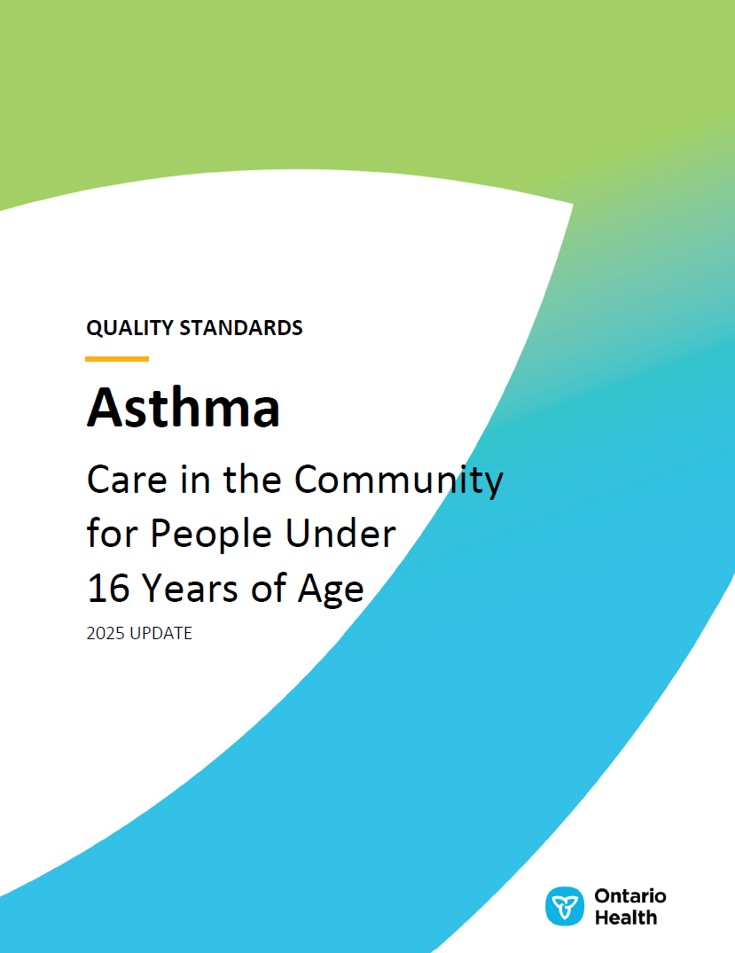
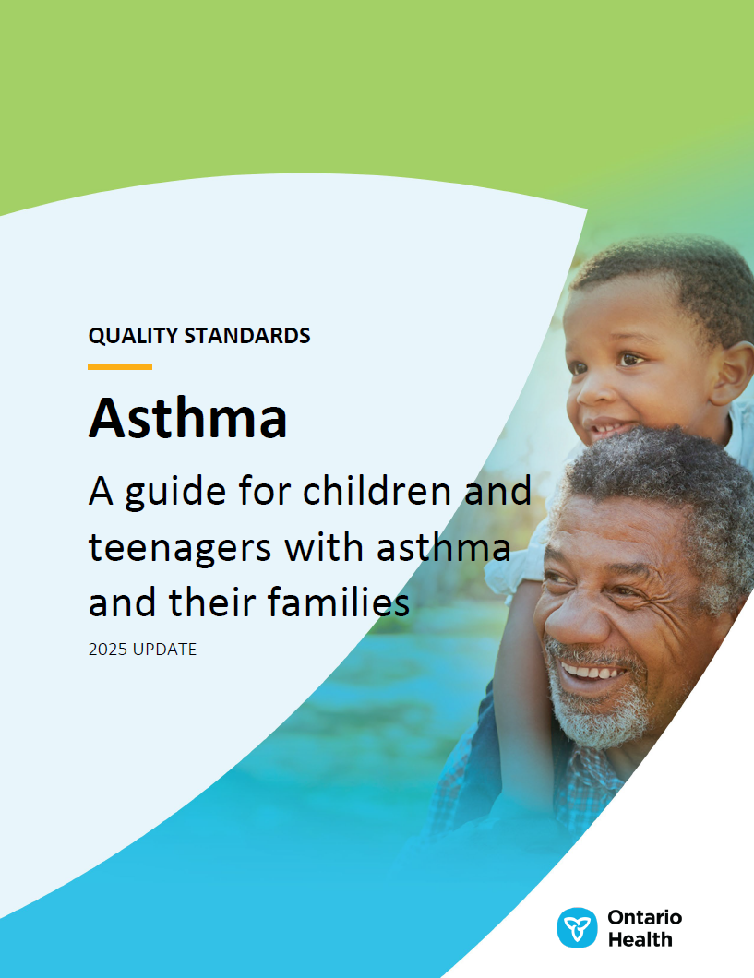
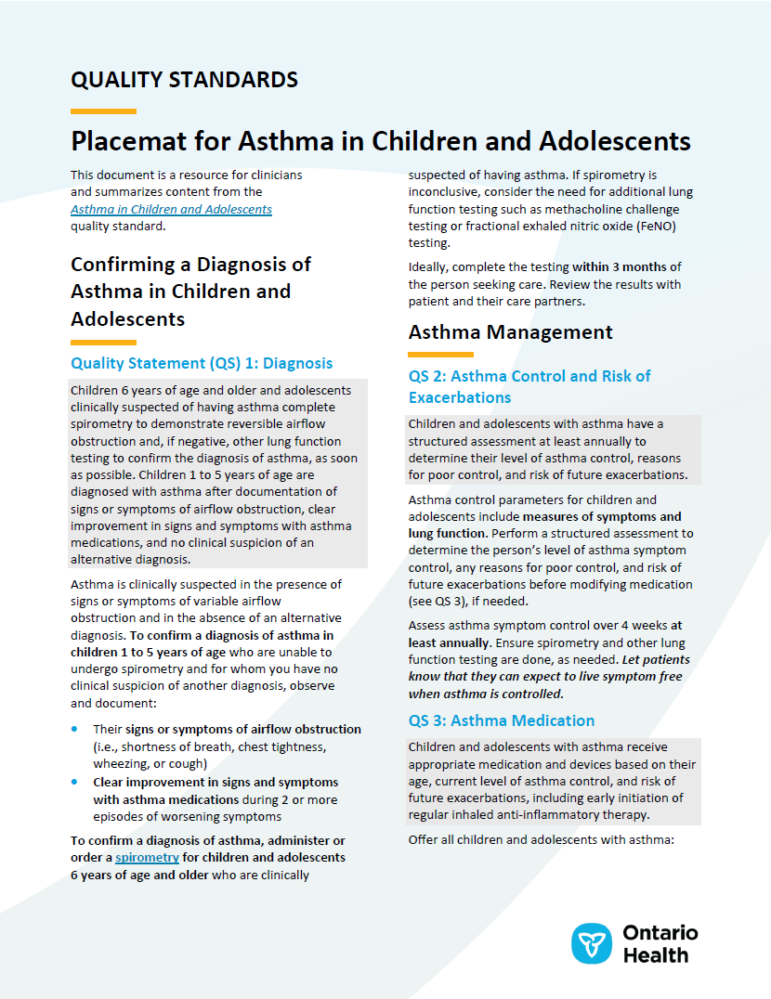
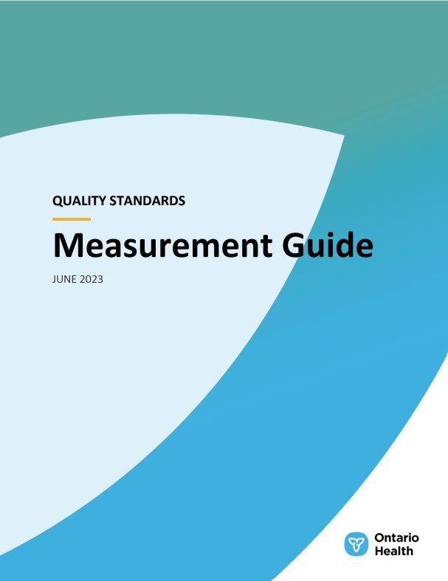
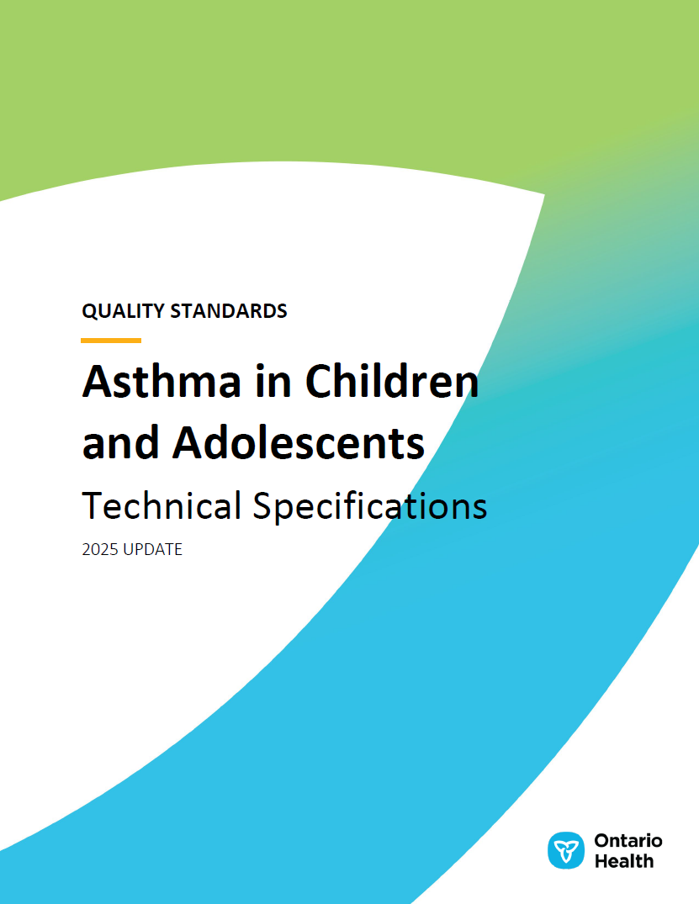
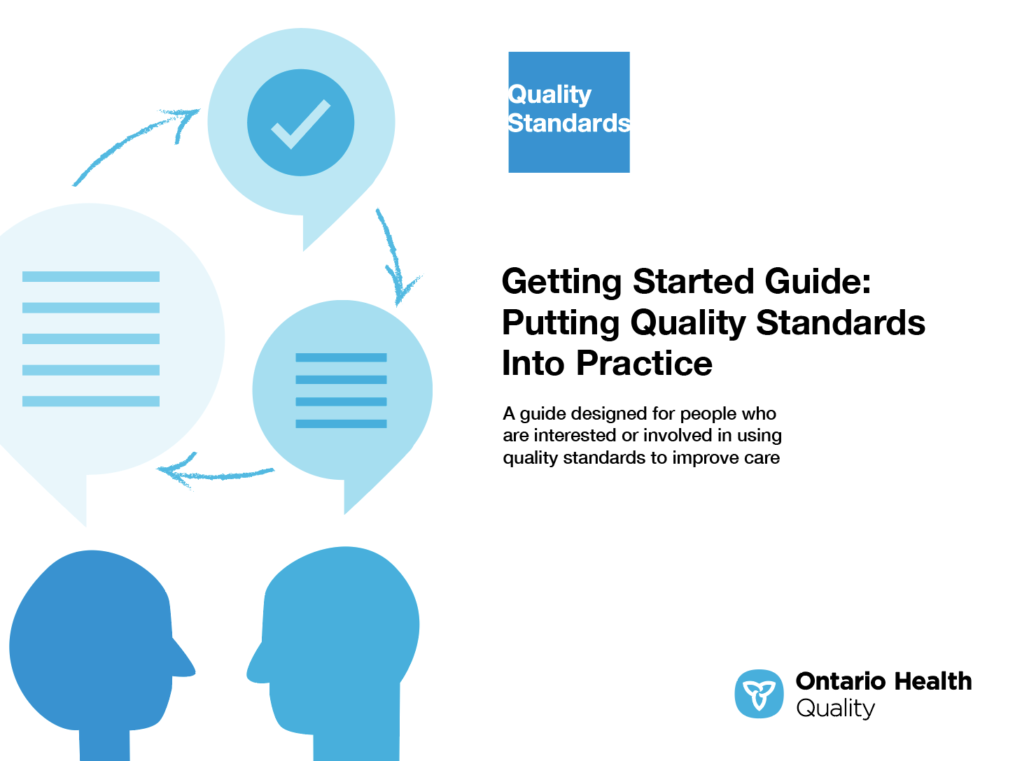
Quality standard resources
Quality Standard
Patient Guide
Placemat
Case for Improvement Deck
Measurement Guide
Technical Specifications
Getting Started Guide
Find these resources on the Asthma in Children and Adolescents quality standard web page.
Notes:
Each quality standard focuses on a specific health care issue. The development of each quality standard is accompanied by an assortment of resources.
Through concise, easy-to-understand statements, quality standards outline what quality care looks like for a condition or topic based on the evidence.
Each quality standard is accompanied by a:
Patient guide
Placemat
Case for Improvement Deck
Measurement guide
Technical specifications
Getting started guide
Quality standards provide the blueprint to enable the health care system in Ontario to work better, facilitate smooth transitions, and ensure patients receive the same high-quality care, regardless of where they reside.

Slide 6
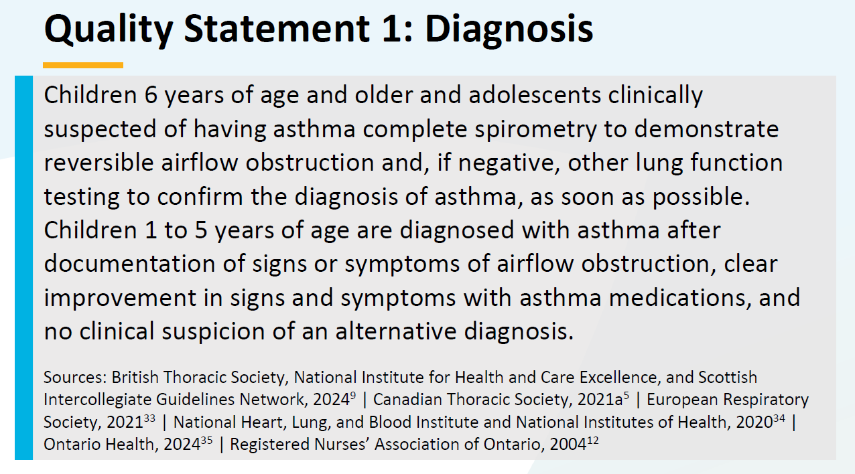
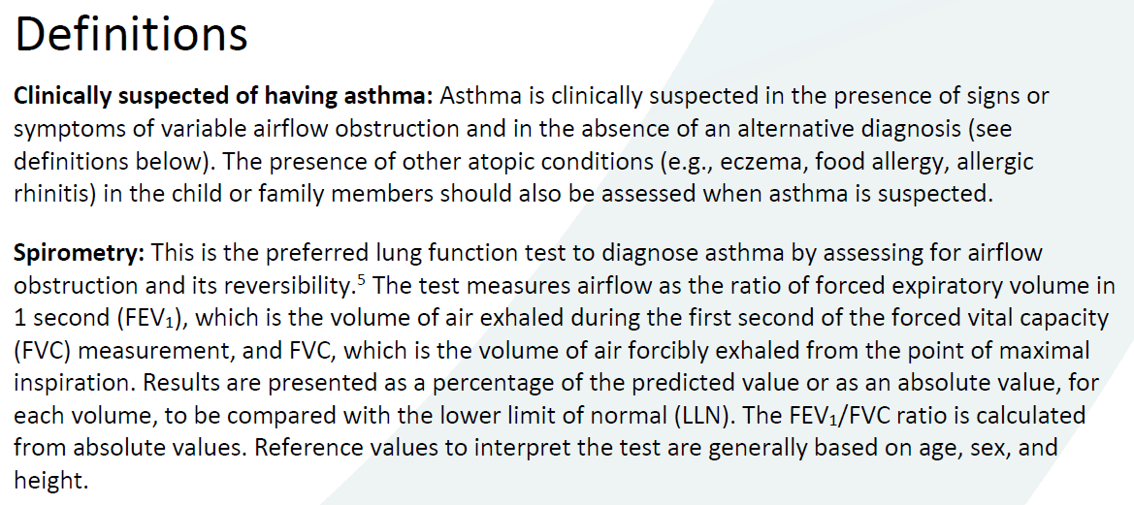
Inside the quality standard
The Quality Statement
The Audience Statements
The Definitions
The Indicators

Slide 7
Patient guide
The patient guide is designed to give patients information about what quality care looks like for various conditions based on the best evidence, so they can ask informed questions of their health care teams.
Notes:
Every quality standard includes a plain language summary for patients, families, care partners and the public called the patient guide.
Patient engagement in quality standards:
Membership on advisory committees
Focus groups and key informant interviews on topic-specific content (when necessary)
Public comment period for each quality standard
Consultations on the patient guide

Slide 8
Placemat
The placemat is a quick-reference resource for clinicians that summarizes the quality standard and includes links to helpful resources and tools.

Slide 9
Case for improvement deck
The case for improvement deck describes why the quality standard was created and shows some of the data used to develop it. Champions can use or adapt this deck to build support for the quality standard in their organizations.

Slide 10
How the health care system can support implementation
Implementing quality standards can be challenging owing to system-level barriers or gaps, many of which have been identified throughout the development of this standard
Ontario Health will work with and support other provincial partners, including the Ministry of Health, to bridge system-level gaps and support the implementation of quality standards

Slide 11
Implementation tools
The Getting Started Guide:
Outlines the process for using the quality standard as a resource to deliver high-quality care
Contains evidence-based approaches, as well as useful tools and templates for implementing change ideas at the practice level
Notes:
There are things we can do today despite the larger systemic barriers that may take time to resolve. The Getting Started Guide is a document that outlines a process for using the quality standards as a resource to deliver high-quality care. It compiles a number of resources to support adoption, such as links to implementation and quality improvement resources, examples and activities for reflection, and templates and documents to support the implementation planning activities. The Getting Started Guide also includes an Action Plan Template and examples on how Quality Improvement Plans can help to advance quality standards.

Slide 12
Quorum
Quorum is an online community dedicated to improving the quality of health care in Ontario.
The Quality Standards Adoption Series highlights efforts in the field to implement changes and close gaps in care related to quality standard topics.
Notes:
The Quality Standards program has highlighted several stories from organizations and groups using various standards and statements within their clinical care settings, organization, or institutions; these are available through posts and discussions on Quorum.
As well, we are working on compiling resources and tools, for both clinicians and patients and families.
The focus is on implementation/adoption stories and how organizations are using quality standards in practice to inform care.
We’d love to hear from you if you are interested in contributing to a post or article.

Slide 13
Measurement guide
The measurement guide describes:
The measurement principles behind the quality indicators included in quality standards
The types of indicators included in quality standards
How local and provincial data are collected and measured

Slide 14
Technical specifications
The technical specifications report outlines 2 types of measurement:
Provincial measurement: how we can monitor the progress being made to improve care at the provincial level
Local measurement: what you can do to assess the quality of care that you provide locally

Slide 15
Why do we need a quality standard for asthma in children and adolescents?

Slide 16
As of fiscal year 2022/23,* nearly 2.5 million people in Ontario have asthma (over 1 in 10). Asthma is one of the most common chronic diseases of childhood in Canada, with nearly half a million people under 20 years of age living with the disease in 2022/23, and over 60% of prevalent cases occurring in people under 15 years of age.
*Data for fiscal year 2022/23 may be incomplete due to the 2-year algorithm to identify asthma, and numbers are subject to change. Due to the observed underutilization of health care services during the COVID-19 pandemic beginning in 2020/21, data captured during this time period may be underestimated.
Source: Ontario Asthma Surveillance Information System (OASIS) (ICES), asthma prevalence crude rates.

Slide 17
Although asthma affects people of all ages, the incidence of asthma is higher in childhood.¹ Notably, for children under 6 years of age, there are no objective tests available to confirm a diagnosis of asthma.²
Thus, clinicians are required to rely on reports from family members or care partners on asthma-like symptoms and exacerbations requiring medical attention rather than conventional methods such as respiratory tests.^{2,3}
This results in uncertainty in diagnosis and treatment planning, as well as higher morbidity, among younger age groups.²⁻⁴
Nunes C, Pereira AM, Morais-Almeida M. Asthma costs and social impact. Asthma Res Pract. 2017 Jan 6;3:1.
Yang CL, Hicks EA, Mitchell P, et al. Canadian Thoracic Society 2021 guideline update: diagnosis and management of asthma in preschoolers, children and adults. Can J Respir Crit Care Sleep Med. 2021;5(6):348-61.
Canadian Institute for Health Information. Asthma hospitalizations among children and youth in Canada: trends and inequalities. Ottawa (ON): The Institute; 2018.
Trottier ED, Chan K, Allain D, et al. Managing an acute asthma exacerbation in children [Internet]. Ottawa (ON): Canadian Paediatric Society; 2021 [updated 2024 Feb 8; cited 2025 Jan 24]. Available from: https://cps.ca/documents/position/managing-an-acute-asthma-exacerbation

Slide 18
In Ontario, spirometry and other lung function testing to diagnose asthma is increasing but not yet routine, posing a risk for misdiagnosis.
According to available administrative health data, about half of people 7 years of age and older (54%) receive a pulmonary function test (PFT) within 1 year prior to or 2.5 years after their incident date to confirm their diagnosis.
Assessing asthma control is also an important gap in care for people with asthma. The percentage of people with asthma who had a PFT to monitor their asthma fell from 10.3% in fiscal year 2000/01 to 4.5% in fiscal year 2022/23.*
*Data for fiscal year 2022/23 may be incomplete due to the 2-year algorithm to identify asthma, and numbers are subject to change. Due to the observed underutilization of health care services during the COVID-19 pandemic beginning in 2020/21, data captured during this time period may be underestimated.
Notes: Ontario Health Insurance Plan (OHIP) billings for PFT may have undercounted its utilization, as it can be part of “bundled care” performed by the clinician and therefore is not billed to OHIP separately. The percentage reported above is based on the percentage of asthma prevalence in people 7 years of age and older who had a PFT within 1 year prior to the index date.
Source: Statistics reported by OASIS, and data provided by ICES, Ontario.

Slide 19
Although the incidence of asthma has been decreasing over time, people with asthma are generally living longer, thus the prevalence of asthma in Ontario (the number of people with the disease) has continued to increase for all ages combined. It rose from 114 per 1,000 people in fiscal year 2000/01 to 156 per 1,000 people in fiscal year 2022/23.*
*Data for fiscal years 2021/22 and 2022/23 may be incomplete due to the 2-year algorithm to identify asthma, and numbers are subject to change. Due to the observed underutilization of health care services during the COVID-19 pandemic beginning in 2020/21, data captured during this time period may be underestimated.
Note: Rates are reported as a crude rate.
Source: OASIS (ICES), asthma prevalence crude rates.

Slide 20
Asthma incidence rates vary across regions in Ontario
In fiscal year 2022/23,* Central region had the highest incidence rate of asthma, whereas North West region had the lowest incidence rate.
*Data for fiscal year 2022/23 may be incomplete due to the 2-year algorithm to identify asthma, and numbers are subject to change. Due to the observed underutilization of health care services during the COVID-19 pandemic beginning in 2020/21, data captured during this time period may be underestimated.
Notes: Rates are reported as a crude rate. This analysis uses former Ontario Health region boundaries that were in use prior to March 31, 2023. In this definition, each region conformed to 1 or more of the legacy Local Health Integration Networks (LHINs). Results in this analysis will not be comparable to region analysis using the aligned regions, effective April 1, 2023. Rates reported by region were back-calculated using OASIS data published by LHIN.
Source: Statistics reported by OASIS, and data provided by ICES, Ontario.

Slide 21
Asthma incidence rates are decreasing over time but still vary across regions in Ontario
*Data for fiscal years 2021/22 and 2022/23 may be incomplete due to the 2-year algorithm to identify asthma, and numbers are subject to change. Due to the observed underutilization of health care services during the COVID-19 pandemic beginning in 2020/21, data captured during this time period may be underestimated.
Notes: Rates are reported as a crude rate. This analysis uses former Ontario Health region boundaries that were in use prior to March 31, 2023. In this definition, each region conformed to 1 or more of the legacy LHINs. Results in this analysis will not be comparable to region analysis using the aligned regions, effective April 1, 2023. Rates reported by region were back-calculated using OASIS data published by LHIN.
Source: Statistics reported by OASIS, and data provided by ICES, Ontario.

Slide 22
Asthma incidence rates are consistently higher in urban areas compared with rural areas
In fiscal year 2022/23,* the asthma incidence rate was 85% higher in urban areas than in rural areas.
Although the reasons for this disparity are not completely understood, there are possible contributing factors¹:
Higher environmental exposures in rural or remote areas, which can protect against asthma development
Rural residents face higher difficulty accessing health care services than urban residents, resulting in decreased asthma diagnosis
*Data for fiscal years 2021/22 and 2022/23 may be incomplete due to the 2-year algorithm to identify asthma, and numbers are subject to change. Due to the observed underutilization of health care services during the COVID-19 pandemic beginning in 2020/21, data captured during this time period may be underestimated.
Note: Rates are reported as a crude rate.
Source: Statistics reported by OASIS, and data provided by ICES, Ontario.
Reference: 1. Canadian Institute for Health Information. Asthma hospitalizations among children and youth in Canada: trends and inequalities [Internet]. Ottawa (ON): The Institute; 2018 [cited 2025 Jan 20]. Available from: https://www.cihi.ca/sites/default/files/document/asthma-hospitalization-children-2018-chartbook-en-web.pdf

Slide 23
Asthma-specific emergency department (ED) visit rates vary across regions in Ontario and across age groups
In fiscal year 2022/23,* North West region had the highest rate of asthma-specific ED visits. The highest rate of asthma-specific ED visits was among children 0–4 years of age and accounted for about 24% of all asthma-specific ED visits among all age groups (i.e., 0–99 years).
*Data for fiscal year 2022/23 may be incomplete due to the 2-year algorithm to identify asthma, and numbers are subject to change. Due to the observed underutilization of health care services during the COVID-19 pandemic beginning in 2020/21, data captured during this time period may be underestimated.
Notes: Rates are reported as a crude rate. This analysis uses former Ontario Health region boundaries that were in use prior to March 31, 2023. In this definition, each region conformed to 1 or more of the legacy LHINs. Results in this analysis will not be comparable to region analysis using the aligned regions, effective April 1, 2023. Rates reported by region were back-calculated using OASIS data published by LHIN.
Source: Statistics reported by OASIS, and data provided by ICES, Ontario.

Slide 24
Asthma-specific hospitalizations are highest among the youngest children
In fiscal year 2022/23,* Ontario hospitals saw a significant increase in hospital stays due to respiratory illnesses among people under 18 years of age.¹ Asthma-specific hospitalizations almost doubled from the previous year for those 0–14 years of age. Higher asthma-specific hospitalization rates observed among the youngest children may be related to difficulties in diagnosing and treating asthma in this age group.²
*Data for fiscal years 2001/22 and 2022/23 may be incomplete due to the 2-year algorithm to identify asthma, and numbers are subject to change. Due to the observed underutilization of health care services during the COVID-19 pandemic beginning in 2020/21, data captured during this time period may be underestimated.
Source: Statistics reported by OASIS, and data provided by ICES, Ontario.
References:
Canadian Institute for Health Information. Hospital stays for respiratory illnesses increase among Canadian children [Internet]. Ottawa (ON): The Institute; 2024 Feb 22 [cited 2024 Nov 25]. Available from: https://www.cihi.ca/en/news/hospital-stays-for-respiratory-illnesses-increase-among-canadian-children
Canadian Institute for Health Information. Asthma hospitalizations among children and youth in Canada: trends and inequalities [Internet]. Ottawa (ON): The Institute; 2018 [cited 2025 Jan 20]. Available from: https://www.cihi.ca/sites/default/files/document/asthma-hospitalization-children-2018-chartbook-en-web.pdf

Slide 25
Asthma-specific hospitalization rates vary across regions in Ontario and across age groups
In fiscal year 2022/23,* the rate of asthma-specific hospitalizations in people of all ages combined was highest in Toronto and North West regions. Children under 5 years of age had the highest rate of asthma-specific hospitalizations.¹
*Data for fiscal year 2022/23 may be incomplete due to the 2-year algorithm to identify asthma, and numbers are subject to change. Due to the observed underutilization of health care services during the COVID-19 pandemic beginning in 2020/21, data captured during this time period may be underestimated.
Notes: Rates are reported as a crude rate. This analysis uses former Ontario Health regions that were in use prior to March 31, 2023. In this definition, each region conformed to 1 or more of the legacy LHINs. Results in this analysis will not be comparable to region analysis using the aligned regions, effective April 1, 2023. Rates reported by region were back-calculated using OASIS data published by LHIN.
Source: Statistics reported by OASIS, and data provided by ICES, Ontario.
Reference: 1. Canadian Institute for Health Information. Asthma hospitalizations among children and youth in Canada: trends and inequalities [Internet]. Ottawa (ON): The Institute; 2018 [cited 2025 Jan 20]. Available from: https://www.cihi.ca/sites/default/files/document/asthma-hospitalization-children-2018-chartbook-en-web.pdf

Slide 26
Asthma-specific physician office visits vary by age group
Children under 5 years of age accounted for over 120,000 asthma-specific physician visits, or about 20% of all asthma-specific physician visits in Ontario, in fiscal year 2022/23.*
*Data for fiscal year 2022/23 may be incomplete due to the 2-year algorithm to identify asthma, and numbers are subject to change. Due to the observed underutilization of health care services during the COVID-19 pandemic beginning in 2020/21, data captured during this time period may be underestimated.
†Percentages for age groups do not add up to 100%, as those aged 20 years and older are not presented.
Note: Asthma-specific physician office visits were extracted from the Ontario Health Insurance Plan (OHIP) database with service delivery at physician office, long-term care, and home.
Source: Statistics reported by OASIS, and data provided by ICES, Ontario.

Slide 27
Quotation from a lived experience advisor
”
“People perceive asthma as ‘minor,’ but I don’t think they recognize the seriousness of it. Asthma can be a huge barrier to people, particularly with respect to health potential, but the ceiling is higher than I expected. This quality standard equips me with knowledge. I can work with my team, and I can ask for the care my child and I need.
“I will use the quality standard to hold myself and the care team accountable as much as I can as an individual patient who sometimes feels vulnerable. I am hoping this quality standard will help people recognize what good health can look like when living with asthma and to not accept anything less.”
– Kate Mulligan, Lived Experience Advisor, Asthma Quality Standards Advisory Committee

Slide 28
Quotation from a pediatrician
”
“Time to spirometry is a big barrier for many practitioners and centres, and getting education out into the community can be challenging. This quality standard is a good start toward changing patient care, particularly for children, and will raise awareness of how to manage this unique population. People who are enthusiastic about asthma will use this document to improve asthma care, and these changes will filter to other sites in the region.”
– Ryan W. Smith, Pediatrician, Asthma Quality Standards Advisory Committee

Slide 29
Quality statements to improve care

Slide 30
Scope of this quality standard
This quality standard addresses the diagnosis and management of asthma in children and adolescents under 16 years of age, with a focus on primary care and community-based settings. It addresses referral to specialized pediatric asthma care for children and adolescents who have indications characterizing severe asthma, but it does not address the management of severe asthma in specialized care, acute asthma exacerbations, or care provided during emergency department visits or hospitalizations.
The Clinical Handbook for Paediatric Asthma by the Provincial Council for Maternal and Child Health and the Lung Health Foundation addresses the emergency department and inpatient episodes of care.
A separate quality standard addresses Asthma in Adults.
Notes:
Scope of This Quality Standard
This quality standard addresses the diagnosis and management of asthma in children and adolescents under 16 years of age, with a focus on primary care and community-based settings. It addresses referral to specialized pediatric asthma care for children and adolescents who have indications characterizing severe asthma, but it does not address the management of severe asthma in specialized care, acute asthma exacerbations, or care provided during emergency department visits or hospitalizations.
A separate quality standard addresses Asthma in Adults.

Slide 31
Quality statement topics
Diagnosis
Asthma control and risk of exacerbations
Asthma medication
Self-management education and asthma action plan
Referral to specialized pediatric asthma care
Follow-up after discharge

Slide 32
Quality statement (QS) 1: Diagnosis
Children 6 years of age and older and adolescents clinically suspected of having asthma complete spirometry to demonstrate reversible airflow obstruction and, if negative, other lung function testing to confirm the diagnosis of asthma, as soon as possible. Children 1 to 5 years of age are diagnosed with asthma after documentation of signs or symptoms of airflow obstruction, clear improvement in signs and symptoms with asthma medications, and no clinical suspicion of an alternative diagnosis.

Slide 33
QS 2: Asthma control and risk of exacerbations
Children and adolescents with asthma have a structured assessment at least annually to determine their level of asthma control, reasons for poor control, and risk of future exacerbations.

Slide 34
QS 3: Asthma medication
Children and adolescents with asthma receive appropriate medication and devices based on their age, current level of asthma control, and risk of future exacerbations, including early initiation of regular inhaled anti-inflammatory therapy.

Slide 35
QS 4: Self-management education and asthma action plan
Children and adolescents with asthma and their care partners receive asthma self-management education and a written personalized asthma action plan that is reviewed regularly with a clinician.

Slide 36
QS 5: Referral to specialized pediatric asthma care
Children and adolescents with asthma with appropriate indications are referred to specialized pediatric asthma care.

Slide 37
QS 6: Follow-up after discharge
Children and adolescents who have had an emergency department visit or been hospitalized for an asthma exacerbation have a follow-up assessment within 2 to 7 days after discharge.

Slide 38
Measures to support improvement
Notes:
The Asthma Quality Standard Advisory Committee identified a set of overarching goals for this quality standard. These have been mapped to indicators that may be used to assess quality of care provincially and locally.

Slide 39
Indicators that can be measured using provincial data
Percentage of children and adolescents ≥ 6 to ≤ 15 years of age with incident asthma whose diagnosis is confirmed with lung function testing
Percentage of children and adolescents ≥ 6 to ≤ 15 years of age with asthma who completed a lung function test in the previous 12 months
Percentage of children and adolescents with asthma who visited the emergency department for an asthma-specific reason in the previous 12 months
Percentage of children and adolescents with asthma who were hospitalized for an asthma-specific reason in the previous 12 months

Slide 40
Indicators that can be measured using only local data
Percentage of young children ≥ 1 to ≤ 5 years of age clinically suspected of having asthma whose diagnosis of asthma is confirmed after the documentation of signs or symptoms of airflow obstruction and clear improvement of those signs or symptoms with medication
Percentage of children and adolescents with asthma who had a structured assessment in the previous 6 months
Percentage of children and adolescents with asthma with 1 or more appropriate indications who are prescribed regular (daily) inhaled anti-inflammatory therapy
Average number of asthma symptom–free days in the previous 4 weeks among children and adolescents with asthma
Average number of days missed from school or work due to asthma in the previous 4 weeks

Slide 41
Data sources and acknowledgement
The data used in this presentation uses asthma statistics reported by the Ontario Asthma Surveillance Information System (OASIS) and data provided by ICES. The opinions, results, and conclusions included in this report are those of the authors and are independent from the funding sources. No endorsement by ICES or OASIS is intended or should be inferred. These datasets were linked using unique encoded identifiers and analyzed at ICES. Parts of this material are based on data and information compiled and provided by the Canadian Institute for Health Information (CIHI). However, the analyses, conclusions, opinions, and statements expressed herein are those of the authors, and not necessarily those of CIHI.

Slide 42
Thank you

