Slide 1


Asthma
Quality Standard
Guiding evidence-based care for people under 16 years of age in Ontario
Notes:
If you have any questions about the content of this presentation, please contact us at QualityStandards@hqontario.ca

Slide 2
Objectives
Overview of quality standards
What are they? How are they used?​
Why this quality standard is needed
Gaps and variations in quality of care for people with asthma in Ontario
How to measure overall success
Indicators that can help measure your quality improvement efforts
Quality statements to improve care
The key statements in the asthma quality standard

Slide 3
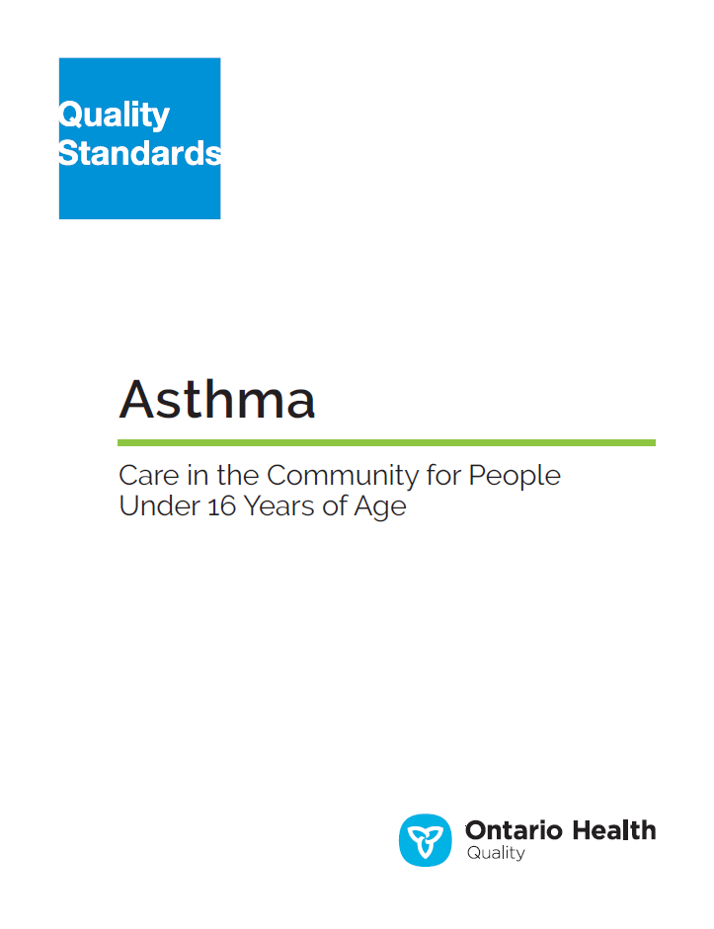
Quality Standards
Inform clinicians and patients what quality care looks like
Focus on conditions or processes where there are large variations in how care is delivered, or where there are gaps between the care provided in Ontario and the care patients should receive
Are grounded in the best available evidence
Notes:
Quality standards are a smaller set of high impact statements that describe optimal care where identified quality gaps exist in Ontario.
Voluntary and aspirational in nature​.
Designed to “raise the ceiling” with the goal of having the best possible care available to all Ontarians, regardless of where they live in the province.
There are many guidelines, professional standards, and other recommendations that contribute to the evidence ecosystem. Quality standards complement these resources.
Quality standards outline the what of care that should be delivered but are agnostic on who should be delivering it (unlike other CPGs, BPGs).
Quality standards are:
Concise: 5 to 15 strong, evidence-based statements focused on high priority areas for improvement.
Accessible: help clinicians and provider organizations offer the highest-quality care; and patients to know what to discuss with their care providers (compared with CPGs that are quite dense, these are very accessible, also written in plain language).
Measurable: each statement is accompanied by one or more quality indicators (structure, process or outcome), with a set of outcome measures for the overall standard.
Implementable: quality improvement tools and resources support each standard, to fuel adoption.

Slide 4
Quality Standards
Help health care professionals know what care to offer, based on evidence and expert consensus
Help health care organizations measure, assess, and improve the quality of care they provide
Help ensure consistent,
high-quality care across the province
Help patients, residents, families, and caregivers know what to ask for in their care
Notes:
Patients, caregivers and the public can use quality standards to understand what excellent care looks like, what they should expect from their health care providers, and how to discuss the quality of their care.
Provincial regions and disease agencies can use quality standards to measure health outcomes, hold health service providers accountable for delivering high-quality care, and inform regional improvement strategies.
Provider organizations can use quality standards to measure and audit their quality of care, identify gaps, guide organizational improvement strategies, and inform clinical program investments.
Health care professionals can use quality standards to evaluate their practice and identify areas for personal and organizational quality improvement, and can incorporate the evidence-based statements into professional education.
Government can use quality standards to identify provincial priority areas, inform new data collection and reporting initiatives, and design performance indicators and funding incentives.

Slide 5
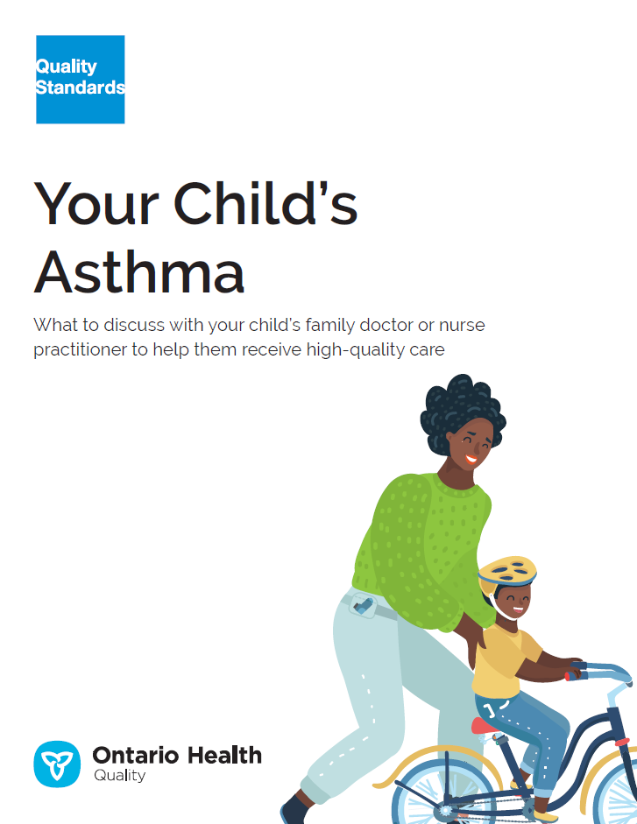
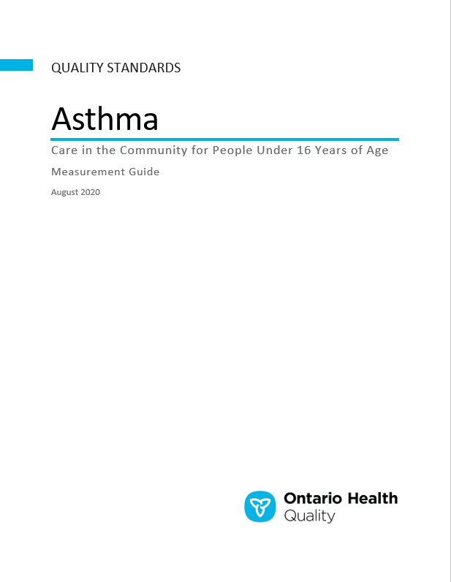
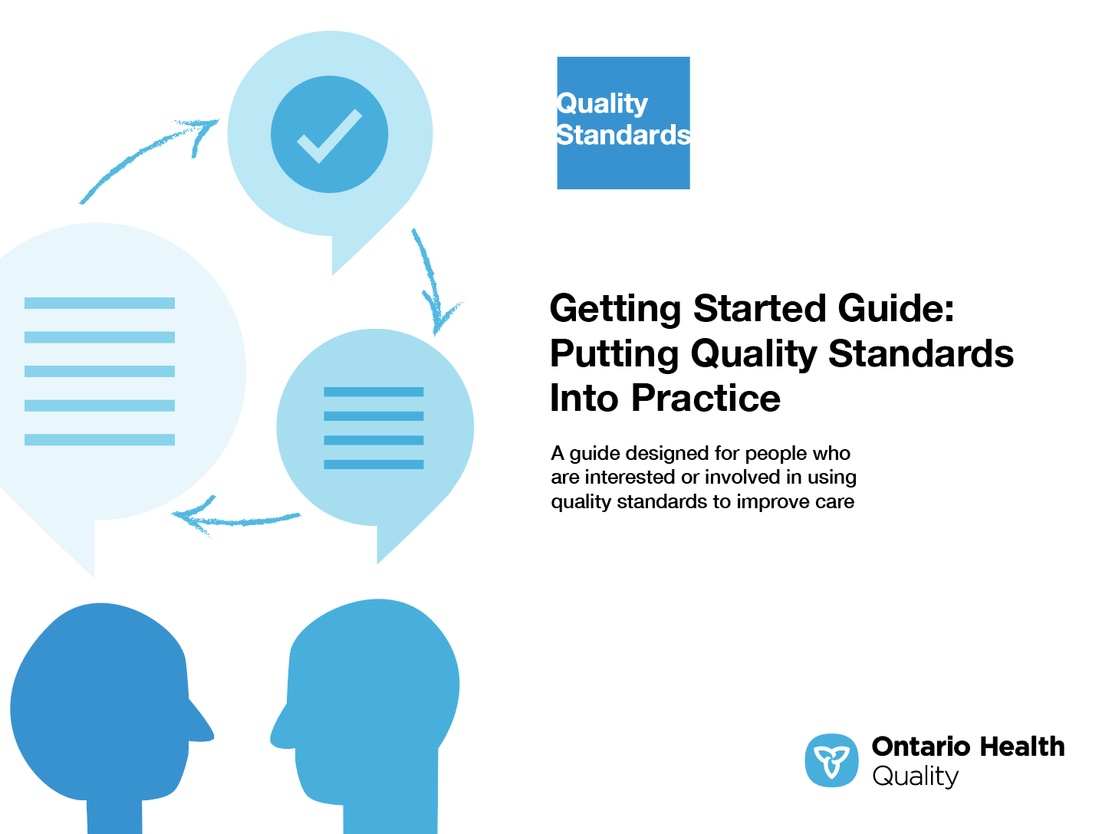
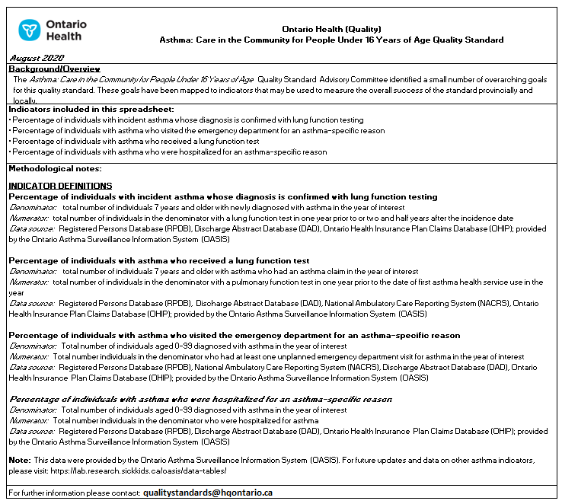
Quality Standard Resources
Quality Standard
Patient Guide
Getting Started Guide
Data Tables
Measurement Guide
Find these resources here:
https://www.hqontario.ca/evidence-to-improve-care/quality-standards/view-all-quality-standards/asthma-in-children-and-adolescents
Notes:
Each quality standard focuses on a specific health care issue. The development of each quality standard is accompanied by an assortment of resources.
Through concise, easy-to-understand statements, quality standards outline what quality care looks like for a condition or topic based on the evidence.
Each quality standard is accompanied by:
A patient conversation guide
A getting started guide
Data tables
A measurement guide
Quality standards provide the blueprint to enable the health care system in Ontario to work better, facilitate smooth transitions, and ensure patients receive the same high-quality care, regardless of where they reside.

Slide 6
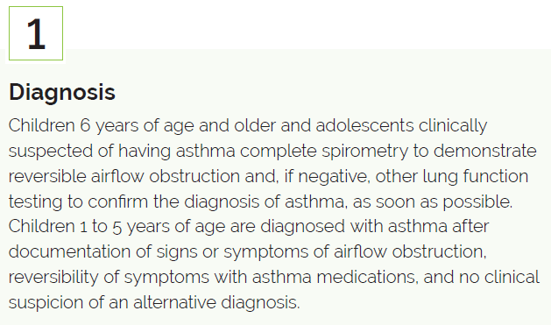
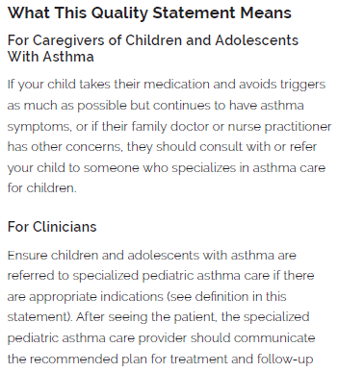
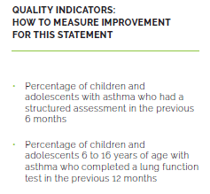
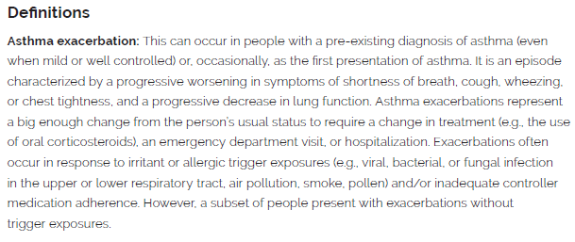
Inside the Quality Standard
The Quality Statement
The Audience Statements
The Definitions
The Indicators

Slide 7
Quality Standards:
Patient Guide
The patient guide is designed to give patients information about what quality care looks like for various conditions based on the best evidence, so they can ask informed questions of their health care providers.
Notes:
Every quality standard includes a plain language summary for patients, families, caregivers and the public called the patient conversation guide.
Patient engagement in quality standards:
Membership on advisory committees
Focus groups and key informant interviews on topic-specific content (when necessary)
Public comment period for each quality standard
Consultations on the patient conversation guide

Slide 8
Quality Standards:
How the Health Care System Can Support Implementation
Implementing quality standards can be challenging due to system-level barriers or gaps, many of which have been identified throughout the development of this standard. Ontario Health will work with and support other provincial partners, including Ministry of Health, to bridge system-level gaps to support the implementation of quality standards.

Slide 9
Quality Standards:
Implementation Tools
The Getting Started Guide:
Outlines the process for using the quality standard as a resource to deliver high-quality care
Contains evidence-based approaches, as well as useful tools and templates for implementing change ideas at the practice level
Notes:
There are things we can do today despite the larger systemic barriers that may take time to resolve. The Getting Started Guide is a document that outlines a process for using the quality standards as a resource to deliver high-quality care. It compiles a number of resources to support adoption, such as links to implementation and quality improvement resources, examples and activities for reflection, and templates and documents to support the implementation planning activities. The Getting Started Guide also includes an Action Plan Template and examples on how Quality Improvement Plans can help to advance quality standards.

Slide 10


Quality Standard Adoption Tools:
QUORUM
Quorum is an online community dedicated to improving the quality of health care in Ontario.
The Quality Standards Adoption Series highlights efforts in the field to implement changes and close gaps in care related to quality standard topics.
quorum.hqontario.ca
Notes:
The Quality Standards program has highlighted several stories from organizations and groups using various standards and statements within their clinical care settings, organization, or institutions; these are available through posts and discussions on Quorum.
As well, we are working on compiling resources and tools, for both clinicians and patients and families.
The focus is on implementation/adoption stories and how organizations are using quality standards in practice to inform care.
We’d love to hear from you if you are interested in contributing to a post or article.

Slide 11
Quality Standards:
Measurement Guide
The measurement guide has two dedicated sections:
Local measurement: what you can do to assess the quality of care that you provide locally
Provincial measurement: how we can measure the success of the quality standard on a provincial level

Slide 12
Quality Standards:
Data Tables
Data tables can be used to examine variations in indicator results across the province. They include data on key indicators:
Over time for Ontario
Across regions in Ontario
For specific measures of equity (age, sex, rurality, and household income)

Slide 13
Why Do We Need a Quality Standard for Asthma?

Slide 14

The incidence of asthma in Ontario (the number of people newly diagnosed each year) has been decreasing across all age groups; it dropped from 9.3 new cases per 1,000 people in 1996 to 2.27 per 1,000 in 2018*.
Source: Ontario Asthma Surveillance Information System, ICES. Asthma incidence crude rates.
*Data for 2018 may be incomplete due to the 2-year algorithm to identify asthma, and numbers are subject to change

Slide 15
At the same time, because people are generally living longer, the prevalence of asthma in Ontario (the number of people living with the disease) continued to increase for all ages; it rose from around 90 per 1,000 people in 1996 to 155 per 1,000 in 2018*.
Source: Ontario Asthma Surveillance Information System, ICES. Asthma prevalence crude rates.
*Data for 2018 may be incomplete due to the 2-year algorithm to identify asthma, and numbers are subject to change

Slide 16
Asthma incidence per 1,000 people, by region, 2018*
Central West region’s incidence was the highest in 2018, while North West region had the lowest incidence
Source: Statistics reported by the Ontario Asthma Surveillance Information System (OASIS) and data provided by ICES, Ontario
*Data for 2018 may be incomplete due to the 2-year algorithm to identify asthma, and numbers are subject to change

Slide 17
Asthma incidence per 1,000 people, by neighbourhood income quintile, 2018*
The incidence of asthma was 21% higher in the lowest neighbourhood income quintile compared with the highest neighbourhood income quintile
Source: Statistics reported by the Ontario Asthma Surveillance Information System (OASIS) and data provided by ICES, Ontario
*Data for 2018 may be incomplete due to the 2-year algorithm to identify asthma, and numbers are subject to change

Slide 18
Asthma-specific emergency department visits per 100 people with asthma, by region and by age group, 2018*
Wide variation was observed across Ontario in ED visits for asthma among people with asthma, with the North East region having the highest rate.
The highest rate of ED visits was among children under 5 years of age.
Source: Statistics reported by the Ontario Asthma Surveillance Information System (OASIS) and data provided by ICES, Ontario
*Data for 2018 may be incomplete due to the 2-year algorithm to identify asthma, and numbers are subject to change
Notes:
NW was 2.65 higher than Mississauga Halton

Slide 19
Asthma-specific hospitalizations per 100 people with asthma, by region and by age group, 2018*
The rate of asthma-specific hospitalizations was highest in the Toronto Central region and lowest in the Champlain region.
Children under 5 years of age had the highest rate of asthma-specific hospitalizations.
Source: Statistics reported by the Ontario Asthma Surveillance Information System (OASIS) and data provided by ICES, Ontario
*Data for 2018 may be incomplete due to the 2-year algorithm to identify asthma, and numbers are subject to change
Notes:
18x higher than the 15-19 age group

Slide 20
“People perceive asthma as 'minor,' but I don’t think they recognize the seriousness of it. Asthma can be a huge barrier to people, particularly with respect to health potential, but the ceiling is higher than I expected. This quality standard equips me with knowledge. I can work with my team, and I can ask for the care my child and I need.
I will use the quality standard to hold myself and the care team accountable as much as I can as an individual patient who sometimes feels vulnerable. I am hoping this quality standard will help people recognize what good health can look like when living with asthma and to not accept anything less.”
– Kate Mulligan, Lived Experience Advisor, Asthma Quality Standards Advisory Committee

Slide 21
“Time to spirometry is a big barrier for many practitioners and centres, and getting education out into the community can be challenging. This quality standard is a good start toward changing patient care, particularly for children, and will raise awareness of how to manage this unique population. People who are enthusiastic about asthma will use this document to improve asthma care, and these changes will filter to other sites in the region.”
– Ryan W. Smith, Pediatrician, Asthma Quality Standards Advisory Committee

Slide 22
Quality Statements to Improve Care

Slide 23
Scope of This Quality Standard
This quality standard addresses the diagnosis and management of asthma in children and adolescents under 16 years of age, with a focus on primary care and community-based settings. It addresses referral to specialized pediatric asthma care for children and adolescents who have indications characterizing severe asthma.
This quality standard does not address the management of severe asthma, acute asthma exacerbations or care provided during emergency department visits, or hospitalizations.
Notes:
Scope of This Quality Standard
This quality standard addresses the diagnosis and management of asthma in children and adolescents under 16 years of age, with a focus on primary care and community-based settings. It addresses referral to specialized pediatric asthma care for children and adolescents who have indications characterizing severe asthma, but it does not address the management of severe asthma, acute asthma exacerbations or care provided during emergency department visits, or hospitalizations.
The Clinical Handbook for Paediatric Asthma by the Provincial Council for Maternal and Child Health and Ontario’s Ministry of Health addresses the emergency department and inpatient episodes of care.¹
A separate quality standard addresses Asthma Care in the Community for People 16 Years of Age and Older.

Slide 24






Quality Statement Topics
Diagnosis
Asthma Control
Asthma Medication
Self-Management Education and Asthma Action Plan
Referral to Specialized Asthma Care
Follow-up After Discharge
Notes:
.

Slide 25
Quality Statement 1:
Diagnosis
Children 6 years of age and older and adolescents clinically suspected of having asthma complete spirometry to demonstrate reversible airflow obstruction and, if negative, other lung function testing to confirm the diagnosis of asthma, as soon as possible. Children 1 to 5 years of age are diagnosed with asthma after documentation of signs or symptoms of airflow obstruction, reversibility of symptoms with asthma medication, and no clinical suspicion of an alternative diagnosis.

Slide 26
Quality Statement 2:
Asthma Control
Children and adolescents with asthma have a structured assessment at least annually to determine their level of asthma control and reasons for poor control.

Slide 27
Quality Statement 3:
Asthma Medication
Children and adolescents with asthma receive appropriate medication and devices based on their age and current level of asthma control, including early initiation of regular inhaled anti-inflammatory therapy.

Slide 28
Quality Statement 4:
Self-Management Education and Asthma Action Plan
Children and adolescents with asthma and their caregivers receive self-management education and a written personalized asthma action plan that is reviewed regularly with a health care professional.

Slide 29
Quality Statement 5:
Referral to Specialized Asthma Care
Children and adolescents with asthma with appropriate indications are referred to specialized pediatric asthma care.

Slide 30
Quality Statement 6:
Follow-Up After Discharge
Children and adolescents who have had an emergency department visit or been hospitalized for an asthma exacerbation have a follow-up assessment within 2 to 7 days after discharge.

Slide 31
How to Measure Overall Success
Notes:
The Asthma Quality Standards Advisory Committee identified a set of overarching goals for this quality standard. These have been mapped to indicators that may be used to assess quality of care provincially and locally.

Slide 32
Indicators That Can Be Measured Using Provincial Data
Percentage of children and adolescents 6 to 16 years of age with asthma whose diagnosis is confirmed with lung function testing
Percentage of children and adolescents 6 to 16 years of age with asthma who had a lung function test in the previous 12 months
Percentage of children and adolescents with asthma who visited the emergency department for an asthma-specific reason in the previous 12 months
Percentage of children and adolescents with asthma who were hospitalized for an asthma-specific reason in the previous 12 months

Slide 33
Indicators That Can Be Measured Using Only Local Data
Percentage of young children 1 to 5 years of age clinically suspected of having asthma whose diagnosis of asthma is confirmed by documented reversibility of signs or symptoms with medication
Percentage of children and adolescents with asthma who had a structured assessment in the previous 6 months to determine their asthma symptom control and the reasons for poor control
Percentage of children and adolescents with asthma with the appropriate indications who are prescribed regular (daily) inhaled anti-inflammatory therapy
Average number of asthma symptom–free days in the previous 4 weeks among children and adolescents with asthma
Average number of days missed from school or work due to asthma in the previous 4 weeks

Slide 34
Data Sources and Acknowledgement
The data used in this presentation was provided by the Institute for Clinical Evaluative Sciences (ICES), which is funded by an annual grant from the Ontario Ministry of Health. The opinions, results, and conclusions included in this report are those of the authors and are independent from the funding sources. No endorsement by ICES or the Ministry of Health is intended or should be inferred. These datasets were linked using unique encoded identifiers and analyzed at ICES. Parts of this material are based on data and information compiled and provided by the Canadian Institute for Health Information (CIHI). However, the analyses, conclusions, opinions, and statements expressed herein are those of the authors, and not necessarily those of CIHI.

Slide 35
Connect with us:
https://quorum.hqontario.ca

