Slide 1
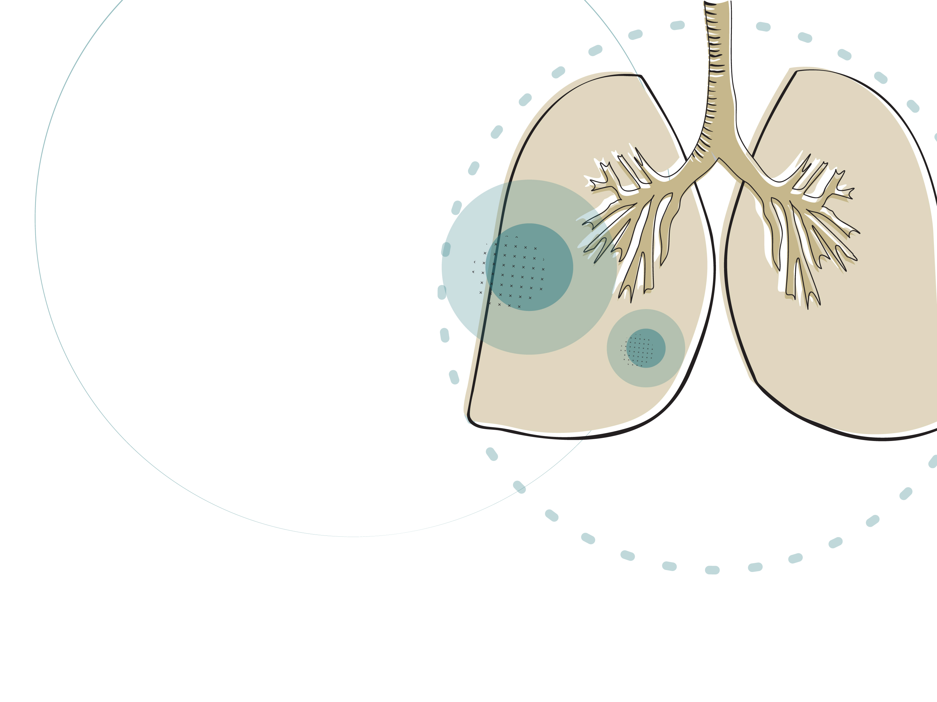
Chronic Obstructive
Pulmonary Disease
A quality standard for guiding evidence-based care for people living with COPD in Ontario
Notes:
If you have any questions about the content of this presentation, please contact us at QualityStandards@hqontario.ca

Slide 2
Objectives
Overview of Quality Standards
What are they? How are they used?​
Why This Quality Standard Is Needed
Gaps and variations in quality of care for people living with COPD across Ontario
How Success Can Be Measured
Indicators that can help measure your quality improvement efforts
Quality Statements in Brief
The key statements in the COPD quality standard

Slide 3
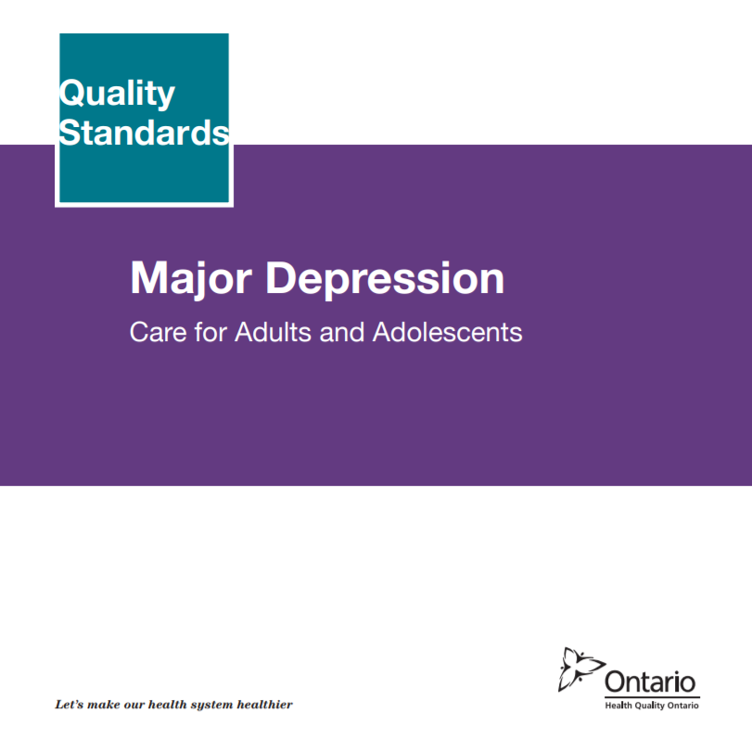
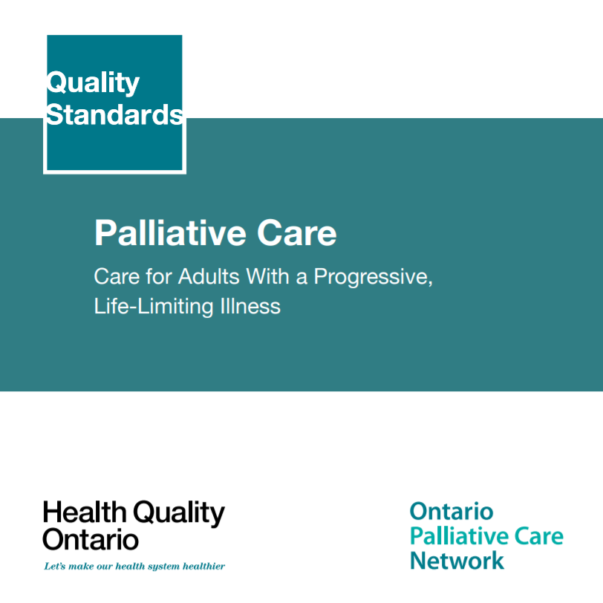
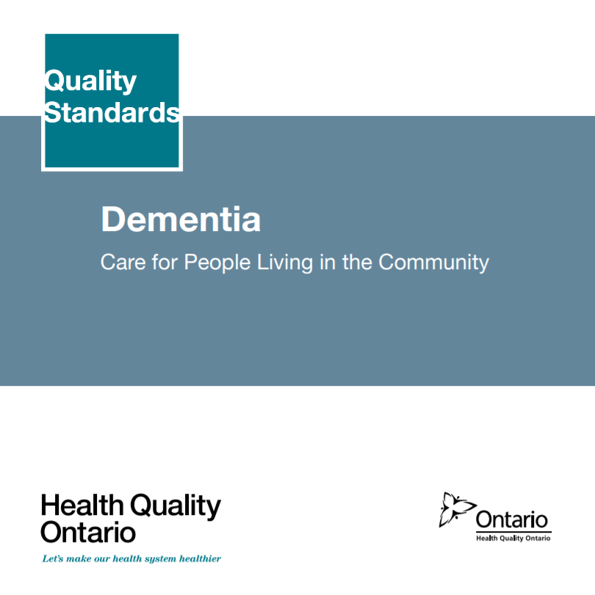
Quality Standards
Inform clinicians and patients what quality care
looks like
Focus on conditions where there are large variations
in how care is delivered, or where there are gaps between the care provided in Ontario and the care patients should receive
Are grounded in the best available evidence
Notes:
Quality standards are a smaller set of high impact statements that describe optimal care where identified quality gaps exist in Ontario.​
Voluntary and aspirational in nature​
Designed to “raise the ceiling” with the goal of having the best possible care available to all Ontarians, regardless of where they live in the province
There are many guidelines, professional standards, and other recommendations that contribute to the evidence ecosystem. Quality standards complement these resources.
Quality standards outline the what of care that should be delivered but is agnostic on who should be delivering it (unlike other CPGs, BPGs).
Quality standards are:
Concise: 5 to 15 strong, evidence-based statements focused on high priority areas for improvement
Accessible: help clinicians and provider organizations offer the highest quality care; and patients to know what to discuss with their care providers (compared to CPGs that are quite dense, these are very accessible, also written in plain language)
Measurable: each statement is accompanied by one or more quality indicators (structure, process or outcome), with a set of outcome measures for the overall standard
Implementable: quality improvement tools and resources support each standard, to fuel adoption

Slide 4
Quality Standards: Vision
Help health care professionals know what care to offer, based on evidence and expert consensus
Help health care organizations measure, assess, and improve the quality of care they provide
Help ensure consistent, high-quality care across the province
Help patients, residents, families, and caregivers know what to ask for in their care
Notes:
Patients, caregivers and the public can use quality standards to understand what excellent care looks like, what they should expect from their health care providers, and how to discuss the quality of their care.
LHINs and disease agencies can use quality standards to measure health outcomes, hold health service providers accountable for delivering high-quality care, and inform regional improvement strategies.
Provider organizations can use quality standards to measure and audit their quality of care, identify gaps, guide organizational improvement strategies, and inform clinical program investments.
Health care professionals can use quality standards to evaluate their practice and identify areas for personal and organizational quality improvement, and can incorporate the evidence-based statements into professional education
Government can use quality standards to identify provincial priority areas, inform new data collection and reporting initiatives, and design performance indicators and funding incentives.

Slide 5

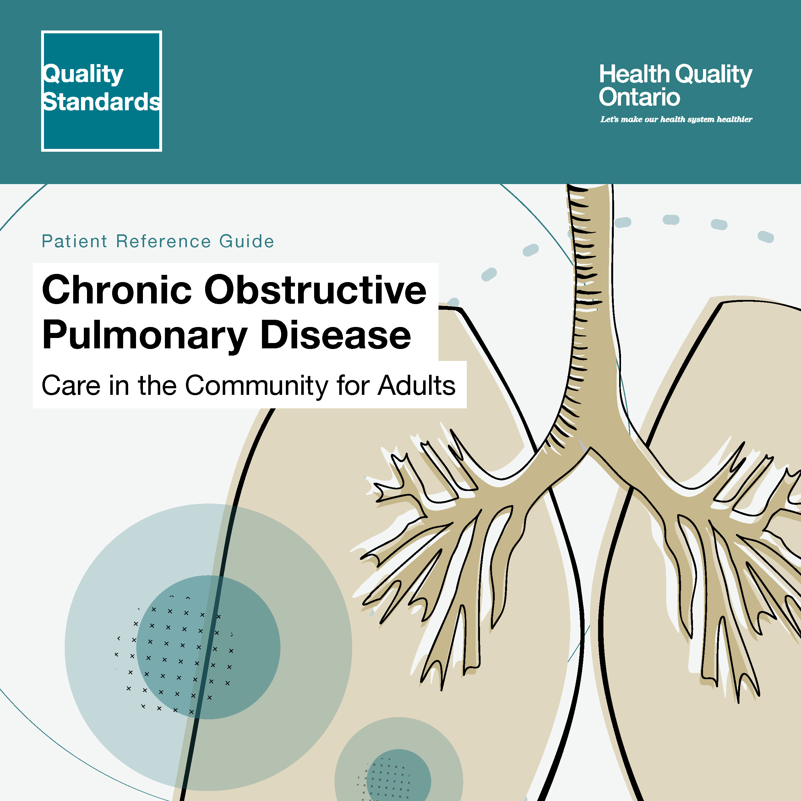
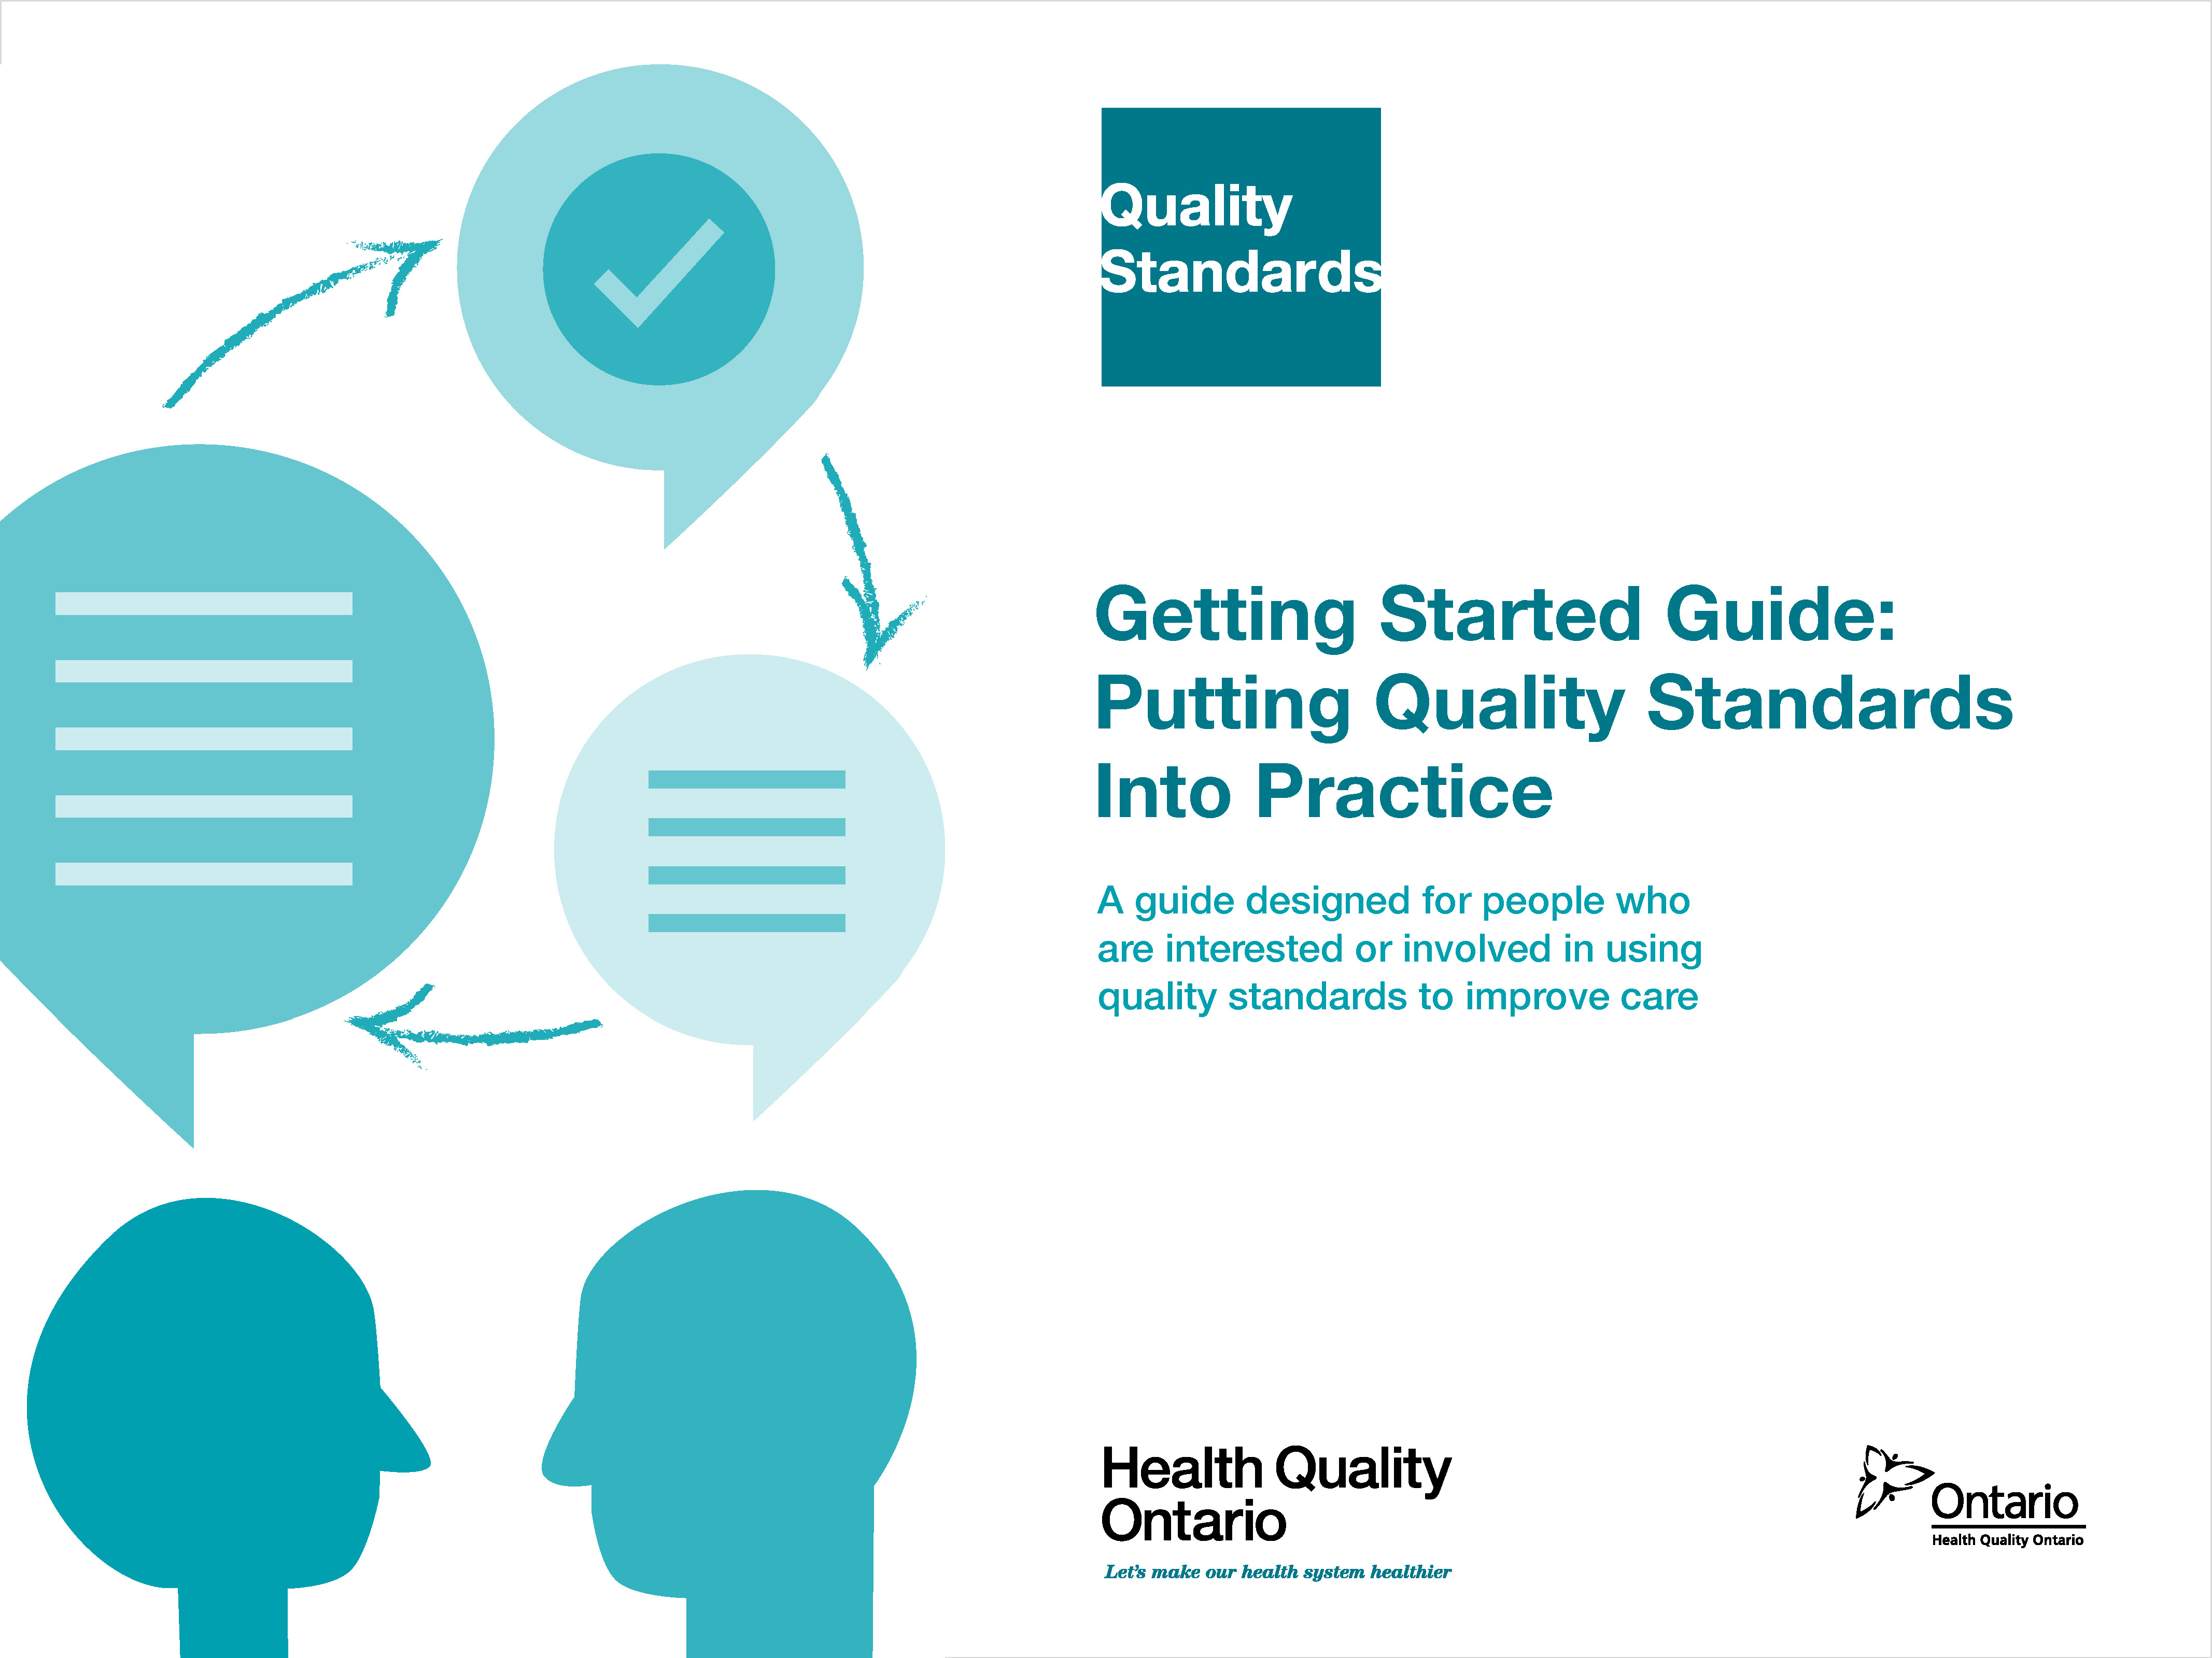
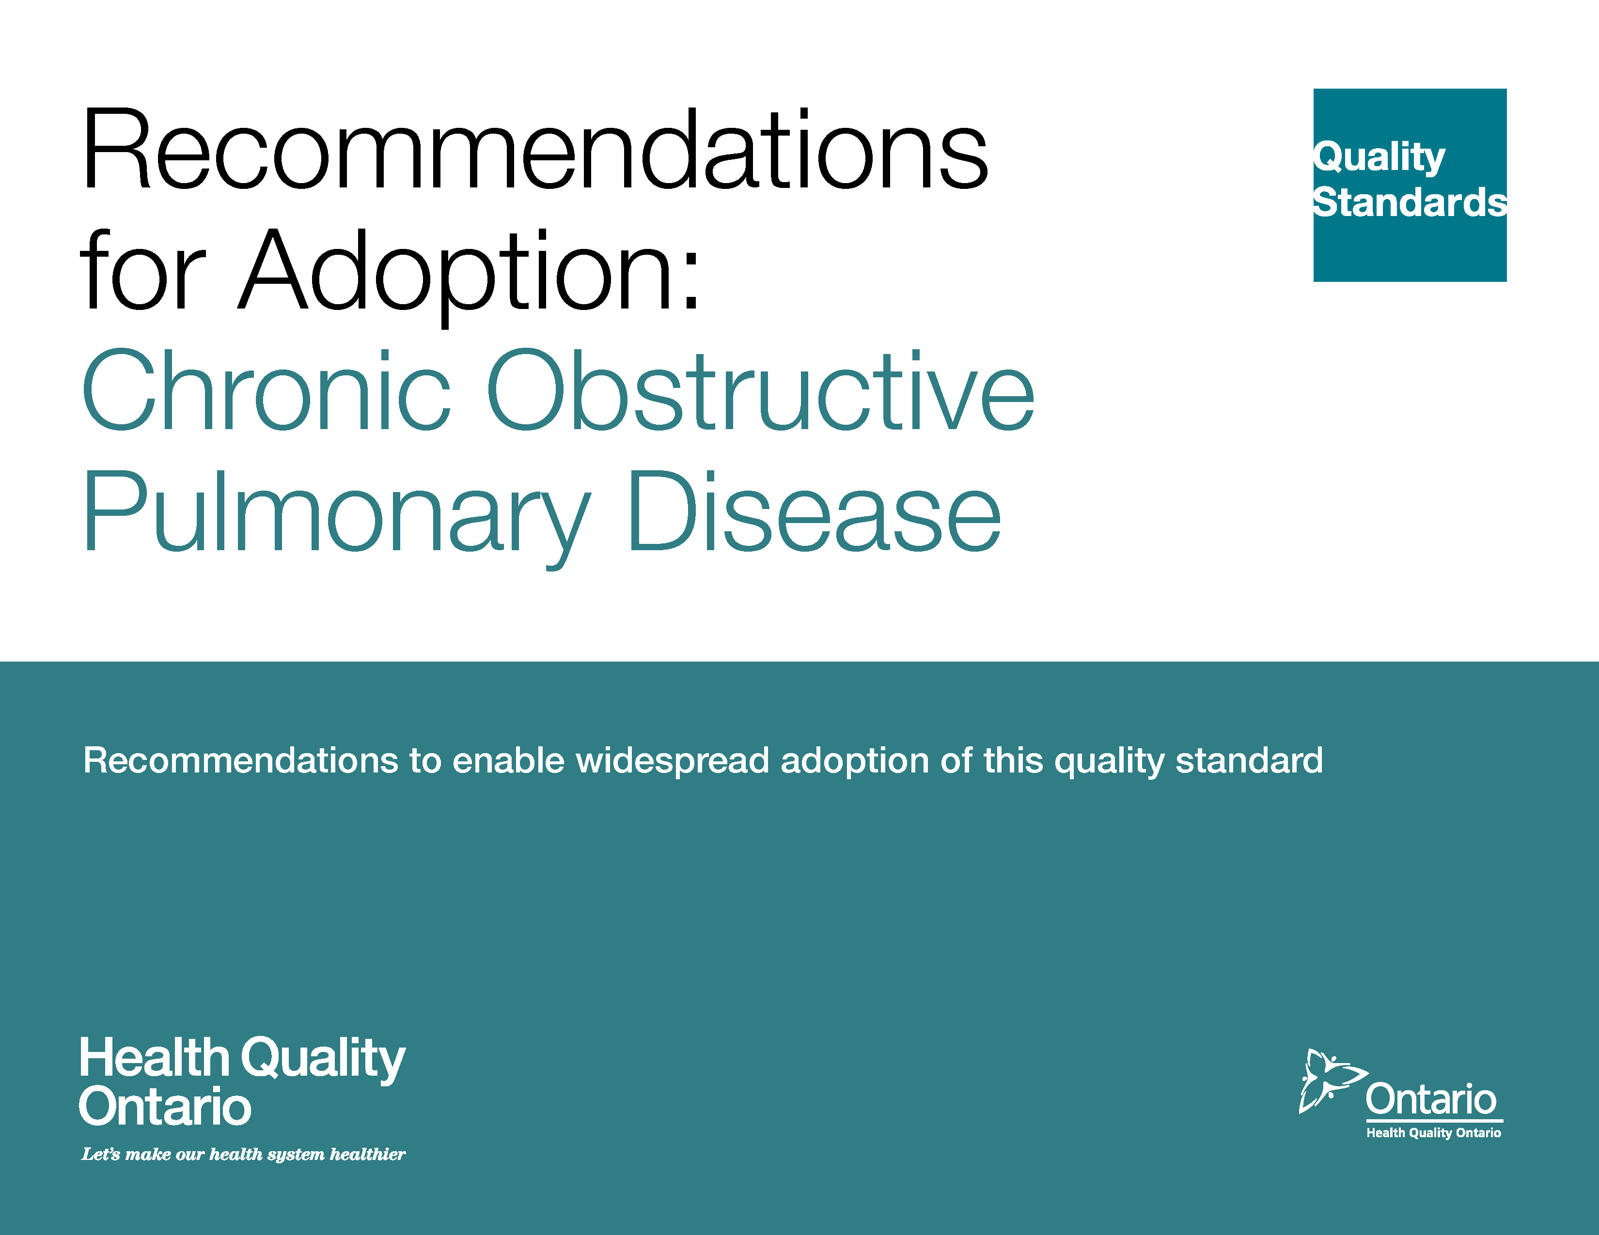
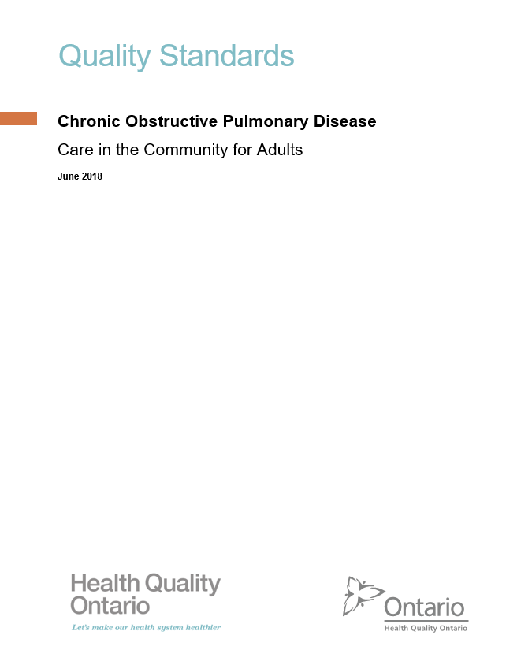
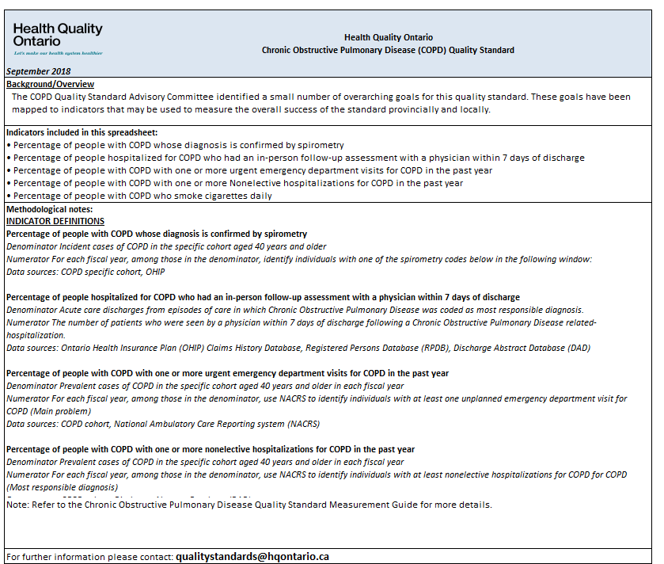
Quality Standards Resources
Quality Standard
Patient Reference Guide
Getting Started Guide
Recommendations for Adoption
Measurement Guide
Data Tables
Find these resources here:
https://www.hqontario.ca/Evidence-to-Improve-Care/Quality-Standards/View-all-Quality-Standards/Chronic-Obstructive-Pulmonary-Disease
Notes:
Each quality standard focuses on a specific health care issue. The development of each quality standard is accompanied by an assortment of resources.
Through concise, easy-to-understand statements, quality standards outline what quality care looks like for a condition or topic based on the evidence.
Each quality standard is accompanied by:
A patient reference guide
Recommendations for adoption
A getting started guide
Data tables
A measurement guide
Quality standards provide the blueprint to enable the health care system in Ontario to work better, facilitate smooth transitions, and ensure patients receive the same high-quality care, regardless of where they reside.

Slide 6
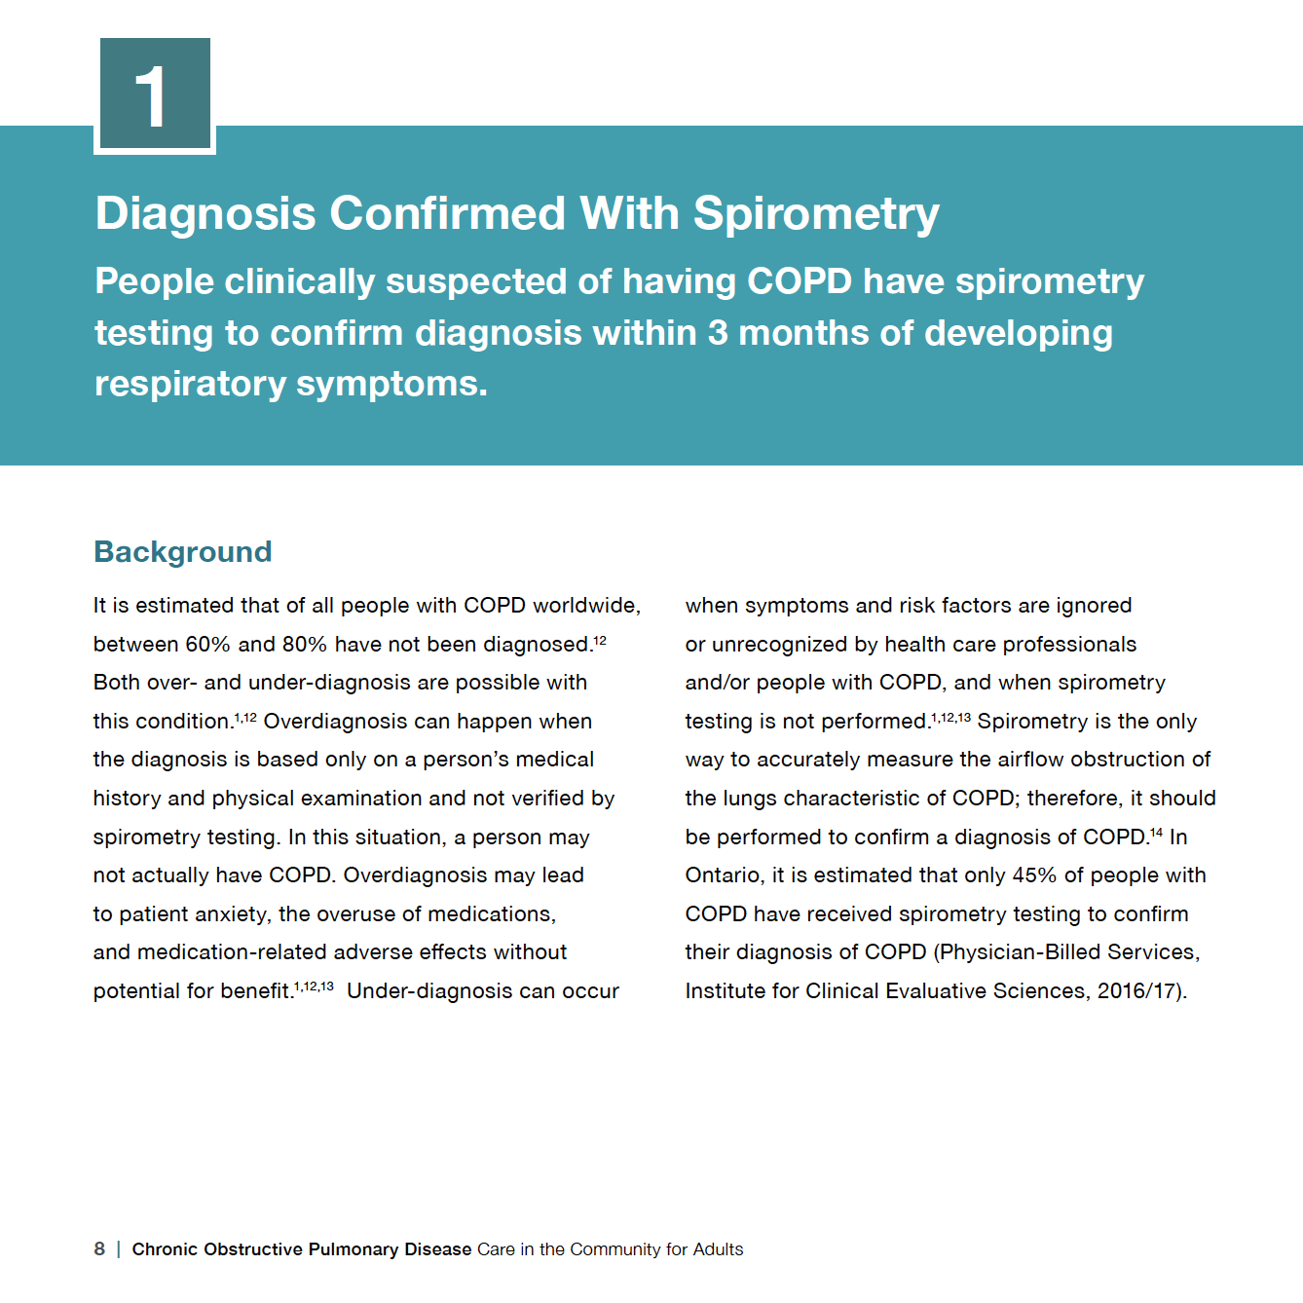
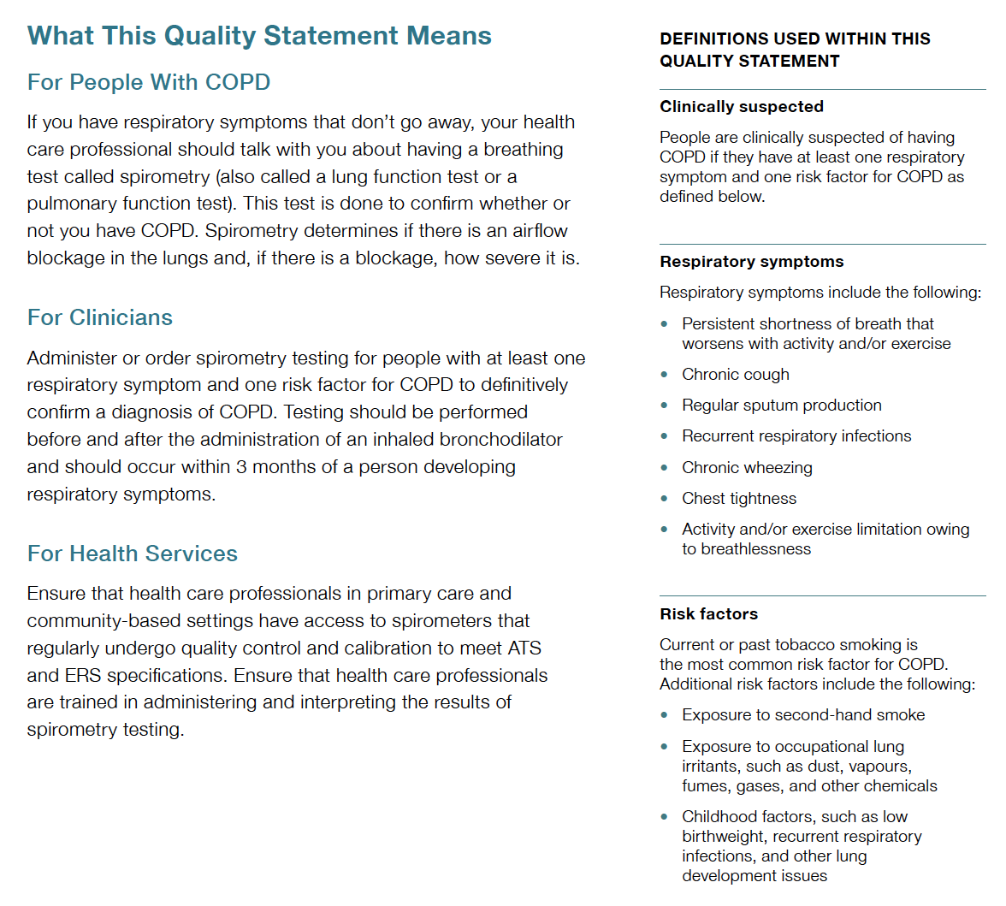
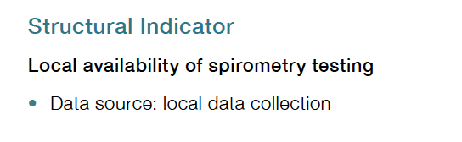
Inside the Quality Standard
Quality Statements
Audience Statements
Definitions
Quality Indicators

Slide 7
Quality Standards:
Patient Reference Guide
A plain language summary of the quality standard for patients, families, and caregivers to help them discuss their care with health care professionals.
Notes:
Every quality standard includes a plain language summary for patients, families, caregivers, and the public called the patient reference guide
Patient engagement in Quality Standards:
Membership on advisory committees
Focus groups and key informant interviews on topic specific content (when necessary)
Public comment period for each Quality Standard
Consultations on the Patient Reference Guide

Slide 8
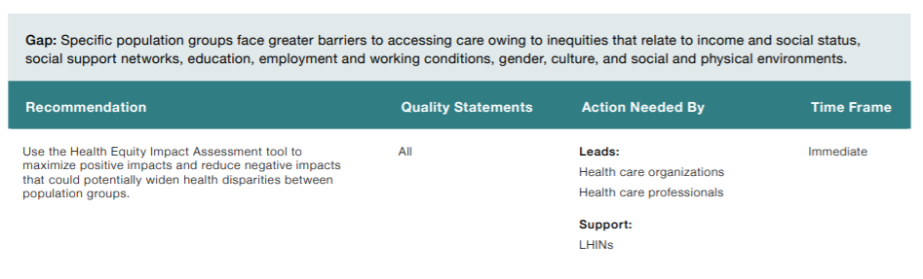
Quality Standards:
Recommendations for Adoption
Recommendations for policy makers, administrators, health care organizations, and professionals that aim to bridge the gaps between current care and care outlined in the quality statements to enable adoption of the quality standard across Ontario.
Notes:
As many aspects of the quality standard represent care that can and should be made available today, it is recognized that there are larger systemic barriers that may impede care delivery as per the standard. This document summarizes the system-wide and regional requirements that are needed to help health care professionals and organizations meet these standards and the time horizon expected to resolve these barriers.

Slide 9
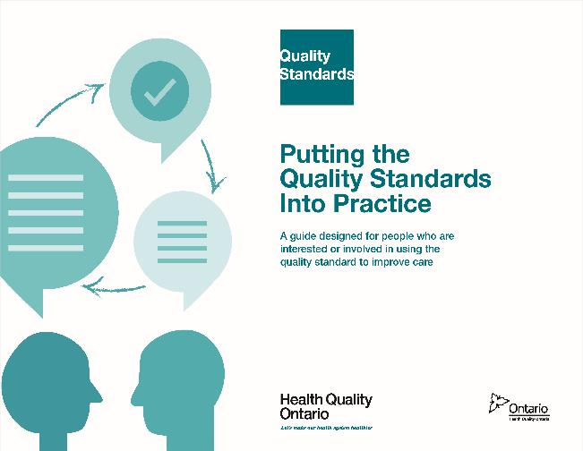
Quality Standards:
Implementation Tools
The Getting Started Guide:
Outlines the process for using the quality standard as a resource to deliver high-quality care
Contains evidence-based approaches, as well as useful tools and templates for implementing changes ideas at the practice level
Notes:
But again, there are things we can do today despite the larger systemic barriers that may take time to resolve. The getting started guide is a document that outlines a process for using the quality standards as a resource to deliver high-quality care. It compiles a number of resources to support adoption such as links to implementation and quality improvement resources, examples and activities for reflection as well as templates and documents to support the implementation planning activities. The getting started guide also includes an Action Plan Template and examples on how Quality Improvement Plans can help to advance quality standards.

Slide 10
Quality Standards:
Measurement Guide
The measurement guide has two dedicated sections:
Local measurement: what you can do to assess the quality of care that you provide locally
Provincial measurement: how we can measure the success of the quality standard on a provincial level

Slide 11
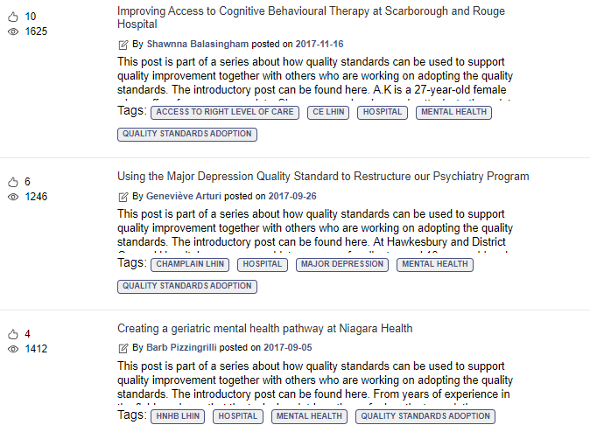
Quality Standards:
Quorum
Quorum is an online community dedicated to improving the quality of health care in Ontario.
The Quality Standards Adoption Series highlights efforts in the field to implement changes and close gaps in care related to quality standard topics.
Visit the Quality Standards Adoption Series on Quorum to learn how organizations are implementing quality standards.

Slide 12
Quality Standards:
Data Tables
Data tables can be used to examine variations in indicator results across the province. They include data on key indicators:
Over time for Ontario
Across regions in Ontario
For specific measures of equity (age, sex, rurality, and household income)

Slide 13
Why a Quality Standard for COPD in Ontario?

Slide 14







More than 1 in 10 people in Ontario have COPD
Source: Gershon AS, Mecredy GC, Ratnasingham S. Chronic obstructive pulmonary disease in Ontario, 1996/97 to 2014/15 [Internet]. Toronto (ON): Institute for Clinical Evaluative Sciences; 2017 [cited 2017 Oct 19]. Available from: https://www.ices.on.ca/Publications/Atlases-and-Reports/2017/COPD

Slide 15
The prevalence of COPD in Ontario varies across the province's regions
Prevalence of COPD among those age 35 years and older in Ontario, 2014/15
Source: COPD Cohort (Gershon et al.), ICES, 2010/11–2014/15.

Slide 16
COPD prevalence in Ontario is highest among those in lower-income neighbourhoods
Prevalence of COPD among those aged 35 years and older in Ontario, by neighbourhood income quintile, 2014/15
Source: COPD Cohort (Gershon et al.), ICES, 2010/11–2014/15.

Slide 17
In Ontario, COPD is the second-most common reason for hospitalization,
after childbirth
Source: Hospital Morbidity Database and Ontario Mental Health Reporting System, Canadian Institute for Health Information, 2014–2016.

Slide 18
Across regions in Ontario, there is wide variation in the percentage of people with COPD who were admitted to hospital for a complication of COPD
People with COPD who were hospitalized with a most responsible diagnosis of COPD, by LHIN Region, 2016/17
Note: Age- and sex-standardized rates. Based on Most Responsible Diagnosis of COPD.
Source: COPD Cohort (Gershon et al.), Discharge Abstract Database (DAD), provided by ICES.

Slide 19
Spirometry—a breathing test—is the only way to accurately diagnose COPD
In Ontario, it is estimated that only 45% of people with COPD receive spirometry testing to confirm their diagnosis
Note: Age- and sex-standardized rate.
Source: COPD Cohort (Gershon et al.), Physician Billed Services 2016/17, provided by ICES.

Slide 20
Across regions in Ontario, there is wide variation in the percentage of people with COPD who had a spirometry test to confirm their diagnosis
People with COPD who received a spirometry test to confirm diagnosis, by LHIN region, 2016/17
Note: Age- and sex-standardized rates.
Source: COPD Cohort (Gershon et al.), Physician Billed Services, provided by ICES.

Slide 21
People with COPD in low-income neighborhoods are less likely to have their condition confirmed through spirometry
People with COPD who received a spirometry test to confirm diagnosis, by income quintile, Ontario, 2016/17
Note: Age- and sex-standardized rates.
Source: COPD Cohort (Gershon et al.), Physician Billed Services, provided by ICES.

Slide 22
Past or current tobacco smoking is the most common risk factor for developing COPD
In 2016, 36% of people with COPD reported that they smoke daily or occasionally
Note: Based on self-report. To account for the CCHS sampling methodology, the smoking rates have been weighted using the CCHS survey weights.
Source: Canadian Community Health Survey, 2016. Provided by the Institute for Clinical Evaluative Sciences (ICES).

Slide 23
Quality Statements in Brief

Slide 24
Scope of the COPD Quality Standard
Addresses care for people with COPD, including the assessment of people who may have COPD.
Provides guidance on the diagnosis, management, and treatment of COPD in community-based settings.
Applies to primary care, specialist care, home care, and long-term care.
Does not address care provided in an emergency department or hospital inpatient setting for the management of acute exacerbations of COPD.
Notes:
Terminology used within the standard:
In this quality standard, the term “health care professional” is used to acknowledge the wide variety of providers who may be involved in the care of people with chronic pain. The term refers to physicians, nurse practitioners, nurses, dentists, pharmacists, and other allied health professionals involved in the assessment, monitoring, and treatment of chronic pain. The term “prescriber” refers to physicians, nurse practitioners, and dentists who are authorized to prescribe opioids.

Slide 25
COPD Quality Statement Topics
Diagnosis Confirmed With Spirometry
Comprehensive Assessment
Goals of Care and Individualized Care Planning
Education and Self-Management
Promoting Smoking Cessation
Pharmacological Management of Stable COPD
Vaccinations
Specialized Respiratory Care
Pulmonary Rehabilitation
Management of Acute Exacerbations of COPD
Follow-Up After Hospitalization for an Acute Exacerbation of COPD
Pulmonary Rehabilitation After Hospitalization for an Acute Exacerbation of COPD
Palliative Care
Long-Term Oxygen Therapy

Slide 26
Quality Statement 1: Diagnosis Confirmed with Spirometry
People clinically suspected of having COPD have spirometry testing to confirm diagnosis within
3 months of developing respiratory symptoms.
Notes:
For each quality statement, there is also:
Background information that include more details on the statement. For example, evidence to support the statement
What the quality statement means for people with COPD, for clinicians, and for health services
Definitions for terminology used within the statements
A set of quality indicators to measure implementation of quality statement

Slide 27
Quality Statement 2: Comprehensive Assessment
People with COPD have a comprehensive assessment to determine the degree of disability, risk of acute exacerbation, and presence of comorbidities near the time of diagnosis and on an annual basis. The severity of airflow limitation, as initially determined by spirometry testing to confirm diagnosis, is reassessed when people’s health status changes.

Slide 28
Quality Statement 3: Goals of Care and Individualized Care Planning
People with COPD discuss their goals of care with their future substitute decision-maker, their primary care provider, and other members of their interprofessional care team. These discussions inform individualized care planning, which is reviewed and updated regularly.

Slide 29
Quality Statement 4: Education and Self-Management
People with COPD and their caregivers receive verbal and written information about COPD from their health care professional and participate in interventions to support self-management, including the development of a written self-management plan.

Slide 30
Quality Statement 5: Promoting Smoking Cessation
People with COPD are asked about their tobacco-smoking status at every opportunity. Those who continue to smoke are offered pharmacological and nonpharmacological smoking cessation interventions.

Slide 31
Quality Statement 6: Pharmacological Management of Stable COPD
People with a confirmed diagnosis of COPD are offered individualized pharmacotherapy to improve symptoms and prevent acute exacerbations. Their medications are reviewed at least annually.

Slide 32
Quality Statement 7: Vaccinations
People with COPD are offered appropriate influenza and pneumococcal vaccinations.

Slide 33
Quality Statement 8: Specialized Respiratory Care
People with a confirmed diagnosis of COPD are referred to specialized respiratory care when clinically indicated, after receiving a comprehensive assessment and being offered treatment in primary care. This consultation occurs in accordance with the urgency of their health status.

Slide 34
Quality Statement 9: Pulmonary Rehabilitation
People with moderate to severe, stable COPD are referred to a pulmonary rehabilitation program if they have activity or exercise limitations and breathlessness despite appropriate pharmacological management.

Slide 35
Quality Statement 10: Management of Acute Exacerbations of COPD
People with COPD have access to their primary care provider or a health care professional in their care team within 24 hours of the onset of an acute exacerbation.

Slide 36
Quality Statement 11: Follow-Up After Hospitalization for an Acute Exacerbation of COPD
People with COPD who have been hospitalized for an acute exacerbation have an in-person follow-up assessment within 7 days after discharge.

Slide 37
Quality Statement 12: Pulmonary Rehabilitation After Hospitalization for an Acute Exacerbation of COPD
People who have been admitted to hospital for an acute exacerbation of COPD are considered for pulmonary rehabilitation at the time of discharge. Those who are referred to a pulmonary rehabilitation program start the program within 1 month of hospital discharge.

Slide 38
Quality Statement 13: Palliative Care
People with COPD and their caregivers are offered palliative care support to meet their needs.

Slide 39
Quality Statement 14: Long-Term Oxygen Therapy
People with stable COPD who have clinical indications of hypoxemia receive an assessment for and, if needed, treatment with long-term oxygen therapy.

Slide 40
How Success Can Be Measured Provincially
Process indicators
  Percentage of people with COPD whose diagnosis is confirmed by spirometry
  Percentage of people hospitalized for COPD who had an in-person follow-up assessment with a physician within 7 days of discharge
Outcome indicators
  Percentage of people with COPD with one or more urgent acute-care visits for COPD in the past year:
    Emergency department visits
    Nonelective hospitalizations
  Percentage of people with COPD who smoke cigarettes daily

Slide 41
Connect with us:
quorum.hqontario.ca/
© Queen’s Printer for Ontario, 2018

