Slide 1


Chronic Pain Quality Standard
Guiding evidence-based
care for people living with chronic pain in Ontario
Notes:
If you have any questions about the content of this presentation, please contact us at QualityStandards@hqontario.ca

Slide 2
Objectives
Overview of quality standards
What are they? How are they used?​
Why this quality standard is needed
Gaps and variations in quality of care for people living with chronic pain in Ontario
How success can be measured
Indicators that can help measure your quality improvement efforts
Quality statements in brief
The key statements in the Chronic Pain quality standard

Slide 3
Quality Standards
Inform clinicians and patients what quality care looks like
Focus on conditions where there are large variations in how care is delivered, or where there are gaps between the care provided in Ontario and the care patients should receive
Are grounded in the best available evidence
Notes:
Quality standards are a smaller set of high impact statements that describe optimal care where identified quality gaps exist in Ontario.
Voluntary and aspirational in nature​.
Designed to “raise the ceiling” with the goal of having the best possible care available to all Ontarians, regardless of where they live in the province.
There are many guidelines, professional standards, and other recommendations that contribute to the evidence ecosystem. Quality standards complement these resources.
Quality standards outline the what of care that should be delivered but are agnostic on who should be delivering it (unlike other CPGs, BPGs).
Quality standards are:
Concise: 5 to 15 strong, evidence-based statements focused on high priority areas for improvement.
Accessible: help clinicians and provider organizations offer the highest-quality care; and patients to know what to discuss with their care providers (compared with CPGs that are quite dense, these are very accessible, also written in plain language).
Measurable: each statement is accompanied by one or more quality indicators (structure, process, or outcome), with a set of outcome measures for the overall standard.
Implementable: quality improvement tools and resources support each standard, to fuel adoption.

Slide 4
Quality Standards
Help health care professionals know what care to offer, based on evidence and expert consensus
Help health care organizations measure, assess, and improve the quality of care they provide
Help ensure consistent,
high-quality care across the province
Help patients, residents, families, and caregivers know what to ask for in their care
Notes:
Patients, caregivers and the public can use quality standards to understand what excellent care looks like, what they should expect from their health care providers, and how to discuss the quality of their care.
Regions and disease agencies can use quality standards to measure health outcomes, hold health service providers accountable for delivering high-quality care, and inform regional improvement strategies.
Provider organizations can use quality standards to measure and audit their quality of care, identify gaps, guide organizational improvement strategies, and inform clinical program investments.
Health care professionals can use quality standards to evaluate their practice and identify areas for personal and organizational quality improvement, and can incorporate the evidence-based statements into professional education.
Government can use quality standards to identify provincial priority areas, inform new data collection and reporting initiatives, and design performance indicators and funding incentives.

Slide 5
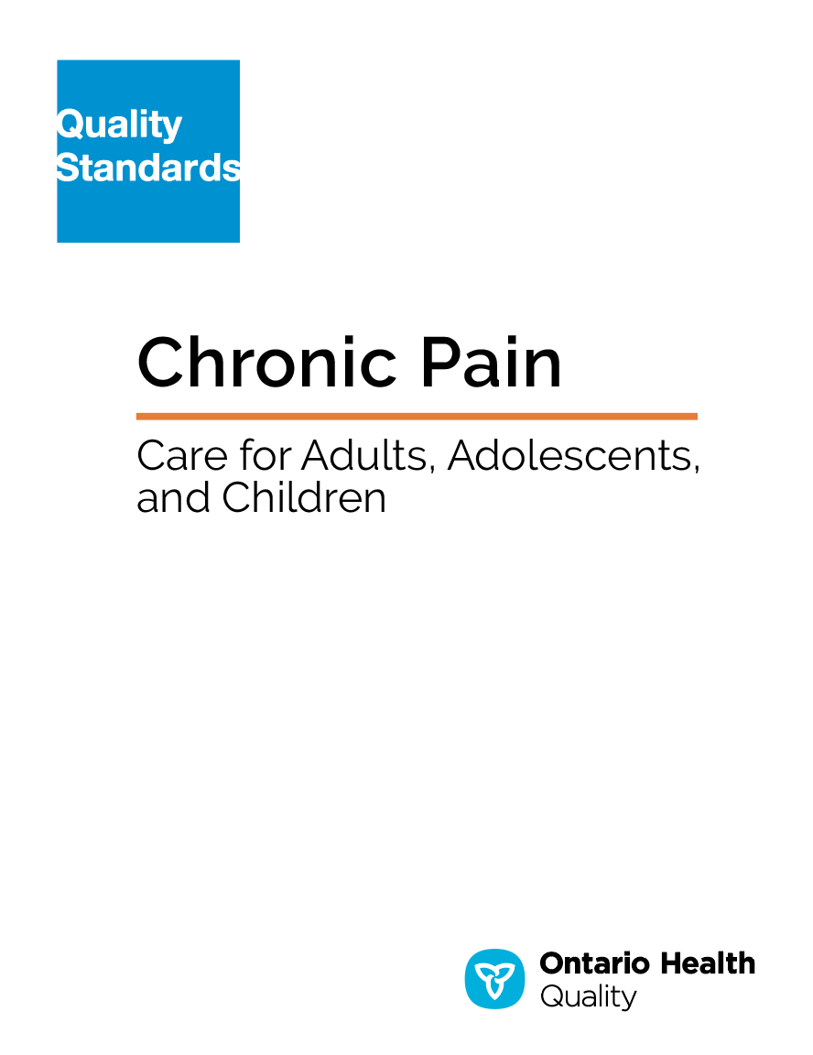
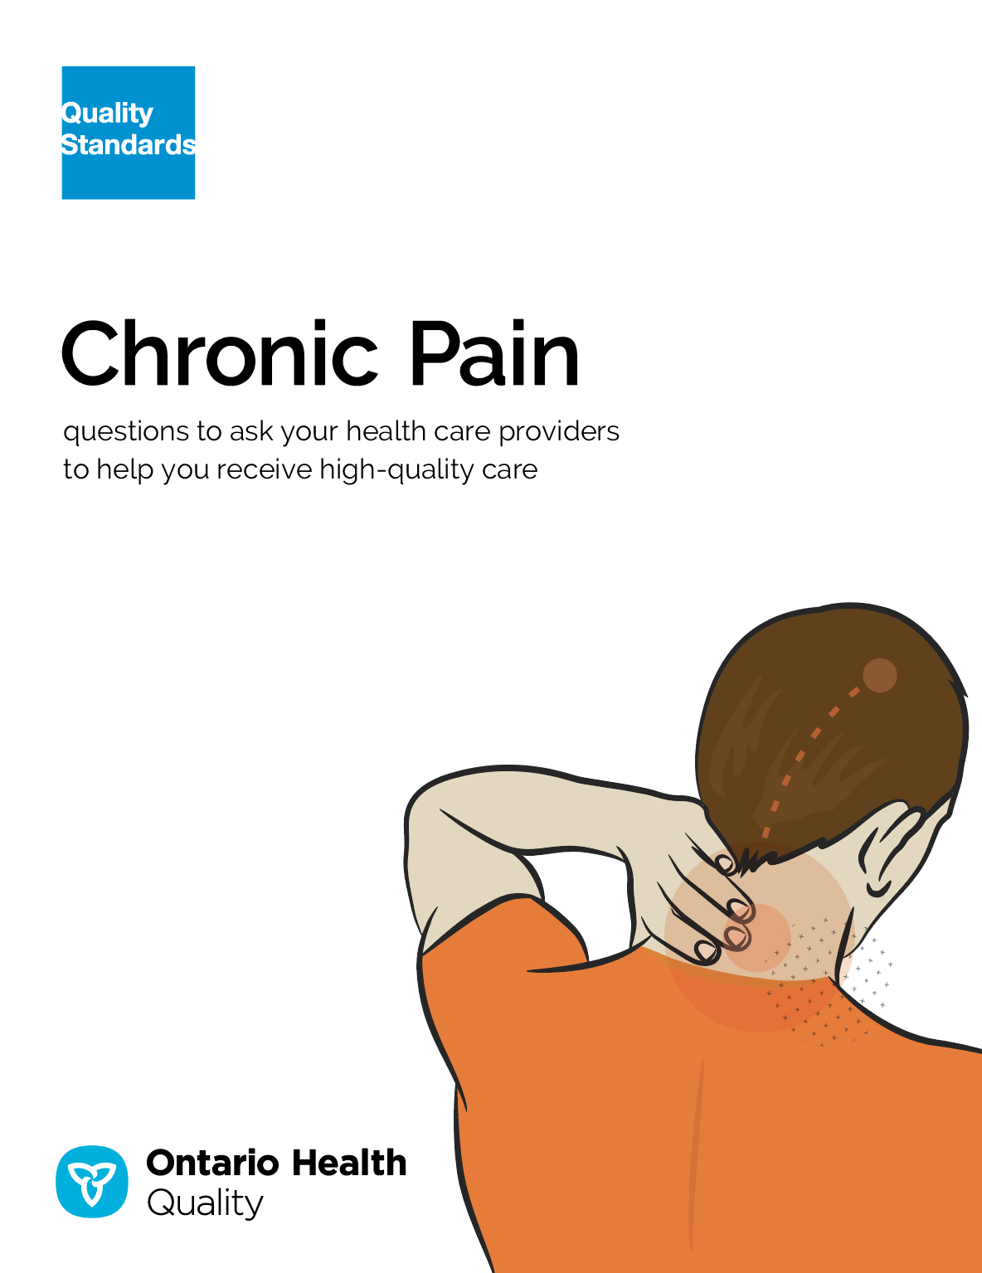
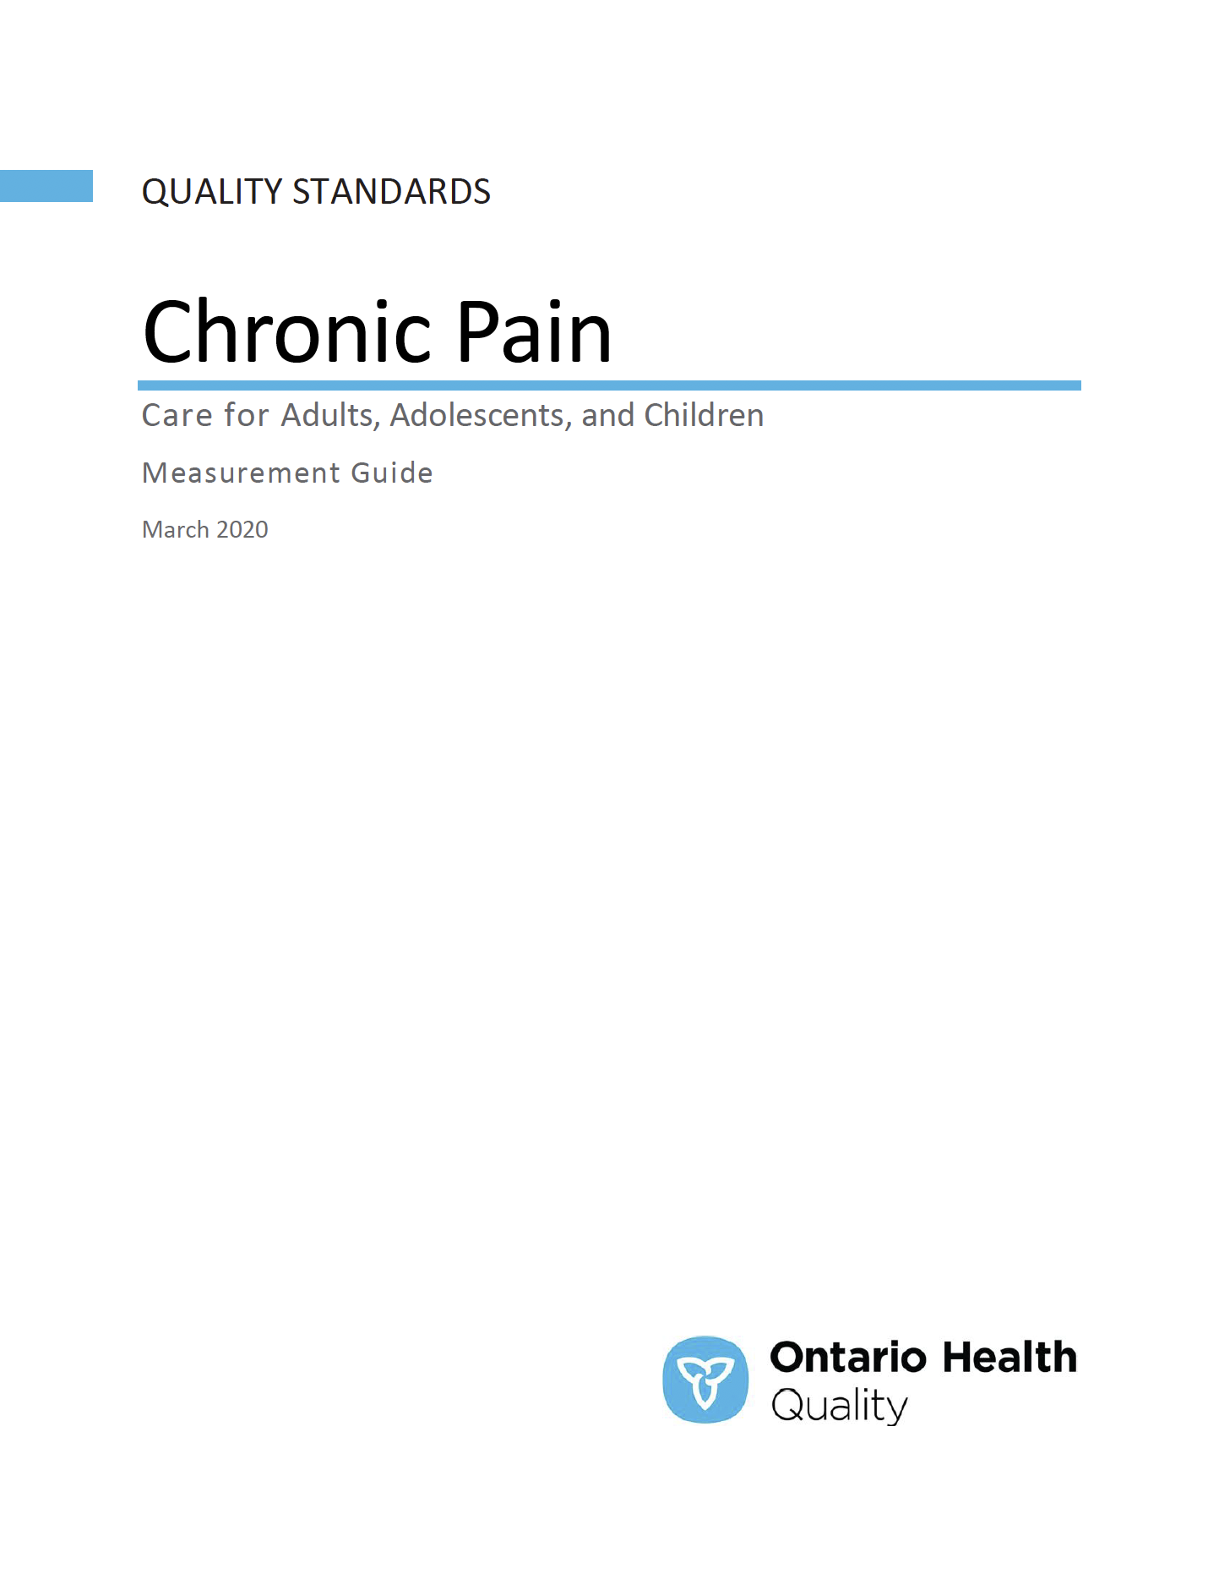
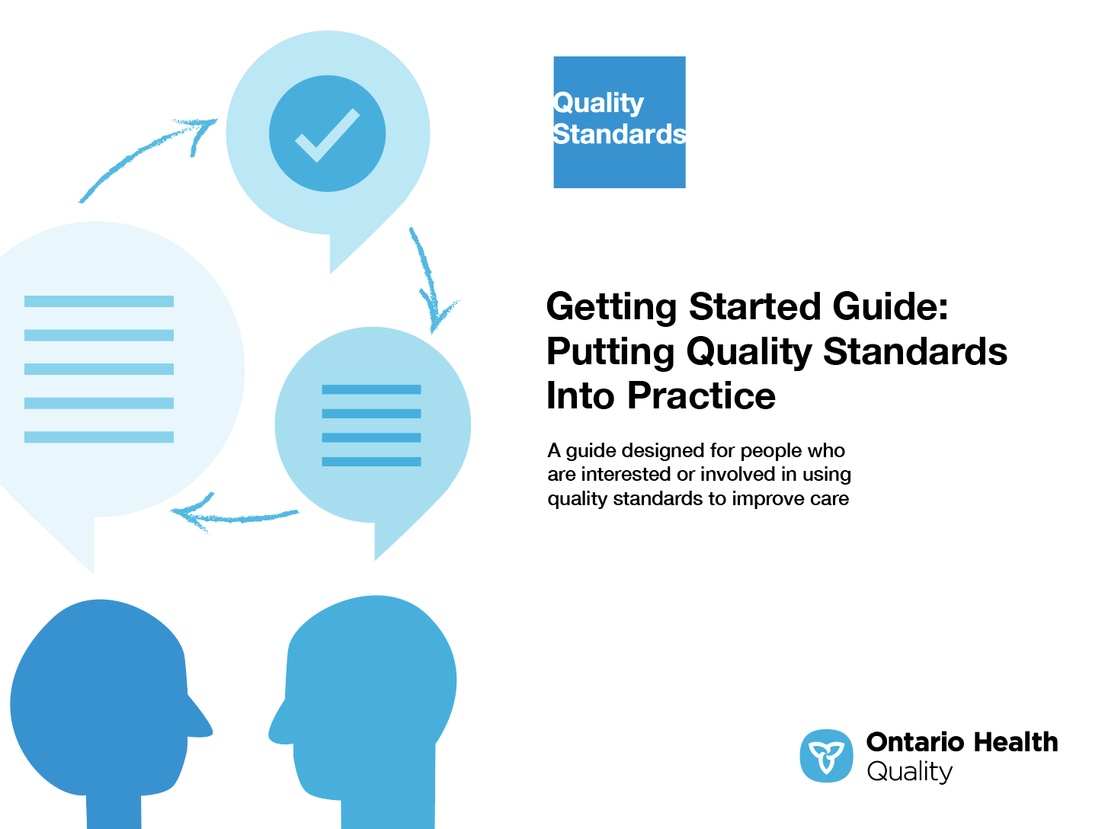
Quality Standard Resources
Quality Standard
Patient Conversation Guide
Getting Started Guide
Measurement Guide
Find these resources here:
https://hqontario.ca/Evidence-to-Improve-Care/Quality-Standards/View-all-Quality-Standards/Chronic-Pain
Notes:
Each quality standard focuses on a specific health care issue. The development of each quality standard is accompanied by an assortment of resources.
Through concise, easy-to-understand statements, quality standards outline what quality care looks like for a condition or topic based on the evidence.
Each quality standard is accompanied by:
A patient conversation guide
A getting started guide
A measurement guide
Quality standards provide the blueprint to enable the health care system in Ontario to work better, facilitate smooth transitions, and ensure patients receive the same high-quality care, regardless of where they reside.

Slide 6
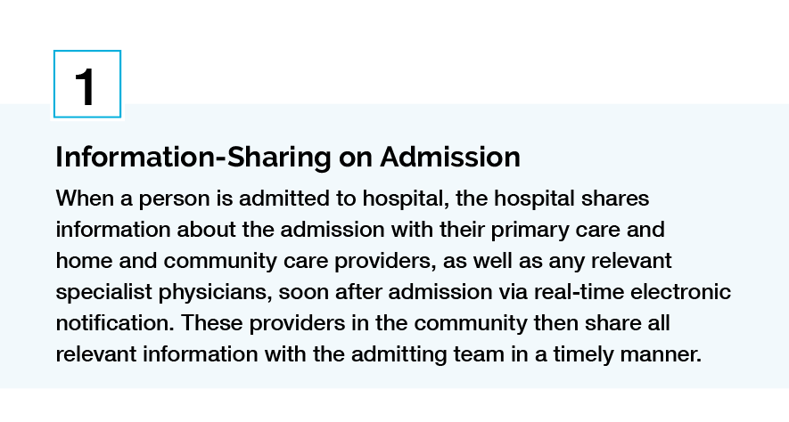
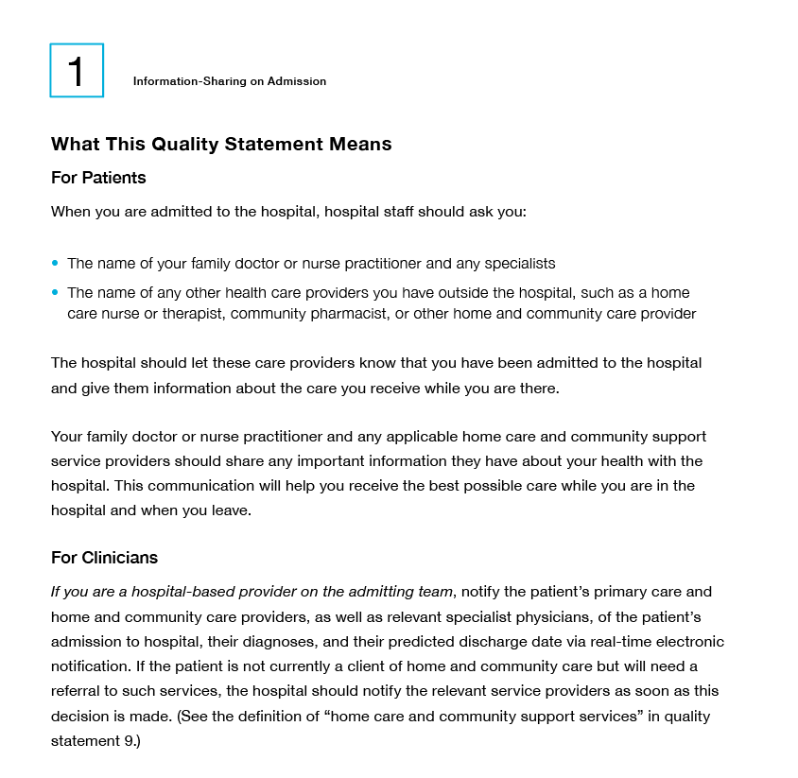
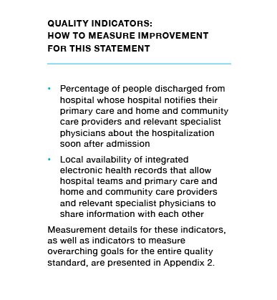
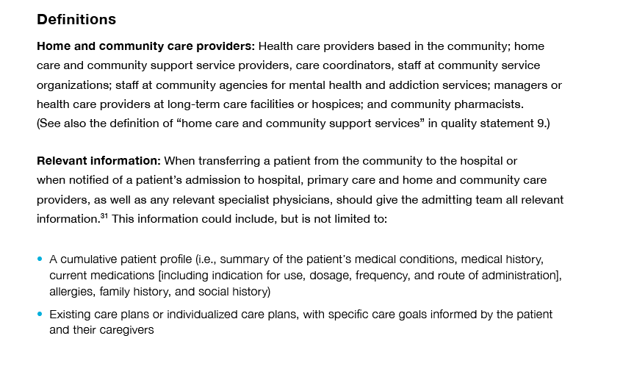
Inside the Quality Standard
The Statement
The Audience
Definitions
The Indicators
*Excerpts are from the Transitions between Hospital to Home quality standard

Slide 7
Quality Standards:
Patient Conversation Guide
The patient conversation guide is designed to give patients information about what quality care looks like for various conditions based on the best evidence, so they can ask informed questions of their health care providers.
Notes:
Every quality standard includes a plain language summary for patients, families, caregivers, and the public called the patient conversation guide.
Patient engagement in quality standards:
Membership on advisory committees
Focus groups and key informant interviews on topic specific content (when necessary)
Public comment period for each quality standard
Consultations on the patient conversation guide

Slide 8
Quality Standards:
How the Health Care System Can Support Implementation
Implementing quality standards can be challenging due to system-level barriers or gaps, many of which have been identified throughout the development of this standard. Ontario Health will work with and support other provincial partners, including Ministry of Health, to bridge system-level gaps to support the implementation of quality standards.

Slide 9
Quality Standards:
Implementation Tools
The Getting Started Guide:
Outlines the process for using the quality standard as a resource to deliver high-quality care
Contains evidence-based approaches, as well as useful tools and templates for implementing change ideas at the practice level
Notes:
There are things we can do today despite the larger systemic barriers that may take time to resolve. The Getting Started Guide is a document that outlines a process for using the quality standards as a resource to deliver high-quality care. It compiles a number of resources to support adoption, such as links to implementation and quality improvement resources, examples and activities for reflection, and templates and documents to support the implementation planning activities. The Getting Started Guide also includes an Action Plan Template and examples on how Quality Improvement Plans can help to advance quality standards.

Slide 10


Quality Standard Adoption Tools:
QUORUM
Quorum is an online community dedicated to improving the quality of health care in Ontario.
The Quality Standards Adoption Series highlights efforts in the field to implement changes and close gaps in care related to quality standard topics.
quorum.hqontario.ca
Notes:
The Quality Standards program has highlighted several stories from organizations and groups using various standards and statements within their clinical care settings, organization, or institutions; these are available through posts and discussions on Quorum.
As well, we are working on compiling resources and tools, for both clinicians and patients and families.
The focus is on implementation/adoption stories and how organizations are using quality standards in practice to inform care.
We’d love to hear from you if you are interested in contributing to a post or article.

Slide 11
Quality Standards:
Measurement Guide
The measurement guide has two dedicated sections:
Local measurement: what you can do to assess the quality of care that you provide locally
Provincial measurement: how we can measure the success of the quality standard on a provincial level

Slide 12
Why Do We Need a Quality Standard for Chronic Pain?
Notes:
The data presented in the following slides is for patients and caregivers with chronic pain.

Slide 13




1 in 5 people are affected by chronic pain
Source: Schopflocher, D., Taenzer, P., & Jovey, R. (2011). The prevalence of chronic pain in Canada. Pain research and management, 16(6), 445-450.
Notes:
In Canada, the prevalence of chronic pain was 18.9% for adults older than 18 years of age (Schopflocher et al., 2011)

Slide 14

Among those affected by chronic pain, the lower back was the most common site (22.3%) and arthritis was the most frequently named cause (36.2%)
Source: Schopflocher, D., Taenzer, P., & Jovey, R. (2011). The prevalence of chronic pain in Canada. Pain research and management, 16(6), 445-450.

Slide 15

Chronic pain has been associated with
• Depression
• Anxiety
• Loneliness
• Suicide ideation and attempts
Source: Ratcliffe, G. E., Enns, M. W., Belik, S. L., & Sareen, J. (2008). Chronic pain conditions and suicidal ideation and suicide attempts: an epidemiologic perspective. The Clinical journal of pain, 24(3), 204-210.

Slide 16

79% of Canadians without chronic pain reported flourishing mental health
(as opposed to moderate or languishing mental health)
The rate declined to 69% among Canadians with chronic pain
Source: Gilmour H. (2015). Chronic Pain, activity restriction and flourishing mental health. Health Reports; 26(1): 15-22

Slide 17



Among people with chronic pain, as pain intensity increased, prevalence with flourishing mental health decreased
73% reported flourishing mental health
68% reported flourishing mental health
59% reported flourishing mental health
Mild Pain
Moderate Pain
Severe Pain
Source: Gilmour H. (2015). Chronic Pain, activity restriction and flourishing mental health. Health Reports; 26(1): 15-22

Slide 18

Respondents with chronic pain reported having fair or poor mental health
3.2 times greater than respondents with no chronic pain
Source: Canadian Community Health Survey (CCHS), 2015 provided by Institute for Clinical Evaluative Sciences (ICES)
Notes:
Age and sex adjusted
Percentage of respondents who reported fair or poor mental health in 2015, Ontario, by chronic pain versus no chronic pain
13.2% of those with chronic pain reported fair or poor mental health
4.1% of those with no chronic pain reported fair or poor mental health

Slide 19

In Canada, chronic pain was estimated to consume approximately
5% ($7.2 billion) of the publicly funded health budget
Source: Hogan, M. E., Taddio, A., Katz, J., Shah, V., & Krahn, M. (2016). Incremental health care costs for chronic pain in Ontario, Canada: A population-based matched cohort study of adolescents and adults using administrative data. Pain, 157(8), 1626-1633.

Slide 20
In Ontario, when pain severity and the number of activity limitations increased, incremental costs also increased
Pain Severity
Activity Limitations From Pain
Source: Hogan, M. E., Taddio, A., Katz, J., Shah, V., & Krahn, M. (2016). Incremental health care costs for chronic pain in Ontario, Canada: A population-based matched cohort study of adolescents and adults using administrative data. Pain, 157(8), 1626-1633.

Slide 21
About one-half of those with chronic pain have suffered for more than 10 years
Source: Schopflocher, D., Taenzer, P., & Jovey, R. (2011). The prevalence of chronic pain in Canada.
Pain research and management, 16(6), 445-450.
Notes:
Respondents who reported a pain severity of 5 or more during their last episode.

Slide 22
In Ontario, patients with chronic pain had greater health care utilization
p < 0.01 for all comparisons
Source: Hogan, M. E., Taddio, A., Katz, J., Shah, V., & Krahn, M. (2016). Incremental health care costs for chronic pain in Ontario, Canada: A population-based matched cohort study of adolescents and adults using administrative data. Pain, 157(8), 1626-1633.

Slide 23
“The quality standard allows clinicians to focus on the chronic pain as a disease. It helps them to treat patients’ pain in an organized way, instead of just haphazardly trying to deal with it and potentially missing gentler methods to help the patient. The patient-focused guide helps people with chronic pain understand the process and know what to ask. With these tools, the physician and the patient create a plan, understand the plan, and deal with the plan as a team—it’s a time-saver for physicians and the patient. And there are better outcomes: there are measuring points and timelines to follow to ensure success. If this quality standard can be implemented and bought into, it will be a huge step forward.”
– Lutz Plotzke, Lived Experienced Advisor, Chronic Pain Quality Standard Advisory Committee

Slide 24
Quality Standard
in Brief

Slide 25
Scope of the Chronic Pain
Quality Standard
Chronic pain lasting longer than 3 months
Signs of serious underlying pathology or other treatable conditions requiring medical or surgical management have been ruled out
Adults, adolescents, and children, but excludes infants
Outpatient settings: primary care, community pain clinics, and interprofessional pain programs
Excludes: headache, pain from active cancer, pain experienced during end of life, and opioid prescribing

Slide 26
Chronic Pain Quality Statement Topics
Comprehensive Assessment
Setting Goals for Pain Management and Function
Supported Self-Management and Education
Physical Activity
Physically Based Interventions
Therapeutic Exercise
Pharmacotherapy
Psychologically Based Interventions
Psychosocial Supports
Interventional Management of Chronic Pain
Access and Referral to an Interprofessional Chronic Pain Program
Transitions and Coordination of Care

Slide 27
Quality Statement 1:
Comprehensive Assessment
People with chronic pain receive a comprehensive assessment that includes consideration of functional status and social determinants of health.
Notes:
Definitions Used Within This Quality Statement

Slide 28
Quality Statement 2:
Setting Goals for Pain Management and Function
People with chronic pain are encouraged to set goals for pain management and improved function. They regularly evaluate these goals with their health care professionals.
Notes:
Definitions Used Within This Quality Statement

Slide 29
Quality Statement 3:
Supported Self-Management and Education
People with chronic pain are offered education and are encouraged and supported to access self-management resources or programs as part of a long-term management strategy.
Notes:
Definitions Used Within This Quality Statement

Slide 30
Quality Statement 4:
Physical Activity
People with chronic pain are encouraged and supported to engage in regular physical activity.
Notes:
Definitions Used Within This Quality Statement

Slide 31
Quality Statement 5:
Physically Based interventions
People with chronic pain are encouraged and supported to engage in physically based interventions.
Notes:
Definitions Used Within This Quality Statement

Slide 32
Quality Statement 6:
Therapeutic Exercise
People with chronic pain are encouraged and supported to engage in therapeutic exercise.
Notes:
Definitions Used Within This Quality Statement

Slide 33
Quality Statement 7:
Pharmacotherapy
People with chronic pain are offered non-opioid pharmacotherapies as first-line treatment for chronic pain. Medications are regularly reviewed for effectiveness in meeting goals for pain management and improved function.
Notes:
Definitions Used Within This Quality Statement

Slide 34
Quality Statement 8:
Psychologically Based Interventions
People with chronic pain are offered psychological assessment and appropriate psychologically based interventions.
Notes:
Definitions Used Within This Quality Statement

Slide 35
Quality Statement 9:
Psychosocial Supports
People with chronic pain, their families, and their caregivers are offered psychosocial supports that consider their emotional, social, cultural, cognitive, accessibility, or spiritual needs. Psychosocial supports may include traditional knowledge, medicines, and healing practices for chronic pain, where appropriate.
Notes:
Definitions Used Within This Quality Statement

Slide 36
Quality Statement 10:
Interventional Management of Chronic Pain
People with chronic pain are offered interventional management, when clinically indicated, in combination with other strategies and interventions as part of an interprofessional approach to chronic pain management.
Notes:
Definitions Used Within This Statement

Slide 37
Quality Statement 11:
Access and Referral to an Interprofessional
Chronic Pain Program
People whose quality of life is significantly impacted by their chronic pain are referred by their primary care provider to an interprofessional pain program. They are seen for a first appointment within 3 months of referral.
Notes:
Definitions Used Within This Statement

Slide 38
Quality Statement 12:
Transitions and Coordination of Care
People with chronic pain receive timely and collaborative care during and after health care transitions.
Notes:
Definitions Used Within This Statement

Slide 39
There is no magic pill that will take away chronic pain. Helping people with chronic pain is a long-term joint effort between patient and provider, requiring communication and trust in order to set goals and develop a treatment plan. It can be rewarding for clinicians to watch their patients’ quality of life improve—a quality standard helps clinicians and patients work together toward this goal. ​
How people experience pain does not remain static, and how people describe their pain can change over time; as a result, care plans are constantly evolving to include different treatment strategies. The quality standard for chronic pain encourages clinicians to continually do a comprehensive pain assessment and reminds them of the importance of using multiple interventions for the management of pain, in addition to pharmacotherapy. ​
​ – Mona Sawhney, Chronic Pain Quality Standard Advisory Committee member

Slide 40
How to Measure Overall Success
Notes:
The Chronic Pain Quality Standard Advisory Committee identified a small number of overarching goals for this quality standard. These have been mapped to indicators that may be used to assess quality of care provincially and locally.

Slide 41
How Success Can Be Measured
We recommend that health care providers consider using the following indicators to measure the quality of care patients are receiving. These indicators cannot be measured provincially using currently available data sources and so rely on locally collected data:
Outcome indicators
Percentage of people with chronic pain who experience an improved quality of life
Percentage of people with chronic pain who experience improved functional status
Process indicators
Percentage of people with chronic pain who receive non-opioid pharmacotherapy as first-line pharmacological treatment
Notes:
In addition to the above provincially measurable indicators, each quality statement within this quality standard is accompanied by one or more indicators.
These indicators are intended to guide measurement of quality improvement efforts related to implementation of the statement.

Slide 42
Connect with us:
https://quorum.hqontario.ca

