Slide 1



Delirium
Quality Standard
Guiding evidence-based care for adults in Ontario
Notes:
If you have any questions about the content of this presentation, please contact us at QualityStandards@hqontario.ca

Slide 2
Objectives
Overview of quality standards
What are they? How are they used?​
Why this quality standard is needed
Gaps and variations in quality of care for people with delirium in Ontario
Quality statements to improve care
The key statements in the delirium quality standard
How to measure overall success
Indicators that can help measure your quality improvement efforts

Slide 3
Quality Standards
Inform clinicians and patients what quality care looks like
Focus on conditions or processes where there are large variations in how care is delivered, or where there are gaps between the care provided in Ontario and the care patients should receive
Are grounded in the best available evidence
Notes:
Quality standards are a smaller set of high-impact statements that describe optimal care where identified quality gaps exist in Ontario.
Voluntary and aspirational in nature​.
Designed to “raise the ceiling” with the goal of having the best possible care available to all Ontarians, regardless of where they live in the province.
There are many guidelines, professional standards, and other recommendations that contribute to the evidence ecosystem. Quality standards complement these resources.
Quality standards outline the what of care that should be delivered but are agnostic on who should be delivering it (unlike other CPGs, BPGs).
Quality standards are:
Concise: 5 to 15 strong, evidence-based statements focused on high priority areas for improvement.
Accessible: help clinicians and provider organizations offer the highest-quality care; and patients to know what to discuss with their care providers (compared with CPGs that are quite dense, these are very accessible, also written in plain language).
Measurable: each statement is accompanied by one or more quality indicators (structure, process or outcome), with a set of outcome measures for the overall standard.
Implementable: quality improvement tools and resources support each standard, to fuel adoption.

Slide 4
Quality Standards
Help health care professionals know what care to offer, based on evidence and expert consensus
Help health care organizations measure, assess, and improve the quality of care they provide
Help ensure consistent,
high-quality care across the province
Help patients, residents, families, and caregivers know what to ask for in their care
Notes:
Patients, caregivers and the public can use quality standards to understand what excellent care looks like, what they should expect from their health care providers, and how to discuss the quality of their care.
Provincial regions and disease agencies can use quality standards to measure health outcomes, hold health service providers accountable for delivering high-quality care, and inform regional improvement strategies.
Provider organizations can use quality standards to measure and audit their quality of care, identify gaps, guide organizational improvement strategies, and inform clinical program investments.
Health care professionals can use quality standards to evaluate their practice and identify areas for personal and organizational quality improvement, and can incorporate the evidence-based statements into professional education.
Government can use quality standards to identify provincial priority areas, inform new data collection and reporting initiatives, and design performance indicators and funding incentives.

Slide 5
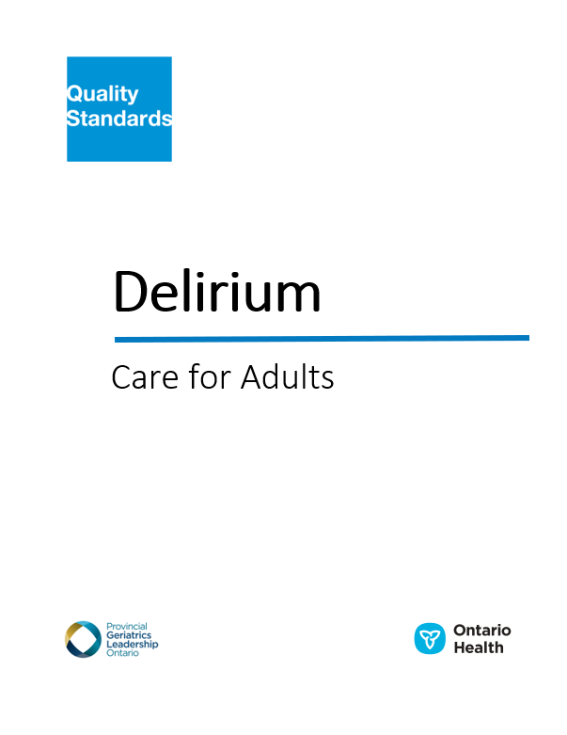
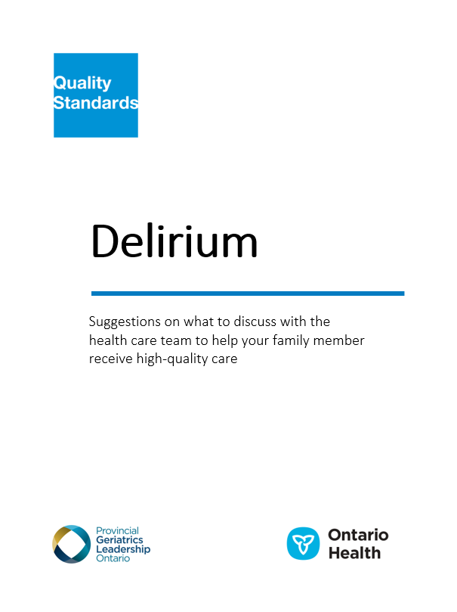
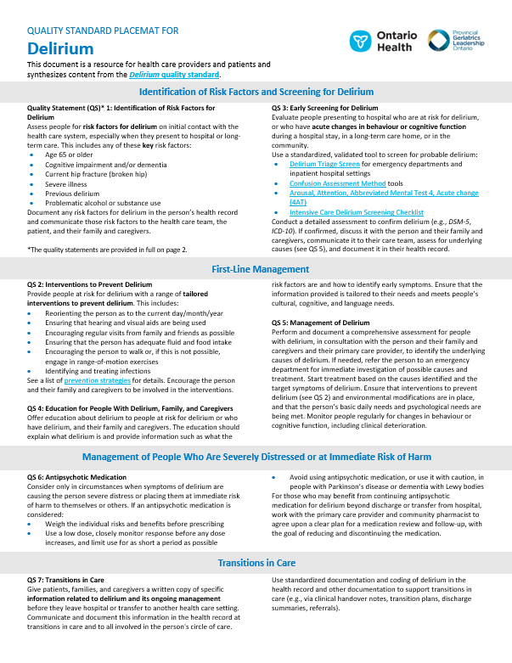
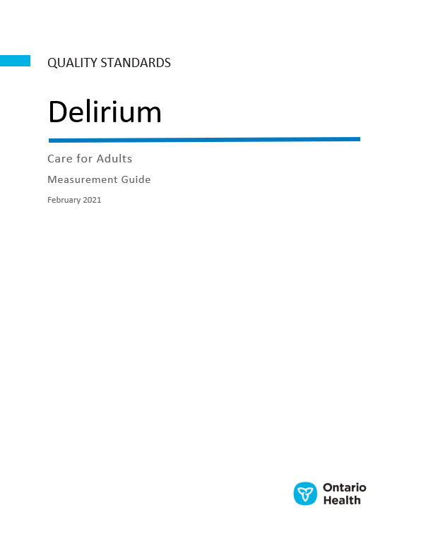
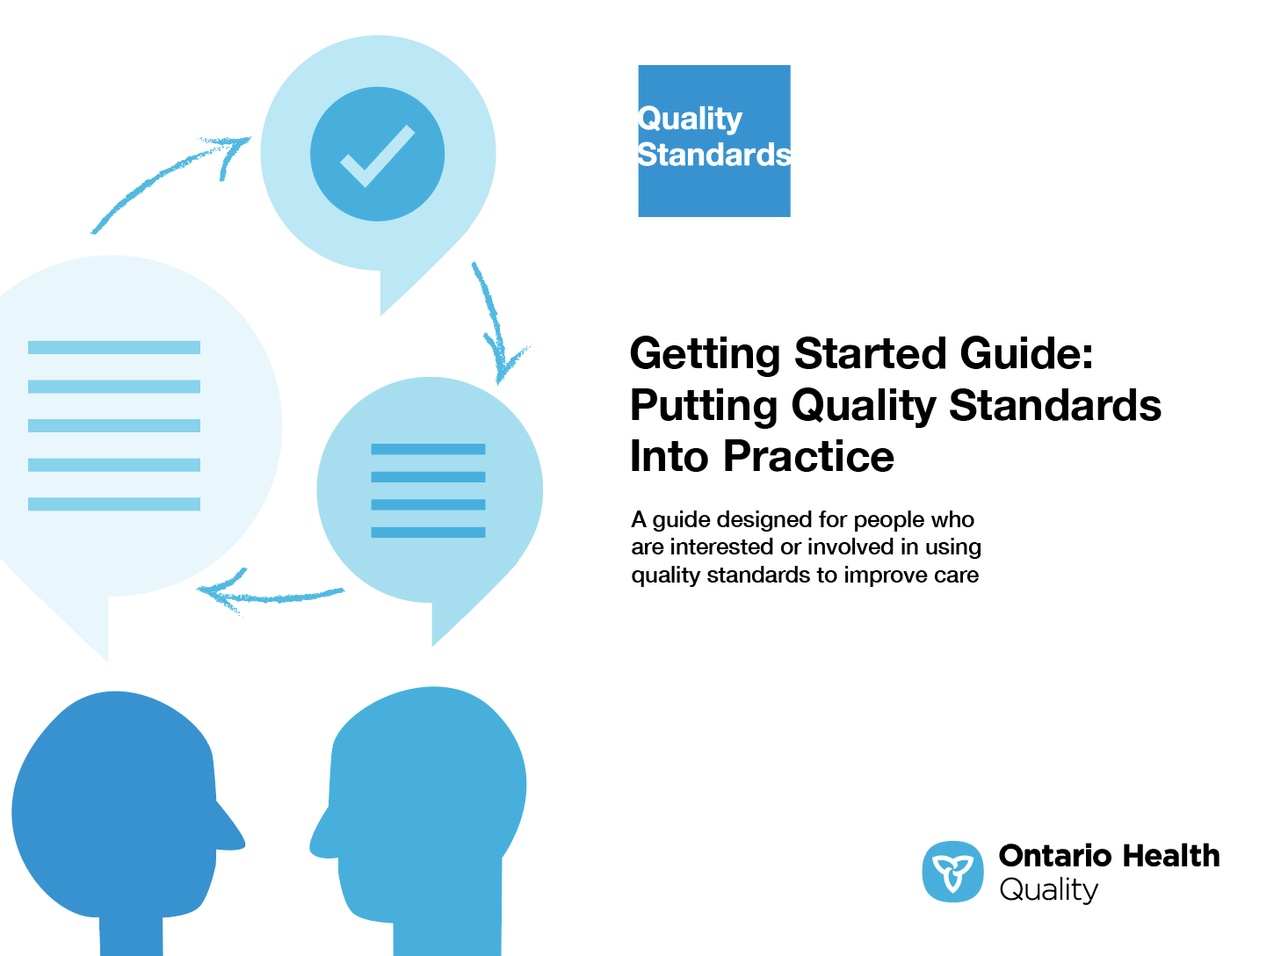
Quality Standard Resources
Quality Standard
Patient Guide
Placemat
Getting Started Guide
Measurement Guide
Find these resources here:
https://www.hqontario.ca/evidence-to-improve-care/quality-standards/view-all-quality-standards/delirium
Notes:
Each quality standard focuses on a specific health care issue. The development of each quality standard is accompanied by an assortment of resources.
Through concise, easy-to-understand statements, quality standards outline what quality care looks like for a condition or topic based on the evidence.
Each quality standard is accompanied by:
A patient conversation guide
A getting started guide
A measurement guide
Quality standards provide the blueprint to enable the health care system in Ontario to work better, facilitate smooth transitions, and ensure patients receive the same high-quality care, regardless of where they reside.

Slide 6
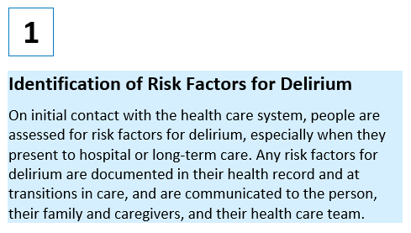
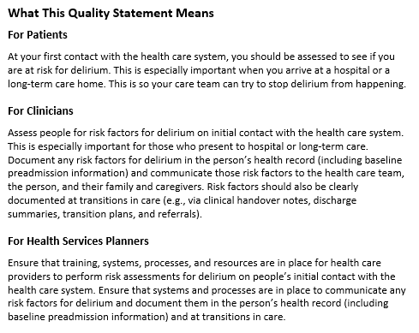
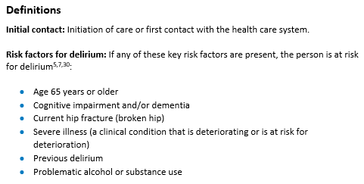
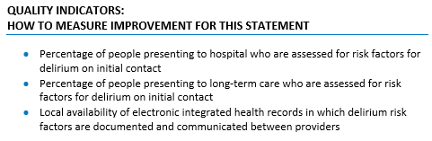
Inside the Quality Standard
The Quality Statement
The Audience Statements
The Definitions
The Indicators

Slide 7
Quality Standards:
Patient Guide
The patient guide is designed to give patients information about what quality care looks like for various conditions based on the best evidence, so they can ask informed questions of their health care providers.
Notes:
Every quality standard includes a plain language summary for patients, families, caregivers and the public called the patient conversation guide.
Patient engagement in quality standards:
Membership on advisory committees
Focus groups and key informant interviews on topic-specific content (when necessary)
Public comment period for each quality standard
Consultations on the patient conversation guide

Slide 8
Quality Standards:
How the Health Care System Can Support Implementation
Implementing quality standards can be challenging due to system-level barriers or gaps, many of which have been identified throughout the development of this standard. Ontario Health will work with and support other provincial partners, including the Ministry of Health, to bridge system-level gaps to support the implementation of quality standards.

Slide 9
Quality Standards:
Implementation Tools
The Getting Started Guide:
Outlines the process for using the quality standard as a resource to deliver high-quality care
Contains evidence-based approaches, as well as useful tools and templates for implementing change ideas at the practice level
Notes:
There are things we can do today despite the larger systemic barriers that may take time to resolve. The Getting Started Guide is a document that outlines a process for using the quality standards as a resource to deliver high-quality care. It compiles a number of resources to support adoption, such as links to implementation and quality improvement resources, examples and activities for reflection, and templates and documents to support the implementation planning activities. The Getting Started Guide also includes an Action Plan Template and examples of how Quality Improvement Plans can help to advance quality standards.

Slide 10

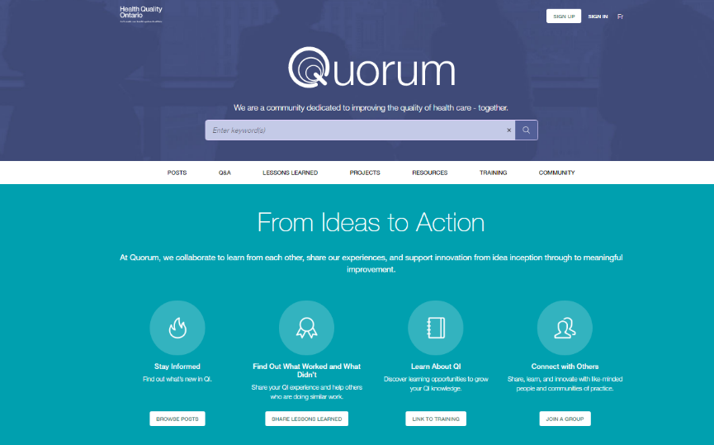
Quality Standard Adoption Tools:
QUORUM
Quorum is an online community dedicated to improving the quality of health care in Ontario.
The Quality Standards Adoption Series highlights efforts in the field to implement changes and close gaps in care related to quality standard topics.
quorum.hqontario.ca
Notes:
The Quality Standards program has highlighted several stories from organizations and groups using various standards and statements within their clinical care settings, organization, or institutions; these are available through posts and discussions on Quorum.
As well, we are working on compiling resources and tools, for both clinicians and patients and families.
The focus is on implementation/adoption stories and how organizations are using quality standards in practice to inform care.
We’d love to hear from you if you are interested in contributing to a post or article.

Slide 11
Quality Standards:
Measurement Guide
The measurement guide has two dedicated sections:
Local measurement: what you can do to assess the quality of care that you provide locally
Provincial measurement: how we can measure the success of the quality standard on a provincial level

Slide 12
Why Do We Need a
Quality Standard for
Delirium?

Slide 13
What Is Delirium?
Delirium is an acute disorder of attention, awareness, and altered mental status.¹ It develops over a short period of time (usually hours to a few days) and tends to fluctuate in severity during the course of a day.¹
Other key clinical features of delirium include disorganized thinking, altered level of consciousness, disorientation, memory impairment, perceptual disturbances (illusions or hallucinations) and delusions, increased or decreased psychomotor activity, and disturbance of the sleep–wake cycle.²
Sources:
¹American Psychiatric Association. Diagnostic and statistical manual of mental disorders. 5th ed. Arlington (VA): The Association; 2013.
²Inouye SK, van Dyck CH, Alessi CA, Balkin S, Siegal AP, Horwitz RI. Clarifying confusion: the confusion assessment method. A new method for detection of delirium. Ann Intern Med. 1990;113(12):941-8.

Slide 14
Who Is at Risk for Delirium?
Key risk factors for delirium include^{1,2}:
  Age 65 years or older
  Cognitive impairment and/or dementia
  Current hip fracture (broken hip)
  Severe illness (a clinical condition that is deteriorating or is at risk for deterioration)
  Previous delirium
  Problematic alcohol or substance use
Sources:
¹National Institute for Health and Care Excellence. Delirium: prevention, diagnosis and management [Internet]. London (UK): The Institute; 2019 [cited 2019 Aug]. Available from: https://www.nice.org.uk/guidance/cg103
²Registered Nurses’ Association of Ontario. Delirium, dementia, and depression in older adults: assessment and care [Internet].
Toronto (ON): The Association; 2016 [cited 2019 Aug]. Available from: https://rnao.ca/sites/rnao-ca/files/bpg/RNAO_Delirium_Dementia_Depression_Older_Adults_Assessment_and_Care.pdf

Slide 15
Delirium is very common in older people in the hospital setting, with overall occurrence rates ranging from
29% to 64%.¹
Prevalence in the community is lower
(1% to 2%) but usually requires emergency care.¹
Settings with the highest incidence rates^{1,2}
Setting | Incidence Rates
Palliative care | 42% to 88%
Intensive care | 19% to 82%
Post-surgical care | 11% to 51%
Long-term care or post-acute care | 20% to 22%
Older people who present to emergency department | 8% to 17%
Sources:
¹Inouye SK, Westendorp RG, Saczynski JS. Delirium in elderly people. Lancet. 2014;383(9920):911-22.
²Watt CL, Momoli F, Ansari MT, Sikora L, Bush SH, Hosie A, et al. The incidence and prevalence of delirium across palliative care settings:
a systematic review. Palliat Med. 2019;33(8):865-77.

Slide 16



Delirium has been identified as the third most common harmful event experienced by people admitted to Canadian hospitals.¹
It has also been associated with:
Increased mortality across settings²
Increased hospital stay²
Increased placement in long-term care after hospitalization²
Sources:
¹Chan B, Cochrane D. Measuring patient harm in Canadian hospitals. What can be done to improve patient safety?
Ottawa (ON): Canadian Institute for Health Information, Canadian Patient Safety Institute; 2016.
²Inouye SK, Westendorp RG, Saczynski JS. Delirium in elderly people. Lancet. 2014;383(9920):911-22.

Slide 17

Delirium is often unrecognized, misdiagnosed as another disorder, or misattributed to dementia.¹ It is recognized in only one-third of cases.² However, early identification of risk factors is important because delirium can be prevented in 30% to 40% of cases.³
Sources:
¹Inouye SK, van Dyck CH, Alessi CA, Balkin S, Siegal AP, Horwitz RI. Clarifying confusion: the confusion assessment method. A new method for detection of delirium. Ann Intern Med. 1990;113(12):941-8.
²Oh ES, Fong TG, Hshieh TT, Inouye SK. Delirium in older persons: advances in diagnosis and treatment. J Am Med Assoc. 2017;318(12):1161-74.
³Inouye SK, Westendorp RG, Saczynski JS. Delirium in elderly people. Lancet. 2014;383(9920):911-22.

Slide 18
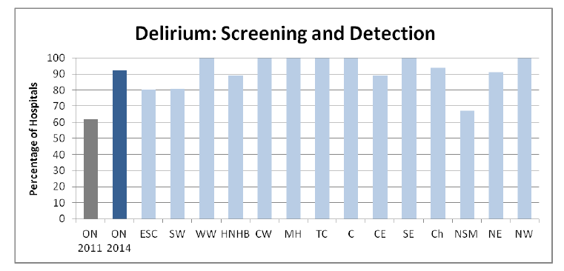
In 2014, 92% of participating Ontario hospitals (n = 135) reported delirium screening and detection processes, an increase from 62% in 2011.
Source: Wong K, Tsang A, Liu B. Update on senior friendly hospital care in Ontario [Internet]. Toronto (ON): Regional Geriatric Program of Toronto;
2015 [updated 2018; cited 2018 Jul 24]. Reproduced with permission from: https://www.rgptoronto.ca/wp-content/uploads/2017/12/SFH_Care_in_Ontario_2015.pdf
Notes:
The Senior Friendly Hospital Strategy in Ontario has identified improvements in practices related to delirium, but also some variation in the spread of these practices within and among participating Ontario hospitals (135 hospitals across the province) (Wong et al, 2018). As part of a broader strategy to improve the care of older adults who are hospitalized, the Senior Friendly Care (sfCare) Framework has been supporting best practices related to delirium (e.g., Senior Friendly Care: SF7 toolkit). Following the implementation of the sfCare Framework, the percentage of participating hospitals reporting delirium screening and detection practices increased from 62% in 2011 to 92% in 2014 (Wong et al, 2018).

Slide 19
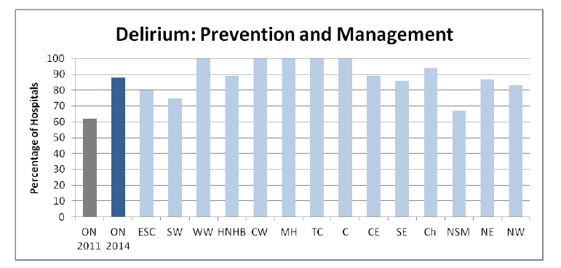
In 2014, 88% of participating Ontario hospitals (n = 135) reported delirium prevention and management procedures, an increase from 62% in 2011.
Source: Wong K, Tsang A, Liu B. Update on senior friendly hospital care in Ontario [Internet]. Toronto (ON): Regional Geriatric Program of Toronto; 2015 [updated 2018; cited 2018 Jul 24]. Reproduced with permission from: https://www.rgptoronto.ca/wp-content/uploads/2017/12/SFH_Care_in_Ontario_2015.pdf
Notes:
Similarly, following the implementation of the sfCare Framework (as described in the previous slide), the percentage of participating hospitals reporting delirium prevention and management strategies increased from 62% in 2011 to 88% in 2014 (Wong et al, 2018).

Slide 20
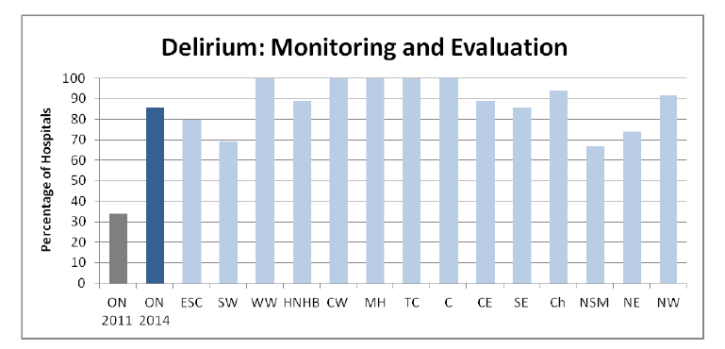
In 2014, 86% of participating Ontario hospitals (n = 135) reported monitoring and evaluating delirium practices, an increase from 34% in 2011.
Source: Wong K, Tsang A, Liu B. Update on senior friendly hospital care in Ontario [Internet]. Toronto (ON): Regional Geriatric Program of Toronto; 2015 [updated 2018; cited 2018 Jul 24]. Reproduced with permission from: https://www.rgptoronto.ca/wp-content/uploads/2017/12/SFH_Care_in_Ontario_2015.pdf
Notes:
Similarly, following the implementation of the sfCare Framework (as described in the previous slides), the percentage of participating hospitals reporting engaging in delirium monitoring and evaluation practices increased from 34% in 2011 to 86% in 2014 (Wong et al, 2018).

Slide 21
There was a 47% increase in the number of inpatient admissions with documented delirium between 2014/15 and 2019/20. In 2019/20,
8% of all hospital admissions among people aged 65 and over included documented delirium.
Source: Discharge Abstract Database 2014/15–2019/20, Ontario Ministry of Health and Long-Term Care, IntelliHealth Ontario.

Slide 22
In 2019/20, in 49% of all hospital admissions with documented delirium, delirium presented prior to admission, whereas in 27%, delirium presented after admission or as a complication of admission.
Source: Discharge Abstract Database 2019/20, Ontario Ministry of Health and Long-Term Care, IntelliHEALTH ONTARIO

Slide 23
In 2019/20, the rate of people with documented delirium during their hospital stay was highest in the North East and Erie St. Clair regions and lowest in the North West and Waterloo Wellington regions.
Source: Discharge Abstract Database 2017/18 to 2019/20, Ontario Ministry of Health and Long-Term Care, IntelliHealth Ontario. Statistics Canada estimates of population (2016 census and administrative data), by age group and sex for July 1, Canada, provinces, territories, health regions (2018 boundaries) and peer groups. Table 17-10-0134-01.

Slide 24
“My husband was discharged home after a week in the ICU, and he soon became very disoriented and agitated, with some periods of lucidity. It was extremely frightening for both of us, and I wasn’t sure how to help him. We eventually found out that he was very dehydrated, which led to his symptoms of delirium. When he was discharged, he was still quite frail, and we didn’t receive any information on strategies for delirium prevention, which I’m sure would have helped both of us.
With this experience, I can see how the Delirium quality standard would be very helpful. All of the statements are interrelated and are important to guide patient care. My biggest hope is that the quality standard is applied in everyday practice to support patients, families, and caregivers—in whichever setting or region across Ontario they are from. Education and preparedness are extremely valuable for patients and caregivers.”
– Nicole Lafrenière-Davis, Lived Experience Advisor,
Delirium Quality Standard Advisory Committee

Slide 25
“As a nurse practitioner in geriatrics, I have seen many patients who developed delirium in the emergency department and on the wards. Delirium often goes undetected and can lead to significant challenges and harms for the patient and their families—as well as for their health care providers. The quality standard on delirium is important because it raises the status of delirium as a clinical entity, and gives providers a standardized, logical approach to care with key metrics and indicators to track. Reinforcing the importance of this condition will also help to educate and empower families and caregivers.”
– Mary-Lynn Peters, Delirium Quality Standard Advisory Committee

Slide 26
Quality Statements to Improve Care

Slide 27
Scope of This Quality Standard
This quality standard addresses care for adults aged 18 years or older who are at risk for delirium or who are experiencing symptoms of delirium. It includes people who are in hospital (including those in emergency departments, acute and critical care, complex continuing care and rehabilitation, and preoperative clinics), those transitioning from hospital to home, and those in long-term care homes and other home and community settings.
The quality standard focuses on the identification, assessment, prevention, and management of delirium across all health care professions.
Some of the statements in this standard may apply to people who develop delirium at end of life—one of many common symptoms associated with a progressive, life-limiting illness.
This quality standard does not apply to people with confusion related to withdrawal from alcohol. It also excludes guidance on the management of specific health complications secondary to delirium (e.g., falls, immobility, pressure injuries).

Slide 28
Quality Statement Topics
Identification of Risk Factors for Delirium
Interventions to Prevent Delirium
Early Screening for Delirium
Education for People With Delirium, Family, and Caregivers
Management of Delirium
Antipsychotic Medication
Transitions in Care
Notes:
.

Slide 29
Quality Statement 1:
Identification of Risk Factors for Delirium
On initial contact with the health care system, people are assessed for risk factors for delirium, especially when they present to hospital or long-term care. Any risk factors for delirium are documented in their health record and at transitions in care, and are communicated to the person, their family and caregivers, and their health care team.

Slide 30
Quality Statement 2:
Interventions to Prevent Delirium
People at risk for delirium receive interventions to prevent delirium that are tailored to their individual needs and care setting.

Slide 31
Quality Statement 3:
Early Screening for Delirium
People presenting to hospital with any risk factors for delirium, or who have an acute change in behaviour or cognitive function during a hospital stay or in a long-term care home or in the community, are screened for delirium in a timely manner by a health care professional who is trained in screening for delirium using standardized, validated tools. The person and their family and caregivers are asked about any acute changes in the person’s behaviour or cognitive function.

Slide 32
Quality Statement 4:
Education for People With Delirium, Family, and Caregivers
People who are at risk for delirium or who have delirium (as well as their family and caregivers) are offered education about delirium.

Slide 33
Quality Statement 5:
Management of Delirium
Based on the results of a comprehensive assessment, people with delirium have a multicomponent interprofessional management plan to address the causes and manage the symptoms of delirium.

Slide 34
Quality Statement 6:
Antipsychotic Medication
Only people who are in severe distress from symptoms of delirium or at immediate risk of harm to themselves or others are considered for antipsychotic medication use. These medications are always be used in combination with first-line management strategies. If antipsychotic medication is started, it is reviewed daily and discontinued as soon as the clinical situation allows.

Slide 35
Quality Statement 7:
Transitions in Care
At transitions in care, people with current or resolved delirium (as well as their family and caregivers) are given information related to delirium and its management. This information is communicated to those involved in the person’s circle of care and documented in the health record at transitions in care.

Slide 36
How to Measure Overall Success
Notes:
The Delirium Quality Standard Advisory Committee identified a set of overarching goals for this quality standard. These have been mapped to indicators that may be used to assess quality of care provincially and locally.

Slide 37
Indicators That Can Be Measured Using Provincial Data
Rate of delirium among people admitted to hospital, with onset during their stay
Percentage of people with delirium who are discharged from hospital to home and who report feeling that they were involved in care delivery and discharge planning as much as they wanted to be

Slide 38
Indicators That Can Be Measured Using Only Local Data
Percentage of people at risk for delirium who have interventions to prevent delirium documented in their care plan
Percentage of people with delirium who have a multicomponent interprofessional management plan to address the causes and manage the symptoms of delirium

Slide 39

Thank you.
LET’S CONTINUE THE CONVERSATION
HQOntario.ca | OntarioHealth.ca
@OntarioHealthOH
Ontario Health
@OntarioHealthOH
Ontario Health

