Slide 1
Dementia
QUALITY STANDARDS
Guiding evidence-based care for people with dementia living in the community in Ontario
Notes:
If you have any questions about the content of this presentation, please contact us at QualityStandards@OntarioHealth.ca

Slide 2
Objectives
Overview of quality standards: What are they? How are they used?​
Why this quality standard is needed: Gaps and variations in quality of care for people with dementia in Ontario
Quality statements to improve care: The key statements in the dementia quality standard
Measures to support improvement: Indicators that can help measure your quality improvement efforts

Slide 3
Quality standards
Inform clinicians and patients what quality care looks like
Focus on conditions or processes where there are large variations in how care is delivered, or where there are gaps between the care provided in Ontario and the care patients should receive
Are grounded in the best available evidence
Notes:
Quality standards are a small set of high impact statements that describe optimal care where identified quality gaps exist in Ontario.
Voluntary and aspirational in nature​.
Designed to “raise the ceiling” with the goal of having the best possible care available to all Ontarians, regardless of where they live in the province.
There are many guidelines, professional standards, and other recommendations that contribute to the evidence ecosystem. Quality standards complement these resources.
Quality standards outline the what of care that should be delivered but are agnostic on who should be delivering it (unlike other CPGs, BPGs).
Quality standards are:
Concise: 5 to 15 strong, evidence-based statements focused on high-priority areas for improvement.
Accessible: help clinicians and provider organizations offer the highest-quality care; and patients to know what to discuss with their clinicians (compared with CPGs that are quite dense, these are very accessible, also written in plain language).
Measurable: each statement is accompanied by one or more quality indicators (structure, process, or outcome), with a set of outcome measures for the overall standard.
Implementable: quality improvement tools and resources support each standard, to fuel adoption.

Slide 4
Quality standards
Help patients, residents, families, and care partners know what to ask for in their care
Help clinicians know what care to offer, based on evidence and expert consensus
Help health care organizations measure, assess, and improve the quality of care they provide
Help ensure consistent, high-quality care across the province
Notes:
Patients, care partners, and the public can use quality standards to understand what excellent care looks like, what they should expect from their clinicians, and how to discuss the quality of their care.
Provincial regions and disease agencies can use quality standards to measure health outcomes, hold health service providers accountable for delivering high-quality care, and inform regional improvement strategies.
Provider organizations can use quality standards to measure and audit their quality of care, identify gaps, guide organizational improvement strategies, and inform clinical program investments.
Clinicians can use quality standards to evaluate their practice and identify areas for personal and organizational quality improvement, and can incorporate the evidence-based statements into professional education.
Government can use quality standards to identify provincial priority areas, inform new data collection and reporting initiatives, and design performance indicators and funding incentives.

Slide 5
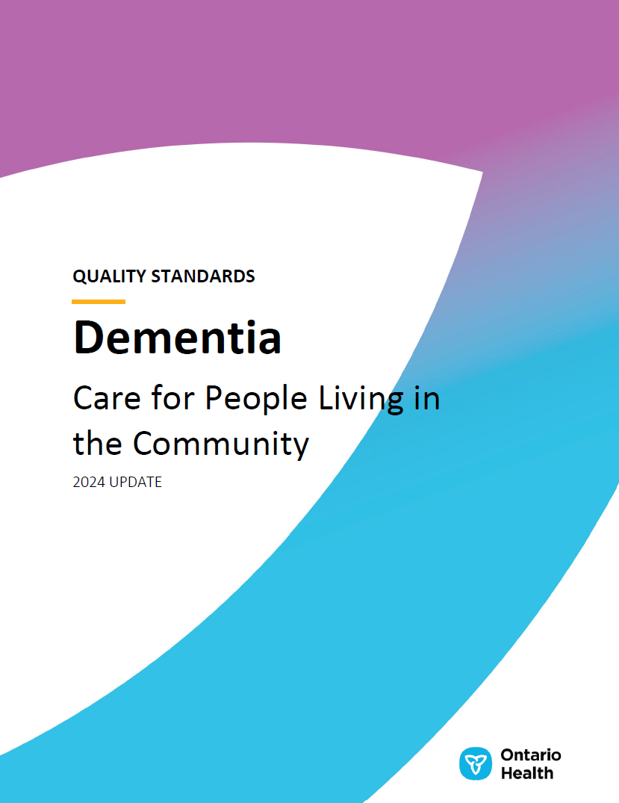
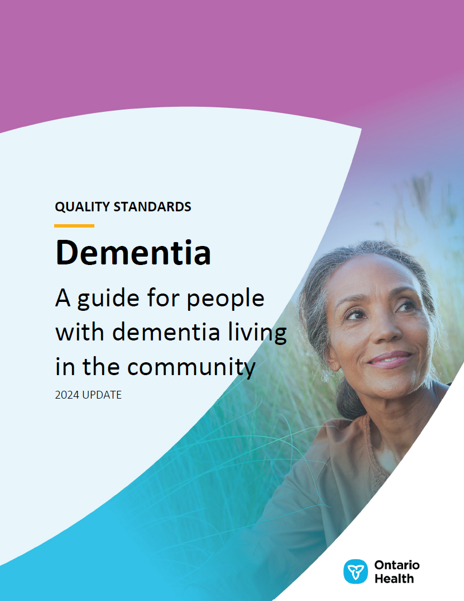
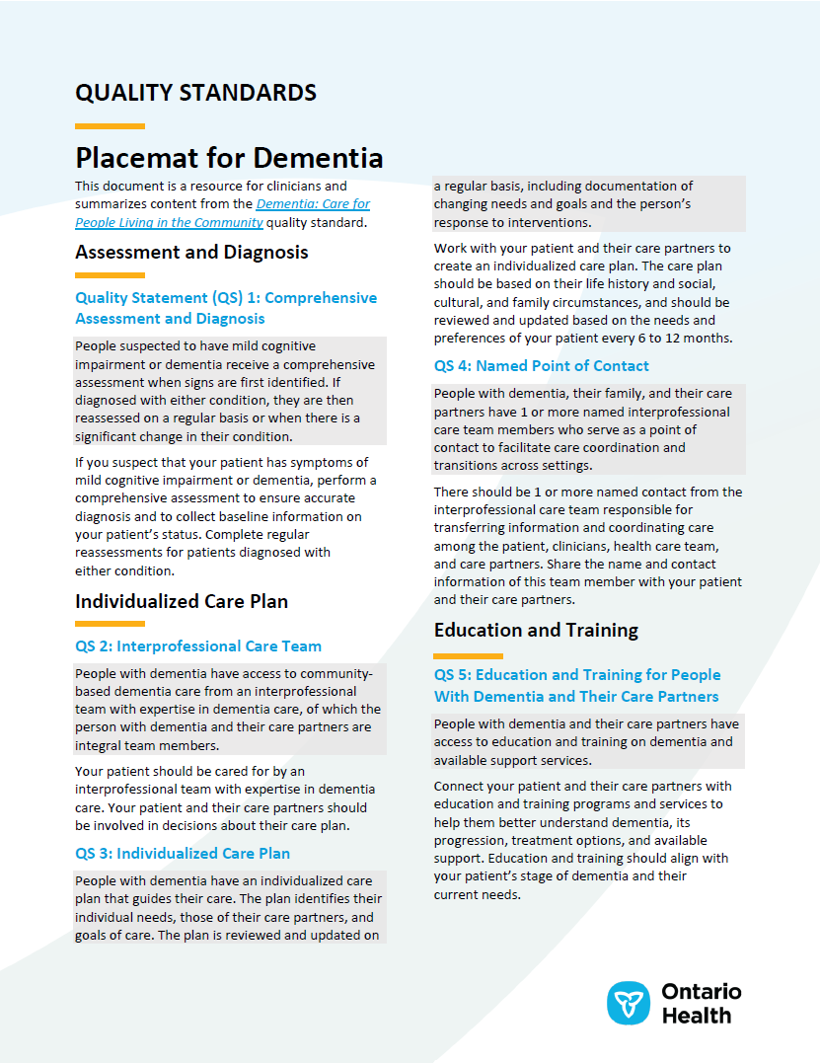
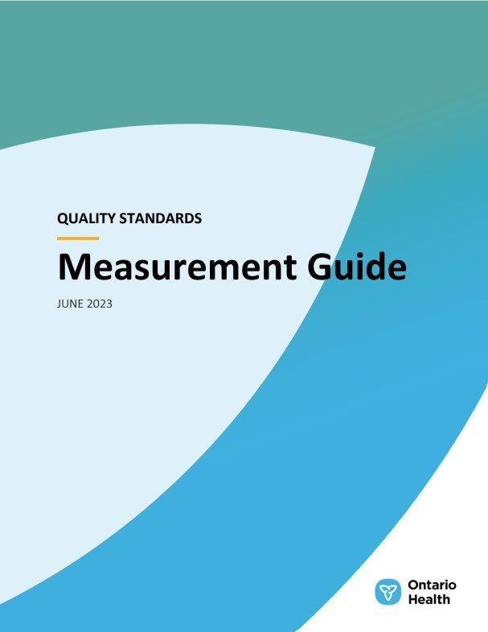
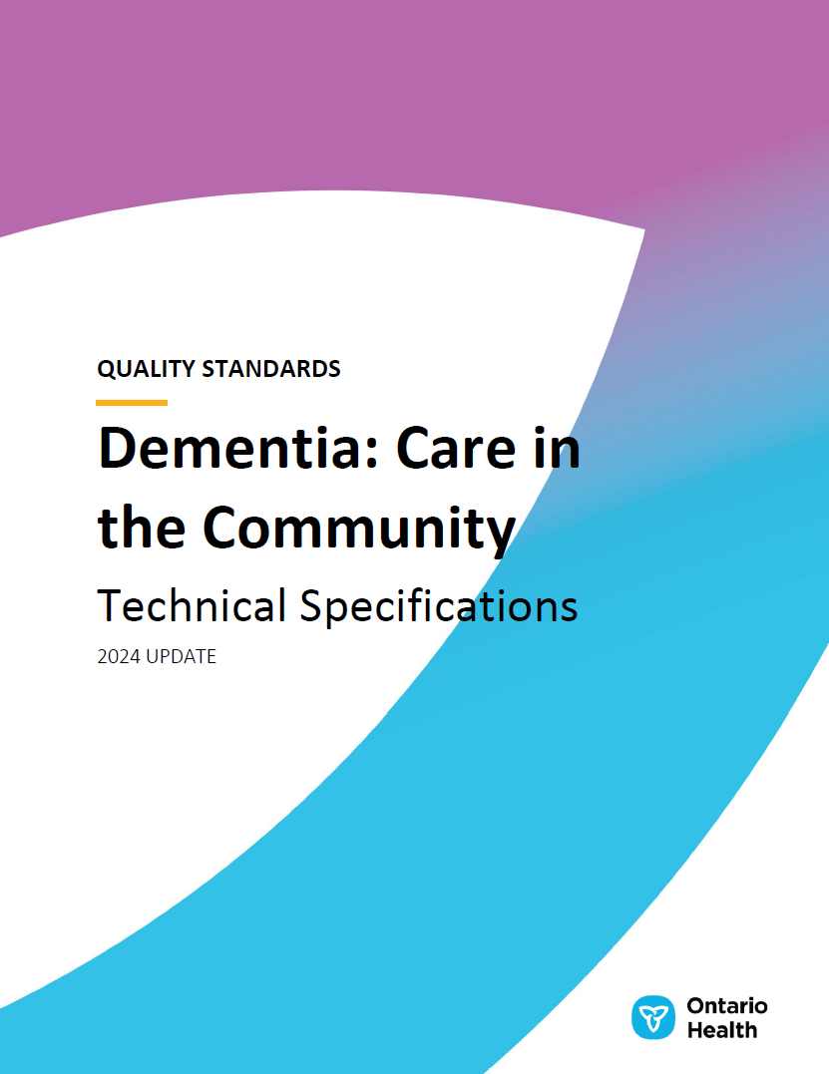
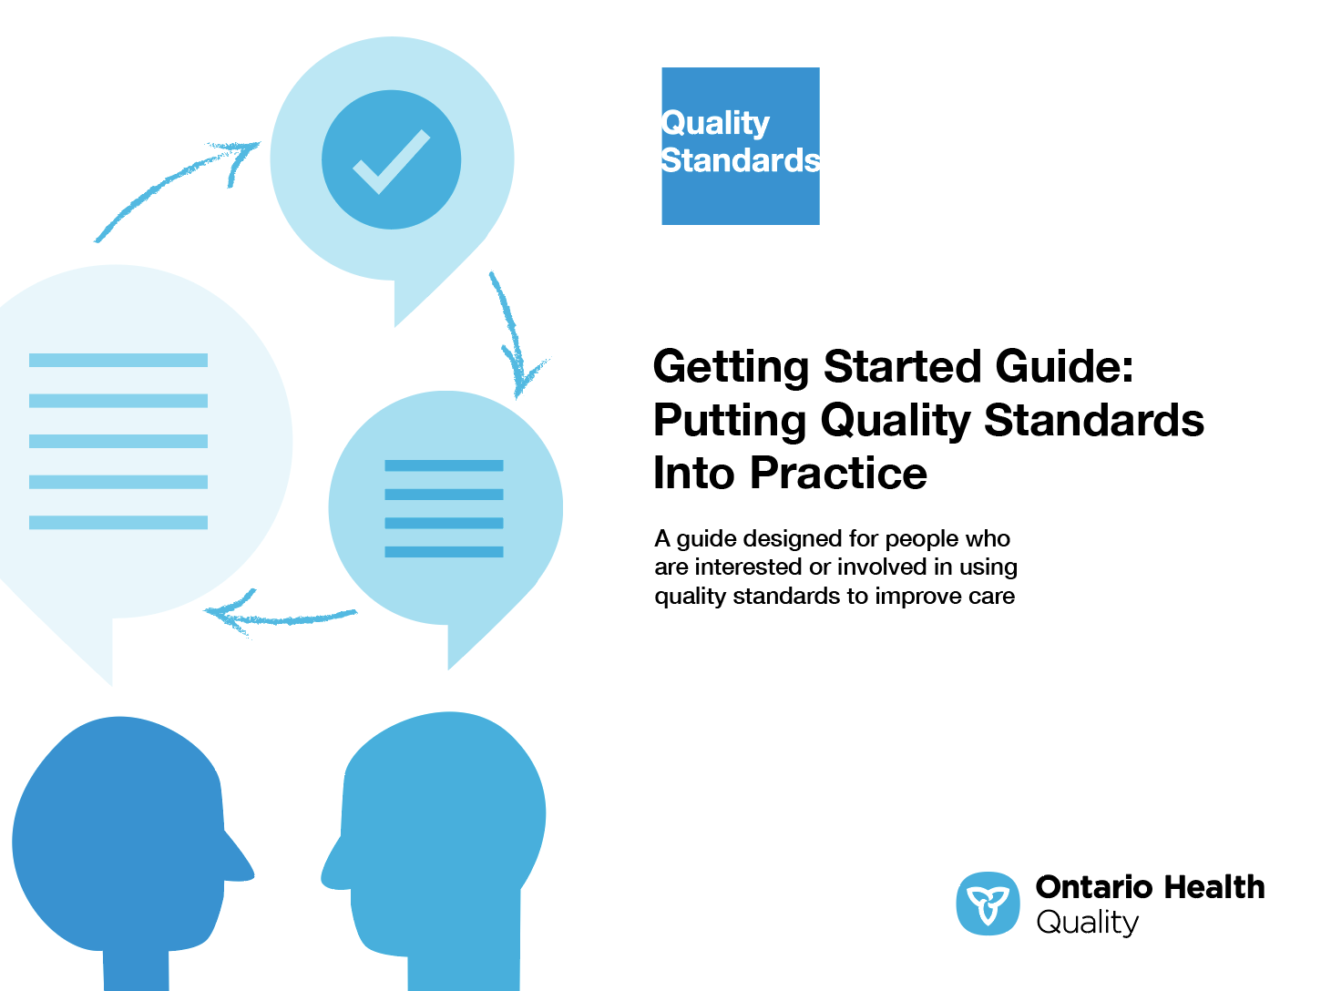
Quality standard resources
Quality Standard
Patient Guide
Placemat
Case for Improvement Deck
Measurement Guide
Technical Specifications
Getting Started Guide
Find these resources here: https://www.hqontario.ca/evidence-to-improve-care/quality-standards/view-all-quality-standards/dementia
Notes:
Each quality standard focuses on a specific health care issue. The development of each quality standard is accompanied by an assortment of resources.
Through concise, easy-to-understand statements, quality standards outline what quality care looks like for a condition or topic based on the evidence.
Each quality standard is accompanied by a:
Patient guide
Placemat
Case for Improvement Deck
Measurement guide
Technical specifications
Getting started guide
Quality standards provide the blueprint to enable the health care system in Ontario to work better, facilitate smooth transitions, and ensure patients receive the same high-quality care, regardless of where they reside.

Slide 6
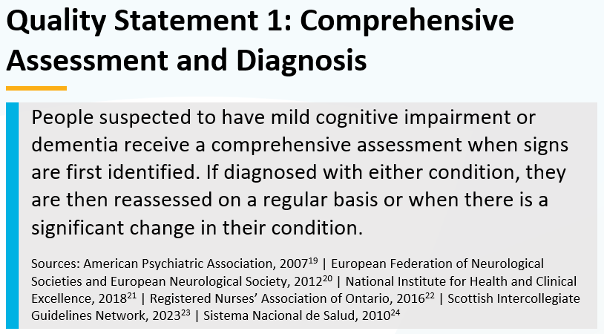
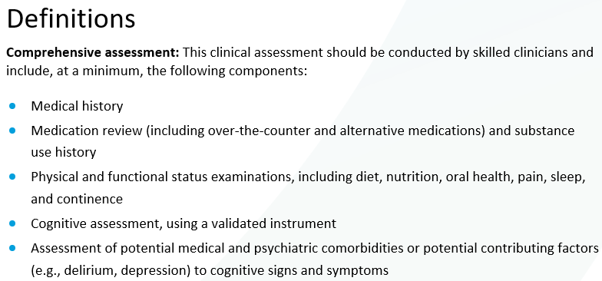
Inside the quality standard
The Quality Statement
The Audience Statements
The Definitions
The Indicators

Slide 7
Patient guide
Quality standards
The patient guide is designed to give patients information about what quality care looks like for various conditions based on the best evidence, so they can ask informed questions of their health care teams.
Notes:
Every quality standard includes a plain language summary for patients, families, care partners and the public called the patient guide.
Patient engagement in quality standards:
Membership on advisory committees
Focus groups and key informant interviews on topic-specific content (when necessary)
Public comment period for each quality standard
Consultations on the patient guide

Slide 8
Placemat
Quality standards
The placemat is a quick-reference resource for clinicians that summarizes the quality standard and includes links to helpful resources and tools.

Slide 9
Case for improvement deck
Quality standards
The case for improvement deck describes why the quality standard was created and shows some of the data used to develop it. Champions can use or adapt this deck to build support for the quality standard in their organizations.

Slide 10
How the health care system can support implementation
Quality standards
Implementing quality standards can be challenging owing to system-level barriers or gaps, many of which have been identified throughout the development of this standard
Ontario Health will work with and support other provincial partners, including the Ministry of Health, to bridge system-level gaps and support the implementation of quality standards

Slide 11
Implementation tools
Quality standards
The Getting Started Guide:
Outlines the process for using the quality standard as a resource to deliver high-quality care
Contains evidence-based approaches, as well as useful tools and templates for implementing change ideas at the practice level
Notes:
There are things we can do today despite the larger systemic barriers that may take time to resolve. The Getting Started Guide is a document that outlines a process for using the quality standards as a resource to deliver high-quality care. It compiles a number of resources to support adoption, such as links to implementation and quality improvement resources, examples and activities for reflection, and templates and documents to support the implementation planning activities. The Getting Started Guide also includes an Action Plan Template and examples on how Quality Improvement Plans can help to advance quality standards.

Slide 12
Quorum
Quality standard adoption tools
Quorum is an online community dedicated to improving the quality of health care in Ontario.
The Quality Standards Adoption Series highlights efforts in the field to implement changes and close gaps in care related to quality standard topics.
quorum.hqontario.ca
Notes:
The Quality Standards program has highlighted several stories from organizations and groups using various standards and statements within their clinical care settings, organization, or institutions; these are available through posts and discussions on Quorum.
As well, we are working on compiling resources and tools, for both clinicians and patients and families.
The focus is on implementation/adoption stories and how organizations are using quality standards in practice to inform care.
We’d love to hear from you if you are interested in contributing to a post or article.

Slide 13
Measurement guide
Quality standards
The measurement guide describes:
The measurement principles behind the quality indicators included in quality standards
The types of indicators included in quality standards
How local and provincial data are collected and measured

Slide 14
Technical specifications
Quality standards
The technical specifications report outlines 2 types of measurement:
Provincial measurement: how we can monitor the progress being made to improve care at the provincial level
Local measurement: what you can do to assess the quality of care that you provide locally

Slide 15
Why do we need a quality standard for dementia care in the community?

Slide 16
About 733,040 people in Canada and 7.5% of adults aged 65 years and older in Ontario are living with dementia.^{1,2}
As Canada’s population ages, these numbers are expected to increase.
People with dementia will require increased support and care from community-based services and care partners as their condition progresses.
Sources:
Alzheimer Society of Canada. Dementia numbers in Canada [Internet]. 2024 [cited 2024 Apr 24]. Available from: https://alzheimer.ca/en/about-dementia/what-dementia/dementia-numbers-canada
Ontario Health Dementia in Ontario Cohort, adapted from methods of Jaakkimainen RL, Bronskill SE, Tierney MC, Herrmann N, Green D, Young J, et al. Identification of physician-diagnosed Alzheimer’s disease and related dementias in population-based administrative data: a validation study using family physicians’ electronic medical records. J Alzheimers Dis. 2016;54:337-49. The population estimate for Ontario was sourced from Statistics Canada’s Population estimates on July 1, by age and gender. Data from Discharge Abstract Database, National Ambulatory Care Reporting System, and Ontario Health Insurance Plan Claims Database.

Slide 17
Since fiscal year 2018/19, the prevalence of dementia among Ontario residents aged 65 years and older has incrementally declined
Sources: Ontario Health Dementia in Ontario Cohort, adapted from methods of Jaakkimainen et al 2016. The population estimate for Ontario was sourced from Statistics Canada’s Population estimates on July 1, by age and gender. Data from Discharge Abstract Database, National Ambulatory Care Reporting System, and Ontario Health Insurance Plan Claims Database, fiscal years 2018/19 to 2022/23.

Slide 18
Higher rates of people with dementia live in low-income neighbourhoods compared with people without dementia
Notes: Crude prevalence rate among adults with dementia aged 40 years and older in fiscal year 2022/23. Income quintiles are defined using after-tax income from the Canada Revenue Agency 2016 census.
Sources: Ontario Health Dementia in Ontario Cohort, adapted from methods of Jaakkimainen et al 2016. Data from Discharge Abstract Database, National Ambulatory Care Reporting System, Ontario Health Insurance Plan Claims Database, and Ontario Marginalization Index dissemination area by income based on the Canada Revenue Agency 2016 census.

Slide 19
The majority of people with dementia aged 65 years and older live outside of LTC settings
52.5%
Abbreviation: LTC, long-term care.
Sources: Ontario Health Dementia in Ontario Cohort, adapted from methods of Jaakkimainen et al 2016. Data from Discharge Abstract Database, National Ambulatory Care Reporting System, and Ontario Health Insurance Plan Claims Database.

Slide 20
Adults aged 65 years and older with dementia living in the community have complex care needs
1 in 4 require extensive assistance from a care partner
1 in 5 require support completing daily living activities
Source: Canadian Institute for Health Information. A step toward understanding health care trajectories of people living with dementia. Ottawa (ON): The Institute; 2024.

Slide 21
Primary care remains the most prevalent setting where people are first diagnosed with dementia at 76% in fiscal year 2022/23
Note: Patients first diagnosed in acute care settings (i.e., hospitalizations) represented 18.2% of new diagnoses in fiscal year 2018/19 and 15.1% of new diagnoses in fiscal year 2022/23, while patients identified using the Ontario Drug Benefit for dementia-related medication remained at 9% throughout the 5-year period.
Sources: Ontario Health Dementia in Ontario Cohort, adapted from methods of Jaakkimainen et al 2016. Data from Discharge Abstract Database, National Ambulatory Care Reporting System, and Ontario Health Insurance Plan Claims Database.

Slide 22
On average, there are 50 unscheduled hospitalizations and 124 unplanned ED visits for every 100 people with dementia each year
Abbreviation: ED, emergency department.
Sources: Ontario Health Dementia in Ontario Cohort, adapted from methods of Jaakkimainen et al 2016. Data from Discharge Abstract Database, National Ambulatory Care Reporting System, and Ontario Health Insurance Plan Claims Database.

Slide 23
The percentage of adults with dementia who had any unplanned ED visits or hospitalizations varied by Ontario Health region
More than half of patients with dementia had at least 1 unscheduled ED visit in fiscal year 2022/23.
Note: Patient care settings may be inadequately determined in administrative databases, and patients from the North East and North West regions may face challenges accessing ED services. This could lead to increased utilization of acute hospitalization.
Sources: Ontario Health Dementia in Ontario Cohort, adapted from methods of Jaakkimainen et al 2016. Data from Discharge Abstract Database, National Ambulatory Care Reporting System, and Ontario Health Insurance Plan Claims Database.

Slide 24
Average length of stay in hospitals has increased over time, while the number of ALC days has remained close to the COVID-19 pandemic period numbers of fiscal year 2021/22
Abbreviation: ALC, alternate level of care.
Note: ALC days is defined as the number of days a patient occupies a bed but does not require the intensity of services provided in that care setting.
Sources: Ontario Health Dementia in Ontario Cohort, adapted from methods of Jaakkimainen et al 2016. Data from Discharge Abstract Database, National Ambulatory Care Reporting System, and Ontario Health Insurance Plan Claims Database.

Slide 25
More than 75% of older adults living in the community were either admitted to LTC or died within 5 years of being diagnosed with dementia.¹
In Ontario, the average time between a patient’s dementia diagnosis and admission to LTC is 3.3 years.²
Sources:
Huyer G, Brown CRL, Spruin S, Hsu AT, Fisher S, Manuel DG, et al. Five-year risk of admission to long-term care home and death for older adults given a new diagnosis of dementia: a population-based retrospective cohort study. CMAJ. 2020;192(16):E422-30.
Ontario Health Dementia in Ontario Cohort, adapted from methods of Jaakkimainen et al 2016. Data from Discharge Abstract Database, National Ambulatory Care Reporting System, Ontario Health Insurance Plan Claims Database, and Continuing Care Reporting System database.

Slide 26
”
“People with dementia living in the community frequently have their personhood taken away. They are all put in the same box – it is assumed because of their diagnosis they are all the same, with the same abilities. This is so not true. They are all unique with different strengths. A quality standard helps people understand this. If we have quality standards of care for people living with dementia, it leads to better care due to better understanding of the unique needs of this patient population. The patient feels heard and understood.”
– Phyllis Fehr, Lived Experience Advisor, Dementia Care in the Community Quality Standard Advisory Committee

Slide 27
Quality statements to improve care

Slide 28
Scope of this quality standard
This quality standard addresses care for people with dementia living in the community, including the assessment of people suspected to have dementia or mild cognitive impairment. It focuses on primary care, specialist care, hospital outpatient services, home care, and community support services.
This quality standard does not address care provided in an emergency department or hospital inpatient setting or to people living in long-term care homes, nor does it address specific aspects of palliative care for people with dementia.
For a quality standard that addresses care for people with dementia and the specific behaviours of agitation or aggression who are in an emergency department, admitted to a hospital, or in a long-term care home, refer to Behavioural Symptoms of Dementia.
Notes:
Scope of This Quality Standard
This quality standard addresses care for people with dementia living in the community, including the assessment of people suspected to have dementia or mild cognitive impairment. It focuses on primary care, specialist care, hospital outpatient services, home care, and community support services.
A separate quality standard addresses care for people with dementia and the specific behaviours of agitation or aggression who are in an emergency department, admitted to a hospital, or in a long-term care home.

Slide 29
Quality statement topics
Comprehensive assessment and diagnosis
Interprofessional care team
Individualized care plan
Named point of contact
Education and training for people with dementia and their care partners
Education and training for the health care team
Access to support services
Care partner assessment and support
Safe living environment
Access to primary care

Slide 30
Comprehensive assessment and diagnosis
Quality statement 1:
People suspected to have mild cognitive impairment or dementia receive a comprehensive assessment when signs are first identified. If diagnosed with either condition, they are then reassessed on a regular basis or when there is a significant change in their condition.

Slide 31
Interprofessional care team
Quality statement 2:
People with dementia have access to community-based dementia care from an interprofessional team with expertise in dementia care, of which the person with dementia and their care partners are integral team members.

Slide 32
Individualized care plan
Quality statement 3:
People with dementia have an individualized care plan that guides their care. The plan identifies their individual needs, those of their care partners, and goals of care. The plan is reviewed and updated on a regular basis, including documentation of changing needs and goals and the person’s response to interventions.

Slide 33
Named point of contact
Quality statement 4:
People with dementia, their family, and their care partners have 1 or more named interprofessional care team members who serve as a point of contact to facilitate care coordination and transitions across settings.

Slide 34
Education and training for people with dementia and their care partners
Quality statement 5:
People with dementia and their care partners have access to education and training on dementia and available support services.

Slide 35
Education and training for the health care team
Quality statement 6:
People with dementia receive care and services from health care team members who have education and training in dementia care.

Slide 36
Access to support services
Quality statement 7:
People with dementia and their care partners have access to support services that are individualized and meet their ongoing goals and needs.

Slide 37
Care partner assessment and support
Quality statement 8:
Care partners of people with dementia are assessed on an ongoing basis and offered supports to address their individual needs.

Slide 38
Safe living environment
Quality statement 9:
People with dementia have access to a safe living environment that meets their specific needs, including design modifications and a range of housing options.

Slide 39
Access to primary care
Quality statement 10:
People with mild cognitive impairment or dementia have regular visits with a primary care physician or nurse practitioner who provides effective primary care that meets both their general health care needs and their specific needs related to cognitive impairment or dementia.

Slide 40
Measures to support improvement
Notes:
The Dementia Care for People in the Community Quality Standard Advisory Committee identified a set of overarching goals for this quality standard. These have been mapped to indicators that may be used to assess quality of care provincially and locally.

Slide 41
Indicators that can be measured using provincial data
Rate of emergency department visits for people with dementia living in the community
Rate of hospitalizations for people with dementia living in the community
Average length of stay in hospital for people with dementia living in the community
Alternate-level-of-care days for people with dementia living in the community
Average length of stay in the community for people with dementia

Slide 42
Indicators that can be measured using only local data
Percentage of people with dementia living in the community and their care partners who each have optimized quality of life
Percentage of people with dementia living in the community who are confident with self-care
Percentage of care partners of people with dementia living in the community who are confident with their ability to work collaboratively with people with dementia to provide care based on their needs and preferences
Percentage of people with dementia living in the community and their care partners who reported being satisfied or very satisfied with the care and services received in the community

Slide 43
Data sources and acknowledgement
Parts of this material are based on data and information compiled and provided by the Canadian Institute for Health Information (CIHI). However, the analyses, conclusions, opinions, and statements expressed herein are those of the authors and not necessarily those of CIHI.

Slide 44
Thank you

