Slide 1


Diabetes in Pregnancy
Quality Standard
Guiding evidence-based care for people of reproductive age living in Ontario
Notes:
If you have any questions about the content of this presentation, please contact us at QualityStandards@ontariohealth.ca

Slide 2
Objectives
Overview of quality standards
What are they? How are they used?​
Why this quality standard is needed
Gaps and variations in quality of care for people with diabetes in pregnancy in Ontario
Quality statements to improve care
The key statements in the diabetes in pregnancy quality standard
How to measure overall success
Indicators that can help measure your quality improvement efforts

Slide 3
Quality Standards
Inform clinicians and patients what quality care looks like
Focus on conditions or processes where there are large variations in how care is delivered, or where there are gaps between the care provided in Ontario and the care patients should receive
Are grounded in the best available evidence
Notes:
Quality standards are a smaller set of high impact statements that describe optimal care where identified quality gaps exist in Ontario.
Voluntary and aspirational in nature​.
Designed to “raise the ceiling” with the goal of having the best possible care available to all Ontarians, regardless of where they live in the province.
There are many guidelines, professional standards, and other recommendations that contribute to the evidence ecosystem. Quality standards complement these resources.
Quality standards outline the what of care that should be delivered but are agnostic on who should be delivering it (unlike other CPGs, BPGs).
Quality standards are:
Concise: 5 to 15 strong, evidence-based statements focused on high priority areas for improvement.
Accessible: help clinicians and provider organizations offer the highest-quality care; and patients to know what to discuss with their care providers (compared with CPGs that are quite dense, these are very accessible, also written in plain language).
Measurable: each statement is accompanied by one or more quality indicators (structure, process or outcome), with a set of outcome measures for the overall standard.
Implementable: quality improvement tools and resources support each standard, to fuel adoption.

Slide 4
Quality Standards
Help health care professionals know what care to offer, based on evidence and expert consensus
Help health care organizations measure, assess, and improve the quality of care they provide
Help ensure consistent,
high-quality care across the province
Help patients, residents, families, and caregivers know what to ask for in their care
Notes:
Patients, caregivers and the public can use quality standards to understand what excellent care looks like, what they should expect from their health care providers, and how to discuss the quality of their care.
Provincial regions and disease agencies can use quality standards to measure health outcomes, hold health service providers accountable for delivering high-quality care, and inform regional improvement strategies.
Provider organizations can use quality standards to measure and audit their quality of care, identify gaps, guide organizational improvement strategies, and inform clinical program investments.
Health care professionals can use quality standards to evaluate their practice and identify areas for personal and organizational quality improvement, and can incorporate the evidence-based statements into professional education.
Government can use quality standards to identify provincial priority areas, inform new data collection and reporting initiatives, and design performance indicators and funding incentives.

Slide 5
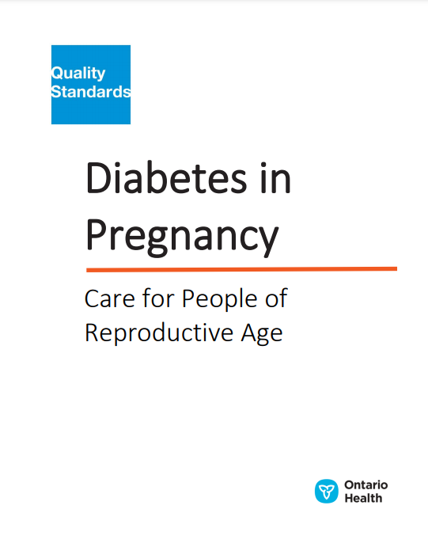

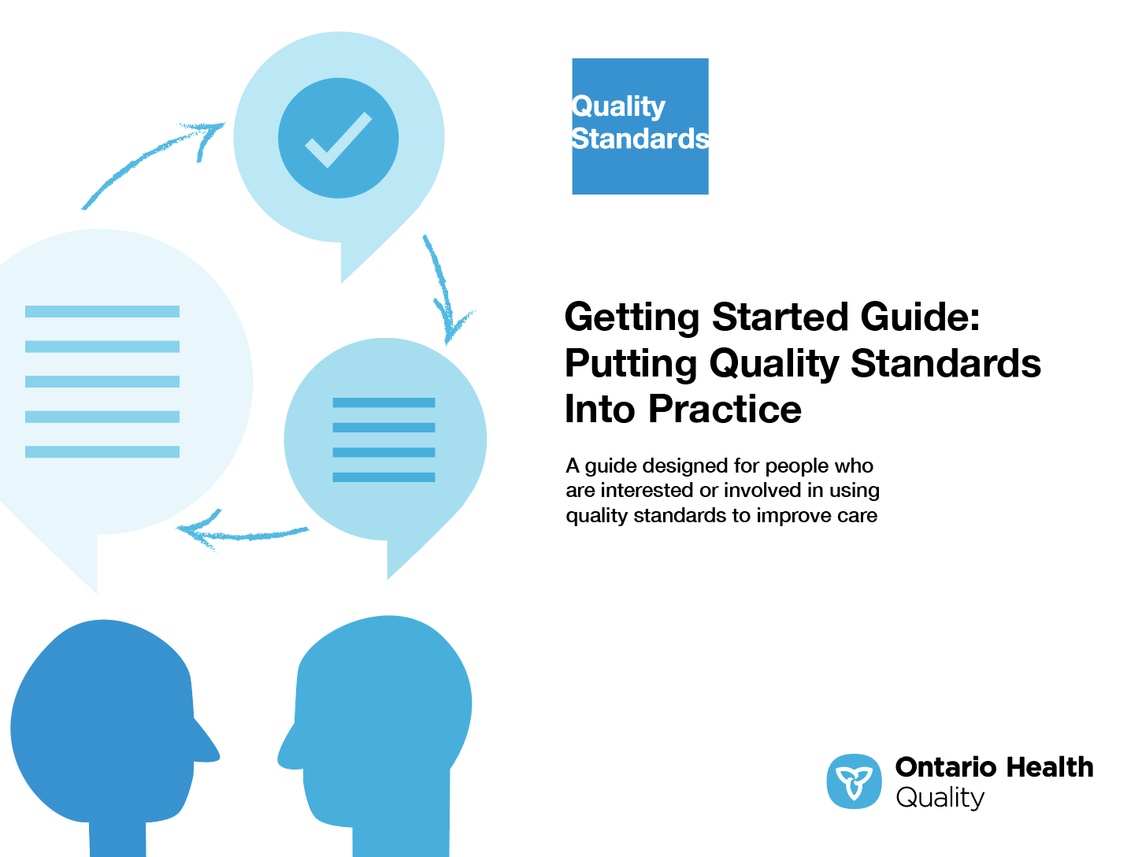
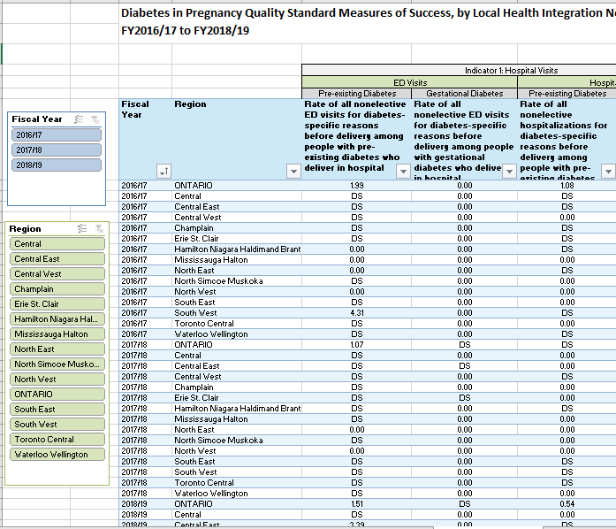

Quality Standard Resources
Quality Standard
Patient Guide
Getting Started Guide
Data Tables
Measurement Guide
Find these resources here:
https://www.hqontario.ca/evidence-to-improve-care/quality-standards/view-all-quality-standards/diabetes-in-pregnancy
Notes:
Each quality standard focuses on a specific health care issue. The development of each quality standard is accompanied by an assortment of resources.
Through concise, easy-to-understand statements, quality standards outline what quality care looks like for a condition or topic based on the evidence.
This quality standard is accompanied by:
A patient conversation guide
A getting started guide
Data tables
A measurement guide
Quality standards provide the blueprint to enable the health care system in Ontario to work better, facilitate smooth transitions, and ensure patients receive the same high-quality care, regardless of where they reside.

Slide 6
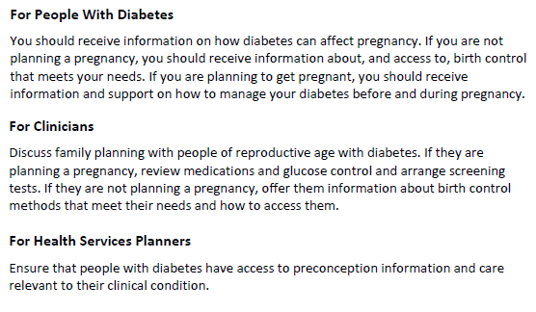
Inside the Quality Standard
The Statement
The Audience
Definitions
The Indicators

Slide 7
Quality Standards:
Patient Guide
The patient guide is designed to give patients information about what quality care looks like for various conditions based on the best evidence, so they can ask informed questions of their health care providers.
Notes:
This quality standard includes a plain language summary for patients, families, caregivers and the public called the patient conversation guide.
Patient engagement in quality standards:
Membership on advisory committees
Focus groups and key informant interviews on topic-specific content (when necessary)
Public comment period for each quality standard
Consultations on the patient conversation guide

Slide 8
Quality Standards:
How the Health Care System Can Support Implementation
Implementing quality standards can be challenging due to system-level barriers or gaps, many of which have been identified throughout the development of this standard. Ontario Health will work with and support other provincial partners, including Ministry of Health, to bridge system-level gaps to support the implementation of quality standards.

Slide 9
Quality Standards:
Implementation Tools
The Getting Started Guide:
Outlines the process for using the quality standard as a resource to deliver high-quality care
Contains evidence-based approaches, as well as useful tools and templates for implementing change ideas at the practice level
Notes:
There are things we can do today despite the larger systemic barriers that may take time to resolve. The Getting Started Guide is a document that outlines a process for using the quality standards as a resource to deliver high-quality care. It compiles a number of resources to support adoption, such as links to implementation and quality improvement resources, examples and activities for reflection, and templates and documents to support the implementation planning activities. The Getting Started Guide also includes an Action Plan Template and examples on how Quality Improvement Plans can help to advance quality standards.

Slide 10


Quality Standard Adoption Tools:
Quorum
Quorum is an online community dedicated to improving the quality of health care in Ontario.
The Quality Standards Adoption Series highlights efforts in the field to implement changes and close gaps in care related to quality standard topics.
quorum.hqontario.ca
Notes:
The Quality Standards program has highlighted several stories from organizations and groups using various standards and statements within their clinical care settings, organization, or institutions; these are available through posts and discussions on Quorum.
As well, we are working on compiling resources and tools, for both clinicians and patients and families.
The focus is on implementation/adoption stories and how organizations are using quality standards in practice to inform care.
We’d love to hear from you if you are interested in contributing to a post or article.

Slide 11
Quality Standards:
Measurement Guide
The measurement guide has two dedicated sections:
Local measurement: what you can do to assess the quality of care that you provide locally
Provincial measurement: how we can measure the success of the quality standard on a provincial level

Slide 12
Quality Standards:
Data Tables
Data tables can be used to examine variations in indicator results across the province. They include data on key indicators:
Over time for Ontario
Across regions in Ontario
For specific measures of equity (age, rurality, and household income)

Slide 13
Why Do We Need a
Quality Standard for
Diabetes in Pregnancy?
Note: Indicator data for the quality standard presented in slides 14 to 17 are preliminary rates and are not adjusted for factors other than age (e.g., complications/conditions) that an individual in the cohort may have. Refer to our accompanying measurement guide for technical specifications, such as inclusion and exclusion criteria.
Notes:
The data presented in the following slides is for people with diabetes in pregnancy and their caregivers.

Slide 14


Among pregnant people in Ontario in 2010, the prevalence of diabetes in pregnancy (gestational diabetes or
pre-existing diabetes)* was¹:
Almost 1 in 10 among people age 30 and older
Almost 1 in 20 among people age 15-29
*Gestational diabetes is diabetes diagnosed in pregnancy; pre-existing diabetes is type 1 or type 2 diabetes diagnosed before pregnancy.
Most cases were gestational diabetes. Rates are age-adjusted.
¹Feig DS, Hwee J, Shah BR, Booth GL, Bierman AS, Lipscombe LL. Trends in incidence of diabetes in pregnancy and serious perinatal outcomes: a large, population-based study in Ontario, Canada, 1996–2010. Diabetes Care. 2014;37(6):1590-1596.
Notes:
Prevalence of diabetes in pregnancy, age 30 and older, 2010: 1 in 10 (9.3%)
GDM: 7.4%, Pre-existing diabetes: 1.9%
Prevalence of diabetes in pregnancy, age 15-29, 2010: 1 in 20 (4.4%)
GDM: 3.5%, Pre-existing diabetes: 0.9%
https://care.diabetesjournals.org/content/37/6/1590

Slide 15

People with diabetes in pregnancy have higher rates of pregnancy complications – including various maternal and perinatal outcomes – compared with the general population.^{1,2}
¹Feig DS, Hwee J, Shah BR, Booth GL, Bierman AS, Lipscombe LL. Trends in incidence of diabetes in pregnancy and serious perinatal outcomes: a large, population-based study in Ontario, Canada, 1996–2010. Diabetes Care. 2014;37(6):1590-1596.
²Diabetes Canada Clinical Practice Guidelines Expert Committee. Diabetes Canada 2018 Clinical practice guidelines for the prevention and management of diabetes in Canada. Can J Diabetes. 2018;42(Suppl 1):S1-S325.

Slide 16
Rates of individual maternal outcomes* in Ontario ranged from:
2.7% to 46.2% among people with pre-existing diabetes
2.1% to 34.9% among people with gestational diabetes
Percentage of people with diabetes in pregnancy (pre-existing diabetes or gestational diabetes) who delivered in hospital who had an antepartum or intrapartum outcome, in Ontario, by maternal outcome,
April 2018 to March 2019
*Data for maternal outcomes include individual rates for pre-eclampsia, operative vaginal delivery, Caesarean section, and third- or fourth-degree lacerations. Rates include only singleton deliveries for all maternal outcomes; the denominator includes all deliveries (vaginal births and Caesarean sections) for all maternal outcomes. Rates are age-standardized.
Sources: Discharge Abstract Database, Ontario Diabetes Database, Ontario Health Insurance Plan Claims Database, Ontario Mother-Baby linked
dataset, Registered Persons Database; fiscal year 2018/19, provided by ICES.

Slide 17
Rates of individual adverse neonatal outcomes* in Ontario ranged from:
5.9% to 23.4% among deliveries with pre-existing diabetes
3.2%% to 17.0% among deliveries with gestational diabetes
Percentage of people with diabetes in pregnancy (pre-existing diabetes or gestational diabetes) who delivered in hospital whose infant had an adverse neonatal outcome, in Ontario, by neonatal outcome, April 2018 to March 2019
*Data for neonatal outcomes include individual rates for neonatal hypoglycemia, macrosomia, shoulder dystocia, preterm birth, hyperbilirubinemia, and respiratory distress.
Rates include only singleton deliveries for all neonatal outcomes. Rates are age-standardized.
Sources: Discharge Abstract Database, Ontario Diabetes Database, Ontario Health Insurance Plan Claims Database, Ontario Mother-Baby linked
dataset, Registered Persons Database; fiscal year 2018/19, provided by ICES.

Slide 18

In Ontario in fiscal year 2018/19, a neonatal intensive care unit admission for 24 hours or more occurred in:
Almost 1 in 4 deliveries with pre-existing diabetes
More than 1 in 10 deliveries with gestational diabetes
Rates include only singleton deliveries. Rates are age-standardized.
Sources: Discharge Abstract Database, Ontario Diabetes Database, Ontario Health Insurance Plan Claims Database, Ontario Mother-Baby linked dataset, Registered Persons Database; fiscal year 2018/19, provided by ICES.
Notes:
Pre-existing diabetes: 23.9%
Gestational diabetes: 11.3%

Slide 19
Rates of neonatal intensive care unit admission for 24 hours or more across local health integration networks (LHINs) in Ontario ranged from:
12.2% to 35.0% among deliveries with pre-existing diabetes
7.9% to 20.1% among deliveries with gestational diabetes
Percentage of people with diabetes in pregnancy (pre-existing diabetes or gestational diabetes) who delivered in hospital whose infant was admitted to a neonatal intensive care unit for 24 hours or more, in Ontario, by LHIN, April 2018 to March 2019
Regions with small sample sizes are indicated by an asterisk (*). Rates include only singleton deliveries. Rates are age-standardized.
Sources: Discharge Abstract Database, Ontario Diabetes Database, Ontario Health Insurance Plan Claims Database, Ontario Mother-Baby linked dataset, Registered Persons Database; fiscal year 2018/19, provided by ICES.

Slide 20


Preconception care can improve maternal and fetal outcomes for people with type 1 or type 2 diabetes.¹
However, about 40% of people do not receive preconception care.^{1,2}
Further, the rate of preconception care in people with type 2 diabetes is lower than in people with type 1 diabetes.³
¹Diabetes Canada Clinical Practice Guidelines Expert Committee. Diabetes Canada 2018 clinical practice guidelines for the prevention and
management of diabetes in Canada. Can J Diabetes. 2018;42(Suppl 1):S1-S325.
²Lipscombe LL, McLaughlin HM, Wu W, Feig DS. Pregnancy planning in women with pregestational diabetes. J Matern Fetal Neonatal Med.
2011 Sept;34(9):1095-1101.
³Kallas-Koeman M, Khandwala F, Donovan LE. Rate of preconception care in women with type 2 diabetes still lags behind that of women with
type 1 diabetes. Can J Diabetes. 2012 August;36(4):170-174.

Slide 21

Postpartum diabetes screening for people with gestational diabetes is important to identify those at risk for diabetes after pregnancy and for those who continue to have diabetes.
However, only about 1 in 6 people with gestational diabetes are screened within 6 months after delivery.¹
The screening rate for type 2 diabetes includes people with gestational diabetes who had a 75 g oral glucose tolerance test in a community laboratory in 2008. Additional analysis is required to assess the current screening rate in Ontario.
¹Shah B, Lipscombe L, Feig D, Lowe J. Missed opportunities for type 2 diabetes testing following gestational diabetes: a population-based cohort study. BJOG. 2011;118(12):1484-1490.

Slide 22
Quality Statements to Improve Care

Slide 23
Scope of the Diabetes in Pregnancy Quality Standard
This quality standard addresses care for people with type 1 and type 2 diabetes who become pregnant and people diagnosed with gestational diabetes
It includes preconception care as well as management of diabetes during pregnancy
This quality standard applies to all settings
This quality standard does not include guidance on preventing gestational diabetes or on postpartum care for neonates born to people with diabetes in pregnancy
Notes:
Scope of This Quality Standard
This quality standard addresses care for people living with type 1 or type 2 diabetes who are planning to become or who are pregnant and for people diagnosed with gestational diabetes. It does not address the primary prevention of gestational diabetes in the general population, although it does provide guidance on lifestyle factors that may contribute to the development of type 2 diabetes in those who previously had gestational diabetes and are therefore at increased risk.
This quality standard applies to all settings.
This quality standard does not include care for people with type 1 and type 2 diabetes outside of preconception care and pregnancy. For quality standards that address care for people with type 1 or type 2 diabetes, please refer to the quality standards Type 1 Diabetes and Prediabetes and Type 2 Diabetes.
This quality standard includes six quality statements on areas identified by the Diabetes in Pregnancy Quality Standard Advisory Committee and several health and social service organizations working with Indigenous populations as having high potential to improve the quality of care in Ontario for people with diabetes in pregnancy.

Slide 24
Quality Statement Topics
Preconception Care for People With Diabetes
Coordinated Interprofessional Care
Self-Management Education and Support
Lifestyle Management During Pregnancy
Fetal Monitoring and Timing of Delivery
Postpartum Diabetes Screening for People With Gestational Diabetes
Notes:
Quality Statement 1: Preconception Care for People With Diabetes
All people of reproductive age who might become pregnant who are living with diabetes receive information about family planning. People with diabetes who are planning to become pregnant receive preconception care from an interprofessional care team, including counselling on optimizing diabetes management, screening for complications, and a review of medications.
Quality Statement 2: Coordinated Interprofessional Care
People with diabetes receive coordinated interprofessional care specific to their needs during preconception and throughout pregnancy. People with gestational diabetes receive interprofessional care at the time of diagnosis and throughout the remainder of their pregnancy.
Quality Statement 3: Self-Management Education and Support
People with diabetes and their families are offered tailored self-management education and support at the beginning of pregnancy, or at the time of gestational diabetes diagnosis, and throughout their pregnancy as needed.
Quality Statement 4: Lifestyle Management During Pregnancy
People with diabetes in pregnancy receive tailored information and support about gestational weight gain, diet, and physical activity to optimize blood glucose levels and maternal and fetal outcomes at the beginning of pregnancy, or at the time of gestational diabetes diagnosis, and throughout pregnancy.
Quality Statement 5: Fetal Monitoring and Timing of Delivery
People with diabetes in pregnancy receive increased fetal monitoring based on glucose control, maternal complications, comorbid conditions, and/or fetal well-being. Induction of labour is considered before 40 weeks’ gestation if maternal or fetal indications exist.
Quality Statement 6: Postpartum Diabetes Screening for People With Gestational Diabetes
People with gestational diabetes are screened for prediabetes and type 2 diabetes with a 75 g oral glucose tolerance test between 6 weeks and 6 months postpartum.

Slide 25
Quality Statement 1:
Preconception Care for People Diabetes
All people of reproductive age who might become pregnant who are living with diabetes receive information about family planning. People with diabetes who are planning to become pregnant receive preconception care from an interprofessional care team, including counselling on optimizing diabetes management, screening for complications, and a review of medications.
Notes:
Quality Statement 1: Preconception Care for People With Diabetes
All people of reproductive age who might become pregnant who are living with diabetes receive information about family planning. People with diabetes who are planning to become pregnant receive preconception care from an interprofessional care team, including counselling on optimizing diabetes management, screening for complications, and a review of medications.

Slide 26
Quality Statement 2:
Coordinated Interprofessional Care
People with diabetes receive coordinated interprofessional care specific to their needs during preconception and throughout pregnancy. People with gestational diabetes receive interprofessional care at the time of diagnosis and throughout the remainder of their pregnancy.
Notes:
Quality Statement 2: Coordinated Interprofessional Care
People with diabetes receive coordinated interprofessional care specific to their needs during preconception and throughout pregnancy. People with gestational diabetes receive interprofessional care at the time of diagnosis and throughout the remainder of their pregnancy.

Slide 27
Quality Statement 3:
Self-Management Education and Support
People with diabetes and their families are offered tailored self-management education and support at the beginning of pregnancy, or at the time of gestational diabetes diagnosis, and throughout their pregnancy as needed.
Notes:
Quality Statement 3: Self-Management Education and Support
People with diabetes and their families are offered tailored self-management education and support at the beginning of pregnancy, or at the time of gestational diabetes diagnosis, and throughout their pregnancy as needed.

Slide 28
Quality Statement 4:
Lifestyle Management During Pregnancy
People with diabetes in pregnancy receive tailored information and support about gestational weight gain, diet, and physical activity to optimize blood glucose levels and maternal and fetal outcomes at the beginning of pregnancy, or at the time of gestational diabetes diagnosis, and throughout pregnancy.
Notes:
Quality Statement 4: Lifestyle Management During Pregnancy
People with diabetes in pregnancy receive tailored information and support about gestational weight gain, diet, and physical activity to optimize blood glucose levels and maternal and fetal outcomes at the beginning of pregnancy, or at the time of gestational diabetes diagnosis, and throughout pregnancy.

Slide 29
Quality Statement 5:
Fetal Monitoring and Timing of Delivery
People with diabetes in pregnancy receive increased fetal monitoring based on glucose control, maternal complications, comorbid complications, and/or fetal
well-being. Induction of labour is considered before
40 weeks’ gestation if maternal or fetal indications exist.
Notes:
Quality Statement 5: Fetal Monitoring and Timing of Delivery
People with diabetes in pregnancy receive increased fetal monitoring based on glucose control, maternal complications, comorbid conditions, and/or fetal well-being. Induction of labour is considered before 40 weeks’ gestation if maternal or fetal indications exist.

Slide 30
Quality Statement 6:
Postpartum Diabetes Screening for
People With Gestational Diabetes
People with gestational diabetes are screened for prediabetes and type 2 diabetes with a 75 g oral glucose tolerance test between 6 weeks and
6 months postpartum.
Notes:
Quality Statement 6: Postpartum Diabetes Screening for People With Gestational Diabetes
People with gestational diabetes are screened for prediabetes and type 2 diabetes with a 75 g oral glucose tolerance test between 6 weeks and 6 months postpartum.

Slide 31
How to Measure Overall Success
Notes:
The Diabetes in Pregnancy Quality Standards Advisory Committee identified some overarching goals for this quality standard. These goals were mapped to indicators that can be used to assess quality of care provincially and locally.

Slide 32
Indicators That Can Be Measured Using
Provincial Data
Rate of all nonelective hospital visits for diabetes-specific reasons before delivery among people with diabetes in pregnancy (pre-existing diabetes or gestational diabetes) who deliver in hospital
  Reported by emergency department visits and hospitalizations
  Diabetes-specific reasons include diabetes with poor control, diabetes without complication, diabetes with hypoglycemia, diabetes with ketoacidosis, diabetes with hyperosmolarity, and a main diagnosis of diabetes with hyperglycemia or hypoglycemia
Percentage of people with diabetes in pregnancy (pre-existing diabetes or gestational diabetes) who deliver in hospital who have an antepartum or intrapartum outcome
  Reported by pre-eclampsia, operative vaginal delivery, Caesarean section, and third- or
  fourth-degree lacerations
Percentage of people with diabetes in pregnancy (pre-existing diabetes or gestational diabetes) who deliver in hospital whose infant has an adverse neonatal outcome
  Reported by neonatal hypoglycemia, macrosomia, shoulder dystocia, stillbirth, preterm birth, hyperbilirubinemia, respiratory distress, and neonatal mortality
Percentage of people with diabetes in pregnancy (pre-existing diabetes or gestational diabetes) who deliver in hospital whose infant is admitted to a neonatal intensive care unit for 24 hours or more

Slide 33
Indicators That Can Be Measured Using Only
Local Data
Percentage of people with diabetes in pregnancy (pre-existing diabetes or gestational diabetes) who receive interprofessional care specific to their needs to manage their diabetes in pregnancy
Percentage of people of reproductive age living with diabetes who are planning to get pregnant who receive preconception care from an interprofessional care team
Percentage of people with diabetes in pregnancy (pre-existing diabetes or gestational diabetes) who receive care for their diabetes who feel involved in decisions about their care
Percentage of people with diabetes in pregnancy (pre-existing diabetes or gestational diabetes) who report feeling confident in knowing how to take care of and manage their diabetes during pregnancy

Slide 34
Data Sources and Acknowledgement
The data used in this presentation were provided by the Institute for Clinical Evaluative Sciences (ICES), which is funded by an annual grant from the Ontario Ministry of Health (MOH) and the Ministry of Long-Term Care (MLTC). The opinions, results, and conclusions included in this presentation are those of the authors and are independent from the funding sources. No endorsement by ICES, the MOH, or the MLTC is intended or should be inferred. These datasets were linked using unique encoded identifiers and analyzed at ICES. Parts of this material are based on data and information compiled and provided by the Canadian Institute for Health Information (CIHI). However, the analyses, conclusions, opinions, and statements expressed herein are those of the authors, and not necessarily those of CIHI.

Slide 35

Thank you.
LET’S CONTINUE THE CONVERSATION
HQOntario.ca | OntarioHealth.ca
@OntarioHealthOH
Ontario Health
@OntarioHealthOH
Ontario Health

