Slide 1

Early Pregnancy Complications and Loss
Guiding evidence-based care for people experiencing early pregnancy complications (such as pain and vaginal bleeding) and/or loss in the first trimester of pregnancy
Notes:
If you have any questions about the content of this presentation, please contact us at QualityStandards@hqontario.ca

Slide 2
Objectives
Overview of quality standards
What are they? How are they used?​
Why this quality standard is needed
Gaps and variations in quality of care for people experiencing
early pregnancy complications and/or loss (EPCL) in the first trimester of pregnancy
How success can be measured
Indicators that can help measure your quality improvement efforts
Quality statements in brief
The key recommendations in the EPCL quality standard

Slide 3
Quality Standards
Inform clinicians and patients what quality care looks like
Focus on conditions where there are large variations in how care is delivered, or where there are gaps between the care provided in Ontario and the care patients should receive
Are grounded in the best available evidence
Notes:
Quality standards are a smaller set of high-impact statements that describe optimal care where identified quality gaps exist in Ontario.
Voluntary and aspirational in nature​.
Designed to “raise the ceiling,” with the goal of having the best possible care available to all Ontarians, regardless of where they live in the province.
There are many guidelines, professional standards, and other recommendations that contribute to the evidence ecosystem. Quality standards complement these resources.
Quality standards outline the what of care that should be delivered but are agnostic on who should be delivering it (unlike other CPGs, BPGs).
Quality standards are:
Concise: 5 to 15 strong, evidence-based statements focused on high-priority areas for improvement.
Accessible: help clinicians and provider organizations offer the highest-quality care; and patients to know what to discuss with their care providers (compared to CPGs that are quite dense, these are very accessible, also written in plain language).
Measurable: each statement is accompanied by one or more quality indicators (structure, process, or outcome), with a set of outcome measures for the overall standard.
Implementable: quality improvement tools and resources support each standard, to fuel adoption.

Slide 4
Quality Standards: Vision
Help health care professionals know what care to offer, based on evidence and expert consensus
Help health care organizations measure, assess, and improve the quality of care they provide
Help ensure consistent,
high-quality care across
the province
Help patients, residents, families, and caregivers know what to ask for in their care
Notes:
Patients, caregivers, and the public can use quality standards to understand what excellent care looks like, what they should expect from their health care providers, and how to discuss the quality of their care.
Provincial regions and disease agencies can use quality standards to measure health outcomes, hold health service providers accountable for delivering high-quality care, and inform regional improvement strategies.
Provider organizations can use quality standards to measure and audit their quality of care, identify gaps, guide organizational improvement strategies, and inform clinical program investments.
Health care professionals can use quality standards to evaluate their practice and identify areas for personal and organizational quality improvement; they can also incorporate the evidence-based statements into professional education.
Government can use quality standards to identify provincial priority areas, inform new data collection and reporting initiatives, and design performance indicators and funding incentives.

Slide 5
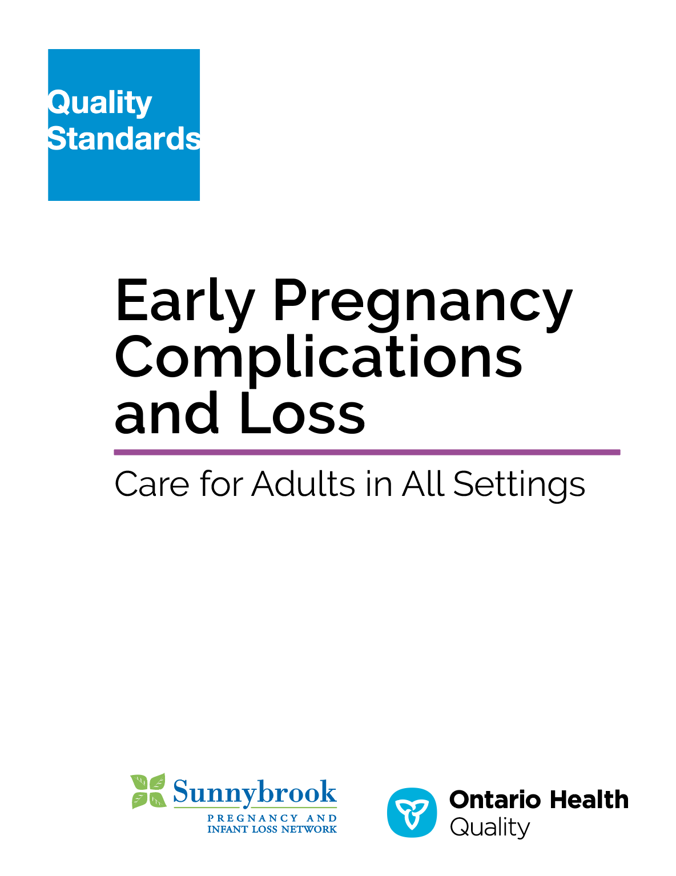
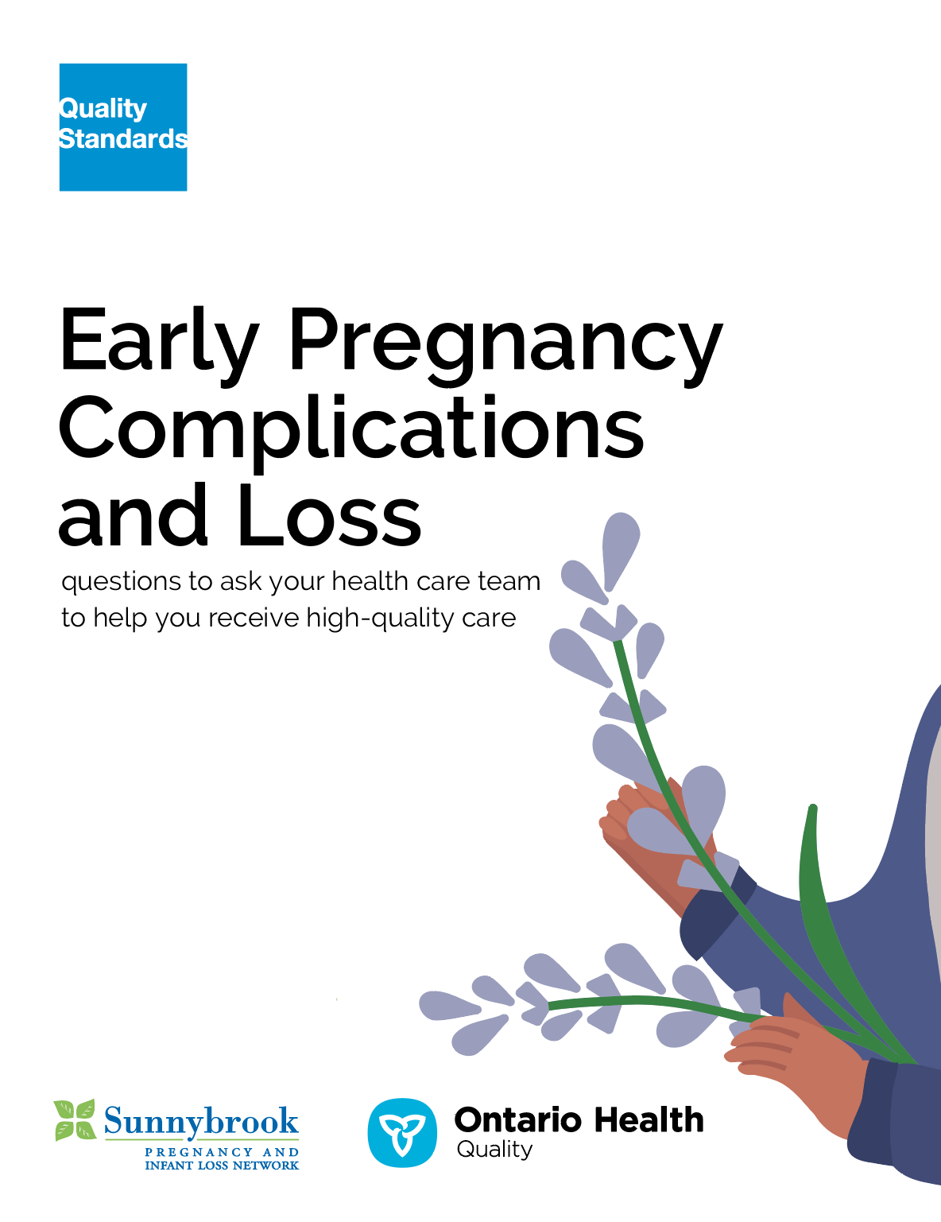
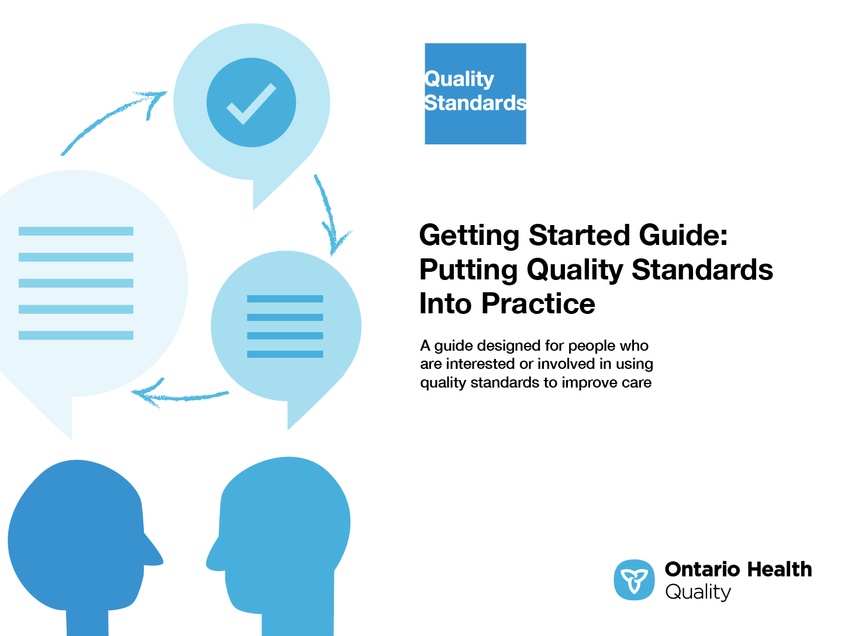
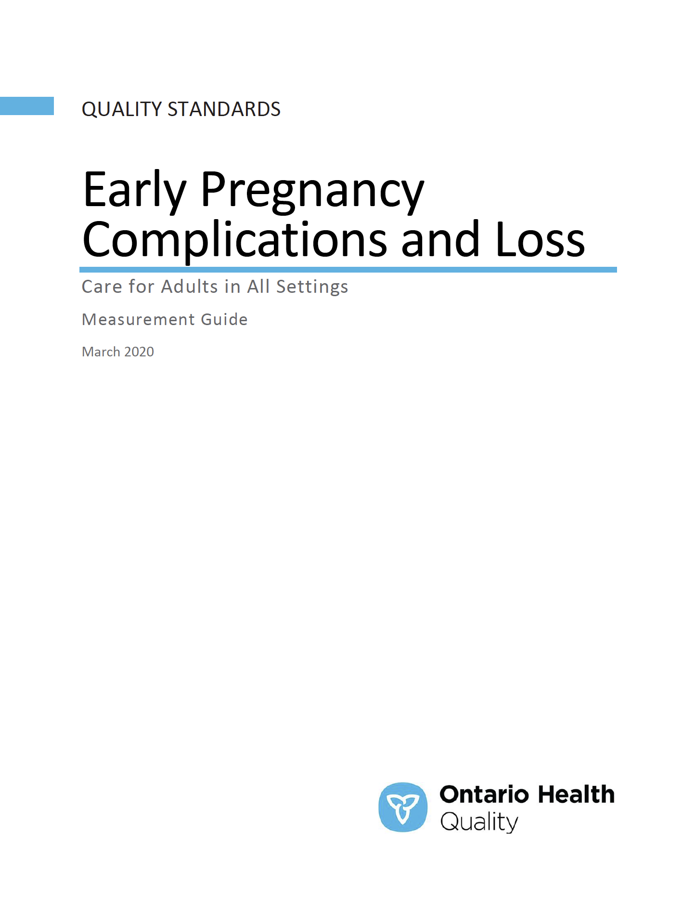
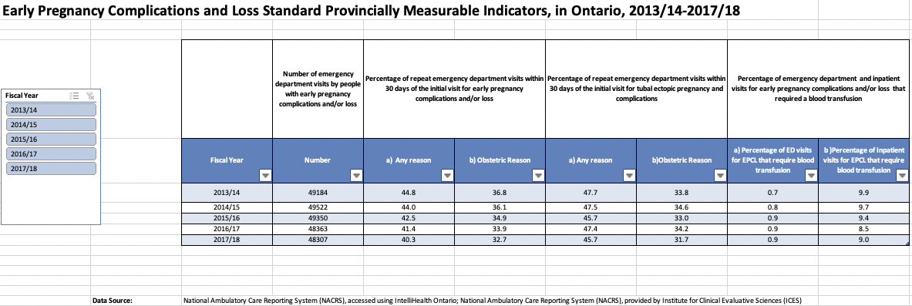
Quality Standards Resources
Quality Standard
Patient Conversation Guide
Getting Started Guide
Measurement Guide
Data Tables
Find these resources here:
https://www.hqontario.ca/evidence-to-improve-care/quality-standards/view-all-quality-standards/early-pregnancy-complications-and-loss
Notes:
Each quality standard focuses on a specific health care issue. The development of each quality standard is accompanied by an assortment of resources.
Through concise, easy-to-understand statements, quality standards outline what quality care looks like for a condition or topic based on the evidence.
Each quality standard is accompanied by:
A patient conversation guide
A getting started guide
Data tables
A measurement guide
Quality standards provide the blueprint to enable the health care system in Ontario to work better, facilitate smooth transitions, and ensure patients receive the same high-quality care, regardless of where they reside.

Slide 6
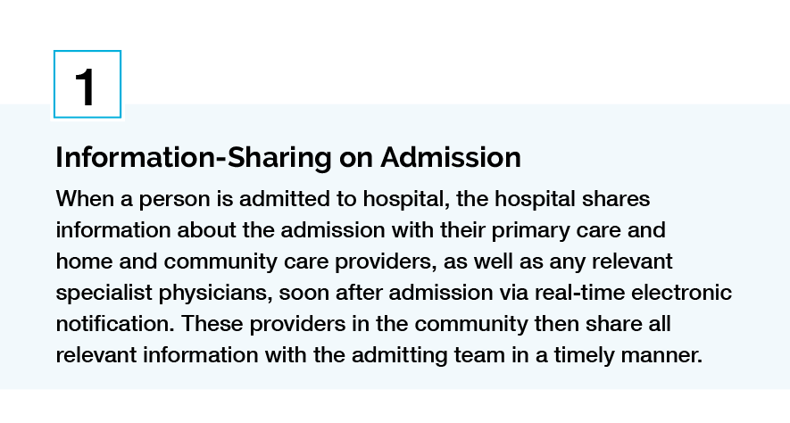
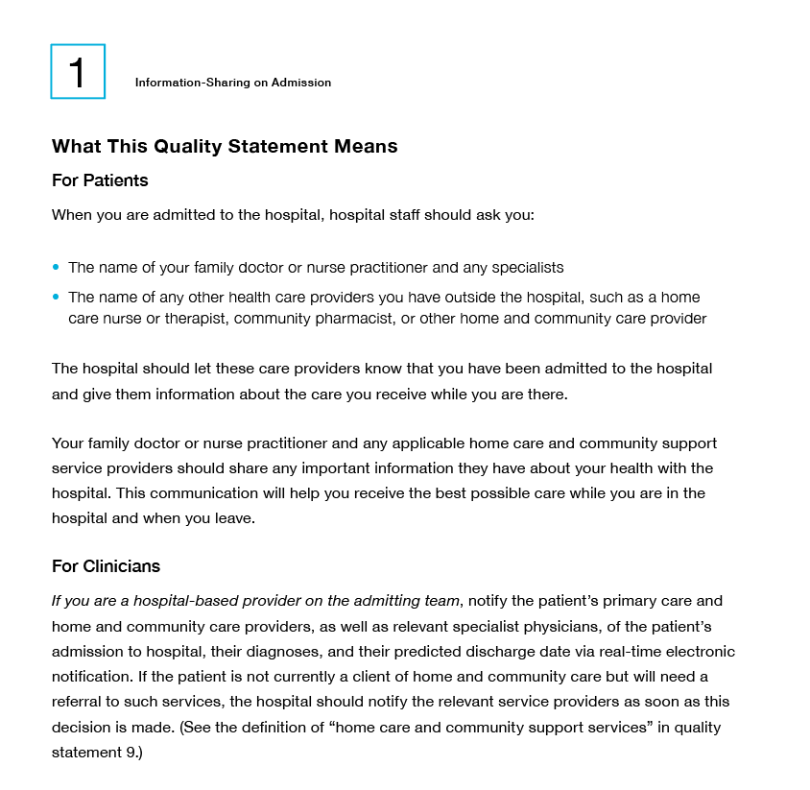
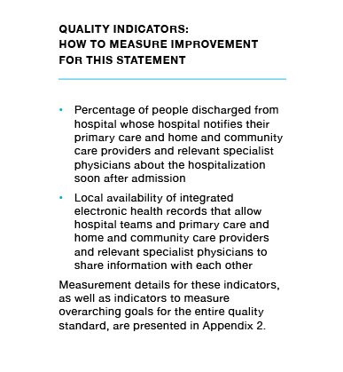
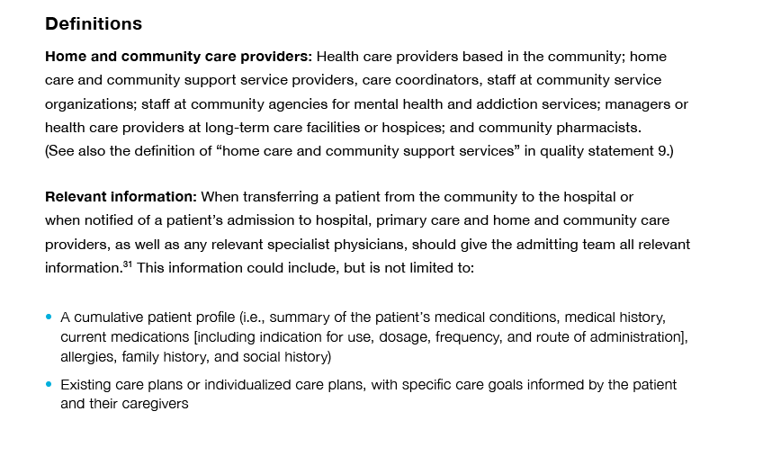
Inside the Quality Standard
The Statement
The Audience
Definitions
The Indicators
*Excerpts are from the Transitions between Hospital to Home quality standard

Slide 7
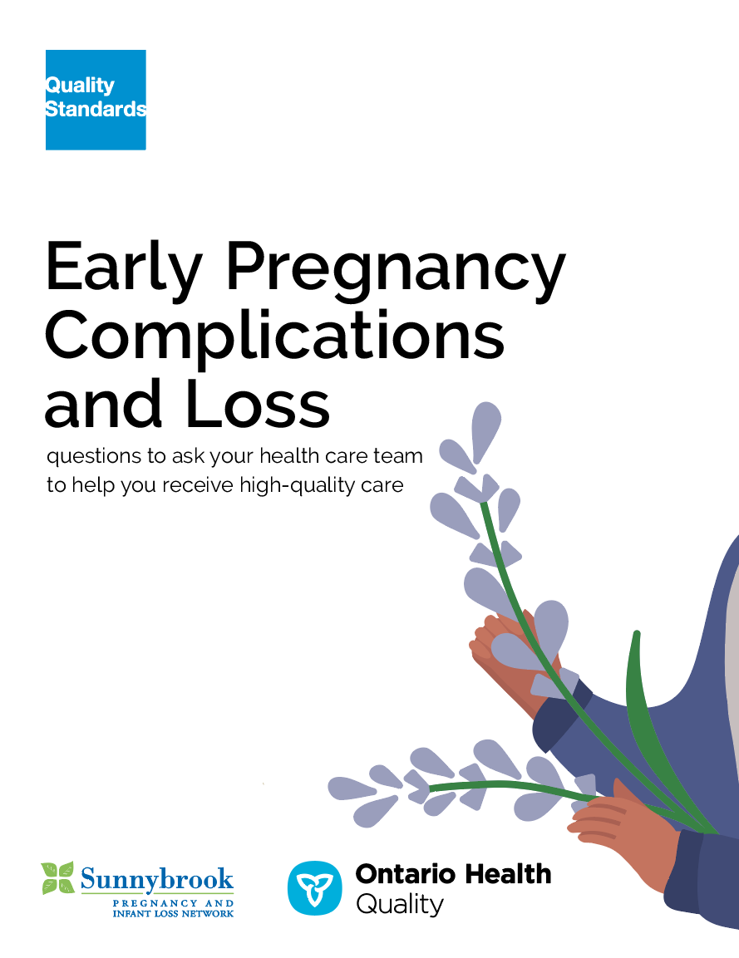
Quality Standards:
Patient Conversation Guide
The patient conversation guide
is designed to give patients information about what quality care looks like for various conditions based on the best evidence, so they can ask informed questions of their health care providers.
Notes:
Every quality standard includes a patient conversation guide for patients, families, caregivers, and the public.
Patient engagement in Quality Standards:
Membership on advisory committees
Focus groups and key informant interviews on topic specific content (when necessary)
Public comment period for each quality standard
Consultations on the patient conversation guide

Slide 8
Quality Standards:
How the Health Care System Can Support Implementation
Implementing quality standards can be challenging due to system-level barriers or gaps, many of which have been identified throughout the development of this standard. Ontario Health will work with and support other provincial partners, including Ministry of Health, to bridge system-level gaps to support the implementation of quality standards.

Slide 9
Quality Standards:
Implementation Tools
The Getting Started Guide:
Outlines the process for using the quality standard as a resource to deliver high-quality care
Contains evidence-based approaches, as well as useful tools and templates for implementing change ideas at the practice level
Notes:
But again, there are things we can do today despite the larger systemic barriers that may take time to resolve. The getting started guide is a document that outlines a process for using the quality standards as a resource to deliver high-quality care. It compiles a number of resources to support adoption such as links to implementation and quality improvement resources, examples, and activities for reflection, as well as templates and documents to support the implementation planning activities. The getting started guide also includes an Action Plan Template and examples on how Quality Improvement Plans can help to advance quality standards.

Slide 10
Quality Standards:
Measurement Guide
The measurement guide has two dedicated sections:
Local measurement: what you can do to assess the quality of care that you provide locally
Provincial measurement: how we can measure the success of the quality standard on a provincial level

Slide 11


Quality Standard Adoption Tools:
QUORUM
Quorum is an online community dedicated to improving the quality of health care in Ontario.
The Quality Standards Adoption Series highlights efforts in the field to implement changes and close gaps in care related to quality standard topics.
quorum.hqontario.ca
Notes:
The Quality Standards program has highlighted several stories from organizations and groups using various standards and statements within their clinical care settings, organization, or institutions; these are available through posts and discussions on Quorum.
As well, we are working on compiling resources and tools, for both clinicians and patients and families.
The focus is on implementation/adoption stories and how organizations are using quality standards in practice to inform care.
We’d love to hear from you if you are interested in contributing to a post or article.

Slide 12
Quality Standards:
Data Tables
Data tables can be used to examine variations in indicator results across the province. They include data on key indicators:
Over time for Ontario
Across regions in Ontario
For specific measures of equity (age, sex, rurality, and household income)

Slide 13
Why a Quality Standard for Early Pregnancy Complications and Loss (EPCL) Is Needed

Slide 14

In 2017/18, over 30,000 patients who visited the emergency department were diagnosed with an early pregnancy complication and/or loss
These patients had a total of 48,307 emergency department visits for EPCL
Source: National Ambulatory Care Reporting System (NACRS), accessed using IntelliHealth Ontario.

Slide 15
More than half of ED visits for EPCL (56.5%) were made by patients between 25 and 34 years of age
Figure: Number of ED visits for patients with an EPCL diagnosis, in Ontario,
by age group, 2017/18
Source: National Ambulatory Care Reporting System (NACRS), accessed using IntelliHealth Ontario.

Slide 16
Almost half of ED visits for EPCL were for hemorrhage in early pregnancy and threatened early pregnancy loss
Figure: Proportion of all ED visits with EPCL as main problem diagnosis, by diagnosis type (top 5), in Ontario, 2017/18
Source: National Ambulatory Care Reporting System (NACRS), accessed using IntelliHealth Ontario
*Threatened early pregnancy loss, antepartum condition or complication is coded as Threatened abortion, antepartum condition or complication

Slide 17
Almost 90% of patients with EPCL were discharged home after their ED visit
Figure: Disposition status for EPCL ED visits in Ontario, 2017/18
Source: National Ambulatory Care Reporting System (NACRS), accessed using IntelliHealth Ontario.

Slide 18

Many repeat ED visits occur within 30 days of the initial visit for EPCL
More than one-fourth of ED visits for EPCL were followed by a repeat visit for any condition within 30 days. Similar results were seen for tubal ectopic pregnancy and complications.
Data source: National Ambulatory Care Reporting System (NACRS), provided by Institute for Clinical Evaluative Sciences (ICES).

Slide 19

People living in rural areas had more repeat ED visits than people living in urban areas
In rural areas, 44.7% of people had repeat ED visits for any reason within 30 days of their initial visit for EPCL, compared with 39.8% in urban areas.
Data source: National Ambulatory Care Reporting System (NACRS), provided by Institute for Clinical Evaluative Sciences (ICES).

Slide 20
Repeat ED visits for any condition after an initial visit for EPCL were higher in younger age groups
Figure: ED revisit for any condition within 30 days of initial visit in ED for EPCL, in Ontario, by age group, 2017/18
Data source: National Ambulatory Care Reporting System (NACRS), provided by Institute for Clinical Evaluative Sciences (ICES).

Slide 21
Repeat ED visits for any condition within 30 days of initial visit for tubal ectopic pregnancy and complications ranged from 28.9% to 72.7% in sub-regions
Figure: ED revisit for any condition within 30 days of initial visit in ED for tubal ectopic pregnancy and complications, in Ontario, by sub-region, 2017/18
Data source: National Ambulatory Care Reporting System (NACRS), provided by Institute for Clinical Evaluative Sciences (ICES).

Slide 22
Those living in lowest-income neighbourhoods had more repeat ED visits for any condition within 30 days of an initial visit for tubal ectopic pregnancy and complications
Figure: ED revisit for any condition within 30 days of initial visit in ED for tubal ectopic pregnancy and complications, in Ontario, by neighbourhood income quintile, 2017/18
Data source: National Ambulatory Care Reporting System (NACRS), provided by Institute for Clinical Evaluative Sciences (ICES).

Slide 23
Impact of EPCL on people’s lives
The emotional and psychological impacts of early pregnancy loss can be serious. For some people, the emotional distress can result in clinical depression,
post-traumatic stress disorder, and/or anxiety.
Ontario families experiencing early pregnancy loss have reported a lack of kindness and respect from health care professionals, that they felt less supported, and that they experienced more stigma at the time of their loss, compared with people whose loss occurred later in the pregnancy.
Sources:
National Institute for Health and Care Excellence. Ectopic pregnancy and miscarriage: diagnosis and initial management [Internet].
London: The Institute; 2019 [cited 2019 May]. Available from: https://www.nice.org.uk/guidance/ng126
Watson J, Simmonds A, La Fontaine M, Fockler ME. Pregnancy and infant loss: a survey of families’ experiences in Ontario Canada.
BMC Pregnancy Childbirth. 2019;19(1):129.

Slide 24
Ectopic pregnancy is a potentially life-threatening event
Ectopic pregnancy is a potentially life-threatening event, and there is a need to standardize care for pregnant people and their families, as well as to ensure people are offered their choice of management options.
Currently, early pregnancy clinics offering assessment, diagnosis, and management of early pregnancy complications and loss outside of the ED setting are available in some communities in Ontario, but the services offered and hours of operation vary.

Slide 25
In a 2017 survey of Ontario EDs, 34 of the 63 EDs reported that they did not offer access to early pregnancy assessment services for women who presented in the ED with early pregnancy complications who were safe to discharge home.
Source: Glicksman R, McLeod S, Thomas J, Varner C. LO40: Services for emergency department patients experiencing early pregnancy complications: a survey of Ontario hospitals. CJEM. 2019;21(S1):S21-S2.

Slide 26
In the same study, 24/7 radiologist interpreted ultrasound was available to only 22 (34.9%) of 63 hospital sites. This is an important diagnostic service for people with early pregnancy complications.
Source: Glicksman R, McLeod S, Thomas J, Varner C. LO40: Services for emergency department patients experiencing early pregnancy complications: a survey of Ontario hospitals. CJEM. 2019;21(S1):S21-S2.

Slide 27

“An estimated one in five pregnancies end in a loss, and 80% of those are in the first trimester. I had two early pregnancy losses, one at 12 weeks and one at 10 weeks. They were both awful. Even if our doctors can’t change the outcome, we all need and deserve compassionate care. Miscarriage is an often-silent, unexpected, and heart-wrenching experience for many.
For health care professionals, this quality standard offers guidance on the diagnosis, follow-up, and management of the physical and emotional aspects of care for patients experiencing early pregnancy complications or loss. Whether you seek care at a large, teaching hospital on University Avenue or at a small, rural hospital in Northern Ontario, you should expect how you are treated to be similar. The patient conversation guide is also a key resource. It can help patients ask informed questions of their health care providers.”
— Amanda Ross-White, Lived Experience Advisor,
EPCL Quality Standard Advisory Committee
”

Slide 28
Quality Statements in Brief

Slide 29
Scope of the Early Pregnancy Complications and Loss Quality Standard
This quality standard addresses care for adults 18 years of age and older experiencing early pregnancy complications and/or loss in the first trimester of pregnancy.
This standard applies to all settings and includes diagnosis, follow-up, management, and psychosocial aspects of care for early pregnancy complications and loss up to 13 completed weeks of pregnancy.
This quality standard does not address other types of ectopic pregnancy, termination of pregnancy (therapeutic abortion), or molar pregnancy (gestational trophoblastic disease).
Notes:
A note on terminology:
Language used to talk about early pregnancy complications and loss should be led by the person and family. Health care professionals should avoid using terms such as “missed abortion” and should ask people what terminology they prefer when referring to the pregnancy (e.g., whether they prefer “baby” or “fetus”).

Slide 30
EPCL Quality Statement Topics
Comprehensive Assessment
Early Pregnancy Assessment Services
Pregnancy of Unknown Location
Diagnosis of Intrauterine Early Pregnancy Loss
Management Options for Intrauterine Early Pregnancy Loss
Management Options for Tubal Ectopic Pregnancy
Compassionate Care
Psychosocial and Peer Supports

Slide 31
Quality Statement 1:
Comprehensive Assessment
People with signs or symptoms of early pregnancy complications receive a comprehensive assessment that includes a transvaginal ultrasound and serum
beta-hCG measurement.

Slide 32
Quality Statement 2:
Early Pregnancy Assessment Services
People experiencing early pregnancy complications and loss have access to early pregnancy assessment services.

Slide 33
Quality Statement 3:
Pregnancy of Unknown Location
People with a pregnancy of unknown location
(not visible in the uterus or adnexa, on ultrasound) receive two serial serum beta-hCG measurements taken 48 hours apart. They are followed until a final diagnosis is made or until
beta-hCG returns to zero.

Slide 34
Quality Statement 4:
Diagnosis of Intrauterine Early Pregnancy Loss
Pregnant people who experience intrauterine early pregnancy loss receive this diagnosis as quickly as possible based on transvaginal ultrasound. While waiting to learn whether or not the pregnancy is viable, they receive information on who to contact, where to go, and how long it should take to receive a diagnosis. A diagnosis of early pregnancy loss is also communicated to the person’s primary or other relevant care providers.

Slide 35
Quality Statement 5:
Management Options for Intrauterine Early
Pregnancy Loss
People with intrauterine early pregnancy loss receive information on all potential management options (expectant, medical, and surgical) and are supported in making an informed decision on the most appropriate management approach for them, based on their diagnosis, clinical situation, values, and preferences.

Slide 36
Quality Statement 6:
Management Options for Tubal Ectopic Pregnancy
People with a confirmed tubal ectopic pregnancy receive information on all potential management options (expectant, medical, and surgical) and are supported to make an informed decision about their care. They have access to their preferred management option. Health care professionals closely monitor signs and symptoms and arrange appropriate access to follow-up care.

Slide 37
Quality Statement 7:
Compassionate Care
People and families experiencing early pregnancy complications and/or loss are treated with dignity and respect, and receive support in a sensitive manner, taking into account their individual circumstances and emotional responses, no matter where they receive their care.

Slide 38
Quality Statement 8:
Psychosocial and Peer Supports
People who experience an early pregnancy loss
and their families are offered information about psychosocial and peer support services and organizations.

Slide 39
How Success Can Be Measured
Notes:
The Early Pregnancy Complications and Loss Quality Standard Advisory Committee identified a small number of overarching goals for this quality standard. These have been mapped to indicators that may be used to assess quality of care provincially and locally.

Slide 40
How Success Can Be Measured Provincially
We recommend the following list of potential indicators to monitor the overall success of the standard provincially:
Number of emergency department visits by people with early pregnancy complications and/or loss
Percentage of repeat emergency department visits within 30 days of the initial visit for early pregnancy complications or loss
Percentage of repeat emergency department visits within 30 days of the initial visit for tubal ectopic pregnancy and complications
Percentage of emergency department and inpatient visits for early pregnancy complications or loss that required a blood transfusion

Slide 41
How Success Can Be Measured Locally
We recommend the following list of potential indicators to monitor the overall success of the standard locally:
Average time that people with early intrauterine pregnancy loss who need a dilatation and curettage (D&C) procedure wait for a D&C
Average wait time from first presentation to a health care professional of early pregnancy complications or loss, to a diagnosis via transvaginal ultrasound of early pregnancy complications or loss
Percentage of people with early pregnancy complications or loss who are satisfied with the care they receive
Notes:
Locally:
In addition, each quality statement within this quality standard is accompanied by one or more indicators.
These indicators are intended to guide measurement of quality improvement efforts related to implementation of the statement.

Slide 42


Pregnancy and Infant Loss (PAIL) Network
https://pailnetwork.sunnybrook.ca/

Slide 43
Connect with us:
https://quorum.hqontario.ca

