Slide 1

Eating Disorders
Quality Standard
Guiding evidence-based care for people in Ontario
Notes:
If you have any questions about the content of this presentation, please contact us at QualityStandards@ontariohealth.ca

Slide 2
Objectives
Overview of quality standards: What are they? How are they used?​
Why this quality standard is needed: Gaps and variations in quality of care for people with eating disorders in Ontario
Quality statements to improve care: The key statements in the eating disorders quality standard
Measures to support implementation: Indicators that can help measure your quality improvement efforts

Slide 3
Quality standards
Inform clinicians and patients what quality care looks like
Focus on conditions or processes where there are large variations in how care is delivered, or where there are gaps between the care provided in Ontario and the care patients should receive
Are grounded in the best available evidence
Notes:
Quality standards are a small set of high impact statements that describe optimal care where identified quality gaps exist in Ontario.
Voluntary and aspirational in nature​.
Designed to “raise the ceiling” with the goal of having the best possible care available to all Ontarians, regardless of where they live in the province.
There are many guidelines, professional standards, and other recommendations that contribute to the evidence ecosystem. Quality standards complement these resources.
Quality standards outline the what of care that should be delivered but are agnostic on who should be delivering it (unlike other CPGs, BPGs).
Quality standards are:
Concise: 5 to 15 strong, evidence-based statements focused on high-priority areas for improvement.
Accessible: help clinicians and provider organizations offer the highest-quality care; and patients to know what to discuss with their care providers (compared with CPGs that are quite dense, these are very accessible, also written in plain language).
Measurable: each statement is accompanied by one or more quality indicators (structure, process, or outcome), with a set of outcome measures for the overall standard.
Implementable: quality improvement tools and resources support each standard, to fuel adoption.

Slide 4
Quality standards
Help health care professionals know what care to offer, based on evidence and expert consensus
Help health care organizations measure, assess, and improve the quality of care they provide
Help ensure consistent,
high-quality care across the province
Help patients, residents, families, and caregivers know what to ask for in their care
Notes:
Patients, caregivers and the public can use quality standards to understand what excellent care looks like, what they should expect from their health care providers, and how to discuss the quality of their care.
Provincial regions and disease agencies can use quality standards to measure health outcomes, hold health service providers accountable for delivering high-quality care, and inform regional improvement strategies.
Provider organizations can use quality standards to measure and audit their quality of care, identify gaps, guide organizational improvement strategies, and inform clinical program investments.
Health care professionals can use quality standards to evaluate their practice and identify areas for personal and organizational quality improvement, and can incorporate the evidence-based statements into professional education.
Government can use quality standards to identify provincial priority areas, inform new data collection and reporting initiatives, and design performance indicators and funding incentives.

Slide 5
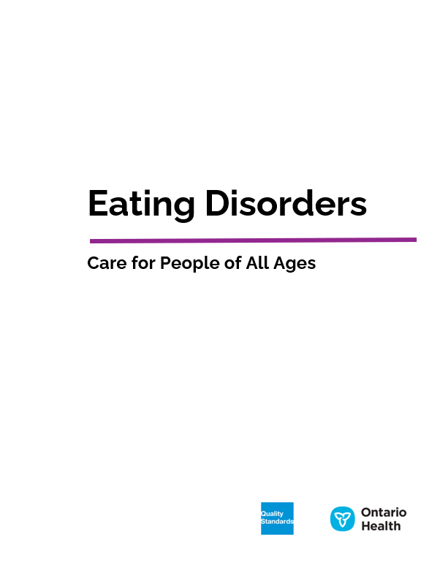
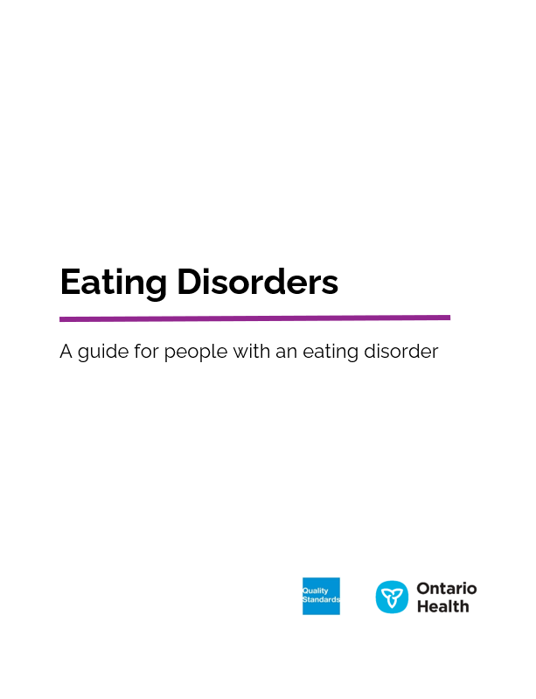
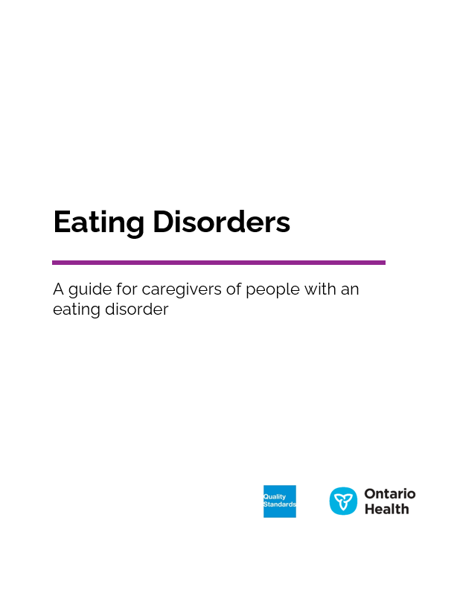
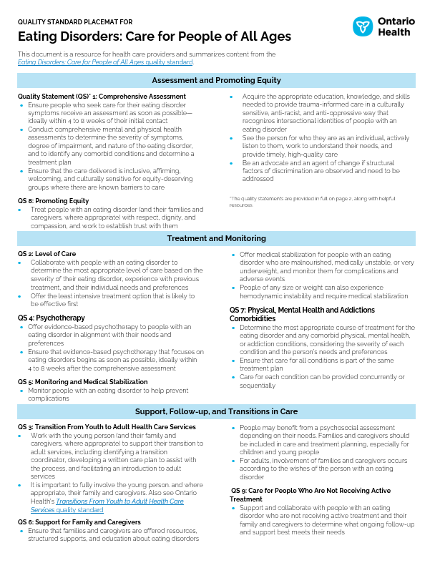
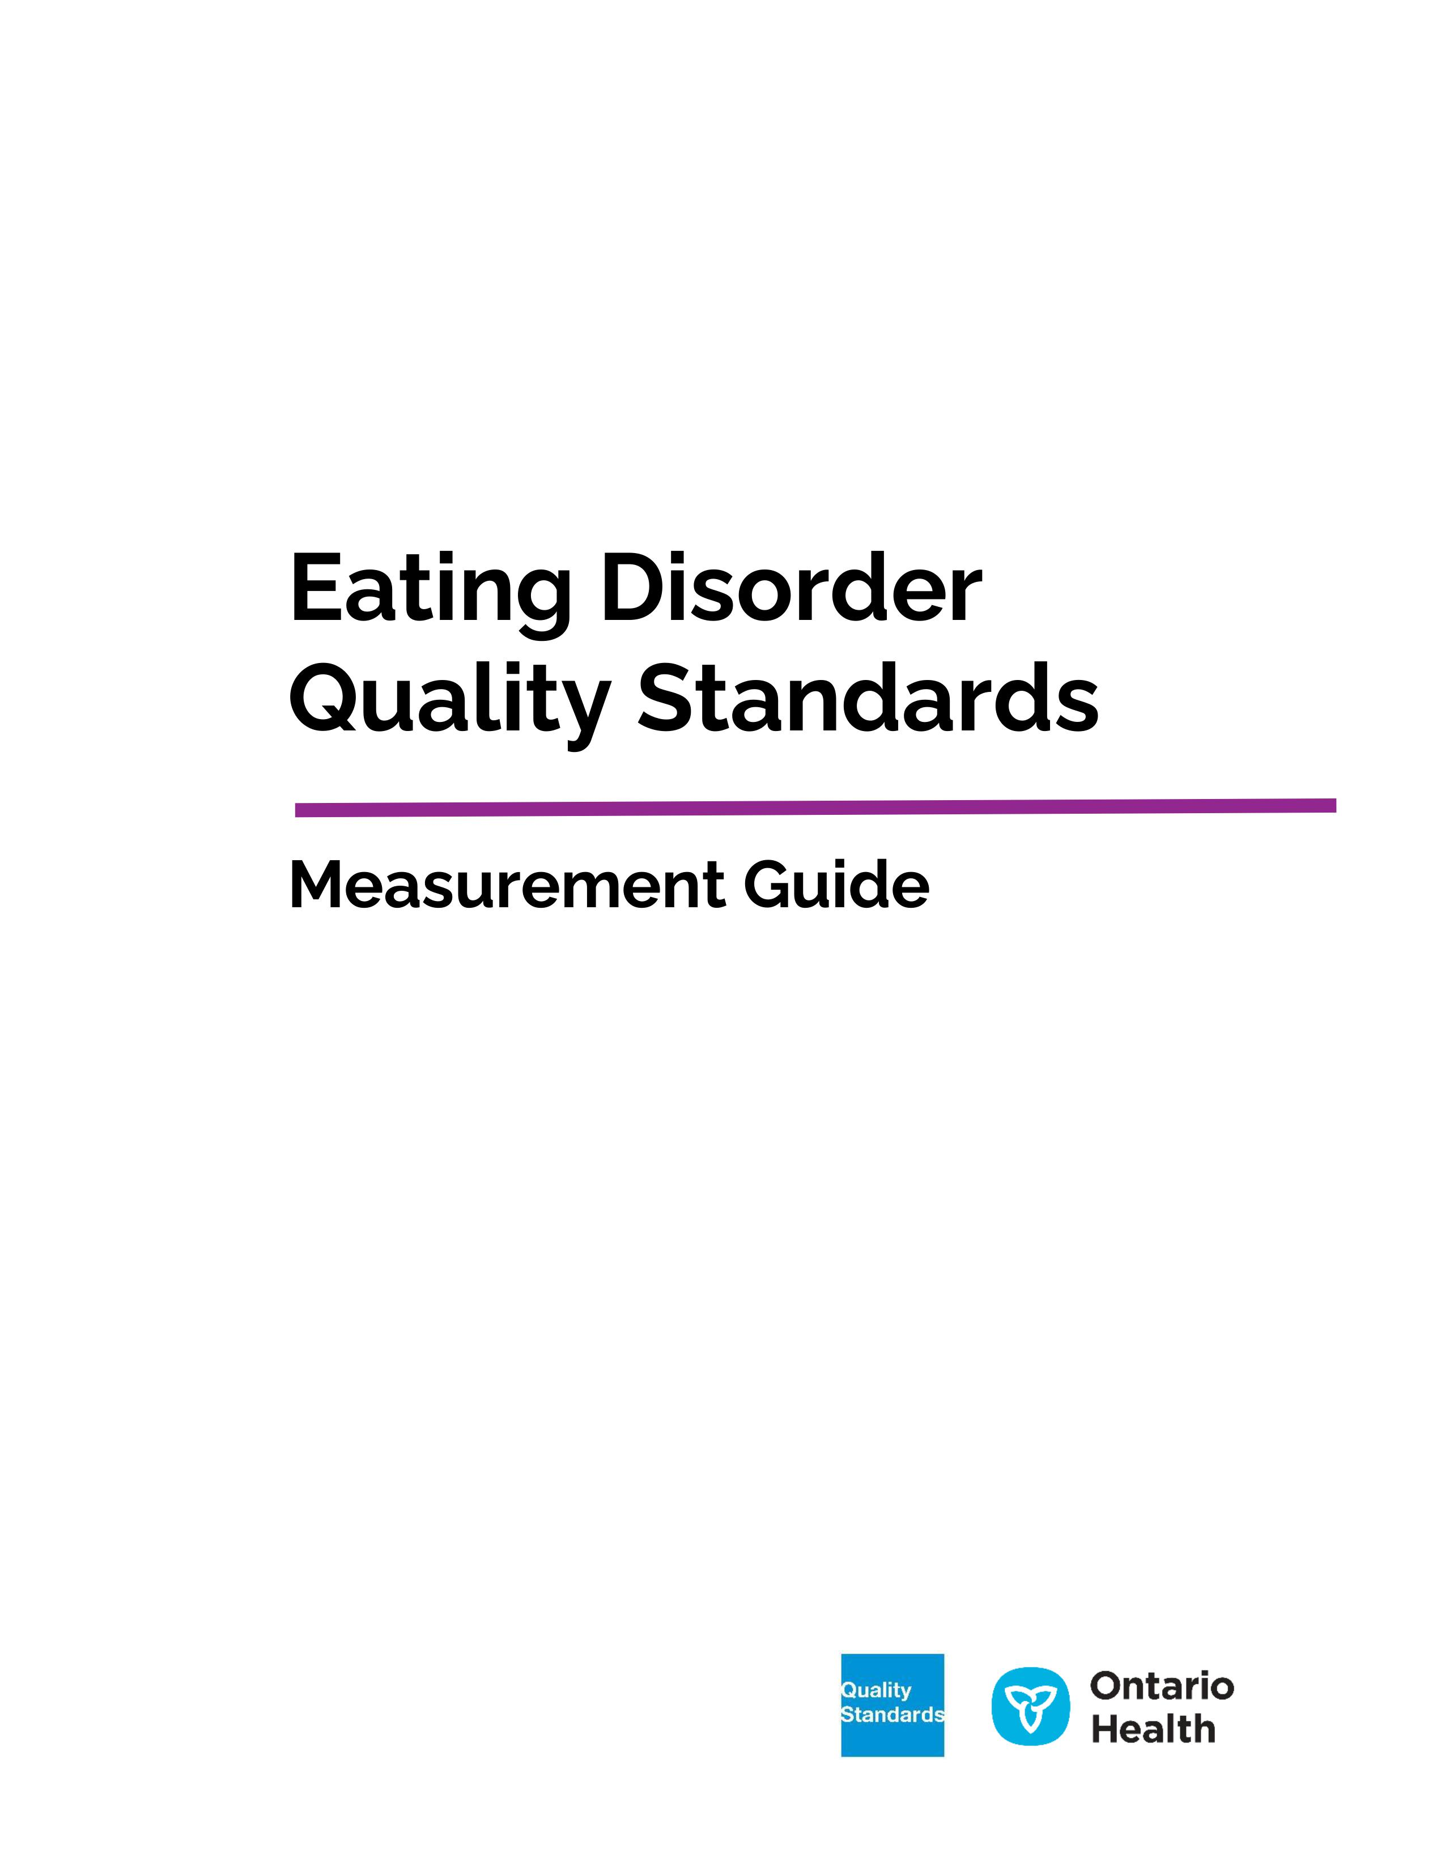
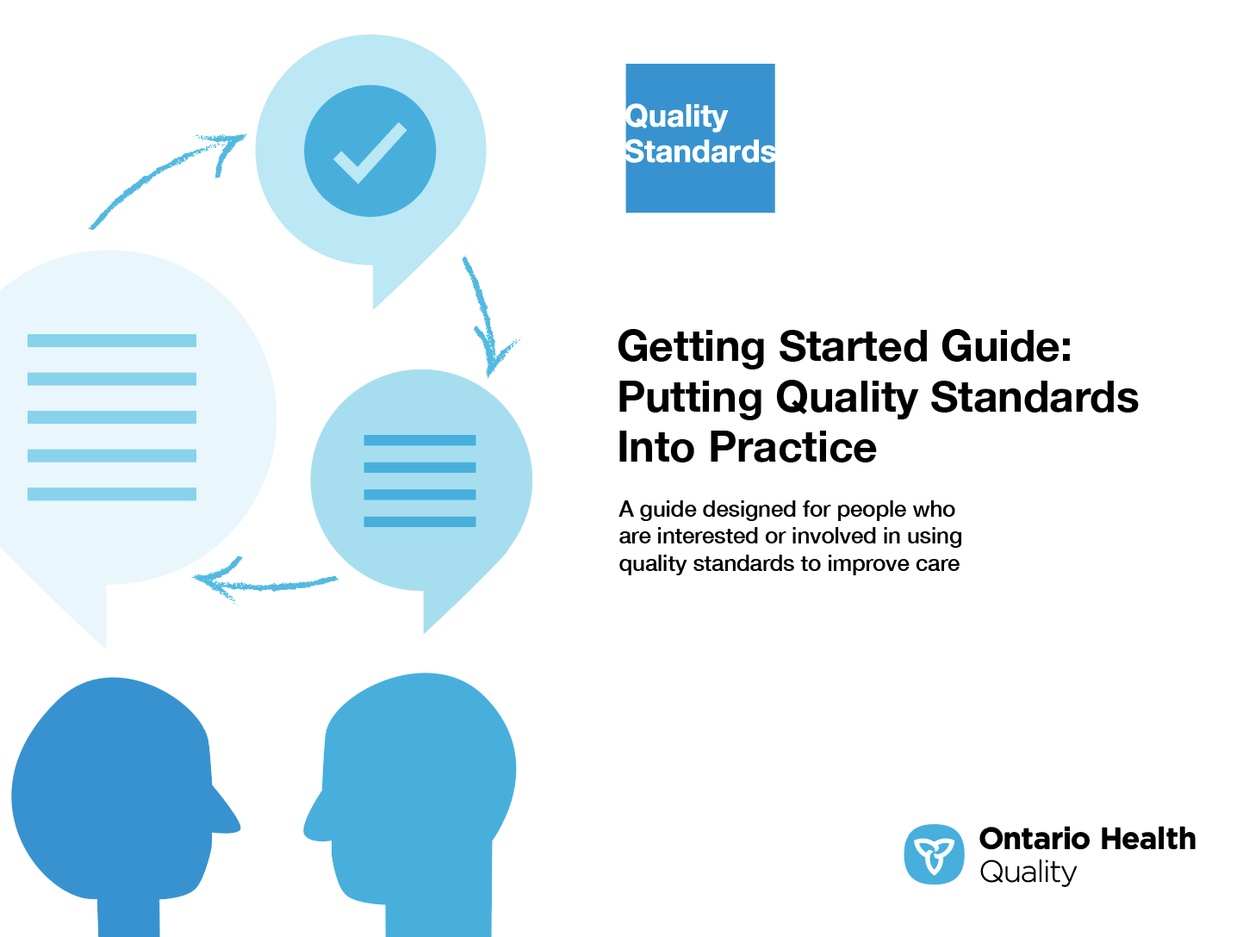
Quality standard resources
Quality Standard
Patient Guide
Caregiver Guide
Placemat
Getting Started Guide
Measurement Guide
Find these resources here:
https://www.hqontario.ca/evidence-to-improve-care/quality-standards/view-all-quality-standards/eating-disorders
Notes:
Each quality standard focuses on a specific health care issue. The development of each quality standard is accompanied by an assortment of resources.
Through concise, easy-to-understand statements, quality standards outline what quality care looks like for a condition or topic based on the evidence.
Each quality standard is accompanied by a:
Patient conversation guide
Getting started guide
Placemat
Measurement guide
Quality standards provide the blueprint to enable the health care system in Ontario to work better, facilitate smooth transitions, and ensure patients receive the same high-quality care, regardless of where they reside.

Slide 6
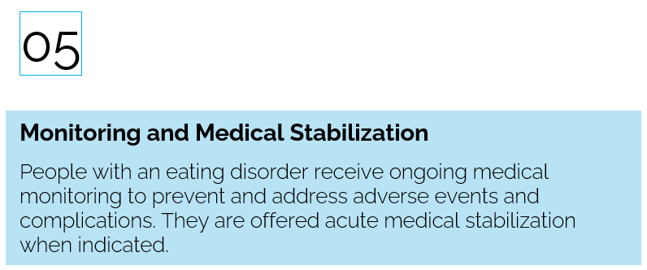
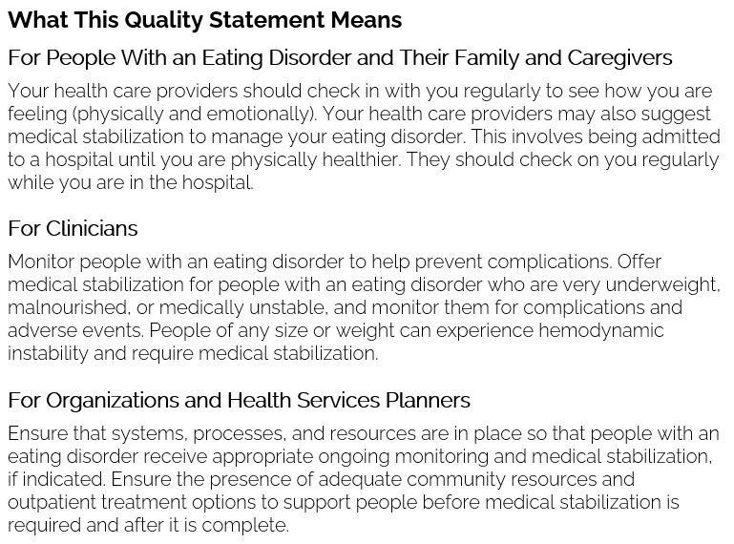
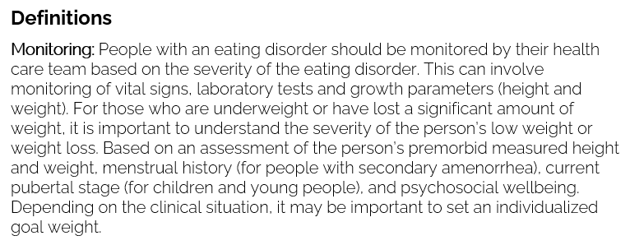
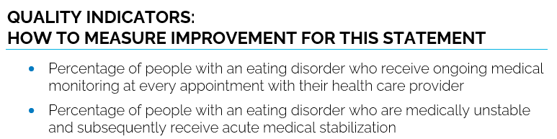
Inside the quality standard
The Audience Statements
The Quality Statement
The Definitions
The Indicators

Slide 7
Quality standards
Patient and caregiver guides
The patient and caregiver guides are designed to give patients, families, and caregivers information about what quality care looks like for various conditions based on the best evidence, so they can ask informed questions of their health care providers.
Notes:
Every quality standard includes a plain language summary for patients, families, caregivers and the public called the patient guide.
Patient engagement in quality standards:
Membership on advisory committees
Focus groups and key informant interviews on topic-specific content (when necessary)
Public comment period for each quality standard
Consultations on the patient guide

Slide 8
Quality standards
How the health care system can support implementation
Implementing quality standards can be challenging owing to system-level barriers or gaps; many of which have been identified throughout the development of this standard
Ontario Health will work with and support other provincial partners, including the Ministry of Health, to bridge system-level gaps to support the implementation of quality standards

Slide 9
Quality standards
Implementation tools
The Getting Started Guide:
Outlines the process for using the quality standard as a resource to deliver high-quality care
Contains evidence-based approaches, as well as useful tools and templates for implementing change ideas at the practice level
Notes:
There are things we can do today despite the larger systemic barriers that may take time to resolve. The Getting Started Guide is a document that outlines a process for using the quality standards as a resource to deliver high-quality care. It compiles a number of resources to support adoption, such as links to implementation and quality improvement resources, examples and activities for reflection, and templates and documents to support the implementation planning activities. The Getting Started Guide also includes an Action Plan Template and examples on how Quality Improvement Plans can help to advance quality standards.

Slide 10


Quality standard adoption tools
Quorum
Quorum is an online community dedicated to improving the quality of health care in Ontario.
The Quality Standards Adoption Series highlights efforts in the field to implement changes and close gaps in care related to quality standard topics.
quorum.hqontario.ca
Notes:
The Quality Standards program has highlighted several stories from organizations and groups using various standards and statements within their clinical care settings, organization, or institutions; these are available through posts and discussions on Quorum.
As well, we are working on compiling resources and tools, for both clinicians and patients and families.
The focus is on implementation/adoption stories and how organizations are using quality standards in practice to inform care.
We’d love to hear from you if you are interested in contributing to a post or article.

Slide 11
Quality standards
Measurement guide
The measurement guide has two dedicated sections:
Local measurement: what you can do to assess the quality of care that you provide locally
Provincial measurement: how we can monitor the progress being made to improve care on a provincial level

Slide 12
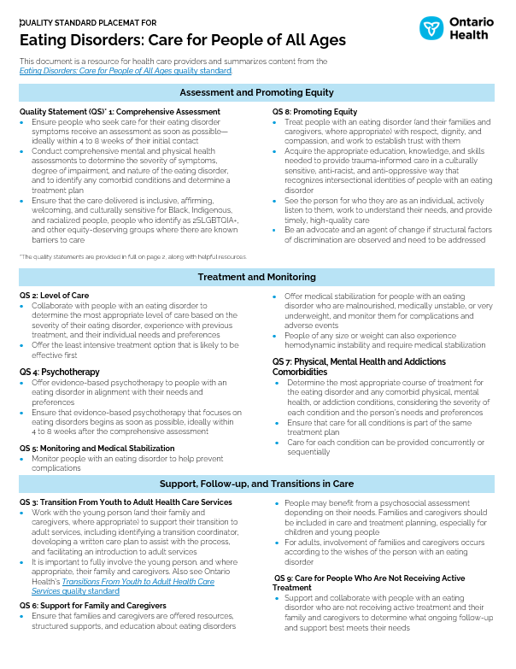
Quality standards
Placemat
The placemat is a quick-reference resource for clinicians that summarizes the quality standard and includes links to helpful resources and tools.

Slide 13
Why do we need a
quality standard for
eating disorders?

Slide 14


The COVID-19 pandemic has greatly impacted the rates of eating disorders.
Since the pandemic, the rate of emergency department visits related to an eating disorder increased by 57% and hospital admissions for children and young people increased by 52%^{3,4}
Eating disorders have been a severe and prevailing mental health condition, with an estimated prevalence of 4% of the population.^{1, 2}
Sources:
Konstantakopoulos G, Tchanturia K, Surguladze SA, David AS. Insight in eating disorders: clinical and cognitive correlates. Psychol Med. 2011;41(9):1951-61.
Vall E, Wade TD. Predictors of treatment outcome in individuals with eating disorders: a systematic review and meta-analysis. Int J Eat Disord. 2015;48(7):946-71.
Toulany A, Yu W, Lebenbaum M, Strauss R, Chen S, Guttmann A, et al. Impact of COVID-19 on adolescent and young adult acute mental health care utilization in Ontario, Canada. Toronto (ON): ICES; 2022.
Toulany A, Kurdyak P, Guttmann A, Stukel TA, Fu L, Strauss R, et al. Acute care visits for eating disorders among children and adolescents after the onset of the COVID-19 pandemic. J Adolesc Health. 2022;70(1):42-7.

Slide 15
From 2017 to 2021, emergency department use associated with eating disorders has increased by 59% across Ontario. Toronto region had the highest rate at over 23 visits per 100,000 people in fiscal year 2021.
CENTRAL
EAST
WEST
Rate of visits per 100,000 population
TORONTO
NORTH EAST
NORTH WEST
Sources:
National Ambulatory Care Reporting System (NACRS), Canadian Institute for Health Information (CIHI), accessed via IntelliHealth, provided by the Ministry of Health
Population estimates by county/municipality and region, Statistics Canada, accessed via IntelliHealth, provided by the Ministry of Health

Slide 16
Young people aged 10–17 years old saw a two-fold increase in emergency department visits associated with eating disorders after the start of the pandemic.
Sources:
National Ambulatory Care Reporting System (NACRS), Canadian Institute for Health Information (CIHI), accessed via IntelliHealth, provided by the Ministry of Health
Population estimates by county/municipality and region, Statistics Canada, accessed via IntelliHealth, provided by the Ministry of Health

Slide 17
Emergency department visits associated with eating disorders are often of high severity. Over a third resulted in admission to hospital (39%), and over half were triaged with high acuity and discharged home (51%), in fiscal year 2021.
Sources:
National Ambulatory Care Reporting System (NACRS), Canadian Institute for Health Information (CIHI), accessed via IntelliHealth, provided by the Ministry of Health.
Canadian Institute for Health Information. NACRS Emergency Department Visits and Length of Stay by Province/Territory, 2021–2022. Ottawa, ON: CIHI; 2022.
CTAS = Canadian Triage and Acuity Scale
Note: Discharged home includes all discharge dispositions that were not an inpatient hospital admission.

Slide 18



Ethnic minorities and immigrants are less likely to be identified as having an eating disorder in hospital contact data. People from racialized communities are often underdiagnosed and undertreated.^{2, 3}
In Canada, there is a higher prevalence of eating disorders in young people and those identifying as female.¹
Sources:
Herpertz-Dahlmann, B. Adolescent eating disorders. Child Adolesc Psychiatr Clin N Am. 2015; 24(1):177–196.
Toulany A, Kurdyak P, Guttmann A, Stukel TA, Fu L, Strauss R, et al. Acute care visits for eating disorders among children and adolescents after the onset of the COVID-19 pandemic. J Adolesc Health. 2022;70(1):42-7.
Martinson J. In the shadow of a pandemic, demand soars for eating disorder treatment [Internet]. Vancouver (BC): CBC News; 2020 Dec 9 [cited 2022 Aug]. Available from: https://www.cbc.ca/news/canada/british-columbia/anorexia-shadow-pandemic-1.5833677

Slide 19
Almost 1 in 5 mental health related emergency department visits for young people aged 10–17 years old involved an eating disorder diagnosis in fiscal year 2021. This has increased three-fold since 2017.
Source:
National Ambulatory Care Reporting System (NACRS), Canadian Institute for Health Information (CIHI), accessed via IntelliHealth, provided by the Ministry of Health

Slide 20
The rate of hospitalization associated with eating disorders for young people (10–17 years old) has increased by approximately 50% since March 2020.
Sources:
Discharge abstract database (DAD), Canadian Institute for Health Information (CIHI), accessed via IntelliHealth, provided by the Ministry of Health
Population estimates by county/municipality and region, Statistics Canada, accessed via IntelliHealth, provided by the Ministry of Health
Note: Hospitalization data includes DAD records only and not Ontario Mental Health Reporting System (OMHRS) records

Slide 21
Anorexia was associated with approximately 55% of hospitalizations for eating disorders and bulimia approximately 9% in fiscal year 2021.
Source:
Discharge abstract database (DAD), Canadian Institute for Health Information (CIHI), accessed via IntelliHealth, provided by the Ministry of Health
Note: Hospitalization data includes DAD records only and doesn’t encompass Ontario Mental Health Reporting System (OMHRS) records.

Slide 22

NORTH WEST:
6.1 days
NORTH EAST:
8.6 days
In fiscal year 2021, the average length of stay in acute care associated with an eating disorder was 13.6 days across Ontario. This varied three-fold across Ontario Health regions, ranging from 6.1 days in the North West region to 21.0 days in the East region.
EAST :
21.0 days
CENTRAL:
14.1 days
WEST:
10.8 days
TORONTO:
11.6 days
Source:
Discharge abstract database (DAD), Canadian Institute for Health Information (CIHI), accessed via IntelliHealth, provided by the Ministry of Health
Note: Hospitalization data includes DAD records only and doesn’t encompass Ontario Mental Health Reporting System (OMHRS) records.

Slide 23
“Currently, access to treatments that are known to be effective for eating disorders is not consistent across Ontario and it is very challenging to navigate the system due to a lack of coordination and standardization of care. As a psychologist working in our public healthcare system, I have often witnessed the impacts of these gaps in the system on patients and their families. The development of this quality standard is a big step forward—toward a future in which all Ontarians are able to access high quality and effective treatments for eating disorders regardless of their age, where they live, physical and other mental health diagnoses, or economic situation. ”
– Kathryn Trottier, Co-chair, Eating Disorders Quality Standard Advisory Committee and Provincial Clinical Lead, Eating Disorders

Slide 24
“Having lived experience with an eating disorder, I wish that the quality standard had existed when I was initially seeking treatment as a teenager. Eating disorders are such highly stigmatized, complex mental illnesses and more information about them is desperately needed, especially in clinical settings. I know this quality standard will help so many individuals with eating disorders and the people that care for them get the treatment and support they deserve.”
– Chloe Grande, Lived Experience Advisor, Eating Disorders Quality Standard Advisory Committee

Slide 25
Quality statements to improve care

Slide 26
Scope of this quality standard
This quality standard addresses care for people of all ages with anorexia nervosa, bulimia nervosa, or binge-eating disorder. It applies to all care settings
Many of the statements may apply to other types of eating disorders beyond those listed above, although this quality standard does not directly address the management of these conditions
Notes:
Scope of This Quality Standard
This quality standard addresses
A separate quality standard addresses

Slide 27
Quality statement topics
Comprehensive Assessment
Level of Care
Transition From Youth to Adult Health Care Services
Psychotherapy
Monitoring and Medical Stabilization
Support for Family and Caregivers
Physical, Mental Health, and Addiction Comorbidities
Promoting Equity
Care for People Who Are Not Receiving Active Treatment

Slide 28
Quality statement 1:
Comprehensive Assessment
People with signs and symptoms of an eating disorder have timely access to comprehensive mental and physical health assessments. The assessment is used to determine whether they have a specific eating disorder, the severity of their symptoms, the degree of impairment, and whether they have any comorbid conditions, and to establish a plan of care.

Slide 29
Quality statement 2:
Level of Care
People with an eating disorder receive the most appropriate level of care, which takes into consideration their needs, goals, and experience with previous treatment.

Slide 30
Quality statement 3:
Transition From Youth to Adult Health Care Services
Young people with an eating disorder who will transition out of youth-oriented services to adult-oriented services receive transitional care that focuses on continuity and helping the young person develop independence.

Slide 31
Quality statement 4:
Psychotherapy
People with an eating disorder receive timely access to evidence-based psychotherapy that considers their individual needs and preferences.

Slide 32
Quality statement 5:
Monitoring and Medical Stabilization
People with an eating disorder receive ongoing medical monitoring to prevent and address adverse events and complications. They are offered acute medical stabilization when indicated.

Slide 33
Quality statement 6:
Support for Family and Caregivers
Families and caregivers of people with an eating disorder are offered resources, structured support, and education in a way that meets their needs.

Slide 34
Quality statement 7:
Physical, Mental Health, and Addiction Comorbidities
People with an eating disorder who have physical, mental health, or addiction comorbidities are offered treatment for their eating disorder and other conditions as part of a comprehensive plan of care.

Slide 35
Quality statement 8:
Promoting Equity
People with an eating disorder experience care from health care providers and a health care system that uses an anti-racist, anti-discrimination, anti-stigma, and anti-oppressive approach. Health care providers promote a culture that is compassionate, trauma informed, unbiased, and respectful of people's diversity. They build trust with people with an eating disorder and their families and caregivers, work to remove barriers to accessing care, and provide care equitably.

Slide 36
Quality statement 9:
Care for People Who Are Not Receiving Active Treatment
People with an eating disorder who are not receiving active treatment are offered medical monitoring, support, and follow-up that meets their needs and preferences.

Slide 37
Measurement to support improvement

Slide 38
Indicators that can be measured using provincial data
Rate of emergency department visits for an eating disorder in the past year
Rate of hospital admissions for an eating disorder in the past year
Percentage of people with an emergency department visit for an eating disorder in the past year for whom the emergency department was the first point of contact for mental health or addictions care

Slide 39
Indicator that can be measured using only local data
Percentage of people with an eating disorder who report an improvement in their quality of life

Slide 40
Data sources and acknowledgement
The data used in this presentation were sourced from IntelliHealth Ontario, a data repository maintained by the Ontario Ministry of Health
The data sources accessed via IntelliHealth included the Discharge Abstract Database (DAD) and the National Ambulatory Care Reporting System (NACRS) from the Canadian Institute for Health Information (CIHI). The analyses, conclusions, opinions, and statements expressed herein are those of the authors and not necessarily those of CIHI

Slide 41

Thank you.
LET’S CONTINUE THE CONVERSATION
HQOntario.ca | OntarioHealth.ca
@OntarioHealthOH
Ontario Health
@OntarioHealthOH
Ontario Health

