Slide 1
QUALITY STANDARDS
Gender-Affirming Care for Gender-Diverse People: Care for Adults
Guiding evidence-based care for people in Ontario
Notes:
If you have any questions about the content of this presentation, please contact us at QualityStandards@OntarioHealth.ca

Slide 2
Objectives
Overview of quality standards: What are they? How are they used?​
Why this quality standard is needed: Gaps and variations in quality of gender-affirming care for gender-diverse adults in Ontario
Quality statements to improve care: The key statements in the Gender-Affirming Care for Gender-Diverse People: Care for Adults quality standard
Measures to support improvement: Indicators that can help measure your quality improvement efforts

Slide 3
Quality standards
Inform clinicians and patients about what quality care looks like
Focus on conditions or processes where there are large variations in how care is delivered or where there are gaps between the care provided in Ontario and the care patients should receive
Are grounded in the best available evidence
Notes:
Quality standards are a small set of high impact statements that describe optimal care where identified quality gaps exist in Ontario.
Voluntary and aspirational in nature​.
Designed to “raise the ceiling” with the goal of having the best possible care available to all Ontarians, regardless of where they live in the province.
There are many guidelines, professional standards, and other recommendations that contribute to the evidence ecosystem. Quality standards complement these resources.
Quality standards outline the what of care that should be delivered but are agnostic on who should be delivering it (unlike other CPGs, BPGs).
Quality standards are:
Concise: 5 to 15 strong, evidence-based statements focused on high-priority areas for improvement.
Accessible: help clinicians and provider organizations offer the highest-quality care; and patients to know what to discuss with their clinicians (compared with CPGs that are quite dense, these are very accessible, also written in plain language).
Measurable: each statement is accompanied by one or more quality indicators (structure, process, or outcome), with a set of outcome measures for the overall standard.
Implementable: quality improvement tools and resources support each standard, to fuel adoption.

Slide 4
Quality standards
Help patients, residents, families, and care partners know what to ask for in their care
Help clinicians know what care to offer based on evidence and expert consensus
Help health care organizations measure, assess, and improve the quality of care they provide
Help ensure consistent, high-quality care across the province
Notes:
Patients, care partners, and the public can use quality standards to understand what excellent care looks like, what they should expect from their clinicians, and how to discuss the quality of their care.
Provincial regions and disease agencies can use quality standards to measure health outcomes, hold health service providers accountable for delivering high-quality care, and inform regional improvement strategies.
Provider organizations can use quality standards to measure and audit their quality of care, identify gaps, guide organizational improvement strategies, and inform clinical program investments.
Clinicians can use quality standards to evaluate their practice and identify areas for personal and organizational quality improvement, and can incorporate the evidence-based statements into professional education.
Government can use quality standards to identify provincial priority areas, inform new data collection and reporting initiatives, and design performance indicators and funding incentives.

Slide 5
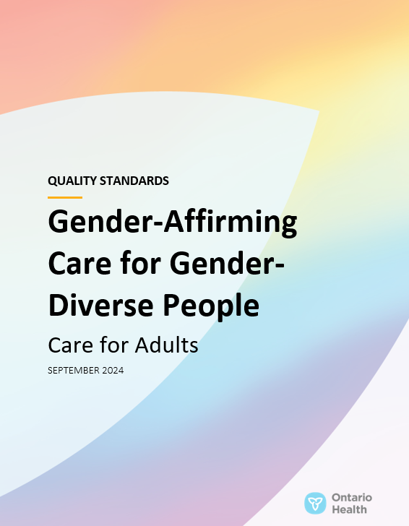
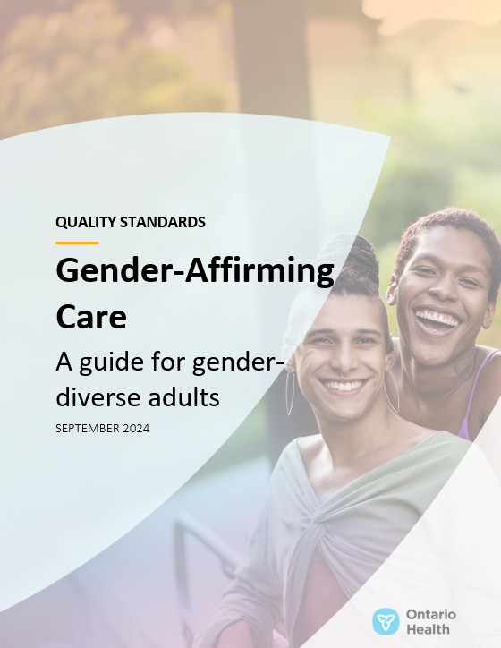
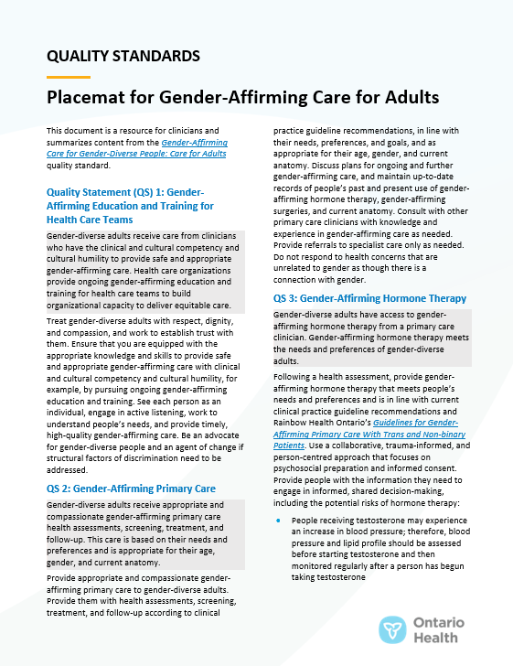
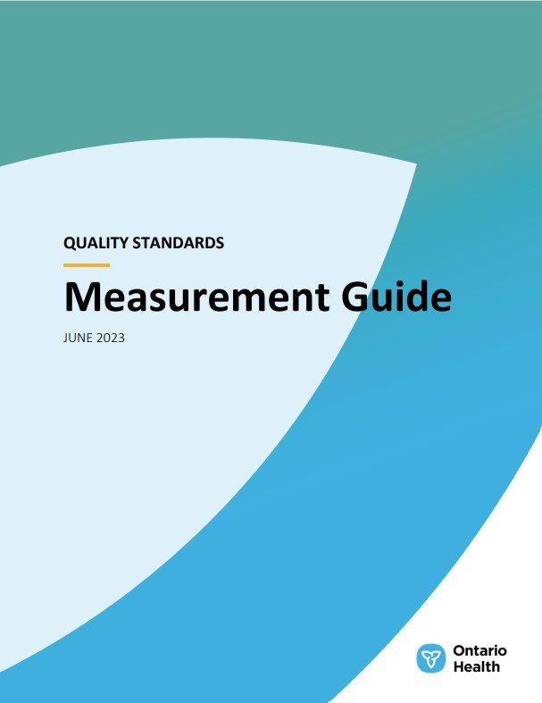
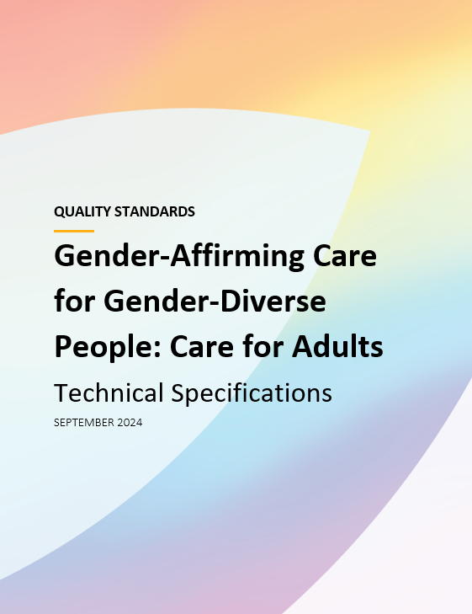
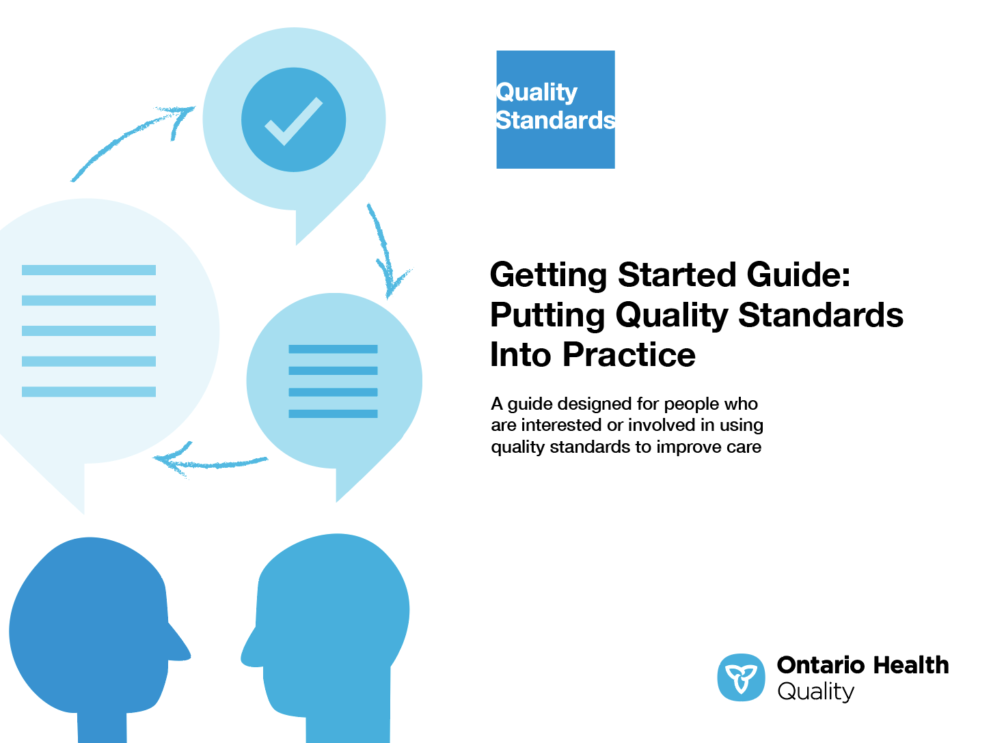
Quality standard resources
Quality Standard
Patient Guide
Placemat
Case for Improvement Deck
Measurement Guide
Technical Specifications
Getting Started Guide
Find these resources here: https://www.hqontario.ca/evidence-to-improve-care/quality-standards/view-all-quality-standards/gender-affirming-care-for-gender-diverse-people
Notes:
Each quality standard focuses on a specific health care issue. The development of each quality standard is accompanied by an assortment of resources.
Through concise, easy-to-understand statements, quality standards outline what quality care looks like for a condition or topic based on the evidence.
Each quality standard is accompanied by a:
Patient guide
Placemat
Case for Improvement Deck
Measurement guide
Technical specifications
Getting started guide
Quality standards provide the blueprint to enable the health care system in Ontario to work better, facilitate smooth transitions, and ensure patients receive the same high-quality care, regardless of where they reside.

Slide 6
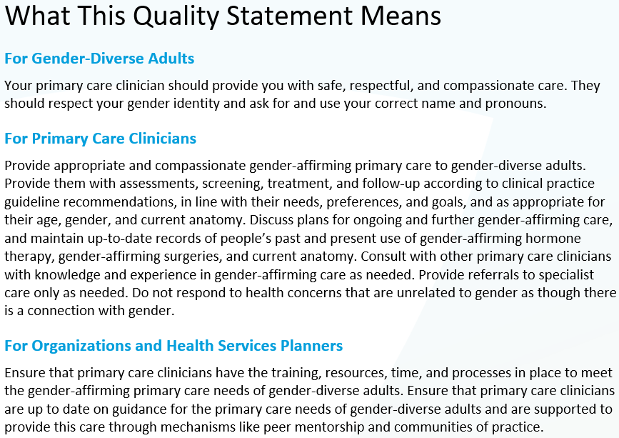
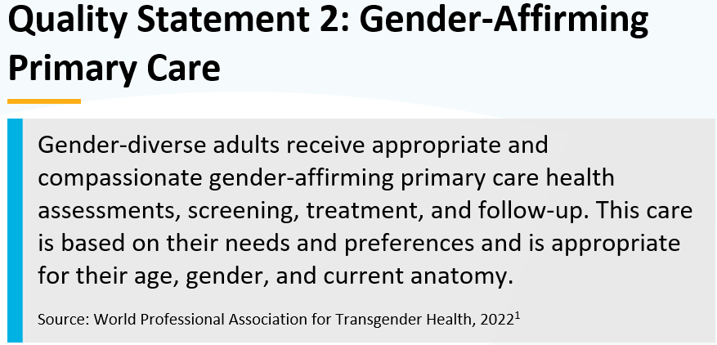
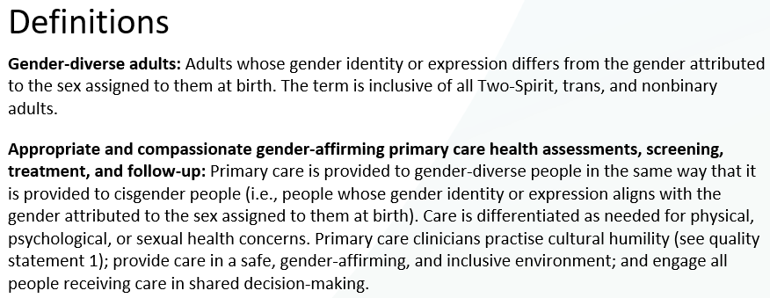
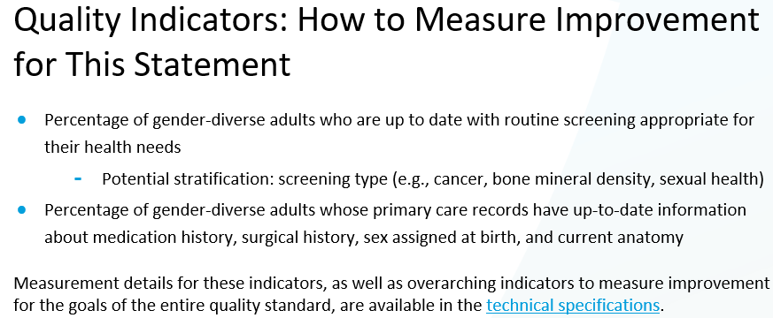
Inside the quality standard
The Quality Statement
The Audience Statements
The Definitions
The Indicators

Slide 7
Patient guide
Quality standards
The patient guide is designed to give patients information about what quality care looks like for various conditions based on the best evidence, so they can ask informed questions of their health care teams.
Notes:
Every quality standard includes a plain language summary for patients, families, care partners and the public called the patient guide.
Patient engagement in quality standards:
Membership on advisory committees
Focus groups and key informant interviews on topic-specific content (when necessary)
Public comment period for each quality standard
Consultations on the patient guide

Slide 8
Placemat
Quality standards
The placemat is a quick-reference resource for clinicians that summarizes the quality standard and includes links to helpful resources and tools.

Slide 9
Case for improvement deck
Quality standards
The case for improvement deck describes why the quality standard was created and shows some of the data used to develop it. Champions can use or adapt this deck to build support for the quality standard in their organizations.

Slide 10
How the health care system can support implementation
Quality standards
Implementing quality standards can be challenging owing to system-level barriers or gaps, many of which have been identified throughout the development of this standard
Ontario Health will work with and support other provincial partners, including the Ministry of Health, to bridge system-level gaps and support the implementation of quality standards

Slide 11
Implementation tools
Quality standards
The Getting Started Guide:
Outlines the process for using the quality standard as a resource to deliver high-quality care
Contains evidence-based approaches, as well as useful tools and templates for implementing change ideas at the practice level
Notes:
There are things we can do today despite the larger systemic barriers that may take time to resolve. The Getting Started Guide is a document that outlines a process for using the quality standards as a resource to deliver high-quality care. It compiles a number of resources to support adoption, such as links to implementation and quality improvement resources, examples and activities for reflection, and templates and documents to support the implementation planning activities. The Getting Started Guide also includes an Action Plan Template and examples on how Quality Improvement Plans can help to advance quality standards.

Slide 12
Quorum
Quality standard adoption tools
Quorum is an online community dedicated to improving the quality of health care in Ontario.
The Quality Standards Adoption Series highlights efforts in the field to implement changes and close gaps in care related to quality standard topics.
quorum.hqontario.ca
Notes:
The Quality Standards program has highlighted several stories from organizations and groups using various standards and statements within their clinical care settings, organization, or institutions; these are available through posts and discussions on Quorum.
As well, we are working on compiling resources and tools, for both clinicians and patients and families.
The focus is on implementation/adoption stories and how organizations are using quality standards in practice to inform care.
We’d love to hear from you if you are interested in contributing to a post or article.

Slide 13
Measurement guide
Quality standards
The measurement guide describes:
The measurement principles behind the quality indicators included in quality standards
The types of indicators included in quality standards
How local and provincial data are collected and measured

Slide 14
Technical specifications
Quality standards
The technical specifications report outlines 2 types of measurement:
Provincial measurement: how we can monitor the progress being made to improve care at the provincial level
Local measurement: what you can do to assess the quality of care that you provide locally

Slide 15
Why do we need a quality standard for gender-affirming care?

Slide 16
1 in 300 people in Ontario (0.33%) identified as gender diverse in the 2021 census,³ and the need for gender-affirming care is growing.⁴
Gender-affirming care refers to health care that recognizes and affirms the gender identity and expression of gender-diverse people, whether socially, medically, legally, or some combination of these.^{1,2}
Gender-diverse people experience discrimination, minority stress, and barriers to accessing health care, all of which contribute to worse physical and mental health outcomes compared with their cisgender peers.^{5,6}
Coleman et al, 2022, Standards of care for the health of transgender and gender diverse people, version 8.
Reisner and Murchison, 2016, A global research synthesis of HIV and STI biobehavioural risks in female-to-male transgender adults.
Statistics Canada, 2021 Canadian census, The Daily, April 27, 2022: Canada is the first country to provide census data on transgender and nonbinary people.
Vandermorris and Metzger, 2023, An affirming approach to caring for transgender and gender-diverse youth.
Flentje et al, 2022, Minority stress, structural stigma, and physical health among sexual and gender minority individuals: examining the relative strength of the relationships.
Hendricks and Testa, 2012, A conceptual framework for clinical work with transgender and gender nonconforming clients: an adaptation of the Minority Stress Model.
16
Notes:
Definitions
Minority stress: for gender-diverse people, a burden of stress specific to a person’s gender-diverse status that is experienced in addition to the typical stress experienced by cisgender people. Minority stress among gender-diverse people includes gender-based discrimination, oppression, rejection, victimization, and anticipation of discrimination or victimization, as well as nonaffirmation of gender identity, internalized transphobia, concealment of sexual and gender identity, structural societal stigma, and internalization of stigma.
Cisgender: describes people whose gender identity or expression aligns with the gender typically attributed to the sex assigned to them at birth.

Slide 17
To meet the needs of the growing gender-diverse community, access to gender-affirming care will need to be made more widely available
Gender diversity is increasing; the rise may be associated with the dismantling of societal stigmas.^{1,2} As a result, the gender-diverse community in Canada is younger, with an average age of 39.4 years, compared to 48.0 years among the cisgender population.¹
Statistics Canada, 2021 Canadian census, The Daily, April 27, 2022: Canada is the first country to provide census data on transgender and nonbinary people.
Zhang et al, 2020, Epidemiological considerations in transgender health: a systematic review with focus on higher quality data.

Slide 18
Gender-diverse adults have lower self-reported health and more unmet health care needs than cisgender adults
Between 2019 and 2021, 82.1% of gender-diverse adults in Ontario rated their health positively (good, very good, or excellent), compared to 87.7% of cisgender adults¹
In the 2019 Trans PULSE Canada survey, 42.3% of gender-diverse respondents in Ontario reported having unmet health care needs in the past year,² compared to 4.8% in the general Ontario population³
1. Canadian Community Health Survey, Ontario Share File; 2019, 2020, and 2021 combined.
2. Scheim et al., 2021, Health care access among transgender and nonbinary people in Canada, 2019: a cross-sectional survey.
3. Canadian Community Health Survey, Ontario Share File, 2019 and 2020 combined.

Slide 19
Gender-diverse adults rate their mental health considerably worse than cisgender adults
49.7% of gender-diverse adults rated their mental health positively (good, very good, or excellent)*, compared to 85.5% of cisgender adults¹
Systemic discrimination, lack of access to gender-affirming care, marginalization, and economic insecurity may be associated with negative mental health outcomes among gender-diverse people²⁻⁴
*
Canadian Community Health Survey, Ontario Share File; 2019, 2020, and 2021 combined.
Statistics Canada, 2020, Experiences of violent victimization and unwanted sexual behaviours among gay, lesbian, bisexual and other sexual minority people, and the transgender population, in Canada, 2018.
Statistics Canada, 2021 Canadian census, The Daily, April 27, 2022, Canada is the first country to provide census data on transgender and nonbinary people.
4. Bhatt et al., 2022, Gender-affirming care for transgender patients.
*Interpret these findings with caution as there was a high sampling variability in the estimate.

Slide 20
Gender-affirming care is important for addressing mental health disparities, including suicidality and mental health diagnoses
Gender-diverse people were more likely to report poorer mental health outcomes, such as having contemplated suicide or having a diagnosis of a mood or anxiety disorder, than cisgender people¹
Access to gender-affirming care is associated with better mental health outcomes and reduced suicidality^{2,3}
Statistics Canada, 2018 survey of safety in public and private spaces, reported in The Daily, April 27, 2022, Canada is the first country to provide census data on transgender and nonbinary people.
Tordoff et al, 2022, Mental health outcomes in transgender and nonbinary youths receiving gender-affirming care.
Jarrett et al, 2021, Gender-affirming care, mental health, and economic stability in the time of COVID-19: a multi-national, cross-sectional study of transgender and nonbinary people.

Slide 21
Gender-affirming primary care is not currently accessible to all gender-diverse adults in Ontario
Between 2019 and 2021, 88.3% of gender-diverse adults and 88.5% of cisgender adults in Ontario reported having a regular primary care clinician (a family doctor, general practitioner, or nurse practitioner)¹
In the 2019 Trans PULSE Canada survey,² only 54.6% of gender-diverse respondents in Ontario reported having a primary care clinician with whom they felt comfortable discussing issues related to their gender identity
54.6%: comfortable experience with gender-affirming primary care
88.3%: access to primary care
Canadian Community Health Survey, Ontario Share File, 2019 and 2020 combined.
Scheim et al, 2021, Health care access among transgender and nonbinary people in Canada, 2019: a cross-sectional survey.

Slide 22
Gender-affirming hormone therapy is most often prescribed in primary care
The 2019 Trans PULSE Canada survey found that two-thirds of the hormone therapy of Ontario respondents was prescribed in primary care¹
Primary care clinicians are encouraged to take an active role in helping people access gender-affirming hormone therapy.^{2,3} Better access via primary care may reduce overall wait times, alleviate the strain on specialists, and improve patient safety by diverting people away from unregulated sources of hormone therapy medications
Personal communication, Trans PULSE Canada study team, June 6, 2024.
Centre for Addiction and Mental Health, Gender Identity Clinic, accessed June 2024.
Rainbow Health Ontario, How do I access or start hormone replacement therapy?, accessed June 2024.

Slide 23
Opportunities exist to improve clinical competency in meeting the health care needs of gender-diverse adults
Limited education and training on gender-affirming care has been identified as a constraint among medical students and nurses in Ontario.^{1,2} A qualitative analysis of physician-perceived barriers found difficulty in accessing resources and referral networks, as well as deficits in medical knowledge, as main barriers.³
The following key enablers to build capacity among clinicians to provide gender-affirming care have been identified^{4,5}:
Continuing education
Clinical practice guidelines
Professional shadowing
Mentorship
Including gender-affirming care in curricula
Chan et al, 2016, Gaps in transgender medicine content identified among Canadian medical school curricula.
Ziegler, 2020, The integral role of nurses in primary care for transgender people: a qualitative descriptive study.
Snelgrove et al, 2012, “Completely out-at-sea” with “two-gender medicine”: a qualitative analysis of physician-side barriers to providing healthcare for transgender patients.
Ziegler et al, 2020, Models of care and team activities in the delivery of transgender primary care: an Ontario case study.
Rainbow Health Ontario, 2021, Guidelines for gender-affirming primary care with trans and non-binary patients.

Slide 24
”
“Navigating my gender identity has been a complex journey, especially with my perspective as a health care professional. The lack of clear guidelines and training on gender-affirming care for clinicians has been a challenge. Despite my professional background and advocacy skills, I have found it difficult to fully embrace my true self without fear of judgment.” “When discussing my chronic gynecological health issues, I have hesitated to include my gender identity as a part of my health care plan.” “It is essential for gender-diverse people to feel supported and understood within the health care system. Establishing formal standards of care demonstrates acceptance and protection of those in the gender-diverse community. Gender-diverse people deserve to receive the same level of care as anyone else. The patient guide that accompanies this quality standard empowers gender-diverse adults to advocate for their care and seek treatment without hesitation.” “The introduction of the gender-affirming care quality standards has given me the confidence to express myself authentically, both personally and professionally.”
– Elena “Leni” Salgado, Lived Experience Advisor and Pharmacist, Gender-Affirming Care Quality Standard Advisory Committee

Slide 25
”
“All gender-diverse people should have access to gender-affirming care, but unfortunately in Ontario this access remains limited for many reasons. One is a shortage of clinicians offering this care, which could be attributed to a lack of training, administrative barriers, and difficulty with system navigation.”
“This quality standard sets a benchmark for what all gender-diverse adults should expect when seeking gender-affirming care. My hope is that the standard will also lead to improved training and expertise among primary care clinicians and a removal of barriers to providing gender-affirming care.”
– Dr. Sean Robinson, Family Physician, Gender-Affirming Care Quality Standard Advisory Committee

Slide 26
Quality statements to improve care

Slide 27
Scope of this quality standard
This quality standard addresses care for gender-diverse adults aged 18 years and older. The quality standard focuses on gender-affirming care and the primary care needs of gender-diverse adults, including health assessment, screening, treatment, and follow-up. It addresses primary care referral for gender-affirming surgical assessment, based on clinical evidence, but not specific surgical procedures.
Although many statements may apply to intersex people, this quality standard does not directly address the care of intersex people.
Notes:
Note: A separate quality standard will address gender-affirming care for adolescents.

Slide 28
Quality statement topics
Gender-affirming education and training for health care teams
Gender-affirming primary care
Gender-affirming hormone therapy
Gender-affirming mental health care
Gender-affirming health care environments

Slide 29
Gender-affirming education and training for health care teams
Quality statement 1:
Gender-diverse adults receive care from clinicians who have the clinical and cultural competency and cultural humility to provide safe and appropriate gender-affirming care. Health care organizations provide ongoing gender-affirming education and training for health care teams to build organizational capacity to deliver equitable care.

Slide 30
Gender-affirming primary care
Quality statement 2:
Gender-diverse adults receive appropriate and compassionate gender-affirming primary care health assessments, screening, treatment, and follow-up. This care is based on their needs and preferences and is appropriate for their age, gender, and current anatomy.

Slide 31
Gender-affirming hormone therapy
Quality statement 3:
Gender-diverse adults have access to gender-affirming hormone therapy from a primary care clinician. Gender-affirming hormone therapy meets the needs and preferences of gender-diverse adults.

Slide 32
Gender-affirming mental health care
Quality statement 4:
Gender-diverse adults are offered trauma-informed, person-centred, gender-affirming care for mental health and substance use concerns as needed. These concerns are considered concurrently with gender incongruence and gender diversity as needed. Care for all aspects of health and well-being is delivered as part of a comprehensive care plan.

Slide 33
Gender-affirming health care environments
Quality statement 5:
Gender-diverse adults receive care in a safe, trauma-informed, gender-affirming, and culturally responsive environment. Person-centred care is provided throughout their care journeys.

Slide 34
Measures to support improvement
Notes:
The Gender-Affirming Care Quality Standard Advisory Committee identified a set of overarching goals for this quality standard. These have been mapped to indicators that may be used to assess quality of care provincially and locally.

Slide 35
Indicators that can be measured using provincial data
Percentage of gender-diverse adults who have a primary care clinician
Percentage of gender-diverse adults who feel their health is good
35

Slide 36
Indicators that can be measured using only local data
Percentage of gender-diverse adults who feel comfortable discussing health care needs related to their gender identity with their primary care clinician
Percentage of gender-diverse adults who felt they were able to access gender-affirming care within an appropriate time frame
Percentage of primary care clinicians who feel comfortable and sufficiently knowledgeable to care for gender-diverse adults
36

Slide 37
Data sources and acknowledgement
Some of the data used in this presentation are from the Canadian Community Health Survey Ontario Share Files (developed by Statistics Canada and provided by the Ontario Ministry of Health), as well as other Statistics Canada surveys. However, the analyses, conclusions, opinions, and statements expressed herein are those of the authors and not necessarily those of the Ontario Ministry of Health or Statistics Canada.
37

Slide 38
Thank you

