Slide 1


Glaucoma Quality Standard
Guiding evidence-based care for adults with primary open-angle glaucoma and those who are at risk for primary open-angle glaucoma in Ontario
Notes:
If you have any questions about the content of this presentation, please contact us at QualityStandards@hqontario.ca

Slide 2
Objectives
Overview of quality standards
What are they? How are they used?​
Why this quality standard is needed
Gaps and variations in quality of care for adults with primary open-angle glaucoma and those who are at risk for primary open-angle glaucoma in Ontario
How success can be measured
Indicators that can help measure your quality improvement efforts
Quality statements in brief
The key recommendations in the glaucoma quality standard

Slide 3

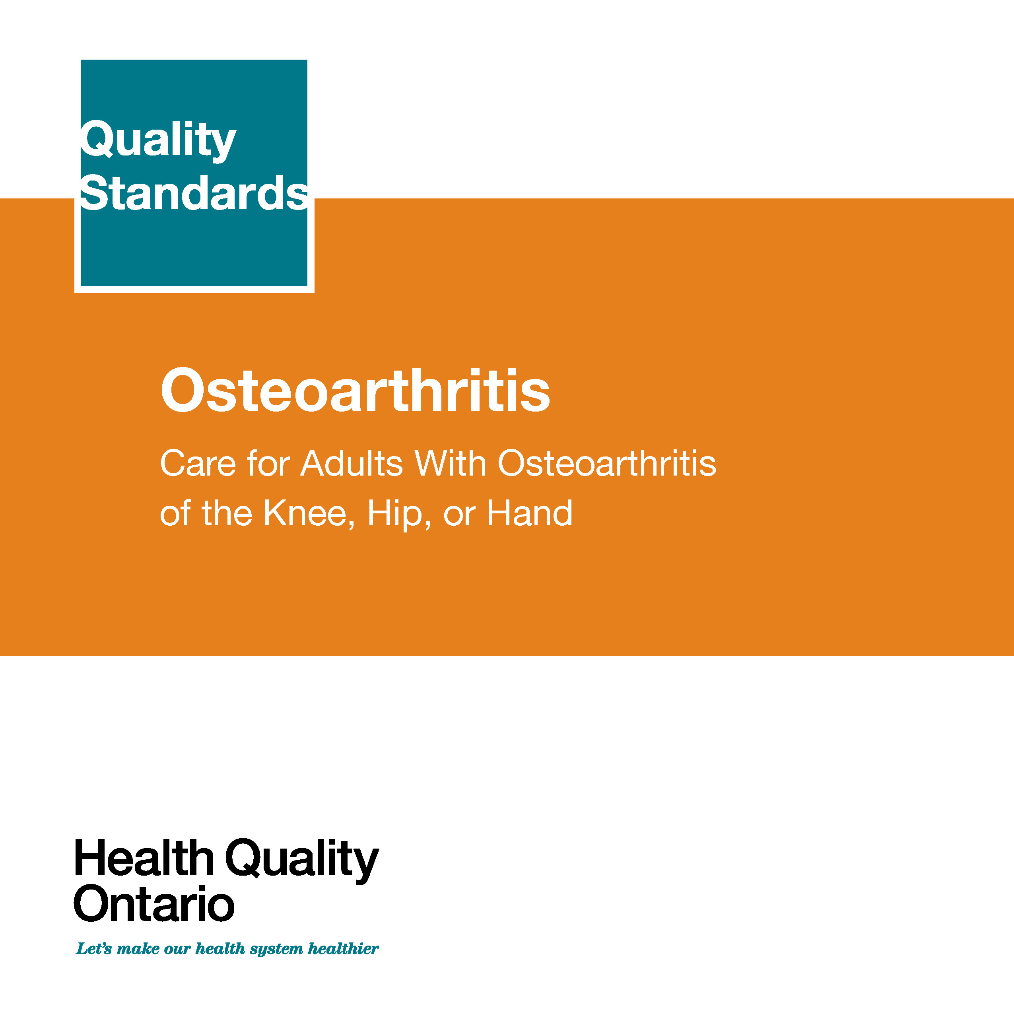
Quality Standards
Inform clinicians and patients what quality care looks like
Focus on conditions where there are large variations in how care is delivered, or where there are gaps between the care provided in Ontario and the care patients should receive
Are grounded in the best available evidence
Notes:
Quality standards are a smaller set of high impact statements that describe optimal care where identified quality gaps exist in Ontario.
Voluntary and aspirational in nature​.
Designed to “raise the ceiling” with the goal of having the best possible care available to all Ontarians, regardless of where they live in the province.
There are many guidelines, professional standards, and other recommendations that contribute to the evidence ecosystem. Quality standards complement these resources.
Quality standards outline the what of care that should be delivered but is agnostic on who should be delivering it (unlike other CPGs, BPGs).
Quality standards are:
Concise: 5 to 15 strong, evidence-based statements focused on high priority areas for improvement.
Accessible: help clinicians and provider organizations offer the highest quality care; and patients to know what to discuss with their care providers (compared to CPGs that are quite dense, these are very accessible, also written in plain language).
Measurable: each statement is accompanied by one or more quality indicators (structure, process or outcome), with a set of outcome measures for the overall standard.
Implementable: quality improvement tools and resources support each standard, to fuel adoption.

Slide 4
Quality Standards
Help health care professionals know what care to offer, based on evidence and expert consensus
Help health care organizations measure, assess, and improve the quality of care they provide
Help ensure consistent,
high-quality care across
the province
Help patients, residents, families, and caregivers know what to ask for in their care
Notes:
Patients, caregivers and the public can use quality standards to understand what excellent care looks like, what they should expect from their health care providers, and how to discuss the quality of their care.
LHINs and disease agencies can use quality standards to measure health outcomes, hold health service providers accountable for delivering high-quality care, and inform regional improvement strategies.
Provider organizations can use quality standards to measure and audit their quality of care, identify gaps, guide organizational improvement strategies, and inform clinical program investments.
Health care professionals can use quality standards to evaluate their practice and identify areas for personal and organizational quality improvement, and can incorporate the evidence-based statements into professional education.
Government can use quality standards to identify provincial priority areas, inform new data collection and reporting initiatives, and design performance indicators and funding incentives.

Slide 5



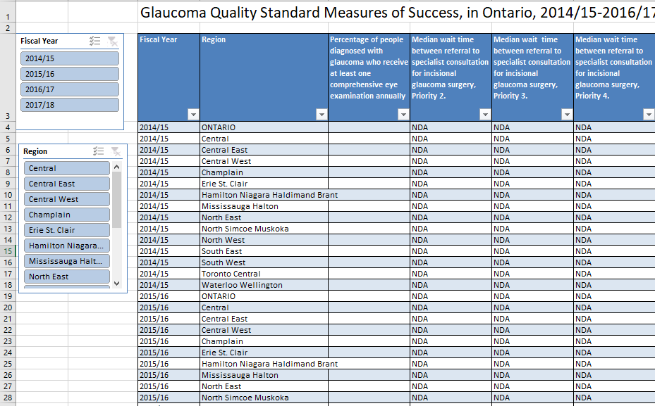


Quality Standard Resources
Quality Standard
Patient Conversation Guide
Getting Started Guide
Recommendations for Adoption
Data Tables
Measurement Guide
Find these resources here:
https://hqontario.ca/evidence-to-improve-care/quality-standards/view-all-quality-standards/glaucoma
Notes:
Each quality standard focuses on a specific health care issue. The development of each quality standard is accompanied by an assortment of resources.
Through concise, easy-to-understand statements, quality standards outline what quality care looks like for a condition or topic based on the evidence.
Each quality standard is accompanied by:
A patient conversation guide
A getting started guide
Recommendations for adoption
Data tables
A measurement guide
Quality standards provide the blueprint to enable the health care system in Ontario to work better, facilitate smooth transitions, and ensure patients receive the same high-quality care, regardless of where they reside.

Slide 6
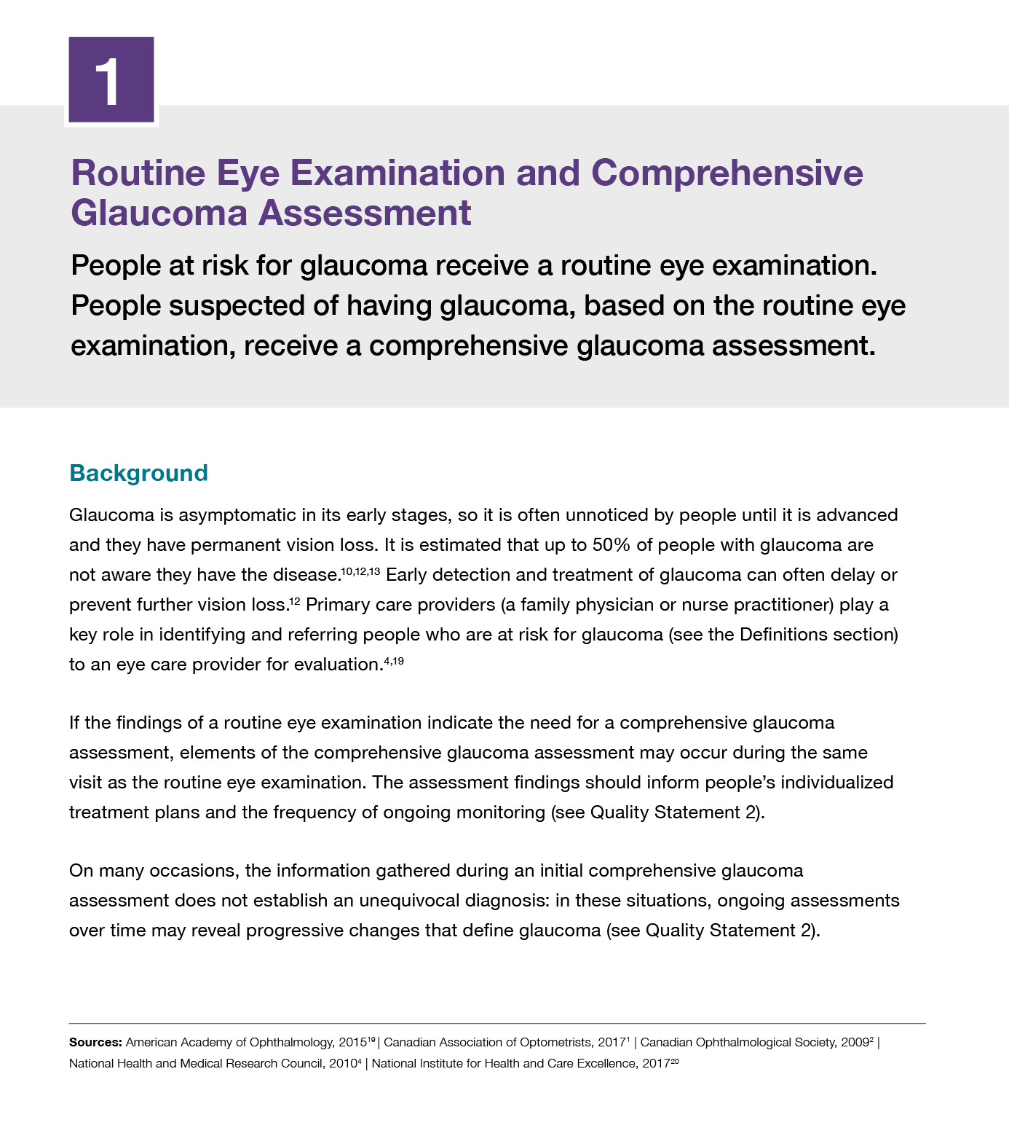
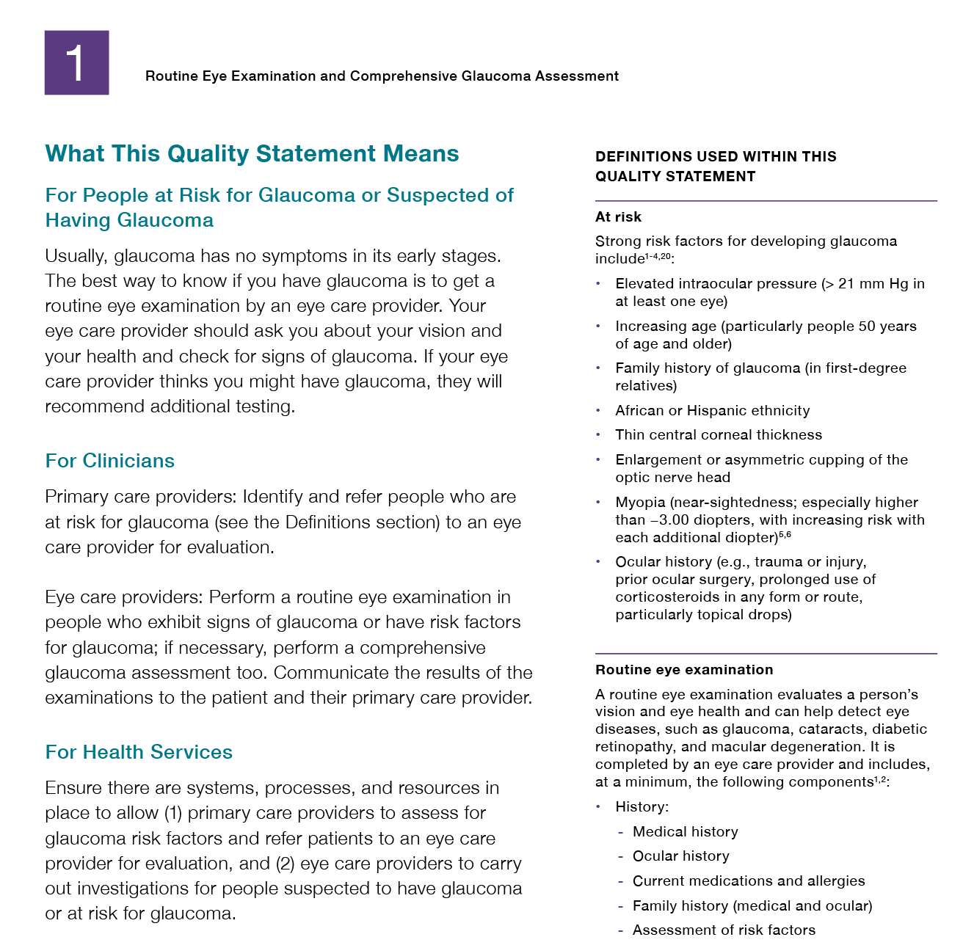
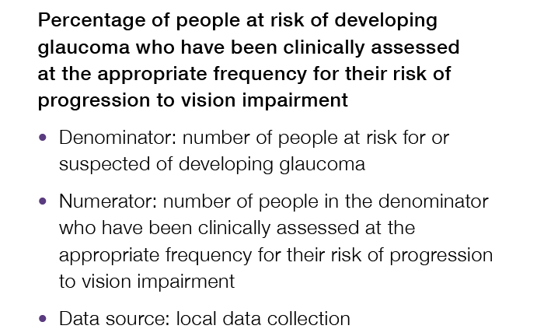
Inside the Quality Standard
The Statement
The Audience
Definitions
The Indicators

Slide 7
Quality Standards:
Patient Conversation Guide
The patient conversation guide is designed to give patients information about what quality care looks like for various conditions based on the best evidence, so they can ask informed questions of their health care providers.
Notes:
Every quality standard includes a plain language summary for patients, families, caregivers, and the public called the patient conversation guide.
Patient engagement in quality standards:
Membership on advisory committees
Focus groups and key informant interviews on topic specific content (when necessary)
Public comment period for each quality standard
Consultations on the patient conversation guide

Slide 8
Quality Standards:
Recommendations for Adoption
Recommendations for policy makers, administrators, health care organizations, and professionals have been made that aim to bridge the gaps between current care and care outlined in the quality statements to enable adoption of the quality standard across Ontario.
Notes:
As many aspects of the quality standard represent care that can and should be made available today, it is recognized that there are larger systemic barriers that may impede care delivery as per the standard. This document summarizes the system-wide and regional requirements that are needed to help health care professionals and organizations meet these standards and the time horizon expected to resolve these barriers.

Slide 9
Quality Standards:
Implementation Tools
The Getting Started Guide:
Outlines the process for using the quality standard as a resource to deliver high-quality care
Contains evidence-based approaches, as well as useful tools and templates for implementing change ideas at the practice level
Notes:
There are things we can do today despite the larger systemic barriers that may take time to resolve. The getting started guide is a document that outlines a process for using the quality standards as a resource to deliver high-quality care. It compiles a number of resources to support adoption such as links to implementation and quality improvement resources, examples and activities for reflection as well as templates and documents to support the implementation planning activities. The getting started guide also includes an Action Plan Template and examples on how Quality Improvement Plans can help to advance quality standards.

Slide 10
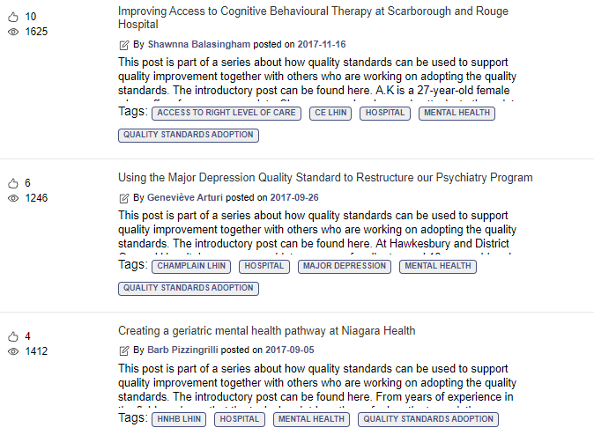
Quality Standards:
Quorum
Quorum is an online community dedicated to improving the quality of health care in Ontario.
The Quality Standards Adoption Series highlights efforts in the field to implement changes and close gaps in care related to quality standard topics.
Visit the Quality Standards Adoption Series on Quorum to learn how organizations are implementing quality standards.

Slide 11
Quality Standards:
Measurement Guide
The measurement guide has two dedicated sections:
Local measurement: what you can do to assess the quality of care that you provide locally
Provincial measurement: how we can measure the success of the quality standard on a provincial level

Slide 12
Quality Standards:
Data Tables
Data tables can be used to examine variations in indicator results across the province. They include data on key indicators:
Over time for Ontario
Across regions in Ontario
For specific measures of equity (age, sex, rurality, and household income)

Slide 13
Why a Quality Standard for Glaucoma in Ontario?

Slide 14
“Glaucoma is the most common cause of irreversible blindness, and it has an enormous impact on people’s quality of life. Through appropriate care, much of that impact can be prevented. But receiving appropriate care is complex in our health care system: identifying people with glaucoma at an early stage, ensuring they see the right professional at the right time, and having access to the more advanced levels of care as needed can all greatly affect outcomes.”
– Robert Campbell, Glaucoma Quality Standard Advisory Committee member

Slide 15

Glaucoma is estimated to affect more than 400,000 Canadians.
Source: Harasymowycz P, Birt C, Gooi P, Heckler L, Hutnik C, Jinapriya D, et al. Medical management of glaucoma in the 21st century
from a Canadian perspective. J Ophthalmol. 2016;2016:6509809.

Slide 16

Glaucoma develops painlessly and gradually; symptoms are often not apparent until there is substantial irreversible damage to the optic nerve fibres

Slide 17










About half of people with glaucoma don’t know they have it
The best way to detect glaucoma is through a routine eye examination by an eye care provider
Source: Routine Eye Examinations for Persons 20-64 Years of Age: An Evidence-Based Analysis. Ont Health Technol Assess Ser. 2006; 6(15): 1-81. https://www.ncbi.nlm.nih.gov/pmc/articles/PMC3379534/

Slide 18

4 in 10 people with glaucoma haven’t had an eye exam in the past year
Eye exams are important for people with glaucoma to monitor progression of the disease
Note: Unadjusted rate. Data for fiscal year 2017/18.
Source: National Ambulatory Care Reporting System, Ontario Health Insurance Plan Claims database; Discharge Abstract Database; Registered Persons Database 2012/13 to 2017/18, provided by the Institute for Clinical Evaluative Sciences (ICES).

Slide 19
The percentage of people with glaucoma who had an eye exam in the past year varied across Ontario’s regions
Percentage of people aged 18+ with glaucoma who had an eye exam in the past year, in Ontario, by region, 2017/18
Note: Unadjusted rate
Source: National Ambulatory Care Reporting System, Ontario Health Insurance Plan Claims database; Discharge Abstract Database; Registered Persons Database 2012/13 to 2017/18, provided by the Institute for Clinical Evaluative Sciences (ICES).

Slide 20
People with glaucoma aged 18 to 64 were the least likely to have had an eye exam in the past year
Percentage of people aged 18+ with glaucoma who reported having an eye exam in the past year, in Ontario, by age group, 2017/18
Note: Unadjusted rate.
Source: National Ambulatory Care Reporting System, Ontario Health Insurance Plan Claims database; Discharge Abstract Database; Registered Persons Database 2012/13 to 2017/18, provided by the Institute for Clinical Evaluative Sciences (ICES).

Slide 21



There is no cure for glaucoma, but its progression can be managed
Medications
Laser therapy
Surgery
Three common options to treat glaucoma by lowering eye pressure are medications (prescription eye drops), laser therapy, and surgery.

Slide 22
The majority of Ontarians receive eye-pressure-lowering surgery within the target timeframe
Wait time from referral to patient's first
eye surgical appointment
Wait time from decision to treat to having eye surgery
95%
Had their first appointment within the target in 2017/18
87%
Received their surgery within the target in 2017/18
Source: Wait time information system (WTIS), provided by Cancer Care Ontario (CCO).
Note: Includes priority 2-4 + missing priority. includes eye pressure lowering surgery for glaucoma.
Access targets for wait time from referral to patient's first eye surgical appointment are 30 days (priority 2), 90 days (priority 3) and 182 days (priority 4). Access targets for wait time from decision to treat to having eye surgery are 14-42 days (priority 2), 42-84 days (priority 3) and 112-182 days (priority 4).

Slide 23
Wait times for an eye surgical appointment vary across regions in Ontario
Median wait time from referral to patient's first eye surgical appointment (eye pressure lowering surgery for glaucoma), 2017/18
Source: Wait time information system (WTIS), provided by Cancer Care Ontario (CCO).
Note: DS: data suppressed.
Includes priority 2-4 + missing priority for eye pressure lowering surgery for glaucoma.
More information on measuring wait times for eye surgeries can be found here: https://www.hqontario.ca/System-Performance/Measuring-System-Performance/Measuring-Wait-Times-for-Eye-Surgeries

Slide 24
Quality Statements in Brief

Slide 25
Scope of the Glaucoma Quality Standard
This quality standard focuses on care for adults 18 years of age and older with glaucoma and those who are at risk for glaucoma.
It addresses primary open-angle glaucoma and focuses on the assessment, diagnosis, and management of this condition. It applies to all care settings.
This quality standard does not address care for people with acute angle-closure glaucoma (a medical emergency that requires immediate treatment to prevent vision loss).
Notes:
Terminology used in this quality standard:
Eye care provider
In this quality standard, “eye care provider” refers to optometrists and ophthalmologists (comprehensive or with subspecialty glaucoma training).
Primary care provider
In this quality standard, “primary care provider” refers to a family physician or nurse practitioner. While much of the diagnosis, monitoring, and treatment of glaucoma is done by eye care providers, primary care providers play critical roles in the care and treatment process for people with glaucoma. The quality standard describes this role in more detail.

Slide 26
Glaucoma Quality Statement Topics
Routine Eye Examination and Comprehensive Glaucoma Assessment
Monitoring
Information
Referral and Timely Access to an Ophthalmologist
Medications and Laser Therapy
Incisional Surgery

Slide 27
Quality Statement 1: Routine Eye Examination and Comprehensive Glaucoma Assessment
People at risk for glaucoma receive a routine eye examination. People suspected of having glaucoma, based on the routine eye examination, receive a comprehensive glaucoma assessment.

Slide 28
Quality Statement 2: Monitoring
People with glaucoma or at risk for glaucoma are monitored on an appropriate reassessment schedule, according to their current stage of disease and risk of progression to vision impairment.

Slide 29
Quality Statement 3: Information
Eye care providers speak with people with glaucoma or at risk for glaucoma about their diagnosis, prognosis, and management, and offer them relevant and accessible information about their condition at initial and subsequent visits.

Slide 30
Quality Statement 4: Referral and Timely Access to an Ophthalmologist
People with glaucoma are referred to and have timely access to an ophthalmologist for consultation, when clinically indicated.

Slide 31
Quality Statement 5: Medications and Laser Therapy
People with glaucoma or at risk for glaucoma are offered medications or laser therapy when
clinically indicated.

Slide 32
Quality Statement 6: Incisional Surgery
People with glaucoma who are at risk of progressing to sight loss despite maximum tolerated medical therapy and laser therapy are offered incisional surgery.

Slide 33
“The quality standard for glaucoma supports interprofessional cooperation and communication, as well as organizational change and improved access, so that patients can move through the system appropriately to receive the care they require when and as they need it.”
– Robert Campbell, Glaucoma Quality Standard Advisory Committee member

Slide 34
“Glaucoma is one of those diseases that is not identified until a lot of damage has already occurred to the eyes. For my husband, getting a diagnosis and effective treatment was a very difficult experience. We did not feel heard, and we encountered different opinions in terms of how and when to detect glaucoma and what to do when he stopped responding to the treatments.
“I think the glaucoma quality standard will improve care because it takes a patient-centred approach, introducing new ideas and expectations for the patient and physician to work with. For example, defining common risk factors for the early detection of glaucoma, the expectation of a coordinated care approach as the disease progresses, and respecting language and culture in good patient care will help patients trust the process. The quality standard also presents busy practitioners with straightforward approaches, based on up-to-date, world-tested research, to effectively treat glaucoma. The quality statements equip patients to understand what to expect during and after a glaucoma diagnosis. Patients can also use the quality statements to prepare questions for their doctors, become confident partners in the care team, and understand when they need to advocate for a different approach.”
– Wife of a person with glaucoma

Slide 35
How Success Can Be Measured
Notes:
The Glaucoma Quality Standard Advisory Committee identified a small number of overarching goals for this quality standard. These have been mapped to indicators that may be used to assess quality of care provincially and locally.

Slide 36
How Success Can Be Measured Provincially
We recommend the following list of potential indicators to monitor the overall success of the standard provincially:
Percentage of people diagnosed with glaucoma who receive at least one comprehensive eye examination annually
Wait time between referral to specialist consultation for incisional glaucoma surgery
Wait time between decision to treat and incisional glaucoma surgery

Slide 37
How Success Can Be Measured Locally
We recommend the following list of potential indicators to monitor the overall success of the standard locally:
Percentage of people treated for glaucoma who report high satisfaction with the eye care they receive
Percentage of people with glaucoma who are legally blind due to visual field loss
Notes:
Locally:
In addition, each quality statement within this quality standard is accompanied by one or more indicators.
These indicators are intended to guide measurement of quality improvement efforts related to implementation of the statement.

Slide 38
Connect with us:
https://quorum.hqontario.ca/

