Slide 1


Heart Failure Care in the Community Quality Standard
Guiding evidence-based
care for people living with heart failure in Ontario
This slide deck and its associated quality standard were developed in 2019 by Health Quality Ontario and CorHealth Ontario, now both part of Ontario Health. We updated these documents in 2022 to reflect new guidance from the Canadian Cardiovascular Society and the European Society of Cardiology on the medication management for people with heart failure who have a reduced ejection fraction.
Notes:
If you have any questions about the content of this presentation, please contact us at qualitystandards@ontariohealth.ca.

Slide 2
Objectives
Overview of quality standards
What are they? How are they used?​
Why this quality standard is needed
Gaps and variations in quality of care for people living with heart failure in Ontario
How success can be measured
Indicators that can help measure your quality improvement efforts
Quality statements in brief
The key statements in the heart failure quality standard

Slide 3
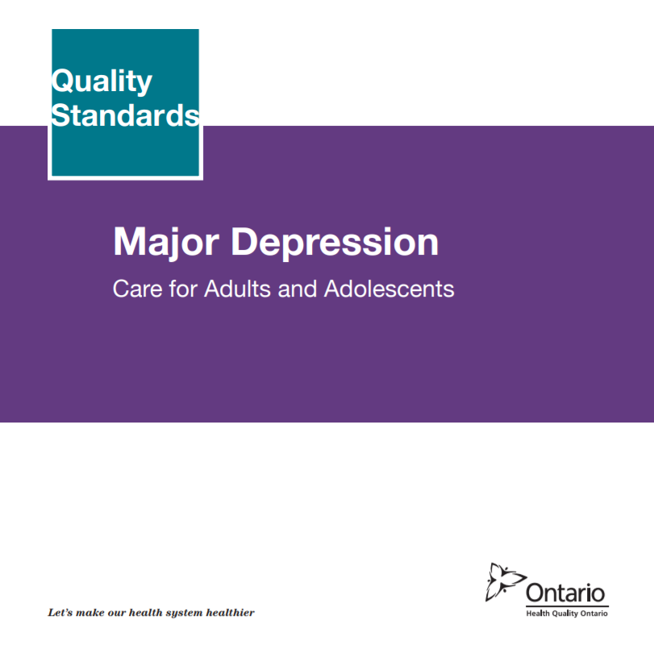

Quality Standards
Inform clinicians and patients what quality care looks like
Focus on conditions where there are large variations in how care is delivered, or where there are gaps between the care provided in Ontario and the care patients should receive
Are grounded in the best available evidence
Notes:
Quality standards are a smaller set of high impact statements that describe optimal care where identified quality gaps exist in Ontario.
Voluntary and aspirational in nature​.
Designed to “raise the ceiling” with the goal of having the best possible care available to all Ontarians, regardless of where they live in the province.
There are many guidelines, professional standards, and other recommendations that contribute to the evidence ecosystem. Quality standards complement these resources.
Quality standards outline the what of care that should be delivered but are agnostic on who should be delivering it (unlike other CPGs, BPGs).
Quality standards are:
Concise: 5 to 15 strong, evidence-based statements focused on high priority areas for improvement.
Accessible: help clinicians and provider organizations offer the highest-quality care; and patients to know what to discuss with their care providers (compared with CPGs that are quite dense, these are very accessible, also written in plain language).
Measurable: each statement is accompanied by one or more quality indicators (structure, process, or outcome), with a set of outcome measures for the overall standard.
Implementable: quality improvement tools and resources support each standard, to fuel adoption.

Slide 4
Quality Standards
Help health care professionals know what care to offer, based on evidence and expert consensus
Help health care organizations measure, assess, and improve the quality of care they provide
Help ensure consistent,
high-quality care across the province
Help patients, residents, families, and caregivers know what to ask for in their care
Notes:
Patients, caregivers and the public can use quality standards to understand what excellent care looks like, what they should expect from their health care providers, and how to discuss the quality of their care.
LHINs and disease agencies can use quality standards to measure health outcomes, hold health service providers accountable for delivering high-quality care, and inform regional improvement strategies.
Provider organizations can use quality standards to measure and audit their quality of care, identify gaps, guide organizational improvement strategies, and inform clinical program investments.
Health care professionals can use quality standards to evaluate their practice and identify areas for personal and organizational quality improvement, and can incorporate the evidence-based statements into professional education.
Government can use quality standards to identify provincial priority areas, inform new data collection and reporting initiatives, and design performance indicators and funding incentives.

Slide 5


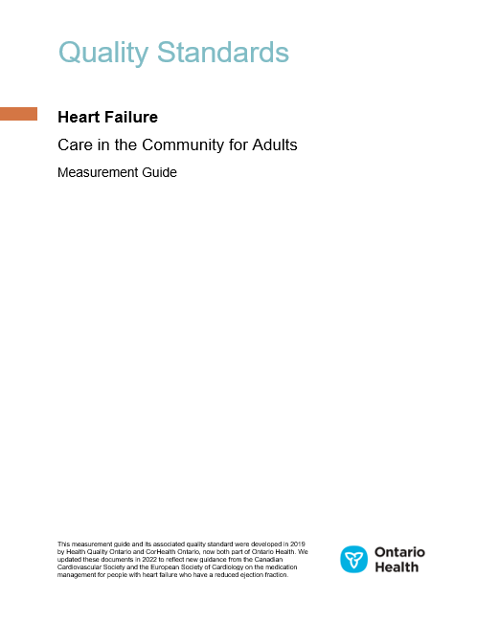

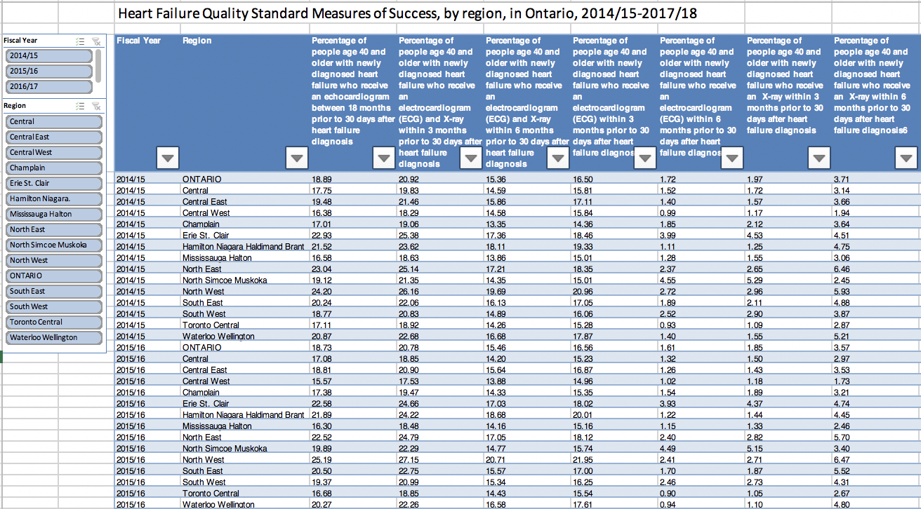
Quality Standard Resources
Quality Standard
Patient Conversation Guide
Measurement Guide
Data Tables
Getting Started Guide
Find these resources here:
https://hqontario.ca/Evidence-to-Improve-Care/Quality-Standards/View-all-Quality-Standards/heart-failure
Notes:
Each quality standard focuses on a specific health care issue. The development of each quality standard is accompanied by an assortment of resources.
Through concise, easy-to-understand statements, quality standards outline what quality care looks like for a condition or topic based on the evidence.
Each quality standard is accompanied by:
A patient conversation guide
A getting started guide
Data tables
A measurement guide
Quality standards provide the blueprint to enable the health care system in Ontario to work better, facilitate smooth transitions, and ensure patients receive the same high-quality care, regardless of where they reside.

Slide 6
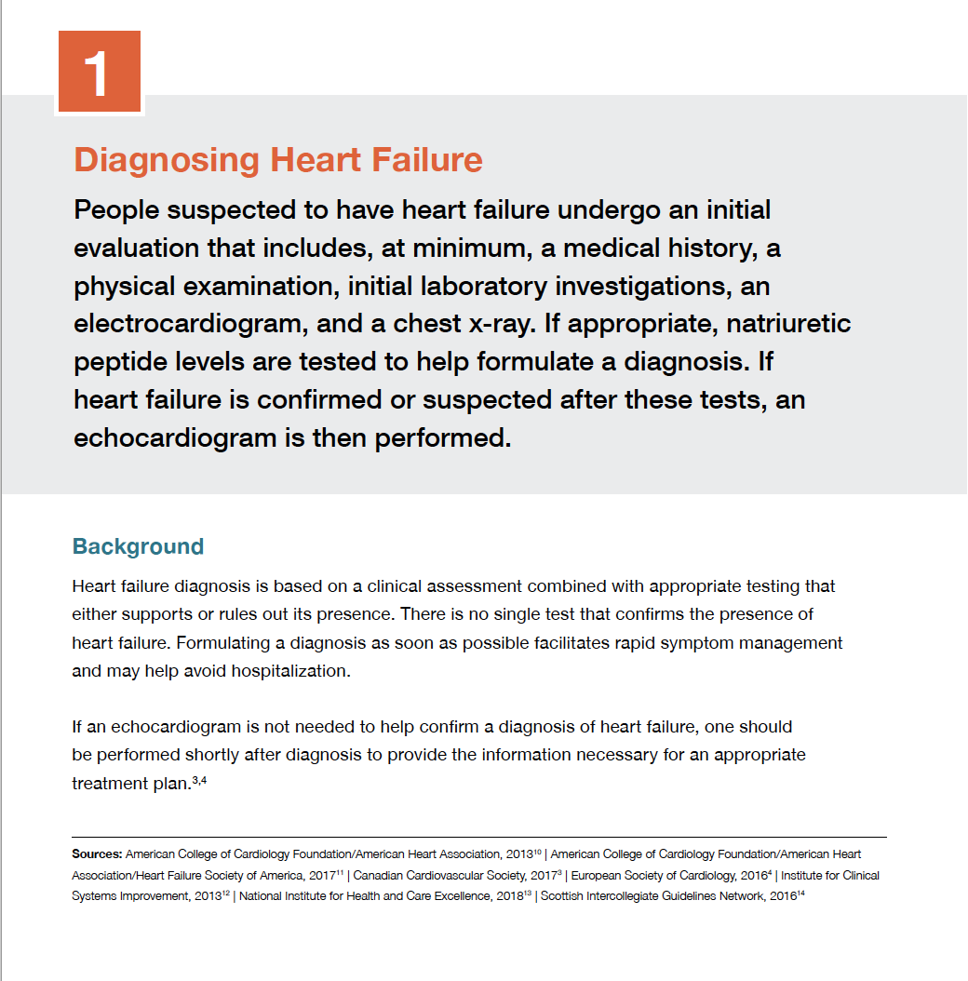
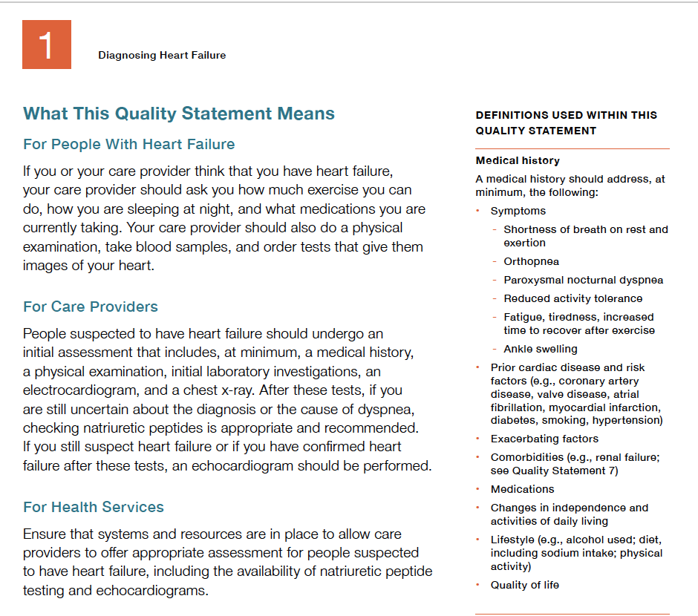
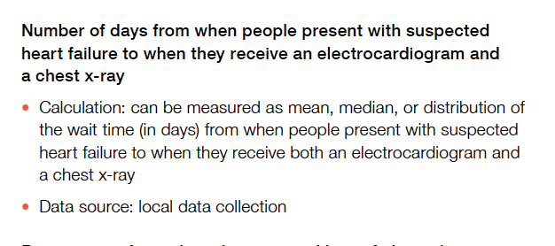
Inside the Quality Standard
The Statement
The Audience
Definitions
The Indicators

Slide 7
Quality Standards:
Patient Conversation Guide
The patient conversation guide is designed to give patients information about what quality care looks like for various conditions based on the best evidence, so they can ask informed questions of their health care providers.
Notes:
Every quality standard includes a plain language summary for patients, families, caregivers, and the public called the patient conversation guide.
Patient engagement in quality standards:
Membership on advisory committees
Focus groups and key informant interviews on topic specific content (when necessary)
Public comment period for each quality standard
Consultations on the patient conversation guide

Slide 8
Quality Standards:
Implementation Tools
The Getting Started Guide:
Outlines the process for using the quality standard as a resource to deliver high-quality care
Contains evidence-based approaches, as well as useful tools and templates for implementing change ideas at the practice level
Notes:
There are things we can do today despite the larger systemic barriers that may take time to resolve. The Getting Started Guide is a document that outlines a process for using the quality standards as a resource to deliver high-quality care. It compiles a number of resources to support adoption, such as links to implementation and quality improvement resources, examples and activities for reflection, and templates and documents to support the implementation planning activities. The Getting Started Guide also includes an Action Plan Template and examples on how Quality Improvement Plans can help to advance quality standards.

Slide 9
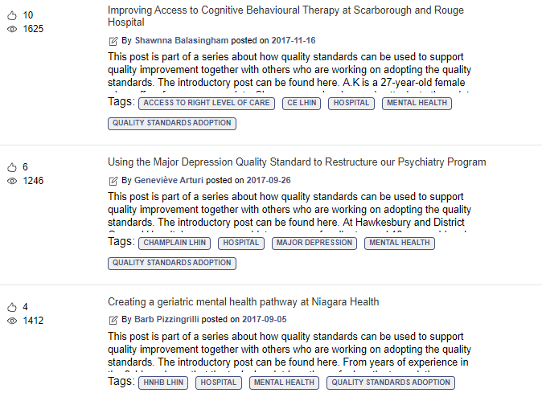
Quality Standards:
Quorum
Quorum is an online community dedicated to improving the quality of health care in Ontario.
The Quality Standards Adoption Series highlights efforts in the field to implement changes and close gaps in care related to quality standard topics.
Visit the Quality Standards Adoption Series on Quorum to learn how organizations are implementing quality standards.

Slide 10
Quality Standards:
Measurement Guide
The measurement guide has two dedicated sections:
Local measurement: what you can do to assess the quality of care that you provide locally
Provincial measurement: how we can measure the success of the quality standard on a provincial level

Slide 11
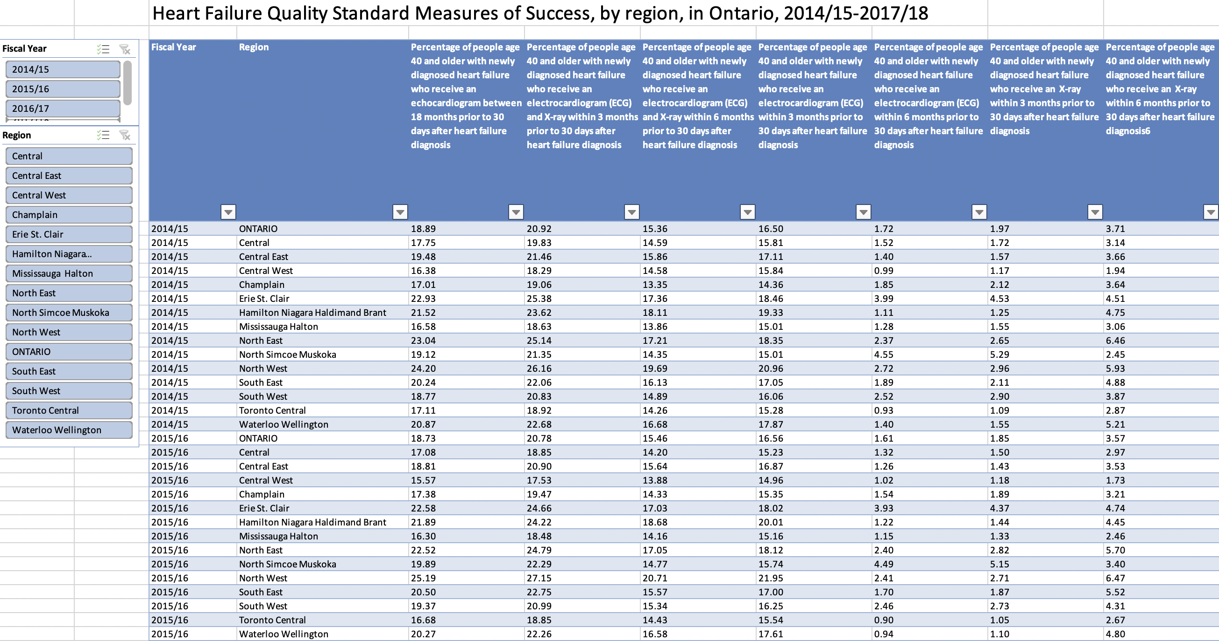
Quality Standards:
Data Tables
Data tables can be used to examine variations in indicator results across the province. They include data on key indicators:
Over time for Ontario
Across regions in Ontario
For specific measures of equity (age, sex, rurality, and household income)

Slide 12

CorHealth Ontario’s Roadmap for Improving Integrated Heart Failure Care
What Is the Roadmap?
Recommendations informed by the learnings from early adopter sites across Ontario that are undertaking the implementation of an integrated model of heart failure care (the “Spoke-Hub-Node” Model), and the quality standard Heart Failure: Care in the Community
The Roadmap for Improving Integrated Heart Failure Care, a supplementary evaluative report, and an Implementation Support Toolkit are available on the CorHealth Ontario website
Notes:
Implementing the heart failure quality standard within integrated heart failure care teams presents an opportunity to have:
A common approach to evaluating local heart failure care providers’ alignment of heart failure care.
A shared understanding and agreement across provider groups on priority areas in need of improvement.
A unified effort and coordinated, collaborative approach across a region on improvement initiatives.
Shared success across local teams, that results in better patient care.

Slide 13
Why a Quality Standard for Heart Failure in Ontario?
Notes:
The data presented in the following slides is for the Ontario population.

Slide 14







1 in 25 people age 40 and older have heart failure
Source: Heart Failure Cohort (Schultz SE, et al.), 2017/18, provided by the Institute for Clinical Evaluative Sciences (ICES). Table 17-10-0086-01, Statistics Canada.
Notes:
1 in 25 (3.9%) people age 40 and older in Ontario were living with heart failure in 2017/18.
There were 37,341 new cases of heart failure in Ontario in fiscal year 2017/18.

Slide 15
More than 9 in 10 people age 40 and older with heart failure have at least one other comorbid condition (such as hypertension or diabetes), and over half have 3 or more comorbid conditions.
Note: Age- and sex-standardized rates.
Source: Heart Failure Cohort (Schultz SE, et al.), Ontario Health Insurance Plan Claims Database (OHIP), National Ambulatory Care Reporting System (NACRS), Discharge Abstract Database (DAD), 2015, provided by ICES.
Notes:
Among people in Ontario with heart failure age 40 and older, more than 9 in 10 (92.0%) people had at least one other comorbid condition (such as hypertension or diabetes), and over half (53.4%) had 3 or more comorbid conditions in 2015.

Slide 16
Mortality among those diagnosed with heart failure in Ontario is higher among females than males
Note: Risk-adjusted by age and Charlson Comorbidity Index. Sex refers to biological sex as reported in the administrative databases.
Source: Heart Failure Cohort (Schultz SE, et al.), Registered Persons Database (RPDB), provided by ICES.
Notes:
In Ontario, mortality within 30 days after heart failure diagnosis is 8.3% for people age 40 and older, and 22.6% within 1 year of diagnosis. Mortality is higher for females than for males. These rates were risk-adjusted by age and Charlson Comorbidity Index, but not by disease severity at diagnosis.

Slide 17
Heart failure is one of the top 5 most common reasons for hospitalization
Source: Inpatient Hospitalizations, Surgeries and Newborn Indicators, 2016-2017, Canadian Institute for Health Information.
Notes:
Heart failure was one of the top 5 most common reasons for hospitalization in 2016/2017
Link for the report: https://secure.cihi.ca/estore/productFamily.htm?pf=PFC3714&lang=en&media=0

Slide 18
1 in 5 people age 40 and older who were admitted to hospital for heart failure had an unplanned readmission within 30 days of their initial heart failure hospitalization
Note: Risk-adjusted by age, sex, and Charlson Comorbidity Index.
Source: Discharge Abstract Database (DAD) and National Ambulatory Care Reporting System (NACRS), 2017/18, provided by ICES.
Notes:
Patients with heart failure have a high rate of unplanned readmissions. In Ontario, 1 in 5 (21.0%) people age 40 and older who were admitted to hospital for heart failure had an unplanned readmission to hospital for any reason within 30 days of initial heart failure hospitalization in 2017/18.

Slide 19
Almost 1 in 5 people with heart failure age 40 and older had not undergone an x-ray and ECG at the time of diagnosis (both are recommended diagnostic tests).
Note: ECG and x-ray done between 6 months prior to and 30 days after heart failure diagnosis are included. The rate is age- and sex-standardized.
Source: Heart Failure Cohort (Schultz SE, et al.), Ontario Health Insurance Plan Claims Database (OHIP), National Ambulatory Care Reporting System (NACRS), Discharge Abstract Database (DAD), 2017/18, provided by ICES.
Notes:
In Ontario, almost 1 in 5 people (18.9%) with heart failure age 40 and older had not undergone an x-ray and ECG at the time of diagnosis in 2017/18 (both are recommended diagnostic tests).

Slide 20
Nearly 1 in 6 people with heart failure age 40 and older had not received an echocardiogram up to 30 days after the diagnosis was made
Note: Echocardiogram testing done between 18 months prior to and 30 days after heart failure diagnosis is included. The rate is age- and sex-standardized.
Source: Heart Failure Cohort (Schultz SE, et al.), Ontario Health Insurance Plan Claims Database (OHIP), National Ambulatory Care Reporting System (NACRS), Discharge Abstract Database (DAD), 2017/18, provided by ICES.
Notes:
Everyone with heart failure should get an echocardiogram, either leading up to their diagnosis or after their diagnosis. However, in Ontario in 2017/18, nearly 1 in 6 people (15.2%) with heart failure age 40 and older had not received this recommended test up to 30 days after the diagnosis was made.

Slide 21

Only 7.5% of people with heart failure age 65 and older had filled “triple therapy” prescriptions at six months after diagnosis. Approximately half of people with heart failure should be taking these medications.
This measure will be updated in the future with new data based on the updated quality statement for quadruple therapy.
Note: Use of triple therapy at 6 months after diagnosis was defined as having prescriptions filled for these medications that covered day 180 post diagnosis. The rate is age- and sex-standardized.
Source: Heart Failure Cohort (Schultz SE, et al.), Ontario Drug Benefit Claims (ODB), 2017/18, provided by ICES.
Notes:
The previous slides presented data on people age 40 and older in Ontario. The slides on medications refer to data for people age 65 and older in Ontario.
In Ontario, only 1 in 13 (7.5%) people with heart failure age 65 and older had filled “triple therapy” prescriptions at six months after diagnosis; approximately 50% of people with heart failure should be taking these medications.
Triple therapy: 3 medication groups used for heart failure – 1) ACEi or ARB or ARNI, 2) BB, 3) MRA
Medication Group #1:
ACEi = angiotensin-converting enzyme inhibitor
ARB = angiotensin II receptor blocker
ARNI = angiotensin receptor neprilysin inhibitor
Medication Group #2:
BB = beta blocker
Medication Group #3:
MRA = mineralocorticoid receptor antagonist
Notes:
It is not possible to separate the diagnosis of heart failure with reduced ejection fraction from other forms of heart failure. About 50% of people with heart failure have heart failure with reduced ejection fraction and should receive triple therapy.
A grace period of 1.5x the days supplied was applied to all medication claims when determining overlapping use of medications on day 180 after heart failure diagnosis.
ARNI medications are newly approved drugs in Ontario, and are represented in low numbers in 2017/18.

Slide 22
In Ontario, “triple therapy” medication use after heart failure diagnosis is low among people age 65 and older, and may be due to low uptake of MRA medications.
This measure will be updated in the future with new data based on the updated quality statement for quadruple therapy.
Note: Use of medications at 180 days after diagnosis was defined as having prescriptions filled for these medications that covered day 180 post diagnosis. Rates are age- and sex-standardized.
Source: Heart Failure Cohort (Schultz SE, et al.), Ontario Drug Benefit Claims (ODB), provided by ICES.
Notes:
People with heart failure who have a reduced ejection fraction (HFrEF) and New York Heart Association (NYHA) class II to IV symptoms are offered pharmacological management with “triple therapy.” These individuals may require additional medications and are prescribed these are needed. Approximately half of the population of people with heart failure have HFrEF, so we would expect to see each of the bars in the graph at approximately 50%.
In Ontario, “triple therapy” medication use at 180 days after heart failure diagnosis is low for people age 65 and older, and may be due to low uptake of MRA medications.
Triple therapy: 3 medication groups used for heart failure: (1) ACEi or ARB or ARNI, (2) BB, (3) MRA
Medication Group #1:
ACEi = angiotensin-converting enzyme inhibitor
ARB = angiotensin II receptor blocker
ARNI = angiotensin receptor neprilysin inhibitor
Medication Group #2:
BB = beta blocker
Medication Group #3:
MRA = mineralocorticoid receptor antagonist
For people with heart failure, age 65 and older:
Medication Group #1 (ACE, ARB or ARNI) is being dispensed to 57.9% of people,
Medication Group #2 (BB) is being dispensed to 59.3% of people, and
Medication Group #3 (MRA) is being dispensed to 12.5% of people
at 180 days after heart failure diagnosis.
Notes:
It is not possible to separate the diagnosis of heart failure with reduced ejection fraction from other forms of heart failure. About 50% of people with heart failure have heart failure with reduced ejection fraction and should receive triple therapy.
A grace period of 1.5x the days supplied was applied to all medication claims when determining overlapping use of medications on day 180 after heart failure diagnosis.
ARNI medications are newly approved drugs in Ontario, and are represented in low numbers 2017/18.

Slide 23
“My experience as a caregiver to a loved one with heart failure taught me that having the right information and asking the right questions can effect change in the way patients receive care. When my husband was discharged from hospital after major cardiac surgery without any touchpoints or arrangements made for follow-up care in my home community (ultimately leading to a hospital readmission), I learned a lot about the value of a supported transition. The quality standard for heart failure addresses this. It also empowers patients and caregivers to ask the right questions to their care team about when, where, and how care should be delivered and helps build comfort and prompt discussion around potentially difficult topics, such as palliative care. These are some of the many reasons it is such an important resource.”
– Kathy Smith, Lived Experience Advisor
Notes:
My experience as a caregiver to a loved one with heart failure taught me that having the right information and asking the right questions can effect change in the way patients receive care. When my husband was discharged from hospital after major cardiac surgery without any touchpoints or arrangements made for follow-up care in my home community (ultimately leading to a hospital readmission), I learned a lot about the value of a supported transition. The quality standard for heart failure addresses this. It also empowers patients and caregivers to ask the right questions to their care team about when, where, and how care should be delivered and helps build comfort and prompt discussion around potentially difficult topics, such as palliative care. These are some of the many reasons it is such an important resource.

Slide 24
“I believe the quality standard recognizes and appreciates that it takes a village to care to people with heart failure. We need to communicate and collaborate with a variety of care providers to improve patient outcomes and the patient and caregiver experience.”
–Karen Harkness, Registered Nurse, Heart Function Clinic

Slide 25
Quality Statements in Brief

Slide 26
Scope of the Heart Failure Care in the Community Quality Standard
This quality standard addresses care for people 18 years of age or older who have heart failure, including the assessment and diagnosis of people with suspected heart failure.
This quality standard applies to community settings, including primary care, specialist care, home care, hospital outpatient clinics, and long-term care.
It does not address care provided in hospital emergency departments or inpatient settings.
Notes:
The scope does not cover:
It does not address heart failure owing to congenital cardiac conditions.
It also does not address the primary prevention of heart failure.
Health Quality Ontario and the Ministry of Health and Long-Term Care have developed the Quality-Based Procedures: Clinical Handbook for Heart Failure (Acute and Postacute) to provide guidance on hospital care for people with heart failure.
Terminology Used in This Quality Standard
The New York Heart Association (NYHA) classification system describes heart failure symptoms. Below are the definitions for the four classifications:
Class I—no symptoms
Class II—symptoms during ordinary activity
Class III—symptoms with less than ordinary activity
Class IV—symptoms at rest or with any minimal activity
The heart failure population can be divided into three major subpopulations based on ejection fraction:
“Heart failure with reduced ejection fraction” (HFrEF) refers to a left ventricular ejection fraction that is less than or equal to 40%³
“Heart failure with preserved ejection fraction” (HFpEF) refers to a left ventricular ejection fraction that is equal to or greater than 50%³
“Heart failure with midrange ejection fraction” (HFmrEF) is a relatively new classification, referring to an intermediate group with a left ventricular ejection fraction of 41% to 49%
Each quality statement applies to all three of these subpopulations, unless specifically mentioned in the text of the statement.

Slide 27
Heart Failure Care in the Community Quality Statement Topics
Diagnosing Heart Failure
Individualized, Person-Centred, Comprehensive Care Plan
Empowering and Supporting People With Heart Failure to Develop Self-Management Skills
Physical Activity and Exercise
Quadruple Therapy for People With Heart Failure Who Have a Reduced Ejection Fraction
Worsening Symptoms of Heart Failure
Management of Non-cardiac Comorbidities
Specialized Multidisciplinary Care
Transition From Hospital to Community
Palliative Care and Heart Failure

Slide 28
Quality Statement 1: Diagnosing Heart Failure
People suspected to have heart failure undergo an initial evaluation that includes, at minimum, a medical history, a physical examination, initial laboratory investigations, an electrocardiogram, and a chest x-ray. If appropriate, natriuretic peptide levels are tested to help formulate a diagnosis. If heart failure is confirmed or suspected after these tests, an echocardiogram is then performed.
Notes:
Definitions Used Within This Quality Statement
Medical history
A medical history should address, at minimum, the following:
Symptoms
Shortness of breath on rest and exertion
Orthopnea
Paroxysmal nocturnal dyspnea
Reduced activity tolerance
Fatigue, tiredness, increased time to recover after exercise
Ankle swelling
Prior cardiac disease and risk factors (e.g., coronary artery disease, valve disease, atrial fibrillation, myocardial infarction, diabetes, smoking, hypertension)
Exacerbating factors
Comorbidities (e.g., renal failure)
Medications
Changes in independence and activities of daily living
Lifestyle (e.g., alcohol used; diet, including sodium intake; physical activity)
Quality of life
Physical examination
A physical examination should include, at minimum, the following:
Vital signs
Volume status
Weight change
Jugular venous pressure
Peripheral edema (e.g., feet, ankles, legs, sacrum)
Cardiac assessment
Cardiac murmur
Laterally displaced apical pulse
Chest examination
Reduced air entry and crackles at lung bases (pleural effusion)
Wheezing
Pulmonary crepitations
Note: Some people with heart failure may have clear lungs on examination but still have fluid overload.
Initial laboratory Investigations
When collecting samples, include, at minimum, the following:
Complete blood count
Serum electrolytes (including calcium and magnesium)
Serum creatinine
Blood urea nitrogen
Glucose
Thyroid-stimulating hormone
Glycated hemoglobin
Appropriate natriuretic peptide testing
Natriuretic peptide testing should be used judiciously, because it is expensive and not always useful in the diagnosis of heart failure. However, it is useful when there is uncertainty about the cause of a person’s dyspnea. For example, it should be used if a care provider is unsure about whether the dyspnea is caused by chronic obstructive pulmonary disease or heart failure. In such cases, a natriuretic peptide test would help rule out heart failure.

Slide 29
Quality Statement 2: Individualized, Person-Centred, Comprehensive Care Plan
People with heart failure and their caregivers collaborate with their care providers to develop an individualized, person-centred, comprehensive care plan. The care plan is reviewed at least every 6 months, and sooner if there is a significant change. It is made readily available to all members of the person’s care team, including the person and their caregiver(s).
Notes:
Definitions Used Within This Quality Statement
Individualized, person-centred comprehensive care plan:
A care plan is a written document that describes a person’s health needs and goals and the care that will be provided to meet them. Care plans describe treatments customized for each person based on their values, wishes, goals, and unique health needs. The person with heart failure drives the care provided; a person-centred approach involves a partnership between the individual and their health care providers.
Having a care plan is not the same as having a discussion about goals of care. Nor is it a decision or consent for treatments. A care plan is broader than and different from a plan of treatment. A plan of treatment is associated with a health care decision and requires informed consent from the patient or substitute decision-maker.
For a person with heart failure, a care plan should, at minimum, address the following:
The name of the person’s identified substitute decision-maker and the person’s goals and wishes, including consideration for palliative care
Treatment decisions and consents to treatments or plan of treatment
Immunizations (annual influenza vaccination and one-time pneumonia vaccination)
Management of heart failure
Management of cardiac and non-cardiac comorbidities
Comprehensive medication review, including potential financial burden for evidence-based medications
Psychosocial factors
Sex-specific issues that are impacted by heart failure symptoms and medications, such as erectile dysfunction and decreased sexual desire
Socioeconomic concerns, such as income, medical costs (e.g., medications), and healthy food choices
Social supports
Mental health concerns, including depression and anxiety
Self-management skills
Clinician follow-up and care coordination
Physical activity and exercise
Dietary concerns
Secondary prevention of cardiovascular disease
Counselling about the possibility of sudden death
Caregiver needs and goals
Significant change:
More frequent review of the care plan will be needed if there is a significant change. This includes anything that has an impact on a person’s physical, emotional, or psychological well-being and may affect their care plan and/or the resources they need, including the following:
Psychosocial changes, including the death of a caregiver or spouse or significant caregiver burden
Mental health changes
Worsening symptoms of heart failure
Worsening physical health
Recent hospitalization for heart failure
Significant changes to medications

Slide 30
Quality Statement 3: Empowering and Supporting People With Heart Failure to Develop Self-Management Skills
People with heart failure and their caregiver(s) collaborate with their care providers to create a tailored self-management program with the goal of enhancing their skills and confidence so that they can be actively involved in their own care.
Notes:
Definitions Used Within This Quality Statement
Self-management program
People should be offered information, support, coaching, and counselling to enhance their knowledge and skills and to improve their strategies for managing heart failure. The goals of a self-management program are to ensure that people with heart failure are better able to make decisions about their care and to increase their confidence to apply their skills in daily life situations. Self-management education and support should be offered at each visit for at least 6 months after diagnosis. Following this 6-month period, people with heart failure will likely require further support and should be offered it as needed. Self-management programs should include content on the following:
Diagnosis and disease process
Available treatment options, including the following:
Medications
Device therapies
Invasive procedures (surgical or interventional options)
Recognizing early signs and symptoms of worsening heart failure (see Quality Statement 6)
Daily weights and when to inform care providers of a significant weight change
Development of an individualized action plan, including when to seek help and who to contact
Elements of the care plan
Diet restrictions
Physical activity and exercise
Motivational interviewing for smoking and alcohol cessation, where applicable
Stress management

Slide 31
Quality Statement 4: Physical Activity and Exercise
People with heart failure are informed of the benefits of daily physical activity and offered a personalized, exercise-based cardiac rehabilitation program.
Notes:
Definitions Used Within This Quality Statement
Exercise-based cardiac rehabilitation program
A personalized, exercise-based cardiac rehabilitation program should be offered to people with heart failure unless their condition is unstable. The program should be preceded by an assessment to ensure it is suitable for the person, and it should:
Provide advice on the types of exercises to consider based on the person’s abilities and activity goals
Be provided in a format and setting that is easily accessible for the person
Include a psychological and educational component
Be accompanied by information and supports
Be as close to home as possible

Slide 32
Quality Statement 5: Quadruple Therapy for People With Heart Failure Who Have a Reduced Ejection Fraction
People with heart failure who have a reduced ejection fraction (HFrEF) and New York Heart Association (NYHA) class II to IV symptoms are offered pharmacological management with “quadruple therapy.” They may require additional medications and are prescribed these as needed.
Notes:
Definitions Used Within This Quality Statement
Quadruple therapy
Quadruple therapy should be adjusted to target doses as tolerated. It includes:
• An ARNI* (or ACE inhibitor or ARB)
• A beta blocker
• An MRA
A sodium glucose transport 2 (SGLT2) inhibitor
*An ARNI is given either as first-line therapy or after switching from an ACE inhibitor or ARB.
Additional medications
In addition to quadruple therapy, other medications that may be considered in the treatment of people with HFrEF include the following:
Loop diuretics
Hydralazine/isosorbide dinitrate
Ivabradine
Digoxin

Slide 33
Quality Statement 6: Worsening Symptoms of Heart Failure
People with heart failure who report gradual, progressive, worsening symptoms are assessed by a care provider and have their medications adjusted (if needed) within 48 hours.

Slide 34
Quality Statement 7: Management of Non-cardiac Comorbidities
People with heart failure are treated for non-cardiac comorbidities that are likely to affect their heart failure management.
Notes:
Definitions Used Within This Quality Statement
Non-cardiac comorbidities
People with heart failure often have multiple comorbidities. The following list is not exhaustive but includes common conditions in people with heart failure that can affect their care plan, treatment options, adherence to therapy, follow-up, and prognosis. A person with heart failure should be treated if they present with signs or symptoms of any of the following comorbidities:
Anemia or iron deficiency
Central or obstructive sleep apnea
Chronic obstructive pulmonary disease (see the Chronic Obstructive Pulmonary Disease quality standard)
Cognitive impairment
Dementia (see the Behavioural Symptoms of Dementia and Dementia Care in the Community quality standards)
Depression or anxiety (see the Major Depression quality standard)
Diabetes
Frailty
Renal dysfunction

Slide 35
Quality Statement 8: Specialized Multidisciplinary Care
People with newly diagnosed heart failure, those who have recently been hospitalized or treated in the emergency department for heart failure, and those with advanced heart failure (NYHA III–IV) are offered a
referral to specialized multidisciplinary care for heart failure.
Notes:
Definitions Used Within This Statement
Specialized multidisciplinary care
Specialized multidisciplinary care is care provided by a team including a physician (family physician, internist, or cardiologist) or nurse practitioner, a pharmacist, and a registered nurse. The team should include at least one care provider with specialized training in heart failure. This care should include, at minimum, the following:
Self-management skills (especially for people newly diagnosed with heart failure)
Medication management and adjustment
Early attention to signs and symptoms of fluid overload and fluid depletion
Promotion of self-care, including self-adjusted diuretic therapy when possible
Initiation or titration of new medications that need specialist supervision
Emphasis on behavioural strategies to increase adherence to treatment
Prompt follow-up after hospital discharge and periods of instability
Increased access to clinicians, including appropriate referrals
Assistance with social and financial concerns
Assessment and monitoring that requires close follow-up
A collaborative cardiology and palliative approach
Continued management of heart failure after an interventional procedure such as the implantation of a cardioverter defibrillator or a cardiac resynchronization device
Management of heart failure that is not responding to current treatment

Slide 36
Quality Statement 9: Transition From Hospital to Community
People hospitalized or treated in the emergency department for heart failure receive a follow-up appointment to reassess volume status and medication reconciliation with a member of their community health care team within 7 days of leaving the hospital.
Notes:
Definitions Used Within This Quality Statement
Community health care team
This team includes care providers with the knowledge, skill, and judgment to reassess a person’s volume status and provide medication reconciliation. Potential providers include a registered nurse, a nurse practitioner, or a physician.

Slide 37
Quality Statement 10: Palliative Care and Heart Failure
People with heart failure and their families have their palliative care needs identified early and are offered support to address their needs.
Notes:
Definitions Used Within This Statement
Palliative care needs
Palliative care needs can stem from any part of a person’s full range of needs (for example, physical, psychological, social, linguistic, cultural, legal, ethical, or spiritual) at any stage of illness. The goal of palliative care is to help people achieve their best possible quality of life in the face of a progressive, life-limiting illness.
For people with heart failure, palliative care should include the following:
Active heart failure management in conjunction with symptom control
Reassessment of goals and current heart failure management
Rationalization of medical therapy that does not support symptom relief or control
Discussions about deactivating anti-tachy therapy (e.g., shock therapy) if the person has an automatic implantable cardioverter defibrillator
Integrated care from an interdisciplinary team
Seamless transitions in care coordinated across settings and health care providers
Timely psychosocial support
Access to resources, respite care, and grief and bereavement support for family and caregivers

Slide 38
How Success Can Be Measured
Notes:
The Heart Failure Quality Standard Advisory Committee identified a small number of overarching goals for this quality standard. These have been mapped to indicators that may be used to assess quality of care provincially and locally.

Slide 39
How Success Can Be Measured Provincially
We recommend the following list of potential indicators to monitor the overall success of the standard provincially:
Process Indicators:
Percentage of people with newly diagnosed heart failure who receive an electrocardiogram and a chest x-ray
Percentage of people with newly diagnosed heart failure who receive an echocardiogram
Percentage of people with newly diagnosed heart failure who are aged 65 years and older who are dispensed quadruple therapy
Percentage of people who were hospitalized or treated in the emergency department for heart failure who are seen by a primary care physician, cardiologist, or internal medicine physician within 7 days of leaving the hospital

Slide 40
How Success Can Be Measured Provincially
Outcome Indicators:
  Percentage of people with newly diagnosed heart failure who die within 30 days of diagnosis of heart failure from any cause of death
  Percentage of people with newly diagnosed heart failure who die within 1 year of diagnosis of heart failure from any cause of death
  Rate of hospital admissions and emergency department visits per 1,000 person days for people with heart failure for:
    Heart failure–specific reasons
    Any reason(s)
  Percentage of people who were hospitalized or treated in the emergency department for heart failure who are readmitted within 30 days of discharge for:
    Heart failure–specific reasons
    Any reason(s)
Notes:
In addition to the above provincially measurable indicators, each quality statement within this quality standard is accompanied by one or more indicators.
These indicators are intended to guide measurement of quality improvement efforts related to implementation of the statement.

Slide 41
Data Sources and Acknowledgement
The data used in this presentation was provided by the Institute for Clinical Evaluative Sciences (ICES), which is funded by an annual grant from the Ontario Ministry of Health and Long-Term Care (MOHLTC). The opinions, results, and conclusions reported in this report are those of the authors and are independent from the funding sources. No endorsement by ICES or the Ontario MOHLTC is intended or should be inferred. These datasets were linked using unique encoded identifiers and analyzed at ICES. Parts of this material are based on data and information compiled and provided by the Canadian Institute for Health Information (CIHI). However, the analyses, conclusions, opinions, and statements expressed herein are those of the author,, and not necessarily those of CIHI.

Slide 42
Connect with us:
https://quorum.hqontario.ca

