Slide 1
Heavy Menstrual Bleeding
QUALITY STANDARDS
Guiding evidence-based care for people in Ontario
Notes:
If you have any questions about the content of this presentation, please contact us at QualityStandards@OntarioHealth.ca

Slide 2
Objectives
Overview of quality standards: What are they? How are they used?​
Why this quality standard is needed: Gaps and variations in quality of care for people with heavy menstrual bleeding in Ontario
Quality statements to improve care: The key statements in the heavy menstrual bleeding quality standard
Measures to support improvement: Indicators that can help measure your quality improvement efforts
2

Slide 3
Quality standards
Inform clinicians and patients what quality care looks like
Focus on conditions or processes where there are large variations in how care is delivered, or where there are gaps between the care provided in Ontario and the care patients should receive
Are grounded in the best available evidence
3
Notes:
Quality standards are a small set of high impact statements that describe optimal care where identified quality gaps exist in Ontario.
Voluntary and aspirational in nature​.
Designed to “raise the ceiling” with the goal of having the best possible care available to all Ontarians, regardless of where they live in the province.
There are many guidelines, professional standards, and other recommendations that contribute to the evidence ecosystem. Quality standards complement these resources.
Quality standards outline the what of care that should be delivered but are agnostic on who should be delivering it (unlike other CPGs, BPGs).
Quality standards are:
Concise: 5 to 15 strong, evidence-based statements focused on high-priority areas for improvement.
Accessible: help clinicians and provider organizations offer the highest-quality care; and patients to know what to discuss with their care providers (compared with CPGs that are quite dense, these are very accessible, also written in plain language).
Measurable: each statement is accompanied by one or more quality indicators (structure, process, or outcome), with a set of outcome measures for the overall standard.
Implementable: quality improvement tools and resources support each standard, to fuel adoption.

Slide 4
Quality standards
Help patients, residents, families, and care partners know what to ask for in their care
Help health care professionals know what care to offer, based on evidence and expert consensus
Help health care organizations measure, assess, and improve the quality of care they provide
Help ensure consistent, high-quality care across the province
4
Notes:
Patients, care partners, and the public can use quality standards to understand what excellent care looks like, what they should expect from their clinicians, and how to discuss the quality of their care.
Provincial regions and disease agencies can use quality standards to measure health outcomes, hold health service providers accountable for delivering high-quality care, and inform regional improvement strategies.
Provider organizations can use quality standards to measure and audit their quality of care, identify gaps, guide organizational improvement strategies, and inform clinical program investments.
Clinicians can use quality standards to evaluate their practice and identify areas for personal and organizational quality improvement and can incorporate the evidence-based statements into professional education.
Government can use quality standards to identify provincial priority areas, inform new data collection and reporting initiatives, and design performance indicators and funding incentives.

Slide 5
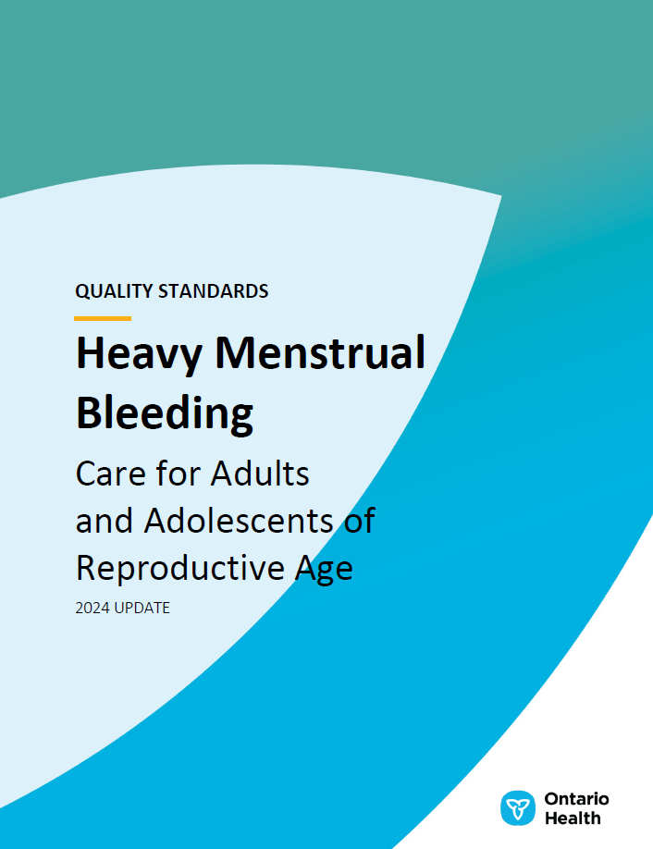
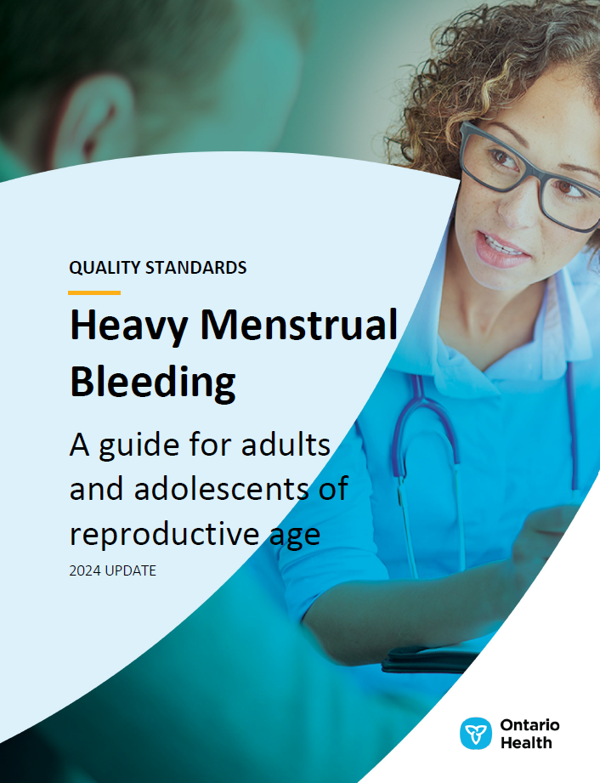
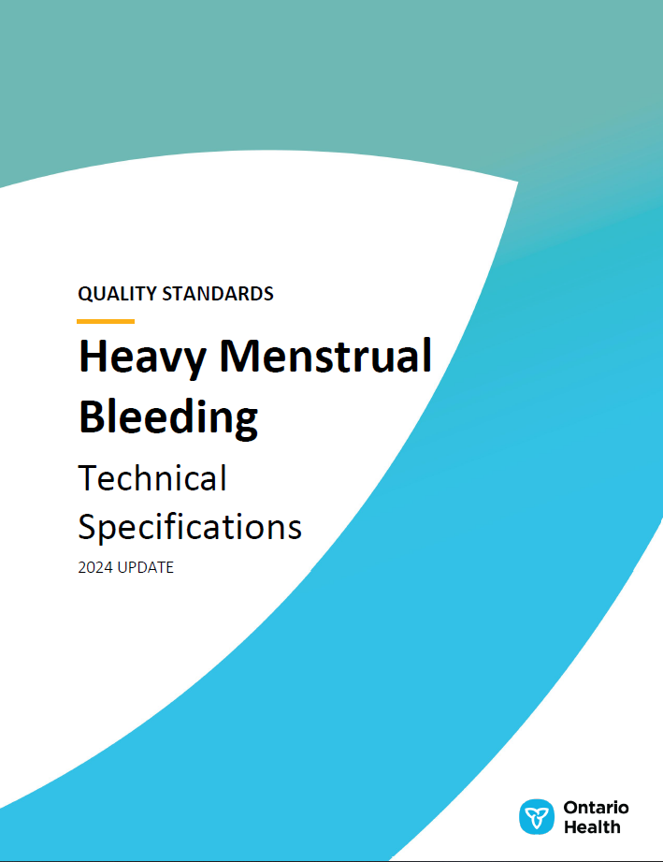
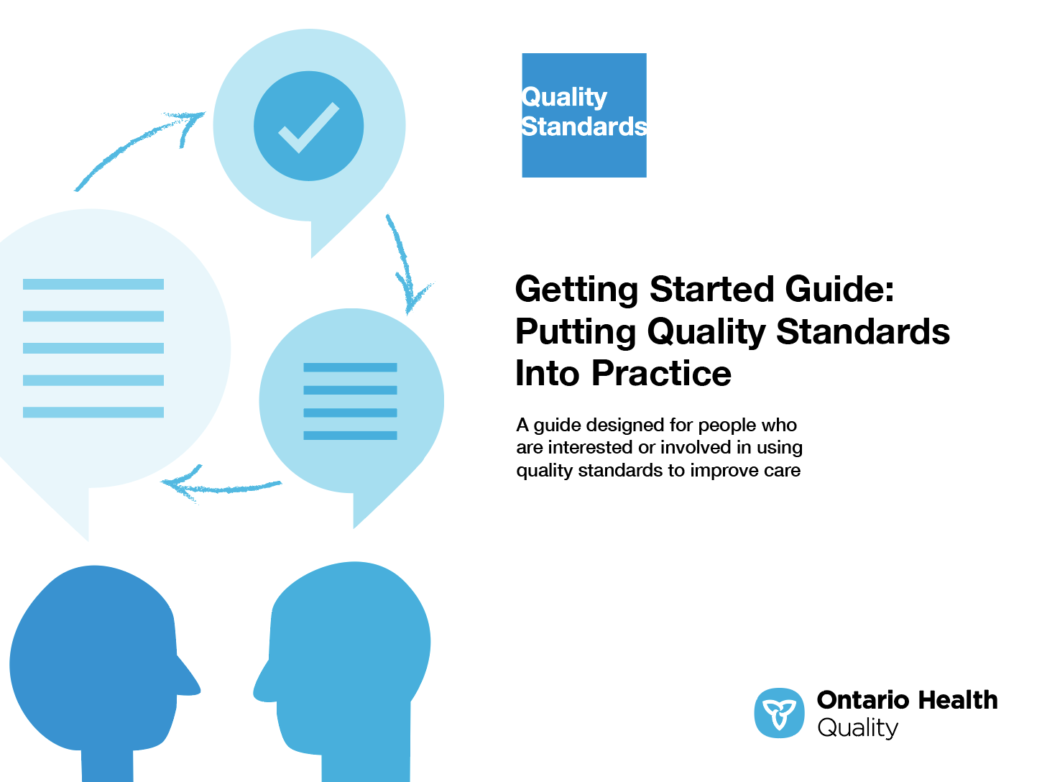
Quality standard resources
Quality Standard
Patient Guide
Placemat
Case for Improvement Deck
Measurement Guide
Technical Specifications
Getting Started Guide
5
Find these resources here: https://www.hqontario.ca/evidence-to-improve-care/quality-standards/view-all-quality-standards/heavy-menstrual-bleeding
Notes:
Each quality standard focuses on a specific health care issue. The development of each quality standard is accompanied by an assortment of resources.
Through concise, easy-to-understand statements, quality standards outline what quality care looks like for a condition or topic based on the evidence.
Each quality standard is accompanied by a:
Patient guide
Placemat
Case for improvement deck
Measurement guide
Technical specifications
Getting started guide
Quality standards provide the blueprint to enable the health care system in Ontario to work better, facilitate smooth transitions, and ensure patients receive the same high-quality care, regardless of where they reside.

Slide 6
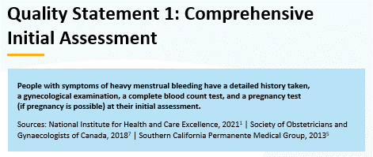
Inside the quality standard
The Quality Statement
The Audience Statements
The Definitions
The Indicators
6

Slide 7
Patient guide
Quality standards
The patient guide is designed to give patients information about what quality care looks like for various conditions based on the best evidence, so they can ask informed questions of their health care teams.
7
Notes:
Every quality standard includes a plain language summary for patients, families, care partners, and the public called the patient guide.
Patient engagement in quality standards:
Membership on advisory committees
Focus groups and key informant interviews on topic-specific content (when necessary)
Public comment period for each quality standard
Consultations on the patient guide

Slide 8
Placemat
Quality standards
The placemat is a quick-reference resource for clinicians that summarizes the quality standard and includes links to helpful resources and tools.
8

Slide 9
Case for improvement deck
Quality standards
The case for improvement deck describes why the quality standard was created and shows some of the data used to develop it. Champions can use or adapt this deck to build support for the quality standard in their organizations.
9

Slide 10
How the health care system can support implementation
Quality standards
Implementing quality standards can be challenging owing to system-level barriers or gaps, many of which have been identified throughout the development of this standard
Ontario Health will work with and support other provincial partners, including the Ministry of Health, to bridge system-level gaps to support the implementation of quality standards
10

Slide 11
Implementation tools
Quality standards
The Getting Started Guide:
Outlines the process for using the quality standard as a resource to deliver high-quality care
Contains evidence-based approaches, as well as useful tools and templates for implementing change ideas at the practice level
11
Notes:
There are things we can do today despite the larger systemic barriers that may take time to resolve. The Getting Started Guide is a document that outlines a process for using the quality standards as a resource to deliver high-quality care. It compiles a number of resources to support adoption, such as links to implementation and quality improvement resources, examples and activities for reflection, and templates and documents to support the implementation planning activities. The Getting Started Guide also includes an Action Plan Template and examples on how Quality Improvement Plans can help to advance quality standards.

Slide 12
Quorum
Quality standard adoption tools
Quorum is an online community dedicated to improving the quality of health care in Ontario.
The Quality Standards Adoption Series highlights efforts in the field to implement changes and close gaps in care related to quality standard topics.
12
quorum.hqontario.ca
Notes:
The Quality Standards program has highlighted several stories from organizations and groups using various standards and statements within their clinical care settings, organization, or institutions; these are available through posts and discussions on Quorum.
As well, we are working on compiling resources and tools, for both clinicians and patients and families.
The focus is on implementation/adoption stories and how organizations are using quality standards in practice to inform care.
We’d love to hear from you if you are interested in contributing to a post or article.

Slide 13
Measurement guide
Quality standards
The measurement guide describes:
The measurement principles behind the quality indicators included in quality standards
The types of indicators included in quality standards
How local and provincial data are collected and measured
13

Slide 14
Technical specifications
Quality standards
The technical specifications report outlines 2 types of measurement:
Provincial measurement: how we can monitor the progress being made to improve care on a provincial level
Local measurement: what you can do to assess the quality of care that you provide locally
14

Slide 15
Why do we need a quality standard for heavy menstrual bleeding?

Slide 16
2.5% of menstruating people in Ontario have sought care for heavy menstrual bleeding in the past 5 years; however, survey data suggest that 18% to 32% experience heavy menstrual bleeding^{2,3}
Heavy menstrual bleeding refers to excessive menstrual blood loss that interferes with people’s physical, social, emotional, or material quality of life¹
There is poor self-recognition of heavy menstrual bleeding, normalization of symptoms, and under-coding of heavy menstrual bleeding in clinical databases²⁻⁴
National Institute for Health and Care Excellence. Heavy menstrual bleeding: assessment and management [Internet]. London, United Kingdom: The Institute; 2021 [cited 2024 Feb 15]. Available from: https://www.nice.org.uk/guidance/ng88/resources/heavy-menstrual-bleeding-assessment-and-management-pdf-183770141254
Singh SS, Alsina JC, Vannuccini S, Koga K, Silva-Filho AL, Yang X, et al. Clinical perspectives on the menstrual pictogram for the assessment of heavy menstrual bleeding. Hum Reprod Open. 2022;2022(4):hoac048.
Fraser IS, Mansour D, Breymann C, Hoffman C, Mezzacasa A, Petraglia F. Prevalence of heavy menstrual bleeding and experiences of affected women in a European patient survey. Int J Gynecol Obstet. 2015;128(3):196-200.
Henry C, Filoche S. Reflections on access to care for heavy menstrual bleeding: past, present, and in times of the COVID-19 pandemic. Int J Gynecol Obstet. 2023;162(S2):23-8.
16

Slide 17
2.5% of menstruating people in Ontario have sought care for HMB in the past 5 years
Clinical administrative data from FY 2022/23 show that 2.5% of menstruating people in Ontario aged 13 to 55 years have sought care for HMB in the past 5 years
Abbreviations: FY, fiscal year; HMB, heavy menstrual bleeding.
Notes: Based on data for people aged 13 to 55 years, restricting the denominator for the percentage to women. Based on advisory committee consensus, a 5-year look-back for health care interactions for HMB was used to define those who currently have HMB, although underdetection is a known limitation.
Sources: Discharge Abstract Database, National Ambulatory Care Reporting System, Ontario Health Insurance Plan, and Registered Persons Database, FY 2015/16 to FY 2022/23.
17

Slide 18
In FY 2022/23, 15% of people with HMB in Ontario had unplanned ED visits for HMB
The percentage of people with HMB who had unplanned visits to the ED for HMB has rebounded, following a drop during the COVID-19 pandemic. Unplanned ED use is a signal of the importance of primary care access for symptom control and treatment options
Abbreviations: ED, emergency department; FY, fiscal year; HMB, heavy menstrual bleeding.
Note: Based on data for people aged 13 to 55 years.
Sources: Discharge Abstract Database, National Ambulatory Care Reporting System, Ontario Health Insurance Plan, and Registered Persons Database, FY 2015/16 to FY 2022/23.

Slide 19
The percentage of people with HMB in Ontario who have unplanned ED visits for HMB varies across regions
People with HMB in the Toronto region were the most likely to have unplanned ED visits for HMB. This may reflect differences in access to EDs, as well as access to primary care for HMB
Abbreviations: ED, emergency department; FY, fiscal year; HMB, heavy menstrual bleeding.
Notes: Based on data for people aged 13 to 55 years. Ontario Health region is determined by patient residence.
Sources: Discharge Abstract Database, National Ambulatory Care Reporting System, Ontario Health Insurance Plan, and Registered Persons Database, FY 2022/23.

Slide 20
2% to 3% of people with HMB in Ontario had a hysterectomy in FY 2022/23
There has been a decline in the proportion of people with HMB who have a hysterectomy. In FY 2015/16, 3.9% of people with HMB had a hysterectomy, versus 2.4% in FY 2022/23. Variation also exists across Ontario Health regions: the West region had the highest rate in FY 2022/23, at 2.8%.
Abbreviations: FY, fiscal year; HMB, heavy menstrual bleeding.
Notes: Based on data for people aged 13 to 55 years. Ontario Health region is determined by patient residence.
Sources: Discharge Abstract Database, National Ambulatory Care Reporting System, Ontario Health Insurance Plan, and Registered Persons Database, FY 2022/23.

Slide 21
Hysterectomies among people with HMB in Ontario are trending toward less invasive surgical approaches
Compared to open abdominal hysterectomies, laparoscopic and/or vaginal hysterectomies are less invasive surgical procedures. In FY 2022/23, approximately 66.6% of all hysterectomies in Ontario for people with HMB were performed using laparoscopic or vaginal approaches.
Abbreviations: FY, fiscal year; HMB, heavy menstrual bleeding.
Note: Based on data for people aged 13 to 55 years.
Sources: Discharge Abstract Database, National Ambulatory Care Reporting System, Ontario Health Insurance Plan, and Registered Persons Database, FY 2022/23.

Slide 22
The type of surgical approach used in hysterectomies for people with HMB in Ontario varies across regions
Although there are 3 main hysterectomy approaches, open abdominal hysterectomies (the more invasive type) continue to be used at different rates in different regions. For example, in FY 2022/23, the Central region had the highest percentage of open abdominal hysterectomies, at 43.1%.
Abbreviations: FY, fiscal year; HMB, heavy menstrual bleeding.
Notes: Based on data for people aged 13 to 55 years. Ontario Health region is determined by location of hysterectomy procedure. North East and North West regions have been combined due to low volumes.
Sources: Discharge Abstract Database, National Ambulatory Care Reporting System, Ontario Health Insurance Plan, and Registered Persons Database, FY 2022/23.

Slide 23
Over half of people who have a hospital visit for HMB in Ontario have an outpatient follow-up within 4 weeks
The percentage of outpatient follow-up visits within 4 weeks after a hospitalization or ED visit for HMB was 56.5% in FY 2022/23. The trend over time may have been affected by changes in who sought hospital care for HMB during the COVID-19 pandemic, as well as increased reliance on virtual care.
Abbreviations: ED, emergency department; FY, fiscal year; HMB, heavy menstrual bleeding.
Notes: Based on data for people aged 13 to 55 years. Follow-up visits include in-person and virtual care.
Sources: Discharge Abstract Database, National Ambulatory Care Reporting System, Ontario Health Insurance Plan, and Registered Persons Database, FY 2022/23.

Slide 24
Outpatient follow-up within 4 weeks of a hospital visit for people with HMB in Ontario varies considerably across regions
There was more than a 2-fold difference across Ontario Health regions in the proportion of people with HMB who received outpatient follow-up within 4 weeks of a hospitalization or ED visit for HMB in FY 2022/23, ranging from 32.7% in the North East region to 68.5% in the Central region
Abbreviations: ED, emergency department; FY, fiscal year; HMB, heavy menstrual bleeding.
Notes: Based on data for people aged 13 to 55 years. Ontario Health region is determined by patient residence. Follow-up visits include in-person and virtual care.
Sources: Discharge Abstract Database, National Ambulatory Care Reporting System, Ontario Health Insurance Plan, and Registered Persons Database, FY 2022/23.

Slide 25
Ultrasound is the most common form of diagnostic imaging for HMB in Ontario
In FY 2022/23, 35.0% of people with HMB had at least 1 type of imaging, showing a moderate increase from 29.7% recorded in FY 2015/16
Abbreviations: FY, fiscal year; HMB, heavy menstrual bleeding; MRI, magnetic resonance imaging.
Notes: Based on data for people aged 13 to 55 years. Imaging options included ultrasound (within and without saline-infused hysterography), hysteroscopy, and pelvic MRI.
Sources: Discharge Abstract Database, National Ambulatory Care Reporting System, Ontario Health Insurance Plan, and Registered Persons Database, FY 2015/16 to FY 2022/23.

Slide 26
People with HMB from the Toronto region are more likely to receive imaging compared to people from other Ontario regions
In FY 2022/3, 41.3% of people with HMB in the Toronto region had at least 1 type of imaging for HMB, compared to 29.9% in the North West region
Abbreviations: FY, fiscal year; HMB, heavy menstrual bleeding; MRI, magnetic resonance imaging.
Notes: Based on data for people aged 13 to 55 years. Imaging options include ultrasound and saline-infused hysterography combined, hysteroscopy, and pelvic MRI. Ontario Health region is determined by patient residence.
Sources: Discharge Abstract Database, National Ambulatory Care Reporting System, and Ontario Health Insurance Plan, FY 2022/23.

Slide 27
In FY 2022/23, 19% of people aged 40 to 55 years with HMB in Ontario received an endometrial biopsy
Endometrial biopsies are important for people with HMB who exhibit risk factors for endometrial cancer, such as age. The percentage of people with HMB who received an endometrial biopsy has been increasing, from 15.0% in FY 2015/16 to 19.3% in FY 2022/23.
Abbreviations: FY, fiscal year; HMB, heavy menstrual bleeding. Notes: Based on data for people aged 40 to 55 years.
Sources: Discharge Abstract Database, National Ambulatory Care Reporting System, Ontario Health Insurance Plan, and Registered Persons Database, FY 2015/16 to FY 2022/23.

Slide 28
Quality statements to improve care

Slide 29
Scope of this quality standard
This quality standard focuses on adults and adolescents of reproductive age presenting with either acute or chronic heavy menstrual bleeding in any care setting, regardless of the underlying cause of the bleeding
It does not cover the management of cancer or endometriosis once diagnosed
This quality standard does not apply to people who are pregnant or postmenopausal, or who have had a delivery, miscarriage, or abortion in the past 3 months
In this quality standard, we consider heavy menstrual bleeding to mean excessive menstrual blood loss that interferes with people’s physical, social, emotional, or material quality of life. It can occur alone or in combination with other symptoms
29

Slide 30
Quality statement topics
Comprehensive initial assessment
Shared decision-making
Pharmacological treatments
Endometrial biopsy
Imaging
Referral to a gynecologist
Endometrial ablation
Acute heavy menstrual bleeding
Dilation and curettage
Offering hysterectomy
Least invasive hysterectomy
Surgical procedures for fibroids causing heavy menstrual bleeding
Bleeding disorders in adolescents
Treatment of anemia and iron deficiency
30

Slide 31
Comprehensive initial assessment
Quality statement 1:
People with symptoms of heavy menstrual bleeding have a detailed history taken, a gynecological examination, a complete blood count test, and a pregnancy test (if pregnancy is possible) at their initial assessment.
31

Slide 32
Shared decision-making
Quality statement 2:
People with heavy menstrual bleeding are provided with information about all potential treatment options and are supported in making an informed decision about the most appropriate treatments for them based on their values, preferences, and goals, including their desire for future fertility. People receive information about the treatment objectives, side effects, risks, impact on fertility, and anticipated out-of-pocket costs for all potential options.
32

Slide 33
Pharmacological treatments
Quality statement 3:
People with heavy menstrual bleeding are offered a choice of non-hormonal and hormonal pharmacological treatment options.
33

Slide 34
Endometrial biopsy
Quality statement 4:
People with heavy menstrual bleeding who exhibit risk factors for endometrial cancer or endometrial hyperplasia undergo an endometrial biopsy.
34

Slide 35
Imaging
Quality statement 5:
People with heavy menstrual bleeding who have suspected structural abnormalities based on a gynecological examination, or who have tried pharmacological treatment but have not had substantial improvement in their symptoms, are offered imaging of their uterus.
35

Slide 36
Referral to a gynecologist
Quality statement 6:
People with heavy menstrual bleeding have a comprehensive initial assessment and pharmacological treatments offered prior to referral to a gynecologist. Once the referral has been made, people are seen by the gynecologist within 3 months.
36

Slide 37
Endometrial ablation
Quality statement 7:
People with heavy menstrual bleeding are offered endometrial ablation. In the absence of structural abnormalities, patients have access to non-resectoscopic endometrial ablation techniques.
37

Slide 38
Acute heavy menstrual bleeding
Quality statement 8:
People presenting acutely with uncontrolled heavy menstrual bleeding receive interventions to stop the bleeding, therapies to rapidly correct severe anemia, and an outpatient follow-up appointment with a clinician at or immediately following their next period (roughly 4 weeks).
38

Slide 39
Dilation and curettage
Quality statement 9:
People with heavy menstrual bleeding do not receive dilation and curettage unless they present acutely with uncontrolled bleeding and medical therapy is ineffective or contraindicated.
39

Slide 40
Offering hysterectomy
Quality statement 10:
People with heavy menstrual bleeding are offered hysterectomy only after a documented discussion about other treatment options, or after other treatments have failed.
40

Slide 41
Least invasive hysterectomy
Quality statement 11:
People with heavy menstrual bleeding who have chosen to have a hysterectomy have it performed by the least invasive route possible.
41

Slide 42
Surgical procedures for fibroids causing heavy menstrual bleeding
Quality statement 12:
People with heavy menstrual bleeding related to fibroids are offered uterine artery embolization, myomectomy, and hysterectomy as surgical treatment options.
42

Slide 43
Bleeding disorders in adolescents
Quality statement 13:
Adolescents with heavy menstrual bleeding are screened for risk of inherited bleeding disorders using a structured assessment tool.
43

Slide 44
Treatment of anemia and iron deficiency
Quality statement 14:
People with heavy menstrual bleeding who have been diagnosed with anemia or iron deficiency are treated with oral and/or intravenous iron.
44

Slide 45
Measures to support improvement
Notes:
The Heavy Menstrual Bleeding Quality Standard Advisory Committee identified a set of overarching goals for this quality standard. These have been mapped to indicators that may be used to assess quality of care provincially and locally.

Slide 46
Indicators that can be measured using provincial data
Percentage of people with heavy menstrual bleeding who have unplanned visits to the emergency department for heavy menstrual bleeding
Rate of hysterectomies in people with heavy menstrual bleeding, by region
46

Slide 47
Indicators that can be measured using only local data
Percentage of people with heavy menstrual bleeding who report being satisfied with symptom control
Percentage of people with heavy menstrual bleeding who report that their clinician always or often involves them in decisions about their care and treatment
47

Slide 48
Data sources and acknowledgement
Some of the data sources used in the analyses are provided by the Canadian Institute for Health Information (CIHI). These data sources include the Discharge Abstract Database and the National Ambulatory Care Reporting System. Ontario Health Insurance Plan claims data are provided by ICES, and the Registered Persons Database is provided by the Ontario Ministry of Health. However, the analyses, conclusions, opinions, and statements expressed herein are those of the authors, and not necessarily those of CIHI, ICES or the Ministry of Health.
48

Slide 49
Thank you

