Slide 1
Hypertension
QUALITY STANDARDS
Guiding evidence-based care for adults in Ontario
Notes:
If you have any questions about the content of this presentation, please contact us at QualityStandards@OntarioHealth.ca

Slide 2
Objectives
Overview of quality standards: What are they? How are they used?​
Why this quality standard is needed: Gaps and variations in quality of care for people with hypertension in Ontario
Quality statements to improve care: The key statements in the hypertension quality standard
Measures to support improvement: Indicators that can help measure your quality improvement efforts
2

Slide 3
Quality standards
Inform clinicians and patients what quality care looks like
Focus on conditions or processes where there are large variations in how care is delivered, or where there are gaps between the care provided in Ontario and the care patients should receive
Are grounded in the best available evidence
3
Notes:
Quality standards are a small set of high-impact statements that describe optimal care where identified quality gaps exist in Ontario.
Voluntary and aspirational in nature​.
Designed to “raise the ceiling” with the goal of having the best possible care available to all Ontarians, regardless of where they live in the province.
There are many guidelines, professional standards, and other recommendations that contribute to the evidence ecosystem. Quality standards complement these resources.
Quality standards outline the what of care that should be delivered but are agnostic on who should be delivering it (unlike other CPGs, BPGs).
Quality standards are:
Concise: 5 to 15 strong, evidence-based statements focused on high-priority areas for improvement.
Accessible: help clinicians and provider organizations offer the highest-quality care; and patients to know what to discuss with their clinicians (compared with CPGs that are quite dense, these are very accessible, also written in plain language).
Measurable: each statement is accompanied by 1 or more quality indicators (structure, process, or outcome), with a set of outcome measures for the overall standard.
Implementable: quality improvement tools and resources support each standard, to fuel adoption.

Slide 4
Quality standards
Help patients, residents, families, and care partners know what to ask for in their care
Help clinicians know what care to offer, based on evidence and expert consensus
Help health care organizations measure, assess, and improve the quality of care they provide
Help ensure consistent, high-quality care across the province
4
Notes:
Patients, care partners, and the public can use quality standards to understand what excellent care looks like, what they should expect from their clinicians, and how to discuss the quality of their care.
Provincial regions and disease agencies can use quality standards to measure health outcomes, hold provider organizations accountable for delivering high-quality care, and inform regional improvement strategies.
Provider organizations can use quality standards to measure and audit their quality of care, identify gaps, guide organizational improvement strategies, and inform clinical program investments.
Clinicians can use quality standards to evaluate their practice and identify areas for personal and organizational quality improvement and can incorporate the evidence-based statements into professional education.
Government can use quality standards to identify provincial priority areas, inform new data collection and reporting initiatives, and design performance indicators and funding incentives.

Slide 5
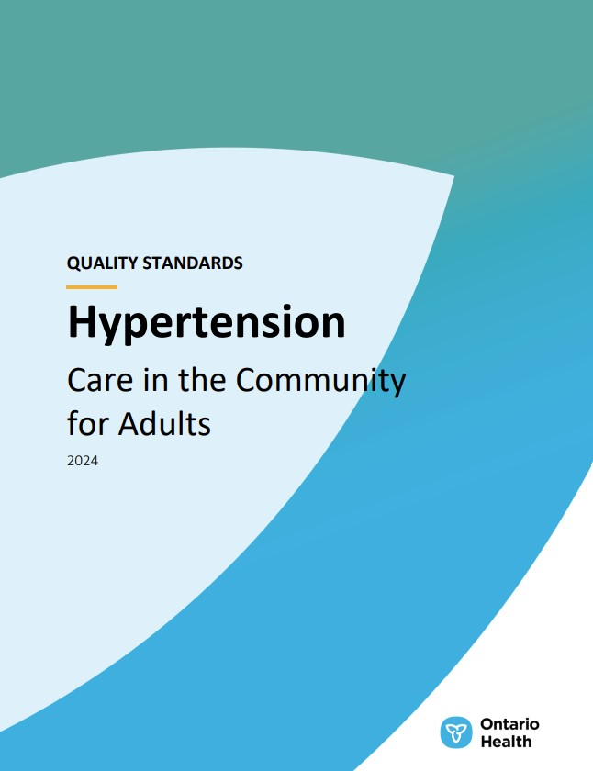
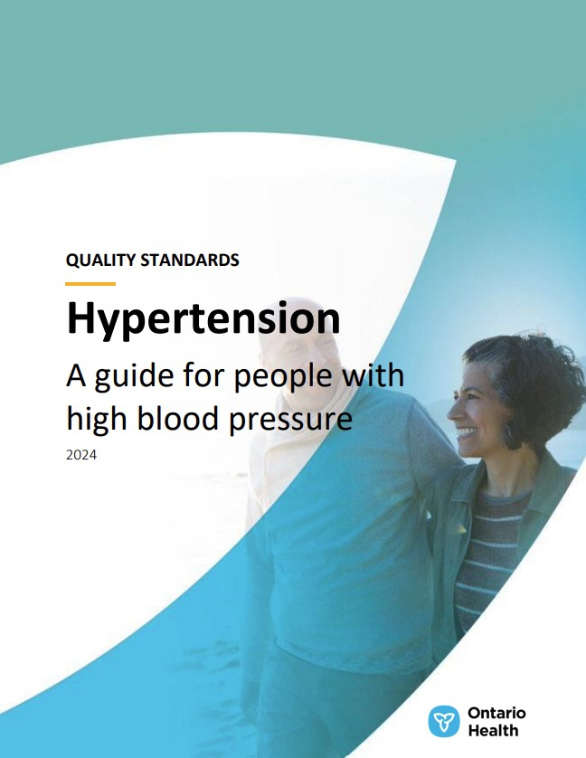
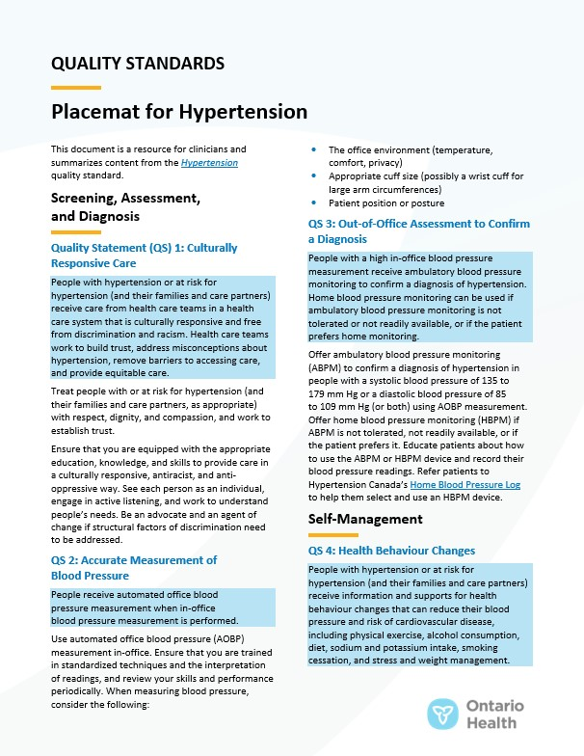
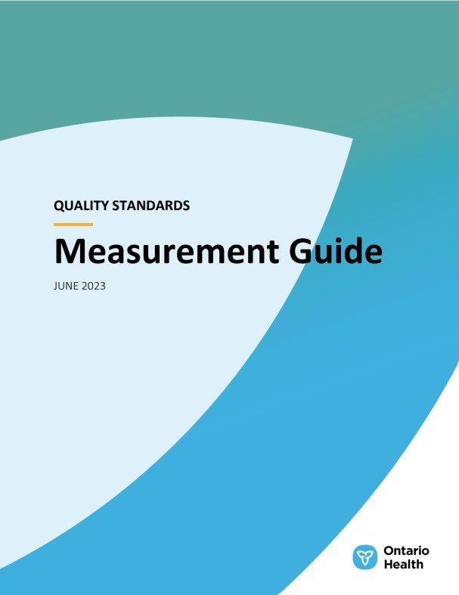
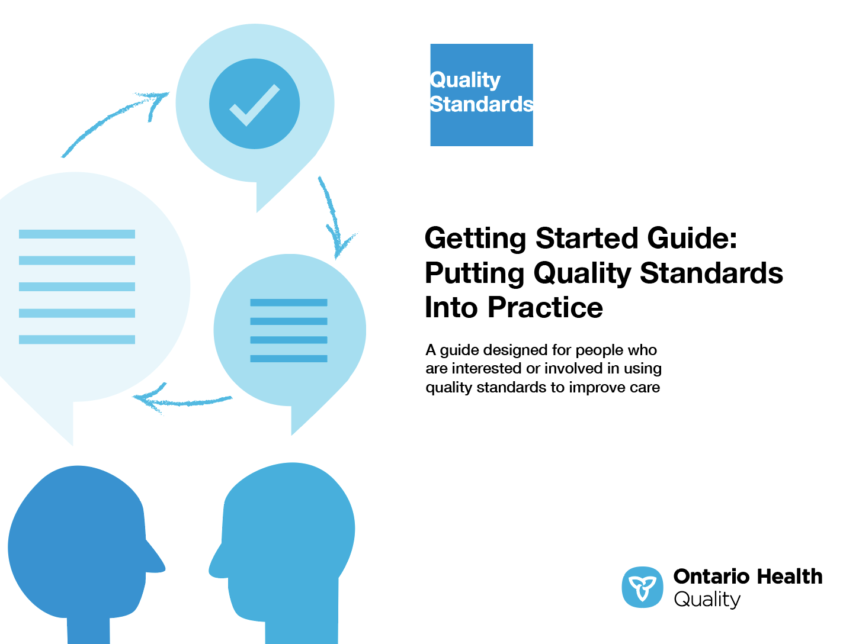
Quality standard resources
Quality Standard
Patient Guide
Placemat
Measurement Guide
Technical Specifications
Getting Started Guide
5
Find these resources here: https://www.hqontario.ca/Evidence-to-Improve-Care/Quality-Standards/View-All-Quality-Standards/hypertension
Notes:
Each quality standard focuses on a specific health care issue. The development of each quality standard is accompanied by an assortment of resources.
Through concise, easy-to-understand statements, quality standards outline what quality care looks like for a condition or topic based on the evidence.
Each quality standard is accompanied by a:
Patient guide
Placemat
Measurement guide
Technical specifications
Getting started guide
Quality standards provide the blueprint to enable the health care system in Ontario to work better, facilitate smooth transitions, and ensure patients receive the same high-quality care, regardless of where they reside.

Slide 6
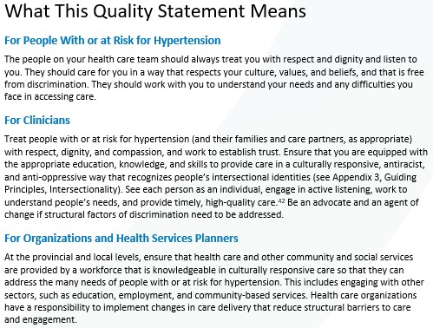
Inside the quality standard
The Quality Statement
The Audience Statements
The Definitions
The Indicators
6

Slide 7
Patient guide
Quality standards
The patient guide is designed to give patients information about what quality care looks like for various conditions based on the best evidence, so they can ask informed questions of their health care teams.
7
Notes:
Every quality standard includes a plain language summary for patients, families, care partners, and the public called the patient guide.
Patient engagement in quality standards:
Membership on advisory committees
Focus groups and key informant interviews on topic-specific content (when necessary)
Public comment period for each quality standard
Consultations on the patient guide

Slide 8
Placemat
Quality standards
The placemat is a quick-reference resource for clinicians that summarizes the quality standard and includes links to helpful resources and tools.
8

Slide 9
How the health care system can support implementation
Quality standards
Implementing quality standards can be challenging owing to system-level barriers or gaps, many of which have been identified throughout the development of this standard
Ontario Health will work with and support other provincial partners, including the Ministry of Health, to bridge system-level gaps and support the implementation of quality standards
9

Slide 10
Implementation tools
Quality standards
The Getting Started Guide:
Outlines the process for using the quality standard as a resource to deliver high-quality care
Contains evidence-based approaches, as well as useful tools and templates for implementing change ideas at the practice level
10
Notes:
There are things we can do today despite the larger systemic barriers that may take time to resolve. The Getting Started Guide is a document that outlines a process for using the quality standards as a resource to deliver high-quality care. It compiles a number of resources to support adoption, such as links to implementation and quality improvement resources, examples and activities for reflection, and templates and documents to support the implementation planning activities. The Getting Started Guide also includes an Action Plan Template and examples on how Quality Improvement Plans can help to advance quality standards.

Slide 11
Quorum
Quality standard adoption tools
Quorum is an online community dedicated to improving the quality of health care in Ontario.
The Quality Standards Adoption Series highlights efforts in the field to implement changes and close gaps in care related to quality standard topics.
11
quorum.hqontario.ca
Notes:
The Quality Standards program has highlighted several stories from organizations and groups using various standards and statements within their clinical care settings, organization, or institutions; these are available through posts and discussions on Quorum.
As well, we are working on compiling resources and tools, for both clinicians and patients and families.
The focus is on implementation/adoption stories and how organizations are using quality standards in practice to inform care.
We’d love to hear from you if you are interested in contributing to a post or article.

Slide 12
Measurement guide
Quality standards
The measurement guide describes:
The measurement principles behind the quality indicators included in quality standards
The types of indicators included in quality standards
How local and provincial data are collected and measured
12

Slide 13
Technical specifications
Quality standards
The technical specifications report outlines 2 types of measurement:
Provincial measurement: how we can monitor the progress being made to improve care at the provincial level
Local measurement: what you can do to assess the quality of care that you provide locally
13

Slide 14
Why do we need a quality standard for hypertension?

Slide 15
In Ontario in fiscal year 2022/23, more than 3 million adults had hypertension, representing a quarter of all adults. 66% of people aged 65 years and older had a diagnosis of hypertension.¹
Hypertension is poorly managed in ⅓ of those with the condition. As well, up to 17% of people may be unaware that they have hypertension.^{2,3}
Sources:
1. Discharge Abstract Database, National Ambulatory Care Reporting System, Ontario Health Insurance Plan Claims Database, fiscal years 2017/18 to 2022/23.
2. Cloutier L, Daskalopoulou SS, Padwal RS, Lamarre-Cliche M, Bolli P, McLean D, et al. A new algorithm for the diagnosis of hypertension in Canada. Can J Cardiol. 2015;31(5):620-30.
3. Schiffrin EL, Campbell NRC, Feldman RD, Kaczorowski J, Lewanczuk R, Padwal R, et al. Hypertension in Canada: past, present, and future. Ann Glob Health. 2016;82(2):288-99.
15
Notes:
Note: These data were obtained through clinical administrative databases and may differ to similar statistics from the quality standard document, this is due to differences in methodology, data sources, and timeframes. Data shown here are preferred.

Slide 16
⅔ of adults aged 65 years and older have hypertension
In Ontario among people aged 65 years and older, more women have hypertension than men.
The prevalence for each age group has been consistent across Ontario Health regions over the past 5 years.
Aged 65+
66.6%
Aged 40-64
22.4%
Aged 18-39
2.39%
Fiscal year 2022/23
Sources: Discharge Abstract Database and Ontario Health Insurance Plan Claims Database, fiscal years 2017/18 to 2022/23.

Slide 17
Hypertension disproportionately affects people from¹⁻⁵:
Black, Indigenous, South Asian, and Francophone populations
Older age groups
Rural and remote settings
In Ontario, people who are Black or South Asian are 3 times more likely to have hypertension than White people.⁶
Sources:
1. Walsemann KM, Goosby BJ, Farr D. Life course SES and cardiovascular risk: heterogeneity across race/ethnicity and gender. Soc Sci Med. 2016;152:147-55.
2. Chiu M, Austin PC, Manuel DG, Tu JV. Comparison of cardiovascular risk profiles among ethnic groups using population health surveys between 1996 and 2007. CMAJ. 2010;182(8):E301-10.
3. Bushnik T, Hennessy DA, McAlister FA, Manuel DG. Factors associated with hypertension control among older Canadians [Internet]. Ottawa (ON): Statistics Canada; 2018 [cited 2023 Aug 2]. Available from: https://www150.statcan.gc.ca/n1/pub/82-003-x/2018006/article/54970-eng.htm.
4. Anand SS, Abonyi S, Arbour L, Balasubramanian K, Brook J, Castleden H, et al. Explaining the variability in cardiovascular risk factors among First Nations communities in Canada: a population-based study. Lancet Planet Health. 2019;3(12):e511-e20.
5. Bouchard L, Batal M, Imbeault P, Gagnon-Arpin I, Makandi E, Seidigh G. The health of Francophones in Ontario. A region-by-region portrait developed from the Canadian Community Health Survey (CCHS) [Internet]. Toronto (ON): Réseau de recherche appliquée sur la santé des francophones de l’Ontario; 2012 [cited 2023 Aug 3]. Available from: https://sante-closm.ca/wp-content/uploads/2022/09/Bouchard-L.-Batal-M.-Imbeault-P.-Gagnon-Arpin-I.-Makvandi-E.-et-Sedigh-G.-2012d.pdf
6. Leenen FHH, Dumais J, McInnis NH, Turton P, Stratychuk L, Nemeth K, et al. Results of the Ontario survey on the prevalence and control of hypertension. CMAJ. 2008;178(11):1441-9.
17

Slide 18
Most new diagnoses of hypertension occur in the primary care setting, but diagnoses in the inpatient care setting almost doubled in fiscal year 2022/23
Note: Inpatient care is defined as hospitalizations with a hypertension diagnosis in any field; primary care is defined as Ontario Health Insurance Plan visits with a hypertension diagnosis.
Sources: Discharge Abstract Database and Ontario Health Insurance Plan Claims Database, fiscal years 2017/18 to 2022/23.

Slide 19
Unplanned ED visits and hospitalizations related to hypertension greatly increased in fiscal year 2022/23
This increase was consistent across age groups, by sex, and by income level.
Abbreviation: ED, emergency department.
Note: Includes adults with hypertension who had at least 1 unscheduled ED visit or 1 nonelective hospitalization with hypertension in any diagnosis field.
Sources: Discharge Abstract Database, National Ambulatory Care Reporting System, Ontario Health Insurance Plan Claims Database, fiscal years 2017/18 to 2022/23.

Slide 20
The percentage of adults with hypertension who had any unplanned hypertension-related acute care visit varied by Ontario Health region
Abbreviation: ED, emergency department.
Note: Includes adults with hypertension who had at least 1 unscheduled ED visit or 1 nonelective hospitalization with hypertension in any diagnosis field. Ontario Health region boundaries as of April 2023.
Sources: Discharge Abstract Database, National Ambulatory Care Reporting System, Ontario Health Insurance Plan Claims Database, fiscal years 2017/18 to 2022/23.

Slide 21
Adults with hypertension living in lower-income neighbourhoods had the highest rates of hypertension-related acute care utilization
Note: Includes adults with hypertension who had at least 1 unscheduled emergency department visit or 1 nonelective hospitalization with hypertension in any diagnosis field.
Sources: Discharge Abstract Database, National Ambulatory Care Reporting System, Ontario Health Insurance Plan Claims Database, fiscal years 2017/18 to 2022/23.

Slide 22
Hypertension is the most common modifiable risk factor for cardiovascular disease.¹ Of adults in Ontario who had been diagnosed with hypertension for at least 1 year in fiscal year 2022/23, 5.5% visited acute care for stroke or cardiovascular disease.²
Sources:
1. Fuchs FD, Whelton PK. High blood pressure and cardiovascular disease. Hypertension. 2020;75(2):285-92.
2. Discharge Abstract Database, National Ambulatory Care Reporting System, Ontario Health Insurance Plan Claims Database, fiscal years 2017/18 to 2022/23.
22

Slide 23
Per 1,000 people with hypertension, 7 had at least 1 stroke event and 55 had at least 1 cardiovascular disease event in fiscal year 2022/23
55 per 1,000 adults with hypertension visited acute care for cardiovascular disease
Abbreviation: AMI, acute myocardial infarction.
Notes: Among adults who had been diagnosed with hypertension for at least 1 year. Other cardiovascular disease excludes ischemic heart disease, AMI, heart failure, and hypertension itself; acute care is defined as any emergency department visit or hospitalization.
Sources: Discharge Abstract Database, National Ambulatory Care Reporting System, Ontario Health Insurance Plan Claims Database, fiscal years 2017/18 to 2022/23.

Slide 24
Among people aged 65 years and older with hypertension who obtained blood pressure medication through the ODB Program, ¾ were persistent with their medications
76.6%
975,343
people
70.0%
1,279,153
people
Abbreviation: ODB, Ontario Drug Benefit.
Notes: Persistent is defined as having blood pressure medication claims in the ODB Database covering 80% or more of the fiscal year (i.e., 292 days or more). The denominator included people aged 65 years and older with hypertension who had any blood pressure medication claims through the ODB Database, and otherwise assumed that they did not initiate or were not prescribed medication.
Sources: Discharge Abstract Database, Ontario Drug Benefit Database, Ontario Health Insurance Plan Claims Database, fiscal years 2017/18 to 2022/23.

Slide 25
”
“I was diagnosed with hypertension and prescribed medication for high blood pressure. After a few months, it became evident that my blood pressure was low and the medication was inappropriate. It took a couple of years to get to a stable, low medication state. I think comprehensive standards would have prevented a rushed prescription.”
– Ravi Venkatesh, Lived Experience Advisor, Hypertension Quality Standard Advisory Committee
25

Slide 26
”
“The identification and effective treatment of hypertension is an important part of primary care. Like much in family practice, treating hypertension is a mixture of hard science, attention to detail, perseverance, and a nuanced approach to care: hard science to know the tools we must use to find and treat it; attention to detail in deploying those tools for maximum benefit and minimum harm; perseverance to follow up methodically and over the long term; and a nuanced approach to ensure that we are truly patient-focused in all that we do. All of this is required if we are to prevent the vascular, ocular, and renal tragedies we know result from or are worsened by poorly managed hypertension. This quality standard reminds me of some of the details I need to embrace to be truly effective. I am hopeful it does so for all clinicians in Ontario.”
– Adam Steacie, Family Physician; Co-chair, Hypertension Quality Standard Advisory Committee
26

Slide 27
Quality statements to improve care

Slide 28
Scope of this quality standard
This quality standard addresses care for adults aged 18 years and older who have been diagnosed with hypertension or who are at risk of developing hypertension
The quality standard focuses on the prevention, screening, assessment, diagnosis, and management of hypertension in primary care, and in long-term care and other home and community care settings
Quality statements may also be applicable to specialist care settings, where appropriate
Quality statements may apply in pregnancy; however, this quality standard does not directly address or include special considerations for the diagnosis and management of hypertension during pregnancy or postpartum
28
Notes:
Scope of This Quality Standard
This quality standard addresses care for adults aged 18 years and older who have been diagnosed with hypertension or who are at risk of developing hypertension. The quality standard focuses on the prevention, screening, assessment, diagnosis, and management of hypertension in primary care, and in long-term care and other home and community care settings. Quality statements may also be applicable to specialist care settings, where appropriate. Quality statements may apply in pregnancy; however, this quality standard does not directly address or include special considerations for the diagnosis and management of hypertension during pregnancy or postpartum.

Slide 29
Quality statement topics
Culturally responsive care
Accurate measurement of blood pressure
Out-of-office assessment to confirm a diagnosis
Health behaviour changes
Care planning and self-management
Monitoring and follow-up after a confirmed diagnosis
Improving adherence to medications
29

Slide 30
Culturally responsive care
Quality statement 1:
People with hypertension or at risk for hypertension (and their families and care partners) receive care from health care teams in a health care system that is culturally responsive and free from discrimination and racism. Health care teams work to build trust, address misconceptions about hypertension, remove barriers to accessing care, and provide equitable care.
30

Slide 31
Accurate measurement of blood pressure
Quality statement 2:
People receive automated office blood pressure measurement when in-office blood pressure measurement is performed.
31

Slide 32
Out-of-office assessment to confirm a diagnosis
Quality statement 3:
People with a high in-office blood pressure measurement receive ambulatory blood pressure monitoring to confirm a diagnosis of hypertension. Home blood pressure monitoring can be used if ambulatory blood pressure monitoring is not tolerated or not readily available, or if the patient prefers home monitoring.
32

Slide 33
Health behaviour changes
Quality statement 4:
People with hypertension or at risk for hypertension (and their families and care partners) receive information and supports for health behaviour changes that can reduce their blood pressure and risk of cardiovascular disease, including physical exercise, alcohol consumption, diet, sodium and potassium intake, smoking cessation, and stress and weight management.
33

Slide 34
Care planning and self-management
Quality statement 5:
People with hypertension (and their families and care partners) collaborate with clinicians and use shared decision-making to create a care plan that includes a target blood pressure range, goals for health behaviour change, medication selection and adherence, recommended diagnostic testing, management of concurrent conditions, and when to follow up.
34

Slide 35
Monitoring and follow-up after a confirmed diagnosis
Quality statement 6:
People with hypertension who are actively modifying their health behaviours but not taking blood pressure medication are assessed by their clinician every 3 to 6 months. Shorter intervals (every 1 to 2 months) may be needed for people with higher blood pressure. People who have been prescribed blood pressure medication are assessed every 1 to 2 months until their target blood pressure has been met on 2 consecutive visits, and then every 3 to 6 months.
35

Slide 36
Improving adherence to medications
Quality statement 7:
People who are prescribed blood pressure medication (and their families and care partners) receive information and supports to help them take their medication regularly and as prescribed. At every follow-up visit for hypertension, they have discussions with their clinicians about medication use, possible side effects, and any barriers they experience in taking their medications as prescribed.
36

Slide 37
Measures to support improvement
Notes:
The Hypertension Quality Standard Advisory Committee identified a set of overarching goals for this quality standard. These have been mapped to indicators that may be used to assess quality of care provincially and locally.

Slide 38
Indicators that can be measured using provincial data
Percentage of people diagnosed with hypertension for at least 1 year who experience 1 or more stroke events in a given year
Percentage of people diagnosed with hypertension for at least 1 year who experience 1 or more cardiovascular disease events in a given year. Stratify by:
Cardiac disease events
All cardiovascular disease events (except hypertension itself)
Percentage of people with hypertension who have 1 or more unplanned acute care visits for hypertension in the past year. Stratify by:
Unscheduled emergency department visits
Nonelective hospitalizations
Percentage of people with hypertension who are persistent in taking their blood pressure medications (measurable only for people aged 65 years and older)
38

Slide 39
Indicator that can be measured using only local data
Percentage of people with hypertension who report that their blood pressure has been within their target range for the past month
39

Slide 40
Data sources and acknowledgement
Parts of this material are based on data and information compiled and provided by the Canadian Institute for Health Information (CIHI). However, the analyses, conclusions, opinions, and statements expressed herein are those of the authors and not necessarily those of CIHI.
40

Slide 41
Thank you

