Slide 1
QUALITY STANDARDS
Major Depression
Guiding evidence-based care for adults and adolescents in Ontario
Notes:
If you have any questions about the content of this presentation, please contact us at QualityStandards@OntarioHealth.ca

Slide 2
Objectives
Overview of quality standards: What are they? How are they used?​
Why this quality standard is needed: Gaps and variations in quality of care for people with major depression in Ontario
Quality statements to improve care: The key statements in the major depression quality standard
Measures to support improvement: Indicators that can help measure your quality improvement efforts
2

Slide 3
Quality standards
Inform clinicians and patients what quality care looks like
Focus on conditions or processes where there are large variations in how care is delivered, or where there are gaps between the care provided in Ontario and the care patients should receive
Are grounded in the best available evidence
3
Notes:
Quality standards are a small set of high impact statements that describe optimal care where identified quality gaps exist in Ontario.
Voluntary and aspirational in nature​.
Designed to “raise the ceiling” with the goal of having the best possible care available to all Ontarians, regardless of where they live in the province.
There are many guidelines, professional standards, and other recommendations that contribute to the evidence ecosystem. Quality standards complement these resources.
Quality standards outline the what of care that should be delivered but are agnostic on who should be delivering it (unlike other CPGs, BPGs).
Quality standards are:
Concise: 5 to 15 strong, evidence-based statements focused on high-priority areas for improvement.
Accessible: help clinicians and provider organizations offer the highest-quality care; and patients to know what to discuss with their health care team (compared with CPGs that are quite dense, these are very accessible, also written in plain language).
Measurable: each statement is accompanied by one or more quality indicators (structure, process, or outcome), with a set of outcome measures for the overall standard.
Implementable: quality improvement tools and resources support each standard, to fuel adoption.

Slide 4
Quality standards
Help patients, residents, families, and care partners know what to ask for in their care
Help clinicians know what care to offer, based on evidence and expert consensus
Help health care organizations measure, assess, and improve the quality of care they provide
Help ensure consistent, high-quality care across the province
4
Notes:
Patients, care partners and the public can use quality standards to understand what excellent care looks like, what they should expect from their health care team, and how to discuss the quality of their care.
Provincial regions and disease agencies can use quality standards to measure health outcomes, hold health service providers accountable for delivering high-quality care, and inform regional improvement strategies.
Provider organizations can use quality standards to measure and audit their quality of care, identify gaps, guide organizational improvement strategies, and inform clinical program investments.
Clinicians can use quality standards to evaluate their practice and identify areas for personal and organizational quality improvement, and can incorporate the evidence-based statements into professional education.
Government can use quality standards to identify provincial priority areas, inform new data collection and reporting initiatives, and design performance indicators and funding incentives.

Slide 5
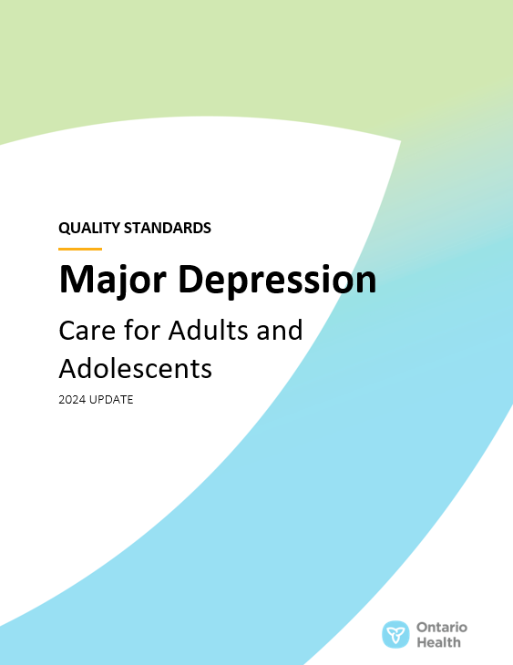
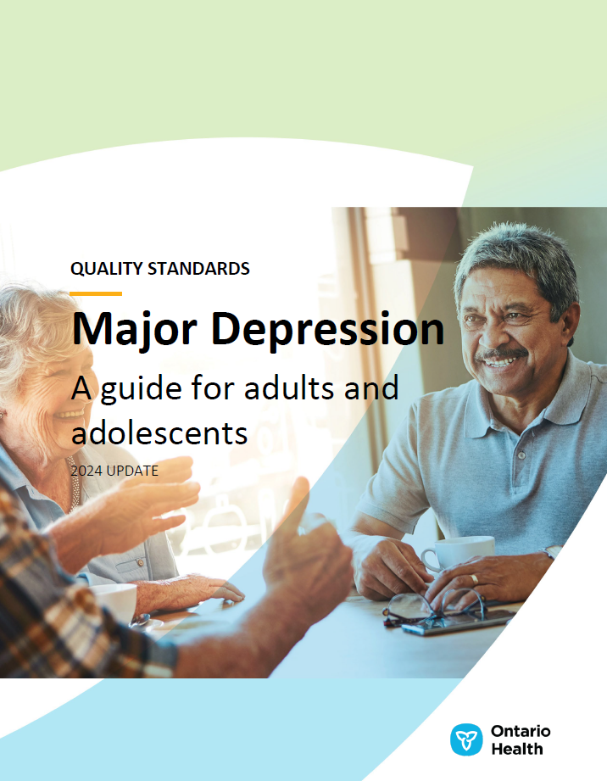
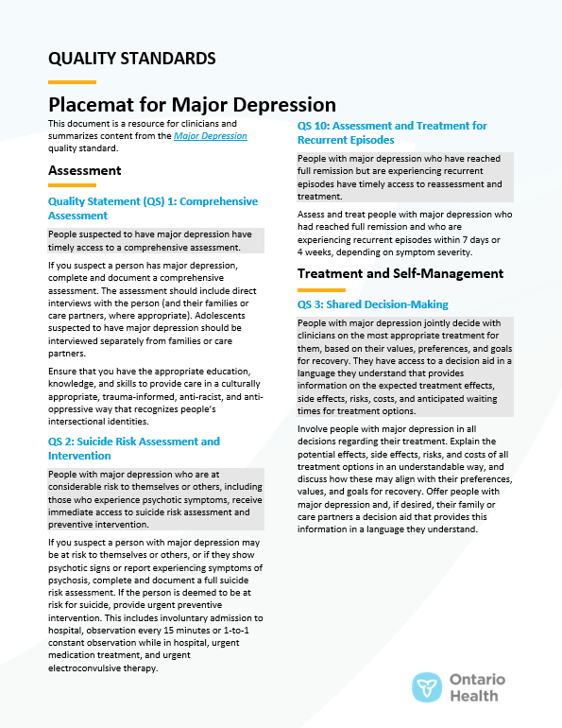
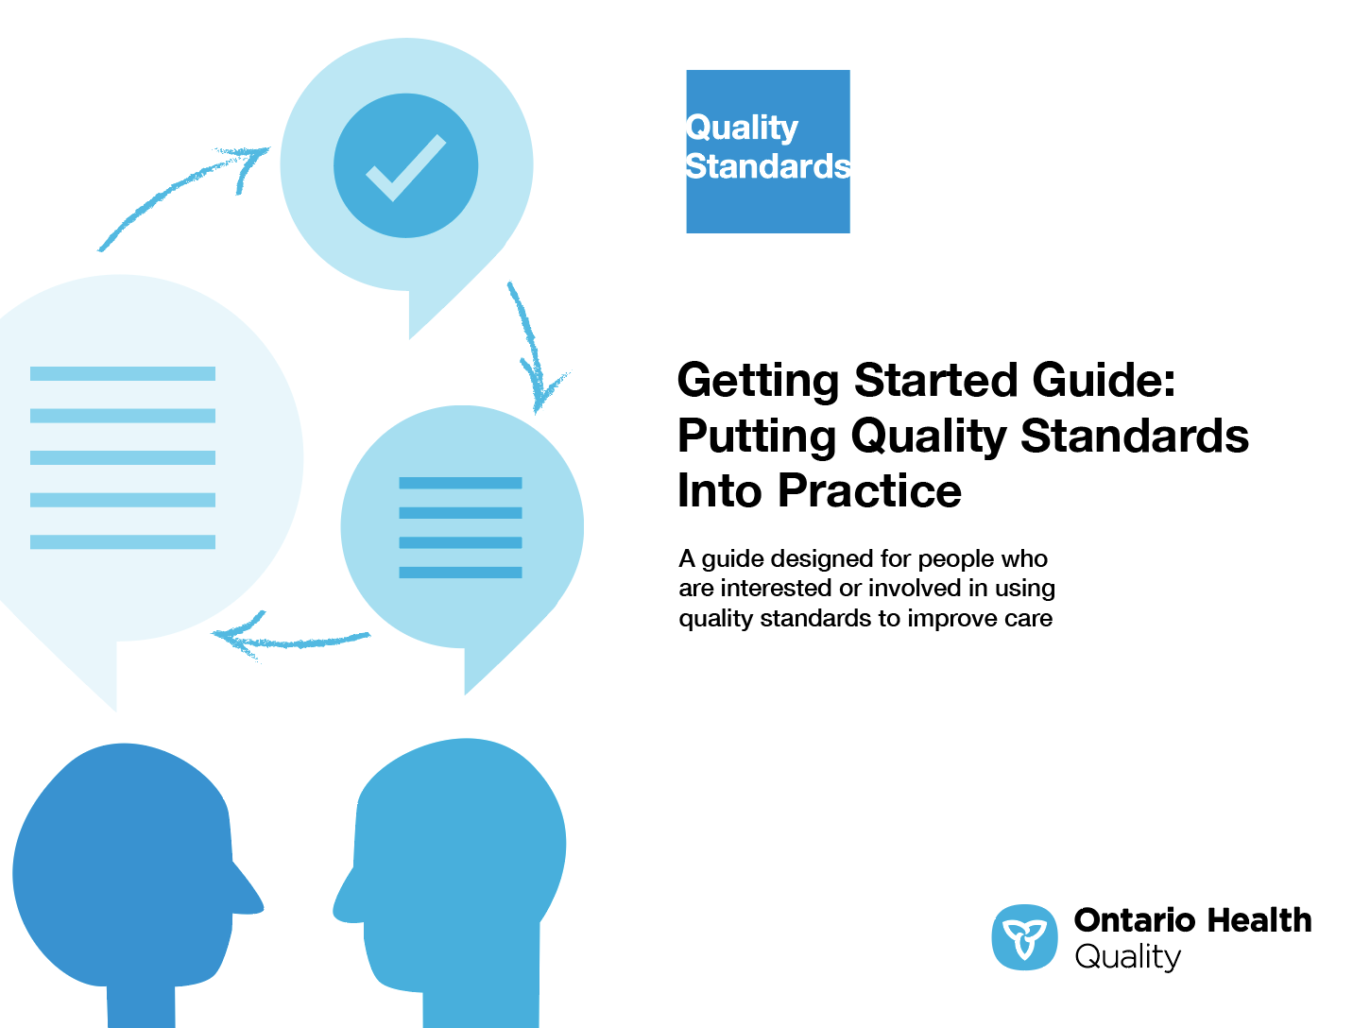
Quality standard resources
Quality Standard
Patient Guide
Placemat
Measurement Guide
Technical Specifications
Getting Started Guide
Find these resources here: https://hqontario.ca/evidence-to-improve-care/quality-standards/view-all-quality-standards/major-depression
5
Notes:
Each quality standard focuses on a specific health care issue. The development of each quality standard is accompanied by an assortment of resources.
Through concise, easy-to-understand statements, quality standards outline what quality care looks like for a condition or topic based on the evidence.
Each quality standard is accompanied by a:
Patient guide
Placemat
Measurement guide
Technical specifications
Getting started guide
Quality standards provide the blueprint to enable the health care system in Ontario to work better, facilitate smooth transitions, and ensure patients receive the same high-quality care, regardless of where they reside.

Slide 6
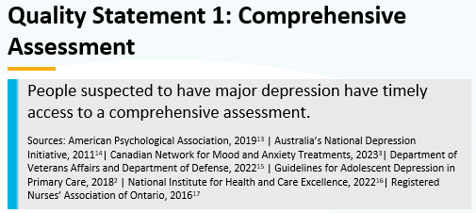
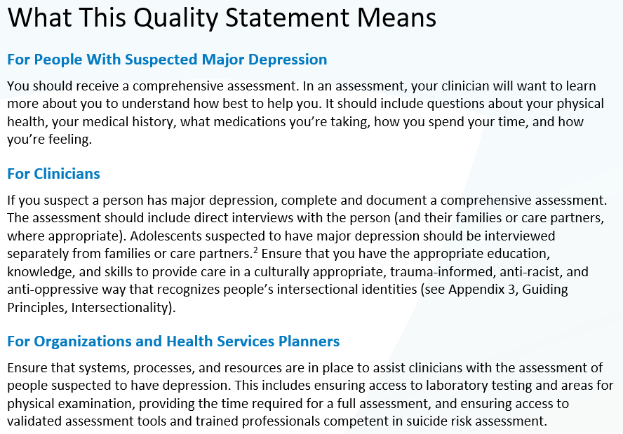
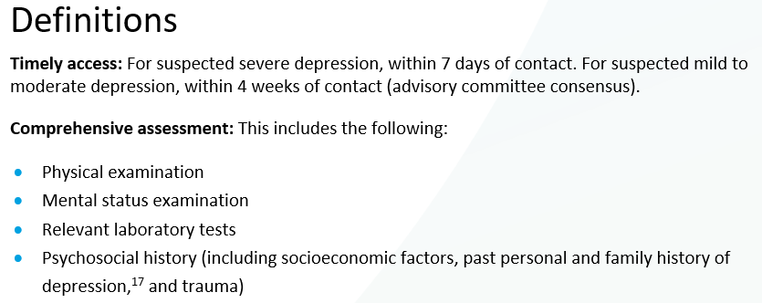
Inside the quality standard
The Quality Statement
The Audience Statements
The Definitions
The Indicators
6

Slide 7
Patient guide
Quality standards
The patient guide is designed to give patients information about what quality care looks like for various conditions based on the best evidence, so they can ask informed questions of their clinicians.
7
Notes:
Every quality standard includes a plain language summary for patients, families, caregivers and the public called the patient guide.
Patient engagement in quality standards:
Membership on advisory committees
Focus groups and key informant interviews on topic-specific content (when necessary)
Public comment period for each quality standard
Consultations on the patient guide

Slide 8
Placemat
Quality standards
The placemat is a quick-reference resource for clinicians that summarizes the quality standard and includes links to helpful resources and tools.
8

Slide 9
How the health care system can support implementation
Quality standards
Implementing quality standards can be challenging owing to system-level barriers or gaps, many of which have been identified throughout the development of this standard
Ontario Health will work with and support other provincial partners, including the Ministry of Health, to bridge system-level gaps to support the implementation of quality standards
9

Slide 10
Implementation tools
Quality standards
The Getting Started Guide:
Outlines the process for using the quality standard as a resource to deliver high-quality care
Contains evidence-based approaches, as well as useful tools and templates for implementing change ideas at the practice level
10
Notes:
There are things we can do today despite the larger systemic barriers that may take time to resolve. The Getting Started Guide is a document that outlines a process for using the quality standards as a resource to deliver high-quality care. It compiles a number of resources to support adoption, such as links to implementation and quality improvement resources, examples and activities for reflection, and templates and documents to support the implementation planning activities. The Getting Started Guide also includes an Action Plan Template and examples on how Quality Improvement Plans can help to advance quality standards.

Slide 11
Quorum
Quality standard adoption tools
Quorum is an online community dedicated to improving the quality of health care in Ontario.
The Quality Standards Adoption Series highlights efforts in the field to implement changes and close gaps in care related to quality standard topics.
11
quorum.hqontario.ca
Notes:
The Quality Standards program has highlighted several stories from organizations and groups using various standards and statements within their clinical care settings, organization, or institutions; these are available through posts and discussions on Quorum.
As well, we are working on compiling resources and tools, for both clinicians and patients and families.
The focus is on implementation/adoption stories and how organizations are using quality standards in practice to inform care.
We’d love to hear from you if you are interested in contributing to a post or article.

Slide 12
Measurement guide
Quality standards
The measurement guide describes:
The measurement principles behind the quality indicators included in quality standards
The types of indicators included in quality standards
How local and provincial data are collected and measured
12

Slide 13
Technical specifications
Quality standards
The technical specifications report outlines 2 types of measurement:
Provincial measurement: how we can monitor the progress being made to improve care at the provincial level
Local measurement: what you can do to assess the quality of care that you provide locally
13

Slide 14
Why do we need a quality standard for major depression?

Slide 15
In FY 2022/23, about 1 in 500 people aged 13 years and older in Ontario visited the ED for major depression
In FY 2022/23, there were more than 27,000 ED visits for major depression. Visits were more common among women (57%) than men (43%), and most visits were among people aged 13–24 years.
Sources: National Ambulatory Care Reporting System (NACRS), FY 2022/23; Statistics Canada, Table 17-10-0005-01, Population estimates on July 1,2022, by age and sex, accessed 2023 Dec 5. Abbreviations: ED, emergency department; FY, fiscal year.
15

Slide 16
Health care contacts for major depression are an important opportunity for suicide prevention
Among people who die by suicide, more than 90% have contact with the health care system in the year before their death, about 1/3 with the ED.¹
Elements to support improvement include enhancing opportunities for intervention, such as including risk assessment in all clinical care for major depression.
Leaving the ED without being seen is a missed opportunity for intervention.
Where patients went after ED visits for major depression, FY 2022/23
Sources: 1. Schaffer A, et al. Population-based analysis of health care contacts among suicide decedents: identifying opportunities for more targeted suicide prevention strategies. World Psychiatry. 2016 Jun;15(2):135-45; graph, NACRS, FY 2022/23. Abbreviations: ED, emergency department; FY, fiscal year.
16

Slide 17
In FY 2022/23, people living in Northern Ontario were more likely to have the ED as their first point of contact for major depression than those living elsewhere in the province
Percentage of people with ED as first point of contact for major depression by Ontario Health region, FY 2022/23
Between FYs 2010/11 and 2022/23, the provincial rate for ED as first point of contact for major depression was about 20%.
Note: Standardized rates. Sources: Discharge Abstract Database (DAD), NACRS, Ontario Health Insurance Plan (OHIP) claims database, Ontario Mental Health Reporting System (OMHRS), FY 2022/23, accessed via ICES. Abbreviations: ED, emergency department; FY, fiscal year.
17

Slide 18
In FY 2022/23, ED return visits for major depression in Ontario were more common in urban settings and among middle-aged adults
Percentage of people who visited the ED for a mental health or addictions condition within 30 days of a previous ED visit for major depression by age group, FY 2022/23
In FY 2022/23, more people living in urban areas (20.8%) visited the ED for a mental health or addictions condition within 30 days of a previous ED visit for major depression than those in living in rural areas (17.8%)
Note: Standardized rates. Sources: DAD, NACRS, OHIP claims database, OMHRS, FY 2022/23, accessed via ICES. Abbreviations: ED, emergency department; FY, fiscal year.
18

Slide 19
In FY2022/23, about 1/3 of people discharged from hospital for major depression in Ontario had a physician follow-up within 7 days
56.3%
34.7%
Percentage of people with an outpatient physician follow-up within 7 days of hospital discharge for major depression, FY 2018/19–2022/23
Distribution of follow-up type among people with outpatient physician follow-up within 7 days of a hospital discharge for major depression, in Ontario, FY 2022/23
Primary care
Psychiatrist
Both
8.9%
Note: Standardized rates. Sources: DAD, OHIP claims database; OMHRS, FY 2022/23, accessed via ICES. Abbreviation: FY, fiscal year.
19

Slide 20
In FY 2022/23 across Ontario Health regions, there was a 2-fold variation in the percentage of people with a physician follow-up within 7 days of discharge from a hospitalization for major depression
Percentage of people with an outpatient physician follow-up within 7 days of discharge from a hospitalization for major depression by Ontario Health region, FY 2022/23
Note: Standardized rates. Sources: DAD, OHIP claims database, OMHRS, FY 2022/23, accessed via ICES. Abbreviation: FY, fiscal year.
20

Slide 21
In FY 2022/23, more than 10% of people hospitalized for major depression in Ontario were readmitted; this rate rose to 12% for people living in the lowest-income neighbourhoods
Notes: Standardized rates. Income quintile is an area-based ranking of the household income in each neighbourhood of residence compared to surrounding neighbourhoods.​ Sources: DAD, OHIP claims database; OMHRS, FY2022/23, accessed via ICES. Abbreviation: FY, fiscal year.
21

Slide 22
Quality statements to improve care

Slide 23
Scope of this quality standard
This quality standard addresses care for people who have major depression or who are suspected to have major depression. It applies to adults and adolescents aged 13 years and older, and it considers all care settings
This quality standard does not apply to people with postpartum depression or to children under 13 years of age
23
Notes:
Scope of This Quality Standard
This quality standard addresses
A separate quality standard addresses

Slide 24
Quality statement topics
Comprehensive assessment
Suicide risk assessment and intervention
Shared decision-making
Treatment after initial diagnosis
Adjunct therapies and self-management
Monitoring for treatment adherence and response
Optimizing, switching, or adding therapies
Continuation of medication
Electroconvulsive therapy
Assessment and treatment for recurrent episodes
Education and support
Transitions in care
24

Slide 25
Comprehensive assessment
Quality statement 1:
People suspected to have major depression have timely access to a comprehensive assessment.
25

Slide 26
Suicide risk assessment and intervention
Quality statement 2:
People with major depression who are at considerable risk to themselves or others, including those who experience psychotic symptoms, receive immediate access to suicide risk assessment and preventive intervention.
26

Slide 27
Shared decision-making
Quality statement 3:
People with major depression jointly decide with clinicians on the most appropriate treatment for them, based on their values, preferences, and goals for recovery. They have access to a decision aid in a language they understand that provides information on the expected treatment effects, side effects, risks, costs, and anticipated waiting times for treatment options.
27

Slide 28
Treatment after initial diagnosis
Quality statement 4:
People with major depression have timely access to either pharmacotherapy or evidence-based psychotherapy, based on their preference, the severity of symptoms, and their ability to tolerate treatment. People with moderate to severe or persistent depression are offered a combination of both treatments.
28

Slide 29
Adjunct therapies and self-management
Quality statement 5:
People with major depression are advised about adjunct therapies and self-management strategies that can complement pharmacotherapy or psychotherapy.
29

Slide 30
Monitoring for treatment adherence and response
Quality statement 6:
People with major depression are monitored for the onset of, or an increase in, suicidal thinking following initiation of any treatment. People with major depression have a follow-up appointment with their clinician at least every 2 weeks for at least 6 weeks or until treatment adherence and response have been achieved. After this, they have a follow-up appointment at least every 4 weeks until they enter remission.
30

Slide 31
Optimizing, switching, or adding therapies
Quality statement 7:
People with major depression who are prescribed medication are monitored for 2 weeks for the onset of effects; after this time, dosage adjustment or switching medications may be considered. People with major depression who do not experience a response to their medication after 8 weeks are offered a different or additional medication, psychotherapy, or a combination of both.
31

Slide 32
Continuation of medication
Quality statement 8:
People taking medication who enter into remission from their first episode of major depression are advised to continue their medication for at least 6 months after remission. People with recurrent episodes of major depression who are taking medication and enter into remission are advised to continue their medication for at least 2 years after remission.
32

Slide 33
Electroconvulsive therapy
Quality statement 9:
People with severe major depression and those with difficult-to-treat depression have access to electroconvulsive therapy.
33

Slide 34
Assessment and treatment of recurrent episodes
Quality statement 10:
People with major depression who have reached full remission but are experiencing recurrent episodes have timely access to reassessment and treatment.
34

Slide 35
Education and support
Quality statement 11:
People with major depression and their family members and care partners are offered education on major depression and information regarding community supports and crisis services.
35

Slide 36
Transitions in care
Quality statement 12:
People with major depression who transition from one clinician to another have a documented care plan that is made available to them and their receiving clinician within 7 days of the transition, with a specific timeline for follow-up. People with major depression who are discharged from acute care have a scheduled follow-up appointment with a clinician within 7 days.
36

Slide 37
Measures to support improvement
Notes:
The Major Depression Quality Standard Advisory Committee identified a set of overarching goals for this quality standard. These have been mapped to indicators that may be used to assess quality of care provincially and locally.

Slide 38
Indicators that can be measured using provincial data
Number of inpatient deaths by suicide among people with a primary diagnosis of major depression
Percentage of people with major depression discharged from a hospital inpatient stay who die by suicide within 30 days, 3 months, 6 months, and 1 year of discharge
Percentage of emergency department visits for major depression that are a person’s first contact with health care services for a diagnosis of major depression
Percentage of people with major depression who show an improvement in depressive symptoms during an inpatient stay
Percentage of readmissions to any hospital within 7 days and within 30 days of discharge from an inpatient hospital stay for major depression, stratified by the reason for readmission:
Any reason
Reason related to mental health and addictions
Major depression
Percentage of unscheduled emergency department visits within 7 days and within 30 days of discharge from an inpatient hospital stay for major depression, stratified by the reason for the visit:
Any reason
Reason related to mental health and addictions
Major depression
Self-harm
38

Slide 39
Indicators that can be measured using only local data
Percentage of people with major depression, or family members of people with major depression, whose overall ratings of services received are good or very good
Percentage of people with major depression who rate the care they receive in the hospital as excellent, very good, or good
Percentage of people with major depression who show a decrease in their unmet needs over time
39

Slide 40
Data sources and acknowledgement
The data used in this presentation were in part provided by the Institute for Clinical Evaluative Sciences (ICES). These datasets were linked using unique encoded identifiers and analyzed at ICES. Data from the Canadian Institute for Health Information (CIHI) and the Ontario Ministry of Health (MOH) were also used. The opinions, results, and conclusions included in this presentation are those of the authors and are independent from the funding sources. No endorsement by ICES, CIHI, or the MOH is intended or should be inferred, and the analyses, conclusions, opinions, and statements expressed herein are those of the authors, not necessarily those of ICES, CIHI, or the MOH.
40

Slide 41
Thank you

