Slide 1
Menopause
QUALITY STANDARDS
Guiding evidence-based care for women and gender-diverse people in Ontario
Notes:
If you have any questions about the content of this presentation, please contact us at QualityStandards@OntarioHealth.ca.

Slide 2
Objectives
Overview of quality standards: What are they? How are they used?​
Why this quality standard is needed: Gaps and variations in
quality of care for people experiencing perimenopause and menopause in Ontario
Quality statements to improve care: The key statements in the Menopause quality standard
Measures to support improvement: Indicators that can help measure your quality improvement efforts

Slide 3
Quality standards
Inform clinicians and patients what quality care looks like
Focus on conditions or processes where there are large variations in how care is delivered, or where there are gaps between the care provided in Ontario and the care patients should receive
Are grounded in the best available evidence
Notes:
Quality standards are a small set of high-impact statements that describe optimal care where identified quality gaps exist in Ontario.
Voluntary and aspirational in nature​.
Designed to “raise the ceiling” with the goal of having the best possible care available to all Ontarians, regardless of where they live in the province.
There are many guidelines, professional standards, and other recommendations that contribute to the evidence ecosystem. Quality standards complement these resources.
Quality standards outline the what of care that should be delivered but are agnostic on who should be delivering it (unlike other CPGs, BPGs).
Quality standards are:
Concise: 5 to 15 strong, evidence-based statements focused on high-priority areas for improvement.
Accessible: help clinicians and provider organizations offer the highest-quality care; and patients to know what to discuss with their clinicians (compared with CPGs that are quite dense, these are very accessible, also written in plain language).
Measurable: each statement is accompanied by 1 or more quality indicators (structure, process, or outcome), with a set of outcome measures for the overall standard.
Implementable: quality improvement tools and resources support each standard, to fuel adoption.

Slide 4
Benefits of quality standards
Help patients, residents, families, and care partners know what to ask for in their care
Help clinicians know what care to offer, based on evidence and expert consensus
Help health care organizations measure, assess, and improve the quality of the care they provide
Help ensure consistent, high-quality care across the province
Notes:
Patients, care partners, and the public can use quality standards to understand what excellent care looks like, what they should expect from their clinicians, and how to discuss the quality of their care.
Provincial regions and disease agencies can use quality standards to measure health outcomes, hold health service providers accountable for delivering high-quality care, and inform regional improvement strategies.
Provider organizations can use quality standards to measure and audit their quality of care, identify gaps, guide organizational improvement strategies, and inform clinical program investments.
Clinicians can use quality standards to evaluate their practice and identify areas for personal and organizational quality improvement, and can incorporate the evidence-based statements into professional education.
Government can use quality standards to identify provincial priority areas, inform new data collection and reporting initiatives, and design performance indicators and funding incentives.

Slide 5

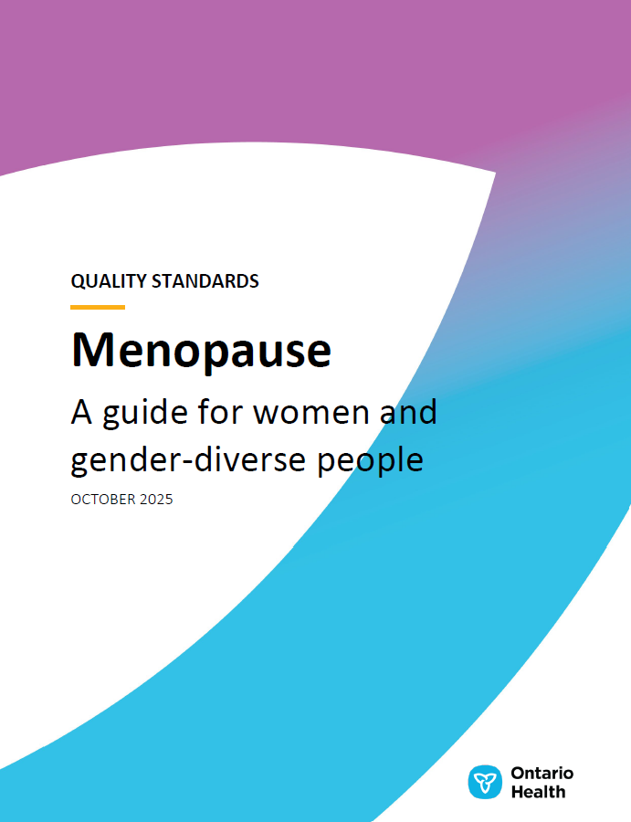
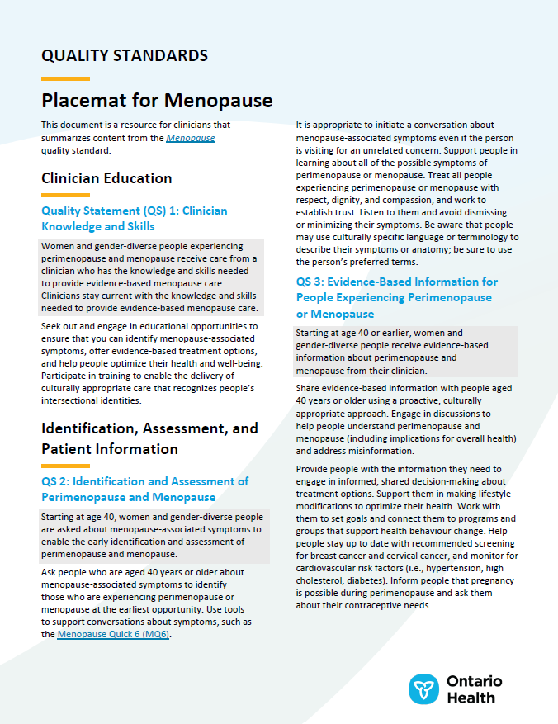



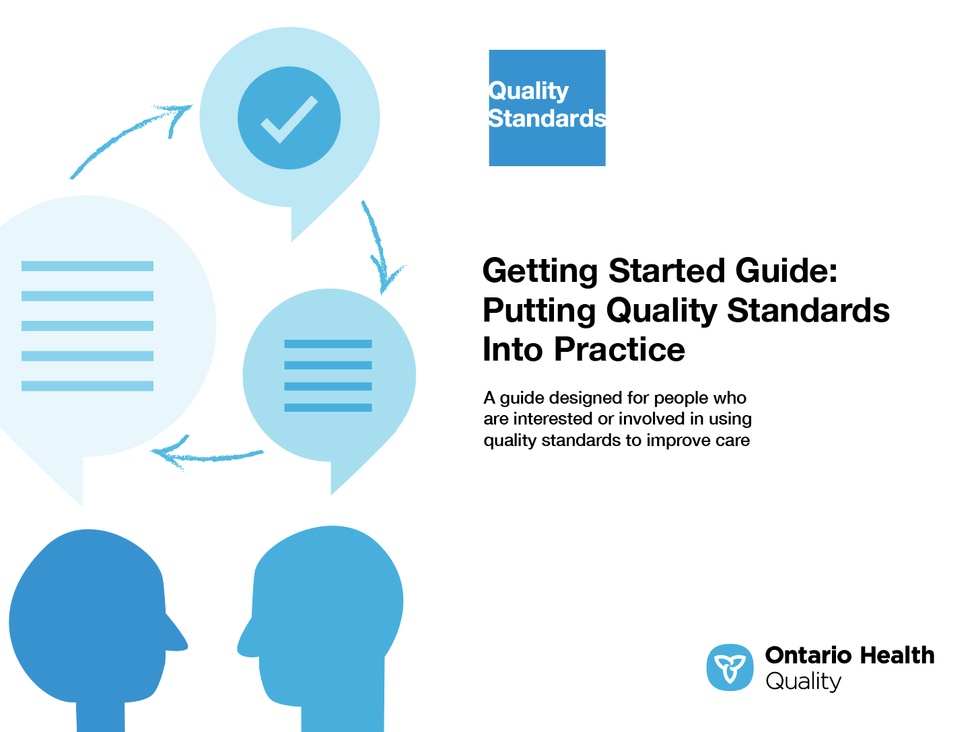
Quality standard resources
Quality Standard
Patient Guide
Placemat
Case for Improvement Deck
Measurement Guide
Technical Specifications
Getting Started Guide
Find these resources on the Menopause quality standard web page.
Notes:
Each quality standard focuses on a specific health care issue. The development of each quality standard is accompanied by an assortment of resources.
Through concise, easy-to-understand statements, quality standards outline what quality care looks like for a condition or topic based on the evidence.
Each quality standard is accompanied by a:
Patient guide
Placemat
Case for Improvement Deck
Measurement guide
Technical specifications
Getting started guide
Quality standards provide the blueprint to enable the health care system in Ontario to work better, facilitate smooth transitions, and ensure patients receive the same high-quality care, regardless of where they reside.

Slide 6
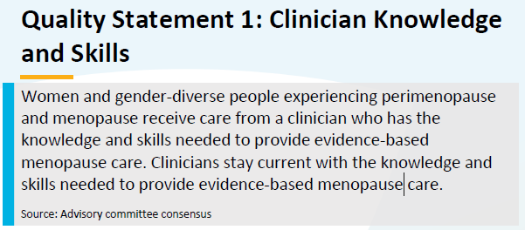
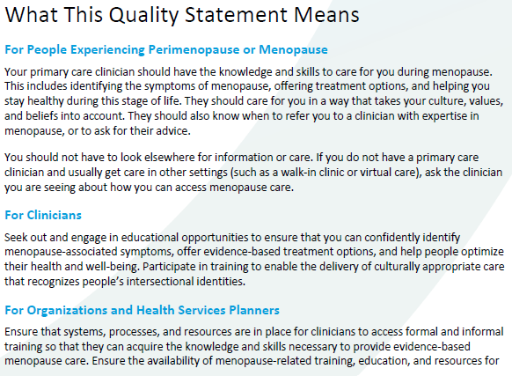
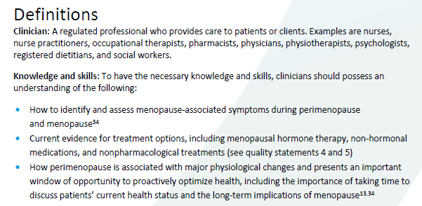
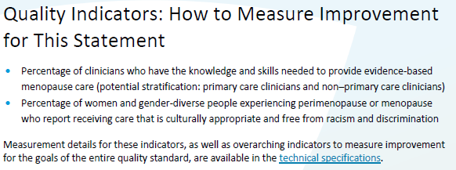
Inside the quality standard
The Quality Statement
The Audience Statements
The Definitions
The Indicators

Slide 7
Patient guide
The patient guide is designed to give patients information about what quality care looks like for various conditions based on the best evidence, so they can ask informed questions of their health care teams.
Notes:
Every quality standard includes a plain language summary for patients, families, care partners and the public called the patient guide.
Patient engagement in quality standards:
Membership on advisory committees
Focus groups and key informant interviews on topic-specific content (when necessary)
Public comment period for each quality standard
Consultations on the patient guide

Slide 8
Placemat
The placemat is a quick-reference resource for clinicians that summarizes the quality standard and includes links to helpful resources and tools.

Slide 9

Case for improvement deck
The case for improvement deck describes why the quality standard was created and shows some of the data used to develop it. Champions can use or adapt this deck to build support for the quality standard in their organizations.

Slide 10
How the health care system can support implementation
Implementing quality standards can be challenging owing to
system-level barriers or gaps, many of which have been identified throughout the development of this standard
Ontario Health will work with and support other provincial partners, including the Ministry of Health, to bridge system-level gaps and support the implementation of quality standards

Slide 11
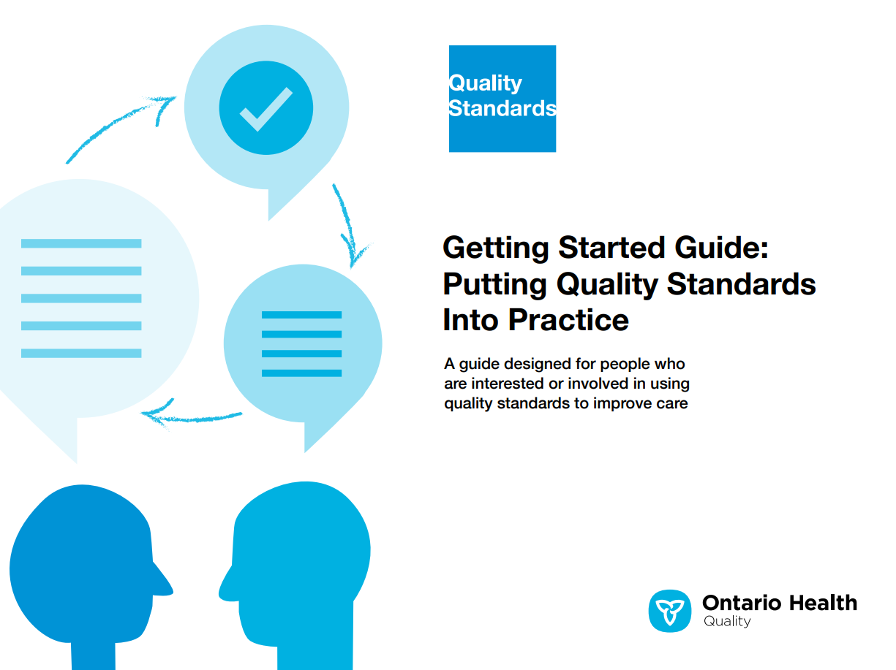
Implementation tools
The Getting Started Guide:
Outlines the process for using the quality standard as a resource to deliver
high-quality care
Contains evidence-based approaches, as well as useful tools and templates for implementing change ideas at the practice level
Notes:
There are things we can do today despite the larger systemic barriers that may take time to resolve. The Getting Started Guide is a document that outlines a process for using the quality standards as a resource to deliver high-quality care. It compiles a number of resources to support adoption, such as links to implementation and quality improvement resources, examples and activities for reflection, and templates and documents to support the implementation planning activities. The Getting Started Guide also includes an Action Plan Template and examples on how Quality Improvement Plans can help to advance quality standards.

Slide 12

Quorum
Quorum is an online community dedicated to improving the quality of health care in Ontario.
The Quality Standards Adoption Series highlights efforts in the field to implement changes and close gaps in care related to quality standard topics.
Notes:
The Quality Standards program has highlighted several stories from organizations and groups using various standards and statements within their clinical care settings, organization, or institutions; these are available through posts and discussions on Quorum.
As well, we are working on compiling resources and tools, for both clinicians and patients and families.
The focus is on implementation/adoption stories and how organizations are using quality standards in practice to inform care.
We’d love to hear from you if you are interested in contributing to a post or article.

Slide 13
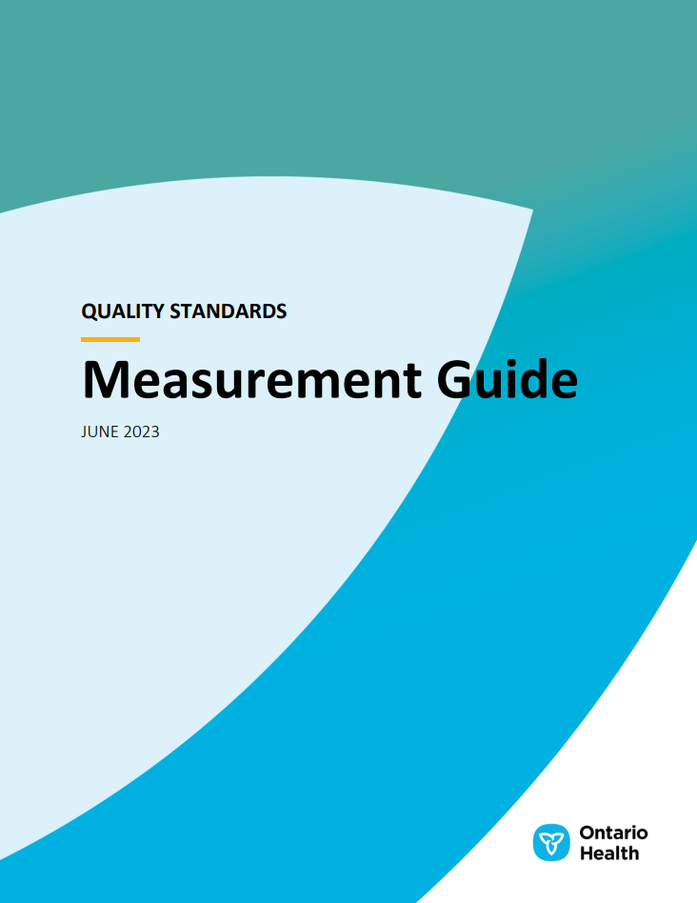
Measurement guide
The measurement guide describes:
The measurement principles behind the quality indicators included in quality standards
The types of indicators included in quality standards
How local and provincial data are collected and measured

Slide 14
Technical specifications
The technical specifications report outlines 2 types of measurement:
Provincial measurement: how we can monitor the progress being made to improve care at the provincial level
Local measurement: what you can do to assess the quality of care that you provide locally

Slide 15
Why do we need a quality standard for menopause?

Slide 16
Menopause is an important life transition for half the population
Women and gender-diverse people experience menopause at a mean age of 51 years. Perimenopause typically begins 4 years before menopause, but it can start as early as 10 years before
The Menopause Foundation of Canada¹ found that
95% of people experiencing menopause report an average
of 7 symptoms
  The most common symptoms were hot flashes (62%), sleep disturbances (57%), and night sweats (55%)
  Genitourinary symptoms reported include vaginal dryness, itching, or burning (30%); low libido (27%); and incontinence
  or leakage (23%)
In Ontario, there are 4.2 million women and gender-diverse people aged 40 years or older, and
3.1 million aged
50 years or older²
References:
Menopause Foundation of Canada. The silence and the stigma: menopause in Canada. Toronto (ON): The Foundation; 2022 [cited 2025 Aug 6]. Available from: https://menopausefoundationcanada.ca/wp-content/uploads/2023/01/MFC_The-Silence-and-the-Stigma_Menopause-in-Canada_Oct22_v2.pdf
Statistics Canada. Table 17-10-0005-01: Population estimates on July 1, by age and gender [Internet]. Ottawa (ON): Statistics Canada; 2024 [cited 2025 Aug 7]. Available from: https://doi.org/10.25318/1710000501-eng
​
Notes:
Vasomotor and genitourinary symptoms are due to reduced estrogen during perimenopause and menopause​.
Other symptoms include depression, mood swings, weight changes, issues with memory.^{1,2}​
Menopause also impacts personal relationships and introduces stigma in the workplace.¹
Menopause Foundation of Canada. The silence and the stigma: menopause in Canada. Toronto (ON): The Foundation; 2022 [cited 2025 Aug 6]. Available from: https://menopausefoundationcanada.ca/wp-content/uploads/2023/01/MFC_The-Silence-and-the-Stigma_Menopause-in-Canada_Oct22_v2.pdf​
Bromberger JT, Kravitz HM, Chang YF, Cyranowski JM, Brown C, Matthews KA. Major depression during and after the menopausal transition: Study of Women's Health Across the Nation (SWAN). Psychol Med. 2011 Sep;41(9):1879-88.

Slide 17

Menopause is often misunderstood, and symptoms are undertreated
Among Canadians surveyed by the Menopause Foundation of Canada in 2022:
  46% said that they felt unprepared for this life transition, and 55% felt that they should have learned about it earlier in life
  Although 77% of people said that they preferred their clinician to be their source of advice and information on menopause, only 27% reported that their family physician initiated a conversation
  38% reported that their clinician had undertreated their menopausal symptoms
Reference: Menopause Foundation of Canada. The silence and the stigma: menopause in Canada. Toronto (ON): The Foundation; 2022 [cited 2025 Aug 6]. Available from: https://menopausefoundationcanada.ca/wp-content/uploads/2023/01/MFC_The-Silence-and-the-Stigma_Menopause-in-Canada_Oct22_v2.pdf
​
Notes:
Lack of knowledge of full range of symptoms, along with stigma, embarrassment, and the belief that menopause is simply a normal part of aging, may prevent individuals from seek advice and treatment.​
Barber K, Charles A. Barriers to accessing effective treatment and support for menopausal symptoms: a qualitative study capturing the behaviours, beliefs and experiences of key stakeholders. Patient Prefer Adherence. 2023;17:2971-80.

Slide 18

Menopausal hormone therapy is underused
Clinical practice guidelines recommend menopausal hormone therapy as
first-line treatment for vasomotor symptoms (emphasizing individualized assessment of risk factors),¹ but clinicians still report hesitation in prescribing it^{2,3}
A report from a major insurance company found that in 2023, just 13.1% of Canadian women and gender-diverse people aged 45 to 65 years made any claims for menopausal hormone therapy⁴
Data from the National Health and Nutrition Examination Survey in the United States showed that use of menopausal hormone therapy declined from 26.9% in 1999 to 4.7% in 2020, especially among non-Hispanic White women⁵
References:
Yuksel N, Evaniuk D, Huang L, Malhotra U, Blake J, Wolfman W, et al. Guideline no. 422a: menopause: vasomotor symptoms, prescription therapeutic agents, complementary and alternative medicine, nutrition, and lifestyle. J Obstet Gynaecol Can. 2021;43(10):1188-204.e1.
Davis SR, Herbert D, Reading M, Bell RJ. Health-care providers' views of menopause and its management: a qualitative study. Climacteric. 2021;24(6):612-7.
Stanzel DKA, Hammarberg DK, Fisher PJ. Challenges in menopausal care of immigrant women. Maturitas. 2021;150:49-60.
Manulife Financial. Hormone therapy for menopause grows 21% in 3 years [Internet]. Toronto (ON): Manulife Financial; 2024 Oct 29 [cited 2025 Aug 6]. Available from: https://www.manulife.ca/business/news/group-benefits-news/horomone-replacement-therapy-for-menopause.html
Yang L, Toriola AT. Menopausal hormone therapy use among postmenopausal women. JAMA Health Forum. 2024;5(9):e243128.

Slide 19
Menopause is poorly captured in health administrative data
Menopause is undercaptured in OHIP records, possibly due to a lack of menopause-specific
billing claims, misdiagnosis of menopausal symptoms, and prioritized billing of other
diagnoses over menopause*
There is no diagnosis code dedicated to perimenopause
Care provided by other clinicians such as nurse practitioners, mental health counsellors, and therapists are underrepresented in OHIP data¹
Monitoring system-level trends in care is difficult without proper data collection across the province
OHIP diagnosis code 627 “Other disorders of female genital tract: menopause, post-menopausal bleeding​” is the primary code for menopause
OHIP diagnosis code 626 “Other disorders of female genital tract: disorders of menstruation” is sometimes used as a proxy code
Abbreviation: OHIP, Ontario Health Insurance Plan.
* Source: Menopause Quality Standard Advisory Committee and public feedback.
† Source: Ontario Health Insurance Plan Claims Database, fiscal year 2024/25.
References:
Zhao D, Liu C, Feng X, Hou F, Xu X, Dong J. Menopausal symptoms and sleep quality during menopausal transition and postmenopause. Maturitas. 2016;91:44-50.
Statistics Canada. Table 17-10-0005-01: Population estimates on July 1, by age and gender [Internet]. Ottawa (ON): Statistics Canada; 2024 [cited 2025 Aug 7]. Available from: https://doi.org/10.25318/1710000501-eng

Slide 20
Data from the Canadian Longitudinal Study on Aging partially portray the menopause experience in Ontario
The prevalence of menopause is over 90% among female participants in Ontario aged 45 years or older
Other health conditions occur around and after
menopause, often associated with older age and decreased estrogen levels (see graph)
Although the CLSA is one of the few sources of menopause data:
The study program has lower levels of endorsement of low income or education, which could confound estimates¹
Over 90% of participants self-identify as White only, meaning that other racial or ethnic groups are underrepresented²
There is a lack of geographical representation across the province, which hinders the assessment of variations in the quality of menopause care
Abbreviation: CLSA, Canadian Longitudinal Study on Aging.
* Please refer to the General Health and Chronic Conditions modules of the CLSA questionnaires.
Source: Canadian Longitudinal Study on Aging, Follow-up 1 (2014-2018) via ICES. Sex reported as male or female, as assigned at birth.
References:
Canadian Longitudinal Study on Aging. CLSA technical document 2025: sampling and computation of response rates and sample weights for the tracking (telephone interview) participants and comprehensive participants [Internet]. Calgary (AB): The Study; 2024. Available from https://www.clsa-elcv.ca/wp-content/uploads/2024/07/CLSA_DataSupportDoc_SampWgts_BL-FUP2_v3.0_2024Jun19.pdf
Canadian Longitudinal Study on Aging. Socio-demographic and economic characteristics – baseline [Internet]. Calgary (AB): The Study; 2025 [cited 2025 Mon June 30]. Available from https://datapreview.clsa-elcv.ca/mica/repository#/search?type=variables&display=list&query=variable(limit(0,20))
Notes:
Standalone surveys are often the only sources of data on people’s experiences of perimenopause and menopause, but such surveys are not representative of the Ontario population

Slide 21
Data from the CLSA estimate the use of menopausal hormone therapy among part of the Ontario population
Over half of CLSA participants who have experienced menopause have never used menopausal hormone therapy (see graph). Among those who did, half started by age 50 years and used it for 5 years
Data on the use of menopausal hormone therapy are fragmented or inconsistent, making it challenging to interpret them meaningfully. For example, data from the CLSA sample contrasts with that from a nationally representative survey in the United States which showed use of menopausal hormone therapy was 4.7% in 2020¹
Ever use was reported among 23% of menopausal female participants aged 45 to 60 years, versus 51% of those aged greater than 60 years. Higher uptake among older age groups (especially 65 years or older at the time of the 2014-2018 CLSA study) would likely have been due to menopausal hormone therapy use prior to the 2002 Women’s Health Initiative study, which inaccurately described the risks of menopausal hormone therapy.³
Note: The CLSA study program is not representative of the Ontario population because it lacks heterogeneity in income, education, and racial or ethnic status.²
Abbreviation: CLSA, Canadian Longitudinal Study on Aging.
Source: Canadian Longitudinal Study on Aging, Follow-up 1 (2014-2018) via ICES. Sex reported as male or female, as assigned at birth.
References:
Yang L, Toriola AT. Menopausal hormone therapy use among postmenopausal women. JAMA Health Forum. 2024;5(9):e243128.
Canadian Longitudinal Study on Aging. CLSA technical document 2025: sampling and computation of response rates and sample weights for the tracking (telephone interview) participants and comprehensive participants [internet]. Calgary (AB): The Study; 2024. Available from https://www.clsa-elcv.ca/wp-content/uploads/2024/07/CLSA_DataSupportDoc_SampWgts_BL-FUP2_v3.0_2024Jun19.pdf
Rossouw JE, Anderson GL, Prentice RL, LaCroix AZ, Kooperberg C, Stefanick ML, et al; Writing Group for the Women's Health Initiative Investigators. Risks and benefits of estrogen plus progestin in healthy postmenopausal women: principal results From the Women's Health Initiative randomized controlled trial. JAMA. 2002;288(3):321-33.

Slide 22


Health care utilization around menopause onset: CLSA
Although doctor’s visits are frequent around menopause onset among CLSA participants who have experienced menopause, menopause is documented in health data less than half the time
  83.5% visited a primary care doctor within a year of menopause onset (for any reason), and 93.63% visited within the year before onset up to the year after onset
  15.3% visited an obstetrician/gynecologist within a year of menopause onset (for any reason), and 28.1% visited within the year before onset up to the year after onset
  24.9% had a documented diagnosis of menopause* or menstruation disorder† during an OHIP visit within a year of menopause onset, and 45.9% had a documented diagnosis within the year before onset up to the year after onset
Note: Results are from linkages between the CLSA sample and OHIP claims data. The CLSA program has lower levels of endorsement of low income or education,¹ and thus is not representative of the general Ontario population.
Abbreviations: CLSA, Canadian Longitudinal Study on Aging; OHIP, Ontario Health Insurance Plan.
* 627 Other disorders of female genital tract: menopause, post-menopausal bleeding​.
† 626 Other disorders of female genital tract: disorders of menstruation.
Source: Canadian Longitudinal Study on Aging, Follow-up 1 (2014-2018), Ontario Health Insurance Plan Claims via ICES.
Reference:
Canadian Longitudinal Study on Aging. CLSA technical document 2025: sampling and computation of response rates and sample weights for the tracking (telephone interview) participants and comprehensive participants [internet]. Calgary (AB): The Study; 2024. Available from https://www.clsa-elcv.ca/wp-content/uploads/2024/07/CLSA_DataSupportDoc_SampWgts_BL-FUP2_v3.0_2024Jun19.pdf
Notes:
Some data are available on menopause-related interactions with the Ontario health care system, but the associated diagnostic codes are poorly recorded and captured

Slide 23
Quotation from a lived experience advisor
”
“As someone with lived experience, I believe a quality standard for menopause in Ontario is essential to address widespread misinformation and ensure that people have access to clear, unbiased, evidence-based information. Given that a large proportion of the population will experience menopause and encounter many variations in care, this quality standard represents a critical opportunity to support consistent, high-quality care across the province. Standardizing care will also help eliminate barriers, improve quality of life, and ensure that the needs of people experiencing perimenopause and menopause are properly met.”
– Hiyam Jibry, Lived Experience Advisor, Menopause Quality Standard Advisory Committee

Slide 24
Quotation from a clinician
”
“About half the patients seen in primary care are likely to experience menopause. As women and gender-diverse people feel more empowered to speak to their primary care physicians about menopause symptoms, we must be prepared to listen and provide appropriate care. As well, because a limited number of specialists are available to provide straightforward care for menopause symptoms, primary care physicians need to be able to support their patients during this period of transition, rather than referring them. The opportunity to help women and gender-diverse people with their menopause symptoms can be an enriching and rewarding experience; I hope that this quality standard supports primary care providers in learning how to provide this care.”
– Taunia Rifai, Primary Care Physician, Menopause Quality Standard Advisory Committee

Slide 25
Quality statements to improve care

Slide 26
Scope of this quality standard
This quality standard addresses care for women and gender-diverse people who are experiencing perimenopause or menopause (and postmenopause), including early or surgically induced menopause
The quality standard focuses on the identification, assessment, and management of symptoms at any stage and in all health care settings
Notes:
Scope of This Quality Standard
This quality standard addresses care for women and gender-diverse people who are experiencing perimenopause or menopause (and postmenopause), including early or surgically induced menopause.
The quality standard focuses on the identification, assessment, and management of symptoms at any stage and in all health care settings.

Slide 27
Quality statement topics
Clinician knowledge and skills
Identification and assessment of perimenopause and menopause
Evidence-based information for people experiencing perimenopause or menopause
Management of vasomotor symptoms
Management of non-vasomotor symptoms
Appropriate referral to a clinician with expertise in menopause

Slide 28
Quality statement 1: Clinician knowledge and skills
Women and gender-diverse people experiencing perimenopause and menopause receive care from a clinician who has the knowledge and skills needed to provide evidence-based menopause care. Clinicians stay current with the knowledge and skills needed to provide evidence-based menopause care.

Slide 29
Quality statement 2: Identification and assessment of perimenopause and menopause
Starting at age 40, women and gender-diverse people are asked about menopause-associated symptoms to enable the early identification and assessment of perimenopause and menopause.

Slide 30
Quality statement 3: Evidence-based information for people experiencing perimenopause or menopause
Starting at age 40 or earlier, women and gender-diverse people receive evidence-based information about perimenopause and menopause from their clinician.

Slide 31
Quality statement 4: Management of vasomotor symptoms
Women and gender-diverse people experiencing vasomotor symptoms during perimenopause and menopause are offered menopausal hormone therapy as first-line treatment, following an assessment of risks, benefits, contraindications, and individual needs and preferences. People who have contraindications to menopausal hormone therapy or who do not desire it are offered other evidence-based treatment options, including non-hormonal medications and nonpharmacological treatments.

Slide 32
Quality statement 5: Management of non-vasomotor symptoms
Women and gender-diverse people experiencing non-vasomotor symptoms during perimenopause and menopause (including those related to genitourinary syndrome of menopause, sexual health, mental health, sleep, and cognition) are offered evidence-based treatment options.

Slide 33
Quality statement 6: Appropriate referral to a clinician with expertise in menopause
Women and gender-diverse people experiencing perimenopause or menopause receive assessment and treatment from their primary care clinician and, if clinically indicated, are referred to a clinician with expertise in menopause.

Slide 34
Measures to support improvement
Notes:
The Menopause Quality Standard Advisory Committee identified a set of overarching goals for this quality standard. These have been mapped to indicators that may be used to assess quality of care provincially and locally.

Slide 35
Indicators that can be measured using provincial data
No provincially measurable indicators have been identified because provincial data sources on menopause are limited, as is the ability to identify people experiencing perimenopause or menopause.

Slide 36
Indicators that can be measured using only local data
Percentage of clinicians who have the knowledge and skills needed to provide evidence-based perimenopause or menopause treatment, including menopausal hormone therapy, non-hormonal medications, and nonpharmacological treatments
Percentage of women and gender-diverse people aged 40 years or older who
receive evidence-based information about perimenopause and menopause from
their clinician
Percentage of women and gender-diverse people experiencing perimenopause or menopause whose primary care clinician refers them to a clinician with expertise
in menopause when clinically indicated
Percentage of women and gender-diverse people who report that their quality of life has improved since receiving menopause care

Slide 37
Data sources and acknowledgement
The data used in this presentation were provided by the Institute for Clinical Evaluative Sciences (ICES), which is funded by an annual grant from the Ontario Ministry of Health (MOH) and the Ministry of Long-Term Care (MLTC). The opinions, results, and conclusions included in this presentation are those of the authors and are independent from the funding sources. No endorsement by ICES, the MOH, or the MLTC is intended or should be inferred. These datasets were linked using unique encoded identifiers and analyzed at ICES.
Parts of this material are based on data and/or information compiled and provided by the Canadian Longitudinal Study on Aging (CLSA). Funding for the CLSA is provided by the Government of Canada through the Canadian Institutes of Health Research under grant reference LSA 94473 and the Canada Foundation for Innovation. The analyses, conclusions, opinions and statements expressed herein are solely those of the authors and do not reflect those of the funding or data sources; no endorsement is intended or should be inferred.

Slide 38
Thank you

