Slide 1

Obsessive–Compulsive Disorder Quality Standard (draft)
Guiding evidence-based
care for people of all ages living in Ontario
Notes:
If you have any questions about the content of this presentation, please contact us at QualityStandards@hqontario.ca

Slide 2
Objectives
Overview of quality standards
What are they? How are they used?​
Why this quality standard is needed
Gaps and variations in quality of care for people with obsessive-compulsive disorder in Ontario
How to measure overall success
Indicators that can help measure your quality improvement efforts
Quality statements to improve care
The key statements in the obsessive-compulsive disorder quality standard

Slide 3
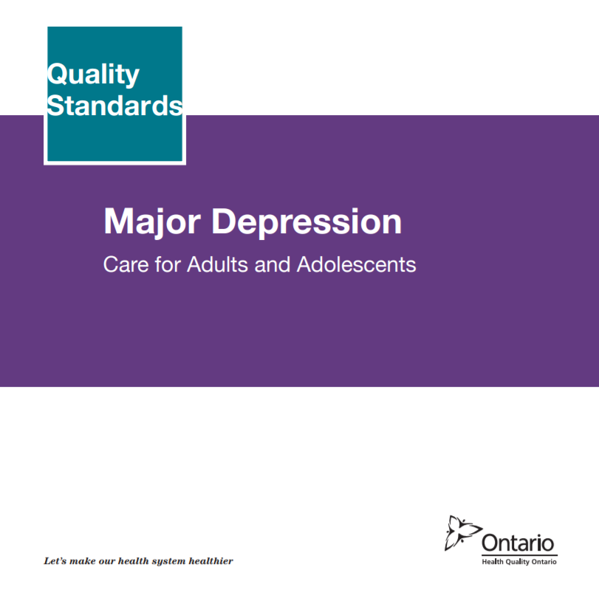
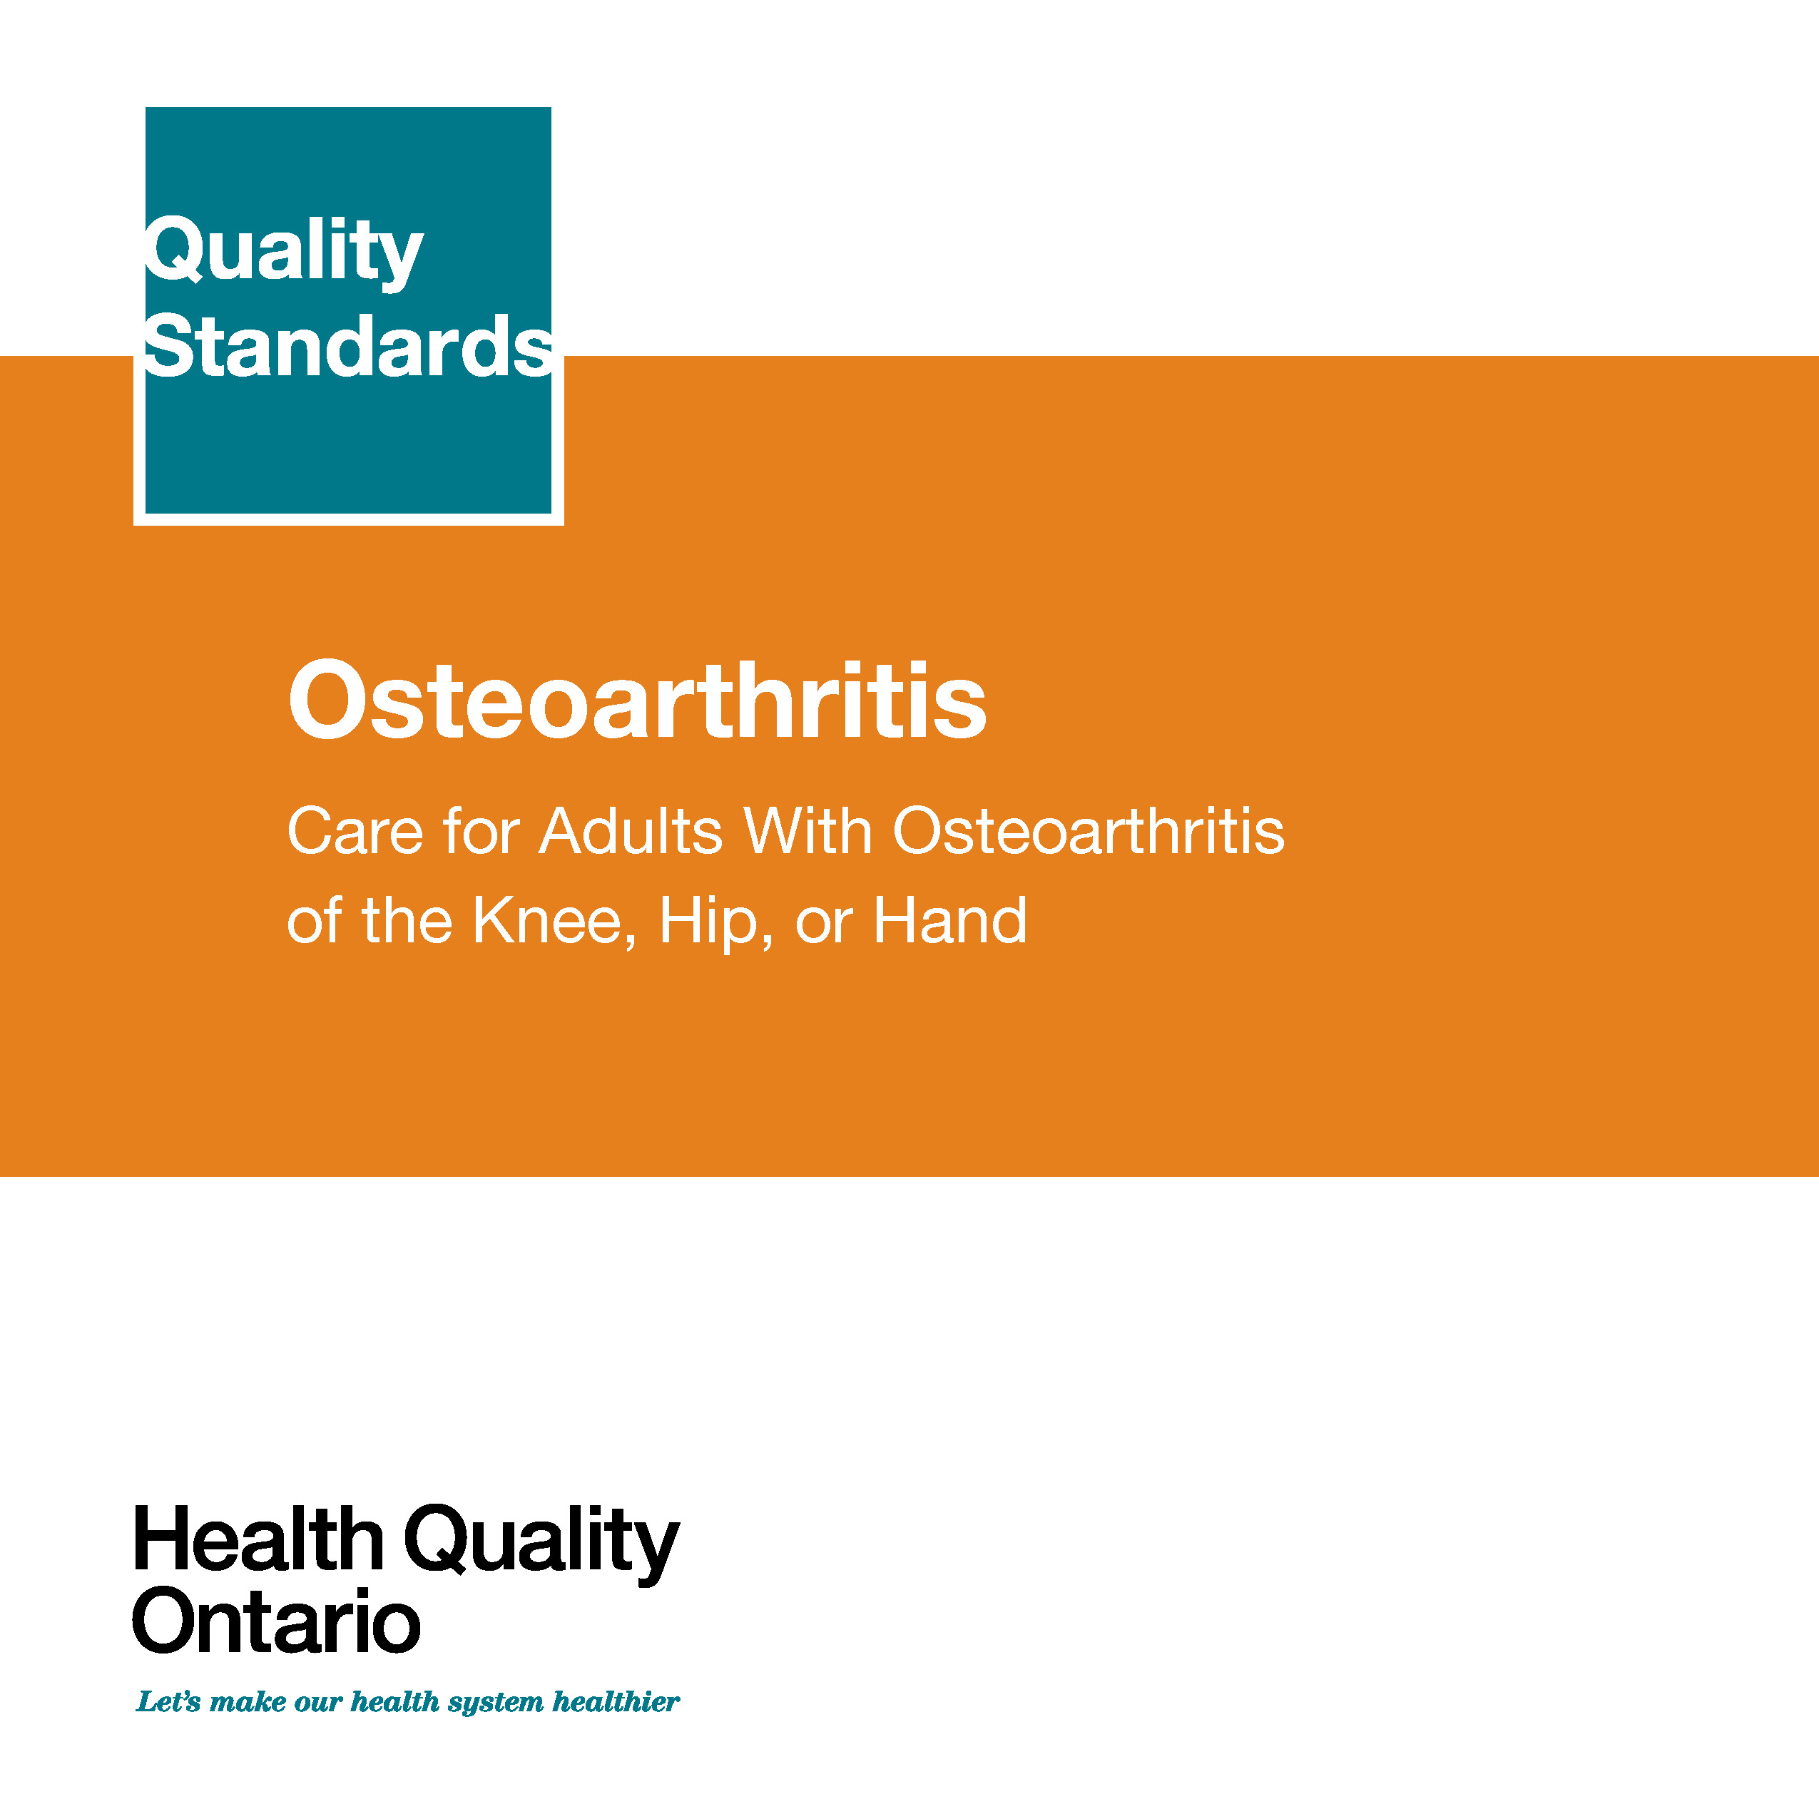
Quality Standards
Inform clinicians and patients what quality care looks like
Focus on conditions or processes where there are large variations in how care is delivered, or where there are gaps between the care provided in Ontario and the care patients should receive
Are grounded in the best available evidence
Notes:
Quality standards are a smaller set of high impact statements that describe optimal care where identified quality gaps exist in Ontario.
Voluntary and aspirational in nature​.
Designed to “raise the ceiling” with the goal of having the best possible care available to all Ontarians, regardless of where they live in the province.
There are many guidelines, professional standards, and other recommendations that contribute to the evidence ecosystem. Quality standards complement these resources.
Quality standards outline the what of care that should be delivered but are agnostic on who should be delivering it (unlike other CPGs, BPGs).
Quality standards are:
Concise: 5 to 15 strong, evidence-based statements focused on high priority areas for improvement.
Accessible: help clinicians and provider organizations offer the highest-quality care; and patients to know what to discuss with their care providers (compared with CPGs that are quite dense, these are very accessible, also written in plain language).
Measurable: each statement is accompanied by one or more quality indicators (structure, process or outcome), with a set of outcome measures for the overall standard.
Implementable: quality improvement tools and resources support each standard, to fuel adoption.

Slide 4
Quality Standards
Help health care professionals know what care to offer, based on evidence and expert consensus
Help health care organizations measure, assess and improve the quality of care they provide
Help ensure consistent,
high-quality care across the province
Help patients, residents, families, and caregivers know what to ask for in their care
Notes:
Patients, caregivers and the public can use quality standards to understand what excellent care looks like, what they should expect from their health care providers, and how to discuss the quality of their care.
Provincial regions and disease agencies can use quality standards to measure health outcomes, hold health service providers accountable for delivering high-quality care, and inform regional improvement strategies.
Provider organizations can use quality standards to measure and audit their quality of care, identify gaps, guide organizational improvement strategies, and inform clinical program investments.
Health care professionals can use quality standards to evaluate their practice and identify areas for personal and organizational quality improvement, and can incorporate the evidence-based statements into professional education.
Government can use quality standards to identify provincial priority areas, inform new data collection and reporting initiatives, and design performance indicators and funding incentives.

Slide 5
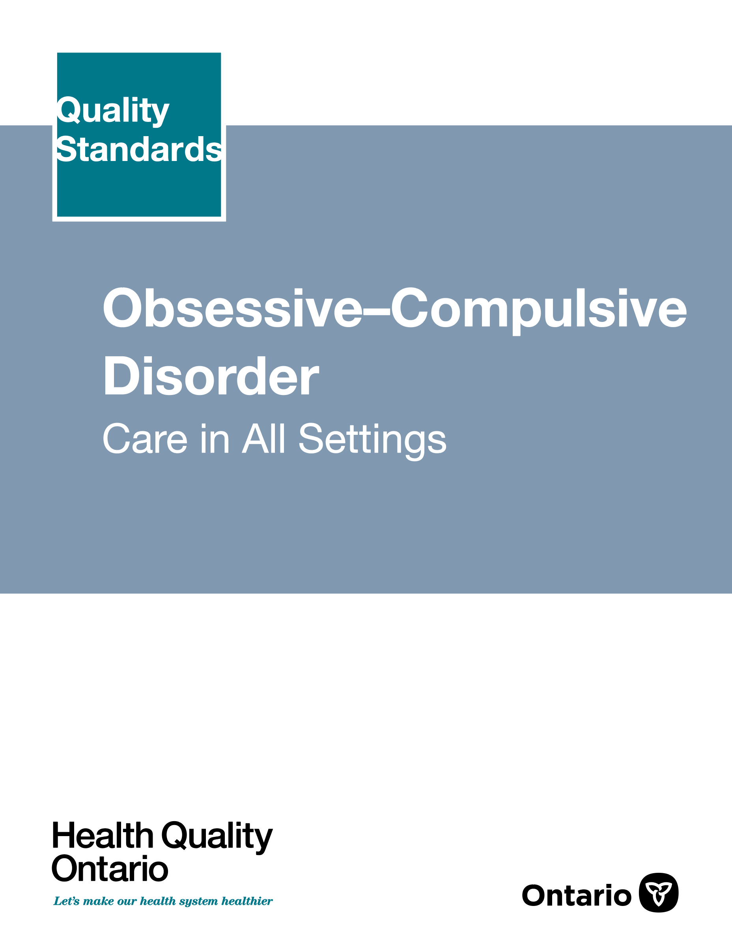
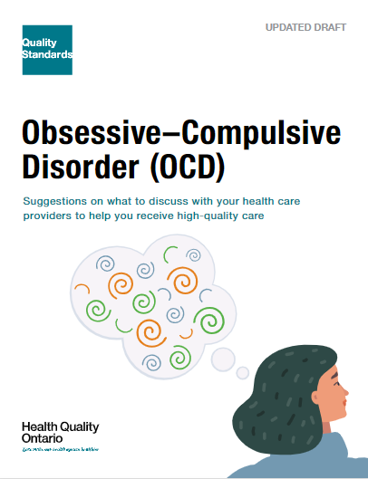
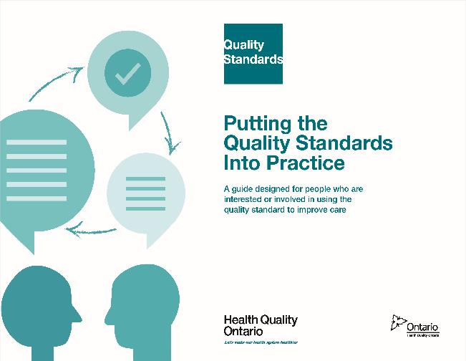
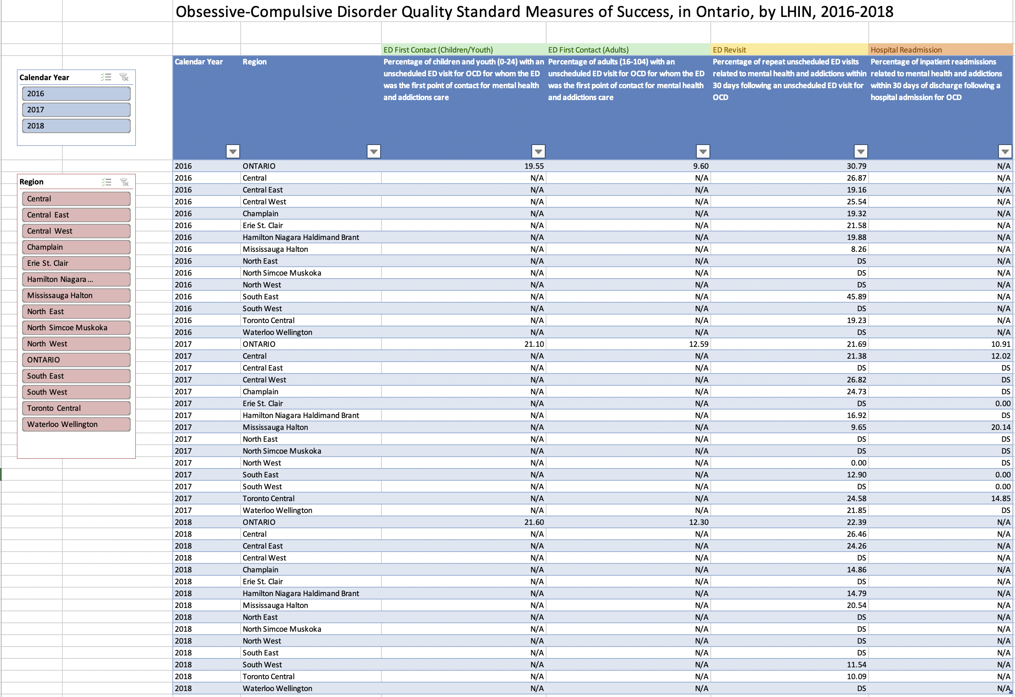
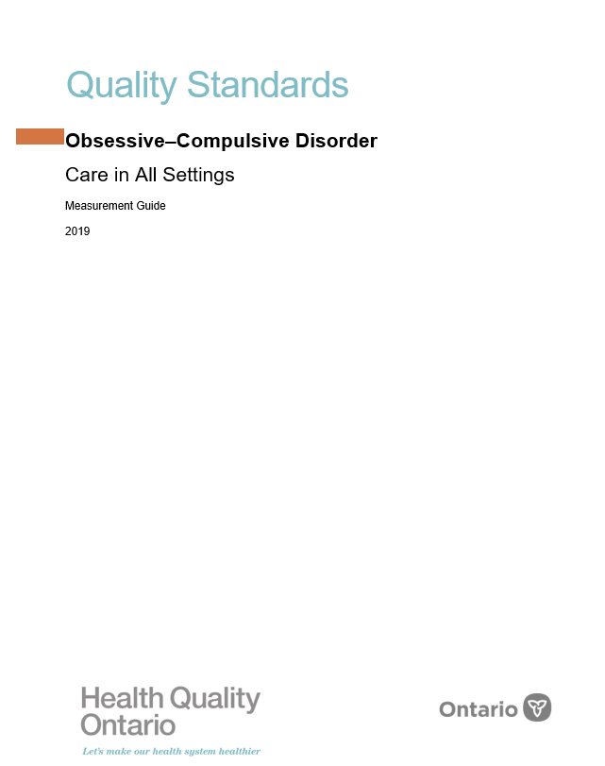
Quality Standard Resources
Quality Standard
Patient Guide
Getting Started Guide
Data Tables
Measurement Guide
Find these resources here:
https://www.hqontario.ca/evidence-to-improve-care/quality-standards/view-all-quality-standards/obsessive-compulsive-disorder
Notes:
Each quality standard focuses on a specific health care issue. The development of each quality standard is accompanied by an assortment of resources.
Through concise, easy-to-understand statements, quality standards outline what quality care looks like for a condition or topic based on the evidence.
Each quality standard is accompanied by:
A patient conversation guide
Recommendations for adoption (note: this is included within the quality standard, Appendix 1: How the Health Care System Can Support Implementation)
A getting started guide
Data tables
A measurement guide
Quality standards provide the blueprint to enable the health care system in Ontario to work better, facilitate smooth transitions, and ensure patients receive the same high-quality care, regardless of where they reside.

Slide 6
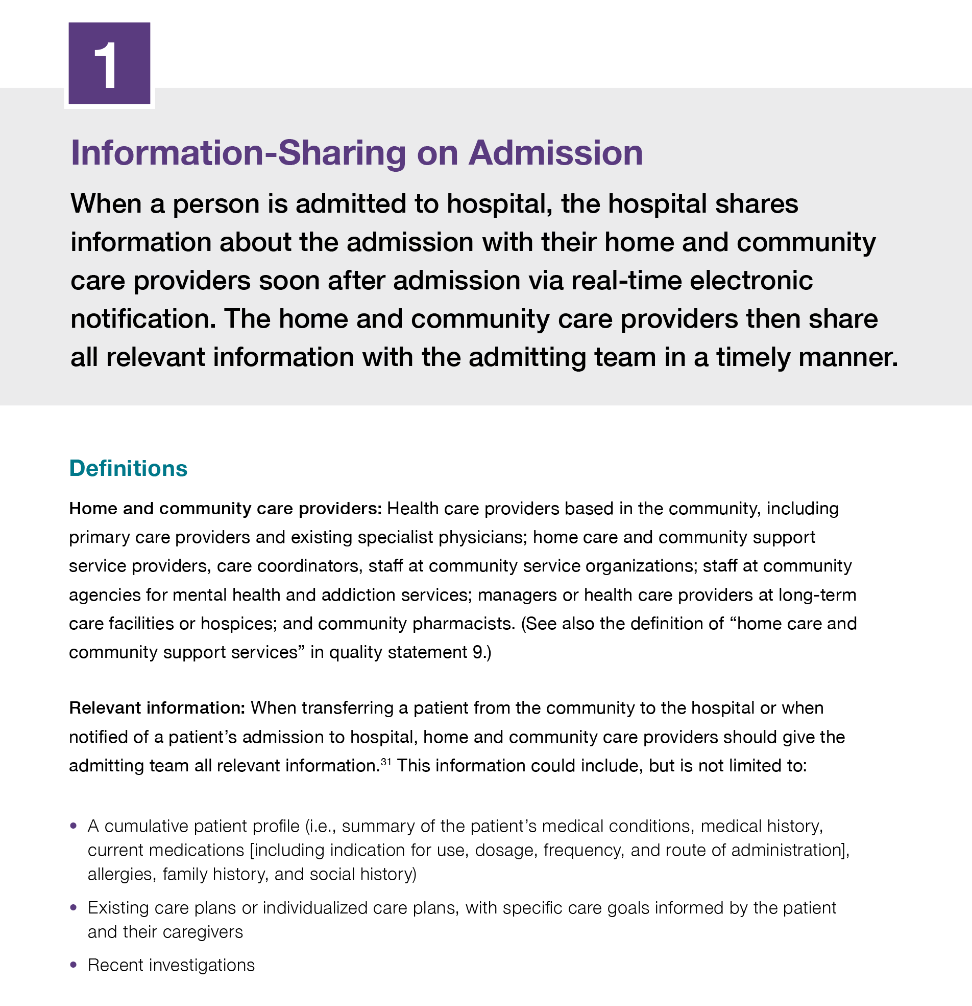
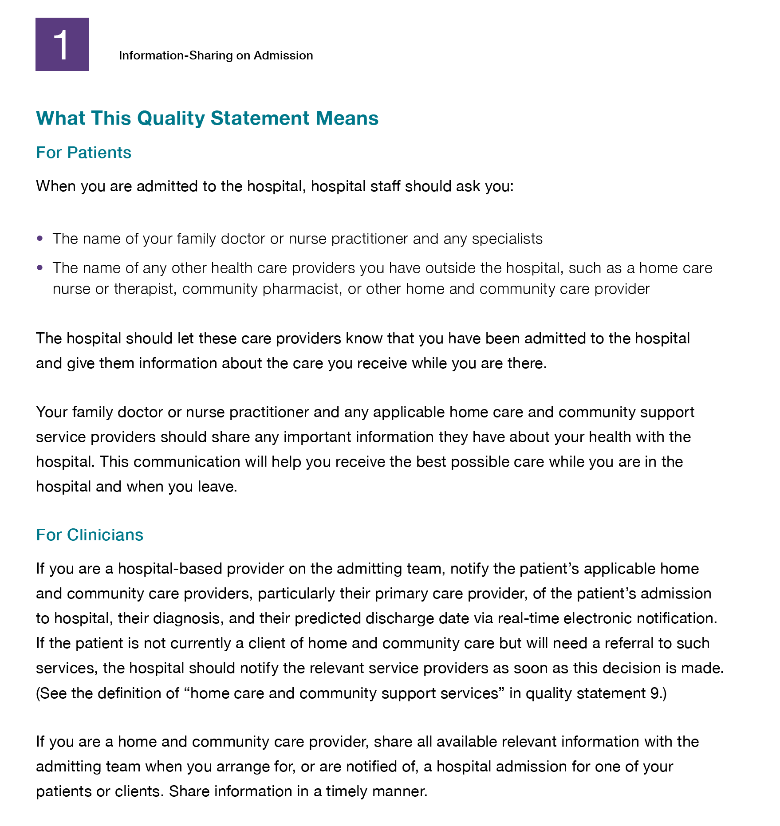
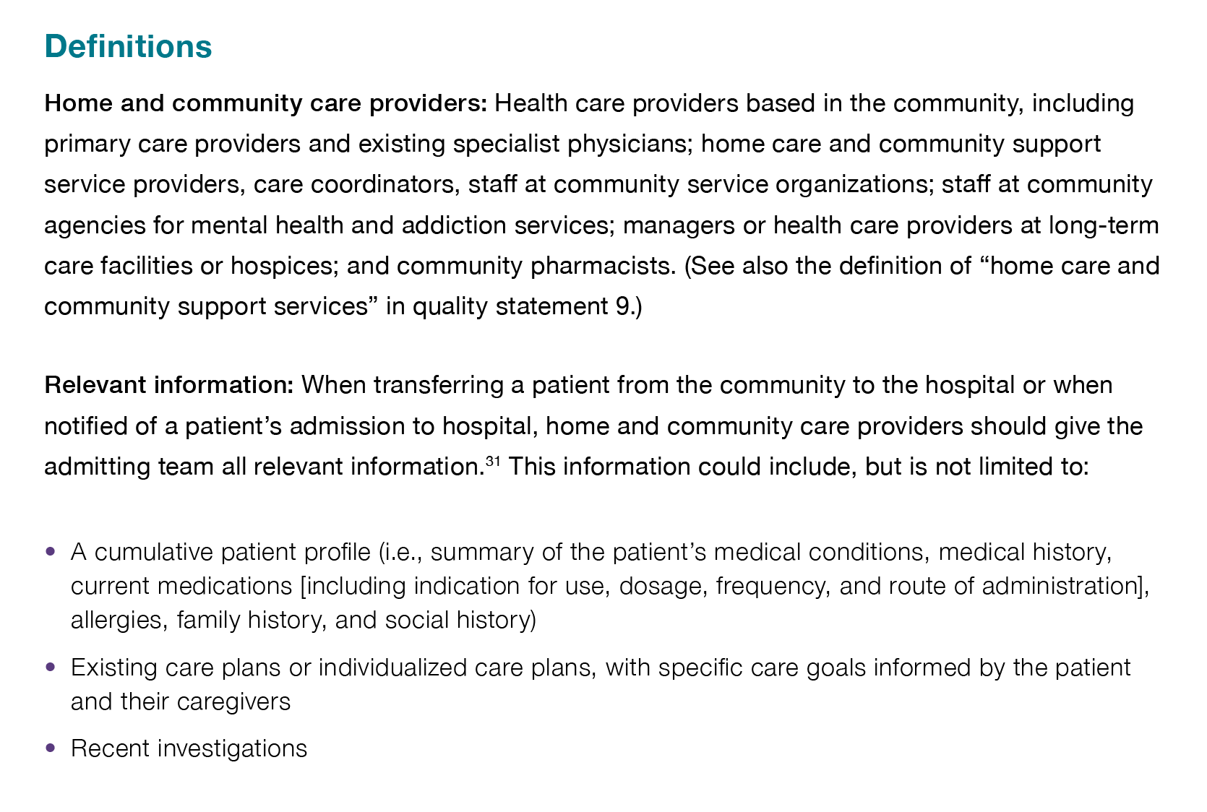
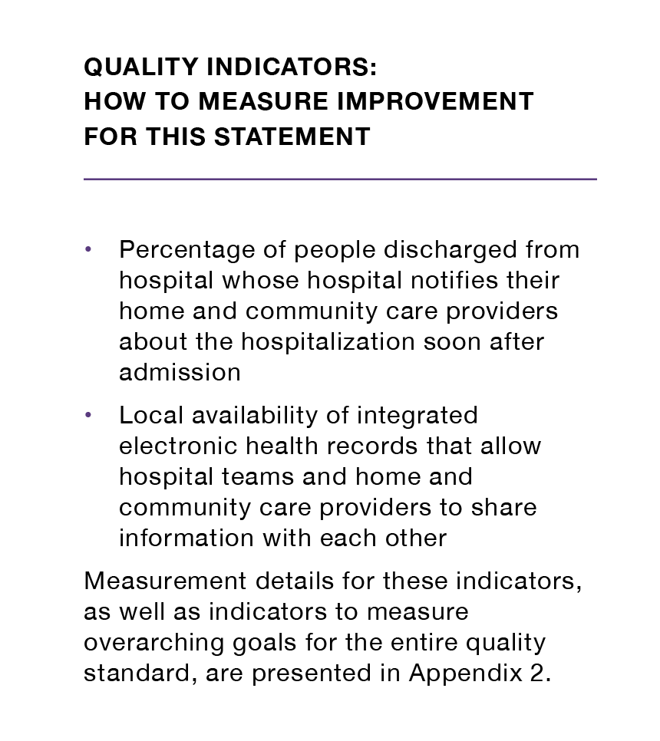
Inside the Quality Standard
The Statement
The Audience
Definitions
The Indicators
*Excerpts are from the Transitions between Hospital to Home quality standard

Slide 7
Quality Standards:
Patient Guide
The patient guide is designed to give patients information about what quality care looks like for various conditions based on the best evidence, so they can ask informed questions of their health care providers.
Notes:
Every quality standard includes a plain language summary for patients, families, caregivers, and the public called the patient conversation guide.
Patient engagement in quality standards:
Membership on advisory committees
Focus groups and key informant interviews on topic specific content (when necessary)
Public comment period for each quality standard
Consultations on the patient conversation guide

Slide 8
Quality Standards:
Recommendations for Adoption
Recommendations for policy makers, administrators, health care organizations, and professionals have been made that aim to bridge the gaps between current care and care outlined in the quality statements to enable adoption of the quality standard across Ontario.
Notes:
As many aspects of the quality standard represent care that can and should be made available today, it is recognized that there are larger systemic barriers that may impede care delivery as per the standard. The recommendations for adoption summarize the system-wide and regional requirements that are needed to help health care professionals and organizations meet these standards and the time horizon expected to resolve these barriers.

Slide 9
Quality Standards:
Implementation Tools
The Getting Started Guide:
Outlines the process for using the quality standard as a resource to deliver high-quality care
Contains evidence-based approaches, as well as useful tools and templates for implementing change ideas at the practice level
Notes:
There are things we can do today despite the larger systemic barriers that may take time to resolve. The Getting Started Guide is a document that outlines a process for using the quality standards as a resource to deliver high-quality care. It compiles a number of resources to support adoption, such as links to implementation and quality improvement resources, examples and activities for reflection, and templates and documents to support the implementation planning activities. The Getting Started Guide also includes an Action Plan Template and examples on how Quality Improvement Plans can help to advance quality standards.

Slide 10
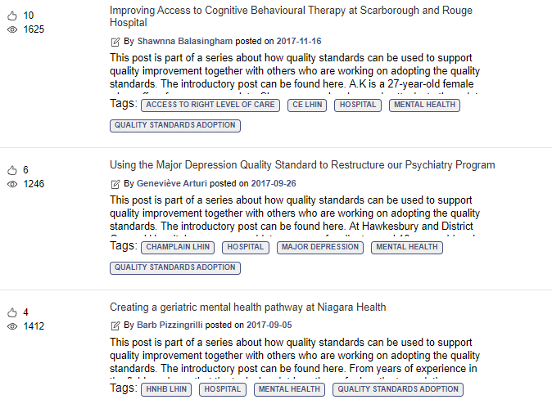
Quality Standards:
Quorum
Quorum is an online community dedicated to improving the quality of health care in Ontario.
The Quality Standards Adoption Series highlights efforts in the field to implement changes and close gaps in care related to quality standard topics.
Visit the Quality Standards Adoption Series on Quorum to learn how organizations are implementing quality standards.

Slide 11
Quality Standards:
Measurement Guide
The measurement guide has two dedicated sections:
Local measurement: what you can do to assess the quality of care that you provide locally
Provincial measurement: how we can measure the success of the quality standard on a provincial level

Slide 12
Quality Standards:
Data Tables
Data tables can be used to examine variations in indicator results across the province. They include data on key indicators:
Over time for Ontario
Across regions in Ontario
For specific measures of equity (age, sex, rurality, and household income)

Slide 13
Why Do We Need a Quality Standard for Obsessive–Compulsive Disorder?
Notes:
The data presented in the following slides is for people with OCD and their family.

Slide 14

The estimated lifetime prevalence of obsessive-compulsive disorder in adults is about 2%, or 1 in 50.
Note: The lifetime prevalence is based on data from the United States.
Source: Katzman MA, Bleau P, Blier P, Chokka P, Kjernisted K, Van Ameringen M, et al. Canadian clinical practice guidelines for the management of anxiety, posttraumatic stress and obsessive-compulsive disorders. BMC Psychiatry. 2014;14 Suppl 1:S1.

Slide 15

Obsessive-compulsive disorder (OCD) is under-recognized and undertreated.¹ On average, 52.8% of people aged 15+ globally who require care for OCD do not receive treatment.² The mean time from first experiencing minor symptoms to onset of OCD in adults is 6 years, and an additional 11 years to receive treatment.³
Sources: ¹Katzman MA, Bleau P, Blier P, Chokka P, Kjernisted K, Van Ameringen M, et al. Canadian clinical practice guidelines for the management of anxiety, posttraumatic stress and obsessive-compulsive disorders. BMC Psychiatry. 2014;14 Suppl 1:S1.
²Kohn R, Saxena S, Levav I, Saraceno B. The treatment gap in mental health care. Bulletin of the World Health Organization. 2004, 82(11).
³Pinto A, Mancebo M, Eisen J, Pagano M, Rasmussen S. The Brown longitudinal obsessive compulsive study: clinical features and symptoms of the sample at intake. J Clin Psychiatry. 2006; 67:5.

Slide 16

About 1 in 8 adults and 1 in 5 children and youth who had an emergency department visit for obsessive-compulsive disorder (OCD) did not have any physician or hospital service for mental health and addictions care in the previous two years in Ontario in 2018.
That is, the first medical service for OCD was in the emergency department.
Notes: Previous mental health and addictions care includes medical services provided by a physician, in an emergency department or hospital. Children and youth are defined as ages 0-24, and adults are defined as ages 16+. The rate is age- and sex-standardized.
Sources: Registered Persons Database (RPDB), National Ambulatory Care Reporting System (NACRS), Discharge Abstract Database (DAD), Ontario Health Insurance Plan Claims Database (OHIP), Ontario Mental Health Reporting System (OMHRS), 2018, provided by ICES.
Notes:
Adults: 12.3%
Children: 21.6%

Slide 17


About 1 in 5 emergency department (ED) visits for obsessive-compulsive disorder in Ontario in 2018 were followed within 30 days by an unplanned ED visit for mental health and addictions care.
This was more common in females (27.2%) than in males (16.8%).
Note: The Ontario rate is age- and sex-standardized. The data by sex is age-standardized. Sex refers to biological sex as reported in the administrative databases.
Sources: Registered Persons Database (RPDB), National Ambulatory Care Reporting System (NACRS), 2018, provided by ICES.
Notes:
22.39%

Slide 18
Number of emergency department visits for obsessive-compulsive disorder (OCD) ranged from 6 to 79, and the number of hospitalizations for OCD ranged from less than 6 to 59 across regions in Ontario
Number of emergency department (ED) visits for OCD discharged to the community and number of hospitalizations for OCD, in Ontario, by local health integration network, January 2017 to December 2017
■ # ED visits  # Hospitalizations
Notes: Regions with small sample sizes are displayed with an asterisk (*). Emergency department visits are included for people discharged to the community (place of residence, residential care, other). The rate is age- and sex-standardized.
Sources: Registered Persons Database (RPDB), National Ambulatory Care Reporting System (NACRS), Discharge Abstract Database (DAD), Ontario Mental Health Reporting System (OMHRS), 2017, provided by ICES.

Slide 19
Nearly 1 in 9 hospital admissions for obsessive-compulsive disorder in Ontario in 2017 were followed within 30 days by an unplanned readmission for mental health and addictions care.
Note: The rate is age- and sex-standardized.
Source: Registered Persons Database (RPDB), Discharge Abstract Database (DAD), Ontario Mental Health Reporting System (OMHRS), 2017, provided by ICES.
Notes:
10.9%

Slide 20
“I live in Northern Ontario and when I was looking for treatment there was nothing geared toward OCD. It took me many tries with many different providers before I was able to get treatment that was successful for me.
“There are a lot of misconceptions and misinformation out there about OCD. This quality standard could help standardize knowledge and skills among providers. It is exciting to think that Ontario could have increased understanding and more services to help people. The quality standard might also give people with OCD the courage to advocate for themselves.”
– Melanie Lefebvre, Lived Experience Advisor, Anxiety Disorders and Obsessive-Compulsive Disorder Quality Standards Advisory Committee

Slide 21
“Identification of OCD [quality statement 1] should be the cornerstone of providing care to patients, because it allows us to intervene before the disorder becomes chronic, when individuals are younger in age and may swiftly respond to treatment. It also means they will have fewer years of suffering.
“Young people with OCD may feel overwhelmed, misunderstood and sometimes ashamed about what they’re experiencing. They often feel very relieved as soon as they learn what’s going on, that it’s not uncommon, and that there is an effective treatment. This quality standard will help contextualize what care is available and what is accessible for individuals with OCD in Ontario.”
– Dr. Noam Soreni, Anxiety Disorders and Obsessive-Compulsive Disorder Quality Standards Advisory Committee member

Slide 22
Quality Statements to Improve Care

Slide 23
Scope of the Obsessive-Compulsive Disorder Quality Standard
This quality standard addresses care for people living with obsessive–compulsive disorder. It applies to care for people in all settings but focuses on primary and community care.
This quality standard focuses on care for adults (age 18 years and older), but it includes content that is relevant for children and adolescents (under age 18 years).
Notes:
Scope of This Quality Standard
This quality standard addresses care for people living with obsessive–compulsive disorder (OCD). It applies to care for people in all settings but focuses on primary and community care. This quality standard focuses on care for adults (age 18 years and older), but it includes content that is relevant for children and adolescents (under age 18 years).
Few clinical practice guidelines were available to support the development of a comprehensive quality standard for children and adolescents. In this standard, guidance is provided where relevant clinical practice guideline recommendations and content for children and adolescents were available.
This quality standard uses the Diagnostic and Statistical Manual of Mental Disorders, Fifth Edition (DSM-5) categorization of OCD as the presence of obsessions, compulsions, or both⁴:
Obsessions are “recurrent and persistent thoughts, urges, or impulses that are experienced as intrusive and unwanted, and that in most individuals cause marked anxiety or distress. The individual attempts to ignore or supress such thoughts, urges, or images, or to neutralize them with some other thought or action”
Compulsions are “repetitive behaviours (e.g., hand washing, ordering, checking) or mental acts (e.g., praying, counting, repeating words silently) that the individual feels driven to perform in response to an obsession or according to rules that must be applied rigidly. The behaviours or mental acts are aimed at preventing or reducing anxiety or stress or preventing some dreaded event or situation”
This quality standard does not include OCD-related disorders, such as body dysmorphic disorder, hoarding disorder, excoriation disorder, or trichotillomania. Disorders related to OCD were excluded from the scope because of limitations in the relevant clinical practice guidelines. This quality standard also does not address trauma- and stressor-related disorders.
For information about anxiety disorders, please see Anxiety Disorders: Care in All Settings, which was developed concurrently with this quality standard.

Slide 24





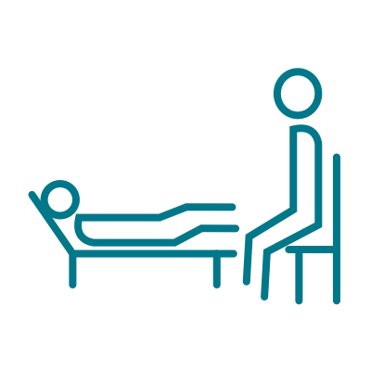






Quality Statement Topics
Identification
Comprehensive Assessment
Support for Family
Stepped-Care Approach for OCD
Self-Help
Cognitive Behavioural Therapy for OCD
OCD-Specific Pharmacological Treatment
Monitoring
Support Through Initial Treatment Response
Intensive Treatment
Relapse Prevention
Transitions in Care
Notes:
.

Slide 25
Quality Statement 1:
Identification
People with suspected OCD are identified early using recognized screening questions and validated severity-rating scales.

Slide 26
Quality Statement 2:
Comprehensive Assessment
People with suspected OCD, or who have had a positive screening result for OCD, receive a timely comprehensive assessment to determine whether they have OCD, the severity of their symptoms, whether they have any comorbid conditions, and whether they have any associated functional impairment.

Slide 27
Quality Statement 3:
Support for Family
People with OCD are encouraged to involve their family during their assessment and treatment, considering individual needs and preferences. Family members are connected to available resources and supports and provided with psychoeducation that includes how to avoid accommodation behaviours.

Slide 28
Quality Statement 4:
Stepped-Care Approach for OCD
People with OCD receive treatment that follows a stepped-care approach, providing the least intensive, most effective intervention first, based on symptom severity, level of functional impairment, and individual needs and preferences.

Slide 29
Quality Statement 5:
Self-Help
People with OCD are informed about and supported in accessing self-help resources, such as self-help books, Internet-based educational resources, and support groups, considering their individual needs and preferences and in alignment with a stepped-care approach.

Slide 30
Quality Statement 6:
Cognitive Behavioural Therapy for OCD
People with OCD have timely access to cognitive behavioural therapy with exposure and response prevention, considering their individual needs and preferences and in alignment with a stepped-care approach. Cognitive behavioural therapy with exposure and response prevention is delivered by a health care professional with expertise in OCD.

Slide 31
Quality Statement 7:
OCD-Specific Pharmacological Treatment
People with moderate to severe OCD, or people who are not responding to psychological treatment, are offered a selective serotonin reuptake inhibitor (SSRI) at an OCD-specific dose and duration, considering their individual needs and preferences and in alignment with a stepped-care approach.

Slide 32
Quality Statement 8:
Monitoring
People with OCD have their response to treatment (effectiveness and tolerability) monitored regularly over the course of treatment using validated tools in conjunction with an assessment of their clinical presentation.

Slide 33
Quality Statement 9:
Support During Initial Treatment Response
People with OCD are informed about what to expect and supported during their initial treatment response. When initial treatment is not working, people with OCD are reassessed. They are offered other treatment options, considering their individual needs and preferences and in alignment with a stepped-care approach.

Slide 34
Quality Statement 10:
Intensive Treatment
When psychological or pharmacological treatment is not working, or in cases of severe OCD, people are referred for intensive treatment, in alignment with a stepped-care approach.

Slide 35
Quality Statement 11:
Relapse Prevention
People with OCD who are receiving treatment are provided with information and education about how to prevent relapse and manage symptoms if they re-emerge.

Slide 36
Quality Statement 12:
Transitions in Care
People with OCD are given appropriate care throughout their lifespan and experience seamless transitions between services and health care professionals, including between care settings and from child and adolescent services to adult services.

Slide 37
How to Measure Overall Success
Notes:
The Anxiety Disorders and Obsessive-Compulsive Disorder Quality Standards Advisory Committee identified a set of overarching goals for this quality standard. These have been mapped to indicators that may be used to assess quality of care provincially and locally.

Slide 38
Indicators That Can Be Measured Using Provincial Data
Percentage of people with an unscheduled ED visit for OCD for whom the ED was the first point of contact for mental health and addictions care
Percentage of repeat unscheduled ED visits related to mental health and addictions within 30 days following an unscheduled ED visit for OCD
Percentage of inpatient readmissions related to mental health and addictions within 30 days of discharge following a hospital admission for OCD

Slide 39
Indicators That Can Be Measured Using Only Local Data
Percentage of people with suspected OCD, or who have had a positive screening result for OCD, who receive a comprehensive assessment that determines whether they have OCD, the severity of their symptoms, whether they have any comorbid conditions, and whether they have any associated functional impairment
Percentage of people with OCD for whom cognitive behavioural therapy (CBT) with exposure and response prevention was determined to be appropriate and who receive CBT with exposure and response prevention delivered by a health care professional with expertise in OCD
Percentage of people with OCD who report an improvement in their quality of life
Percentage of people with OCD who “strongly agree” with the following question: “The services I have received have helped me deal more effectively with my life’s challenges”
Percentage of people with OCD who complete CBT with exposure and response prevention and have reliable recovery
Percentage of people with OCD who complete CBT with exposure and response prevention and have reliable improvement
Percentage of people with moderate to severe OCD, or people who are not responding to psychological treatment for whom pharmacological treatment was determined to be appropriate, and who receive a selective serotonin reuptake inhibitor (SSRI) at an OCD-specific dose and duration

Slide 40
Data Sources and Acknowledgement
The data used in this presentation was provided by the Institute for Clinical Evaluative Sciences (ICES), which is funded by an annual grant from the Ontario Ministry of Health. The opinions, results, and conclusions reported in this report are those of the authors and are independent from the funding sources. No endorsement by ICES or the Ministry of Health is intended or should be inferred. These datasets were linked using unique encoded identifiers and analyzed at ICES. Parts of this material are based on data and information compiled and provided by the Canadian Institute for Health Information (CIHI). However, the analyses, conclusions, opinions, and statements expressed herein are those of the author, and not necessarily those of CIHI.

Slide 41
Connect with us:
https://quorum.hqontario.ca
© Queen’s Printer for Ontario, 2019​

