Slide 1


Prediabetes and Type 2
Diabetes Quality Standard
Guiding evidence-based care for people of all ages living with prediabetes and type 2 diabetes in Ontario
Notes:
If you have any questions about the content of this presentation, please contact us at QualityStandards@hqontario.ca

Slide 2
Objectives
Overview of quality standards
What are they? How are they used?​
Why this quality standard is needed
Gaps and variations in quality of care for people with prediabetes and type 2 diabetes in Ontario
Quality statements to improve care
The key statements in the prediabetes and type 2 diabetes quality standard
How to measure overall success
Indicators that can help measure your quality improvement efforts

Slide 3
Quality Standards
Inform clinicians and patients what quality care looks like
Focus on conditions or processes where there are large variations in how care is delivered, or where there are gaps between the care provided in Ontario and the care patients should receive
Are grounded in the best available evidence
Notes:
Quality standards are a smaller set of high impact statements that describe optimal care where identified quality gaps exist in Ontario.
Voluntary and aspirational in nature​.
Designed to “raise the ceiling” with the goal of having the best possible care available to all Ontarians, regardless of where they live in the province.
There are many guidelines, professional standards, and other recommendations that contribute to the evidence ecosystem. Quality standards complement these resources.
Quality standards outline the what of care that should be delivered but are agnostic on who should be delivering it (unlike other CPGs, BPGs).
Quality standards are:
Concise: 5 to 15 strong, evidence-based statements focused on high priority areas for improvement.
Accessible: help clinicians and provider organizations offer the highest-quality care; and patients to know what to discuss with their care providers (compared with CPGs that are quite dense, these are very accessible, also written in plain language).
Measurable: each statement is accompanied by one or more quality indicators (structure, process or outcome), with a set of outcome measures for the overall standard.
Implementable: quality improvement tools and resources support each standard, to fuel adoption.

Slide 4
Quality Standards
Help health care professionals know what care to offer, based on evidence and expert consensus
Help health care organizations measure, assess, and improve the quality of care they provide
Help ensure consistent,
high-quality care across the province
Help patients, residents, families, and caregivers know what to ask for in their care
Notes:
Patients, caregivers and the public can use quality standards to understand what excellent care looks like, what they should expect from their health care providers, and how to discuss the quality of their care.
Provincial regions and disease agencies can use quality standards to measure health outcomes, hold health service providers accountable for delivering high-quality care, and inform regional improvement strategies.
Provider organizations can use quality standards to measure and audit their quality of care, identify gaps, guide organizational improvement strategies, and inform clinical program investments.
Health care professionals can use quality standards to evaluate their practice and identify areas for personal and organizational quality improvement, and can incorporate the evidence-based statements into professional education.
Government can use quality standards to identify provincial priority areas, inform new data collection and reporting initiatives, and design performance indicators and funding incentives.

Slide 5

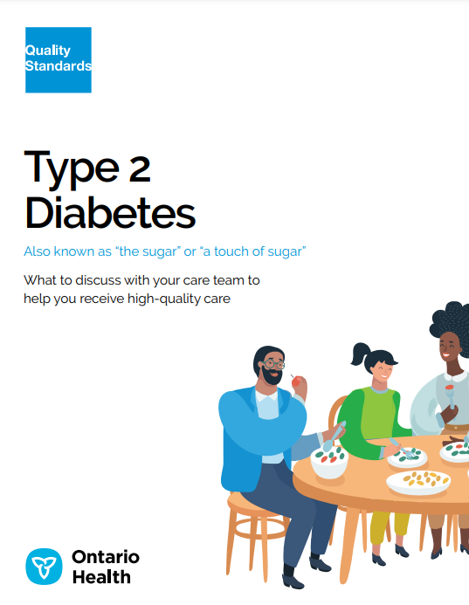
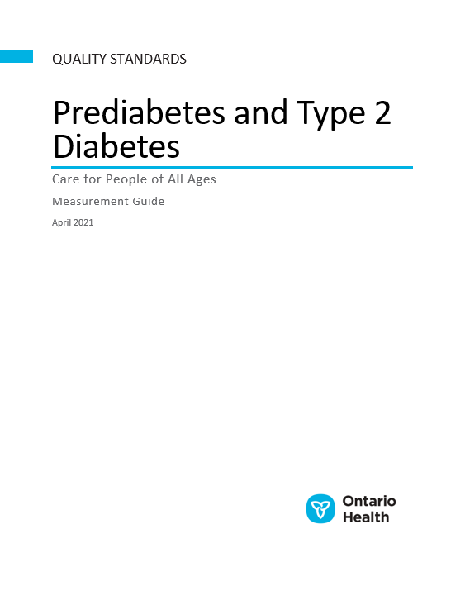
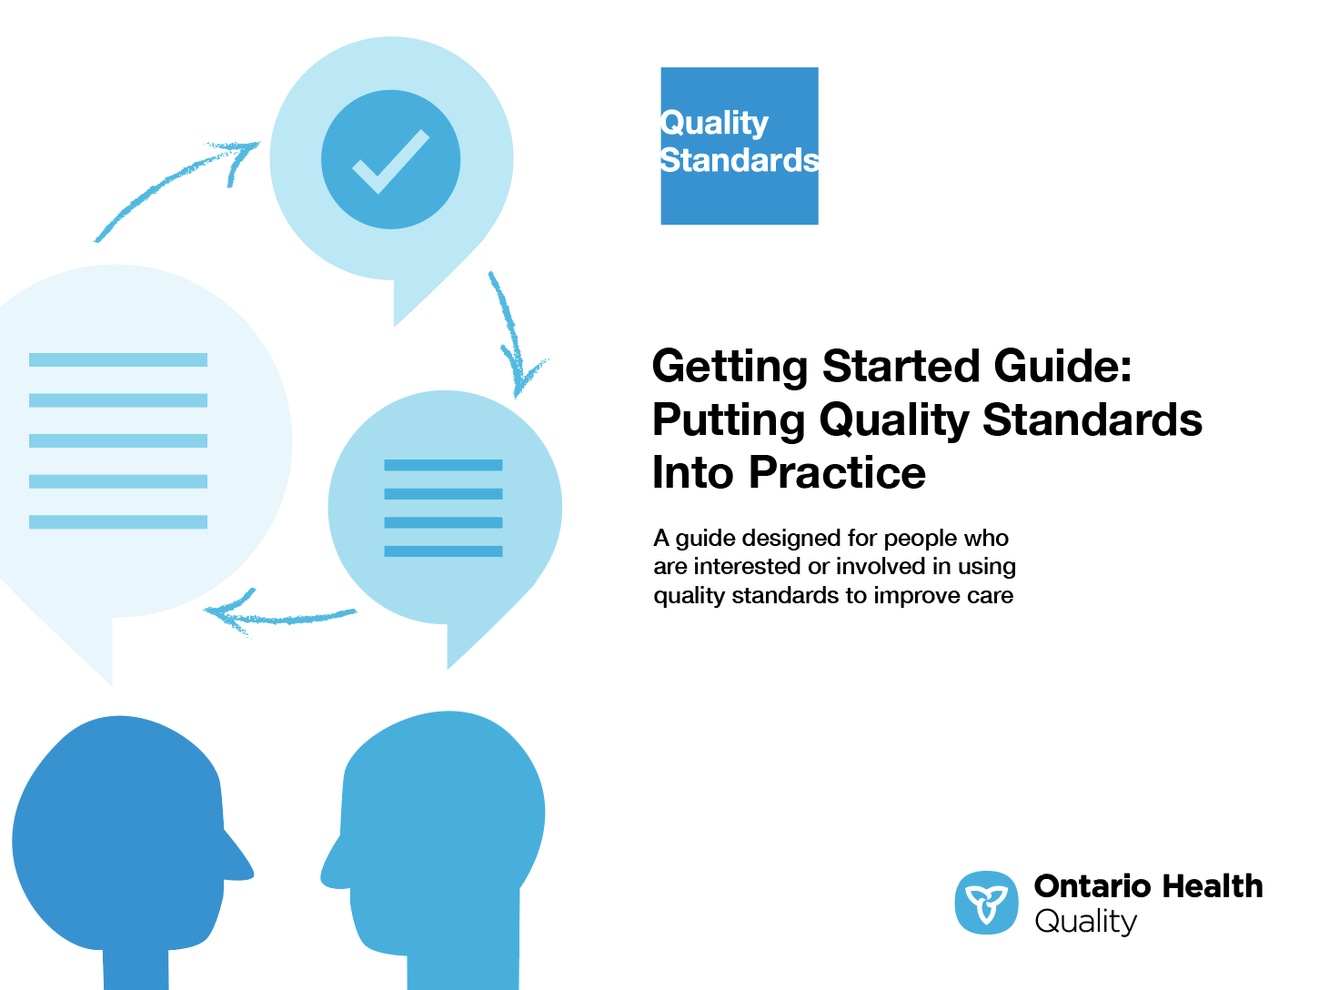
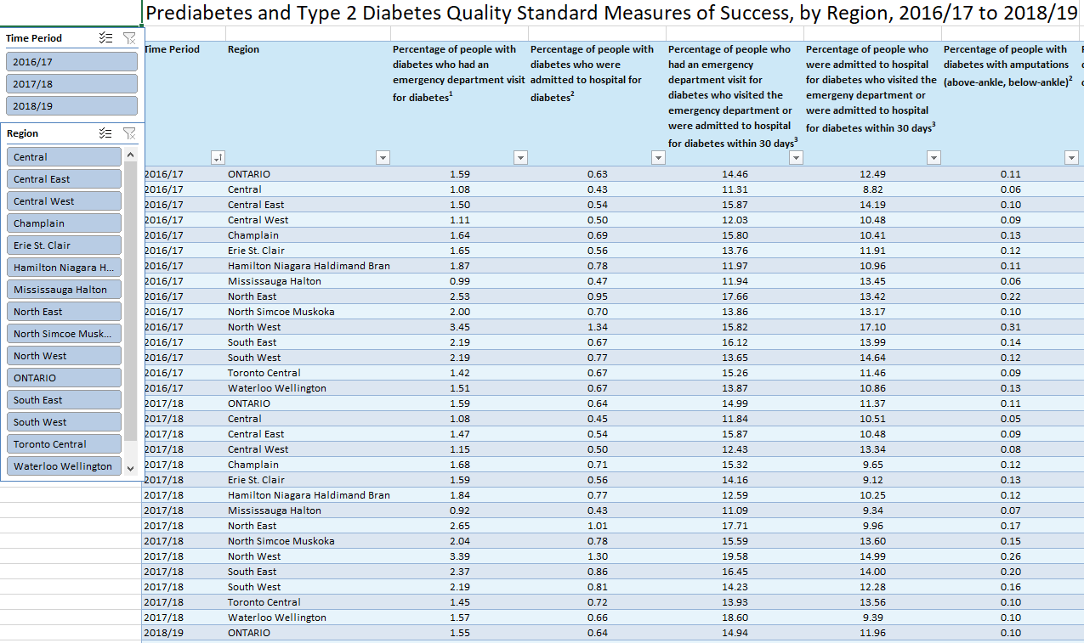
Quality Standard Resources
Quality Standard
Patient Guide
Getting Started Guide
Data Tables
Measurement Guide
Find these resources here:
https://hqontario.ca/evidence-to-improve-care/quality-standards/view-all-quality-standards/diabetes-prediabetes-and-type-2
Notes:
Each quality standard focuses on a specific health care issue. Each quality standard is accompanied by an assortment of resources.
Through concise, easy-to-understand statements, quality standards outline what quality care looks like for a condition or topic based on the evidence.
This quality standard is accompanied by:
A patient guide
A getting started guide
Data tables
A measurement guide
Quality standards provide the blueprint to enable the health care system in Ontario to work better, facilitate smooth transitions, and ensure patients receive the same high-quality care, regardless of where they reside.

Slide 6
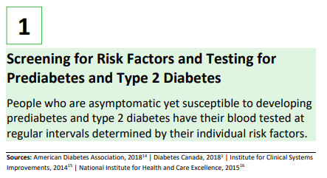
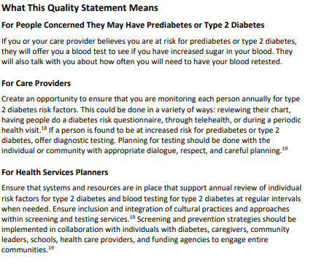
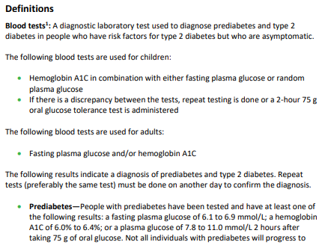
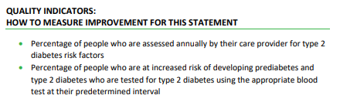
Inside the Quality Standard
The Statement
The Audience Statements
Definitions
The Indicators

Slide 7
Quality Standards:
Patient Guide
The patient guide is designed to give patients information about what quality care looks like for various conditions based on the best evidence, so they can ask informed questions of their health care providers.
Notes:
Each quality standard includes a plain language summary for patients, families, caregivers and the public called the patient guide.
Patient engagement in quality standards:
Membership on advisory committees
Focus groups and key informant interviews on topic-specific content (when necessary)
Public comment period for each quality standard
Consultations on the patient guide

Slide 8
Quality Standards:
How the Health Care System Can Support Implementation
Implementing quality standards can be challenging due to system-level barriers or gaps, many of which have been identified throughout the development of this standard. Ontario Health will work with and support other provincial partners, including Ministry of Health, to bridge system-level gaps to support the implementation of quality standards.

Slide 9
Quality Standards:
Implementation Tools
The Getting Started Guide:
Outlines the process for using the quality standard as a resource to deliver high-quality care
Contains evidence-based approaches, as well as useful tools and templates for implementing change ideas at the practice level
Notes:
There are things we can do today despite the larger systemic barriers that may take time to resolve. The Getting Started Guide is a document that outlines a process for using the quality standards as a resource to deliver high-quality care. It compiles a number of resources to support adoption, such as links to implementation and quality improvement resources, examples and activities for reflection, and templates and documents to support the implementation planning activities. The Getting Started Guide also includes an Action Plan Template and examples on how Quality Improvement Plans can help to advance quality standards.

Slide 10


Quality Standard Adoption Tools:
Quorum
Quorum is an online community dedicated to improving the quality of health care in Ontario.
The Quality Standards Adoption Series highlights efforts in the field to implement changes and close gaps in care related to quality standard topics.
quorum.hqontario.ca
Notes:
The Quality Standards program has highlighted several stories from organizations and groups using various standards and statements within their clinical care settings, organization, or institutions; these are available through posts and discussions on Quorum.
As well, we are working on compiling resources and tools, for both clinicians and patients and families.
The focus is on implementation/adoption stories and how organizations are using quality standards in practice to inform care.
We’d love to hear from you if you are interested in contributing to a post or article.

Slide 11
Quality Standards:
Measurement Guide
The measurement guide has two dedicated sections:
Local measurement: what you can do to assess the quality of care that you provide locally
Provincial measurement: how we can measure the success of the quality standard on a provincial level

Slide 12
Quality Standards:
Data Tables
Data tables can be used to examine variations in indicator results across the province. They include data on key indicators:
Over time for Ontario
Across regions in Ontario
For specific measures of equity (age, geography, income and sex)

Slide 13
Why Do We Need a Quality
Standard for Prediabetes and
Type 2 Diabetes?
Note: Indicator data for the Prediabetes and Type 2 Diabetes Quality Standard presented in slides 15 to 20 are preliminary rates and are not adjusted for factors other than age and sex (e.g., complications/conditions) that an individual with diabetes may have. Refer to the Prediabetes and Type 2 Diabetes Quality Standard Measurement Guide for technical specifications (e.g., inclusion and exclusion criteria).​
Notes:
The data presented in the following slides is for people with prediabetes and type 2 diabetes and their caregivers.

Slide 14

In 2019, an estimated
4.4 million Ontarians were living with diabetes and prediabetes (type 1 diabetes, diagnosed and undiagnosed type 2 diabetes, and prediabetes combined).
Roughly 90% of all cases of diabetes are type 2 diabetes.
Sources: Diabetes Canada. Diabetes in Ontario [Internet]. Toronto (ON): Diabetes Canada; 2019 [cited 2019 Dec]. Available from: https://www.diabetes.ca/DiabetesCanadaWebsite/media/About-Diabetes/Diabetes%20Charter/2019-Backgrounder-Ontario.pdf
Diabetes Canada. 2018 Clinical practice guidelines [Internet]. Toronto (ON): Diabetes Canada; 2018 [cited 2019 Jul 30]. Available from: https://guidelines.diabetes.ca/docs/CPG-2018-full-EN.pdf

Slide 15

People with diabetes are at risk of developing:
  serious acute complications
  (e.g., severe hypoglycemia)
  long-term microvascular complications affecting the eyes, kidneys, and nerves
  cardiovascular disease
Source: Diabetes Canada. 2018 clinical practice guidelines [Internet]. Toronto (ON): Diabetes Canada; 2018 [cited 2019 Jul 30]. Available from: https://guidelines.diabetes.ca/docs/CPG-2018-full-EN.pdf

Slide 16
Certain populations experience higher rates of type 2 diabetes, such as:
  those with low income
  people of African, Arab, South Asian, or Hispanic descent
  Indigenous populations
In Ontario, the prevalence of self-reported diabetes is roughly twice as high for South Asian people (8.1%) and Black people (8.5%) as it is for White people (4.2%). Indigenous populations are three to five times more likely to have type 2 diabetes than are non-Indigenous Canadians.
Sources: Diabetes Canada. 2018 clinical practice guidelines [Internet]. Toronto (ON): Diabetes Canada; 2018 [cited 2019 Jul 30]. Available from: https://guidelines.diabetes.ca/docs/CPG-2018-full-EN.pdf
Dinca-Panaitescu M, Dinca-Panaitescu S, Raphael D. The dynamics of the relationship between diabetes incidence and low income: longitudinal results from Canada's national population health survey. Maturitas. 2012 Jul;72(3):229-35.
Fischbacher CM, Bhopal R, Steiner M, Morris AD, Chalmers J. Is there equity of service delivery and intermediate outcomes in South Asians with type 2 diabetes? Analysis of DARTS database and summary of UK publications. J Public Health (Oxf). 2009;31(2):239-49.
Marshall MC. Diabetes in African Americans. Postgrad Med J. 2005;81(962):734-40.
Vandenheede H, Deboosere P. Type 2 diabetes in Belgians of Turkish and Moroccan origin. Arch Public Health. 2009;67(2):62-87.
Dinca-Panaitescu M, Dinca-Panaitescu S, Bryant T. Diabetes prevalence and income: results of the Canadian community health survey. Health Policy. 2011;99:116-23.
Shah BR. Diabetes in visible minority populations in Ontario. Healthcare Quarterly [Internet]. 2013 Oct [cited 2019 Jul 30]; 16(4):14-7. Available from: https://www.longwoods.com/content/23660

Slide 17

There are also variations in the rates of diabetes-related outcomes across Ontario’s geographical regions.
Hospitalizations for cardiovascular conditions, chronic dialysis or kidney transplant, and lower-extremity amputation were highest in Northern Ontario, particularly among First Nations communities, and in predominantly rural areas in Southern Ontario (between 2006/07 and 2010/11).
Source: Booth GL, Polsky JY, Gozdyra P, Cauch-Dudek K, Kiran T, Shah BR, et al. Regional measures of diabetes burden in Ontario [Internet]. Toronto (ON): ICES; 2012 [cited 2019 Jul 30]. Available from: https://www.ices.on.ca/Publications/Atlases-and-Reports/2012/Regional-Measures-of-Diabetes-Burden-in-Ontario

Slide 18
In 2018/19, 1.55% (n=22,300) and 0.64% (n=9,153) of people with diabetes visited the emergency department or were admitted to hospital for diabetes, respectively. The North West and North East regions had the highest rates
of both.
Note: Currently available data sources are limited in their ability to differentiate between types of diabetes. In the data tables, the indicator results include both type 1 and type 2 diabetes.
Sources: Discharge Abstract Database, National Ambulatory Care Reporting System, Ontario Diabetes Database; provided by the Institute for Clinical Evaluative Sciences.

Slide 19
In 2018/19, younger people with diabetes were more likely than older people with diabetes to visit the emergency department or be admitted to hospital for diabetes.
Note: Currently available data sources are limited in their ability to differentiate between types of diabetes. In the data tables, the indicator results include both type 1 and type 2 diabetes.
Sources: Discharge Abstract Database, National Ambulatory Care Reporting System, Ontario Diabetes Database; provided by the Institute for Clinical Evaluative Sciences.

Slide 20
In 2018/19, 14.94% of people who visited the emergency department and
11.96% of people who were admitted to hospital for diabetes had an urgent
acute care visit for diabetes within 30 days.
Note: Currently available data sources are limited in their ability to differentiate between types of diabetes. In the data tables, the indicator results include both type 1 and type 2 diabetes.
Sources: Discharge Abstract Database, National Ambulatory Care Reporting System; provided by the Institute for Clinical Evaluative Sciences.

Slide 21
In 2018/19, people with diabetes had a wide range of diabetes-related complications.
Note: Currently available data sources are limited in their ability to differentiate between types of diabetes. In the data tables, the indicator results include both type 1 and type 2 diabetes.
Sources: Discharge Abstract Database, National Ambulatory Care Reporting System, Ontario Diabetes Database, Ontario Health Insurance Plan; provided by the Institute for Clinical Evaluative Sciences.

Slide 22
In 2018/19, people with diabetes who had a lower income were more likely to have a diabetes-related complication.
Income quintile:
Note: Currently available data sources are limited in their ability to differentiate between types of diabetes. In the data tables, the indicator results include both type 1 and type 2 diabetes.
Sources: Discharge Abstract Database, National Ambulatory Care Reporting System, Ontario Diabetes Database, Ontario Health Insurance Plan; provided by the Institute for Clinical Evaluative Sciences.

Slide 23
Quality Statements to Improve Care

Slide 24
Scope of the Prediabetes and Type 2 Diabetes Quality Standard
This quality standard addresses care for children and adults who are at risk of developing prediabetes or type 2 diabetes or who already have a diagnosis of either. It does not address the prevention of type 2 diabetes in the general population, although it does provide guidance on risks and lifestyle factors that may affect the progression from prediabetes to type 2 diabetes
This quality standard applies to all settings
This quality standard does not include care for pregnant people with type 2 diabetes. For a quality standard that addresses care for people with type 1 or type 2 diabetes who become pregnant, or people diagnosed with gestational diabetes, please refer to the Diabetes in Pregnancy quality standard
Notes:
Scope of This Quality Standard
This quality standard addresses care for children and adults who are at risk of developing prediabetes or type 2 diabetes or who already have a diagnosis of either. It does not address the prevention of type 2 diabetes in the general population, although it does provide guidance on risks and lifestyle factors that may affect the progression from prediabetes to type 2 diabetes.
This quality standard applies to all settings.
This quality standard does not include care for pregnant people with type 2 diabetes. For a quality standard that addresses care for people with type 1 or type 2 diabetes who become pregnant, or people diagnosed with gestational diabetes, please refer to the Diabetes in Pregnancy quality standard.
This quality standard includes nine quality statements on areas identified by the Type 2 Diabetes Quality Standard Advisory Committee and several health and social service organizations working with Indigenous populations as having high potential to improve the quality of care in Ontario for people at risk for or living with prediabetes and type 2 diabetes.

Slide 25
Quality Statement Topics
Screening for Risk Factors and Testing for Prediabetes and Type 2 Diabetes
Reducing the Risk of Type 2 Diabetes
Identifying and Assessing Mental Health Needs
Healthy Behaviour Changes
Setting and Achieving Glycemic Targets
Access to a Collaborative Interprofessional Care Team
Promoting Self-Management Skills
Screening for Complications and Risk Factors
Cardiovascular Protection
Notes:
Quality Statement 1: Screening for Risk Factors and Testing for Prediabetes and Type 2 Diabetes
People who are asymptomatic yet susceptible to developing prediabetes and type 2 diabetes have their blood tested at regular intervals determined by their individual risk factors.
Quality Statement 2: Reducing the Risk of Type 2 Diabetes
People with prediabetes and their caregivers collaborate with their care provider to create a tailored plan to prevent or slow the progression from prediabetes to type 2 diabetes.
Quality Statement 3: Identifying and Assessing Mental Health Needs
People with type 2 diabetes are screened for psychological distress and mental health disorders on a regular basis using recognized screening questions or validated screening tools. People who screen positive for a mental health disorder are referred to a health care professional with expertise in mental health for further assessment and treatment.
Quality Statement 4: Healthy Behaviour Changes
People with prediabetes or type 2 diabetes receive education and coaching on healthy behaviour changes, including increasing physical activity, improving diet, managing stress, and quitting smoking. People who have concerns about their weight despite implementing healthy behaviour changes are offered individualized weight management interventions.
Quality Statement 5: Setting and Achieving Glycemic Targets
People with type 2 diabetes, in collaboration with their health care team, set individualized glycemic targets, including glycated hemoglobin (hemoglobin A1C) and other available measures of glycemia. All available data are used to assess whether individualized glycemic targets are achieved and to guide treatment decisions and self-management activities.
Quality Statement 6: Access to a Collaborative Interprofessional Care Team
People with prediabetes or type 2 diabetes and their caregivers have access to a collaborative interprofessional care team to comprehensively manage their prediabetes or diabetes and additional health care needs.
Quality Statement 7: Promoting Self-Management Skills
People with prediabetes and type 2 diabetes and their caregivers collaborate with their interprofessional care team to create a tailored self-management plan based on their needs and preferences, with the goal of enhancing their ability to participate in their diabetes management.
Quality Statement 8: Screening for Complications and Risk Factors
People with type 2 diabetes are screened for complications and risk factors at diagnosis and at regular follow-up intervals.
Quality Statement 9: Cardiovascular Protection
People with type 2 diabetes receive care that incorporates an individualized cardiovascular risk reduction approach.

Slide 26
Quality Statement 1:
Screening for Risk Factors and Testing for Prediabetes and Type 2 Diabetes
People who are asymptomatic yet susceptible to developing prediabetes and type 2 diabetes have their blood tested at regular intervals determined by their individual risk factors.
Notes:
Quality Statement 1: Screening for Risk Factors and Testing for Prediabetes and Type 2 Diabetes
People who are asymptomatic yet susceptible to developing prediabetes and type 2 diabetes have their blood tested at regular intervals determined by their individual risk factors.

Slide 27
Quality Statement 2:
Reducing the Risk of Type 2 Diabetes
People with prediabetes and their caregivers collaborate with their care provider to create a tailored plan to prevent or slow the progression from prediabetes to type 2 diabetes.
Notes:
Quality Statement 2: Reducing the Risk of Type 2 Diabetes
People with prediabetes and their caregivers collaborate with their care provider to create a tailored plan to prevent or slow the progression from prediabetes to type 2 diabetes.

Slide 28
Quality Statement 3:
Identifying and Assessing Mental Health Needs
People with type 2 diabetes are screened for psychological distress and mental health disorders on a regular basis using recognized screening questions or validated screening tools. People who screen positive for a mental health disorder are referred to a health care professional with expertise in mental health for further assessment and treatment.
Notes:
Quality Statement 3: Identifying and Assessing Mental Health Needs
People with type 2 diabetes are screened for psychological distress and mental health disorders on a regular basis using recognized screening questions or validated screening tools. People who screen positive for a mental health disorder are referred to a health care professional with expertise in mental health for further assessment and treatment.

Slide 29
Quality Statement 4:
Healthy Behaviour Changes
People with prediabetes or type 2 diabetes receive education and coaching on healthy behaviour changes, including increasing physical activity, improving diet, managing stress, and quitting smoking. People who have concerns about their weight despite implementing healthy behaviour changes are offered individualized weight management interventions.
Notes:
Quality Statement 4: Healthy Behaviour Changes
People with prediabetes or type 2 diabetes receive education and coaching on healthy behaviour changes, including increasing physical activity, improving diet, managing stress, and quitting smoking. People who have concerns about their weight despite implementing healthy behaviour changes are offered individualized weight management interventions.

Slide 30
Quality Statement 5:
Setting and Achieving Glycemic Targets
People with type 2 diabetes, in collaboration with their health care team, set individualized glycemic targets, including glycated hemoglobin (hemoglobin A1C) and other available measures of glycemia. All available data are used to assess whether individualized glycemic targets are achieved and to guide treatment decisions and self-management activities.
Notes:
Quality Statement 5: Setting and Achieving Glycemic Targets
People with type 2 diabetes, in collaboration with their health care team, set individualized glycemic targets, including glycated hemoglobin (hemoglobin A1C) and other available measures of glycemia. All available data are used to assess whether individualized glycemic targets are achieved and to guide treatment decisions and self-management activities.

Slide 31
Quality Statement 6:
Access to a Collaborative Interprofessional Care Team
People with prediabetes or type 2 diabetes and their caregivers have access to a collaborative interprofessional care team to comprehensively manage their prediabetes or diabetes and additional health care needs.
Notes:
Quality Statement 6: Access to a Collaborative Interprofessional Care Team
People with prediabetes or type 2 diabetes and their caregivers have access to a collaborative interprofessional care team to comprehensively manage their prediabetes or diabetes and additional health care needs.

Slide 32
Quality Statement 7:
Promoting Self-Management Skills
People with prediabetes and type 2 diabetes and their caregivers collaborate with their interprofessional care team to create a tailored self-management plan based on their needs and preferences, with the goal of enhancing their ability to participate in their diabetes management.
Notes:
Quality Statement 7: Promoting Self-Management Skills
People with prediabetes and type 2 diabetes and their caregivers collaborate with their interprofessional care team to create a tailored self-management plan based on their needs and preferences, with the goal of enhancing their ability to participate in their diabetes management.

Slide 33
Quality Statement 8:
Screening for Complications and Risk Factors
People with type 2 diabetes are screened for complications and risk factors at diagnosis and at regular follow-up intervals.
Notes:
Quality Statement 8: Screening for Complications and Risk Factors
People with type 2 diabetes are screened for complications and risk factors at diagnosis and at regular follow-up intervals.

Slide 34
Quality Statement 9:
Cardiovascular Protection
People with type 2 diabetes receive care that incorporates an individualized cardiovascular risk reduction approach.
Notes:
Quality Statement 9: Cardiovascular Protection
People with type 2 diabetes receive care that incorporates an individualized cardiovascular risk reduction approach.

Slide 35
How to Measure Overall Success
Notes:
The Type 2 Diabetes Quality Standard Advisory Committee identified some overarching goals for this quality standard. These goals were mapped to indicators that can be used to assess quality of care provincially and locally.

Slide 36
Indicators That Can Be Measured Using Provincial Data
Note: The indicators below are meant to apply to people with type 2 diabetes specifically; however, currently available data sources are limited in their ability to differentiate the types of diabetes. Exploratory work is currently under way to address this. For now, these measures include all people with diabetes.

Slide 37
Indicators That Can Be Measured Using Provincial Data (cont.)
Percentage of people with diabetes who have had an urgent acute care visit for diabetes, as reported by:
  Emergency department visits
  Hospital admissions
Percentage of people who had an urgent acute care visit for diabetes who visited the emergency department or were admitted to hospital for diabetes within 30 days, as reported by:
  Emergency department visits
  Hospital admissions

Slide 38
Indicators That Can Be Measured Using Provincial Data (cont.)
Percentage of people with diabetes who have had a diabetes-related complication, as reported by:
  Amputations (above-ankle, below-ankle)
  Cardiovascular complications
  End-stage renal disease
  Retinopathy
  Skin and soft tissue infection or foot ulcer

Slide 39
Indicators That Can Be Measured Using Only Local Data
Percentage of people who are at increased risk of developing prediabetes and type 2 diabetes who are tested for type 2 diabetes using the appropriate blood test at their predetermined interval
Percentage of people with type 2 diabetes and their families and caregivers (where appropriate) who report feeling confident managing their condition
Percentage of people with prediabetes who do not progress to type 2 diabetes

Slide 40
Data Sources and Acknowledgement
The data used in this presentation were provided by the Institute for Clinical Evaluative Sciences (ICES), which is funded by an annual grant from the Ontario Ministry of Health (MOH) and the Ministry of Long-Term Care (MLTC). The opinions, results, and conclusions included in this report are those of the authors and are independent from the funding sources. No endorsement by ICES, the MOH, or the MLTC is intended or should be inferred. These datasets were linked using unique encoded identifiers and analyzed at ICES. Parts of this material are based on data and information compiled and provided by the Canadian Institute for Health Information (CIHI). However, the analyses, conclusions, opinions, and statements expressed herein are those of the authors, and not necessarily those of CIHI.

Slide 41

Thank you.
LET’S CONTINUE THE CONVERSATION
HQOntario.ca | OntarioHealth.ca
@OntarioHealthOH
Ontario Health
@OntarioHealthOH
Ontario Health

