Slide 1

Schizophrenia Care for Adults in Hospitals and in the Community
Quality Standards
Guiding evidence-based care for people in Ontario
Presenter name | Date goes here
Notes:
If you have any questions about the content of this presentation, please contact us at QualityStandards@OntarioHealth.ca

Slide 2
Objectives
Overview of quality standards: What are they? How are they used?​
Why these quality standards are needed: Gaps and variations in quality of care in hospitals and in the community for people with schizophrenia in Ontario
Quality statements to improve care: The key statements in the Schizophrenia: Care for Adults in Hospitals and the Schizophrenia: Care for Adults in the Community quality standards
Measures to support improvement: Indicators that can help measure your quality improvement efforts

Slide 3
Quality standards
Inform clinicians and patients what quality care looks like
Focus on conditions or processes where there are large variations in how care is delivered, or where there are gaps between the care provided in Ontario and the care patients should receive
Are grounded in the best available evidence
Notes:
Quality standards are a small set of high impact statements that describe optimal care where identified quality gaps exist in Ontario.
Voluntary and aspirational in nature​.
Designed to “raise the ceiling” with the goal of having the best possible care available to all Ontarians, regardless of where they live in the province.
There are many guidelines, professional standards, and other recommendations that contribute to the evidence ecosystem. Quality standards complement these resources.
Quality standards outline the what of care that should be delivered but are agnostic on who should be delivering it (unlike other CPGs, BPGs).
Quality standards are:
Concise: 5 to 15 strong, evidence-based statements focused on high-priority areas for improvement.
Accessible: help clinicians and provider organizations offer the highest-quality care; and patients to know what to discuss with their care providers (compared with CPGs that are quite dense, these are very accessible, also written in plain language).
Measurable: each statement is accompanied by one or more quality indicators (structure, process, or outcome), with a set of outcome measures for the overall standard.
Implementable: quality improvement tools and resources support each standard, to fuel adoption.

Slide 4
Quality standards
Help health care professionals know what care to offer, based on evidence and expert consensus
Help health care organizations measure, assess, and improve the quality of care they provide
Help ensure consistent,
high-quality care across the province
Help patients, residents, families, and caregivers know what to ask for in their care
Notes:
Patients, caregivers and the public can use quality standards to understand what excellent care looks like, what they should expect from their health care providers, and how to discuss the quality of their care.
Provincial regions and disease agencies can use quality standards to measure health outcomes, hold health service providers accountable for delivering high-quality care, and inform regional improvement strategies.
Provider organizations can use quality standards to measure and audit their quality of care, identify gaps, guide organizational improvement strategies, and inform clinical program investments.
Health care professionals can use quality standards to evaluate their practice and identify areas for personal and organizational quality improvement, and can incorporate the evidence-based statements into professional education.
Government can use quality standards to identify provincial priority areas, inform new data collection and reporting initiatives, and design performance indicators and funding incentives.

Slide 5
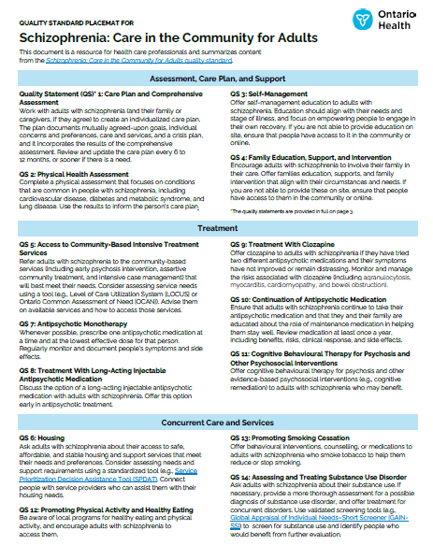
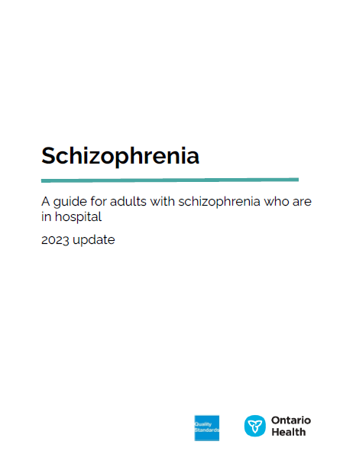


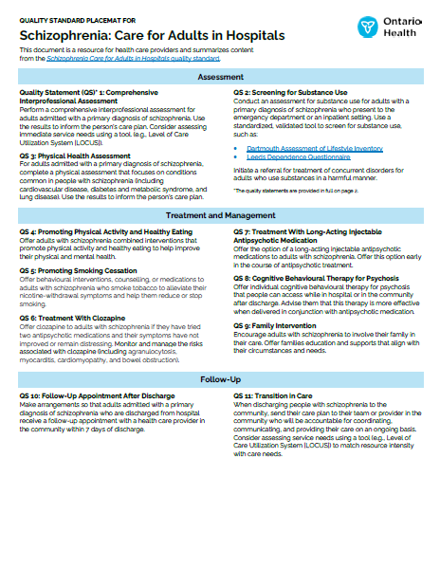
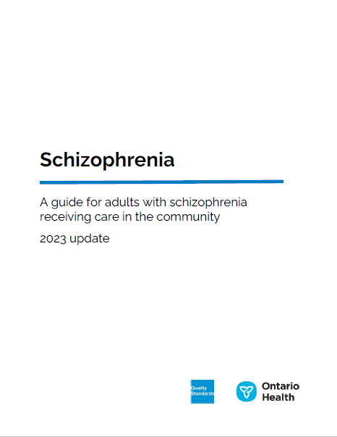
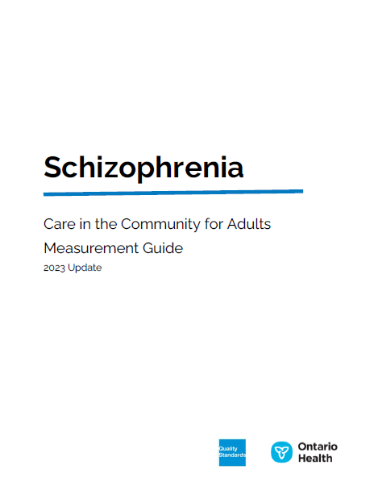
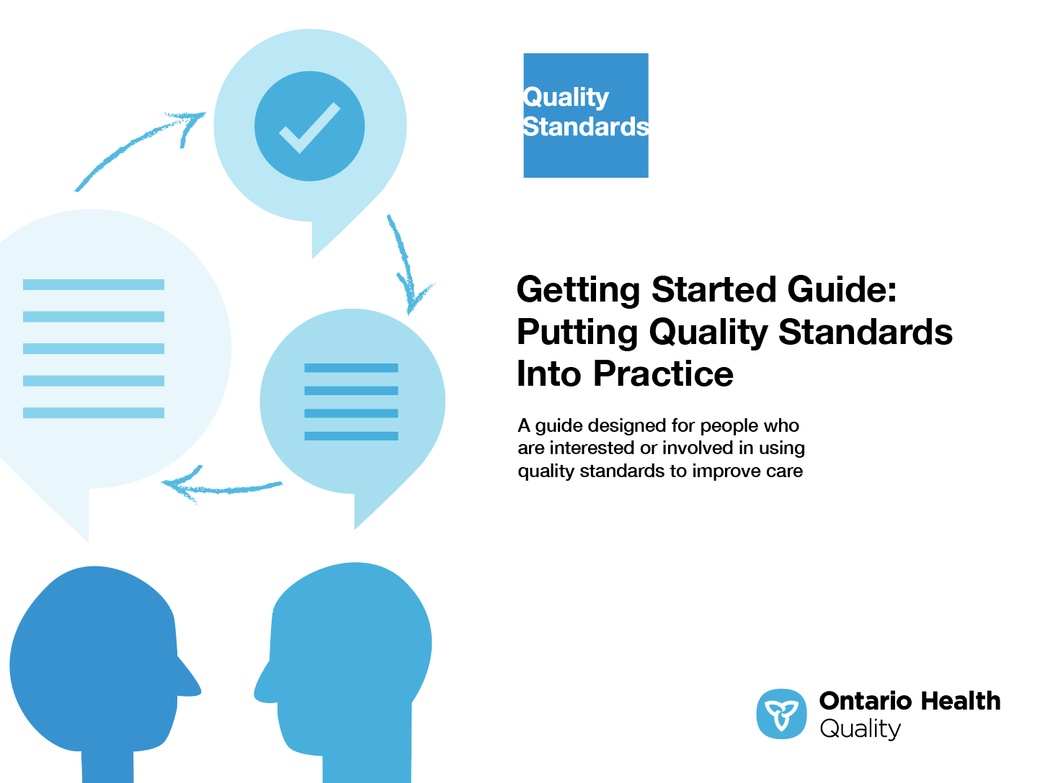
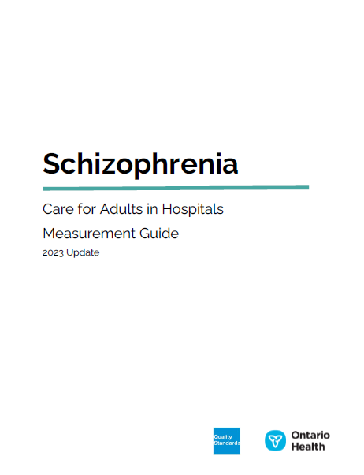
Quality standard resources
Placemat
Patient Guide
Quality Standard
Getting Started Guide
Measurement Guide
Find these resources here:
https://hqontario.ca/evidence-to-improve-care/quality-standards/view-all-quality-standards/schizophrenia-care-in-hospital
https://hqontario.ca/evidence-to-improve-care/quality-standards/view-all-quality-standards/schizophrenia-care-in-the-community
Notes:
Each quality standard focuses on a specific health care issue. The development of each quality standard is accompanied by an assortment of resources.
Through concise, easy-to-understand statements, quality standards outline what quality care looks like for a condition or topic based on the evidence.
Each quality standard is accompanied by a:
Patient conversation guide
Getting started guide
Placemat
Measurement guide
Quality standards provide the blueprint to enable the health care system in Ontario to work better, facilitate smooth transitions, and ensure patients receive the same high-quality care, regardless of where they reside.

Slide 6
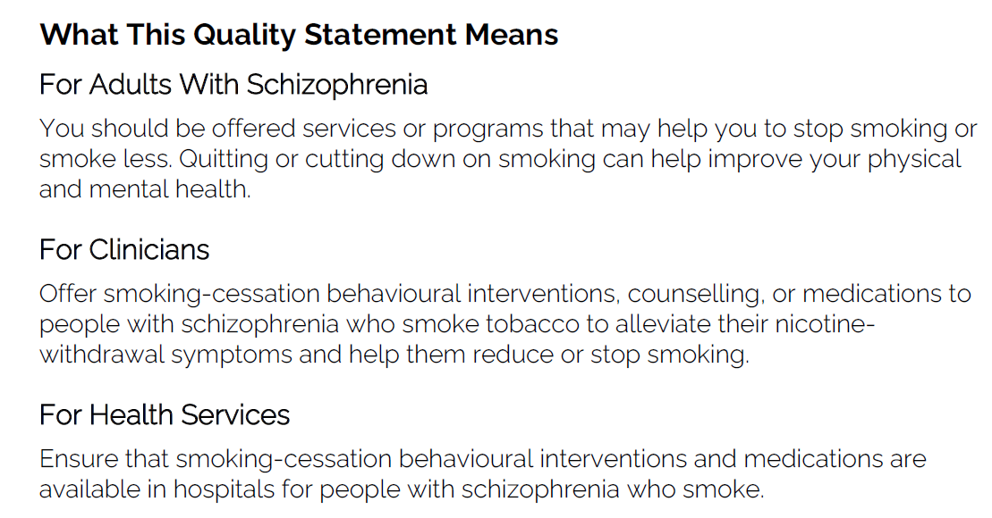
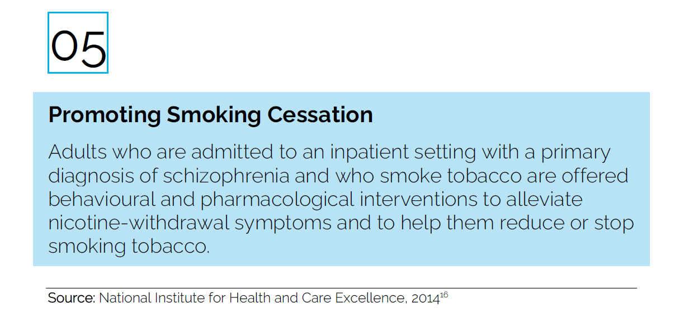
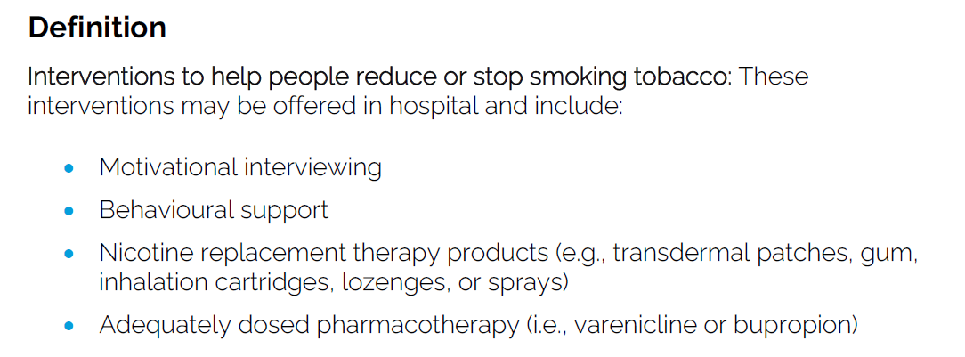
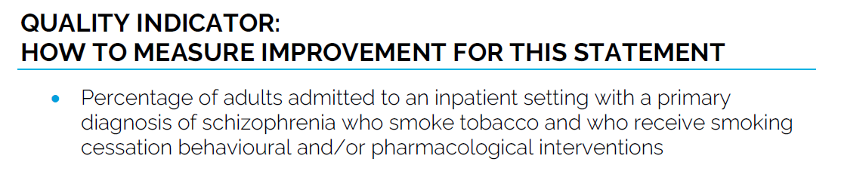
Inside the quality standard
The Audience Statements
The Quality Statement
The Definitions
The Indicators

Slide 7
Quality standards
Patient guide
The patient guide is designed to give patients information about what quality care looks like for various conditions based on the best evidence, so they can ask informed questions of their health care providers.
Notes:
Every quality standard includes a plain language summary for patients, families, caregivers and the public called the patient guide.
Patient engagement in quality standards:
Membership on advisory committees
Focus groups and key informant interviews on topic-specific content (when necessary)
Public comment period for each quality standard
Consultations on the patient guide

Slide 8
Quality Standards
Measurement guide
The measurement guide has two dedicated sections:
Local measurement: what you can do to assess the quality of care that you provide locally
Provincial measurement: how we can monitor the progress being made to improve care on a provincial level

Slide 9
Quality standards
Placemat
The placemat is a quick-reference resource for clinicians that summarizes the quality standard and includes links to helpful resources and tools.

Slide 10
Quality standards
How the health care system can support implementation
Implementing quality standards can be challenging owing to system-level barriers or gaps, many of which have been identified throughout the development of this standard
Ontario Health will work with and support other provincial partners, including the Ministry of Health, to bridge system-level gaps to support the implementation of quality standards

Slide 11
Quality standards
Implementation tools
The Getting Started Guide:
Outlines the process for using the quality standard as a resource to deliver high-quality care
Contains evidence-based approaches, as well as useful tools and templates for implementing change ideas at the practice level
Notes:
There are things we can do today despite the larger systemic barriers that may take time to resolve. The Getting Started Guide is a document that outlines a process for using the quality standards as a resource to deliver high-quality care. It compiles a number of resources to support adoption, such as links to implementation and quality improvement resources, examples and activities for reflection, and templates and documents to support the implementation planning activities. The Getting Started Guide also includes an Action Plan Template and examples on how Quality Improvement Plans can help to advance quality standards.

Slide 12


Quality standard adoption tools
Quorum
Quorum is an online community dedicated to improving the quality of health care in Ontario.
The Quality Standards Adoption Series highlights efforts in the field to implement changes and close gaps in care related to quality standard topics.
quorum.hqontario.ca
Notes:
The Quality Standards program has highlighted several stories from organizations and groups using various standards and statements within their clinical care settings, organization, or institutions; these are available through posts and discussions on Quorum.
As well, we are working on compiling resources and tools, for both clinicians and patients and families.
The focus is on implementation/adoption stories and how organizations are using quality standards in practice to inform care.
We’d love to hear from you if you are interested in contributing to a post or article.

Slide 13
Why do we need
quality standards for schizophrenia?

Slide 14

Approximately 1% of people in Ontario have schizophrenia and rates are higher among men (1.2%) than women (0.9%).¹
People with schizophrenia often experience increased physical health risks related to their condition and are disproportionately affected by homelessness and precarious housing.²
Sources:
Public Health Agency of Canada. Public Health Infobase. Canadian Chronic Disease Surveillance System (CCDSS). Accessed March 2023.
Millier A, Schmidt U, Angermeyer MC., Chauhan D, Murthy V, Toumi M, Cadi-Soussi, N. Humanistic burden in schizophrenia: A literature review. Journal of Psychiatric Research. 2014;54:85-93.

Slide 15
The proportion of the population with schizophrenia has increased from 2012 to 2019
Source: Public Health Agency of Canada. Public Health Infobase. Canadian Chronic Disease Surveillance System (CCDSS). Accessed March 2023.
Note: Incidence and prevalence rates are crude rates.

Slide 16
All-cause mortality is more than 3 times higher for people with schizophrenia and is increasing over time
Source: Public Health Agency of Canada. Public Health Infobase. Canadian Chronic Disease Surveillance System (CCDSS). Accessed March 2023.
Note: Mortality rates are age standardized.

Slide 17

Suicide is over 170 times more likely for people with schizophrenia
Suicide occurs among 1 out of 58 Ontarians with schizophrenia or related disorders; a rate of 171 per 10,000 people compared to approximately 1 in 10,000 people in the general population.^{1,2}
The risk of death by suicide is higher among men than women and is of greatest risk early in the course of illness, shortly after diagnosis.¹
Sources:
Zaheer J, Olfson M, Mallia E, Lam JSH, de Oliveira C, Rudoler D, et al. Predictors of suicide at time of diagnosis in schizophrenia spectrum disorder: A 20-year total population study in Ontario, Canada. Schizophrenia Research. 2020;222:382-388.
ICES. Suicide rate for people with schizophrenia spectrum disorders 170 times higher than the general population [news release]. June 18, 2020. Toronto. Available from: https://www.ices.on.ca/Newsroom/News-Releases/2020/Suicide-rate-for-people-with-schizophrenia-spectrum-disorders-170-times-higher-than-the-general.

Slide 18

Schizophrenia hospitalizations last 14 days on average, compared to an average of 6 days for psychiatric hospitalizations overall.
Source: Mental Health and Addictions Program Framework Research Team. Mental health and addictions system performance in Ontario: 2021 Scorecard. Chart Pack. Toronto, ON: ICES; 2021. Available from: https://www.ices.on.ca/Publications/Atlases-and-Reports/2021/Mental-Health-and-Addictions-System-Performance-in-Ontario-2021-Scorecard

Slide 19
26.8% of people in Ontario hospitalized for schizophrenia visited a primary care doctor or psychiatrist within a week of their discharge, with threefold variation across Ontario Health Regions
Sources: Discharge Abstract Database (DAD), Ontario Health Insurance Plan (OHIP) database, Ontario Mental Health Reporting System (OMHRS), Registered Persons Database (RPDB), provided by ICES.
Note: Rates are standardized by age and sex..

Slide 20
7-day physician follow-up for schizophrenia, fiscal year 2021/22
People living in urbans areas across Ontario were 1.5 times more likely than those in rural areas to visit a primary care doctor or psychiatrist within a week of their discharge from hospital for schizophrenia.
  27.3%
  17.5%
Rates of 7-day physician follow-up have remained relatively consistent over time between fiscal years 2012/13 and 2021/22.
Sources: Discharge Abstract Database (DAD), Ontario Health Insurance Plan (OHIP) database, Ontario Mental Health Reporting System (OMHRS), Registered Persons Database (RPDB), provided by ICES.
Note: Rates are standardized by age and sex.

Slide 21
16.6% of people in Ontario hospitalized for schizophrenia had a readmission for mental health or addictions within 30 days of discharge, ranging from 13.1% in the North West region to 17.6% in the North East region
Sources: Discharge Abstract Database (DAD), Ontario Mental Health Reporting System (OMHRS), Registered Persons Database (RPDB), provided by ICES.
Note: Rates are standardized by age and sex.

Slide 22
There has been a modest decline over time for readmissions for mental health or addictions within 30 days of a hospitalization for schizophrenia in Ontario
Sources: Discharge Abstract Database (DAD), Ontario Mental Health Reporting System (OMHRS), Registered Persons Database (RPDB), provided by ICES.
Note: Rates are standardized by age and sex.

Slide 23
People in the lowest income neighbourhoods had the highest readmission rates for mental health or addictions conditions in the month following a schizophrenia hospitalization
Sources: Discharge Abstract Database (DAD), Ontario Mental Health Reporting System (OMHRS), Registered Persons Database (RPDB), provided by ICES.
Note: Rates are standardized by age and sex.

Slide 24
Scope and topic areas

Slide 25
Schizophrenia: Care for Adults in Hospitals
Scope
This quality standard focuses on care for adults 18 years of age and older with a primary diagnosis of schizophrenia (including related disorders such as schizoaffective disorder) who are seen in an emergency department or admitted to an inpatient setting.
It also provides guidance for the care of people who are transitioning from the inpatient setting to the community.
Notes:
Scope of This Quality Standard
This quality standard focuses on care for adults 18 years of age and older with a primary diagnosis of schizophrenia (including related disorders such as schizoaffective disorder) who are seen in an emergency department or admitted to an inpatient setting. It also provides guidance for the care of people who are transitioning from the inpatient setting to the community.
A separate quality standard addresses care for adults with schizophrenia in the community, please see Schizophrenia: Care in the Community for Adults.

Slide 26
Schizophrenia: Care in Community for Adults
Scope
This quality standard focuses on care for adults 18 years of age and older with a primary diagnosis of schizophrenia, including related disorders such as schizoaffective disorder.
It also provides guidance on early psychosis intervention for people who experience a first episode of schizophrenia.
The quality standard focuses on care provided in the community, including primary care, hospital outpatient care, rehabilitation, correctional facilities, and community supports and services.
Notes:
Scope of This Quality Standard
This quality standard focuses on care for adults 18 years of age and older with a primary diagnosis of schizophrenia, including related disorders such as schizoaffective disorder. It also provides guidance on early psychosis intervention for people who experience a first episode of schizophrenia.
The quality standard focuses on care provided in the community, including primary care, hospital outpatient care, rehabilitation, correctional facilities, and community supports and services.
A separate quality standard addresses For a quality standard that addreses care for adults with schizophrenia who are seen in an emergency department or admitted to a hospital inpatient setting, please see Schizophrenia: Care for Adults in Hospitals.

Slide 27
Quality standard topic areas
Care in Hospital and in the Community
Comprehensive Interprofessional Assessment*
Screening for Substance Use*
Physical Health Assessment*
Promoting Physical Activity and Healthy Eating*
Promoting Smoking Cessation*
Treatment With Clozapine*
Treatment With Long-Acting Injectable Antipsychotic Medication*
Cognitive Behavioural Therapy*
Family Intervention*
Care in Hospital
Follow-Up Appointment After Discharge
Transitions in Care
Care in the Community
Access to Community-Based Intensive Treatment Services
Housing
Antipsychotic Monotherapy
Self-management
Continuation of Antipsychotic Medication
Employment and Occupational Support
*These quality statement topics appear in both quality standards, although there may be variations in how care is approached in each setting.

Slide 28
Quality statements to improve care

Slide 29
“Implementing the schizophrenia quality standard represents an opportunity to advance quality in a way that we have never had before and that no other province in Canada has had. Implementing the quality standard will represent a paradigm change. It will bring a better service user experience and a different lens that will be more aligned with recovery and better clinical outcomes for the patient. For example, we have historically assumed that people with schizophrenia just need medication and time. The new notion that a patient with schizophrenia gets a psychological treatment or at very least should be offered a psychological treatment is a really significant change. If patients and family members have these statements in front of them they will be more informed about the best evidence-based treatments and they will ask the right questions to make sure they get the best evidence-based treatments.”
– Dr. Phil Klassen, Schizophrenia Quality Standard Advisory Committee member (Hospital and Community)

Slide 30
Schizophrenia: Care for Adults in Hospitals
Quality Statement 1:
Comprehensive Interprofessional Assessment
Adults who are admitted to an inpatient setting with a primary diagnosis of schizophrenia undergo a comprehensive interprofessional assessment that informs their care plan.

Slide 31
Schizophrenia: Care for Adults in Hospitals
Quality Statement 2:
Screening for Substance Use
Adults who present to an emergency department or in an inpatient setting with a primary diagnosis of schizophrenia are assessed for substance use and, if appropriate, offered treatment for concurrent disorders.

Slide 32
Schizophrenia: Care for Adults in Hospitals
Quality Statement 3:
Physical Health Assessment
Adults who are admitted to an inpatient setting with a primary diagnosis of schizophrenia undergo a physical health assessment focusing on conditions common in people with schizophrenia. This assessment informs their care plan.

Slide 33
Schizophrenia: Care for Adults in Hospitals
Quality Statement 4:
Promoting Physical Activity and Healthy Eating
Adults who are admitted to an inpatient setting with a primary diagnosis of schizophrenia are offered interventions that promote both physical activity and healthy eating.

Slide 34
Schizophrenia: Care for Adults in Hospitals
Quality Statement 5:
Promoting Smoking Cessation
Adults who are admitted to an inpatient setting with a primary diagnosis of schizophrenia and who smoke tobacco are offered behavioural and pharmacological interventions to alleviate nicotine-withdrawal symptoms and to help them reduce or stop smoking tobacco.
Notes:
*

Slide 35
Schizophrenia: Care for Adults in Hospitals
Quality Statement 6:
Treatment With Clozapine
Adults who are admitted to an inpatient setting with a primary diagnosis of schizophrenia, and whose symptoms have not responded to previous adequate trials of treatment with two different antipsychotic medications, are offered clozapine.

Slide 36
Schizophrenia: Care for Adults in Hospitals
Quality Statement 7:
Treatment With Long-Acting Injectable Antipsychotic Medication
Adults who are admitted to an inpatient setting with a primary diagnosis of schizophrenia are offered the option of a long-acting injectable antipsychotic medication.

Slide 37
Schizophrenia: Care for Adults in Hospitals
Quality Statement 8:
Cognitive Behavioural Therapy for Psychosis
Adults who are admitted to an inpatient setting with a primary diagnosis of schizophrenia are offered individual cognitive behavioural therapy for psychosis, either in the inpatient setting or as part of a post-discharge care plan.
Notes:
*
*
Follow-Up Appointment After Discharge
Transitions in Care

Slide 38
Schizophrenia: Care for Adults in Hospitals
Quality Statement 9:
Family Intervention
Adults who are admitted to an inpatient setting with a primary diagnosis of schizophrenia are offered family intervention.

Slide 39
Schizophrenia: Care for Adults in Hospitals
Quality Statement 10:
Follow-Up Appointment After Discharge
Adults with a primary diagnosis of schizophrenia who are discharged from an inpatient setting have a follow-up appointment within 7 days.

Slide 40
Schizophrenia: Care for Adults in Hospitals
Quality Statement 11:
Transitions in Care
Adults with a primary diagnosis of schizophrenia who are discharged from an inpatient setting have a team or provider who is accountable for communication and the coordination and delivery of a care plan that is tailored to their needs.

Slide 41
Schizophrenia: Care for Adults in Hospital
Emerging Practice Statement: Nonpharmacological Interventions in Hospital*
Apart from cognitive behavioural therapy for psychosis and family intervention, we cannot provide guidance at this time on the use of other nonpharmacological treatments in acute care for adults who are admitted with a primary diagnosis of schizophrenia. There is a paucity of evidence or uncertainty in the evidence base relating to the effectiveness of such treatments; further evidence is needed before a quality statement can be developed.
*An emerging practice statement describes an area for quality improvement that has been prioritized by the advisory committee but for which there is insufficient or inconsistent evidence in the guidelines used in the development of the quality statements. An emerging practice statement acknowledges that further evidence is needed before a quality statement can be made.

Slide 42
Quality statements to improve care

Slide 43
“I think this quality standard will bring people with lived experience and their family members hope. It will help them understand that there are more services available to them than they might know about. They will know that there are therapies that complement or even minimize medication use and that a diagnosis of schizophrenia does not have to mean hospitalization. There are other options and services that can help people with schizophrenia recover from acute episodes and live good, meaningful lives. When people get the right support in the community at the right time, they get well and stay well.”
– Sheryl Pedersen, Lived Experience Advisor for the Schizophrenia Care in Community for Adults Quality Standard

Slide 44
Schizophrenia: Care in Community for Adults
Quality Statement 1:
Care Plan and Comprehensive Assessment
Adults with schizophrenia have a care plan that is regularly reviewed and updated, and that is informed by a comprehensive assessment.

Slide 45
Schizophrenia: Care in Community for Adults
Quality Statement 2:
Physical Health Assessment
Adults with schizophrenia receive a physical health assessment on a regular basis.

Slide 46
Schizophrenia: Care in Community for Adults
Quality Statement 3:
Self-Management
Adults with schizophrenia have access to information and education that supports the development of self-management skills.

Slide 47
Schizophrenia: Care in Community for Adults
Quality Statement 4:
Family Education, Support, and Intervention
Families of adults with schizophrenia are given ongoing education, support, and family intervention that is tailored to their needs and preferences.

Slide 48
Schizophrenia: Care in Community for Adults
Quality Statement 5:
Access to Community-Based Intensive Treatment Services
Adults with schizophrenia have timely access to community-based intensive treatment services based on their needs and preferences.

Slide 49
Schizophrenia: Care in Community for Adults
Quality Statement 6:
Housing
Adults with schizophrenia have a safe, affordable, stable living environment that reflects their needs and preferences.

Slide 50
Schizophrenia: Care in Community for Adults
Quality Statement 7:
Antipsychotic Monotherapy
Adults with schizophrenia are prescribed a single antipsychotic medication, whenever possible.

Slide 51
Schizophrenia: Care in Community for Adults
Quality Statement 8:
Treatment With Long-Acting Injectable Antipsychotic Medication
Adults with schizophrenia are offered the option of a long-acting injectable antipsychotic medication.

Slide 52
Schizophrenia: Care in Community for Adults
Quality Statement 9:
Treatment With Clozapine
Adults with schizophrenia whose symptoms have not responded to previous adequate trials of treatment with two different antipsychotic medications are offered clozapine.

Slide 53
Schizophrenia: Care in Community for Adults
Quality Statement 10:
Continuation of Antipsychotic Medication
Adults with schizophrenia whose symptoms have improved with antipsychotic medication are advised to continue their antipsychotic medication for the long term.

Slide 54
Schizophrenia: Care in Community for Adults
Quality Statement 11:
Cognitive Behavioural Therapy for Psychosis and Other Psychosocial Interventions
Adults with schizophrenia are offered cognitive behavioural therapy for psychosis and other evidence-based psychosocial interventions, based on their needs.

Slide 55
Schizophrenia: Care in Community for Adults
Quality Statement 12:
Promoting Physical Activity and Healthy Eating
Adults with schizophrenia are offered readily accessible interventions that promote physical activity and healthy eating.
Notes:
Quality Statement 12:

Slide 56
Schizophrenia: Care in Community for Adults
Quality Statement 13:
Promoting Smoking Cessation
Adults with schizophrenia who smoke tobacco are offered pharmacological and nonpharmacological interventions to help them reduce or stop smoking tobacco.

Slide 57
Schizophrenia: Care in Community for Adults
Quality Statement 14:
Assessing and Treating Substance Use Disorder
Adults with schizophrenia are asked about their substance use and, if appropriate, they are assessed for substance use disorder and offered treatment.

Slide 58
Schizophrenia: Care in Community for Adults
Quality Statement 15:
Employment and Occupational Support
Adults with schizophrenia who wish to find work or return to work are offered supported employment programs. Adults with schizophrenia who are not seeking paid work are supported in other occupational or educational activities, in accordance with their needs and preferences.

Slide 59
Schizophrenia: Care in Community for Adults
Emerging Practice Statement: Peer Support, Illness Management and Recovery Training, Wellness Recovery Action Planning, and Social Skills Training*
We cannot provide guidance at this time on peer support, illness management and recovery training, wellness recovery action planning, or social skills training because of conflicting recommendations in the guidelines used to develop the quality statements.
*An emerging practice statement describes an area for quality improvement that has been prioritized by the advisory committee but for which there is insufficient or inconsistent evidence in the guidelines used in the development of the quality statements. An emerging practice statement acknowledges that further evidence is needed before a quality statement can be made.

Slide 60
Measures to Support Improvement
Notes:
The Schizophrenia Care in the Hospital Quality Standard Advisory Committee identified a set of overarching goals for this quality standard. These have been mapped to indicators that may be used to assess quality of care provincially and locally.

Slide 61
Schizophrenia: Care for Adults in Hospitals
Indicators that can be measured using provincial data
Number of deaths by inpatient suicide among adults with a primary diagnosis of schizophrenia
Percentage of adults admitted to hospital with a primary diagnosis of schizophrenia who die by suicide within 30 days of discharge

Slide 62
Schizophrenia: Care for Adults in Hospitals
Indicators that can be measured using provincial data (continued)
Rates of readmission to any facility within 7 days and 30 days of discharge, stratified by the reason for readmission:
    Any reason
    A reason related to mental health and addictions
    Schizophrenia

Slide 63
Schizophrenia: Care for Adults in Hospitals
Indicators that can be measured using provincial data (continued)
Rates of unscheduled emergency department visits after hospital inpatient discharge within 7 days and 30 days, stratified by the reason for the visit:
    Any reason
    A reason related to mental health and addictions
    Schizophrenia
    Self-harm

Slide 64
Schizophrenia: Care for Adults in Hospitals
Indicators That can be Measured Using Local Data
Percentage of adults admitted to hospital with a primary diagnosis of schizophrenia who experience an improvement in behavioural symptoms between admission and discharge, stratified by their length of stay
Percentage of adults admitted to hospital with a primary diagnosis of schizophrenia who experience an improvement in positive symptoms between admission and discharge, stratified by their length of stay

Slide 65
Measures to Support Improvement
Notes:
The Schizophrenia Care in the Community Quality Standard Advisory Committee identified a set of overarching goals for this quality standard. These have been mapped to indicators that may be used to assess quality of care provincially and locally.

Slide 66
Schizophrenia: Care in Community for Adults
Indicators that can be measured using provincial data
Percentage of adults hospitalized for schizophrenia who have had an unplanned hospital readmission for a mental health or addictions condition within 30 days of discharge
Percentage of adults hospitalized for schizophrenia who had a follow-up visit with a trained mental health physician:
    Within 7 days of hospital discharge
    Within 28 days of hospital discharge

Slide 67
Schizophrenia: Care in Community for Adults
Indicators That can be Measured Using Local Data
Percentage of adults with schizophrenia who report unmet care needs
Percentage of adults with schizophrenia who report living in stable housing for the past year
Percentage of adults hospitalized for schizophrenia who had a follow-up visit with a trained mental health professional:
    Within 7 days of hospital discharge
    Within 28 days of hospital discharge

Slide 68
Data Sources and Acknowledgement
Databases used in this presentation included the Canadian Institute for Health Information’s (CIHI’s) Discharge Abstract Database (DAD), the Ontario Mental Health Reporting System (OMHRS), Ontario Health Insurance Plan (OHIP) data, and the Registered Persons Database (RPDB). Data from the Public Health Agency of Canada’s (PHAC’s) Canadian Chronic Disease Surveillance System was also referenced.
This presentation draws on analyses provided ICES, with data from a variety of sources including the Canadian Institute of Health Information. However, the opinions, results, and conclusions included in this presentation are those of the authors, are independent, and do not imply endorsement by ICES, CIHI, the Ontario Ministry of Health (MOH), the Ontario Ministry of Long-Term Care (MLTC), or the Public Health Agency of Canada.

Slide 69

Thank you.
LET’S CONTINUE THE CONVERSATION
HQOntario.ca | OntarioHealth.ca
@OntarioHealthOH
Ontario Health
@OntarioHealthOH
Ontario Health

