Slide 1

Schizophrenia Care in the Community Quality Standard
Guiding evidence-based community-based care for adults with schizophrenia in Ontario
Notes:
If you have any questions about the content of this presentation, please contact us at QualityStandards@hqontario.ca

Slide 2
Objectives
Overview of quality standards
What are they? How are they used?​
Why this quality standard is needed
Gaps and variations in quality of care for adults with schizophrenia in Ontario
Quality statements in brief
The key recommendations in the schizophrenia quality standard
How success can be measured
Indicators that can help measure your quality improvement efforts

Slide 3
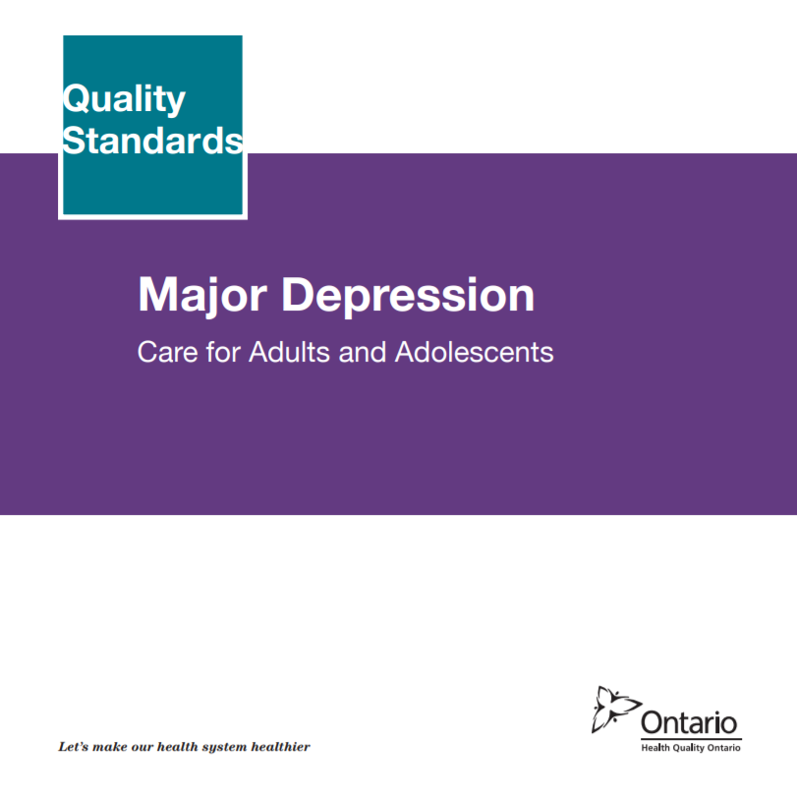
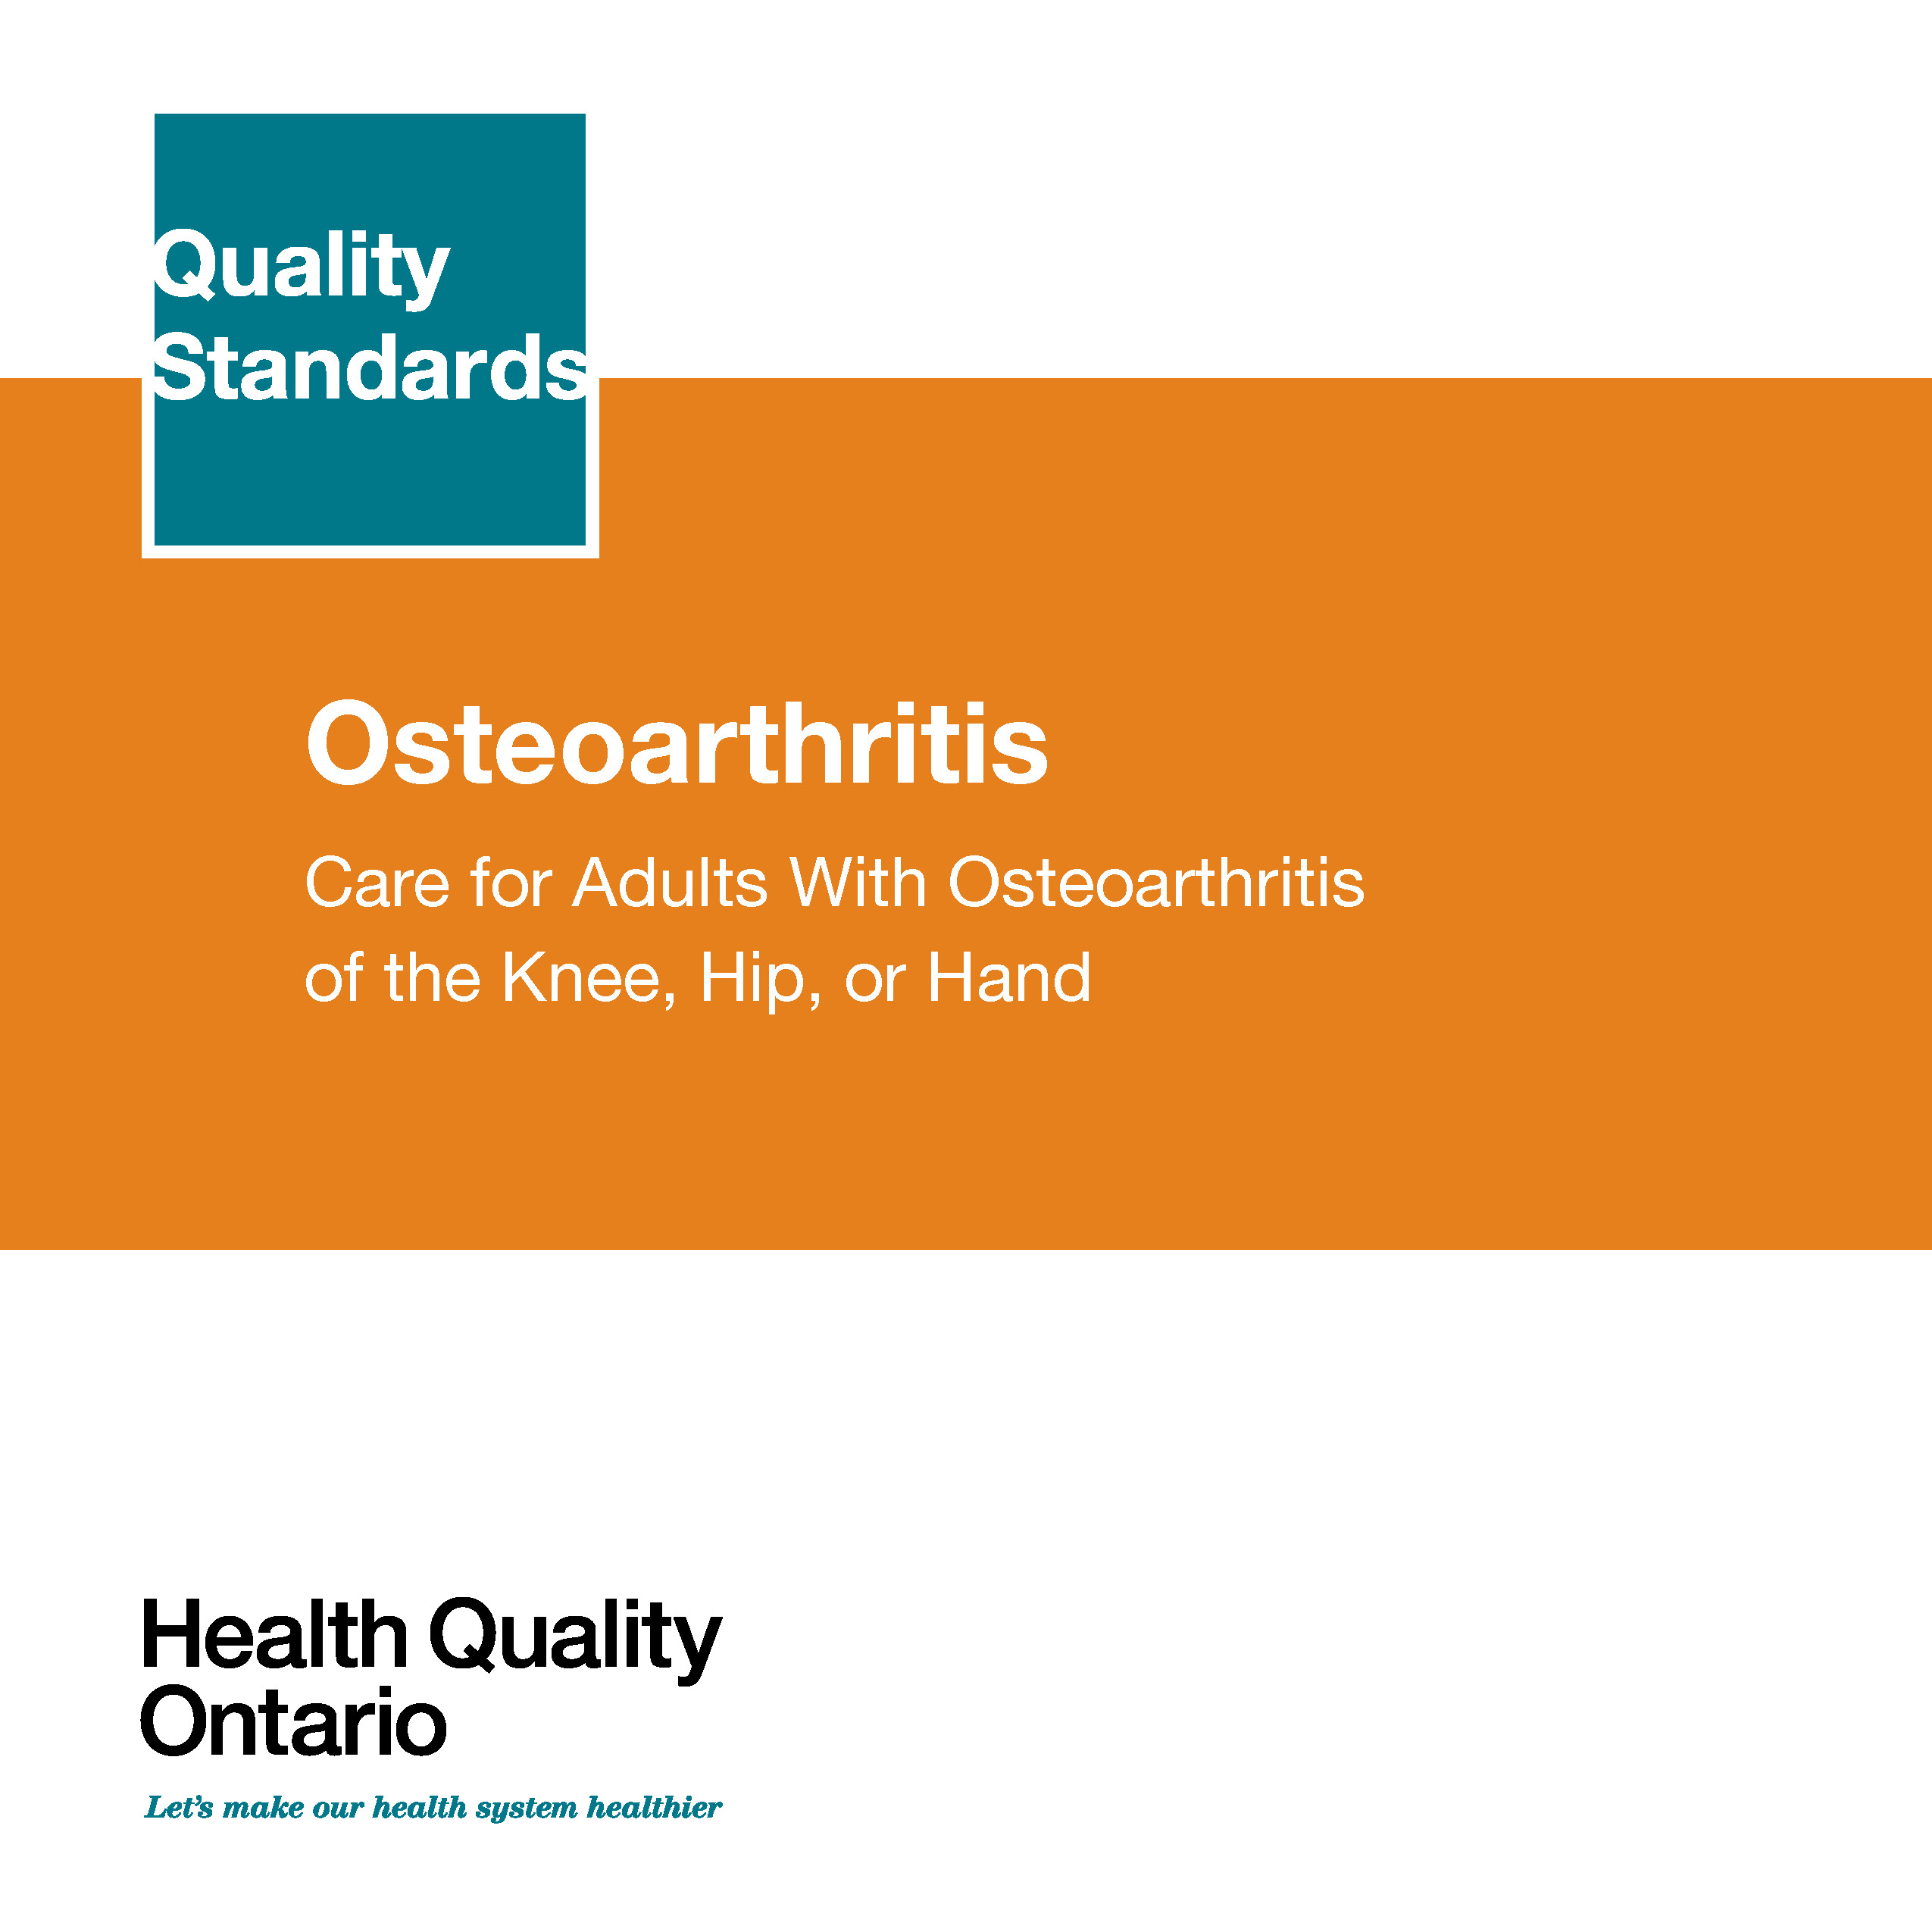
Quality Standards
Inform clinicians and patients what quality care looks like
Focus on conditions where there are large variations in how care is delivered, or where there are gaps between the care provided in Ontario and the care patients should receive
Are grounded in the best available evidence
Notes:
Quality standards are a smaller set of high impact statements that describe optimal care where identified quality gaps exist in Ontario.
Voluntary and aspirational in nature​.
Designed to “raise the ceiling” with the goal of having the best possible care available to all Ontarians, regardless of where they live in the province.
There are many guidelines, professional standards, and other recommendations that contribute to the evidence ecosystem. Quality standards complement these resources.
Quality standards outline the what of care that should be delivered but is agnostic on who should be delivering it (unlike other CPGs, BPGs).
Quality standards are:
Concise: 5 to 15 strong, evidence-based statements focused on high priority areas for improvement.
Accessible: help clinicians and provider organizations offer the highest quality care; and patients to know what to discuss with their care providers (compared to CPGs that are quite dense, these are very accessible, also written in plain language).
Measurable: each statement is accompanied by one or more quality indicators (structure, process or outcome), with a set of outcome measures for the overall standard.
Implementable: quality improvement tools and resources support each standard, to fuel adoption.

Slide 4
Quality Standards
Help health care professionals know what care to offer, based on evidence and expert consensus
Help health care organizations measure, assess, and improve the quality of care they provide
Help ensure consistent,
high-quality care across
the province
Help patients, residents, families, and caregivers know what to ask for in their care
Notes:
Patients, caregivers and the public can use quality standards to understand what excellent care looks like, what they should expect from their health care providers, and how to discuss the quality of their care.
LHINs and disease agencies can use quality standards to measure health outcomes, hold health service providers accountable for delivering high-quality care, and inform regional improvement strategies.
Provider organizations can use quality standards to measure and audit their quality of care, identify gaps, guide organizational improvement strategies, and inform clinical program investments.
Health care professionals can use quality standards to evaluate their practice and identify areas for personal and organizational quality improvement. They can incorporate the evidence-based statements into professional education.
Government can use quality standards to identify provincial priority areas, inform new data collection and reporting initiatives, and design performance indicators and funding incentives.

Slide 5




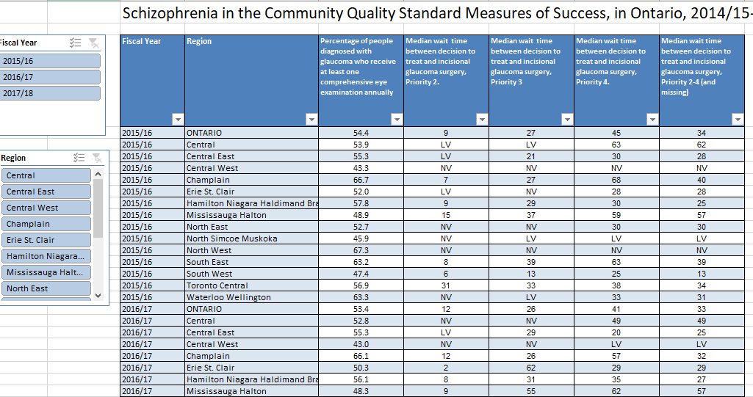
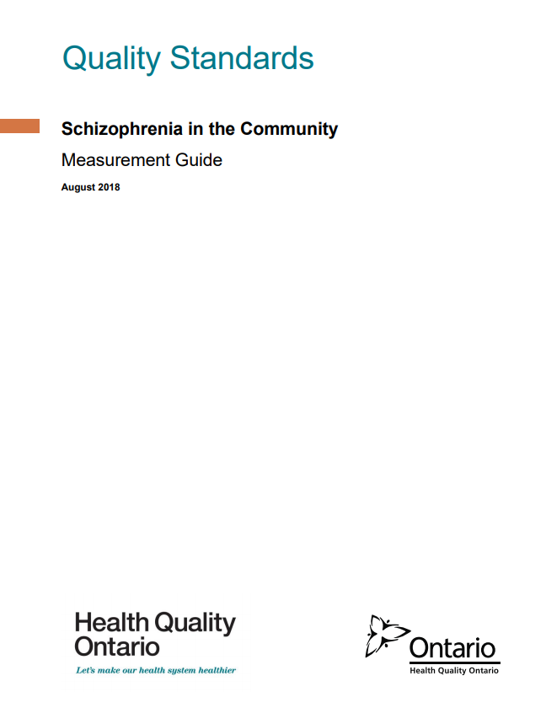
Quality Standard Resources
Quality Standard
Patient Reference Guide
Getting Started Guide
Recommendations for Adoption
Data Tables
Measurement Guide
Find these resources here:
https://hqontario.ca/evidence-to-improve-care/quality-standards/view-all-quality-standards/schizophrenia-care-in-the-community
Notes:
Each quality standard focuses on a specific health care issue. The development of each quality standard is accompanied by an assortment of resources.
Through concise, easy-to-understand statements, quality standards outline what quality care looks like for a condition or topic based on the evidence.
Each quality standard is accompanied by:
A patient conversation guide
A getting started guide
Recommendations for adoption
Data tables
A measurement guide
Quality standards provide the blueprint to enable the health care system in Ontario to work better, facilitate smooth transitions, and ensure patients receive the same high-quality care, regardless of where they reside.

Slide 6
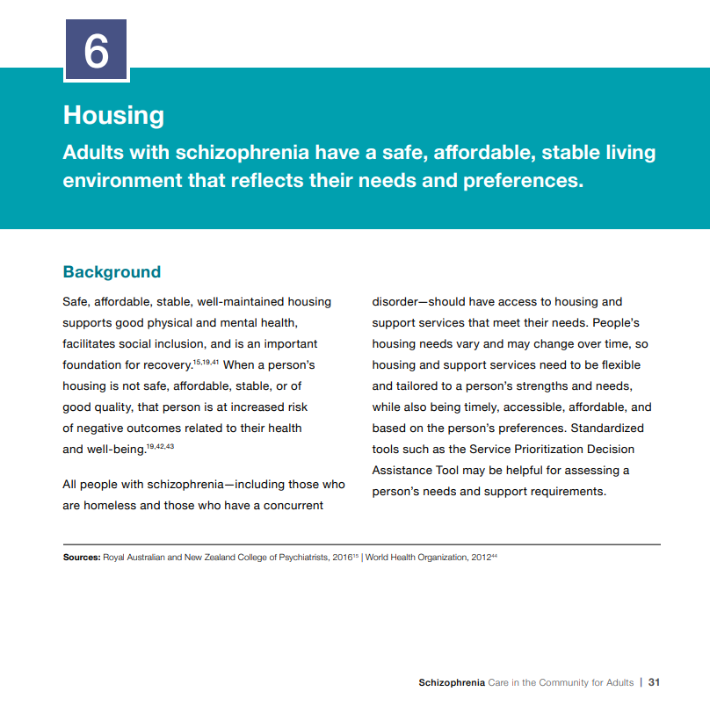
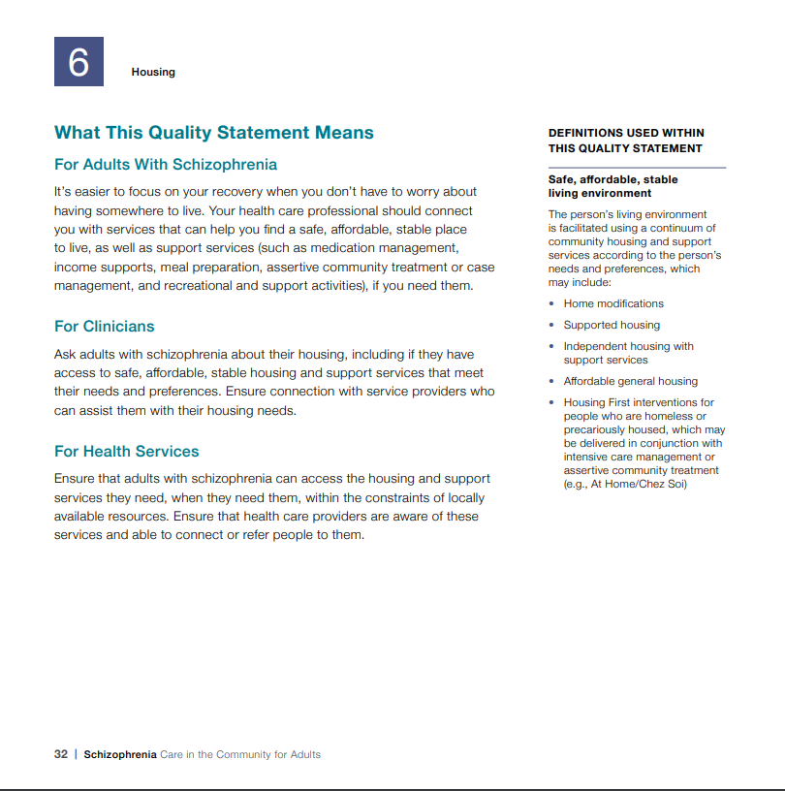
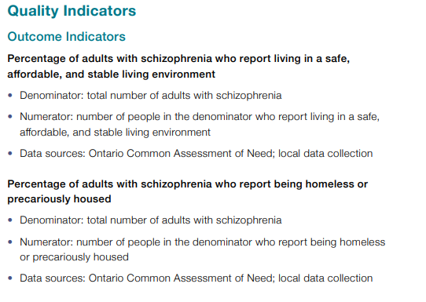
Inside the Quality Standard
The Statement
The Audience
Definitions
The Indicators

Slide 7
Quality Standards:
Patient Reference Guide
The patient reference guide is designed to give patients information about what quality care looks like for various conditions based on the best evidence, so they know what to ask for when receiving care.
Notes:
Every quality standard includes a plain language summary for patients, families, caregivers, and the public called the patient conversation guide.
Patient engagement in quality standards:
Membership on advisory committees
Focus groups and key informant interviews on topic specific content (when necessary)
Public comment period for each quality standard
Consultations on the patient conversation guide

Slide 8
Quality Standards:
Recommendations for Adoption
Recommendations for policy makers, administrators, health care organizations, and professionals have been made that aim to bridge the gaps between current care and care outlined in the quality statements to enable adoption of the quality standard across Ontario.
Notes:
As many aspects of the quality standard represent care that can and should be made available today, it is recognized that there are larger systemic barriers that may impede care delivery as per the standard. This document summarizes the system-wide and regional requirements that are needed to help health care professionals and organizations meet these standards and the time horizon expected to resolve these barriers.

Slide 9
Quality Standards:
Implementation Tools
The Getting Started Guide:
Outlines the process for using the quality standard as a resource to deliver high-quality care
Contains evidence-based approaches, as well as useful tools and templates for implementing change ideas at the practice level
Notes:
There are things we can do today despite the larger systemic barriers that may take time to resolve. The getting started guide is a document that outlines a process for using the quality standards as a resource to deliver high-quality care. It compiles a number of resources to support adoption such as links to implementation and quality improvement resources, examples and activities for reflection as well as templates and documents to support the implementation planning activities. The getting started guide also includes an Action Plan Template and examples on how Quality Improvement Plans can help to advance quality standards.

Slide 10
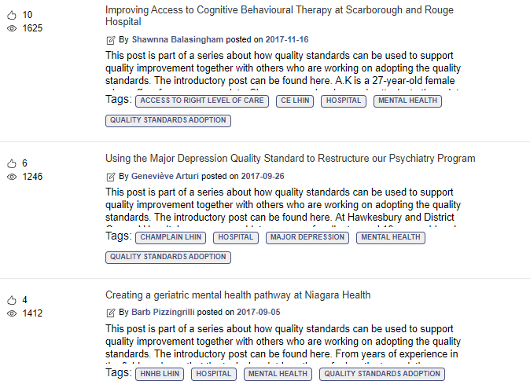
Quality Standards:
Quorum
Quorum is an online community dedicated to improving the quality of health care in Ontario.
The Quality Standards Adoption Series highlights efforts in the field to implement changes and close gaps in care related to quality standard topics.
Visit the Quality Standards Adoption Series on Quorum to learn how organizations are implementing quality standards.

Slide 11
Quality Standards:
Measurement Guide
The measurement guide has two dedicated sections:
Local measurement: what you can do to assess the quality of care that you provide locally
Provincial measurement: how we can measure the success of the quality standard on a provincial level

Slide 12
Quality Standards:
Data Tables
Data tables can be used to examine variations in indicator results across the province. They include data on key indicators:
Over time for Ontario
Across regions in Ontario
For specific measures of equity (age, sex, rurality, and household income)

Slide 13
Why a Quality Standard for Community-Based Schizophrenia Care in Ontario?

Slide 14
“When it comes to providing care in the community for individuals living with schizophrenia, there are no standards of practice. This leads to situations where people fall through the cracks, and ultimately only make contact with health care professionals after they have been left untreated for long periods of time. This quality standard will help the health care system address these gaps so that providers are available and accessible to deliver the right care at the right time for individuals living with schizophrenia.”
– Sylvain Roy, Schizophrenia Care in the Community for Adults Quality Standard

Slide 15

In Canada, about 1% of people have schizophrenia
Source: Health Canada. A report on mental illnesses in Canada: chapter 3, schizophrenia [Internet]. Ottawa (ON): Health Canada; 2002

Slide 16
People with schizophrenia face a number of physical health risks related to their condition and die about 15 to 20 years earlier than the general population.
Source: Wahlbeck K, Westman J, Nordentoft M, Gissler M, Laursen TM. Outcomes of Nordic mental health systems: life expectancy of patients with mental disorders. Br J Psychiatry. 2011;199(6):453-8.

Slide 17

People with schizophrenia are often disproportionately affected by homelessness, or are precariously housed
Source: Mental Health Policy Research Group. Mental illness and pathways into homelessness: proceedings and recommendations. Toronto (ON): The Group; 1998.

Slide 18
The percentage of people who were readmitted to hospital for a mental health or addictions condition within 30 days of a previous hospital discharge for schizophrenia ranged from 13.1% to 18.7% across regions in the province
Percentage of people who were readmitted to hospital for a mental health or addictions condition within 30 days of a previous hospital discharge for schizophrenia, in Ontario, by LHIN region, 2017/18
Data sources: Discharge Abstract Database, Ontario Mental Health Reporting System, Registered Persons Database, provided by the Institute for Clinical Evaluative Sciences
Note: Age-sex standardized rates

Slide 19
The percentage of people who were readmitted to hospital for a mental health or addictions condition within 30 days of a previous hospital discharge for schizophrenia was lowest for people with the highest income
Percentage of people who were readmitted to hospital for a mental health or addictions condition within 30 days of a previous hospital discharge for schizophrenia, in Ontario, by income quintile, 2017/18
Data sources: Discharge Abstract Database, Ontario Mental Health Reporting System, Registered Persons Database, provided by the Institute for Clinical Evaluative Sciences
Note: Age-sex standardized rates

Slide 20
Only 3 out of 10 people hospitalized for schizophrenia in Ontario have a follow-up visit with a family doctor or psychiatrist within 7 days of discharge
Data sources: Discharge Abstract Database, Ontario Mental Health Reporting System, Registered Persons Database, provided by the Institute for Clinical Evaluative Sciences

Slide 21
The percentage of people who had contact with a family doctor or a psychiatrist within 7 days of a previous hospital discharge for schizophrenia varied across regions from 17.8% to 45.0%
Percentage of people who had contact with a family doctor or a psychiatrist within 7 days of a previous hospital discharge for schizophrenia, in Ontario, by LHIN region, 2017/18
Data sources: Discharge Abstract Database, Ontario Mental Health Reporting System, Registered Persons Database, provided by the Institute for Clinical Evaluative Sciences
Note: Age-sex standardized rates

Slide 22
Quality Standard in Brief

Slide 23
Scope of the Schizophrenia Community Quality Standard
This quality standard focuses on care for adults 18 years of age and older with a primary diagnosis of schizophrenia, including related disorders such as schizoaffective disorder.
It also provides guidance on early psychosis intervention for people who experience a first episode of schizophrenia.
The quality standard focuses on care provided in the community, including primary care, hospital outpatient care, rehabilitation, correctional facilities, and community supports and services.

Slide 24


For a quality standard that addresses care for adults with schizophrenia who present at the emergency department or are admitted to hospital, please refer to the quality standard Schizophrenia: Care for Adults in Hospitals.

Slide 25
Schizophrenia Community Quality Standard: Quality Statements
Care Plan and
Comprehensive Assessment*
Physical Health Assessment*
Self-Management
Family Education, Support,
and Intervention*
Access to Community-Based Intensive Treatment Services
Housing
Antipsychotic Monotherapy
Treatment With
Long-Acting Injectable Antipsychotic Medication*
Treatment With Clozapine*
Continuation of
Antipsychotic Medication
Cognitive Behavioural Therapy
for Psychosis* and Other Psychosocial Interventions
Promoting Physical Activity
and Healthy Eating*
Promoting Smoking Cessation*
Assessing and Treating Substance Use Disorder*
Employment and
Occupational Support
* The hospital schizophrenia quality standard includes a similar quality statement

Slide 26
Quality Statement 1: Care Plan and Comprehensive Assessment
Adults with schizophrenia have a care plan that is regularly reviewed and updated, and that is informed by a comprehensive assessment.

Slide 27
Quality Statement 2: Physical Health Assessment
Adults with schizophrenia receive a physical health assessment on a regular basis.

Slide 28
Quality Statement 3: Self-Management
Adults with schizophrenia have access to information and education that supports the development of self-management skills.

Slide 29
Quality Statement 4: Family Education, Support, and Intervention
Families of adults with schizophrenia are given ongoing education, support, and family intervention that is tailored to their needs and preferences.

Slide 30
Quality Statement 5: Access to Community-Based Intensive Treatment Services
Adults with schizophrenia have timely access to community-based intensive treatment services based on their needs and preferences.

Slide 31
Quality Statement 6: Housing
Adults with schizophrenia have a safe, affordable, stable living environment that reflects their needs and preferences.

Slide 32
Quality Statement 7: Antipsychotic Monotherapy
Adults with schizophrenia are prescribed a single antipsychotic medication, whenever possible.

Slide 33
Quality Statement 8: Treatment With
Long-Acting Injectable Antipsychotic Medication
Adults with schizophrenia are offered the option of a long-acting injectable antipsychotic medication.

Slide 34
Quality Statement 9: Treatment With Clozapine
Adults with schizophrenia who have not responded to previous adequate trials of treatment with two different antipsychotic medications are offered clozapine.

Slide 35
Quality Statement 10: Continuation of Antipsychotic Medication
Adults with schizophrenia whose symptoms have improved with antipsychotic medication are advised to continue their antipsychotic medication for the long term.

Slide 36
Quality Statement 11: Cognitive Behavioural Therapy for Psychosis and Other Psychosocial Interventions
Adults with schizophrenia are offered cognitive behavioural therapy for psychosis and other evidence-based psychosocial interventions, based on their needs.

Slide 37
Quality Statement 12: Promoting Physical Activity and Healthy Eating
Adults with schizophrenia are offered readily accessible interventions that promote physical activity and healthy eating.
Notes:
Quality Statement 12:

Slide 38
Quality Statement 13: Promoting Smoking Cessation
Adults with schizophrenia who smoke tobacco are offered pharmacological and nonpharmacological interventions to help them reduce or stop smoking tobacco.

Slide 39
Quality Statement 14: Assessing and Treating Substance Use Disorder
Adults with schizophrenia are asked about their substance use and, if appropriate, they are assessed for substance use disorder and offered treatment.

Slide 40
Quality Statement 15: Employment and Occupational Support
Adults with schizophrenia who wish to find work or return to work are offered supported employment programs. Adults with schizophrenia who are not seeking paid work are supported in other occupational or educational activities, in accordance with their needs and preferences.

Slide 41
Emerging Practice Statement*
We cannot provide guidance at this time on peer support, illness management and recovery training, wellness recovery action planning, or social skills training because of conflicting recommendations in the guidelines used to develop the quality statements.
*An emerging practice statement describes an area for quality improvement that has been prioritized by the advisory committee but for which there is insufficient or inconsistent evidence in the guidelines used in the development of the quality statements. An emerging practice statement acknowledges that further evidence is needed before a quality statement can be made.

Slide 42
“I think this quality standard will bring people with lived experience and their family members hope. It will help them understand that there are more services available to them than they might know about. They will know that there are therapies that complement or even minimize medication use and that a diagnosis of schizophrenia does not have to mean hospitalization. There are other options and services that can help people with schizophrenia recover from acute episodes and live good, meaningful lives. When people get the right support in the community at the right time, they get well and stay well.”
– Sheryl Pedersen, Lived Experience Advisor on Schizophrenia Care in the Community for Adults Quality Standard

Slide 43
How Success Can Be Measured
Notes:
The Schizophrenia Community Quality Standard Advisory Committee identified a small number of overarching goals for this quality standard. They have been mapped to indicators that may be used to assess quality of care provincially and locally.

Slide 44
How Success Can Be Measured Provincially
We recommend the following list of indicators to monitor the overall success of the standard provincially:
Percentage of adults hospitalized for schizophrenia who have had an unplanned hospital readmission for a mental health or addictions condition within 30 days of discharge (See slides 17 and 18)
Percentage of adults hospitalized for schizophrenia who had contact with a trained mental health physician:
  Within 7 days of hospital discharge (See slides 19 and 20)
  Within 28 days of hospital discharge

Slide 45
How Success Can Be Measured Locally
We recommend the following list of indicators to monitor the overall success of the standard locally:
Percentage of adults with schizophrenia who report unmet care needs (suggested stratification: type of need)
Percentage of adults with schizophrenia who report living in stable housing for the past year
Percentage of adults hospitalized for schizophrenia who had contact with a trained mental health professional*:
  Within 7 days of hospital discharge
  Within 28 days of hospital discharge
* These indicators include physician contact (as per the provincially measurable indicator) and contact by other trained mental health professionals that cannot be measured using current provincial administrative data (e.g., nurse practitioners)
Notes:
Locally:
In addition, each quality statement within this quality standard is accompanied by one or more indicators.
These indicators are intended to guide measurement of quality improvement efforts related to implementation of the statement.

Slide 46
Connect with us:
https://quorum.hqontario.ca

