Slide 1

Schizophrenia Care in the Hospital Quality Standard
Guiding evidence-based care for adults with schizophrenia in Ontario
Notes:
If you have any questions about the content of this presentation, please contact us at QualityStandards@hqontario.ca

Slide 2
Objectives
Overview of quality standards
What are they? How are they used?​
Why this quality standard is needed
Gaps and variations in quality of care for adults with schizophrenia in Ontario
Quality statements in brief
The key recommendations in the schizophrenia quality standard
How success can be measured
Indicators that can help measure your quality improvement efforts

Slide 3
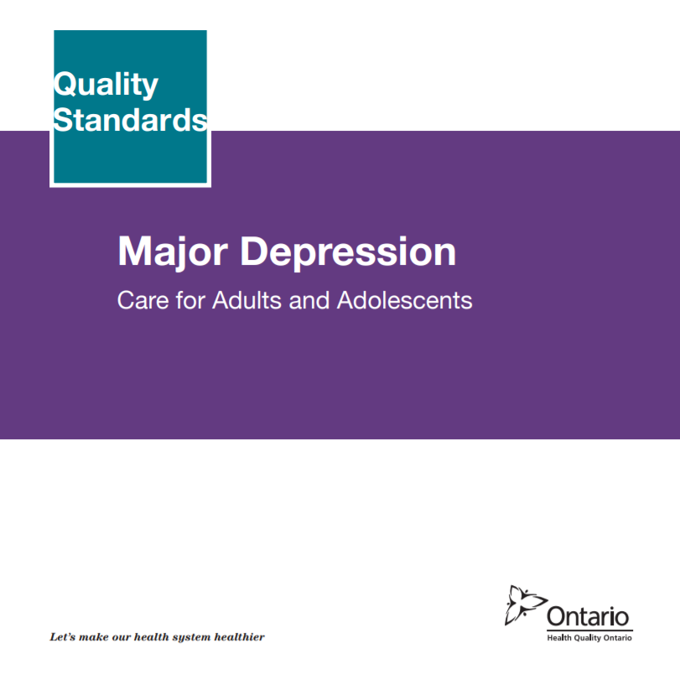
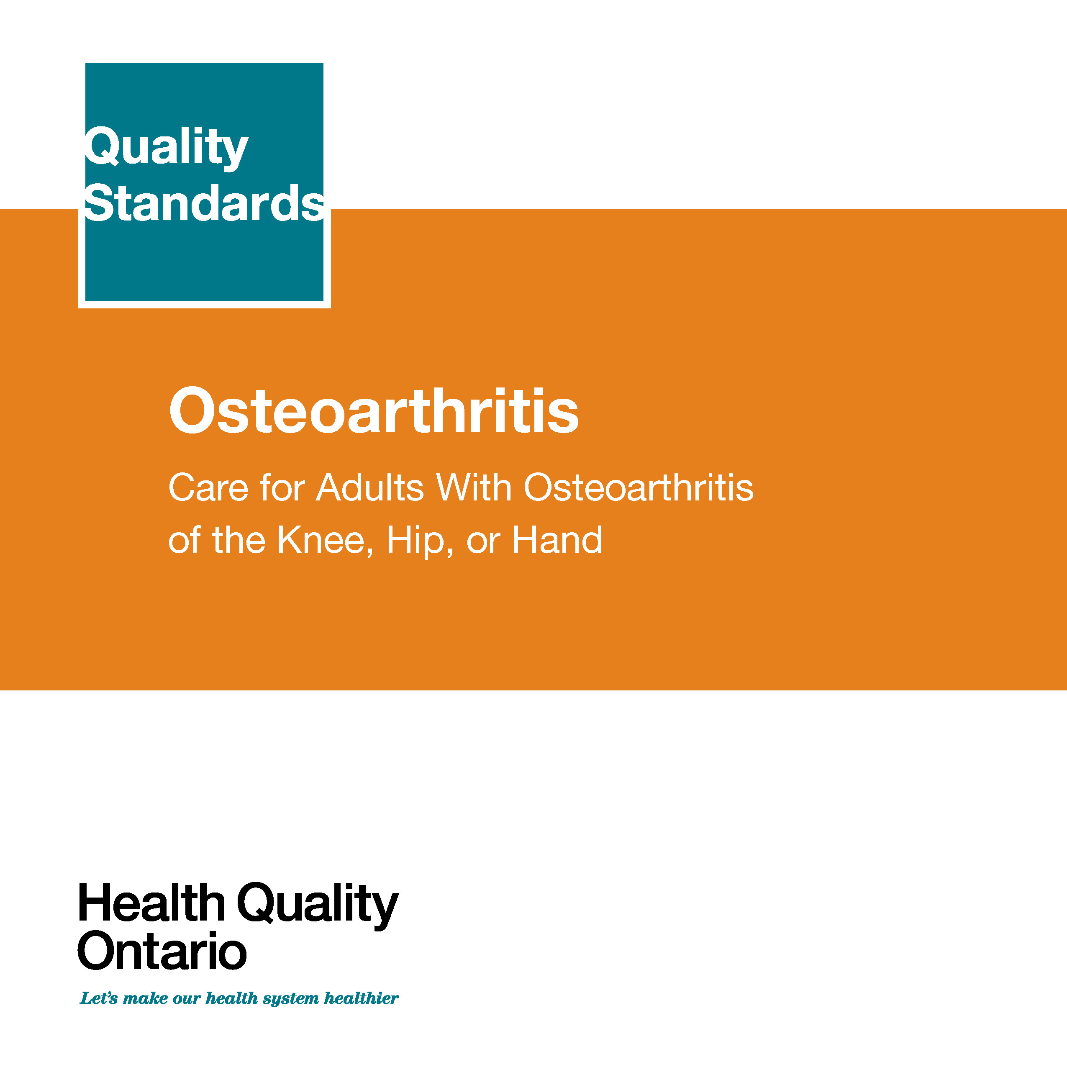
Quality Standards
Inform clinicians and patients what quality care looks like
Focus on conditions where there are large variations in how care is delivered, or where there are gaps between the care provided in Ontario and the care patients should receive
Are grounded in the best available evidence
Notes:
Quality standards are a smaller set of high impact statements that describe optimal care where identified quality gaps exist in Ontario.
Voluntary and aspirational in nature​.
Designed to “raise the ceiling” with the goal of having the best possible care available to all Ontarians, regardless of where they live in the province.
There are many guidelines, professional standards, and other recommendations that contribute to the evidence ecosystem. Quality standards complement these resources.
Quality standards outline the what of care that should be delivered, but is agnostic on who should be delivering it (unlike other CPGs, BPGs).
Quality standards are:
Concise: 5 to 15 strong, evidence-based statements focused on high priority areas for improvement.
Accessible: help clinicians and provider organizations to offer the highest quality care, and patients to know what to discuss with their care providers (compared to CPGs that are quite dense, these are very accessible, also written in plain language).
Measurable: each statement is accompanied by one or more quality indicators (structure, process or outcome), with a set of outcome measures for the overall standard.
Implementable: quality improvement tools and resources support each standard, to fuel adoption.

Slide 4
Quality Standards
Help health care professionals know what care to offer, based on evidence and expert consensus
Help health care organizations measure, assess, and improve the quality of care they provide
Help ensure consistent,
high-quality care across
the province
Help patients, residents, families, and caregivers know what to ask for in their care
Notes:
Patients, caregivers, and the public can use quality standards to understand what excellent care looks like, what they should expect from their health care providers, and how to discuss the quality of their care.
LHINs and disease agencies can use quality standards to measure health outcomes, hold health service providers accountable for delivering high-quality care, and inform regional improvement strategies.
Provider organizations can use quality standards to measure and audit their quality of care, identify gaps, guide organizational improvement strategies, and inform clinical program investments.
Health care professionals can use quality standards to evaluate their practice and identify areas for personal and organizational quality improvement. They can incorporate the evidence-based statements into professional education.
Government can use quality standards to identify provincial priority areas, inform new data collection and reporting initiatives, and design performance indicators and funding incentives.

Slide 5

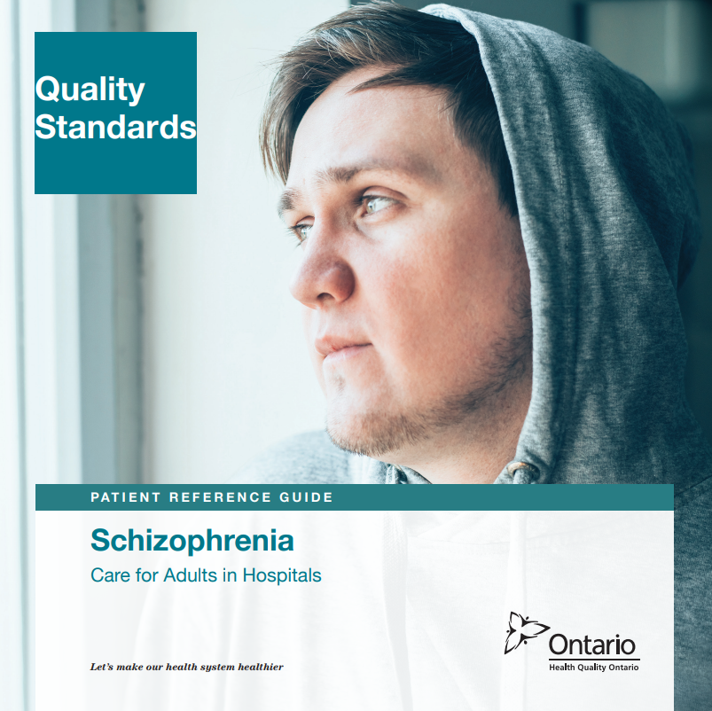

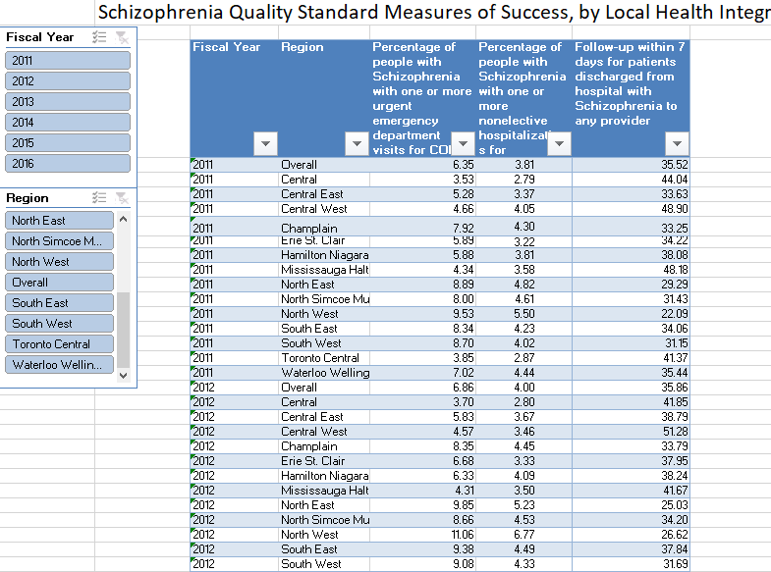
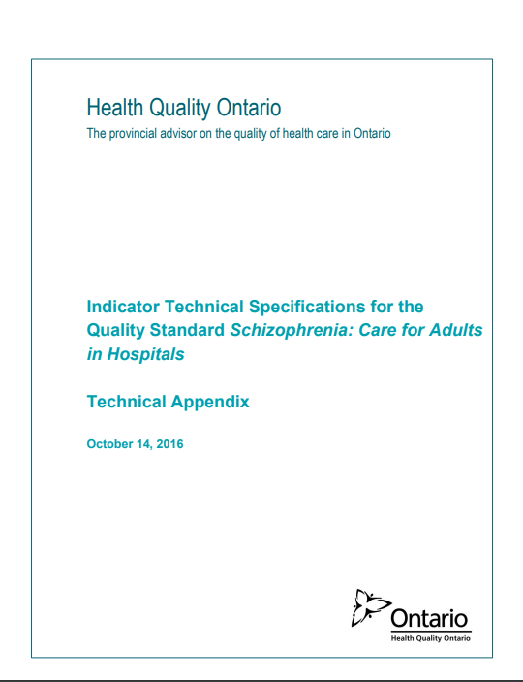

Quality Standard Resources
Quality Standard
Patient Reference Guide
Getting Started Guide
Recommendations for Adoption
Data Tables
Measurement Guide
Find these resources here:
https://hqontario.ca/evidence-to-improve-care/quality-standards/view-all-quality-standards/schizophrenia-care-in-hospital
Notes:
Each quality standard focuses on a specific health care issue. The development of each quality standard is accompanied by an assortment of resources.
Through concise, easy-to-understand statements, quality standards outline what quality care looks like for a condition or topic based on the evidence.
Each quality standard is accompanied by:
A patient conversation guide
A getting started guide
Recommendations for adoption
Data tables
A measurement guide
Quality standards provide the blueprint to enable the health care system in Ontario to work better, facilitate smooth transitions, and ensure patients receive the same high-quality care, regardless of where they reside.

Slide 6
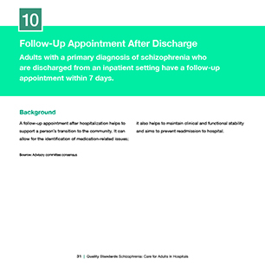
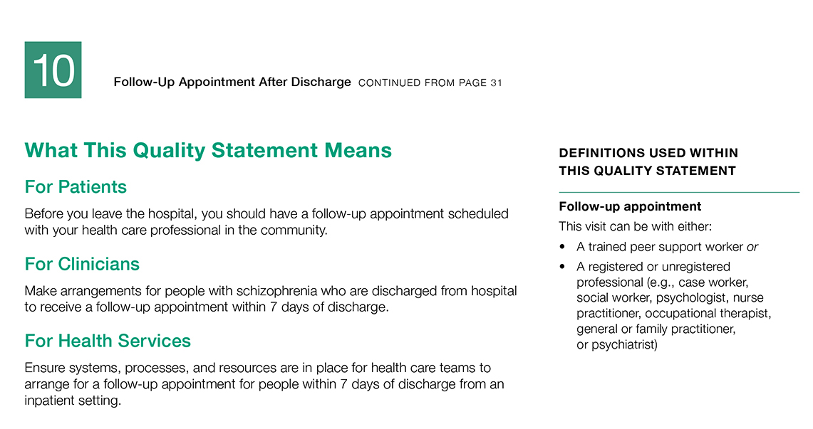
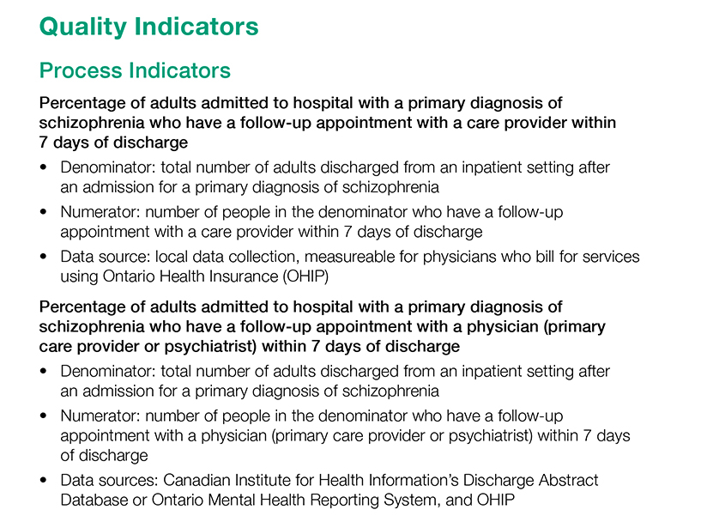
Inside the Quality Standard
The Statement
The Audience
Definitions
The Indicators

Slide 7

Quality Standards:
Patient Reference Guide
The patient reference guide is designed to give patients information about what quality care looks like for various conditions based on the best evidence, so they know what to ask for when receiving treatment.
Notes:
Every quality standard includes a plain language summary for patients, families, caregivers, and the public called the patient conversation guide.
Patient engagement in quality standards:
Membership on advisory committees
Focus groups and key informant interviews on topic specific content (when necessary)
Public comment period for each quality standard
Consultations on the patient conversation guide

Slide 8
Quality Standards:
Recommendations for Adoption
Recommendations for policy makers, administrators, health care organizations, and professionals have been made that aim to bridge the gaps between current care and care outlined in the quality statements to enable adoption of the quality standard across Ontario.
Notes:
As many aspects of the quality standard represent care that can and should be made available today, it is recognized that there are larger systemic barriers that may impede care delivery as per the standard. This document summarizes the system-wide and regional requirements that are needed to help health care professionals and organizations meet these standards and the time horizon expected to resolve these barriers.

Slide 9
Quality Standards:
Implementation Tools
The Getting Started Guide:
Outlines the process for using the quality standard as a resource to deliver high-quality care
Contains evidence-based approaches, as well as useful tools and templates for implementing change ideas at the practice level
Notes:
There are things we can do today despite the larger systemic barriers that may take time to resolve. The getting started guide is a document that outlines a process for using the quality standards as a resource to deliver high-quality care. It compiles a number of resources to support adoption such as links to implementation and quality improvement resources, examples and activities for reflection as well as templates and documents to support the implementation planning activities. The getting started guide also includes an Action Plan Template and examples on how Quality Improvement Plans can help to advance quality standards.

Slide 10
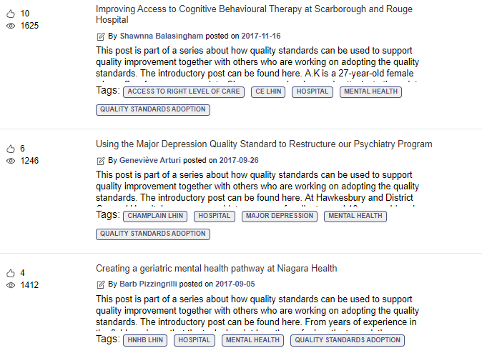
Quality Standards:
Quorum
Quorum is an online community dedicated to improving the quality of health care in Ontario.
The Quality Standards Adoption Series highlights efforts in the field to implement changes and close gaps in care related to quality standard topics.
Visit the Quality Standards Adoption Series on Quorum to learn how organizations are implementing quality standards.

Slide 11
Quality Standards:
Technical Appendix
The technical appendix has two dedicated sections:
Local measurement: what you can do to assess the quality of care that you provide locally
Provincial measurement: how we can measure the success of the quality standard on a provincial level

Slide 12
Quality Standards:
Data Tables
Data tables can be used to examine variations in indicator results across the province. They include data on key indicators:
Over time for Ontario
Across regions in Ontario
For specific measures of equity (age, sex, rurality, and household income)

Slide 13
Why a Quality Standard for Inpatient Schizophrenia Care in Ontario?

Slide 14

In Canada, about 1% of people have schizophrenia
Source: Health Canada. A report on mental illnesses in Canada: chapter 3, schizophrenia [Internet]. Ottawa (ON): Health Canada; 2002
[modified 2012 Mar 26; cited 2017 Dec].

Slide 15
People with schizophrenia face a number of physical health risks related to their condition and die about 15 to 20 years earlier than the general population.
Source: Wahlbeck K, Westman J, Nordentoft M, Gissler M, Laursen TM. Outcomes of Nordic mental health systems: life expectancy of patients with mental disorders. Br J Psychiatry. 2011;199(6):453-8.

Slide 16

People with schizophrenia are often disproportionately affected by homelessness, or are precariously housed
Source: Mental Health Policy Research Group. Mental illness and pathways into homelessness: proceedings and recommendations. Toronto (ON): The Group; 1998.

Slide 17
The percentage of people who were readmitted to hospital for a mental health or addictions condition within 30 days of a previous hospital discharge for schizophrenia ranged from 13.1% to 18.7% across regions in the province
Percentage of people who were readmitted to hospital for a mental health or addictions condition within 30 days of a previous hospital discharge for schizophrenia, in Ontario, by LHIN region, 2017/18
Data sources: Discharge Abstract Database, Ontario Mental Health Reporting System, Registered Persons Database, provided by the Institute for Clinical Evaluative Sciences.
Note: Age-sex standardized rates

Slide 18
The percentage of people who were readmitted to hospital for a mental health or addictions condition within 30 days of a previous hospital discharge for schizophrenia was lowest for people with the highest income
Percentage of people who were readmitted to hospital for a mental health or addictions condition within 30 days of a previous hospital discharge for schizophrenia, in Ontario, by income quintile, 2017/18
Data sources: Discharge Abstract Database, Ontario Mental Health Reporting System, Registered Persons Database, provided by the Institute for Clinical Evaluative Sciences.
Note: Age-sex standardized rates

Slide 19
Only 3 out of 10 people hospitalized for schizophrenia in Ontario have a follow-up visit with a family doctor or psychiatrist within 7 days of discharge
Data sources: Discharge Abstract Database, Ontario Mental Health Reporting System, Registered Persons Database, provided by the Institute for Clinical Evaluative Sciences.

Slide 20
The percentage of people who had contact with a family doctor or a psychiatrist within 7 days of a previous hospital discharge for schizophrenia varied across regions from 17.8% to 45.0%
Percentage of people who had contact with a family doctor or a psychiatrist within 7 days of a previous hospital discharge for schizophrenia, in Ontario, by LHIN region, 2017/18
Data sources: Discharge Abstract Database, Ontario Mental Health Reporting System, Registered Persons Database, provided by the Institute for Clinical Evaluative Sciences
Note: Age-sex standardized rates

Slide 21
Quality Standard in Brief

Slide 22
Scope of the Schizophrenia Hospital Quality Standard
This quality standard focuses on care for adults 18 years of age and older with a primary diagnosis of schizophrenia (including related disorders such as schizoaffective disorder) who are seen in an emergency department or admitted to an inpatient setting.
It also provides guidance for the care of people who are transitioning from the inpatient setting to the community.
While focused on hospital care, some interventions described are likely to take place outside of the hospital, following their initiation or a referral in hospital.

Slide 23


For a quality standard that addresses care provided in the community for adults with schizophrenia, please refer to the quality standard Schizophrenia: Care in the Community for Adults.
Notes:
Schizophrenia Care in the Community Quality Standard

Slide 24
Schizophrenia Hospital Quality Standard: Quality Statements
Comprehensive Interprofessional Assessment*
Screening for Substance Use*
Physical Health Assessment*
Promoting Physical Activity and Healthy Eating*
Promoting Smoking Cessation*
Treatment With Clozapine*
Treatment With Long-Acting Injectable Antipsychotic Medication*
Cognitive Behavioural Therapy*
Family Intervention*
Follow-Up Appointment After Discharge
Transitions in Care
*The community schizophrenia quality standard includes a similar quality statement.

Slide 25
“Implementing the schizophrenia quality standard represents an opportunity to advance quality in a way that we have never had before and that no other province in Canada has had. Implementing the quality standard will represent a paradigm change. It will bring a better service user experience and a different lens that will be more aligned with recovery and better clinical outcomes for the patient. For example, we have historically assumed that people with schizophrenia just need medication and time. The new notion that a patient with schizophrenia gets a psychological treatment or at very least should be offered a psychological treatment is a really significant change. If patients and family members have these statements in front of them they will be more informed about the best evidence-based treatments and they will ask the right questions to make sure they get the best evidence-based treatments.”
– Dr. Phil Klassen, Schizophrenia Quality Standard Advisory Committee member

Slide 26
Quality Statement 1: Comprehensive Interprofessional Assessment
Adults who are admitted to an inpatient setting with a primary diagnosis of schizophrenia undergo a comprehensive interprofessional assessment that informs their care plan.

Slide 27
Quality Statement 2: Screening for Substance Use
Adults who present to an emergency department or in an inpatient setting with a primary diagnosis of schizophrenia are assessed for substance use and, if appropriate, offered treatment for concurrent disorders.

Slide 28
Quality Statement 3: Physical Health Assessment
Adults who are admitted to an inpatient setting with a primary diagnosis of schizophrenia undergo a physical health assessment focusing on conditions common in people with schizophrenia. This assessment informs their care plan.

Slide 29
Quality Statement 4: Promoting Physical Activity and Healthy Eating
Adults who are admitted to an inpatient setting with a primary diagnosis of schizophrenia are offered interventions that promote both physical activity and healthy eating.

Slide 30
Quality Statement 5: Promoting Smoking Cessation
Adults who are admitted to an inpatient setting with a primary diagnosis of schizophrenia are offered behavioural and pharmacological interventions to alleviate nicotine-withdrawal symptoms and to help them reduce or stop smoking tobacco.

Slide 31
Quality Statement 6: Treatment With Clozapine
Adults who are admitted to an inpatient setting with a primary diagnosis of schizophrenia who have failed to respond to previous adequate trials of treatment with two antipsychotic medications are offered clozapine.

Slide 32
Quality Statement 7: Treatment With
Long-Acting Injectable Antipsychotic Medication
Adults who are admitted to an inpatient setting with a primary diagnosis of schizophrenia are offered the option of a long-acting injectable antipsychotic medication.

Slide 33
Quality Statement 8: Cognitive Behavioural Therapy
Adults who are admitted to an inpatient setting with a primary diagnosis of schizophrenia are offered individual cognitive behavioural therapy for psychosis either in the inpatient setting or as part of a post-discharge care plan.

Slide 34
Quality Statement 9: Family Intervention
Adults who are admitted to an inpatient setting with a primary diagnosis of schizophrenia are offered family intervention.
Notes:
Family Intervention

Slide 35
Quality Statement 10: Follow-Up Appointment After Discharge
Adults with a primary diagnosis of schizophrenia who are discharged from an inpatient setting have a follow-up appointment within 7 days.

Slide 36
Quality Statement 11: Transitions in Care
Adults with a primary diagnosis of schizophrenia who are discharged from an inpatient setting have a team or provider who is accountable for communication and the coordination and delivery of a care plan that is tailored to their needs.

Slide 37
Emerging Practice Statement*: Nonpharmacological Interventions
Apart from cognitive behavioural therapy and family intervention, we cannot provide guidance at this time on the use of other nonpharmacological treatments in acute care for adults who are admitted with a primary diagnosis of schizophrenia because of conflicting recommendations in the guidelines used to develop the quality statements.
*An emerging practice statement describes an area for quality improvement that has been prioritized by the advisory committee but for which there is insufficient or inconsistent evidence in the guidelines used in the development of the quality statements. An emerging practice statement acknowledges that there is a need for evidence-based guidance to be developed in an area, but the evidence base in this area is still emerging.

Slide 38
"[Before joining this committee,] “I don’t think I ever had an opportunity to have a really constructive discussion about the mental health system. Those questions [addressed by the quality standard] were never able to be formulated because you just come into the system, you talk to a psychiatrist and you get re-directed, you get re-directed … and you follow a path that is set out by other people. A lot of experiences of clients and a lot of feelings and thoughts and viewpoints of clients are really not taken into consideration. If we can get the proper support and real, accurate, professional information and knowledge, we will not be so dependent on our mental health system. We can go on and live our lives. That would be good for so many aspects including self-respect and self-esteem. We will not be overly reliant on a mental health professional. [What underlies the standards is] self-determination, a person being able to find their own path, not feeling uncomfortable to speak, being able to feel comfortable to ask questions, to ask for what they need … that is where I hope the conversations will start with this quality standard."
– Lived Experience Advisor, Schizophrenia Quality Standard Advisory Committee

Slide 39
How Success Can Be Measured
Notes:
The Schizophrenia Hospital Quality Standard Advisory Committee identified a small number of overarching goals for this quality standard. These have been mapped to indicators that may be used to assess quality of care provincially and locally.

Slide 40
How Success Can Be Measured Provincially
We recommend the following list of indicators to monitor the overall success of the standard provincially:
Number of deaths by inpatient suicide among people with a primary diagnosis of schizophrenia
Percentage of people admitted to hospital with a primary diagnosis of schizophrenia who die by suicide within 30 days of discharge
Rates of readmission to any facility within 7 and 30 days of discharge, stratified by the reason for readmission:
  Any reason
  A reason related to mental health and addictions
  Schizophrenia
Rates of unscheduled emergency department visits after hospital inpatient discharge within 7 and 30 days, stratified by the reason for the visit:
  Any reason
  A reason related to mental health and addictions
  Schizophrenia
  Self-harm

Slide 41
How Success Can Be Measured Locally
We recommend the following list of indicators to monitor the overall success of the standard locally:
Percentage of people admitted to hospital with a primary diagnosis of schizophrenia who experience an improvement in behavioural symptoms between their admission and discharge, stratified by length of stay
Percentage of people admitted to hospital with a primary diagnosis of schizophrenia who experience an improvement in positive symptoms between admission and discharge, stratified by length of stay

Slide 42
Connect with us:
https://quorum.hqontario.ca

