Slide 1

Sickle Cell Disease
Quality Standard
Guiding evidence-based care for people in Ontario
Notes:
If you have any questions about the content of this presentation, please contact us at QualityStandards@ontariohealth.ca

Slide 2
Objectives
Overview of quality standards: What are they? How are they used?​
Why this quality standard is needed: Gaps and variations in quality of care for people with sickle cell disease in Ontario
Quality statements to improve care: The key statements in the sickle cell disease quality standard
How to measure overall success: Indicators that can help measure your quality improvement efforts

Slide 3
Quality standards
Inform clinicians and patients what quality care looks like
Focus on conditions or processes where there are large variations in how care is delivered, or where there are gaps between the care provided in Ontario and the care patients should receive
Are grounded in the best available evidence
Notes:
Quality standards are a small set of high impact statements that describe optimal care where identified quality gaps exist in Ontario.
Voluntary and aspirational in nature​.
Designed to “raise the ceiling” with the goal of having the best possible care available to all Ontarians, regardless of where they live in the province.
There are many guidelines, professional standards, and other recommendations that contribute to the evidence ecosystem. Quality standards complement these resources.
Quality standards outline the what of care that should be delivered but are agnostic on who should be delivering it (unlike other CPGs, BPGs).
Quality standards are:
Concise: 5 to 15 strong, evidence-based statements focused on high-priority areas for improvement.
Accessible: help clinicians and provider organizations offer the highest-quality care; and patients to know what to discuss with their care providers (compared with CPGs that are quite dense, these are very accessible, also written in plain language).
Measurable: each statement is accompanied by one or more quality indicators (structure, process, or outcome), with a set of outcome measures for the overall standard.
Implementable: quality improvement tools and resources support each standard, to fuel adoption.

Slide 4
Quality standards
Help health care professionals know what care to offer, based on evidence and expert consensus
Help health care organizations measure, assess, and improve the quality of care they provide
Help ensure consistent,
high-quality care across the province
Help patients, residents, families, and caregivers know what to ask for in their care
Notes:
Patients, caregivers and the public can use quality standards to understand what excellent care looks like, what they should expect from their health care providers, and how to discuss the quality of their care.
Provincial regions and disease agencies can use quality standards to measure health outcomes, hold health service providers accountable for delivering high-quality care, and inform regional improvement strategies.
Provider organizations can use quality standards to measure and audit their quality of care, identify gaps, guide organizational improvement strategies, and inform clinical program investments.
Health care professionals can use quality standards to evaluate their practice and identify areas for personal and organizational quality improvement, and can incorporate the evidence-based statements into professional education.
Government can use quality standards to identify provincial priority areas, inform new data collection and reporting initiatives, and design performance indicators and funding incentives.

Slide 5
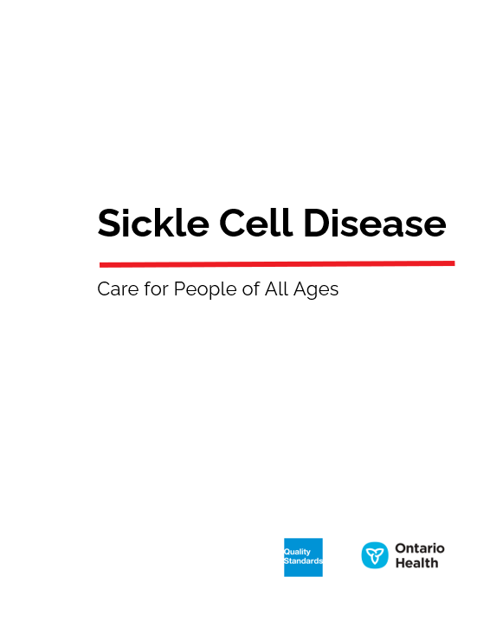
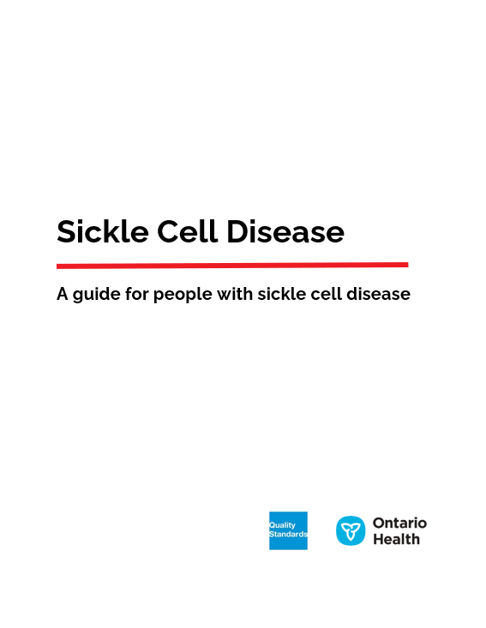
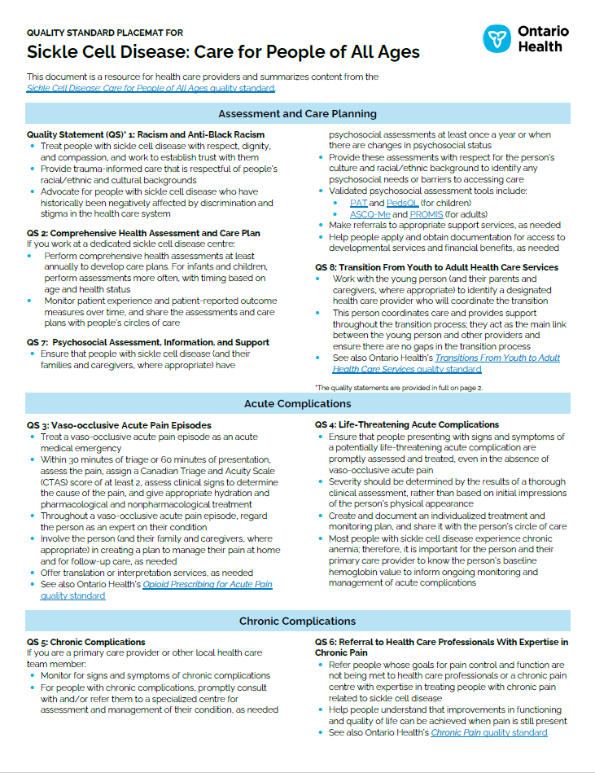
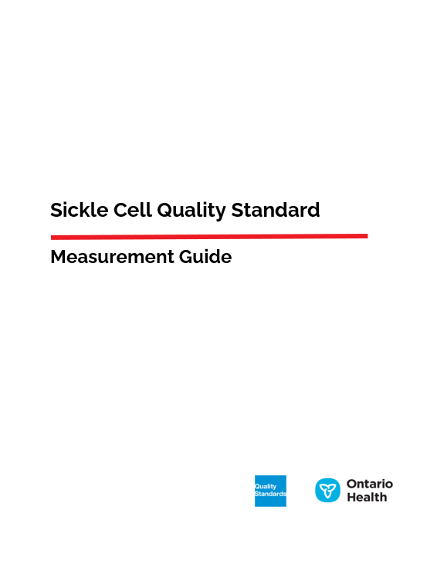
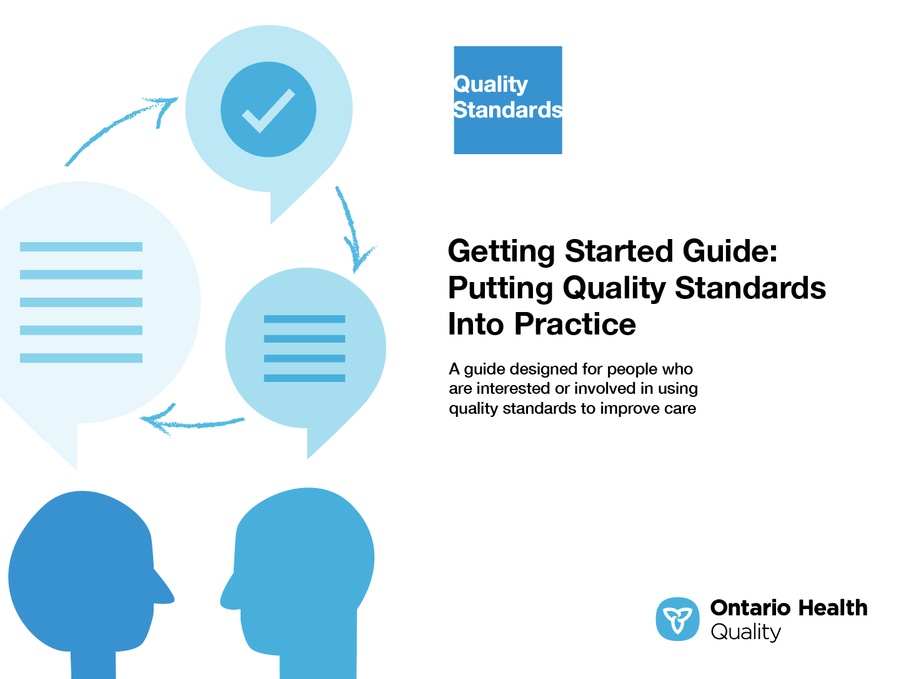
Quality standard resources
Quality Standard
Patient Guide
Placemat
Getting Started Guide
Measurement Guide
Find these resources here:
https://www.hqontario.ca/evidence-to-improve-care/quality-standards/view-all-quality-standards/sickle-cell-disease
Notes:
Each quality standard focuses on a specific health care issue. The development of each quality standard is accompanied by an assortment of resources.
Through concise, easy-to-understand statements, quality standards outline what quality care looks like for a condition or topic based on the evidence.
Each quality standard is accompanied by a:
Patient conversation guide
Getting started guide
Placemat
Measurement guide
Quality standards provide the blueprint to enable the health care system in Ontario to work better, facilitate smooth transitions, and ensure patients receive the same high-quality care, regardless of where they reside.

Slide 6
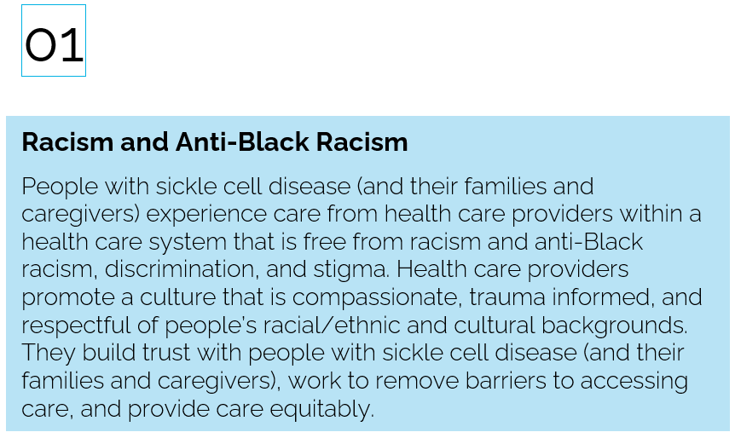
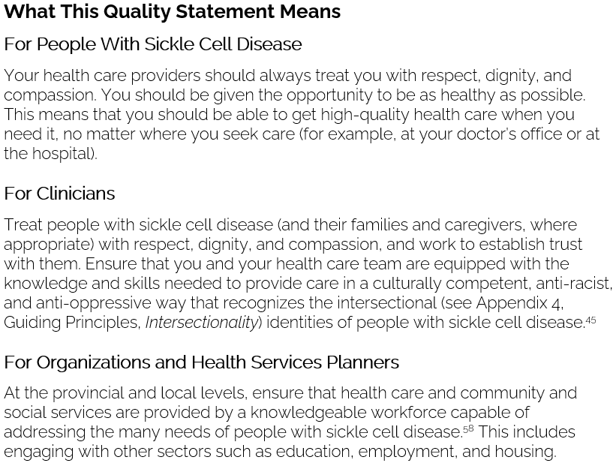
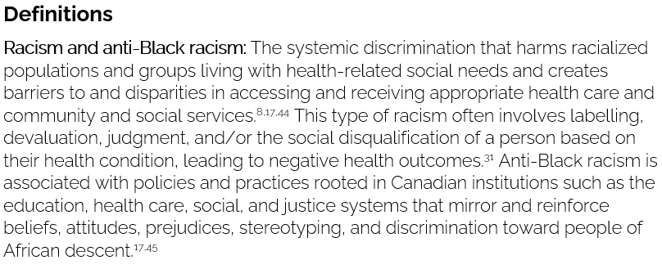
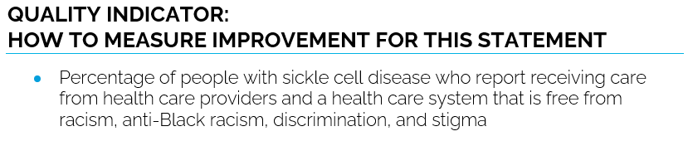
Inside the quality standard
The Quality Statement
The Audience Statements
The Definitions
The Indicators

Slide 7
Quality standards
Patient guide
The patient guide is designed to give patients information about what quality care looks like for various conditions based on the best evidence, so they can ask informed questions of their health care providers.
Notes:
Every quality standard includes a plain language summary for patients, families, caregivers and the public called the patient conversation guide.
Patient engagement in quality standards:
Membership on advisory committees
Focus groups and key informant interviews on topic-specific content (when necessary)
Public comment period for each quality standard
Consultations on the patient guide

Slide 8
Quality standards
How the health care system can support implementation
Implementing quality standards can be challenging owing to system-level barriers or gaps, many of which have been identified throughout the development of this standard
Ontario Health will work with and support other provincial partners, including the Ministry of Health, to bridge system-level gaps to support the implementation of quality standards

Slide 9
Quality standards
Implementation tools
The Getting Started Guide:
Outlines the process for using the quality standard as a resource to deliver high-quality care
Contains evidence-based approaches, as well as useful tools and templates for implementing change ideas at the practice level
Notes:
There are things we can do today despite the larger systemic barriers that may take time to resolve. The Getting Started Guide is a document that outlines a process for using the quality standards as a resource to deliver high-quality care. It compiles a number of resources to support adoption, such as links to implementation and quality improvement resources, examples and activities for reflection, and templates and documents to support the implementation planning activities. The Getting Started Guide also includes an Action Plan Template and examples on how Quality Improvement Plans can help to advance quality standards.

Slide 10


Quality standard adoption tools
Quorum
Quorum is an online community dedicated to improving the quality of health care in Ontario.
The Quality Standards Adoption Series highlights efforts in the field to implement changes and close gaps in care related to quality standard topics.
quorum.hqontario.ca
Notes:
The Quality Standards program has highlighted several stories from organizations and groups using various standards and statements within their clinical care settings, organization, or institutions; these are available through posts and discussions on Quorum.
As well, we are working on compiling resources and tools, for both clinicians and patients and families.
The focus is on implementation/adoption stories and how organizations are using quality standards in practice to inform care.
We’d love to hear from you if you are interested in contributing to a post or article.

Slide 11
Quality standards
Measurement guide
The measurement guide has two dedicated sections:
Local measurement: what you can do to assess the quality of care that you provide locally
Provincial measurement: how we can monitor the progress being made to improve care on a provincial level

Slide 12
Quality standards
Placemat
The placemat is a quick-reference resource for clinicians that summarizes the quality standard and includes links to helpful resources and tools.

Slide 13
Why do we need a
quality standard for
sickle cell disease?

Slide 14
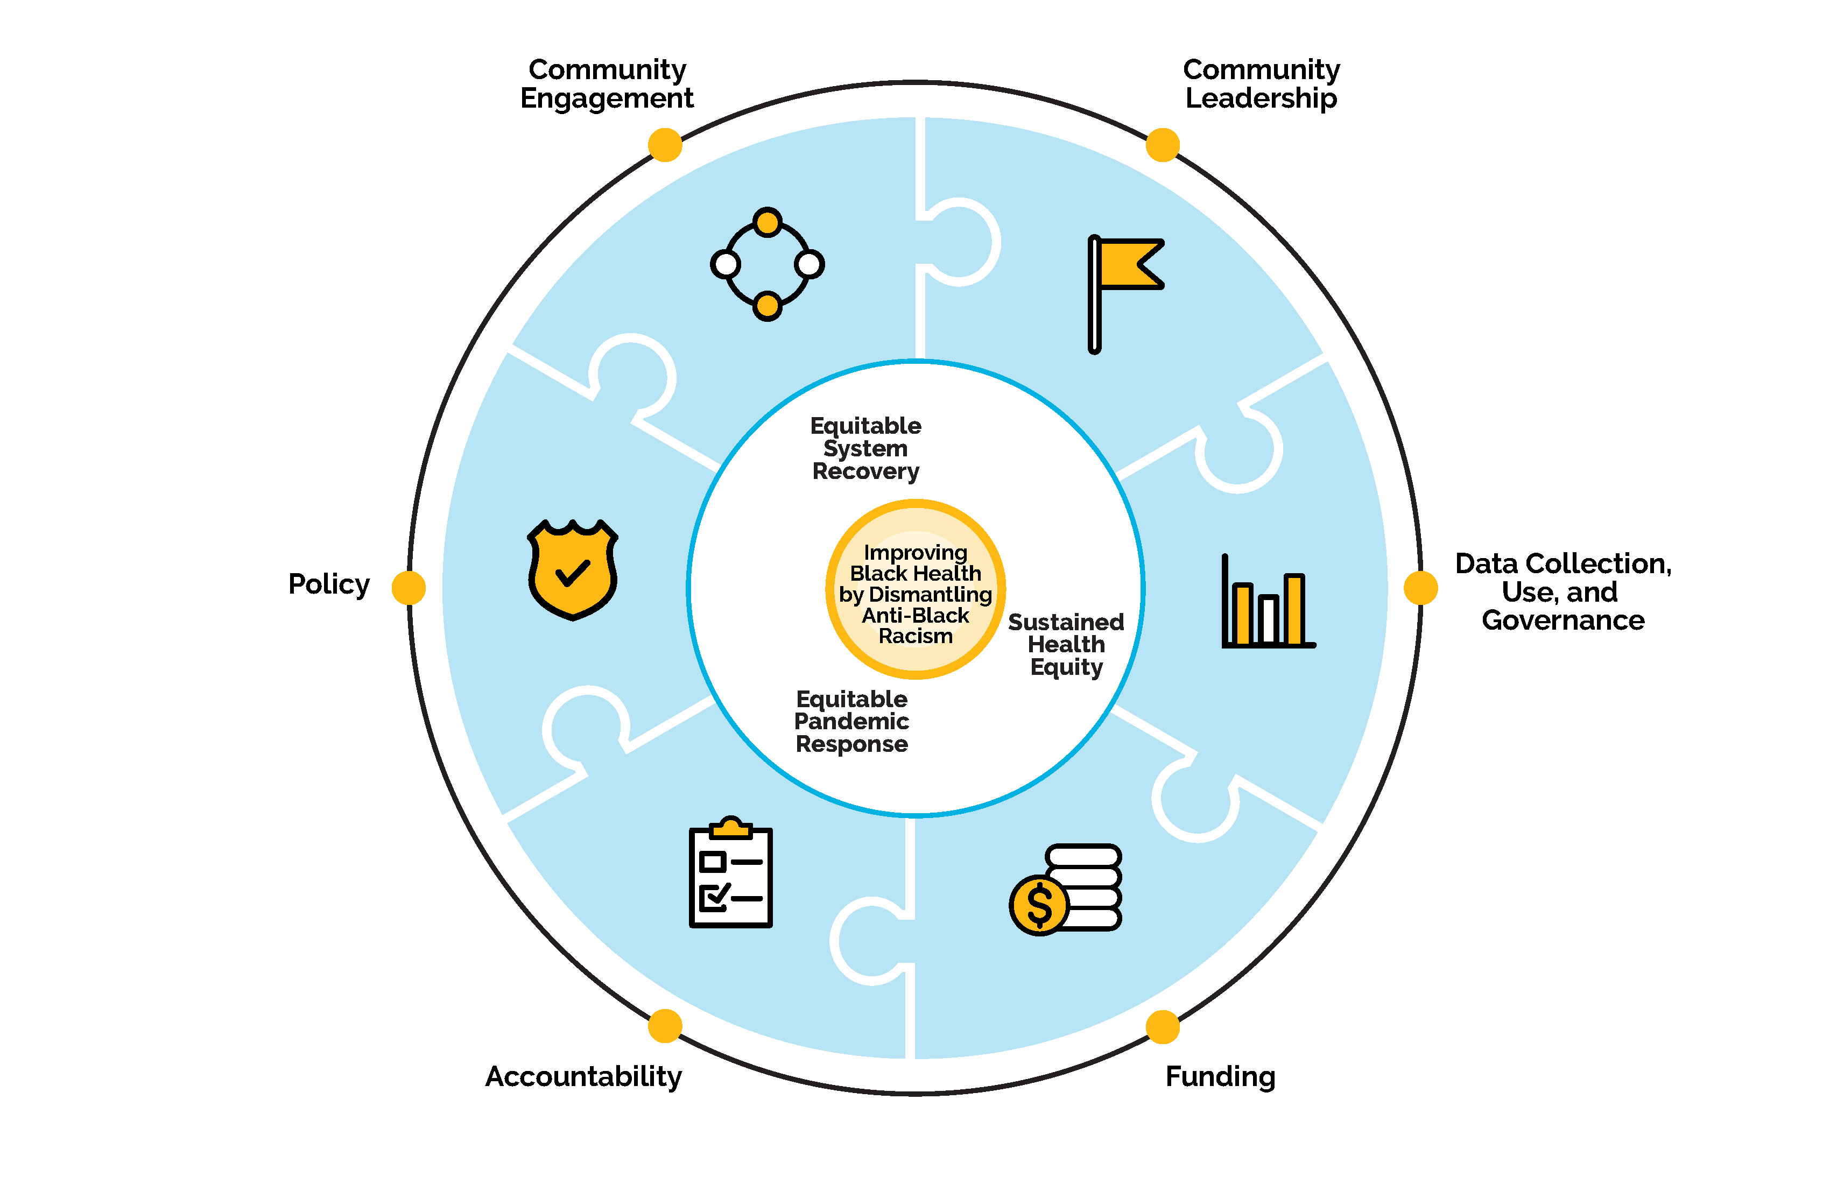
Ontario Health’s Black Health Plan
Alignment to Black Health Plan, advancing the goals of the Equity, Inclusion, Diversity and Anti-Racism Framework

Slide 15


About 3,500 people in Ontario and 6,500 people across Canada have sickle cell disease.^{1,2}
These numbers are expected to increase with immigration from countries with high disease prevalence, and with new births in Canada from parents who carry the sickle cell trait.^{1,2}
Sources:
Sickle Cell Awareness Group of Ontario. Addressing the health equity gap in sickle cell disease in Ontario [Internet]. North York (ON): The Group; no date [cited 2022 Feb]. Available from: https://sicklecellanemia.ca/health-equity-gap-in-sickle-cell-disease-in-ontario-canada?utm_source=rss&utm_medium=rss&utm_campaign=health-equity-gap-in-sickle-cell-disease-in-ontario-canada
Kim E, Graves E, Tunji Ajayi L, Pendergrast J. How many sickle cell disease patients are there in Ontario? Results of a query of health services administrative databases [Internet]. North York (ON): Sickle Cell Awareness Group of Ontario; no date [cited 2022 Feb]. Available from: https://sicklecellanemia.ca/how-many-sickle-cell-disease-patients-are-there-in-ontario

Slide 16

In Ontario and across Canada, sickle cell disease mostly affects racialized people, particularly those who identify as Black.¹ These people often experience racism and anti-Black racism in their interactions with the health care system, which negatively impact the quality of health care provided to them.^{1,2}
Sources:
Sickle Cell Awareness Group of Ontario. Addressing the health equity gap in sickle cell disease in Ontario [Internet]. North York (ON): The Group; no date [cited 2022 Feb]. Available from: https://sicklecellanemia.ca/health-equity-gap-in-sickle-cell-disease-in-ontario-canada?utm_source=rss&utm_medium=rss&utm_campaign=health-equity-gap-in-sickle-cell-disease-in-ontario-canada
Centre for Addiction and Mental Health. Dismantling anti-Black racism: a strategy of fair & just CAMH [Internet]. Toronto (ON): The Centre; 2022 [cited 2022 Jul]. Available from: https://www.camh.ca/-/media/files/camh-dismantling-anti-black-racism-pdf.pdf

Slide 17

Living under stressful social and economic conditions can impact the overall health and well-being of people with sickle cell disease.^{1,2} Such stresses include social stigma, discrimination, and inadequate access to education, employment, income, and housing.^{3,4,5}
A review of Ontario data (from 2007 to 2017) showed that about 40% of patients with sickle cell disease lived in neighbourhoods with the lowest income.³
Sources:
Lee L, Smith-Whitley K, Banks S, Puckrein G. Reducing health care disparities in sickle cell disease: a review. Public Health Rep. 2019;134(6):599-607.
Smith LA, Oyeku SO, Homer C, Zuckerman B. Sickle cell disease: a question of equity and quality. Pediatrics. 2006;117(5):1763-70.
Kim E, Graves E, Tunji Ajayi L, Pendergrast J. How many sickle cell disease patients are there in Ontario? Results of a query of health services administrative databases [Internet]. Sickle Cell Awareness Group of Ontario; no date [cited 2022 Feb]. Available from: https://sicklecellanemia.ca/how-many-sickle-cell-disease-patients-are-there-in-ontario
Bulgin D, Tanabe P, Jenerette C. Stigma of sickle cell disease: a systematic review. Issues Ment Health Nurs. 2018;39(8):675-86.
Power-Hays A, Li S, Mensah A, Sobota A. Universal screening for social determinants of health in pediatric sickle cell disease: a quality-improvement initiative. Pediatr Blood Cancer. 2020;67(1):e28006.

Slide 18


  People living in rural, remote, and Northern communities may face additional challenges to accessing comprehensive care compared with their urban peers.¹
  These geographic barriers, which include the need to travel to large urban centres and hospitals and the time and financial resources required to do so, can further worsen continuity of care.¹
Source:
Lee L, Smith-Whitley K, Banks S, Puckrein G. Reducing health care disparities in sickle cell disease: a review. Public Health Rep. 2019;134(6):599-607.

Slide 19
More than half of caregivers surveyed reported that patient symptoms impacted various aspects of their lives, such as their ability to attend work or school, earning potential, mental health, and overall
well-being.¹
Source:
Odame I, Anderson A, Costa F, Inusa B, Jastaniah W, Kunz J, et al. Sickle Cell Health Awareness, Perspectives and Experiences (SHAPE) survey: findings on the burden of sickle cell disease and unmet needs as reported by patients and caregivers. Paper presented at: 4th Global Congress on Sickle Cell Disease; 2022 Jun 16-18; Paris.

Slide 20

Emergency department care
When compared with the general population seeking emergency department care, people with sickle cell disease are more likely to¹:
Be admitted to hospital
Have a longer hospital stay and
Experience higher rates of repeat emergency department visits within
30 days of being discharged from the emergency department
Source:
Chan D, Kouyoumdjian F, Athale U, Pendergrast J, Verhovsek M. Emergency department quality of care for sickle cell disease in Ontario, Canada: a population-based matched cohort study. Blood. 2020;136:38-9.

Slide 21
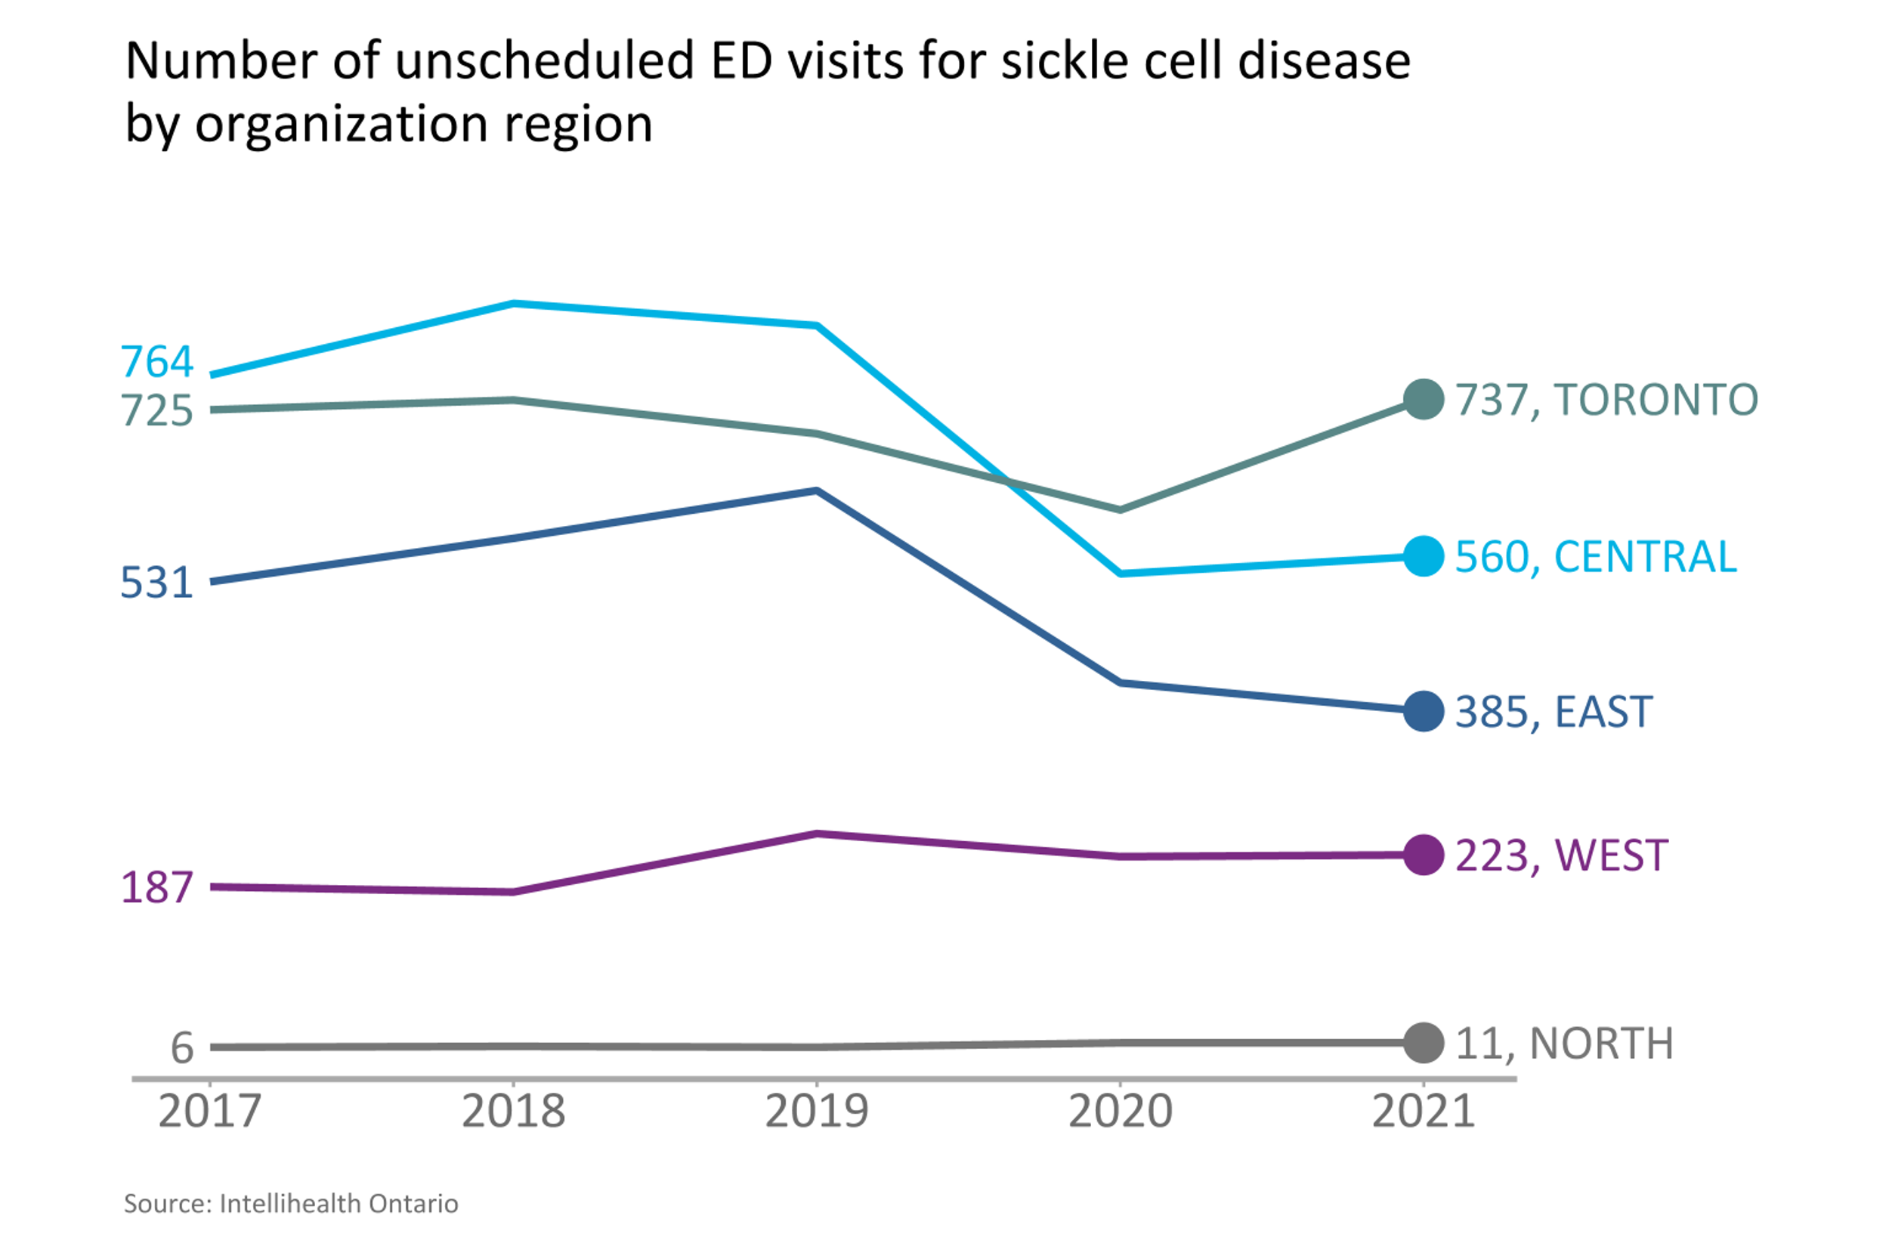
Most people with sickle cell disease visit emergency departments (EDs) in the Toronto and Central regions
Notes:
As see in the previous slide, most people with sickle cell disease live in the Central and East Ontario Health Regions, whereas only 10% live in the Toronto region. However, the majority seek care emergency department care at hospitals in the Central and Toronto Regions.

Slide 22
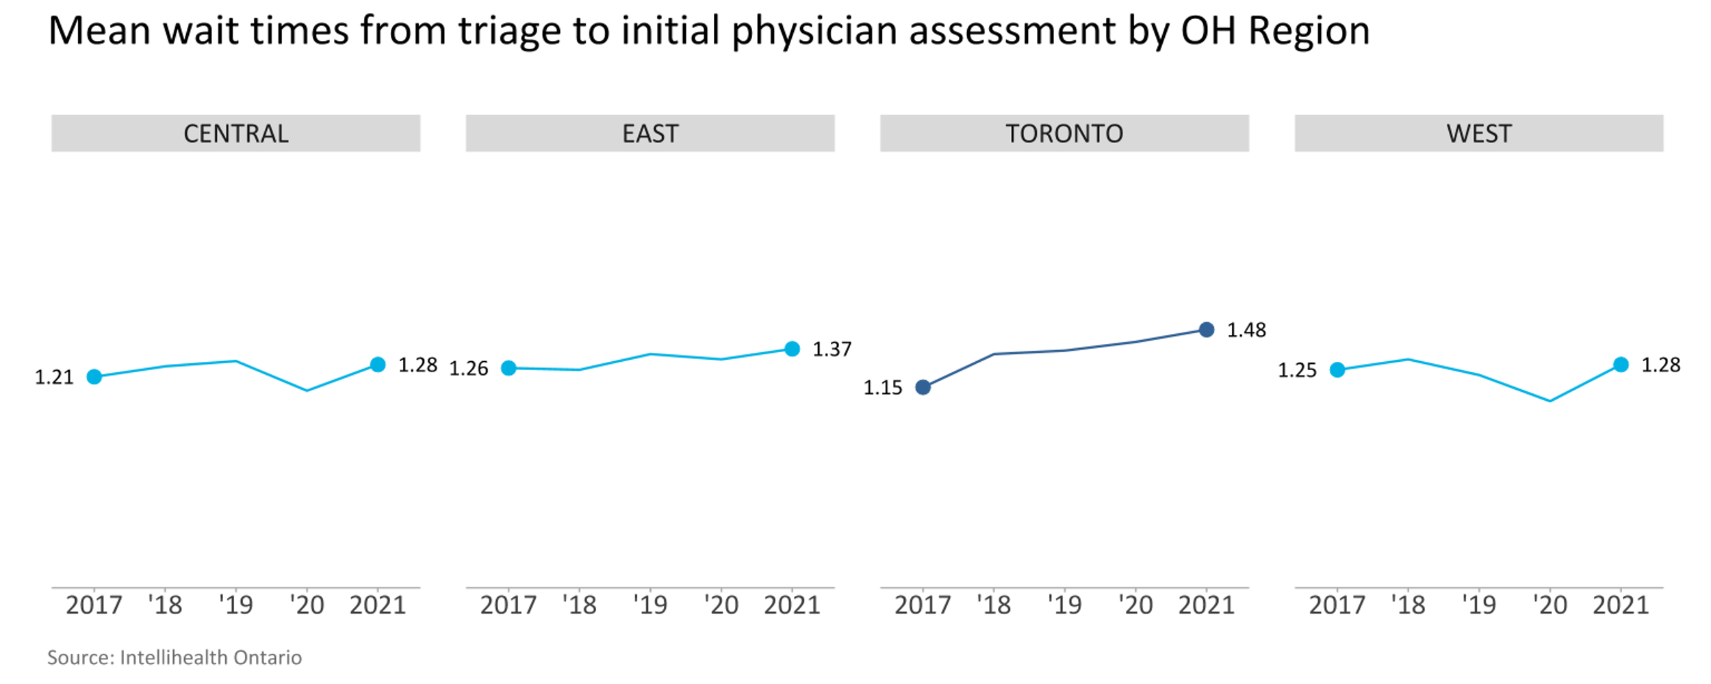
Mean wait times from triage to initial physician assessment have been climbing across Ontario and are highest in the Toronto Region
Notes:
This graph shows the various levels of acuity assigned to people with sickle cell disease when triaged at the emergency department from 2017 to 2021, obtained from the NACRS database. The Canadian Triage and Acuity Scale (CTAS) is a tool used both nationally and internationally to allow emergency departments and their staff to prioritize patient care requirements. From here, we can see that people under the age of 20 are more likely to be triaged at a higher acuity (CTAS 1 or 2) than those who are older than 20 (CTAS 3, 4, or even 5). The standard of care is for people with sickle cell disease who present to the emergency department to be triaged as CTAS 1 or 2 due to the vaso-occlusive acute pain episode or life-threatening acute complication they may be experiencing, regardless of their age.
US data: mean life expectancy for males = 42; mean life expectancy for females = 48

Slide 23
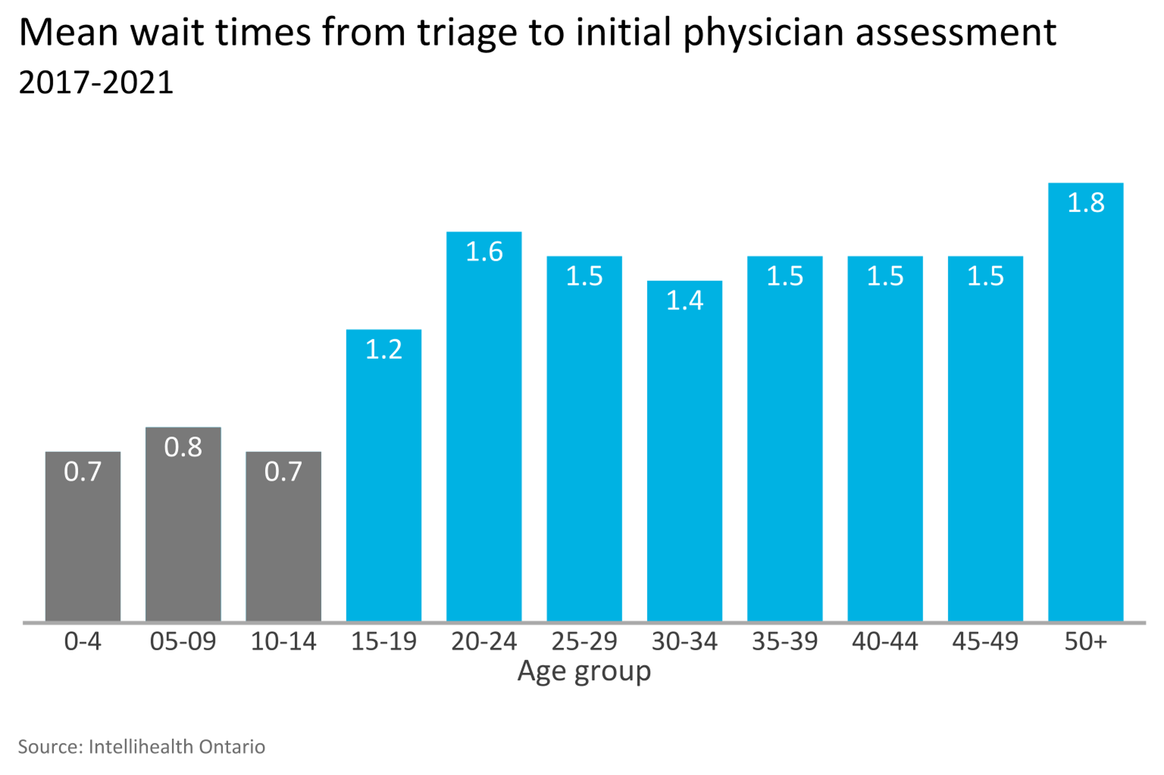
Mean wait times from triage to initial physician assessment are lowest among people under 15 years of age
Notes:
This indicator measures average time elapsed from registration or triage to initial assessment by a physician. Wait times to initial physician assessment were greater for patients 20 years or older. For example, patients older than 50 years waited up to 1 hour longer than those who were younger than 15 years of age.
From this, we can see that adult patients with sickle cell disease were seen by a physician and potentially received treatment (such as analgesia or hydration, as needed) much later than the clinically recommended targets of receiving treatment within 30 minutes of triage and 60 minutes of presentation.

Slide 24
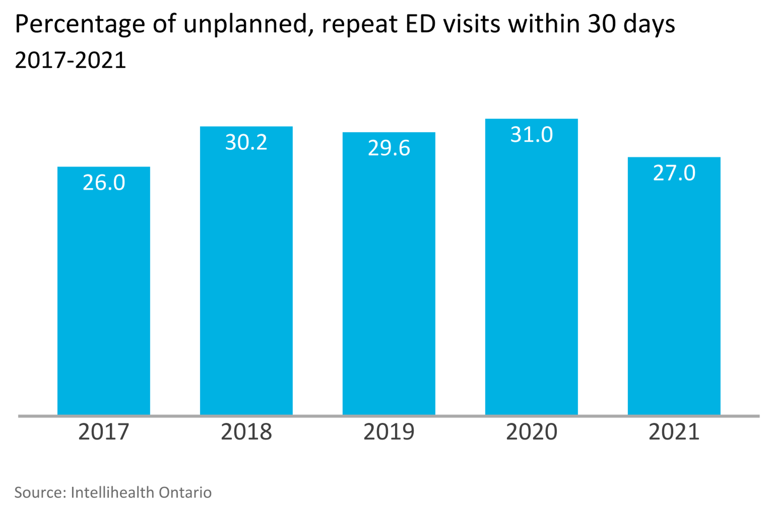
More than 1 out of 4 people with sickle cell disease who visit an emergency department have a repeat visit within 30 days

Slide 25
Opportunities for improvement in Ontario exist to ensure that high-quality, timely care is delivered in the emergency department and other hospital settings for people experiencing acute complications of sickle cell disease. A survey of people with sickle cell disease found the following¹:
  54% felt the quality of care received was below their expectations
  For those presenting to the emergency department with pain, many waited more than 1 hour to see a nurse (31%) or physician (56%) and for the administration of pain medication (50%)
  Only 60% reported that the first person they met at triage was respectful, empathetic, and caring
  About 22% reported feeling stigmatized or afraid of dying during their hospital visit, and 44% reported feeling lonely or helpless
  71% reported that their health care provider was not responsive or only somewhat responsive to their concerns
  Although 60% of respondents reported that their health care providers were very or extremely knowledgeable, 40% reported that their providers were not at all or only somewhat knowledgeable
Source:
Tunji-Ajayi L, Jemitola S, Darkwa M, Verhovsek M, Kirby-Allen M, Williams S, et al. Identifying hospitals in need of education to provide optimal care for patients living with SCD in Ontario [Internet]. North York (ON): Sickle Cell Awareness Group of Ontario; 2021 [cited 2022 Jul]. Available from: https://sicklecellanemia.ca/identifying-hospitals-in-need-of-education-to-provide-optimal-care-for-patients-living-with-scd-in-ontario

Slide 26
“A sickle cell disease quality standard would immediately improve the timing and quality of care for patients. For example, one day I showed up in the ED in a crisis, but instead of being fast-tracked to receive emergency care, I had to wait another hour before I was in a room and then had to wait longer to receive medication. I was then given a high dose of opioids while in a hallway unsupervised. In this case, my advocates had to ask the nurse for the hospital’s sickle cell disease protocol, which they had never heard about. Once they located it, I was immediately moved to observation and treated. I then was admitted because of the time it took to administer analgesia.”
“Having a quality standard for sickle cell disease will change patient care by acknowledging how anti-Black racism plays a part in delaying optimal care. Education, engagement, and implementing this quality standard will ensure positive outcomes for patients and their providers. Just knowing that there is now a quality standard for sickle cell disease is a sign of hope.”
– Serena Thompson, co-chair and lived experience advisor, Sickle Cell Disease Quality Standard Advisory Committee

Slide 27
“As a practising pediatric hematologist in a large sickle cell centre in Toronto that cares for children and adolescents with the disease across the GTA, I’ve often struggled with advising my patients and families to seek acute care at their local hospital. My struggle stems from the wide variability in the quality of care patients receive across Toronto. Families are forced to travel longer distances to seek care in my centre, posing extra burdens on patients and their families.”
“I am looking forward to a future where I can confidently assure patients and families, regardless of where they live, of the convenience and advantages of seeking acute care near where they live because the quality of care is no different than it is in my centre in downtown Toronto. The development of this quality standard for sickle cell disease management in Ontario is crucial in helping achieve this goal.”
– Dr. Isaac Odame, co-chair, Sickle Cell Disease Quality Standard Advisory Committee

Slide 28
Quality statements to improve care

Slide 29
Scope of this quality standard
This quality standard addresses care for children, young people, and adults with sickle cell disease. Where appropriate, it also addresses the needs of families and caregivers or other substitute decision-makers.
The scope of this quality standard includes screening for and the prevention of complications, the assessment and management of acute and chronic complications, and the use of disease-modifying therapies
It applies to all pediatric and adult health care settings (including hospitals, emergency departments, urgent care clinics, and primary care, specialist care, and home and community care settings)
Notes:
Although many of the statements may apply to pregnant people, this quality standard does not directly address the management of sickle cell disease in pregnancy.
The Clinical Handbook for Sickle Cell Disease Vaso-occlusive Crisis by the Provincial Council for Maternal and Child Health and the Ontario Ministry of Health addresses care for sickle cell crisis (referred to as a “vaso-occlusive acute pain episode” in this quality standard) and applies to quality statement 3.

Slide 30
Quality statement topics
Racism and anti-Black racism
Comprehensive health assessment and care plan
Vaso-occlusive acute pain episodes
Life-threatening acute complications
Chronic complications
Referral to health care professionals with expertise in chronic pain
Psychosocial assessment, information, and support
Transition from youth to adult health care services

Slide 31
Quality statement 1:
Racism and anti-Black racism
People with sickle cell disease (and their families and caregivers) experience care from health care providers within a health care system that is free from racism and anti-Black racism, discrimination, and stigma. Health care providers promote a culture that is compassionate, trauma informed, and respectful of people’s racial/ethnic and cultural backgrounds. They build trust with people with sickle cell disease (and their families and caregivers), work to remove barriers to accessing care, and provide care equitably.

Slide 32
Quality statement 2:
Comprehensive health assessment and care plan
People with sickle cell disease have a comprehensive health assessment at least annually from an interprofessional care team at a dedicated sickle cell disease centre to develop an individualized, person-centred care plan. The assessment and care plan are documented and shared with the person’s circle of care.

Slide 33
Quality statement 3:
Vaso-occlusive acute pain episodes
People with sickle cell disease who present to an emergency department or hospital with a vaso-occlusive acute pain episode receive a timely pain assessment and clinical assessment. Their treatment begins within 30 minutes of triage or 60 minutes of presentation. Before discharge, they are involved in the development of a plan for continuing to manage their acute pain episode at home. This plan includes symptom management strategies and information on how to access follow-up care and support from health care providers, as needed.

Slide 34
Quality statement 4:
Life-threatening acute complications
People who present to an emergency department or hospital with a potentially life-threatening acute complication of sickle cell disease have their condition and its severity identified through a prompt clinical assessment. Their condition is managed appropriately with an individualized treatment and monitoring plan.

Slide 35
Quality statement 5:
Chronic complications
People with sickle cell disease are monitored by their local health care team for signs and symptoms of chronic complications of sickle cell disease. People with chronic complications are promptly referred to a dedicated sickle cell disease or other specialized centre for consultation and/or assessment and management of their condition, as needed.

Slide 36
Quality statement 6:
Referral to health care professionals with expertise in chronic pain
People whose quality of life is significantly impacted by chronic pain caused by sickle cell disease are referred to individual health care professionals or a chronic pain centre with expertise in chronic pain related to sickle cell disease and the ability to offer pharmacological and nonpharmacological interventions.

Slide 37
Quality statement 7:
Psychosocial assessment, information, and support
People with sickle cell disease (and their families and caregivers, where appropriate) have regular psychosocial assessments to identify any psychosocial needs or barriers to accessing care. Those with unmet psychosocial needs are offered information and support to address these needs.

Slide 38
Quality statement 8:
Transitions from youth to adult health care services
Young people with sickle cell disease have a designated health care provider for the transition from youth to adult health care services. This provider works with the young person (and their parents and caregivers, where appropriate) to coordinate their care and provide support throughout the transition process. The provider continues to provide support until the young person (and their parents and caregivers, where appropriate) confirms that the transition is complete.

Slide 39
How to measure overall success
Notes:
The Sickle Cell Disease Quality Standard Advisory Committee identified a set of overarching goals for this quality standard. These have been mapped to indicators that may be used to assess quality of care provincially and locally.

Slide 40
Indicators that can be measured using provincial data
Percentage of people with an unscheduled emergency department visit for sickle cell disease
Percentage of repeat unscheduled emergency department visits for sickle cell disease within 30 days
Percentage of people with sickle cell disease who visited the emergency department for a mental health concern
Percentage of people who were hospitalized for sickle cell disease

Slide 41
Indicators that can be measured using only local data
Percentage of people with sickle cell disease who report an improvement in their quality of life
Percentage of people with sickle cell disease who report being satisfied with their interaction with their health care provider

Slide 42
Monitoring and reporting
Ontario Health will be reporting on provincially measurable indicators through its eReports platform
Decision support staff at hospitals with ONE ID accounts can log on to the eReports platform to view data for their hospital
These data can be used for monitoring and quality improvement purposes

Slide 43
Data source and acknowledgement
The data used in this presentation were sourced from IntelliHealth Ontario, a data repository maintained by the Ontario Ministry of Health

Slide 44

Thank you.
LET’S CONTINUE THE CONVERSATION
HQOntario.ca | OntarioHealth.ca
@OntarioHealthOH
Ontario Health
@OntarioHealthOH
Ontario Health

