Slide 1



Transitions From Youth to Adult Health Care Services Quality Standard
Guiding evidence-based care for young people aged 15 to 24 years in Ontario
Notes:
If you have any questions about the content of this presentation, please contact us at QualityStandards@ontariohealth.ca
https://www.hqontario.ca/evidence-to-improve-care/quality-standards

Slide 2
Objectives
Overview of quality standards
What are they? How are they used?​
Why this quality standard is needed
Gaps and variations in quality of care for young people who are transitioning from youth to adult health care services in Ontario
How to measure overall success
Indicators that can help measure your quality improvement efforts
Quality statements to improve care
The key statements in the transitions from youth to adult health care services quality standard

Slide 3
Quality Standards
Inform clinicians and patients what quality care
looks like
Focus on conditions or processes where there are large variations in how care is delivered, or where there are gaps between the care provided in Ontario and the care patients should receive
Are grounded in the best available evidence
Notes:
Quality standards are a small set of high impact statements that describe optimal care where identified quality gaps exist in Ontario.
Voluntary and aspirational in nature​.
Designed to “raise the ceiling” with the goal of having the best possible care available to all Ontarians, regardless of where they live in the province.
There are many guidelines, professional standards, and other recommendations that contribute to the evidence ecosystem. Quality standards complement these resources.
Quality standards outline the what of care that should be delivered but are agnostic on who should be delivering it (unlike other CPGs, BPGs).
Quality standards are:
Concise: 5 to 15 strong, evidence-based statements focused on high-priority areas for improvement.
Accessible: help clinicians and provider organizations offer the highest-quality care; and patients to know what to discuss with their care providers (compared with CPGs that are quite dense, these are very accessible, also written in plain language).
Measurable: each statement is accompanied by one or more quality indicators (structure, process, or outcome), with a set of outcome measures for the overall standard.
Implementable: quality improvement tools and resources support each standard, to fuel adoption.

Slide 4
Quality Standards
Help health care professionals know what care to offer, based on evidence and expert consensus
Help health care organizations measure, assess, and improve the quality of care they provide
Help ensure consistent,
high-quality care across the province
Help patients, residents, families, and caregivers know what to ask for in their care
Notes:
Patients, caregivers and the public can use quality standards to understand what excellent care looks like, what they should expect from their health care providers, and how to discuss the quality of their care.
Provincial regions and disease agencies can use quality standards to measure health outcomes, hold health service providers accountable for delivering high-quality care, and inform regional improvement strategies.
Provider organizations can use quality standards to measure and audit their quality of care, identify gaps, guide organizational improvement strategies, and inform clinical program investments.
Health care professionals can use quality standards to evaluate their practice and identify areas for personal and organizational quality improvement, and can incorporate the evidence-based statements into professional education.
Government can use quality standards to identify provincial priority areas, inform new data collection and reporting initiatives, and design performance indicators and funding incentives.

Slide 5
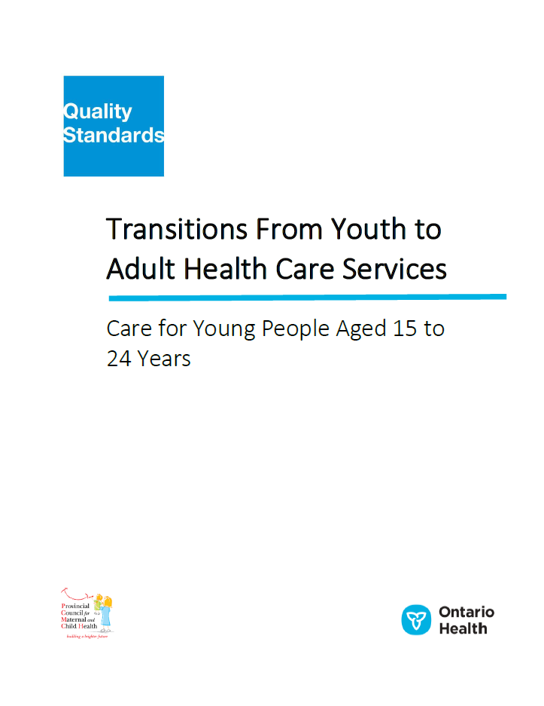
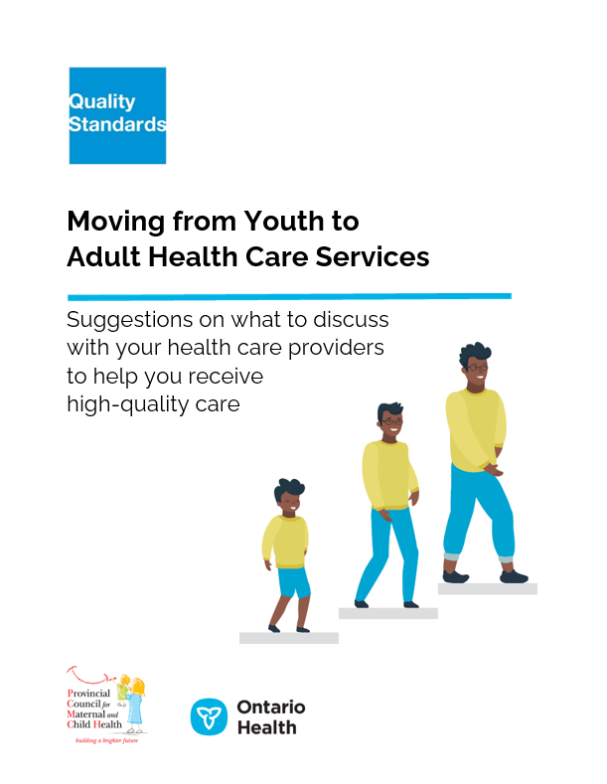
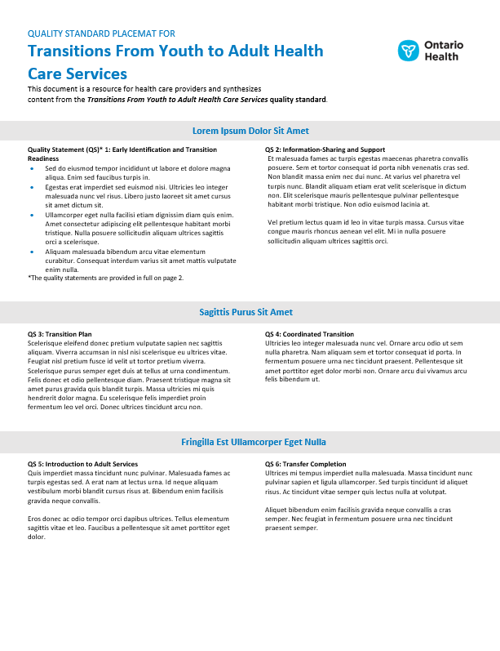
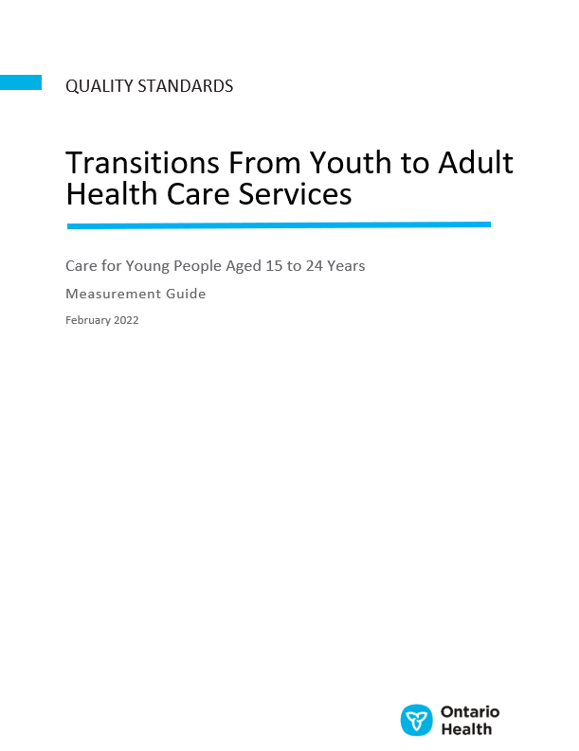
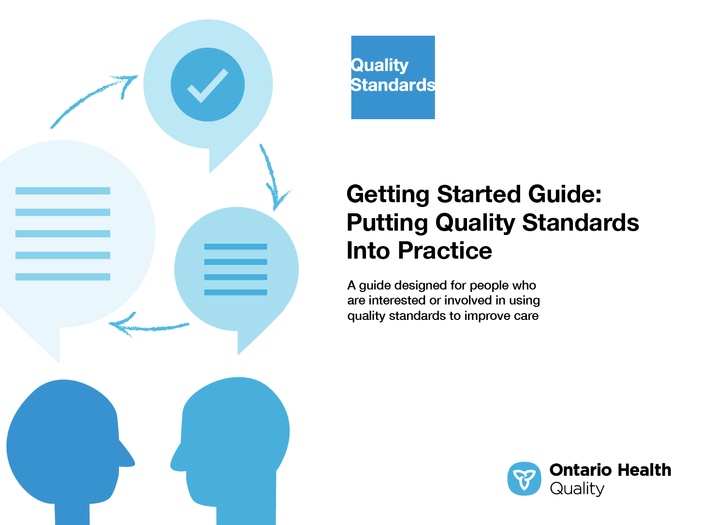
Quality Standard Resources
Quality Standard
Patient Guide
Placemat
Getting Started Guide
Measurement Guide
Find these resources here:
https://www.hqontario.ca/evidence-to-improve-care/quality-standards/view-all-quality-standards/transitions-from-youth-to-adult-health-care-services
Notes:
Each quality standard focuses on a specific health care issue. The development of each quality standard is accompanied by an assortment of resources.
Through concise, easy-to-understand statements, quality standards outline what quality care looks like for a condition or topic based on the evidence.
Each quality standard is accompanied by a:
Patient conversation guide
Getting started guide
Placemat
Measurement guide
Quality standards provide the blueprint to enable the health care system in Ontario to work better, facilitate smooth transitions, and ensure patients receive the same high-quality care, regardless of where they reside.

Slide 6
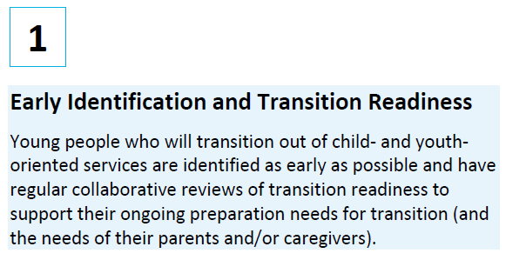
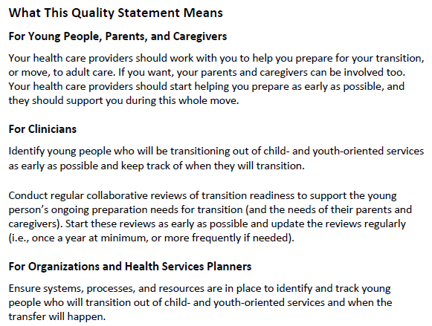

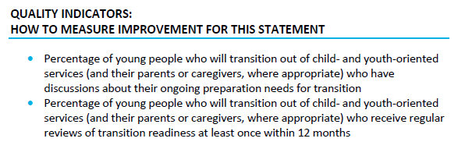
Inside the Quality Standard
The Quality Statement
The Audience Statements
The Definitions
The Indicators

Slide 7
Quality Standards:
Patient Guide
The patient guide is designed to give patients information about what quality care looks like for various conditions based on the best evidence, so they can ask informed questions of their health care providers.
Notes:
Every quality standard includes a plain language summary for patients, families, caregivers and the public called the patient conversation guide. For the Youth to Adult Health Care Services quality standard, we have two guides: one for patients and one for their caregivers
Patient engagement in quality standards:
Membership on advisory committees
Focus groups and key informant interviews on topic-specific content (when necessary)
Public comment period for each quality standard
Consultations on the patient conversation guide

Slide 8
Quality Standards:
How the Health Care System Can Support Implementation
Implementing quality standards can be challenging owing to system-level barriers or gaps, many of which have been identified throughout the development of this standard. Ontario Health will work with and support other provincial partners, including the Ministry of Health, to bridge system-level gaps to support the implementation of quality standards.

Slide 9
Quality Standards:
Implementation Tools
The Getting Started Guide:
Outlines the process for using the quality standard as a resource to deliver high-quality care
Contains evidence-based approaches, as well as useful tools and templates for implementing change ideas at the practice level
Notes:
There are things we can do today despite the larger systemic barriers that may take time to resolve. The Getting Started Guide is a document that outlines a process for using the quality standards as a resource to deliver high-quality care. It compiles a number of resources to support adoption, such as links to implementation and quality improvement resources, examples and activities for reflection, and templates and documents to support the implementation planning activities. The Getting Started Guide also includes an Action Plan Template and examples on how Quality Improvement Plans can help to advance quality standards.

Slide 10


Quality Standard Adoption Tools:
QUORUM
Quorum is an online community dedicated to improving the quality of health care in Ontario.
The Quality Standards Adoption Series highlights efforts in the field to implement changes and close gaps in care related to quality standard topics.
quorum.hqontario.ca
Notes:
The Quality Standards program has highlighted several stories from organizations and groups using various standards and statements within their clinical care settings, organization, or institutions; these are available through posts and discussions on Quorum.
As well, we are working on compiling resources and tools, for both clinicians and patients and families.
The focus is on implementation/adoption stories and how organizations are using quality standards in practice to inform care.
We’d love to hear from you if you are interested in contributing to a post or article.

Slide 11
Quality Standards:
Measurement Guide
The measurement guide has two dedicated sections:
Local measurement: what you can do to assess the quality of care that you provide locally
Provincial measurement: how we can measure the success of the quality standard on a provincial level

Slide 12
Quality Standards:
Placemat
The placemat is a quick-reference resource for clinicians that summarizes the quality standard and includes links to helpful resources and tools.

Slide 13
Why Do We Need a Quality Standard for Transitions From Youth to Adult Health Care Services?

Slide 14




15–18% of young people in North America have a chronic health condition.¹
Nearly all of these young people (98%) are expected to reach adulthood, needing a
transition to adult health care services.^{1,2}
Sources:
¹ Pinzon J, Harvey J, Canadian Paediatric Society, Adolescent Health Committee. Care of adolescents with chronic conditions. Paediatrics & Child Health. 2006;11(1):43-8.
² Bhawra J, Toulany A, Cohen E, Hepburn CM, Guttmann A. Primary care interventions to improve transition of youth with chronic health conditions from paediatric to adult healthcare: a systematic review. BMJ Open. 2016;6(5):e011871.

Slide 15

Care Transitions
The transfer from youth- to adult-oriented health care services is a vulnerable time for young people and their parents and caregivers.¹
During this period, young people are learning to manage their own health care. Many also change health care providers and adapt to new services, people, and processes, while also transitioning to adulthood—a time of physical, psychological, and social change.^{1,2}
Sources:
¹ Bhawra J, Toulany A, Cohen E, Hepburn CM, Guttmann A. Primary care interventions to improve transition of youth with chronic health conditions from paediatric to adult healthcare: a systematic review. BMJ Open. 2016;6(5):e011871.
² Campbell F, Biggs K, Aldiss SK, O'Neill PM, Clowes M, McDonagh J, et al. Transition of care for adolescents from paediatric services to adult health services. The Cochrane database of systematic reviews. 2016;4:Cd009794.

Slide 16


Care coordination and information-sharing and support are important aspects of the transition.¹
Without these components, young people may experience negative outcomes, such as loss to follow-up in adult care and low satisfaction.^{2,3} These can lead to emergency department visits or hospitalizations.⁴
Sources:
¹ National Institute for Health and Care Excellence. Transition from children’s to adults’ services for young people using health or social care services [Internet]. London (UK): The Institute; 2016 [cited 2021 July 28]. Available from: https://www.nice.org.uk/guidance/ng43
² Higginson A, Forgeron P, Dick B, Harrison D. Moving on: A survey of Canadian nurses’ self-reported transition practices for young people with chronic pain. Canadian Journal of Pain. 2018;2(1):169-181.
³ Hepburn CM, Cohen E, Bhawra J, Weiser N, Hayeems RZ, Guttmann A. Health system strategies supporting transition to adult care. Arch Dis Child. 2015;100(6):559-564.
⁴ Cohen E, Gandhi S, Toulany A, Moore C, Fu L, Orkin J, et al. Health care use during transfer to adult care among youth with chronic conditions. Pediatrics. 2016;137(3):e20152734.

Slide 17



Young people (and their parents and caregivers*) should work collaboratively with their health care providers to develop the transition plan¹ and should receive appropriate information and support throughout the transition process.¹
However, some studies based on young people with mental health care needs or substance use, and their caregivers, stated that young people reported receiving limited information, being left out of the transition discussions, and receiving care that was poorly planned and executed.^{2,3}
*Where appropriate.
Sources:
¹ National Institute for Health and Care Excellence. Transition from children’s to adults’ services for young people using health or social care services [Internet]. London (UK): The Institute; 2016 [cited 2022 Feb 10]. Available from: https://www.nice.org.uk/guidance/ng43
² Cleverley K, Stevens K, Davies J, McCann E, Ashley T, Brathwaite D, et al. Mixed-methods study protocol for an evaluation of the mental health transition navigator model in child and adolescent mental health services: the Navigator Evaluation Advancing Transitions (NEAT) study. BMJ Open. 2021;11(6):e051190.
³ Cleverley K, Lenters L, McCann E. “Objectively terrifying”: a qualitative study of youth’s experiences of transitions out of child and adolescent mental health services at age 18. BMC Psychiatry. 2020;20(1):147.

Slide 18


Young people with complex medical conditions, developmental disabilities, and/or intellectual disabilities are particularly vulnerable during transitions.¹
For example, young people with complex physical disabilities, and their parents and caregivers, experienced a lack of access to health services and information and uncertainty about the transition process.²
Sources:
¹ White PH, Cooley WC, Transitions Clinical Report Authoring Group, American Academy of Pediatrics, American Academy of Family Physicians, American College of Physicians. Supporting the health care transition from adolescence to adulthood in the medical home. Pediatrics. 2018;142(5):e20182587.
² Young NL, Barden WS, Mills WA, Burke TA, Law M, Boydell K. Transition to adult-oriented health care: perspectives of youth and adults with complex physical disabilities. Phys Occup Ther Pediatr. 2009;29(4):345-61.

Slide 19


Some groups of young people may face additional barriers in accessing the appropriate care when transitioning to adult health care services.¹
Some examples include:
  Those living in rural, remote, and Northern communities, who face geographical barriers compared with their urban peers, which impedes their access to care²
  Those in care in the child welfare system, who experience higher rates of homelessness, unemployment, poverty, and lower levels of education compared with peers who were not in care. Indigenous, Black, and racialized youth are at a greater risk of facing challenges. These systemic inequities can lead to negative outcomes during the transition¹
Sources:
¹ Doucet M, National Council of Youth in Care Advocates. Equitable standards for transitions to adulthood for youth in care [Internet]. Ottawa (ON): Child Welfare League of Canada; 2021 [cited 2022 Feb 10]. Available from: https://www.cwlc.ca/_files/ugd/f54667_45d7b4d41270453e8d720296d22edc6c.pdf
² Youth Action Committee, The New Mentality, Children's Mental Health Ontario. From crisis to quality: briding gaps in child and youth mental health services [Internet]. Toronto (ON): Children's Mental Health Ontario; 2018 [cited 2022 Feb]. Available from: https://cmho.org/wp-content/uploads/From-Crisis-to-Quality-_English_-min.pdf

Slide 20
Young people sometimes experience a gap between discharge from youth-oriented services and a first appointment in adult care¹, which can lead to poor health outcomes. Some examples include these:
  Among adolescents with severe mental illness in Ontario in 2009–2017, those with no primary care had a 30% increased rate of hospitalization in adulthood compared with those who had continuous primary care during the transition period²
  Among young people with diabetes in Ontario in 2006-2015, nearly half had a gap in care of more than 1 year. This gap in care or a lack of primary care visits during the transition* was linked to a higher risk of ketoacidosis or death³
* Age 17 to < 19
Sources:
¹ National Institute for Health and Care Excellence. Transition from children’s to adults’ services quality standard [Internet]. London (UK): The Institute; 2016 [cited 2022 Feb 10]. Available from: https://www.nice.org.uk/guidance/qs140
² Toulany A, Stukel TA, Kurdyak P, Fu L, Guttmann A. Association of Primary Care Continuity With Outcomes Following Transition to Adult Care for Adolescents With Severe Mental Illness. JAMA Network Open. 2019;2(8):e198415.
³ Shulman R, Shah BR, Fu L, Chafe R, Guttmann A. Diabetes transition care and adverse events: a population-based cohort study in Ontario, Canada. Diabetic Medicine. 2018;35(11):1515-1522.

Slide 21
As a family physician for 30+ years, I have frequently been left hanging when patients transition from pediatric to adult services. Sometimes I get a fax from a pediatrician with pages of documents without context. Sometimes I get a “discharge note” that says, “This person is now 18 and is no longer eligible for pediatric services. We are transferring their care to you.” The lack of communication makes it difficult for me to support young people as best I can as they transition to adult health care services.
For these patients and families, it is frightening to lose a connection with the team that has worked with them, often for years. They are starting over with a new physician, who has little understanding of the nuances of their condition.
This quality standard creates an expectation that both pediatric and adult care clinicians will fully collaborate throughout a patient’s transition. No longer should a transfer of care feel like, “TAG! You’re IT!”
– Dr. Marilyn Crabtree, Family Physician,
Transitions From Youth to Adult Health Care Services Quality Standard Advisory Committee

Slide 22
I was always a curious child, which was evident each time I was diagnosed with a chronic illness. My curiosity quickly turned into confusion, though; my various providers didn’t ensure that I understood the foundation of my own care. I felt out of control and uncertain.
My transition from pediatric to adult services helped me spark my curiosity again by diving into learning as much as possible about my health. In finding my voice, I became my biggest advocate, which was a crucial skill for “crossing into the adult world.” I learned how to speak up when something wasn’t sitting right. In advocating for myself, I avoided delays in my care, didn’t need visits to the emergency room, and even noticed a decrease in my anxiety. I felt more independent, which gave me hope for a successful future away from home at university.
This quality standard encourages health care providers to always include young people in their transition plans. And it supports young people to ask questions, share information, and advocate for their own health.
– Young person with lived experience

Slide 23
Quality Statements to Improve Care

Slide 24
Scope of This Quality Standard
This quality standard addresses care for young people aged 15 to 24 years who are transitioning from youth to adult health care services.
The scope of this quality standard includes:
  All clinical populations, including young people with disabilities or special health care needs such as those with chronic and/or complex physical, intellectual, or developmental conditions and/or with mental illness and substance use.
  Where appropriate, parents and caregivers or other substitute decision-makers
  All pediatric and adult health care settings and providers relevant to the transition to adult health care services.

Slide 25
Quality Statement Topics
Early Identification and Transition Readiness
Information-Sharing and Support
Transition Plan
Coordinated Transition
Introduction to Adult Services
Transfer Completion
Notes:
.

Slide 26
Quality Statement 1:
Early Identification and Transition Readiness
Young people who will transition out of child- and youth-oriented services are identified as early as possible and have regular collaborative reviews of transition readiness to support their ongoing preparation needs for transition (and the needs of their parents and/or caregivers).

Slide 27
Quality Statement 2:
Information-Sharing and Support
Young people (and their parents and caregivers, where appropriate) are offered developmentally appropriate information and support to meet their needs throughout the transition process. Information-sharing is collaborative, and health care providers actively seek the experience and expertise of the young person (and their parents and caregivers, where appropriate) and incorporate it into the transition planning and shared goal-setting.

Slide 28
Quality Statement 3:
Transition Plan
Young people have an individualized transition plan that is co-created, documented, and shared within their circle of care.

Slide 29
Quality Statement 4:
Coordinated Transition
Young people have a designated most responsible provider for the transition process. This provider works with the young person (and their parents and caregivers, where appropriate) to coordinate their care and provide support throughout the transition process and until the young person (and their parents and caregivers, where appropriate) confirms that the process is complete.

Slide 30
Quality Statement 5:
Introduction to Adult Services
Young people (and their parents and caregivers, where appropriate) have a meeting with key adult services or other providers before the transfer, to facilitate and maintain continuity of care.

Slide 31
Quality Statement 6:
Transfer Completion
Young people remain connected to the designated most responsible provider for their transition and are supported until health care service transitions are complete and confirmed by the young person (and their parents and caregivers, where appropriate).

Slide 32
How to Measure Overall Success
Notes:
The Transitions From Youth to Adult Health Care Services Quality Standard Advisory Committee identified a set of measures of success for this quality standard. These have been mapped to indicators that may be used to assess quality of care provincially and locally.

Slide 33
Indicators That Can Be Measured Using Provincial Data
Percentage of young people who have transitioned out of youth-oriented services who have their first visit with an adult service or another provider after transfer of care
  Notes:
    This indicator is applicable to young people with health care needs that require regular follow-up with a provider
    For measurement purposes, this could be a visit within 12 months after transfer. However, the time period can be tailored based on health care needs
    Provincial data sources capture physician visits. Local data collection may be required, depending on the health care need and to track visits to nonphysician services
    This indicator does not capture continuity of care in adult services beyond the first visit
Percentage of young people who have transitioned out of youth-oriented services who have an unscheduled emergency department visit in the first year after transfer of care

Slide 34
Indicators That Can Be Measured Using Only Local Data
Percentage of young people who have transitioned out of youth-oriented services (and their parents or caregivers, where appropriate) who report being involved as much as they want to be in co-creating the transition plan
  Data collected and measured separately for each subgroup: Young people; Parents or caregivers
Percentage of young people who have transitioned out of youth-oriented services who had a designated most responsible provider for the transition

Slide 35
Indicators That Can Be Measured Using Only Local Data (cont’d)
Percentage of young people who have transitioned out of youth-oriented services (and their parents or caregivers, where appropriate) who completed a transition readiness assessment prior to transfer of care
  Data collected and measured separately for each subgroup: Young people; Parents or caregivers
Percentage of young people who have transitioned out of youth-oriented services (and their parents or caregivers, where appropriate) who report being satisfied with the transition
  Data collected and measured separately for each subgroup: Young people; Parents or caregivers
Percentage of young people who have transitioned out of youth-oriented services who report that they maintained their quality of life around the period of transfer of care

Slide 36

Thank you.
LET’S CONTINUE THE CONVERSATION
HQOntario.ca | OntarioHealth.ca
@OntarioHealthOH
Ontario Health
@OntarioHealthOH
Ontario Health

