Slide 1


Type 1 Diabetes
Quality Standard
Guiding evidence-based care for people of all ages living with type 1 diabetes in Ontario
Notes:
If you have any questions about the content of this presentation, please contact us at QualityStandards@hqontario.ca

Slide 2
Objectives
Overview of quality standards
What are they? How are they used?​
Why this quality standard is needed
Gaps and variations in quality of care for people with type 1 diabetes in Ontario
Quality statements to improve care
The key statements in the type 1 diabetes quality standard
How to measure overall success
Indicators that can help measure your quality improvement efforts

Slide 3
Quality Standards
Inform clinicians and patients what quality care looks like
Focus on conditions or processes where there are large variations in how care is delivered, or where there are gaps between the care provided in Ontario and the care patients should receive
Are grounded in the best available evidence
Notes:
Quality standards are a smaller set of high impact statements that describe optimal care where identified quality gaps exist in Ontario.
Voluntary and aspirational in nature​.
Designed to “raise the ceiling” with the goal of having the best possible care available to all Ontarians, regardless of where they live in the province.
There are many guidelines, professional standards, and other recommendations that contribute to the evidence ecosystem. Quality standards complement these resources.
Quality standards outline the what of care that should be delivered but are agnostic on who should be delivering it (unlike other CPGs, BPGs).
Quality standards are:
Concise: 5 to 15 strong, evidence-based statements focused on high priority areas for improvement.
Accessible: help clinicians and provider organizations offer the highest-quality care; and patients to know what to discuss with their care providers (compared with CPGs that are quite dense, these are very accessible, also written in plain language).
Measurable: each statement is accompanied by one or more quality indicators (structure, process or outcome), with a set of outcome measures for the overall standard.
Implementable: quality improvement tools and resources support each standard, to fuel implementation.

Slide 4
Quality Standards
Help health care professionals know what care to offer, based on evidence and expert consensus
Help health care organizations measure, assess, and improve the quality of care they provide
Help ensure consistent,
high-quality care across the province
Help patients, residents, families, and caregivers know what to ask for in their care
Notes:
Patients, caregivers and the public can use quality standards to understand what excellent care looks like, what they should expect from their health care providers, and how to discuss the quality of their care.
Provincial regions and disease agencies can use quality standards to measure health outcomes, hold health service providers accountable for delivering high-quality care, and inform regional improvement strategies.
Provider organizations can use quality standards to measure and audit their quality of care, identify gaps, guide organizational improvement strategies, and inform clinical program investments.
Health care professionals can use quality standards to evaluate their practice and identify areas for personal and organizational quality improvement, and can incorporate the evidence-based statements into professional education.
Government can use quality standards to identify provincial priority areas, inform new data collection and reporting initiatives, and design performance indicators and funding incentives.

Slide 5
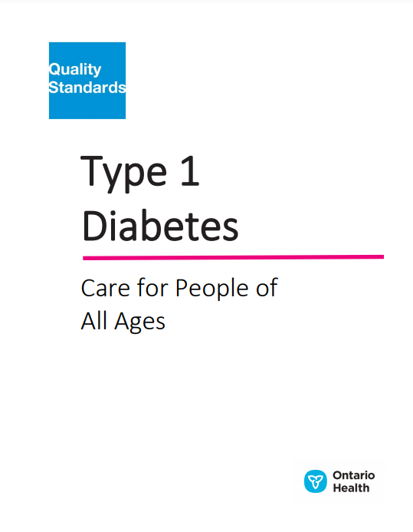

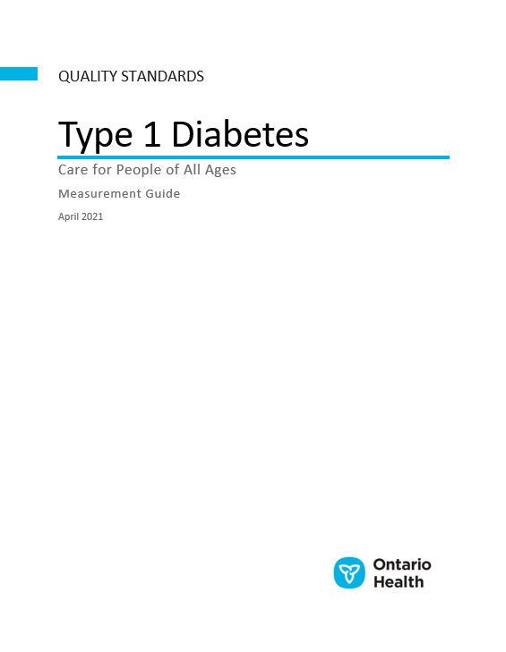
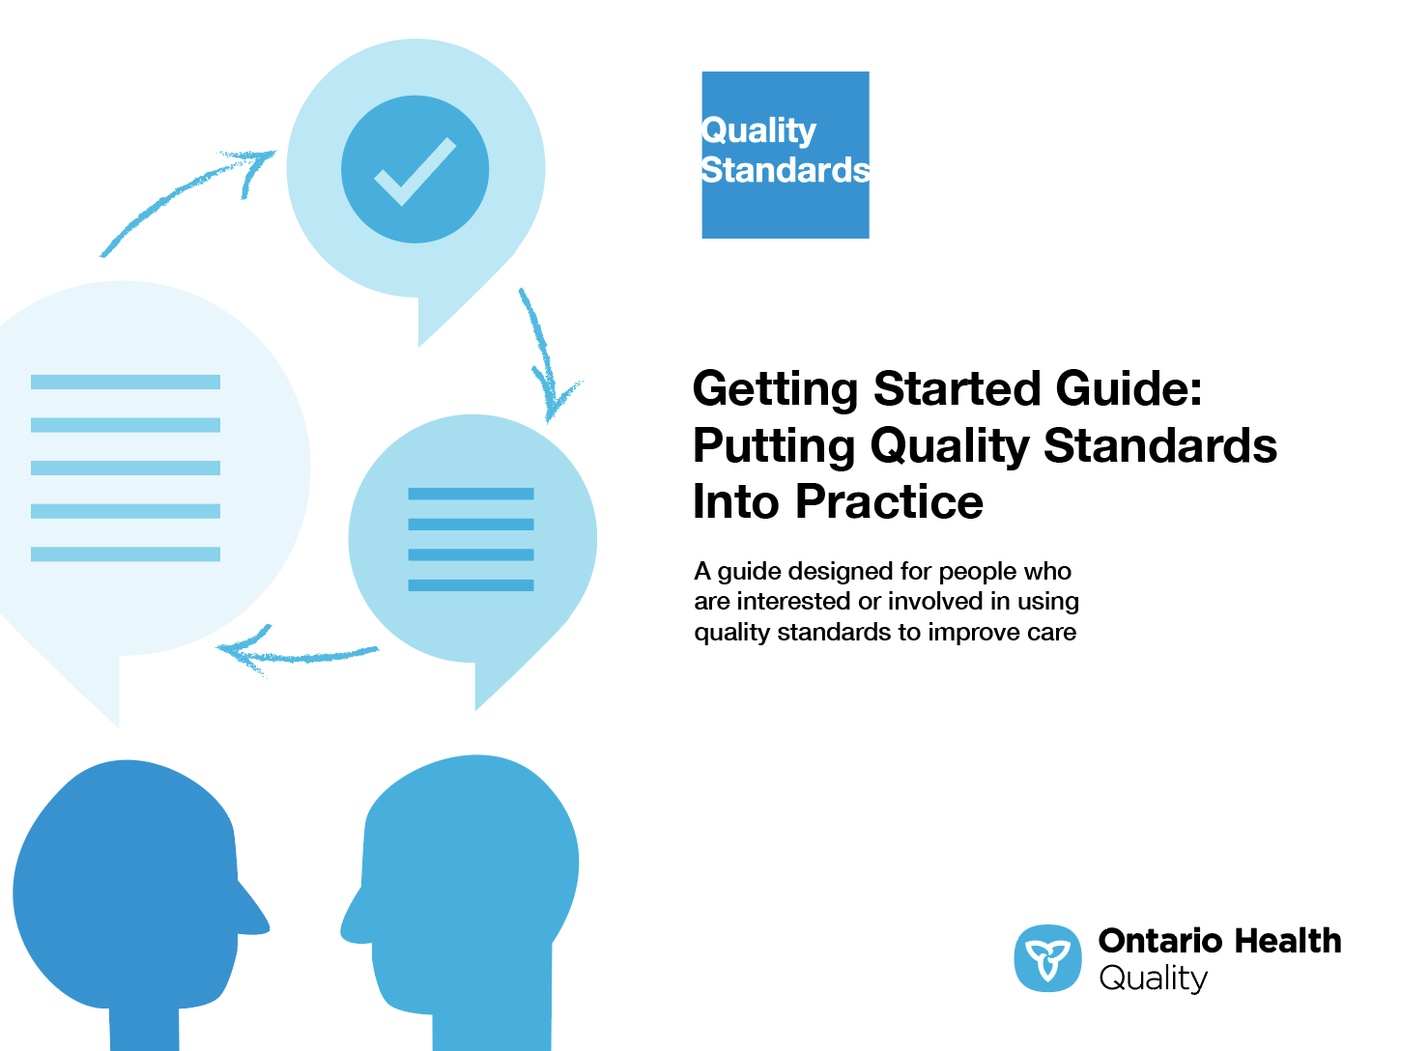
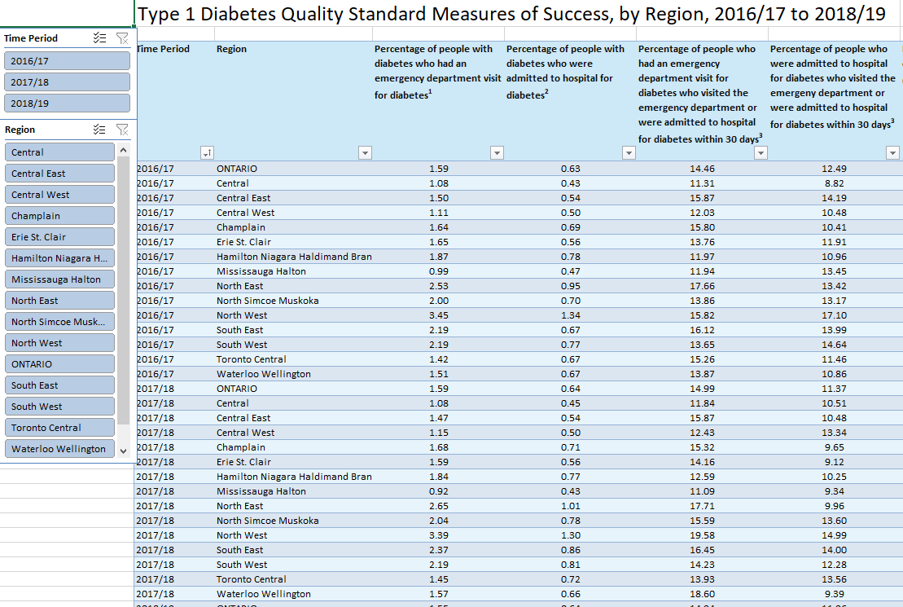
Quality Standard Resources
Quality Standard
Patient Guide
Getting Started Guide
Data Tables
Measurement Guide
Find these resources here:
https://hqontario.ca/evidence-to-improve-care/quality-standards/view-all-quality-standards/diabetes-type-1
Notes:
Each quality standard focuses on a specific health care issue. Each quality standard is accompanied by an assortment of resources.
Through concise, easy-to-understand statements, quality standards outline what quality care looks like for a condition or topic based on the evidence.
This quality standard is accompanied by:
A patient guide
A getting started guide
Data tables
A measurement guide
Quality standards provide the blueprint to enable the health care system in Ontario to work better, facilitate smooth transitions, and ensure patients receive the same high-quality care, regardless of where they reside.

Slide 6
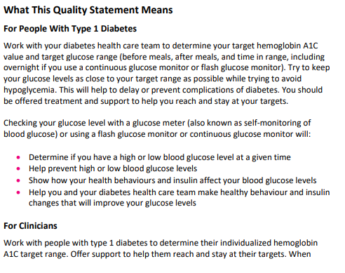
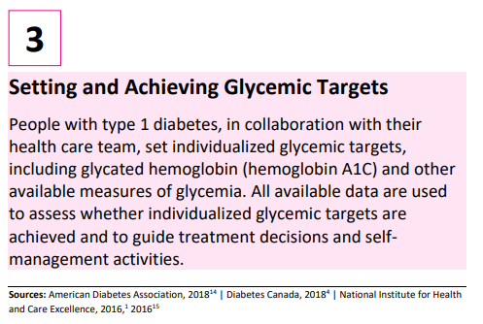
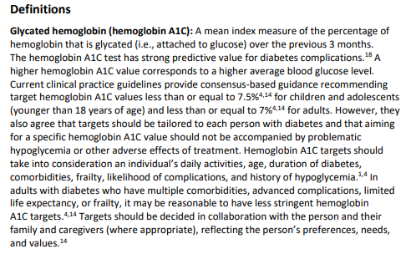
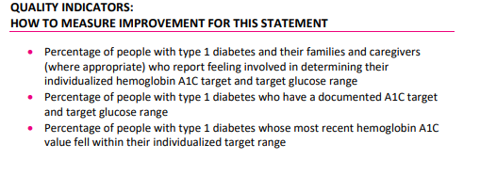
Inside the Quality Standard
The Statement
The Audience Statements
Definitions
The Indicators

Slide 7
Quality Standards:
Patient Guide
The patient guide is designed to give patients information about what quality care looks like for various conditions based on the best evidence, so they can ask informed questions of their health care providers.
Notes:
Each quality standard includes a plain language summary for patients, families, caregivers and the public called the patient guide.
Patient engagement in quality standards:
Membership on advisory committees
Focus groups and key informant interviews on topic-specific content (when necessary)
Public comment period for each quality standard
Consultations on the patient conversation guide

Slide 8
Quality Standards:
How the Health Care System Can Support Implementation
Implementing quality standards can be challenging due to system-level barriers or gaps, many of which have been identified throughout the development of this standard. Ontario Health will work with and support other provincial partners, including Ministry of Health, to bridge system-level gaps to support the implementation of quality standards.

Slide 9
Quality Standards:
Implementation Tools
The Getting Started Guide:
Outlines the process for using the quality standard as a resource to deliver high-quality care
Contains evidence-based approaches, as well as useful tools and templates for implementing change ideas at the practice level
Notes:
There are things we can do today despite the larger systemic barriers that may take time to resolve. The Getting Started Guide is a document that outlines a process for using the quality standards as a resource to deliver high-quality care. It compiles a number of resources to support adoption, such as links to implementation and quality improvement resources, examples and activities for reflection, and templates and documents to support the implementation planning activities. The Getting Started Guide also includes an Action Plan Template and examples on how Quality Improvement Plans can help to advance quality standards.

Slide 10


Quality Standard Adoption Tools:
Quorum
Quorum is an online community dedicated to improving the quality of health care in Ontario.
The Quality Standards Adoption Series highlights efforts in the field to implement changes and close gaps in care related to quality standard topics.
quorum.hqontario.ca
Notes:
The Quality Standards program has highlighted several stories from organizations and groups using various standards and statements within their clinical care settings, organization, or institutions; these are available through posts and discussions on Quorum.
As well, we are working on compiling resources and tools, for both clinicians and patients and families.
The focus is on implementation/adoption stories and how organizations are using quality standards in practice to inform care.
We’d love to hear from you if you are interested in contributing to a post or article.

Slide 11
Quality Standards:
Measurement Guide
The measurement guide has two dedicated sections:
Local measurement: what you can do to assess the quality of care that you provide locally
Provincial measurement: how we can measure the success of the quality standard on a provincial level

Slide 12
Quality Standards:
Data Tables
Data tables can be used to examine variations in indicator results across the province. They include data on key indicators:
Over time for Ontario
Across regions in Ontario
For specific measures of equity (age, geography, income and sex)

Slide 13
Why Do We Need a Quality Standard
for Type 1 Diabetes?
Note: Indicator data for the Type 1 Diabetes Quality Standard presented in slides 15 to 20 are preliminary rates and are not adjusted for factors other than age and sex (e.g., complications/conditions) that an individual with diabetes may have. Refer to the Type 1 Diabetes Quality Standard Measurement Guide for technical specifications (e.g., inclusion and exclusion criteria).​
Notes:
The data presented in the following slides is for people with type 1 diabetes and their caregivers.

Slide 14

In 2019, an estimated
1.5 million Ontarians, or 10% of the provincial population, were living with diabetes (type 1 and type 2 combined).
Estimates suggest that 5% to 10% of these cases are type 1 diabetes.
Source: Diabetes Canada. Diabetes in Ontario. [Internet]. Toronto (ON): Diabetes Canada; 2019 [cited 2020 Jan 16]. Available from: https://www.diabetes.ca/DiabetesCanadaWebsite/media/About-Diabetes/Diabetes%20Charter/2019-Backgrounder-Ontario.pdf

Slide 15

Compared with the general population, people with diabetes (type 1 or type 2) are more likely to be hospitalized with:
  Cardiovascular disease (3x as likely)
  End-stage kidney disease (12x as likely)
  Nontraumatic lower-limb amputation (20x as likely)
The risk of blindness in people with diabetes is up to 25 times higher than in those without diabetes
Source: Public Health Agency of Canada. Diabetes in Canada: facts and figures from a public health perspective. [Internet]. Ottawa (ON): The Agency; 2011 [cited 2019 Mar 6]. Available from: http://www.phac-aspc.gc.ca/cd-mc/publications/diabetes-diabete/facts-figures-faits-chiffres-2011/index-eng.php

Slide 16

More than 30% of people with diabetes experience significant depressive symptoms, and 11% of people with diabetes meet the diagnostic criteria for comorbid major depressive disorder—twice the number of people without diabetes.
Source: Diabetes Canada. Diabetes in Ontario. [Internet]. Toronto (ON): Diabetes Canada; 2019 [cited 2020 Jan 16]. Available from: https://www.diabetes.ca/DiabetesCanadaWebsite/media/About-Diabetes/Diabetes%20Charter/2019-Backgrounder-Ontario.pdf

Slide 17
In 2018/19, 1.55% (n=22,300) and 0.64% (n=9,153) of people with diabetes visited the emergency department or were admitted to hospital for diabetes, respectively. The North West and North East regions had the highest rates of both.
Note: Currently available data sources are limited in their ability to differentiate between types of diabetes. In the data tables, the indicator results include both type 1 and type 2 diabetes.
Sources: Discharge Abstract Database, National Ambulatory Care Reporting System, Ontario Diabetes Database; provided by the Institute for Clinical Evaluative Sciences.

Slide 18
In 2018/19, younger people with diabetes were more likely than older people
with diabetes to visit the emergency department or be admitted to hospital
for diabetes.
Note: Currently available data sources are limited in their ability to differentiate between types of diabetes. In the data tables, the indicator results include both type 1 and type 2 diabetes.
Sources: Discharge Abstract Database, National Ambulatory Care Reporting System, Ontario Diabetes Database; provided by the Institute for Clinical Evaluative Sciences.

Slide 19
In 2018/19, 14.94% of people who visited the emergency department and
11.96% of people who were admitted to hospital for diabetes had an urgent
acute care visit for diabetes within 30 days.
Note: Currently available data sources are limited in their ability to differentiate between types of diabetes. In the data tables, the indicator results include both type 1 and type 2 diabetes.
Sources: Discharge Abstract Database, National Ambulatory Care Reporting System; provided by the Institute for Clinical Evaluative Sciences.

Slide 20
In 2018/19, people with diabetes had a wide range of diabetes-related complications.
Note: Currently available data sources are limited in their ability to differentiate between types of diabetes. In the data tables, the indicator results include both type 1 and type 2 diabetes.
Sources: Discharge Abstract Database, National Ambulatory Care Reporting System, Ontario Diabetes Database, Ontario Health Insurance Plan; provided by the Institute for Clinical Evaluative Sciences.

Slide 21
In 2018/19, people with diabetes who had a lower income were more likely to have a diabetes-related complication.
Note: Currently available data sources are limited in their ability to differentiate between types of diabetes. In the data tables, the indicator results include both type 1 and type 2 diabetes.
Sources: Discharge Abstract Database, National Ambulatory Care Reporting System, Ontario Diabetes Database, Ontario Health Insurance Plan; provided by the Institute for Clinical Evaluative Sciences.

Slide 22
In 2018/19, only half of all people with diabetes in Ontario had at least
2 physician-administered hemoglobin A1C tests. Less than one-third of youth and less than two-thirds of adults met the prescribed hemoglobin A1C thresholds.
Indicator | Percent
Percentage of people with diabetes who had at least 2 hemoglobin A1C tests in a 1-year period | 50.99%
Percentage of people with diabetes whose most recent hemoglobin A1C value was: | Less than or equal to 7.0% for people 18 years of age and older: 29.99%
Percentage of people with diabetes who had a hemoglobin A1C test whose most recent hemoglobin A1C value was less than or equal to 7.5% (for people younger than 18 years of age) | Less than or equal to 7.5% for people younger than 18 years of age: 60.24%
Note: Currently available data sources are limited in their ability to differentiate between types of diabetes. In the data tables, the indicator results include both type 1 and type 2 diabetes.
Sources: Ontario Diabetes Database, Ontario Laboratories Information System; provided by the Institute for Clinical Evaluative Sciences.

Slide 23
Quality Statements to Improve Care

Slide 24
Scope of the Type 1 Diabetes Quality Standard
This quality standard addresses care for people of any age with a diagnosis of type 1 diabetes. It applies to all settings
This quality standard does not include care for pregnant people with type 1 diabetes. For a quality standard that addresses care for people with type 1 or type 2 diabetes who become pregnant, or people diagnosed with gestational diabetes, please refer to the Diabetes in Pregnancy quality standard
Notes:
Scope of This Quality Standard
This quality standard addresses care for people of any age with a diagnosis of type 1 diabetes. It applies to all settings.
This quality standard does not include care for pregnant people with type 1 diabetes. For a quality standard that addresses care for people with type 1 or type 2 diabetes who become pregnant, or people diagnosed with gestational diabetes, please refer to the Diabetes in Pregnancy quality standard.

Slide 25
Quality Statement Topics
Diabetes Self-Management Education and Support
Access to an Interprofessional Care Team
Setting and Achieving Glycemic Targets
Identifying and Assessing Mental Health Needs
Transition From Pediatric to Adult Diabetes Care
Notes:
Quality Statement 1: Diabetes Self-Management Education and Support
People with type 1 diabetes and their families and caregivers are offered an individualized, structured self-management education and support program at diagnosis and on an ongoing basis.
Quality Statement 2: Access to an Interprofessional Care Team
People with type 1 diabetes have access to an interprofessional diabetes health care team with training in type 1 diabetes.
Quality Statement 3: Setting and Achieving Glycemic Targets
People with type 1 diabetes, in collaboration with their health care team, set individualized glycemic targets, including glycated hemoglobin (hemoglobin A1C) and other available measures of glycemia. All available data are used to assess whether individualized glycemic targets are achieved and to guide treatment decisions and self-management activities.
Quality Statement 4: Identifying and Assessing Mental Health Needs
People with type 1 diabetes are screened for psychological distress and mental health disorders on a regular basis using recognized screening questions or validated screening tools. People who screen positive for a mental health disorder are referred to a health care professional with expertise in mental health for further assessment and treatment.
Quality Statement 5: Transition From Pediatric to Adult Diabetes Care
People with type 1 diabetes experience planned, coordinated, and supported transitions from pediatric to adult diabetes care.

Slide 26
Quality Statement 1:
Diabetes Self-Management Education and Support
People with type 1 diabetes and their families and caregivers are offered an individualized, structured self-management education and support program at diagnosis and on an ongoing basis.
Notes:
Quality Statement 1: People with type 1 diabetes and their families and caregivers are offered an individualized, structured self-management education and support program at diagnosis and on an ongoing basis.

Slide 27
Quality Statement 2:
Access to an Interprofessional Care Team
People with type 1 diabetes have access to an interprofessional diabetes health care team with training in type 1 diabetes.
Notes:
Quality Statement 2: Access to an Interprofessional Care Team
People with type 1 diabetes have access to an interprofessional diabetes health care team with training in type 1 diabetes.

Slide 28
Quality Statement 3:
Setting and Achieving Glycemic Targets
People with type 1 diabetes, in collaboration with their health care team, set individualized glycemic targets, including glycated hemoglobin (hemoglobin A1C) and other available measures of glycemia. All available data are used to assess whether individualized glycemic targets are achieved and to guide treatment decisions and self-management activities.
Notes:
Quality Statement 3: Setting and Achieving Glycemic Targets
People with type 1 diabetes, in collaboration with their health care team, set individualized glycemic targets, including glycated hemoglobin (hemoglobin A1C) and other available measures of glycemia. All available data are used to assess whether individualized glycemic targets are achieved and to guide treatment decisions and self-management activities.

Slide 29
Quality Statement 4:
Identifying and Assessing Mental Health Needs
People with type 1 diabetes are screened for psychological distress and mental health disorders on a regular basis using recognized screening questions or validated screening tools. People who screen positive for a mental health disorder are referred to a health care professional with expertise in mental health for further assessment and treatment.
Notes:
Quality Statement 4: Identifying and Assessing Mental Health Needs
People with type 1 diabetes are screened for psychological distress and mental health disorders on a regular basis using recognized screening questions or validated screening tools. People who screen positive for a mental health disorder are referred to a health care professional with expertise in mental health for further assessment and treatment.

Slide 30
Quality Statement 5:
Transition From Pediatric to Adult Diabetes Care
People with type 1 diabetes experience planned, coordinated, and supported transitions from pediatric to adult diabetes care.
Notes:
Quality Statement 5: Transition From Pediatric to Adult Diabetes Care
People with type 1 diabetes experience planned, coordinated, and supported transitions from pediatric to adult diabetes care.

Slide 31
How to Measure Overall Success
Notes:
The Type 1 Diabetes Quality Standard Advisory Committee identified some overarching goals for this quality standard. These goals were mapped to indicators that can be used to assess quality of care provincially and locally.

Slide 32
Indicators That Can Be Measured Using Provincial Data
Note: The indicators below are meant to apply to people with type 1 diabetes specifically; however, currently available data sources are limited in their ability to differentiate the types of diabetes. Exploratory work is currently under way to address this. For now, these measures include all people with diabetes.

Slide 33
Indicators That Can Be Measured Using Provincial Data (cont.)
Percentage of people with diabetes who have had an urgent acute care visit for diabetes, as reported by:
  Emergency department visits
  Hospital admissions
Percentage of people who had an urgent acute care visit for diabetes who visited the emergency department or were admitted to hospital for diabetes within 30 days, as reported by:
  Emergency department visits
  Hospital admissions

Slide 34
Indicators That Can Be Measured Using Provincial Data (cont.)
Percentage of people with diabetes who have had a diabetes-related complication, as reported by:
  Amputations (above-ankle, below-ankle)
  Cardiovascular complications
  End-stage renal disease
  Hyperglycemia, hypoglycemia, or ketoacidosis
  Retinopathy
  Skin and soft tissue infection or foot ulcer
Percentage of people with diabetes who had at least two hemoglobin A1C tests in a 1-year period

Slide 35
Indicators That Can Be Measured Using Provincial Data (cont.)
Percentage of people with diabetes whose most recent hemoglobin A1C value was less than or equal to:
  7.0% for people 18 years of age and older
  7.5% for people younger than 18 years of age
Percentage of people with diabetes who have had an urgent acute care visit for a mental health disorder, as reported by:
  Emergency department visits
  Hospital admissions

Slide 36
Indicators That Can Be Measured Using Only Local Data
Percentage of people with type 1 diabetes and their families and caregivers (where appropriate) who report feeling confident in knowing how to take care of and manage their diabetes
Percentage of people with type 1 diabetes who report that their interprofessional diabetes health care team always or often involves them in decisions about their care

Slide 37
Data Sources and Acknowledgement
The data used in this presentation were provided by the Institute for Clinical Evaluative Sciences (ICES), which is funded by an annual grant from the Ontario Ministry of Health (MOH) and the Ministry of Long-Term Care (MLTC). The opinions, results, and conclusions included in this report are those of the authors and are independent from the funding sources. No endorsement by ICES, the MOH, or the MLTC is intended or should be inferred. These datasets were linked using unique encoded identifiers and analyzed at ICES. Parts of this material are based on data and information compiled and provided by the Canadian Institute for Health Information (CIHI). However, the analyses, conclusions, opinions, and statements expressed herein are those of the authors, and not necessarily those of CIHI.

Slide 38

Thank you.
LET’S CONTINUE THE CONVERSATION
HQOntario.ca | OntarioHealth.ca
@OntarioHealthOH
Ontario Health
@OntarioHealthOH
Ontario Health

