Slide 1



Vaginal Birth After Caesarean
QUALITY STANDARDS
Guiding evidence-based care for people who have had a Caesarean and are planning their next birth
Notes:
If you have any questions about the content of this presentation, please contact us at QualityStandards@OntarioHealth.ca

Slide 2
Objectives
Overview of quality standards: What are they? How are they used?​
Why this quality standard is needed: Gaps and variations in quality of care for people in Ontario who have had a Caesarean birth and are planning their next birth
Quality statements to improve care: The key statements in the Vaginal Birth After Caesarean (VBAC) quality standard
Measures to support improvement: Indicators that can help measure your quality improvement efforts

Slide 3
Quality standards
Inform clinicians and patients what quality care looks like
Focus on conditions or processes where there are large variations in how care is delivered, or where there are gaps between the care provided in Ontario and the care patients should receive
Are grounded in the best available evidence
Notes:
Quality standards are a small set of high impact statements that describe optimal care where identified quality gaps exist in Ontario.
Voluntary and aspirational in nature​.
Designed to “raise the ceiling” with the goal of having the best possible care available to all Ontarians, regardless of where they live in the province.
There are many guidelines, professional standards, and other recommendations that contribute to the evidence ecosystem. Quality standards complement these resources.
Quality standards outline the what of care that should be delivered but are agnostic on who should be delivering it (unlike other CPGs, BPGs).
Quality standards are:
Concise: 5 to 15 strong, evidence-based statements focused on high-priority areas for improvement.
Accessible: help clinicians and provider organizations offer the highest-quality care; and patients to know what to discuss with their clinicians (compared with CPGs that are quite dense, these are very accessible, also written in plain language).
Measurable: each statement is accompanied by one or more quality indicators (structure, process, or outcome), with a set of outcome measures for the overall standard.
Implementable: quality improvement tools and resources support each standard, to fuel adoption.

Slide 4
Quality standards
Help patients, residents, families, and care partners know what to ask for in their care
Help clinicians know what care to offer, based on evidence and expert consensus
Help health care organizations measure, assess, and improve the quality of care they provide
Help ensure consistent,
high-quality care across
the province
Notes:
Patients, care partners, and the public can use quality standards to understand what excellent care looks like, what they should expect from their clinicians, and how to discuss the quality of their care.
Provincial regions and disease agencies can use quality standards to measure health outcomes, hold health service providers accountable for delivering high-quality care, and inform regional improvement strategies.
Provider organizations can use quality standards to measure and audit their quality of care, identify gaps, guide organizational improvement strategies, and inform clinical program investments.
Clinicians can use quality standards to evaluate their practice and identify areas for personal and organizational quality improvement, and can incorporate the evidence-based statements into professional education.
Government can use quality standards to identify provincial priority areas, inform new data collection and reporting initiatives, and design performance indicators and funding incentives.

Slide 5
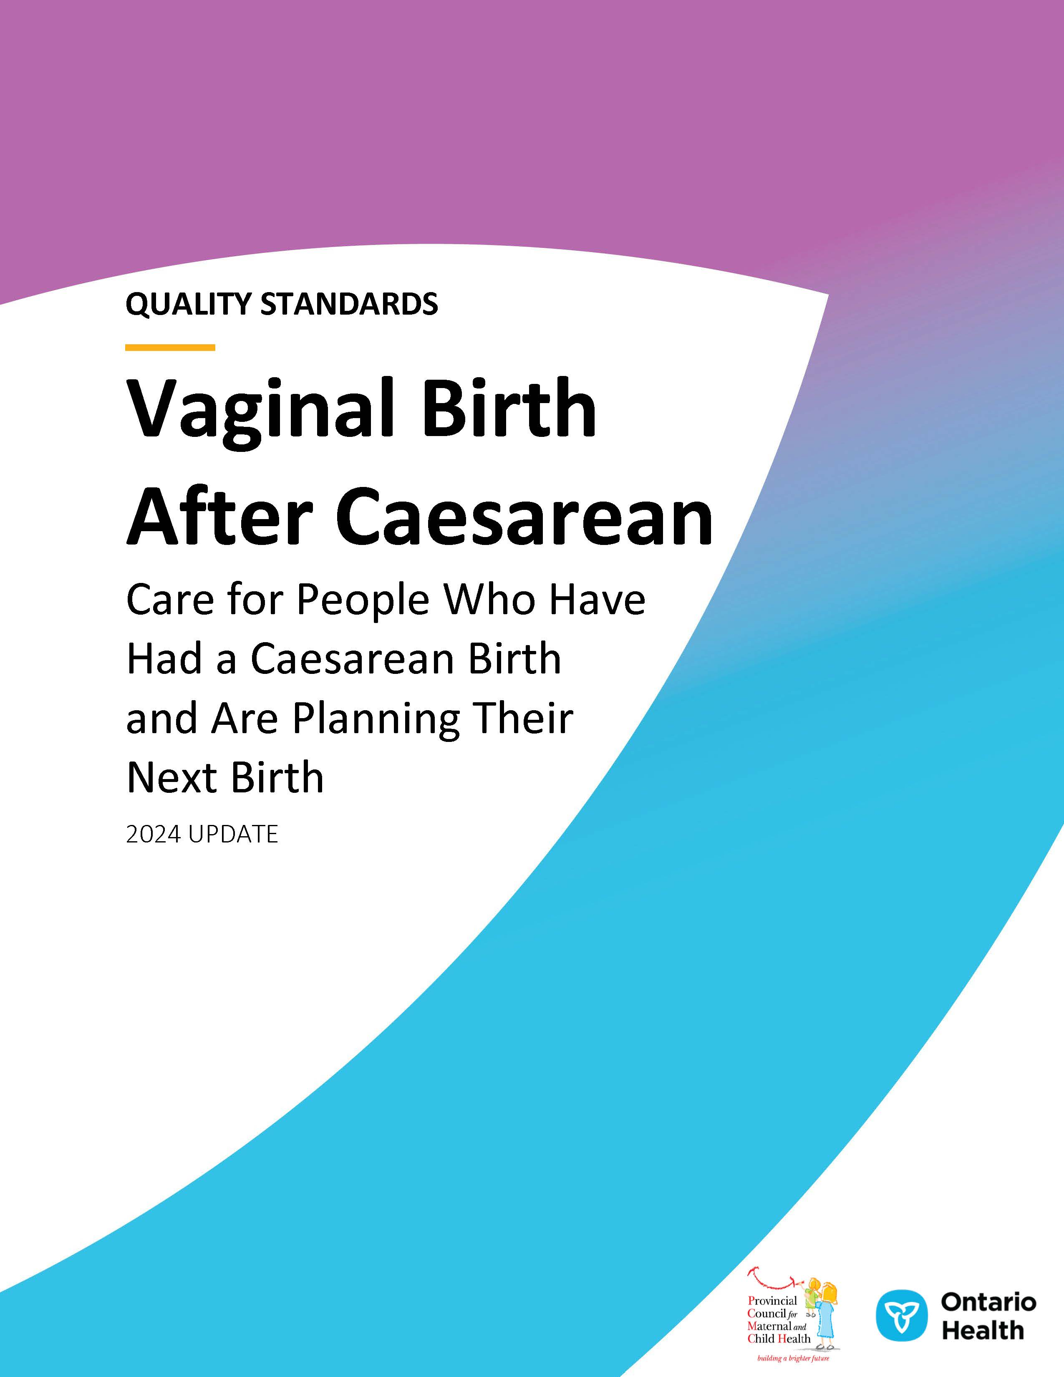
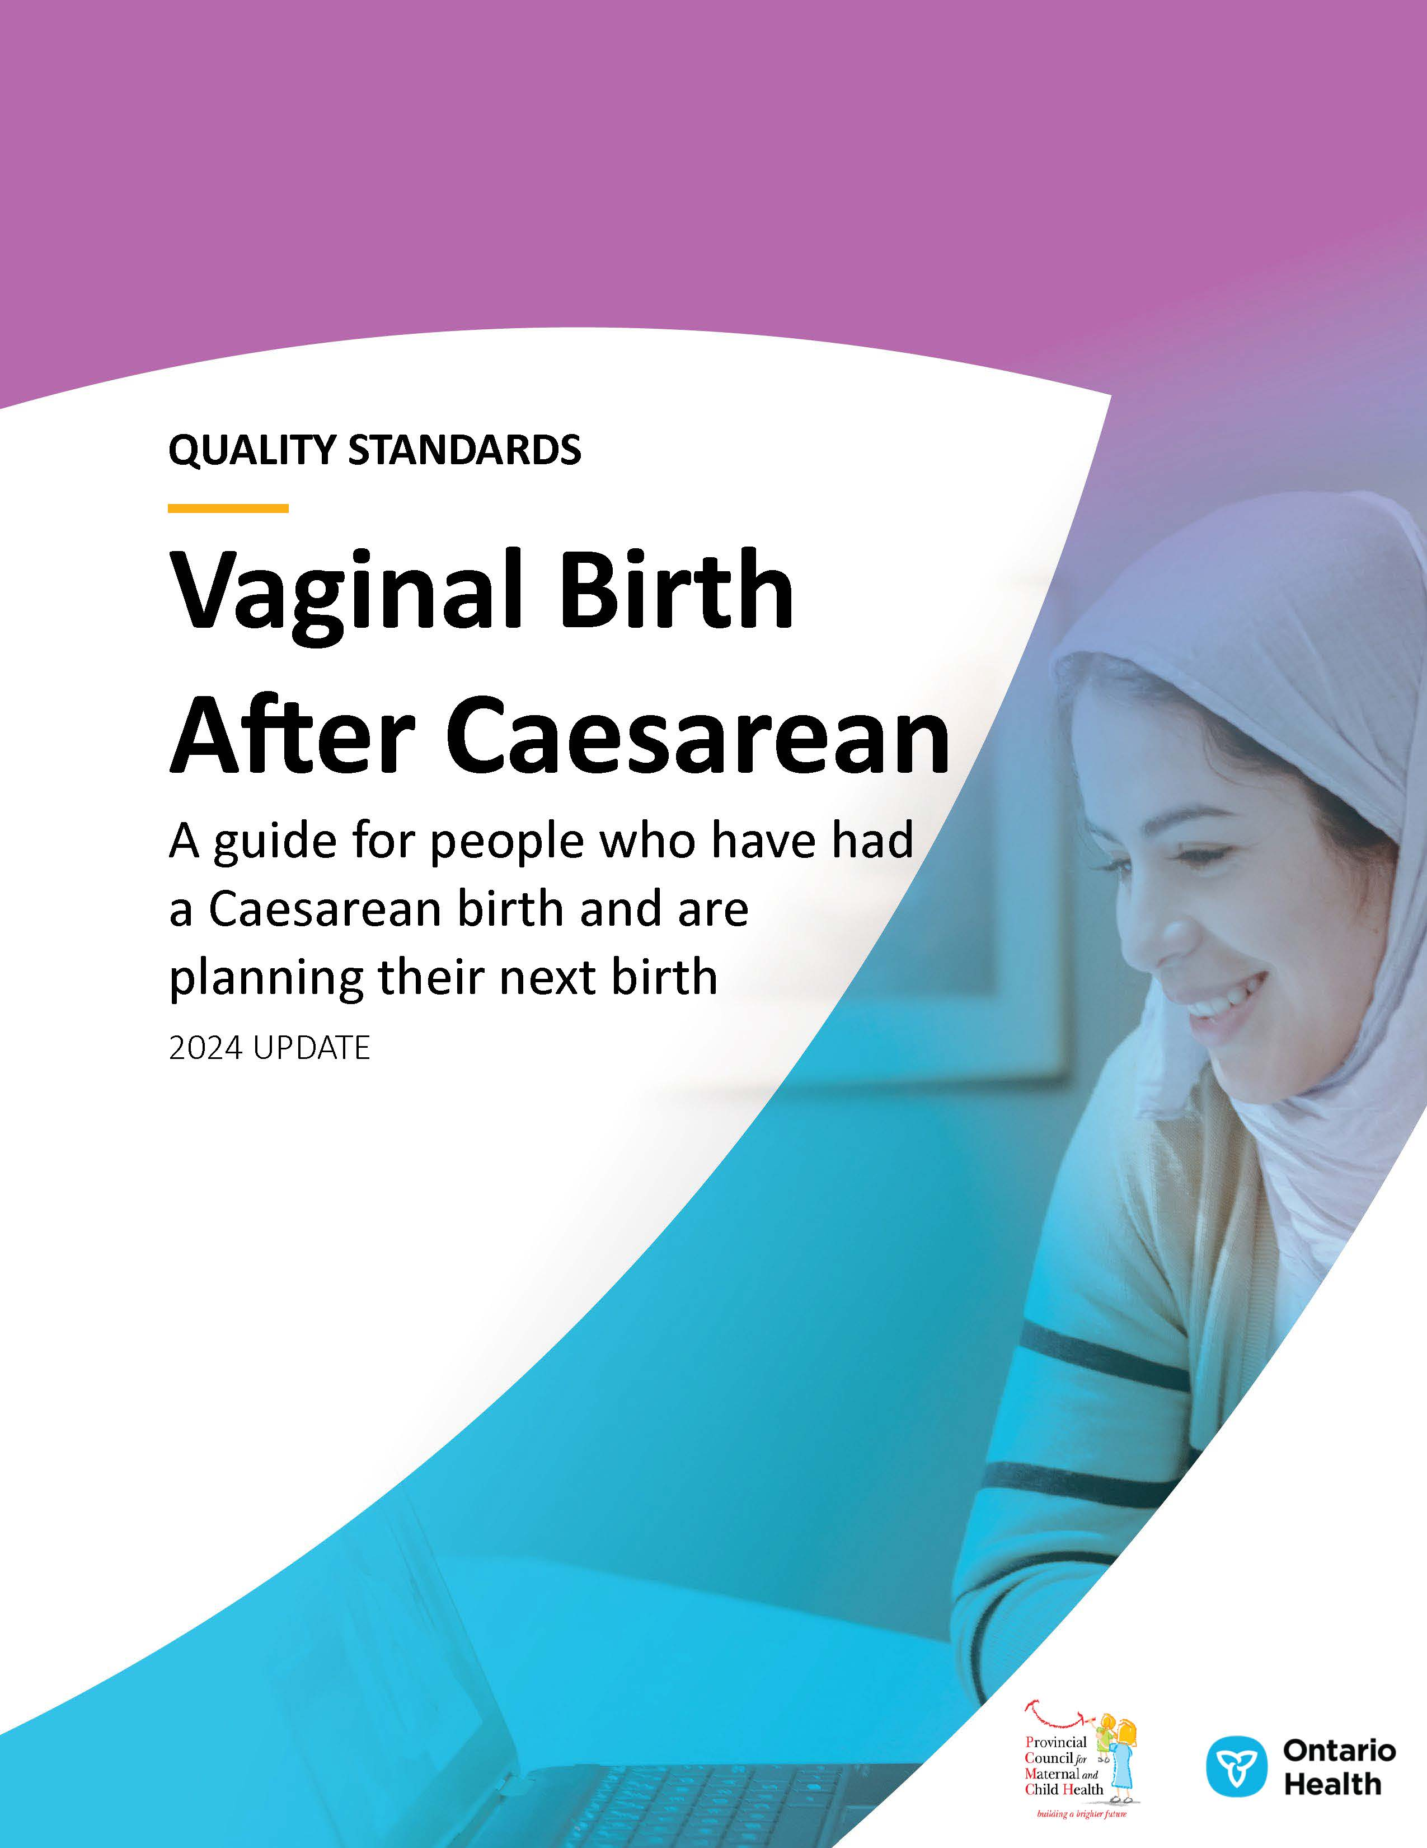
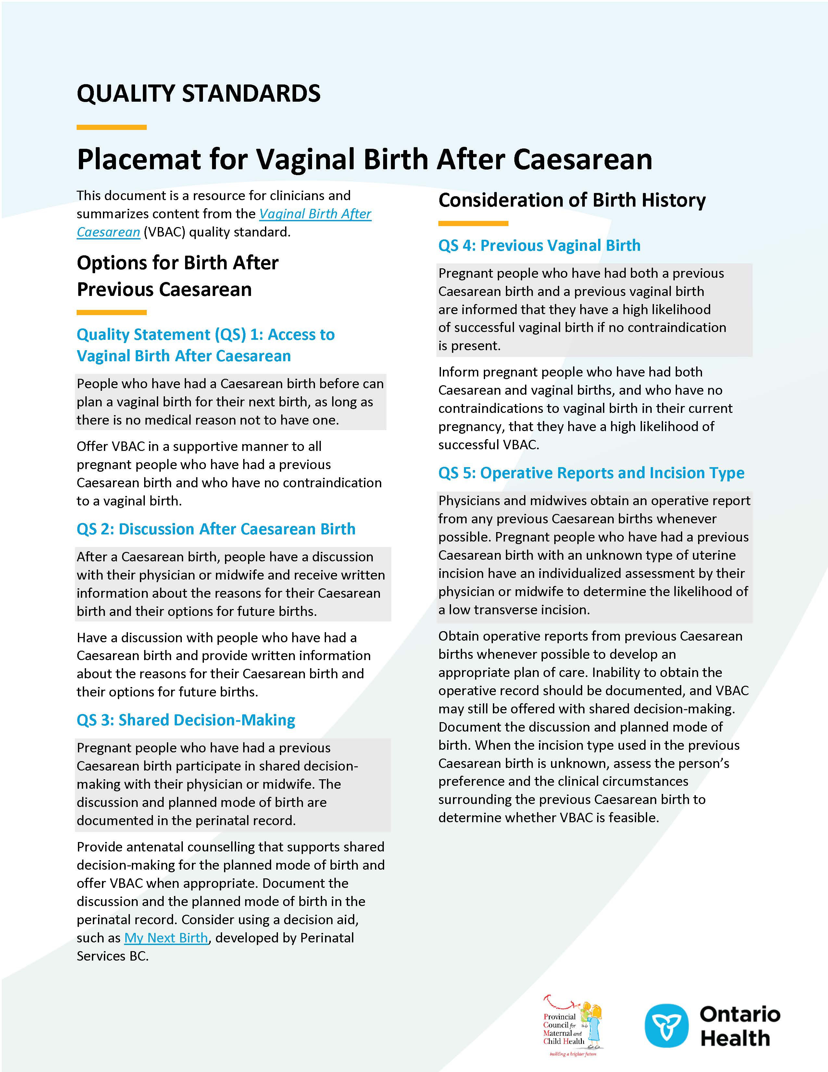


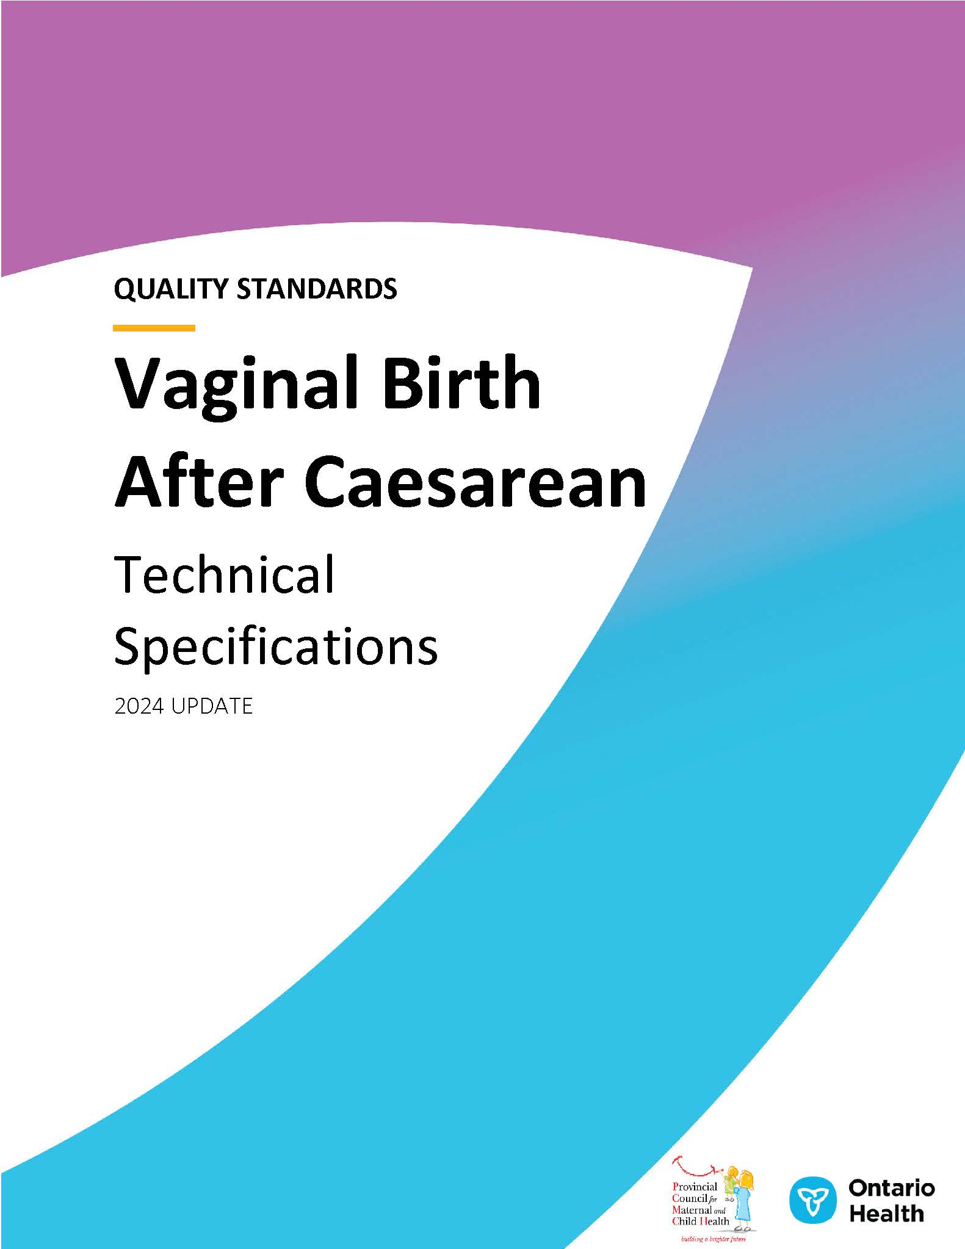
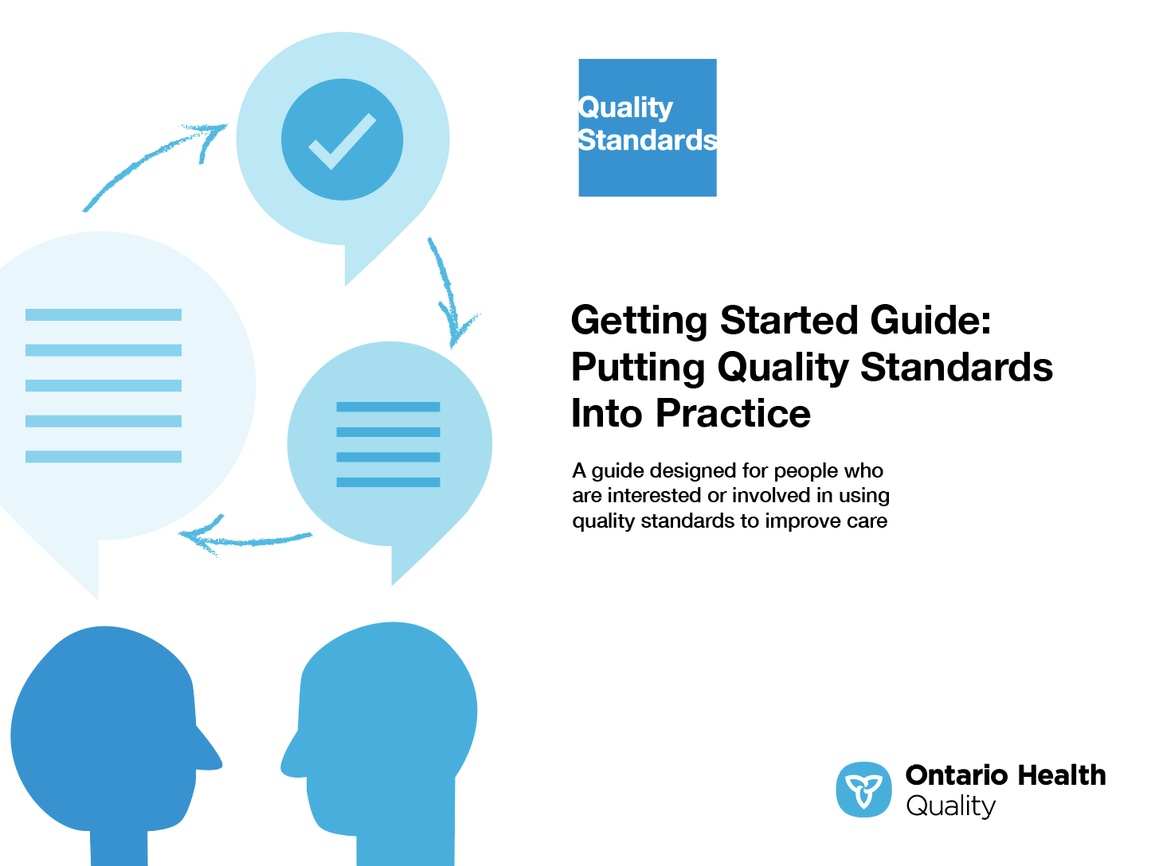
Quality standard resources
Quality Standard
Patient Guide
Placemat
Case for Improvement Deck
Measurement Guide
Technical Specifications
Getting Started Guide
Find these resources here:
https://www.hqontario.ca/evidence-to-improve-care/quality-standards/view-all-quality-standards/vaginal-birth-after-caesarean
Notes:
Each quality standard focuses on a specific health care issue. The development of each quality standard is accompanied by an assortment of resources.
Through concise, easy-to-understand statements, quality standards outline what quality care looks like for a condition or topic based on the evidence.
Each quality standard is accompanied by a:
Patient guide
Placemat
Case for Improvement Deck
Measurement guide
Technical specifications
Getting started guide
Quality standards provide the blueprint to enable the health care system in Ontario to work better, facilitate smooth transitions, and ensure patients receive the same high-quality care, regardless of where they reside.

Slide 6
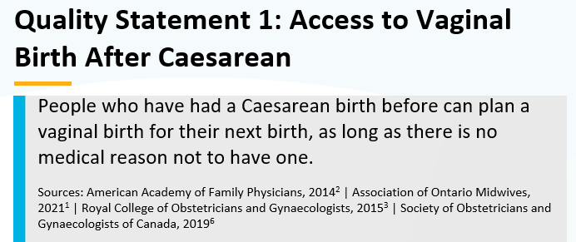
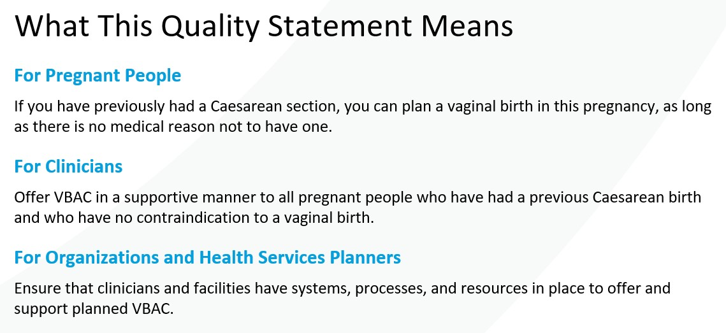


Inside the quality standard
The Quality Statement
The Audience Statements
The Definitions
The Indicators

Slide 7
Patient guide
Quality standards
The patient guide is designed to give patients information about what quality care looks like for various conditions based on the best evidence, so they can ask informed questions of their health care teams.
Notes:
Every quality standard includes a plain language summary for patients, families, care partners and the public called the patient guide.
Patient engagement in quality standards:
Membership on advisory committees
Focus groups and key informant interviews on topic-specific content (when necessary)
Public comment period for each quality standard
Consultations on the patient guide

Slide 8
Placemat
Quality standards
The placemat is a quick-reference resource
for clinicians that summarizes the quality standard and includes links to helpful resources and tools.

Slide 9
Case for improvement deck
Quality standards
The case for improvement deck describes why the quality standard was created and shows some of the data used to develop it. Champions can use or adapt this deck to build support for the quality standard in their organizations.

Slide 10
How the health care system can support implementation
Quality standards
Implementing quality standards can be challenging owing to
system-level barriers or gaps, many of which have been identified throughout the development of this standard
Ontario Health will work with and support other provincial partners, including the Ministry of Health, to bridge system-level gaps and support the implementation of quality standards

Slide 11
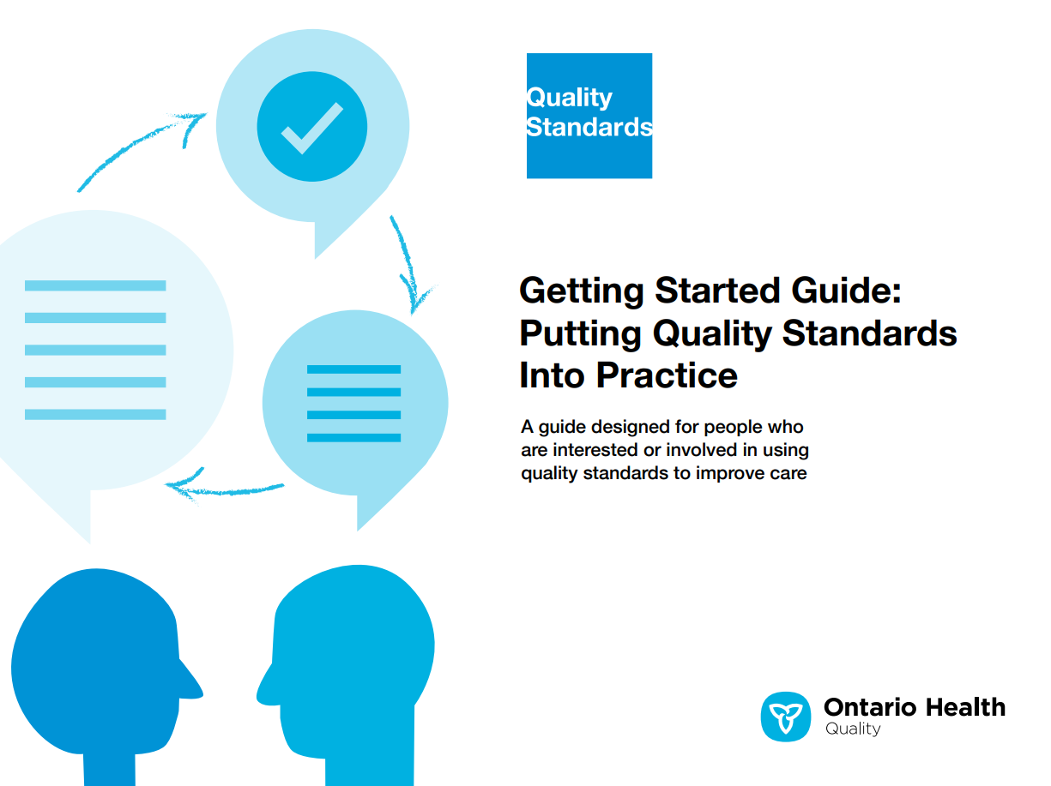
Implementation tools
Quality standards
The Getting Started Guide:
Outlines the process for using the quality standard as a resource to deliver
high-quality care
Contains evidence-based approaches, as well as useful tools and templates for implementing change ideas at the
practice level
Notes:
There are things we can do today despite the larger systemic barriers that may take time to resolve. The Getting Started Guide is a document that outlines a process for using the quality standards as a resource to deliver high-quality care. It compiles a number of resources to support adoption, such as links to implementation and quality improvement resources, examples and activities for reflection, and templates and documents to support the implementation planning activities. The Getting Started Guide also includes an Action Plan Template and examples on how Quality Improvement Plans can help to advance quality standards.

Slide 12

Quorum
Quality standard adoption tools
Quorum is an online community dedicated to improving the quality of health care in Ontario.
The Quality Standards Adoption Series highlights efforts in the field to implement changes and close gaps in care related to quality standard topics.
quorum.hqontario.ca
Notes:
The Quality Standards program has highlighted several stories from organizations and groups using various standards and statements within their clinical care settings, organization, or institutions; these are available through posts and discussions on Quorum.
As well, we are working on compiling resources and tools, for both clinicians and patients and families.
The focus is on implementation/adoption stories and how organizations are using quality standards in practice to inform care.
We’d love to hear from you if you are interested in contributing to a post or article.

Slide 13
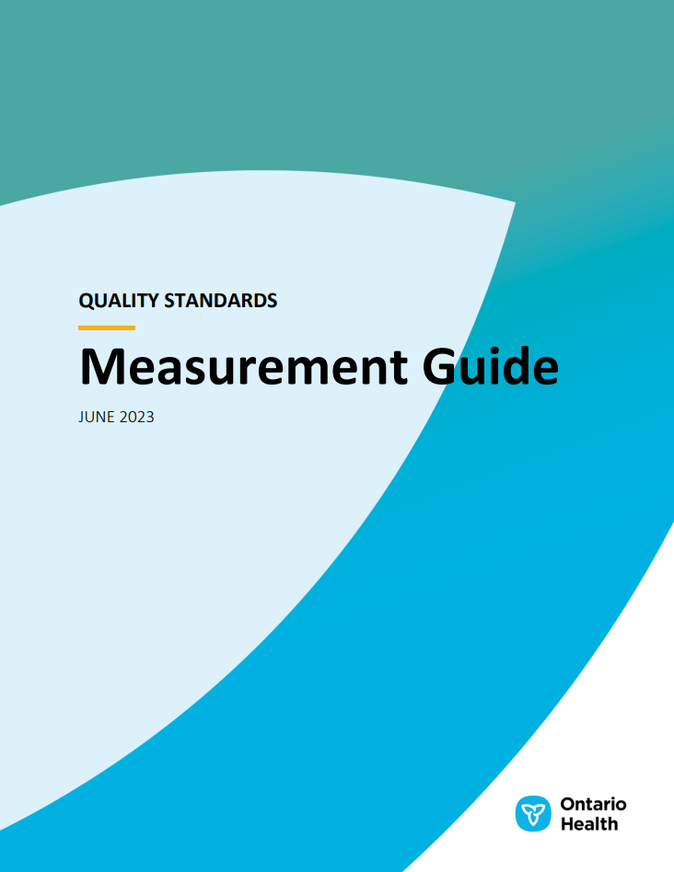
Measurement guide
Quality standards
The measurement guide describes:
The measurement principles behind
the quality indicators included in
quality standards
The types of indicators included in quality standards
How local and provincial data are collected and measured

Slide 14
Technical specifications
Quality standards
The technical specifications report outlines
2 types of measurement:
Provincial measurement: how we can monitor the progress being made to improve care at the provincial level
Local measurement: what you can do to assess the quality of care that you
provide locally

Slide 15
Why do we need a quality standard for VBAC?

Slide 16



About 29% of infants are born through Caesarean birth in Ontario.¹ Most people who have had a Caesarean birth can have a VBAC, which provides a wide range of benefits.¹⁻³
The rate of planned VBACs has decreased in Ontario over time. Additionally, there is significant variation in the rates of planned VBACs across Ontario Health regions.⁴
The benefits of VBAC need to be considered alongside the potential risks. Informed and shared decision-making is important so that pregnant people can receive the care that is most consistent with their values and preferences.
Abbreviations: VBAC, vaginal birth after Caesarean.
Sources:
Association of Ontario Midwives, Gure F, MacDonald T, Minichiello A. Clinical practice guideline no. 14: management of vaginal birth after previous low-segment Caesarean section [Internet]. Toronto (ON): The Organization; 2021.
American Academy of Family Physicians. Clinical practice guideline: planning for labor and vaginal birth after Cesarean [Internet]. Leawood (KS): The Academy; 2014.
Royal College of Obstetricians and Gynaecologists. Birth after previous Caesarean birth green-top guideline no. 45 [Internet]. London (UK): The College; 2015.
Canadian Institute for Health Information. QuickStats: childbirth indicators by place of residence 2014–2015; what is the repeat Caesarean section rate in Ontario, 2014–2015? [Internet]. North York (ON): The Institute; 2016.

Slide 17
In Ontario, between fiscal years 2014/15 and 2022/23, about 85% of pregnant people with a previous Caesarean birth were eligible for a VBAC
This quality standard intends to improve access to VBAC among people with a previous Caesarean birth and the following clinical circumstances:
Singleton gestation with head-down presentation
Gestational age greater than or equal to 37 weeks
84.7%
Abbreviations: VBAC, vaginal birth after Caesarean.
Note: For full inclusion and exclusion criteria, please see the accompanying Technical Specifications document.
Source: Better Outcomes Registry and Network (BORN) Ontario. Tabulated data, extracted June 2024.
Notes:
Exclusion criteria for VBAC:
Previous classical or inverted “T” uterine scar
Previous hysterotomy or myomectomy entering the uterine cavity
Previous uterine rupture
Placental disorders including (placenta accreta, placenta increta, placenta percreta, and placenta previa)
Pregnant people with “fetal anomaly,” “malposition/malpresentation,” or “other obstetrical complication” as an indication for Caesarean section

Slide 18
The percentages of people who planned and who attempted VBAC have decreased over time in Ontario
Abbreviations: VBAC, vaginal birth after Caesarean.
Note: “Planned VBAC” is defined as an eligible pregnancy in which the clinician or midwife flagged that the person planned on delivering through VBAC; “attempted VBAC” is defined as all pregnancies in which the data element denoted a vaginal delivery or a trial of labour for a vaginal delivery.
Source: Better Outcomes Registry and Network (BORN) Ontario. Tabulated data, extracted June 2024.

Slide 19
The percentage of planned VBACs varied across Ontario Health regions in fiscal year 2022/23
% of eligible people who planned VBAC
Ontario
North West
West
Toronto
East
Central
North East
Number of planned VBACs
4,727
91
1,592
890
906
1,116
132
Abbreviations: VBAC, vaginal birth after Caesarean.
Note: Ontario Health region is based on the location of birth, which may be different from the location of residence.
Source: Better Outcomes Registry and Network (BORN) Ontario. Tabulated data, extracted June 2024.

Slide 20
The percentages of people who deliver successfully via VBAC have remained stable over time
Abbreviations: VBAC, vaginal birth after Caesarean.
Note: “Planned VBAC” is defined as an eligible pregnancy in which the clinician or midwife flagged that the person planned on delivering through VBAC; “attempted VBAC” is defined as all pregnancies in which the data element denoted a vaginal delivery or a trial of labour for a vaginal delivery.
Source: Better Outcomes Registry and Network (BORN) Ontario. Tabulated data, extracted June 2024.

Slide 21
Uterine rupture following a planned VBAC is a rare outcome, occurring in about 5 per 1,000 (1 in 200) planned VBACs from fiscal year 2014/15 to fiscal year 2022/23
Uterine ruptures are a very rare outcome of VBAC, at around 15 to 40 total cases annually in Ontario, and the low volumes lead to a somewhat volatile rate year over year.
Abbreviations: VBAC, vaginal birth after Caesarean.
Source: Better Outcomes Registry and Network (BORN) Ontario. Tabulated data, extracted June 2024.

Slide 22
NICU admission rates were similar for neonates born to people who planned a VBAC compared with neonates born to those who did not
Abbreviations: NICU, neonatal intensive care unit; VBAC, vaginal birth after Caesarean.
Note: The cohort of people who did not plan a VBAC is used as a proxy for people who planned an elective repeat Caesarean.
Sources: Better Outcomes Registry and Network (BORN) Ontario. Tabulated data, extracted June 2024.
Discharge Abstract Database (Canadian Institute for Health Information).

Slide 23
In fiscal year 2021/22, rates of NICU admission for more than 4 hours varied by region but were similar for neonates born to people who planned a VBAC compared with neonates born to those who did not
Abbreviations: NICU, neonatal intensive care unit; VBAC, vaginal birth after Caesarean.
Note: Ontario Health region is based on the location of birth, which may be different from the location of residence; the cohort of people who did not plan a VBAC is used as a proxy for people who planned an elective repeat Caesarean.
Sources: Better Outcomes Registry and Network (BORN) Ontario. Tabulated data, extracted June 2024.
Discharge Abstract Database (Canadian Institute for Health Information).

Slide 24
Mortality and morbidity rates among neonates born to people who planned VBAC were similar to rates for neonates born to those who did not, with a slight increase over time
Abbreviations: VBAC, vaginal birth after Caesarean.
Note: The cohort of people who did not plan a VBAC is used as a proxy for people who planned an elective repeat Caesarean.
Sources: Better Outcomes Registry and Network (BORN) Ontario. Tabulated data, extracted June 2024.
Discharge Abstract Database (Canadian Institute for Health Information).

Slide 25
Rates of neonatal morbidity or mortality varied across Ontario Health regions but were similar for neonates born to people who planned VBAC and for neonates born to those who did not
Abbreviations: VBAC, vaginal birth after Caesarean.
Note: Ontario Health region is based on the location of birth, which may be different from the location of residence. Morbidity and mortality is determined by the incidence of either respiratory problems, seizures, or death among neonates. The cohort of people who did not plan a VBAC is used as a proxy for people who planned an elective repeat Caesarean.
Sources: Better Outcomes Registry and Network (BORN) Ontario. Tabulated data, extracted June 2024.
Discharge Abstract Database (Canadian Institute for Health Information).

Slide 26
“While I carried the story and hardship of my first birth experience, I was still hoping to have a VBAC. There was no indication that I was unhealthy or unfit to have a VBAC … I knew I was a good candidate. The most important thing is understanding the information and being supported to make a decision based on your own level of acceptable risk and what you value for your family. I wanted to give myself and my baby a chance to have a vaginal delivery; I also wanted that personal feeling of ‘my body is able to do this!’
Oddly enough, even though my second birth experience was still far from ‘perfect,’ I was overjoyed. Despite once again having a longer stay in the NICU, as occurred with my daughter, I was impressed, thankful, and proud that I had a VBAC.”
– Catherine Lombardo, Person With Lived Experience
”

Slide 27
“With ever-increasing rates of Caesarean section, we need good-quality guidance for best practices within our own context. This is especially important for immigrant and marginalized populations. Quality standards in place improve choice and the understanding of risks, especially for those who are the most likely to be disempowered in our system.”
– Manavi Handa, Associate Professor, Midwifery, Toronto Metropolitan University; Co-Chair, Vaginal Birth After Caesarean Quality Standard Advisory Committee
”

Slide 28
Quality statements to improve care

Slide 29
Scope of this quality standard
The scope of this quality standard extends from postpartum counselling after a Caesarean birth through antenatal and intrapartum care during the next pregnancy and birth
The guidance provided in this quality standard on pregnancy care focuses on people with a previous Caesarean birth who are pregnant with 1 baby that is head-down and at full term
(> 37 weeks), who are receiving pregnancy care from any type of clinician
People with more than 1 previous Caesarean birth are included in the scope; however, research evidence is limited for this population. Careful individualized assessment and clinical judgment as part of shared decision-making are essential in this situation
This quality standard does not apply to people who have certain contraindications to vaginal birth after Caesarean
Notes:
Scope of This Quality Standard
The scope of this quality standard extends from postpartum counselling after a Caesarean birth through antenatal and intrapartum care during the next pregnancy and birth. The guidance provided in this quality standard on pregnancy care focuses on people with a previous Caesarean birth who are pregnant with one baby that is head-down and at full term (> 37 weeks), who are receiving pregnancy care from any type of clinician. People with more than one previous Caesarean birth are included in the scope; however, research evidence is limited for this population. Careful individualized assessment and clinical judgment as part of shared decision-making is essential in this situation.
This standard does not apply to people who have the following contraindications to vaginal birth after Caesarean (VBAC):
Previous classical or inverted “T” uterine scar
Previous hysterotomy or myomectomy entering the uterine cavity
Previous uterine rupture
Placenta accreta
Placenta increta
Placenta percreta
Placenta previa
Any other maternal or fetal complication that is a contraindication to vaginal birth

Slide 30
Quality statement topics
Access to vaginal birth after Caesarean
Discussion after Caesarean birth
Shared decision-making
Previous vaginal birth
Operative reports and incision type
Timely access to Caesarean birth
Unplanned labour
Induction and augmentation of labour
Signs and symptoms of uterine rupture

Slide 31
Access to vaginal birth after Caesarean
Quality statement 1:
People who have had a Caesarean birth before can plan a vaginal birth for their next birth, as long as there is no medical reason not to have one.

Slide 32
Discussion after Caesarean birth
Quality statement 2:
After a Caesarean birth, people have a discussion with their physician or midwife and receive written information about the reasons for their Caesarean birth and their options for future births.

Slide 33
Shared decision-making
Quality statement 3:
Pregnant people who have had a previous Caesarean birth participate in shared decision-making with their physician or midwife. The discussion and planned mode of birth are documented in the perinatal record.

Slide 34
Previous vaginal birth
Quality statement 4:
Pregnant people who have had both a previous Caesarean birth and a previous vaginal birth are informed that they have a high likelihood of successful vaginal birth if no contraindication is present.

Slide 35
Operative reports and incision type
Quality statement 5:
Physicians and midwives obtain an operative report from any previous Caesarean births whenever possible. Pregnant people who have had a previous Caesarean birth with an unknown type of uterine incision have an individualized assessment by their physician or midwife to determine the likelihood of a low transverse incision.

Slide 36
Timely access to Caesarean birth
Quality statement 6:
Pregnant people planning a vaginal birth after Caesarean are aware of the resources available and not available at their planned place of birth, including physician, midwifery, nursing, anesthesiology, and neonatal care, and the ability to provide timely access to Caesarean birth.

Slide 37
Unplanned labour
Quality statement 7:
Pregnant people planning an elective repeat Caesarean section should have a documented discussion with their physician or midwife about the feasibility of vaginal birth after Caesarean if they go into unplanned labour. This discussion should take place during antenatal care and again if the person arrives at the hospital in labour.

Slide 38
Induction and augmentation of labour
Quality statement 8:
Pregnant people who have had a previous Caesarean birth are offered induction and/or oxytocin augmentation of labour when medically indicated, and are informed by their physician or midwife about the potential benefits and harms associated with the method proposed. Discussion about this should begin in the antenatal period.

Slide 39
Signs and symptoms of uterine rupture
Quality statement 9:
During active labour, pregnant people who have had a previous Caesarean birth are closely monitored for signs or symptoms of uterine rupture.

Slide 40
Measures to support improvement
Notes:
The Vaginal Birth After Caesarean Quality Standard Advisory Committee identified a set of overarching goals for this quality standard. These have been mapped to indicators that may be used to assess quality of care provincially and locally.

Slide 41
Indicators that can be measured using provincial data
Percentage of eligible pregnant people who plan a vaginal birth after Caesarean
Percentage of eligible pregnant people who have a successful vaginal birth after Caesarean
Percentage of eligible pregnant people who plan an elective repeat Caesarean section
Rate of uterine rupture per 1,000 planned vaginal births after Caesarean
Percentage of neonates who remained in neonatal intensive care for more than 4 hours among infants born to people who planned vaginal birth after Caesarean and among infants born to people who planned elective repeat Caesarean section
Rate of neonatal morbidity and mortality among infants born to people who planned vaginal birth after Caesarean and among infants born to people who planned elective repeat Caesarean section

Slide 42
Data sources and acknowledgement
The data used in this presentation were provided by the Better Outcomes Registry and Network (BORN) Ontario, as well as the Canadian Institute for Health Information (CIHI). All inferences, opinions, and conclusions drawn in this publication are those of the authors, and do not necessarily reflect the opinions or policies of BORN Ontario or CIHI.

Slide 43
Thank you

