Slide 1

Health Links: Excerpts from the 2017/18 Q1 Report
07 September 2017

Slide 2
Health Links:
Improving integrated care for patients with multiple conditions and complex needs.

Slide 3
Supporting the Health Link Approach to Care
Health Links Improving integrated care for patients with multiple conditions and complex needs
MOHLTC | LHIN
Sets the strategic direction for Health Links Provides overall funding to the LHINs Oversees the overall performance of the Health Links initiative to guide strategy Facilitates operational success by implementing provincial level tools and supports | Sets regional priorities for Health Links and ensures alignment with provincial priorities Funds Health Links in accordance with priorities Maintains overall accountability for Health Links performance Drives operations through implementation of plans and support for adoption of provincial tools Identifies and implements regional supports and tools as required
Health Quality Ontario
Support data collection, timely reports and analysis Lead systematic identification of emerging innovations and best practices Increase rate of progress through standardization of best practices across all Health Links Support inter-Health Link sharing of lessons learned on regional and/or provincial basis Connect LHIN Health Link Leads with other relevant provincial quality initiatives
Source: “Guide to the Advanced Health Links Model Guide” Ministry of Health Long-Term Care, November 12, 2015

Slide 4
Health Links at a Glance – Q1 Update
2016/17 | Number of Health Links Actively Recruiting Patients | Number of Coordinated Care Plans Completed | Number of Patients Connected to a Primary Care Provider
Q1 | 79 | 3,782 | 3,668
Q2 | 79 | 3,670 | 3,787
Q3 | 78 | 4,025 | 3,948
Q4 | 84 | 6,102 | 5,942
Q1 2017/18 | 79* | 6,073 | 6,236
Cumulative Total to Date | 79 | 42,847 | 53,426
*Note: The Hamilton Niagara Haldimand Brant LHIN consolidated the reporting of their eleven Health Links into the LHIN’s six identified sub-regions. The South West LHIN merged North and South Grey Bruce Health Links to align with sub-region geographies. The District of Kenora Health Link started reporting in this quarter.

Slide 5
Patient Story
About the Patient
Martha is a 94-year-old widow who has multiple comorbidities, including vascular parkinsonism and visual impairment. She has a live-in caregiver and two supportive sons.

Slide 6
Patient Story (continued)
Health Links Support
Martha was referred to the Geriatric Outreach Team (GOT) for investigation of syncope after an admission to hospital. She reported low mood due to visual impairment and isolation in the home, and decreased mobility, resulting in deconditioning and difficulty with transfers; she was taking 16 medications. Martha received an in-home visit from the CCAC Care Coordinator and a family physician with a Care of the Elderly (COE) designation, who together completed a comprehensive assessment and developed a joint coordinated care plan with Martha. The COE physician engaged Martha’s family physician to facilitate sharing of the coordinated care plan (CCP). All partners then facilitated comprehensive in-home care, with positive, patient-focused outcomes as part of the plan. Recommendations included strategies to improve mood, such as having regular daily routines and trying new activities, increasing socialization by attending a community program, and improving her ability to cope with visual impairment frustrations. A physiotherapist conducted a home safety assessment and taught Martha exercises to improve strength, function, and mobility to reduce her risk of falls.

Slide 7
Patient Story (continued)
Today
Martha feels physically better with discontinuation of three medications and her family physician is engaged and aware of all changes to her coordinated care plan.

Slide 8
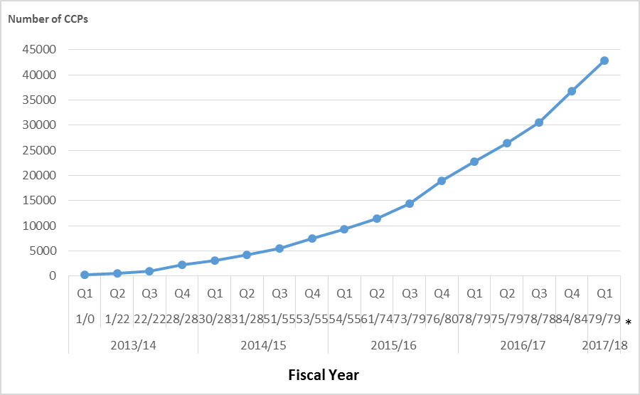
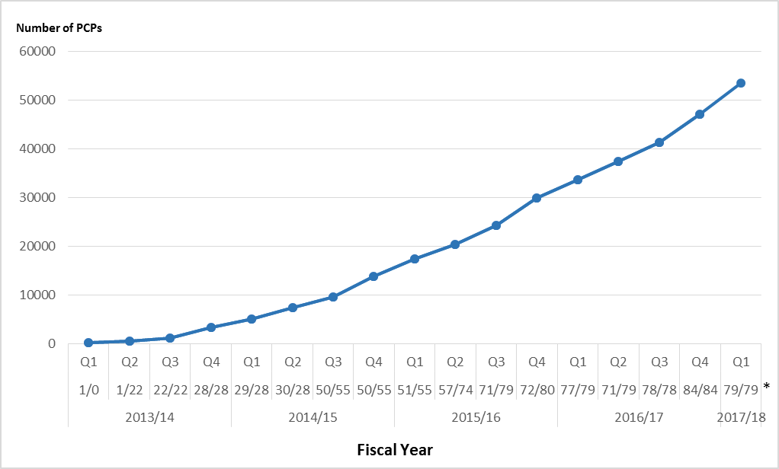
Impact of Health Links – Q1 Update
Coordinated Care Plans: Cumulative Total Number of CCPs to Date
Access to Primary Care: Cumulative Total Number of Patients with Access to PCPs
42,847 complex patients have been provided with coordinated care plans through Health Links.
53,426 Health Links patients have been connected to regular and timely access to primary care.
Data Source: Health Quality Ontario’s Quality Improvement Reporting and Analysis Platform (QIRAP) – self-reported by Health Links.
CCP – coordinated care plan, PCP – primary care provider.

Slide 9
Quarterly and Cumulative Data – Q1 Update

