Slide 1

Health Links: Excerpts from the 2017/18 Q2 Report
08 DECEMBER 2017

Slide 2
Health Links:
Improving Integrated Care for Patients with Multiple Conditions and Complex Needs

Slide 3
The Health Links Quarterly Report
Provides a summary of data reported by Health Links in each quarter
  Two quality indicators measured: number of patients with a coordinated care plan and number of patients connected to a primary care provider
Offers a deeper understanding of Health Links practices across the province and progress to date
Highlights patients who are benefiting from a Health Links approach to care
Reviewed by Health Link leads from all 14 LHINs and Health Quality Ontario Regional Quality Improvement Specialists
Circulated to Health Link teams, LHINs, Health Quality Ontario, and the Ministry of Health and Long-Term Care
Used to share observations, identify areas of interest, and guide conversations and planning

Slide 4
Highlights from this Quarter
The Health Links Approach to Care Community of Practice is now on Quorum
  Currently at 95 members
  Provides an opportunity to innovate, connect with partners across the province
  Shared goal: improved quality
The 3rd annual Health Links Leadership Summit was held in Toronto on September 28, 2017
  Theme: sustainability and spread
  Focus: the patient and caregiver experience
Digital strategy update: each LHIN is moving to a single, interim care coordination solution (CHRIS or SHIIP)
A Health Links Measurement Task Group has been created to develop the parameters for new indicators and to provide recommendations on measurement and data collection.
  Monthly updates from LHINs and Health Quality Ontario will be sent to Health Link leads and partners
  Work to be completed by Q2 of 2018/19

Slide 5
Numbers at a Glance – Q2 Update
Fiscal Year, Quarter | No. of Health Links Actively Recruiting Patients | No. of Patients with a Completed CCP | No. of Patients Connected to a PCP
2016/17, Q1 | 79 | 3,832 | 3,697
2016/17, Q2 | 79 | 3,723 | 3,776
2016/17, Q3 | 78 | 4,180 | 3,925
2016/17, Q4 | 84 | 6,035 | 5,943
2017/18, Q1 | 79 | 6,507 | 6,456
2017/18, Q2 | 86 | 6,086 | 6,144
Cumulative Total to Date | 86 | 49,285 | 59,774

Slide 6
Patient Story: Mr. TD
Thank you to the Mississauga Halton LHIN for sharing this story
Mr. TD has multiple mental health disorders, and over the past 12 months he has visited the emergency department upwards of 60 times. With no primary care physician, Mr. TD turns to the emergency department to address issues of anxiety, cyclic vomiting, and chronic pain, which are treated with fluids and narcotics. Connect Care could not find a primary care physician who would care for a patient with this history, so the patient was referred to the East Mississauga Health Link.
Mr. TD experiences other life stresses. His wife is receiving active cancer treatment and also suffers from mental health conditions. The family struggles financially and often does not have enough money for food or transportation.
How did the Health Link help this patient? To read the full patient story, visit the Health Links Approach to Care Community of Practice on Quorum.

Slide 7
Patient Story: Sandra
Thank you to the South West LHIN for sharing this story
Sandra is a single, 17-year-old, female high school student who lives at home with her mom, her younger sister, and her mom’s current boyfriend. Her home environment is unstable and chaotic. Many individuals in the community use her home as a temporary housing solution, and the associated income helps support her mom’s addiction. There is a family history of mental health conditions.
Sandra has been diagnosed with post-traumatic stress disorder (PTSD) after a recent sexual assault, anxiety, and depression, with borderline personality traits.
Sandra has presented to the emergency department multiple times, with subsequent hospitalizations to acute care (mental health and pediatrics)—these hospitalizations have been related to suicide risk. In the recent past, she also had a 30-day admission to a specialized children’s mental health inpatient unit. Several of these hospitalizations have been Form 1 admissions, meaning that Sandra has not been able to leave hospital without psychiatric assessment. Multiple alternate housing arrangements have been arranged without success, which have resulted in in readmission to hospital due to risk of self-harm.
The years of transition between pediatric and adult mental health services have been difficult and have complicated Sandra’s provision of care. During her most recent hospitalization (to a pediatric unit), health care providers recognized that due to the complexity of her situation additional coordination of care and planning was required to increase her chances of successful community reintegration.
How did the local Health Link help this patient? To read the full patient story, visit the Health Links Approach to Care Community of Practice on Quorum.

Slide 8
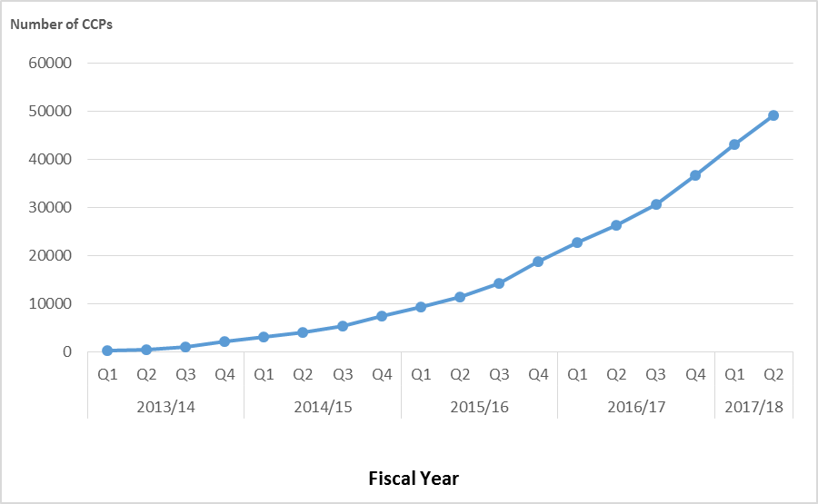
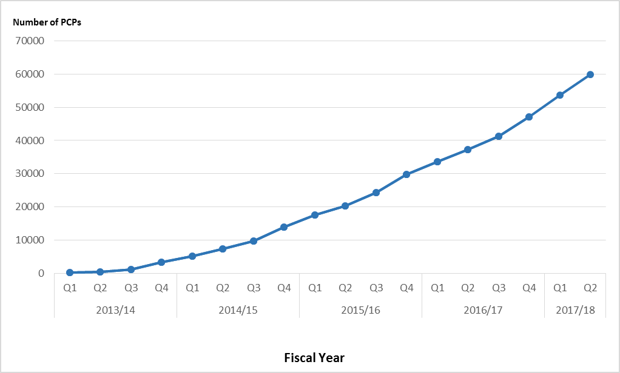
Impact of Health Links – Q2 Update
Cumulative Total Number of Coordinated Care Plans Completed
Cumulative Total Number of Patients with Access to Primary Care Providers
49,285 complex patients have been provided with coordinated care plans through Health Links to date.
59,774 complex patients have been connected to regular and timely access to primary care to date.
Data Source: Health Quality Ontario’s Quality Improvement Reporting and Analysis Platform (QIRAP) – self-reported by Health Links.

Slide 9
Quarterly and Cumulative Data – Q2 Update
*Some LHINs have changed their target populations to the sub-region numbers released by MOHLTC in October 2017 while others have kept the numbers from May 2016. One Health Link in the NE LHIN does not yet have a target population. It should be noted that the “target population” listed, based on patients with four or more chronic conditions, refers to the number of patients that may benefit from a Health Links approach to care and is generally accepted to be approximately 5% of the population in each LHIN. LHINs set and enter quarterly targets in QI RAP so that they can be reported here as a reference point.

Slide 10
Supporting the Health Links Approach to Care
Health Links: Improving Integrated Care for Patients with Multiple Conditions and Complex Needs
MOHLTC | LHIN
Sets the strategic direction for Health Links Provides overall funding to the LHINs Oversees the overall performance of the Health Links initiative to guide strategy Facilitates operational success by implementing provincial level tools and supports | Sets regional priorities for Health Links and ensures alignment with provincial priorities Funds Health Links in accordance with priorities Maintains overall accountability for Health Links performance Drives operations by implementing plans and supporting adoption of provincial tools Identifies and implements regional supports and tools as required
Health Quality Ontario
Supports data collection, timely reports, and analysis Leads systematic identification of emerging innovations and best practices Increases rate of progress through standardization of best practices across all Health Links Supports inter-Health Link sharing of lessons learned, regionally and/or provincially Connects LHIN Health Link Leads with other relevant provincial quality initiatives
Source: Adapted from “Guide to the Advanced Health Links Model Guide,” Ministry of Health Long-Term Care, November 12, 2015.
LHIN – local health integration network, MOHLTC – Ministry of Health and Long-Term Care.

