Slide 1
No limit to better:
Leading quality improvement
at St. Michael’s Hospital
Dr. Robert Howard, President and CEO,
St. Michael’s Hospital

Slide 2
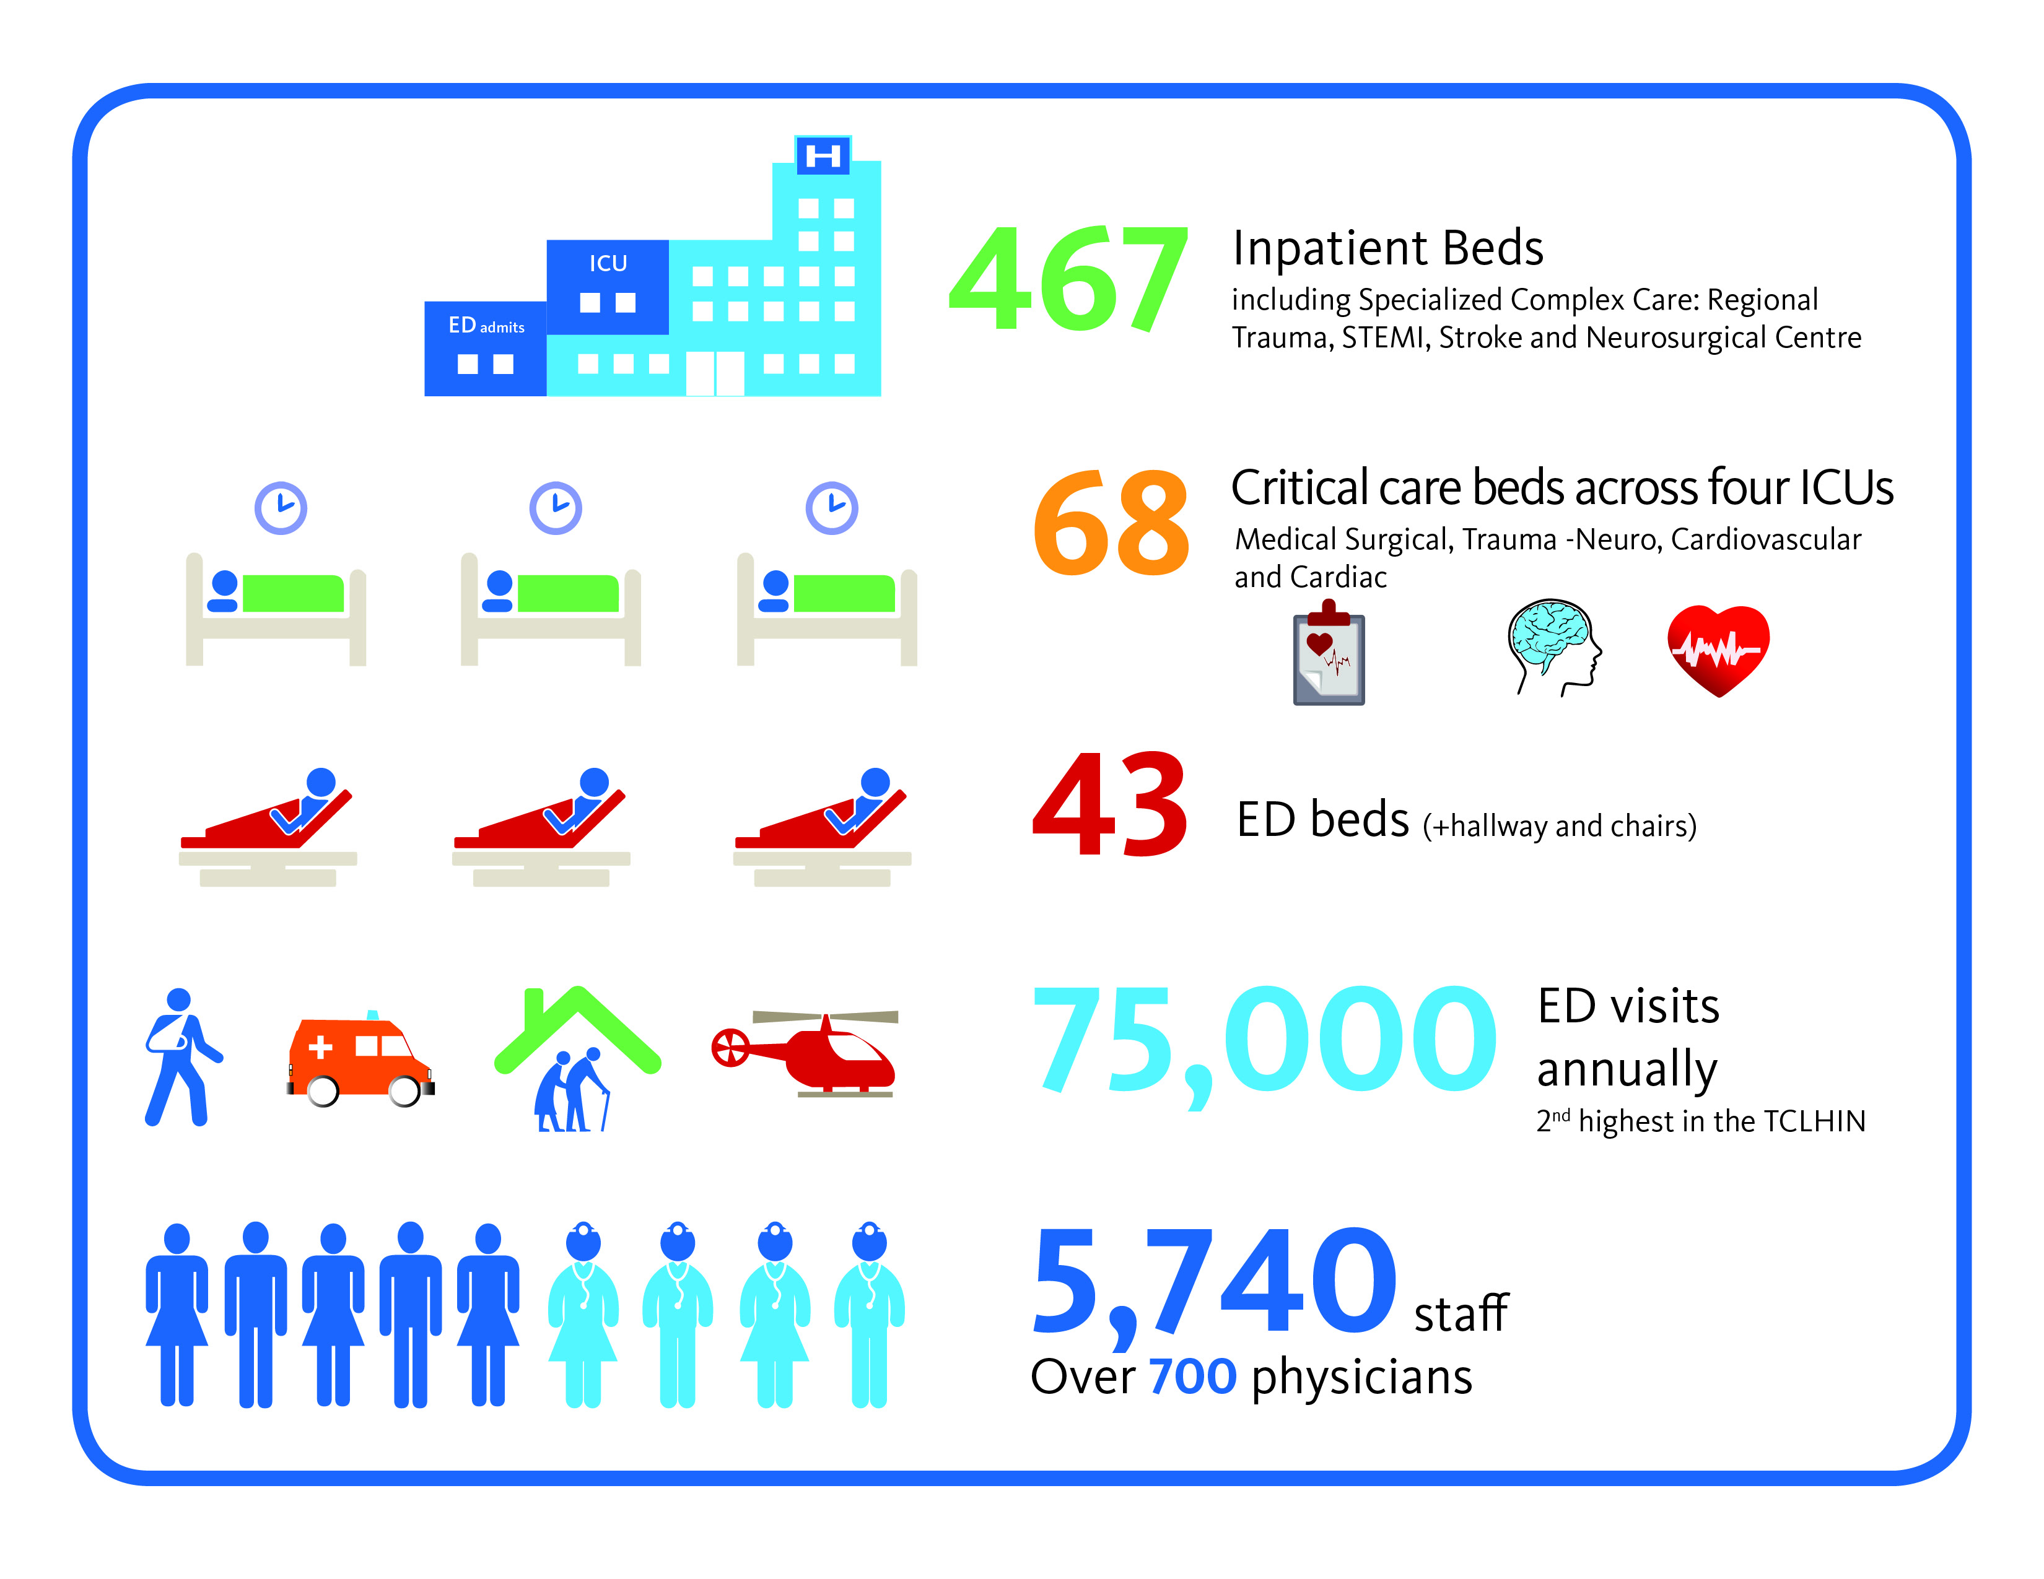
700 physicians
3,000 students
1,200 research papers/year
Notes:
So when we talk about demand and capacity, here is a quick snapshot of our demand and capacity. This is by no means a comprehensive list of all the inputs, nor all the resources required to support patient care and movement, but it gives you an idea of what we’re working with
We have 467 inpatient beds, including 68 critical care beds across 4 ICUs
The ED has about 43 beds, plus a number of designated chairs and makeshift hallway stretchers, and sees 75,000 patients annually – which is the second highest ED volume in the TCLHIN
And we have over 5700 staff and physicians

Slide 3

WHY focus on quality?
No limit to better
No new money
Systems of care
Notes:
Medical science and technology have advanced at an unprecedented rate
Healthcare has become very complex
Humans make mistakes
Business model assumes that well intentioned healthcare professionals will provide high quality, safe and cost-effective care through hard work, vigilance and use of evidence

Slide 4
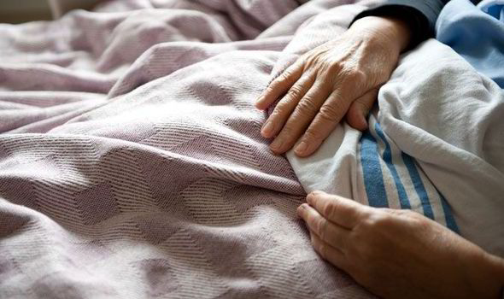
Notes:
However we have thousands upon thousands of patient interactions every year. Vigilance and hard work are not enough to ensure that every one of those interactions meets our standards of excellent care
As CEO I hear about the good work we do every day. However sometimes we let our patients and their families down. Let me tell you the story of a patient from several years ago. A 92 year-old man, adored by his family etc etc came to us for care. Within twenty-four hours of admission to St. Mike’s, he fell out of his hospital bed. Complications related to that fall led to his death. St. Michael’s is a top-tier, academic hospital with brilliant and extremely committed physicians and staff – some of the top clinicians in the world. We have the best technology and countless protocols based on the latest evidence. Yet we failed to honour our first and most important responsibility to this patient: keep him safe.
How can we prevent this kind of devastating failure? We need sophisticated systems to protect patients, support staff, and ensure that our care constantly improves.

Slide 5
THE WHAT
Performance Improvement
QUALITY IMPROVEMENT
IMITATION
INNOVATION
Systematic approach to achieving higher performance
Incremental
Seeking out
best-in-class performance and introducing it as a new model
Creating a new idea/model
Inventing
IMPLEMENTATION SCIENCE AND METHODS
RISK OF FAILURE

Slide 6
THE WHAT
Value
Quality
Value =
Cost

Slide 7
THE WHAT
Systems Integration
Cooperation
Collaboration
Alliance
Amalgamation
INFORMAL
FORMAL

Slide 8
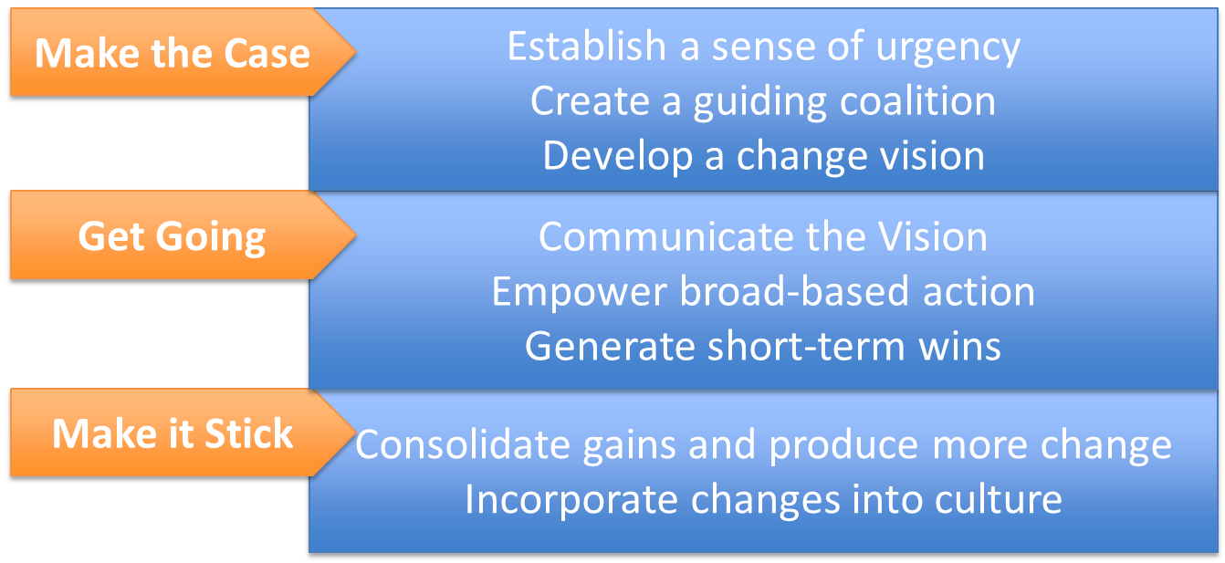
THE HOW
Improve by "Leading Change"
*J. Kotter. Leading Change, 1996.

Slide 9
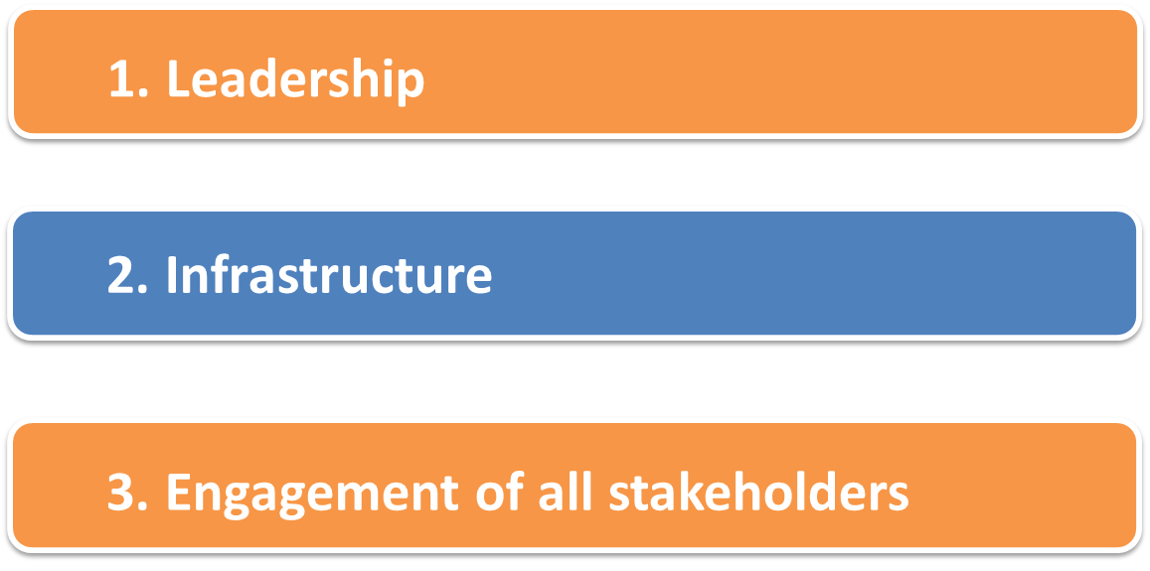
THE HOW
Creating a culture of Quality
Reinertsen JL, Bisognano M, Pugh MD. Seven Leadership Leverage Points for Organization-Level Improvement in Health Care (Second Edition). IHI Innovation Series white paper. Cambridge, MA: Institute for Healthcare Improvement; 2008.

Slide 10
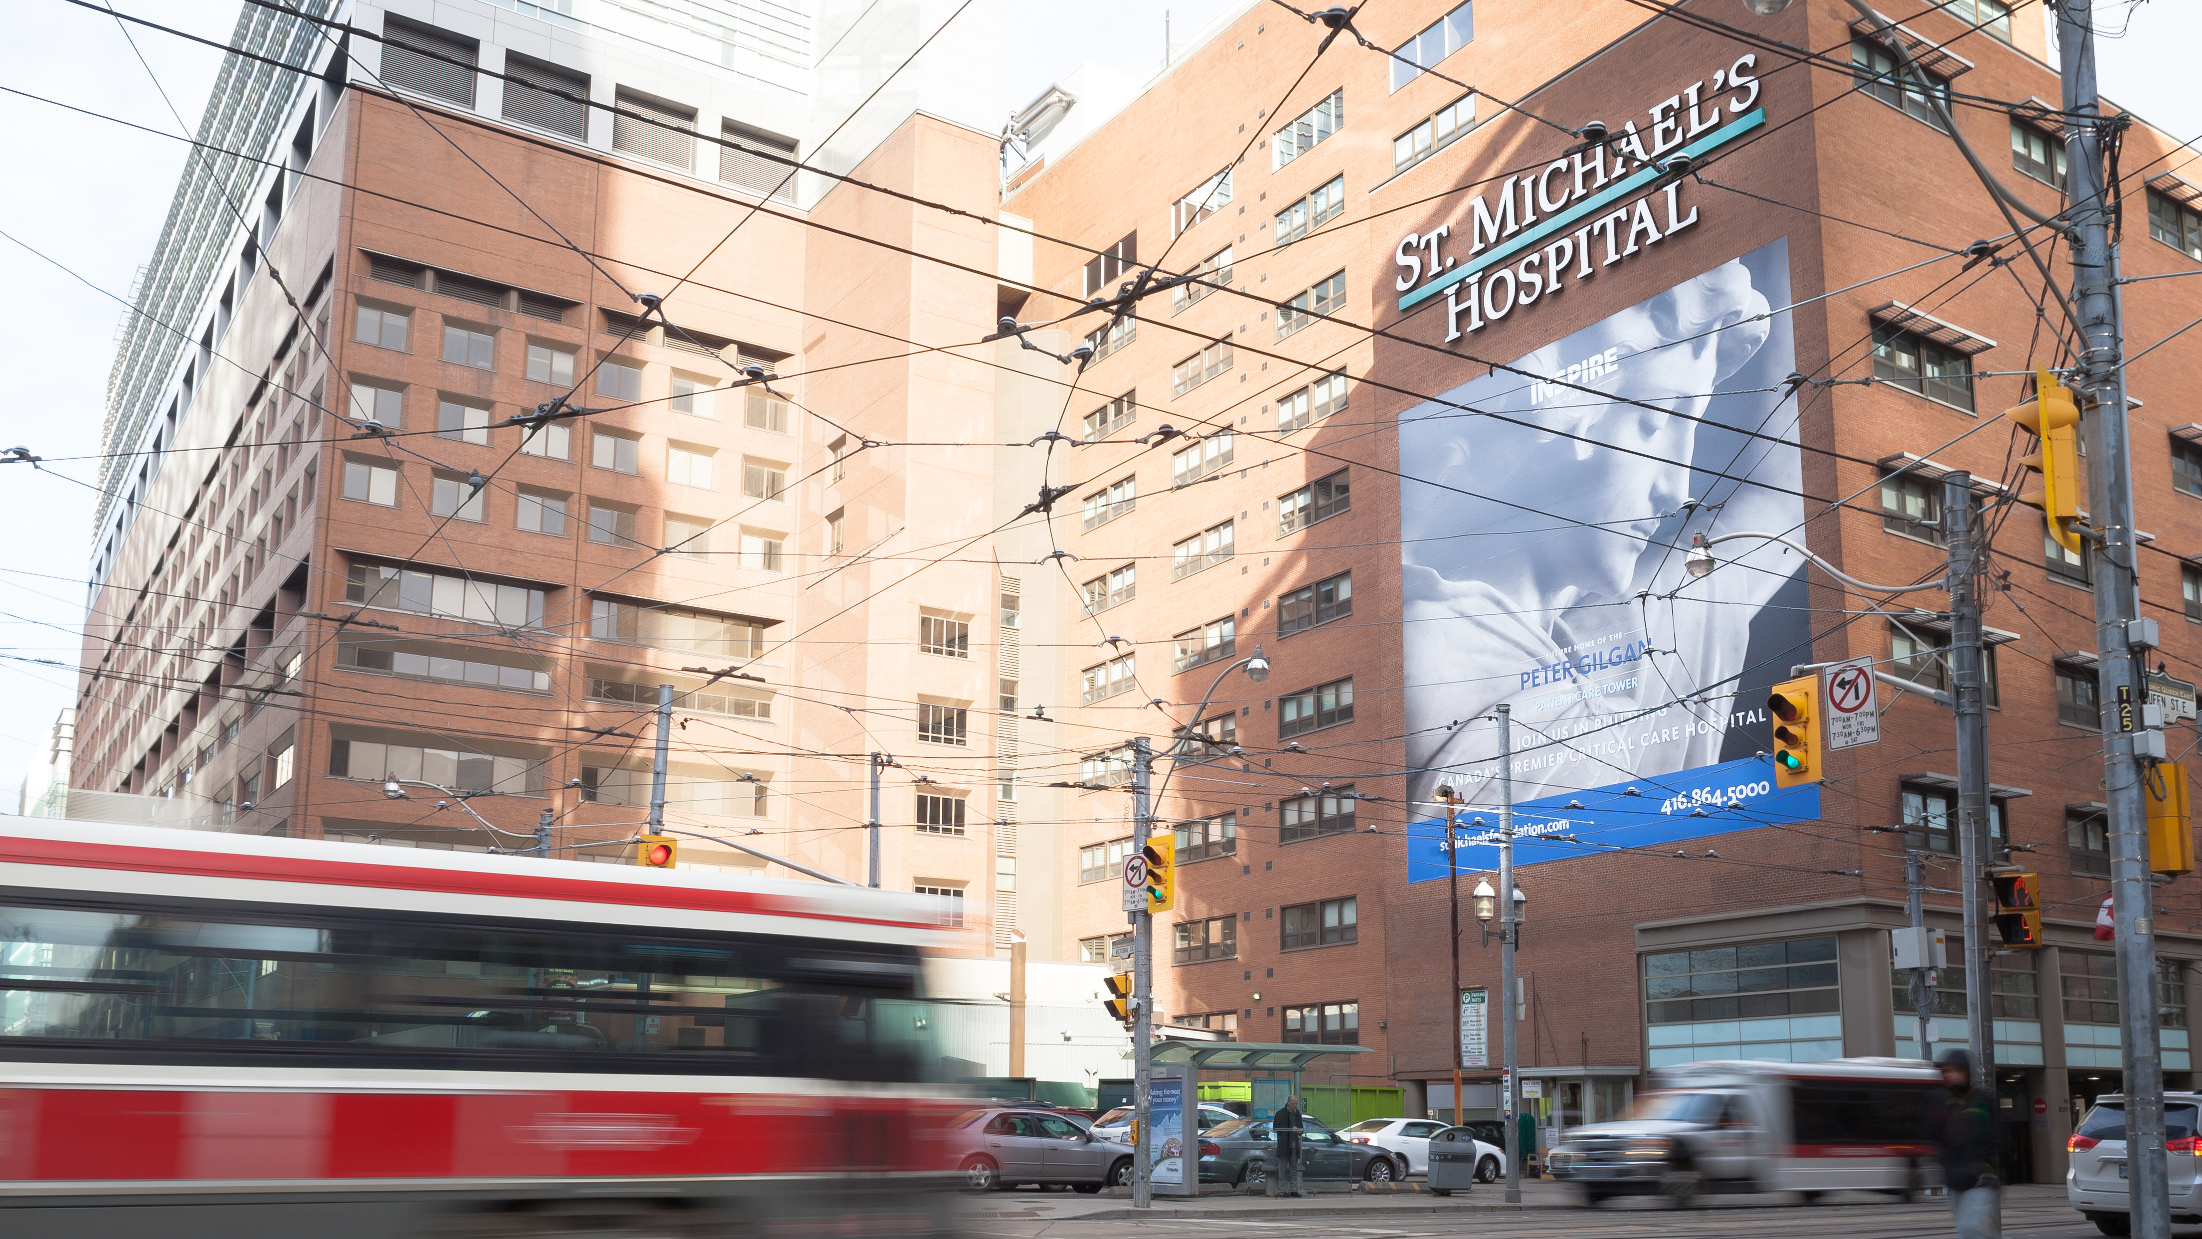
The St. Michael’s experience

Slide 11
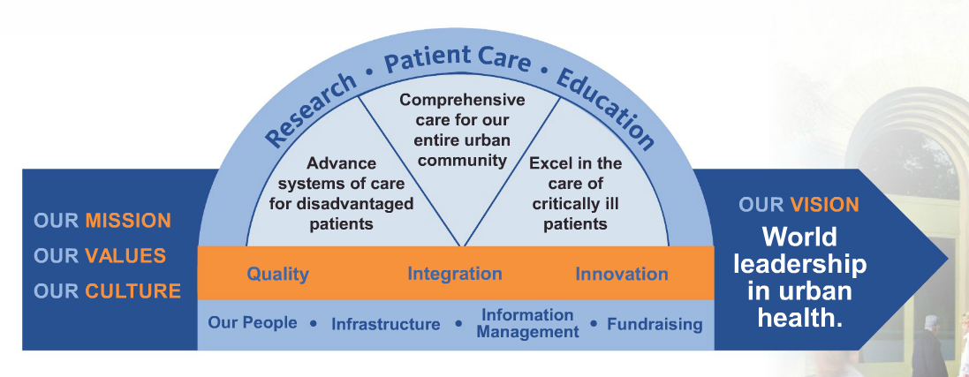
The WHAT & HOW at St. Michael’s

Slide 12

GOAL: Create a culture of quality improvement
We define quality as the best patient experience in:
  Safety
  Outcomes
  Access
  Patient-centredness
  Efficiency
  Equity
This broad definition allows for everyone at St. Michael’s to see their role in quality

Slide 13
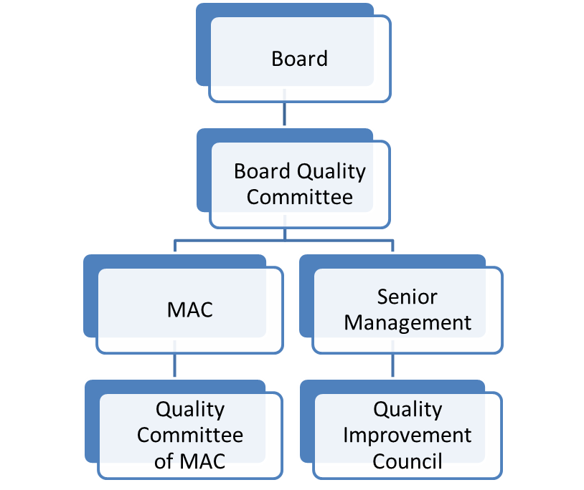

CREATING A CULTURE OF QUALITY:
Governance
Senior Leadership Committee
Programs & Departments
Improvement teams & work groups

Slide 14
CREATING A CULTURE OF QUALITY:
Resources
Quality and Performance Portfolio
Quality Improvement
(Safety, QI, Project Management)
Patient Experience/ Patient Relations
Decision Support
Informatics (IT)
Process Redesign (project management)
Risk and Privacy
7 STAFF + Medical lead
3 STAFF
12 STAFF
6 STAFF + Medical lead
4 STAFF
3 STAFF

Slide 15
CREATING A CULTURE OF QUALITY:
Not all improvement opportunities are equal
  Corporate
Large impact or resource requirements
  Supported by corporate team and program leadership
Macro
Meso
  Programmatic or department priorities
  Some support from corporate team (typically data)
Micro
  Just Do It
  Locally led

Slide 16
CREATING A CULTURE OF QUALITY:
Annual Planning Cycle
Understand emerging issues
Consider operating plan and business objectives
Set priorities and resources
Implement, monitor, adjust
Assess current performance
“I have an idea”

Slide 17
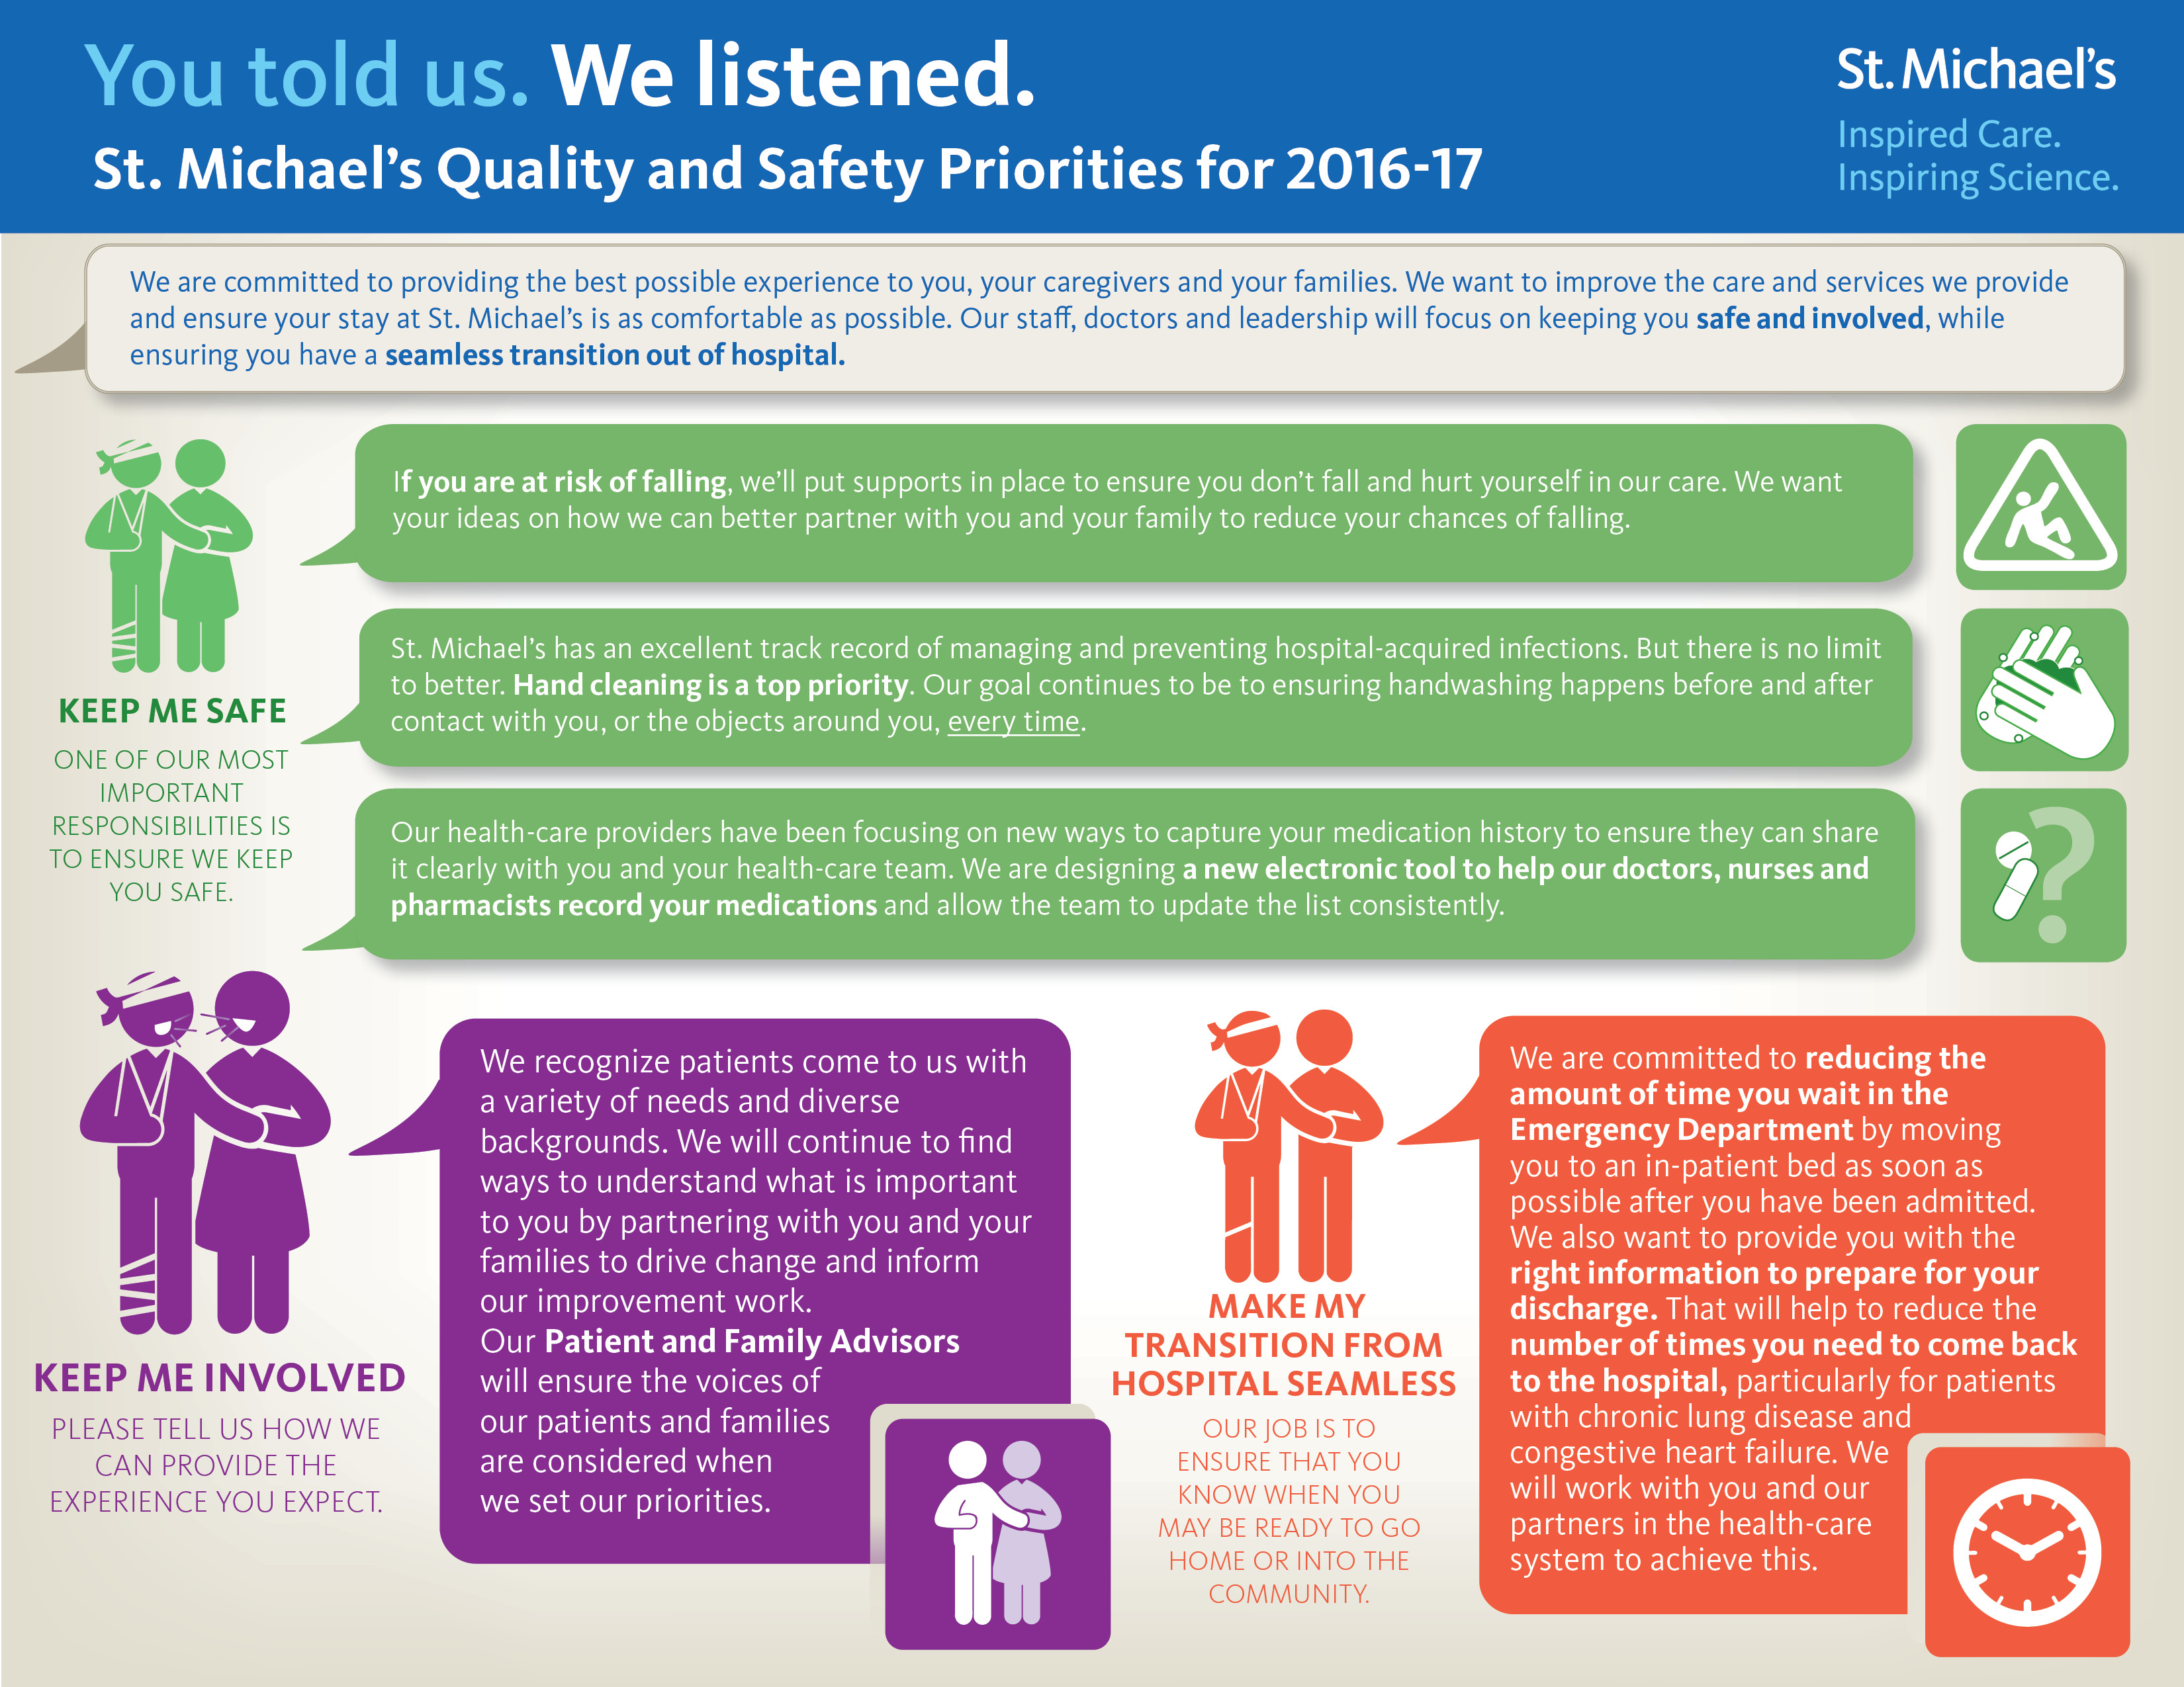
Notes:
Our focus this year

Slide 18
CREATING A CULTURE OF QUALITY:
St. Michael’s Quality Management System
QUALITY MANAGEMENT SYSTEM
1
2
3
Quality Improvement Toolkit
Analytics
Communications
4
5
6
Education and Capacity Building
Research and
Evaluation
Patient Centredness

Slide 19
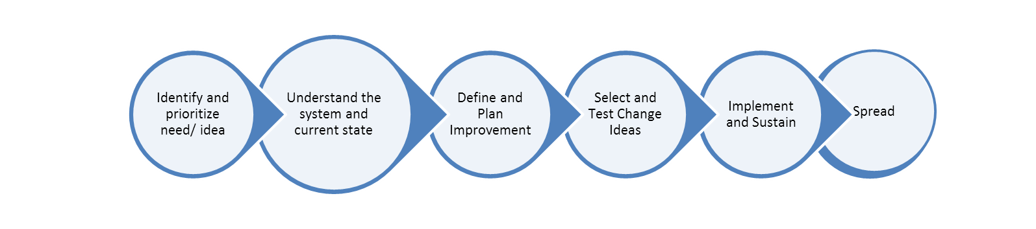
The SMH Quality Improvement Toolkit
Continuous monitoring, performance measurement and evaluation

Slide 20
Analytics and Measurement
Why is measurement important?
  Demonstrates whether changes are leading to actual improvements or unintended consequences
  Identifies need for course correction throughout improvement cycle
  Getting the right measures is critical to understanding whether you are actually improving.
  E.g. Overall hospital patient satisfaction measure combines all three positive responses (includes excellent, very good and good)
  How do we know if we’re improving from low box scores (good and very good) to the top box score (excellent)?

Slide 21
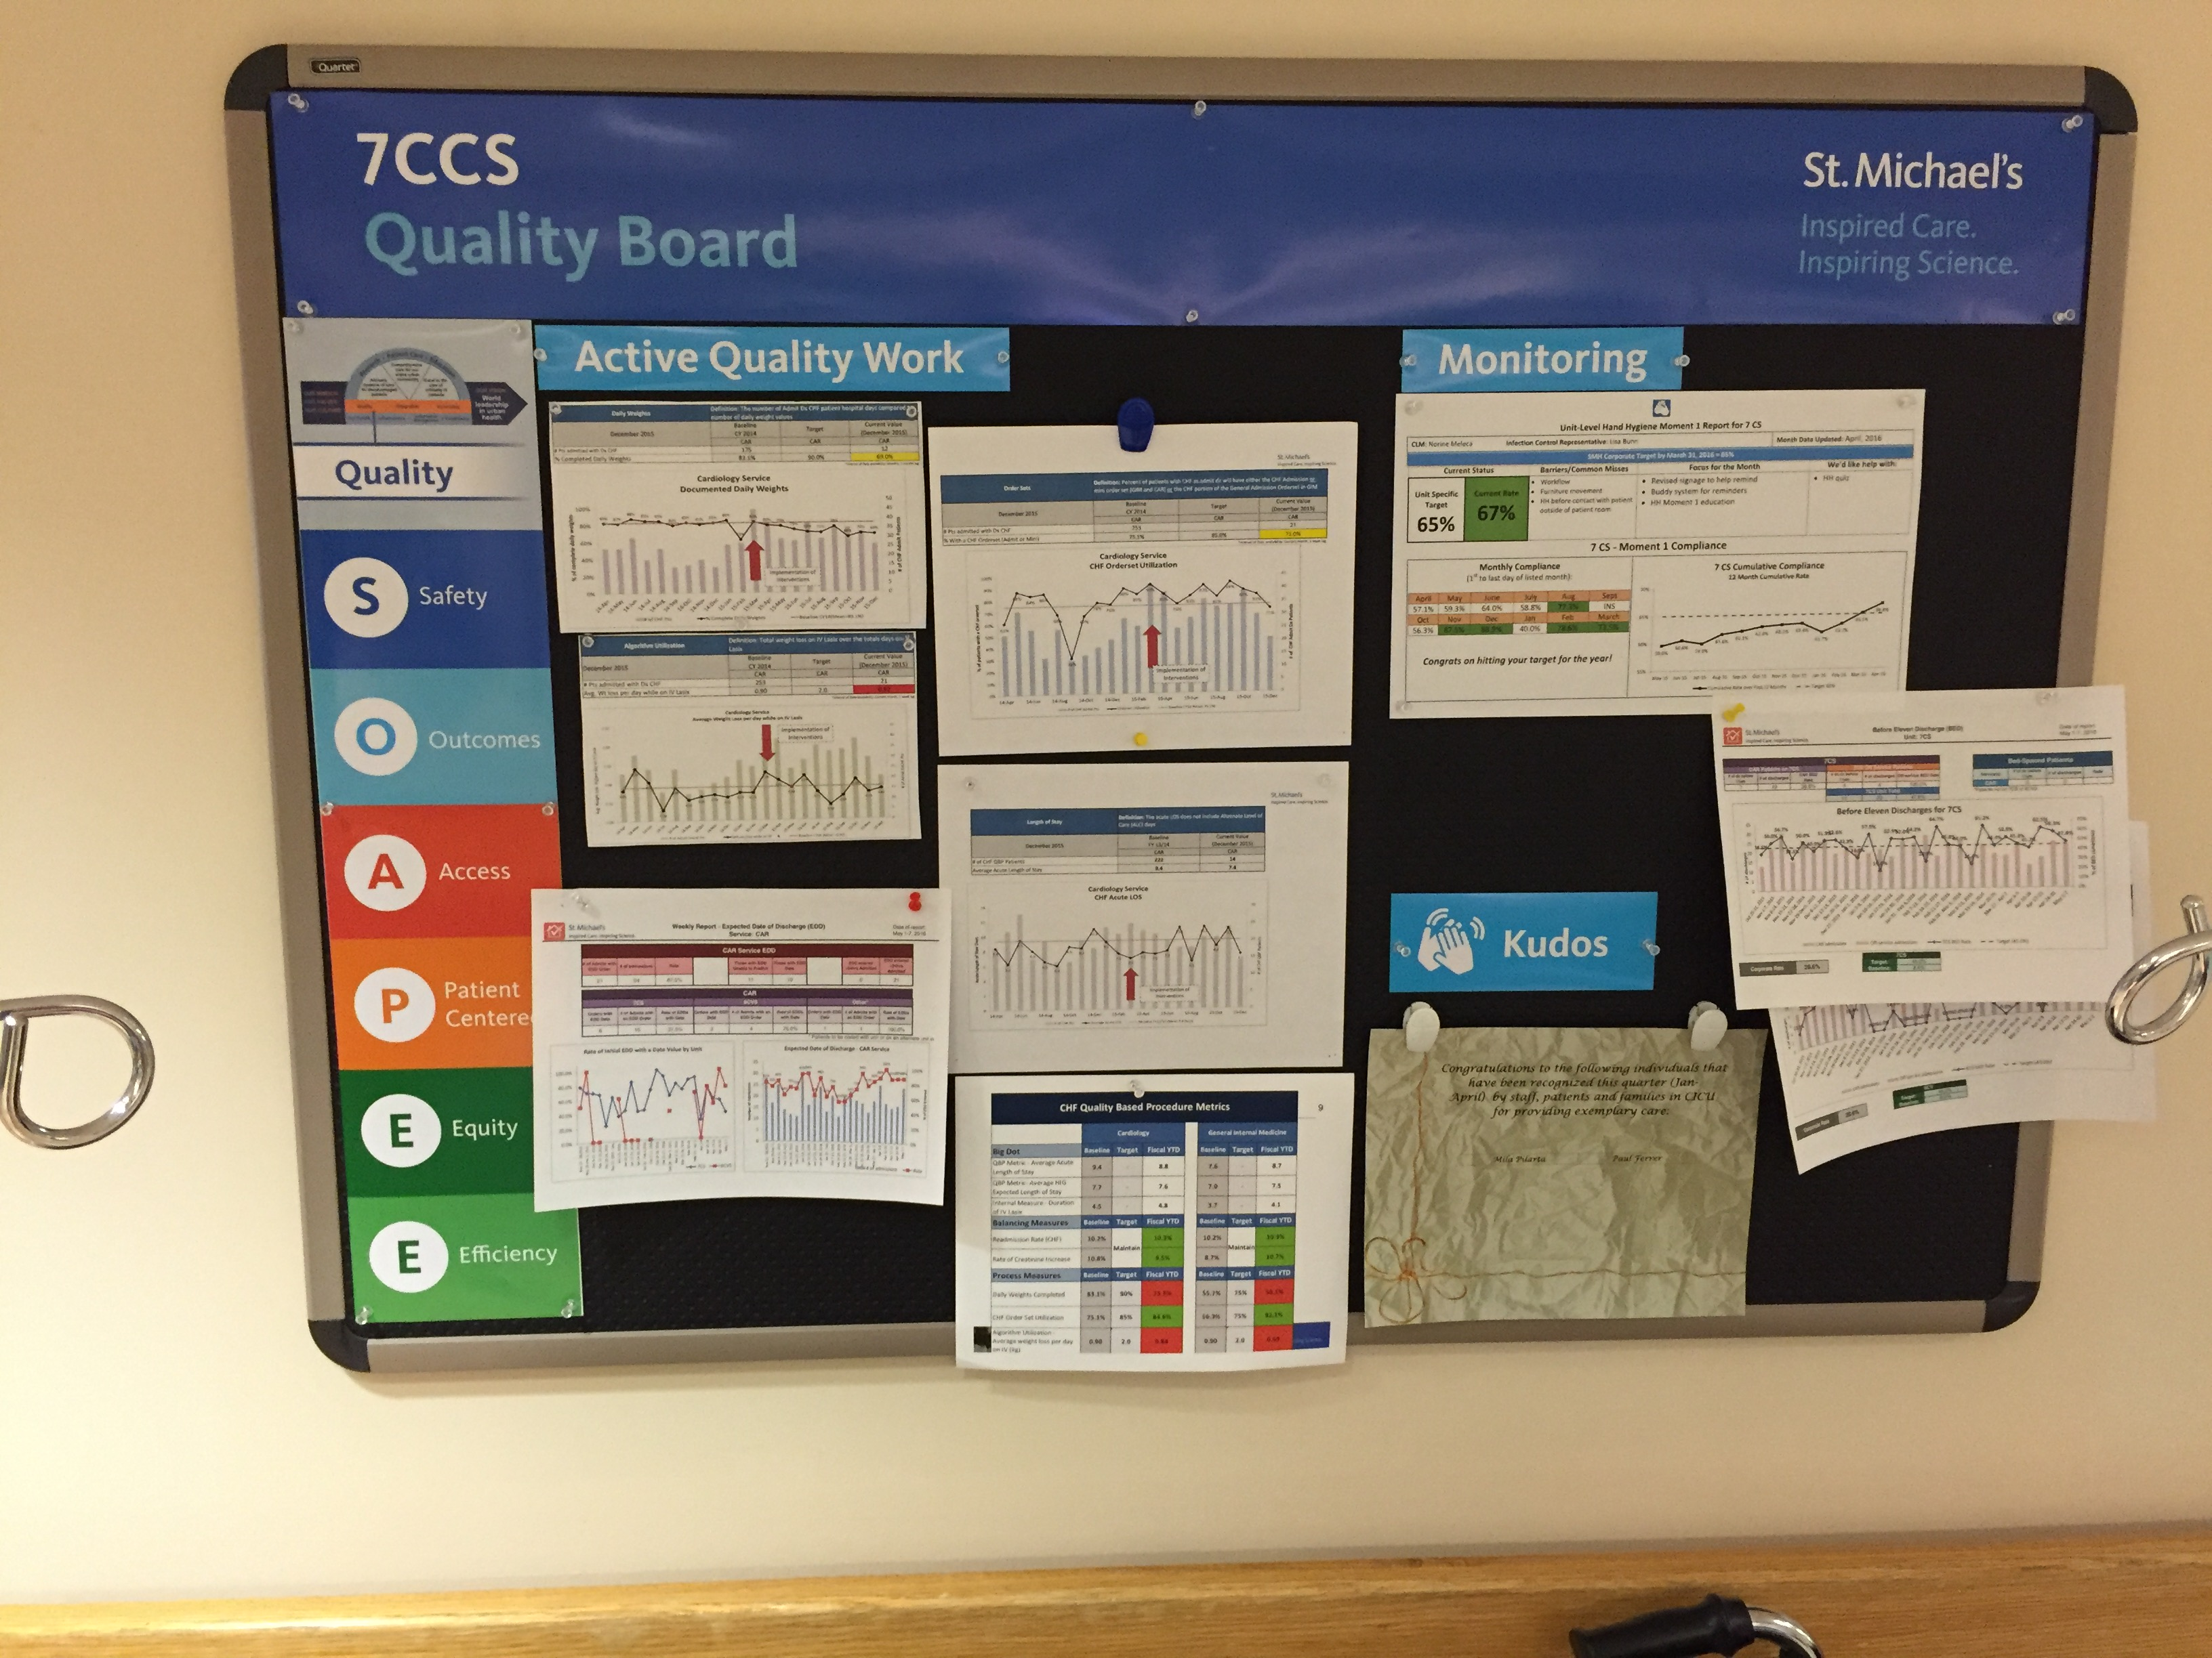
Communication

Slide 22

Corporate Communication
Notes:
Corporate communications has been a key resource to help create a culture of quality and safety at St. Mike’s – building excitement and engagement, and supporting the spread of great initiatives.
For several years now, we’ve had an internal blog focused just on quality – a place for our staff and physicians to get inspired and share ideas.
We talk about quality at every staff town hall and management forum.
In 2014 we teamed up with Dr. Mike Evans, HQO and IHI to create a whiteboard video on quality improvement in health care. It went viral – has had more than 100,000 views.
And we are constantly sharing and promoting stories about our quality successes and learnings from across the organization – in our newsletters, on our website and on social media.

Slide 23
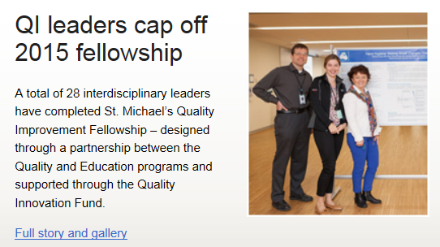
Education: Building Capability
Targeted capacity building
QI teams complete Fellowship as part of project cycle
  Target managers, physicians and front line
Leverage QI trained staff/MDs
Front line staff training

Slide 24

Research & Evaluation
An academic focus distinguishes our approach to quality improvement
Embedding and integrating Research activity in the Quality agenda
Enhanced scholarly dissemination of our work

Slide 25
Patient-Centered Framework
GOVERNANCE
CO-DESIGN
FEEDBACK
CARE
Helping to guide decision making (e.g. on committees; committee purpose includes patient experience)
Helping to design better delivery
Helping us with how we are doing
Helping us deliver care that meets our patients needs
Patient decision-making in care

Slide 26
Take-Away Messages
It’s a journey
It requires more than doing Quality Improvement projects – it’s a quality management system
It’s broader than Quality Improvement = Performance Improvement

Slide 27

Thank you

Slide 28
moderated by:
Lee Fairclough, VP- qi
Discussion Period

Slide 29
Quality Rounds Survey
Go to https://www.sli.do/
Type the event code #7976
Click join event (towards the left part of the screen)
Once on Live Poll page, please complete the two questions and click send.
Thank you!

Slide 30
Question 1
How did you attend the session?

Slide 31
Question 2
How likely are you to apply at least one option from this session in your practice/organization?

Slide 32
www.HQOntario.ca
FOLLOW@HQOntario

Slide 33
www.HQOntario.ca
FOLLOW@HQOntario

