Slide 1


Behavioural Symptoms of Dementia
Care for Patients in Hospitals and Residents in Long-Term Care Homes
INFORMATION AND DATA BRIEF: Why this quality standard is needed
Let’s make our health system healthier

Slide 2
What Are Quality Standards
Concise sets of easy-to-understand statements outlining what care should look like for people living with certain conditions and being cared for in specific settings
Based on the best available evidence
Designed for health care providers to know what care they should be offering
To also help patients, residents, families and caregivers know what to ask for in their care

Slide 3
The Purpose of this Brief
More than 200,000 people over the age of 65 in Ontario are living with dementia [1]
Many experience behavioural symptoms of agitation and aggression and are cared for in hospitals and long-term care homes
This brief provides information and data demonstrating why a quality standard is needed for people experiencing behavioural symptoms of dementia
Specifically, it provides performance data on indicators that reflect the care received by people in long-term care homes, where a substantial number of residents are living with dementia - 66% or 47,340 people [2]
[1] Alzheimer Society Ontario. 2012. Dementia Evidence Brief: Ontario. Toronto, Ontario.
[2] Continuing Care Reporting System (CCRS), provided by the Canadian Institute for Health Information (CIHI)

Slide 4
The Purpose of this Brief
The indicators included are not specifically limited to the population with dementia, but do reflect care that residents with dementia may receive and care that is described in the quality standard
The data demonstrate that care for people living in long-term care homes who may have dementia and be experiencing behavioural symptoms needs to be improved
That is why this quality standard has been created:
  To inform clinicians and organizations what high-quality health care for people living with this condition should look like
  To help clinicians and organizations assess the quality of care they are delivering, so they can identify gaps and areas for improvement

Slide 5
How We Look at the Data
When available, the information presented reflects different perspectives
  Provincial results over time offer a broad overall system view
  Results by LHIN region highlight some of the local differences
  The distribution of the results across facilities provides some points of reference to the service providers

Slide 6
The Data

Slide 7
Some Context
Because one of the quality standard aims is to improve behavioural symptoms such as agitation or aggression among people living with dementia who are experiencing such symptoms, we examine the percentage of individuals with improved behavioural symptoms in long-term care homes.

Slide 8
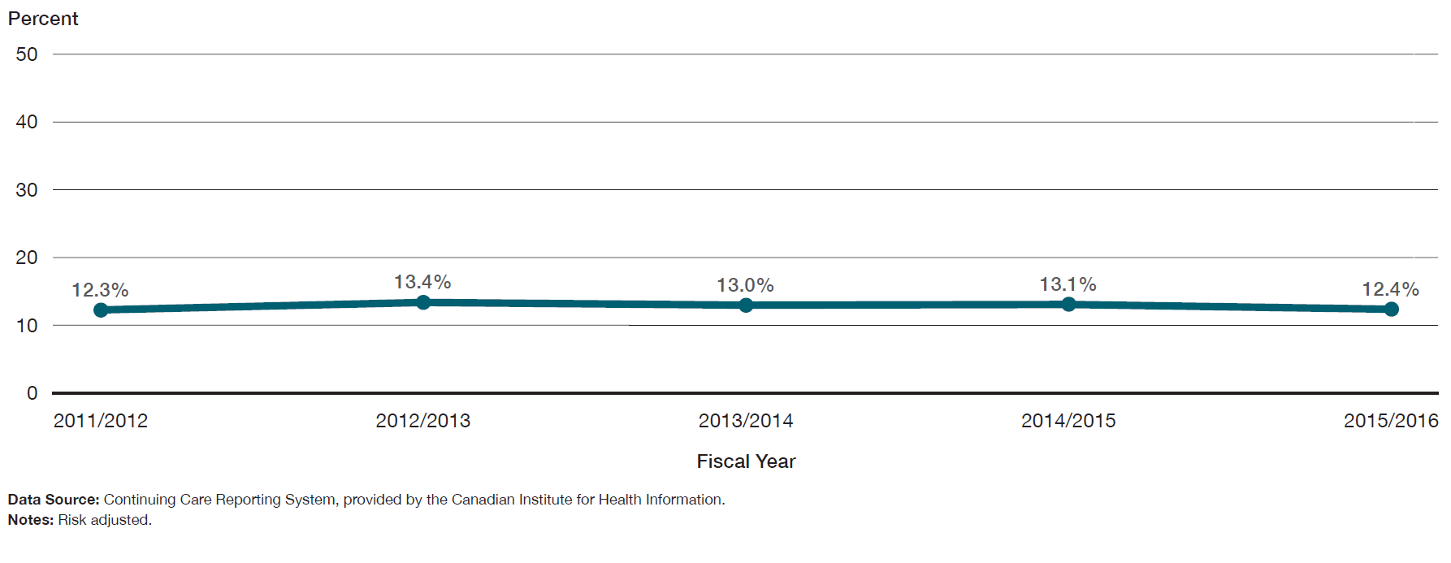
Only 12.4% of long-term care home residents experienced improved behavioural symptoms. This proportion has not improved in the last four years.
Percentage of long-term care home residents who experienced improved behavioural symptoms, in Ontario, 2011/12 to 2015/16

Slide 9
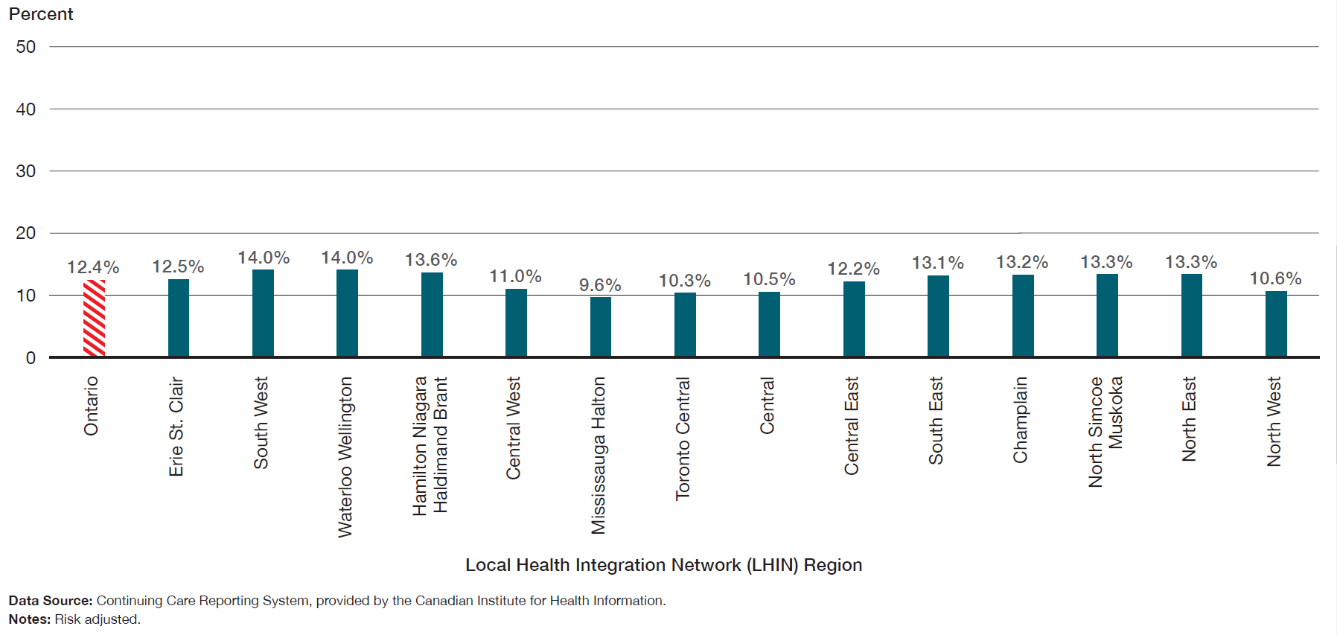
The percentage of long-term care home residents whose behavioural symptoms improved varies across LHIN regions, ranging from 9.6% of residents to 14.0%.
Percentage of long-term care home residents who experienced improved behavioural symptoms, in Ontario, by LHIN region, 2015/16

Slide 10
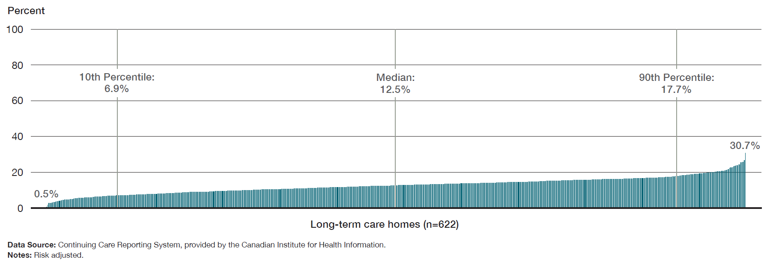
The percentage of long-term care residents who showed improvement in behavioural symptoms ranged from 0.5% to 30.7%.
Percentage of long-term care home residents who experienced improved behavioural symptoms, in Ontario, by long-term care home, 2015/16

Slide 11
Some Context
Because the quality standard recommends that residents living with dementia who experience behavioural symptoms should be prescribed non-drug treatments first, and that medications should be prescribed only if residents are in severe distress (or if there is a concern they might harm themselves or someone else), we examine the percentage of long-term care home residents with no recorded diagnosis of psychosis who were prescribed antipsychotic medication in the seven days preceding their resident assessment, and who did not have a diagnosis of psychosis.

Slide 12
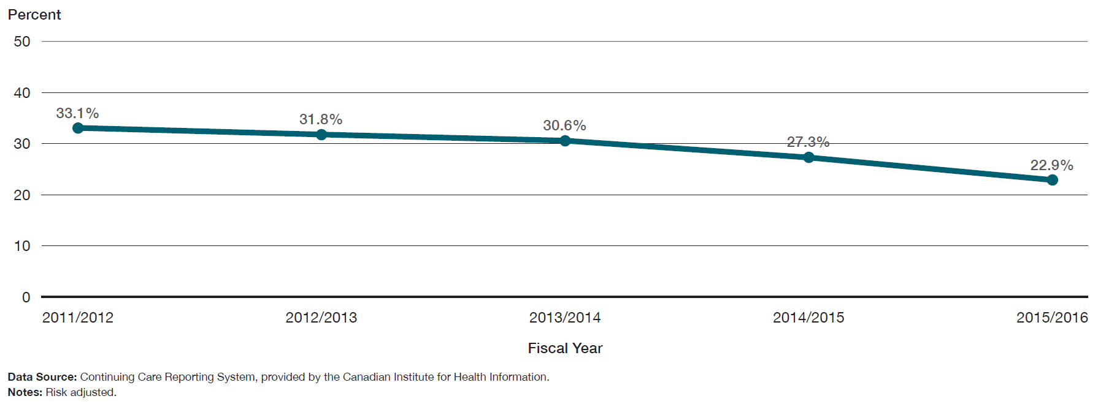
The percentage of long-term care home residents without psychosis using antipsychotic medications has decreased over the past four years.
Percentage of long-term care home residents without psychosis using antipsychotic medications, in Ontario, 2011/12 to 2015/16

Slide 13
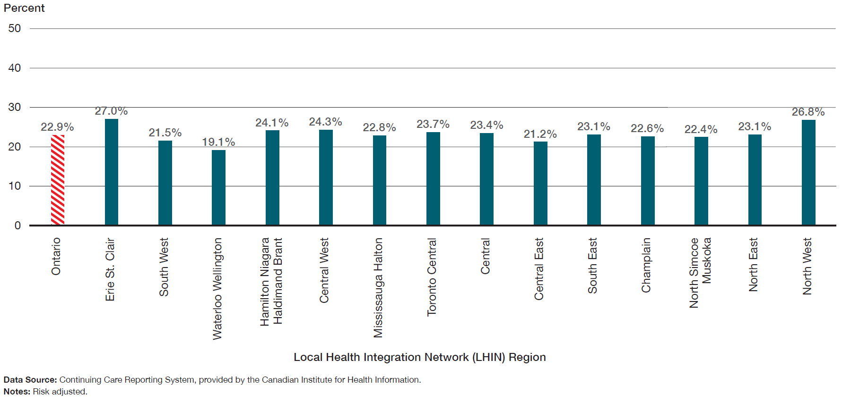
The percentage of long-term care residents without psychosis using antipsychotic medications varied from 19.1% to 27.0% across LHIN regions.
Percentage of long-term care home residents without psychosis using antipsychotic medications, in Ontario, by LHIN region, 2015/16

Slide 14
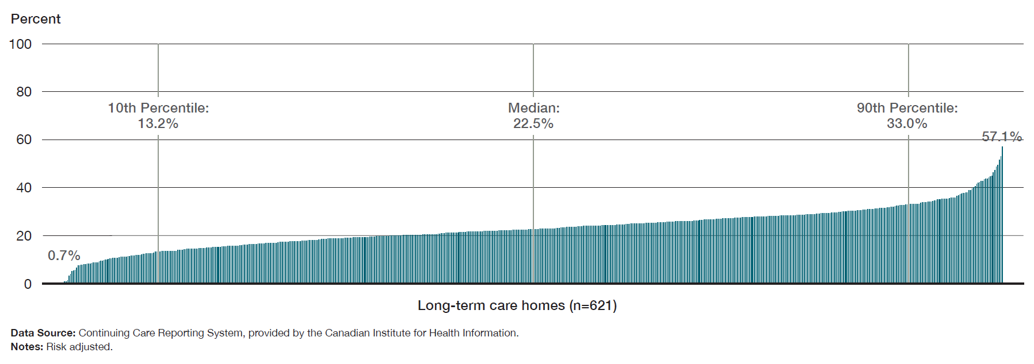
Across long-term care homes, the percentage of residents without psychosis using antipsychotic medications varied from 0.7% to 57.1%.
Percentage of long-term care home residents without psychosis using antipsychotic medications, in Ontario, by long-term care home, 2015/16

Slide 15
Some Context
Because the quality standard recommends that residents living with dementia who are experiencing behavioural symptoms not be physically restrained, we examine the percentage of long-term care home residents who were physically restrained daily over the seven days preceding their resident assessment.

Slide 16
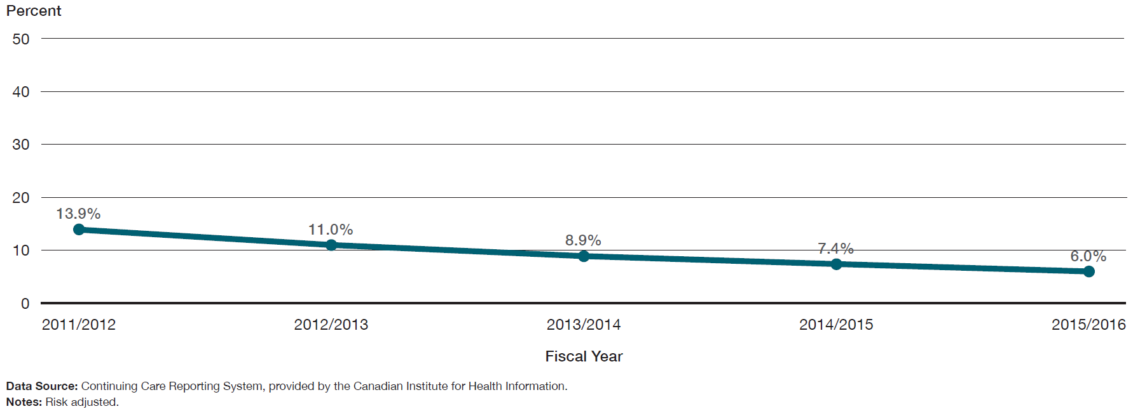
The percentage of long-term care home residents who were physically restrained on a daily basis decreased over the past four years.
Percentage of long-term care home residents in daily physical restraints, in Ontario, 2011/12 to 2015/16

Slide 17
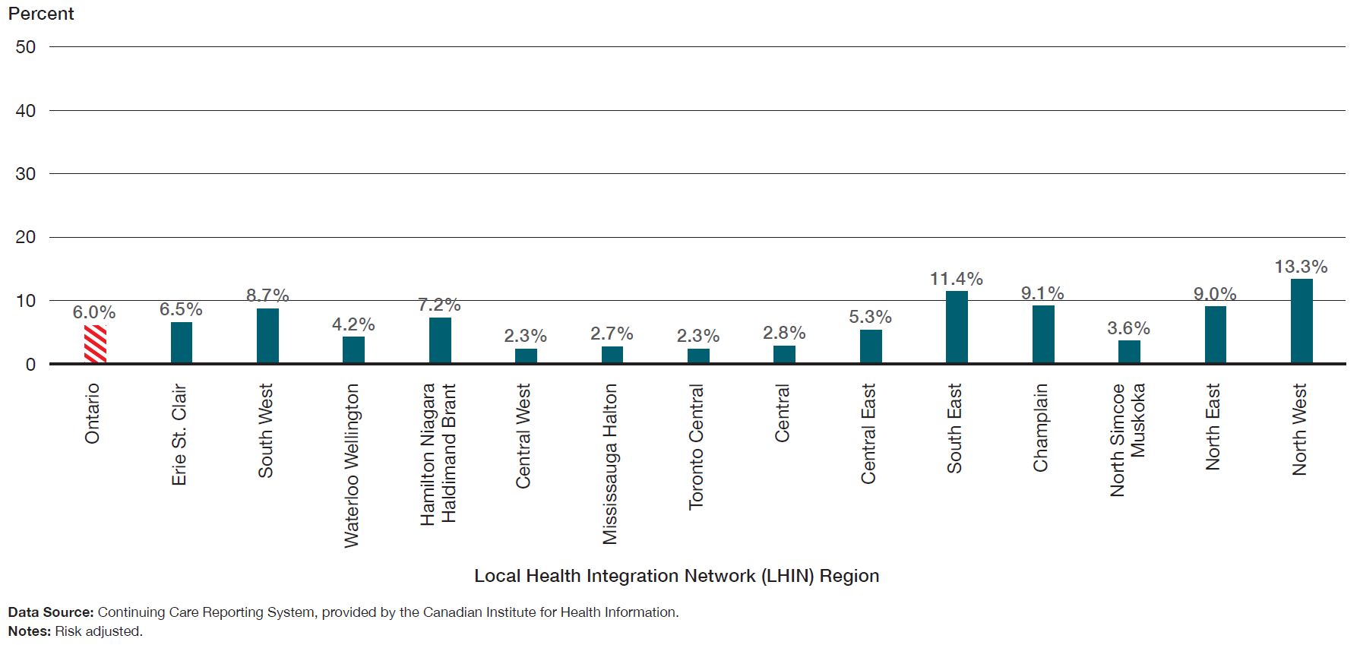
The percentage of long-term care home residents who were physically restrained on a daily basis varied from 2.3% to 13.3% across LHIN regions.
Percentage of long-term care home residents in daily physical restraints, in Ontario, by LHIN region, 2015/16

Slide 18
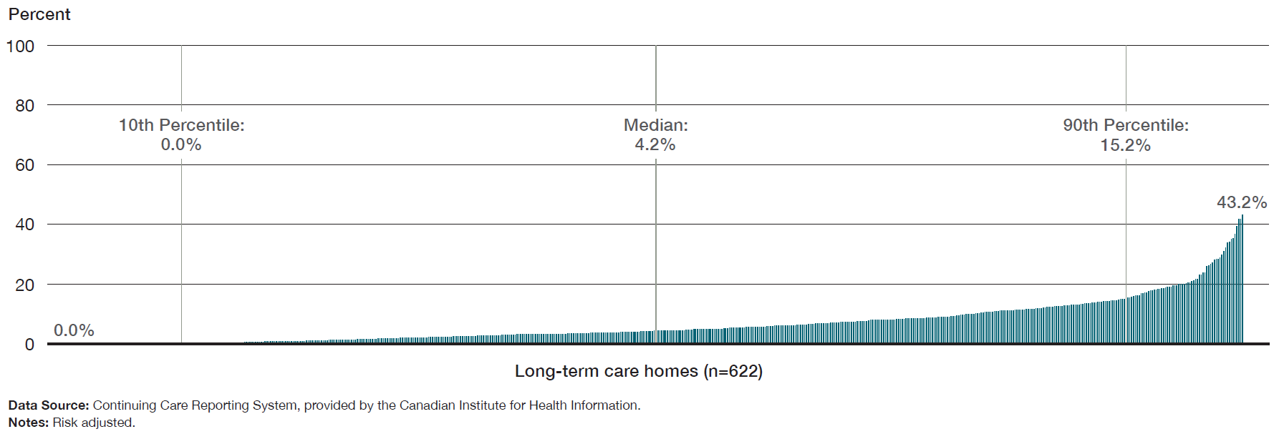
The percentage of long-term care home residents who were physically restrained on a daily basis ranged from 0% to 43.2% across Ontario long-term care homes.
Percentage of long-term care home residents in daily physical restraints, in Ontario, by long-term care home, 2015/16

Slide 19
Additional Resources
This Information Brief is intended to support the Behavioural Symptoms of Dementia Quality Standard, which can be found in full HERE

Slide 20
Acknowledgements
Health Quality Ontario acknowledges and thanks Dr. Julie Auger for her review of this brief.
Parts of this material are based on data and information compiled and provided by the Canadian Institute for Health Information (CIHI). However, the analyses, conclusions, opinions and statements expressed herein are those of the author, and not necessarily those of CIHI.

Slide 21
www.HQOntario.ca
FOLLOW@HQOntario

